Slide 1
America’s Promise Program: New Grant Program Project Director/Manager Orientation
High Impact Partners on behalf
of the Employment and Training
Administration, DOL
September 14, 2018

Slide 2
Gregory Scheib
Workforce Analyst
U.S. Department of Labor, Employment and Training Administration

Slide 3
Heidi Sheppard
HIP Project Lead, AP
U.S. Department of Labor, Employment and Training Administration
Erika Humphrey
HIP TA Lead, AP
U.S. Department of Labor, Employment and Training Administration

Slide 4
Rana Al-Igoe
Director, Work-Based Initiatives
Workforce Intelligence, Southeast Michigan Community Alliance
Julie Parks
Executive Director, Workforce Training Grand Rapids Community College
Julie Parks
Executive Director,
Workforce Training
Grant Rapids Community College

Slide 5
What are your key grant concerns or challenges?
Staff capacity
Participant recruitment
Performance reporting
Program implementation
Partnership development
Other (if other, type answer in the chat box)

Slide 6
Provide an overview of the America’s Promise program
Highlight key program and performance resources
Introduce Technical Assistance (TA) Menu and types of TA available
Walk through the America’s Promise Community of Practice
Answer your questions

Slide 7
Background Orientation Resources
FOA
ETA Grantee Handbook
Performance Resources
Orientation Webinar
ETA Roles
Communication Channels
Reporting Requirements Evaluations
Modifications
7

Slide 8
Funding Opportunity Announcement

Slide 9
ETA Grantee Handbook

Slide 10
Employment and Training Administration Roles
The Federal Program Office has several functions:
Supports Federal Project Officers (FPOs)
Provides policy clarification and guidance
Provides Technical Assistance (“TA”)
Together with an external TA provider
Creates peer learning opportunities
Collects performance data
Reviews some grant modifications
Periodically requests additional information about your grant

Slide 11
Communication Channels
Always contact your FPO first if you have questions!
If you… | Contact:
Are the grant lead | FPO
Are a member of a grant project | The lead for your grant
Have questions about the performance reporting system | AmericasPromise@dol.gov with a copy to your FPO
Have questions or difficulty accessing the financial reporting system | EBSS.help@dol.gov, with a copy to your FPO and AmericasPromise@dol.gov
Have questions about evaluations | AmericasPromise@dol.gov with a copy to your FPO
Have TA questions | Your TA coach
Want to discuss an issue with peer grantees | The Discussion section of the CoP

Slide 12
Reporting Requirement Evaluation
America's Promise grantees are required to submit quarterly reports to ETA, including a final report
These reports are:
Quarterly Progress Reports (QPR)
WIPs performance report
Narrative report
Quarterly Financial Report (ETA-9130)
Final Report

Slide 13
Modifications
Change in Period of Performance
Change Indirect Cost Rate
Change Authorized Representative
Equipment Purchases
Budget Changes
Scope of Work Changes
Training(s) offered
Occupational focus
Service Area
Change in Partners
Key Personnel Changes

Slide 14
Technical Assistance
Together, the TA team:
Provide TA to America’s Promise grantees
Support the America’s Promise Program Office and your Federal Project Officer (FPO)
Team HIP-AACC includes High Impact Partners, American Association of Community Colleges, and National Association of Workforce Boards.

Slide 15
TECHNICAL ASSISTANCE
TA Menu
Types of TA
Coaching Services
TA Live Events
Written Resources

Slide 16
America’s Promise Community Of Practice (CoP)
What is the CoP?
https://www.workforcegps.org/register
Join now to receive the weekly updates
What does it communicate:
FAQs
Upcoming TA event registration
Materials from previous TA events
Success Stories, Blogs, Case Studies
Resources for new grantee staff

Slide 18
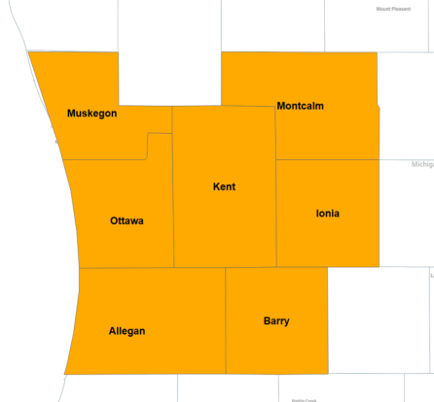
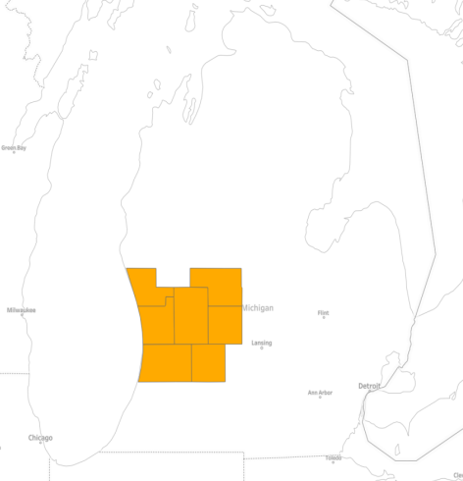
Grantee Insights
Julie Parks, Executive Director of Workforce Training
Grand Rapids Community College

Slide 19
Grantee Insights
Rana Al-Igoe, Sr. Project Manager
Southeast Michigan Community Alliance

Slide 21
Webinar: Telling Your Story
September 25, 2018
Webinar: Innovative Supportive Services
October 2018

Slide 22
Additional Resources:
America’s Promise Community of Practice
https://h1bap.workforcegps.org/
https://h1bap.workforcegps.org/resources/2018/06/27/18/27/Resources-for-new-grantee-staff
Performance Reporting Resources
https://h1bap.workforcegps.org/resources/2018/01/17/16/46/H-1B-Performance-Reporting-Resources-for-TechHire-SWFI-and-America-s-Promise-Grants
WIPS Tips
https://h1bap.workforcegps.org/blog/Tips-and-Information/2018/03/27/19/45/H-1B-WIPS-Tips

Slide 23
America’s Promise U.S. Department of Labor
AmericasPromise@dol.gov

