Slide 2
Let’s get to know who is on the call today. Using the poll, select the role that you play in your TechHire grant
Authorized representative
Program director/manager
IT/Data manager or staff
Training partner
5. Employer partner
6. Service Provider
7. Other (please specify!)

Slide 3
H-1B TechHire Grants Webinar: Engaging Employers to Support Work-Based Learning as a Strategy to Diversify the Talent Pipeline
September, 5, 2018
Presented By: DOL/ETA

Slide 4
Danielle Kittrell, Ph.D
Workforce Analyst
U.S. Department of Labor, Employment and Training Administration

Slide 5
Sara Lamback
Associate Director
JFF

Slide 6
John Shaw
Research and Strategic Initiatives Manager
Northern Virginia Technology Council
Paul Spivey
Assistant Dean - Division of Technology, Engineering, and Mathematics
Bossier Parish Community College
Eric Seleznow
Senior Advisor
JFF

Slide 7
Understand how work-based learning combines academic learning with on-the-job experience and can support educational and career advancement, ultimately building a diverse talent pipeline.
Understand the various types of work-based learning models and how these models can support TechHire projects and participant placement.
Understand employer perceptions of work-based learning initiatives and highlight specific strategies to secure employer support for work-based learning activities.
Offer examples of high-quality and innovative work-based learning models and related resources.

Slide 8
Today’s Agenda
12:30 | Welcome and Introduction
12:40 | Work-Based Learning: A Primer
12:55 | Employer Perspectives on Work-Based Learning and Talent Development
1:10 | Lessons from Bossier Parish Community College
1:20 | Discussion and Questions
1:40 | Next Steps and Closing

Slide 9
What is your comfort level or expertise in engaging with employers about work-based learning opportunities?
Beginner: I’m new to engaging employers about WBL opportunities.
Intermediate: I have a basic understanding of how to engage with employers around WBL Opportunities.
Advanced: I am experienced at engaging employers with WBL opportunities.
Not sure

Slide 10
Work-Based Learning: A Primer
Eric Seleznow Senior Advisor, JFF

Slide 11
What is Work-Based Learning?
Core Purposes:
Exposes participants to the world of work
Exposes participants to a career field
Strengthens academic learning
Enhances professional skills
Provides a temporary or permanent job

Slide 12
Work-Based Learning Framework

Slide 13
Benefits of Work-Based Learning
Benefits to Participants
Benefits to Employers
Develop professional and career-track skills
Gain real-world work experience
Earn postsecondary credentials that match employer expectations and needs
Employees have the information and skills needed to make informed job and long-term career choices
Reduced turnover
Greater productivity
Lower costs

Slide 14
Types of Work-Based Learning Strategies
Registered Apprenticeship
Pre-Apprenticeship
On-the-Job Training (OJT)
Customized Training
Incumbent Worker Training
Work Experiences
Transitional Jobs

Slide 15
7 Principles of Work-Based Learning
Support entry and advancement in a career track.
Provide meaningful job tasks that build career skills and knowledge
Offer compensation.
Identify target skills and how gains will be validated.
Reward skill development
Support college entry, persistence, and completion
Provide comprehensive student supports.

Slide 16
Apprenticeship: Quality, Rigor, Standards
Paid employment with wage increases commensurate with skill gains
Structured on-the-job learning supervised by a qualified mentor, and typically a year or more
Related Training and Instruction that complements on-the-job learning
Ongoing assessment of skills development
Culminating in a recognized postsecondary credential

Slide 17
Pre-Apprenticeship
Designed to prepare individuals to enter and succeed in a Registered Apprenticeship (RA) program. Components include:
Training/curriculum aligned with employer needs
Access to educational/career counseling and other supportive services
Hands-on, meaningful learning activities connected to education and training (e.g., exploring career options, understanding how skills learned apply to a future career)
Opportunities to attain at least one industry-recognized credential
Partnership with at least one RA program

Slide 18
Employer Participation: The Holy Grail
Tough to get employers to participate – know your WBL strategies and concepts. Be persistent
Identify talent pain points
Use other WBL examples from business and industry
Tight labor market – time to “grow your own” pipeline of the next generation of workers
Find, identify, or create industry intermediaries to assist employers

Slide 20
Employers Perspectives on Work-Based Learning and Talent Development
John Shaw
Research and Strategic Initiatives Manager, NOVA Technology Council (NVTC)

Slide 21
About NVTC
The Northern Virginia Technology Council (NVTC) is the membership and trade association for the technology community in Northern Virginia.
As the largest technology council in the nation, NVTC serves about 1,000 companies from all sectors of the technology industry, as well as service providers, universities, foreign embassies, nonprofit organizations and governmental agencies.
Through its member companies, NVTC represents about 300,000 employees in the region.

Slide 22
Tech Talent Initiative (TTI) Overview
NVTC’s Tech Talent Initiative houses NVTC’s workforce related programs & research into one online hub and is comprised of four sub-pages:
Workforce Development
Business Workforce Resources
Workforce Needs Assessments
Competency Mapping

Slide 23
Tech Talent Employer Collaborative
Uses the Talent Pipeline Management methodology to enable an employer-driven shared-needs approach to skill and capacity gap reductions in the local workforce
2017 focused on software development & cybersecurity while 2018 added in data analytics and network infrastructure
Outreach to “Talent Providers” will begin soon after confirming 2018 generic job profiles for each area
Program open to any Greater Washington employer of software development, cybersecurity, analytics and network infrastructure talent

Slide 24
Work-Based Learning
Employer participants of the collaborative express reluctance to pursue setting up new traditional internship work-based learning (WBL) programs
Their hiring pain-point is with mid experience level (3-5 years of on-the-job experience)
Resource allocation drives this decision – the consensus is that they are already stretched to thin to effectively deliver an additional program
Internships are not eligible to be counted towards work experience requirements in federal contracts
Some members have legacy programs, which are administered through a different HR department (members are talent management/recruiting managers)
There is openness towards apprenticeships
Model is unknown – education will be required to fully engage IT employers to new tech apprenticeship programs

Slide 25
IT Workforce Needs Assessments
The Workforce Needs Assessments portal highlights original research with local employers on IT workforce demand, focusing on skill and capacity gaps, competency and certification requirements, and other factors influencing the Greater Washington technology labor market.
The December 2016 Needs Assessment report is currently being updated using data from primary research with employer participants in the TTEC.

Slide 26
2018 Needs Assessment Update
The current work updating the Needs Assessment report uses employer-submitted resumes representing “model employees” to identify high-demand coding languages, technical competencies (frameworks, applications, toolkits, etc.) and certifications
The report will be used to inform curriculum at community colleges, private sector training providers and high school STEM curricula
Anticipate a fall publication

Slide 27
2018 Needs Assessment Data: Coding
Top 20 Coding Languages by Unique Resume Citations

Slide 28
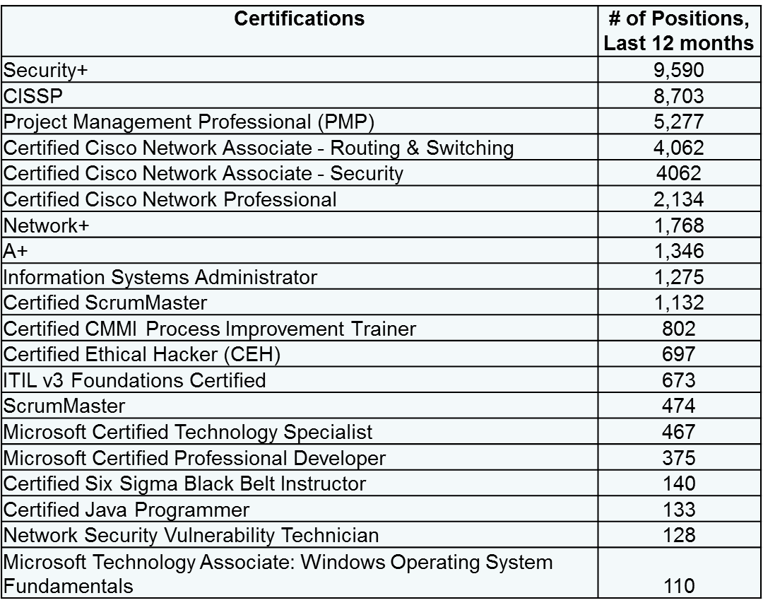
2018 Needs Assessment Data: Top 20 Certifications by Unique Job Ad Citations

Slide 29
Cybersecurity Job Profile

Slide 31
Building Employer Support for Work-based Learning: Lessons from Bossier Parish Community College
Paul Spivey
Assistant Dean - Division of Technology, Engineering, and Mathematics
Bossier Parrish Community College

Slide 32
Challenges Engaging Employers
Unmet needs - Previous students hired not meeting needs
Resistant to change - Colleges being rigid in changing curriculum
Misconceptions of competency – employers not giving students a chance
Outdated HR requirements - more education or years of experience needed
Unknown program - Hesitancy over program being relatively new

Slide 33
Work-based Learning – Internship Capstone
Why have an internship course?
Increased chances of employment
More engaged learner from the start
Employer buy-in
Agreement/Sites
MOU signed by chancellor and company (one time)
Student agreement form signed
Mentor must be knowledgeable in field
Work must apply to degree
Some fields transcend one type of company Example (IT - banks, k-12 schools, hospitals)
Program Director is able to sub course for upper level class if no internship can be found
Course Logistics
Students receives credit for the class
Register for online or hybrid offerings
100 contact hours
Internship must be done when enrolled in course
Students can find internship sites or instructor will help place
Local or national; face-to-face or virtual
Paid or unpaid
Course required (preferred) but some elective
Mock interviews - panel of IT managers interviewing students giving them good practice
New group course developed – employer comes to class and gives project to work on

Slide 34
Practical Activities to Engage Employers
Alumni/employee panel
Resume & interviewing workshop
Classroom guest speakers
Hiring managers meeting & tour (BPCC Day at CSRA)
Academic Curriculum Summit
Joint Career Fairs & Special Technology Career Fairs

Slide 35
Upcoming TA Next Steps
Please stay tuned for upcoming TA Events, including:
September-October 2018: Series of small group peer learning calls, by organization type. These calls will help build connections between similar grantees by bringing together:
Institutions of higher education
Nonprofits and community-based organizations
Workforce boards and unions

Slide 36
How do you feel after today’s webinar?
Geronimo! We are excited to apply these data and other resources to our TechHire project.
WBL What?!…We still have a few more questions!
A little overwhelmed, but excited!

Slide 38
TechHire Grantee Mailbox TechHire@dol.gov

Slide 39
Appendix
Additional findings from the NOVA Tech Council’s workforce assessment

Slide 40
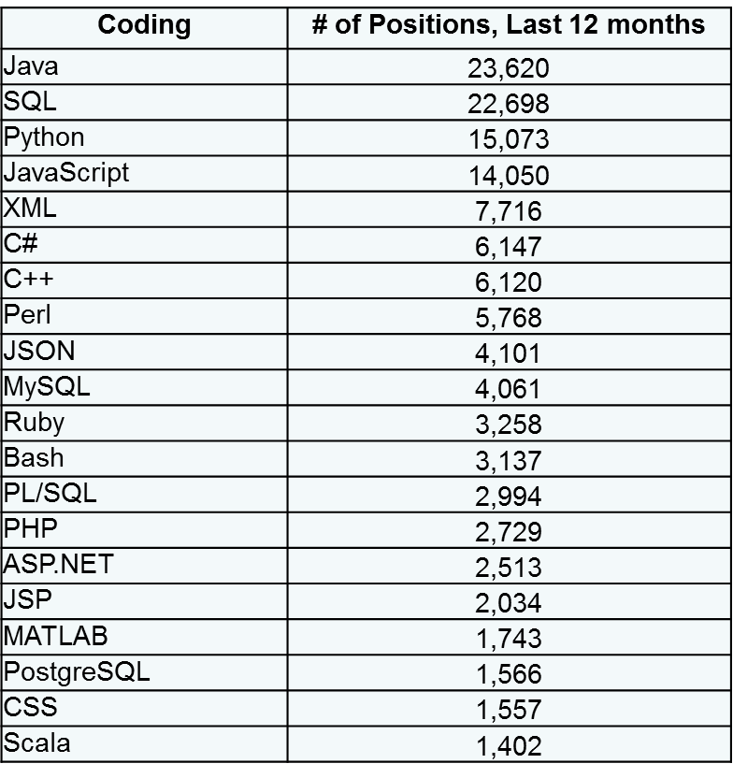
2018 Needs Assessment Data Coding
Top 20 Coding Languages by Unique Job Ad Citations

Slide 41
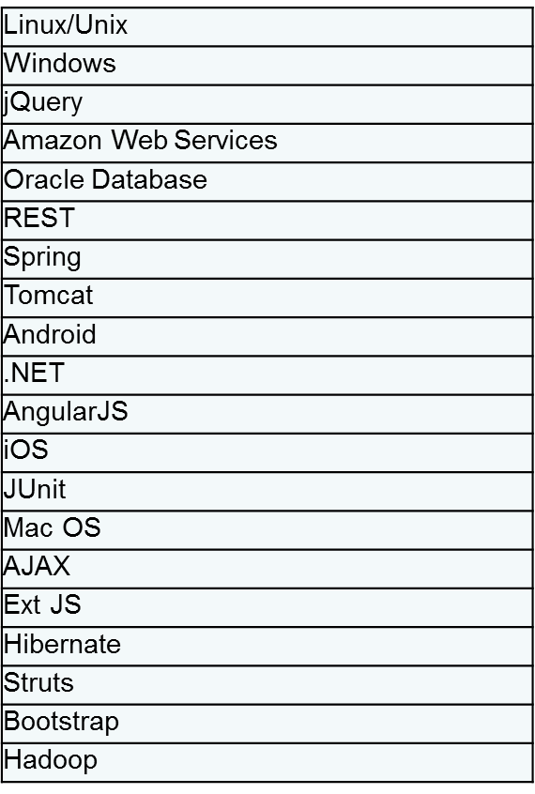
2018 Needs Assessment Data: Frameworks
Top 20 Frameworks by Unique Resume Citations

Slide 42
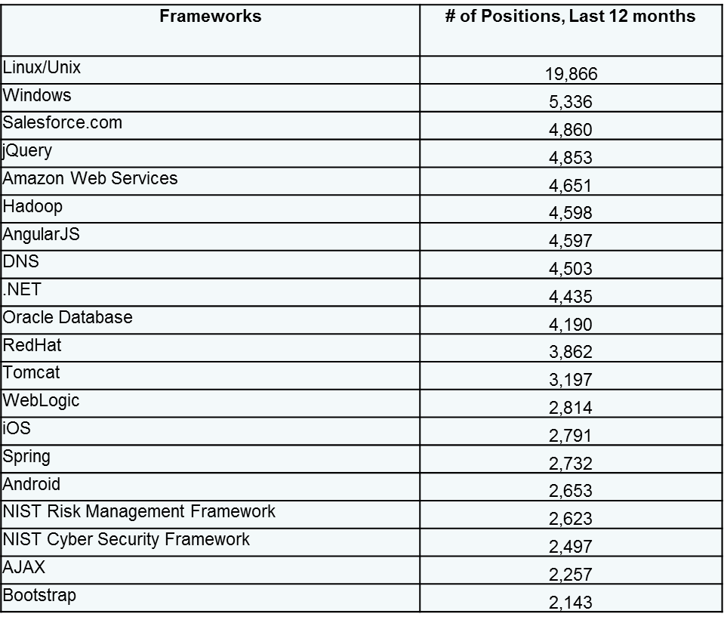
2018 Needs Assessment Data: Frameworks
Top 20 Frameworks by Unique Job Ad Citations

Slide 43
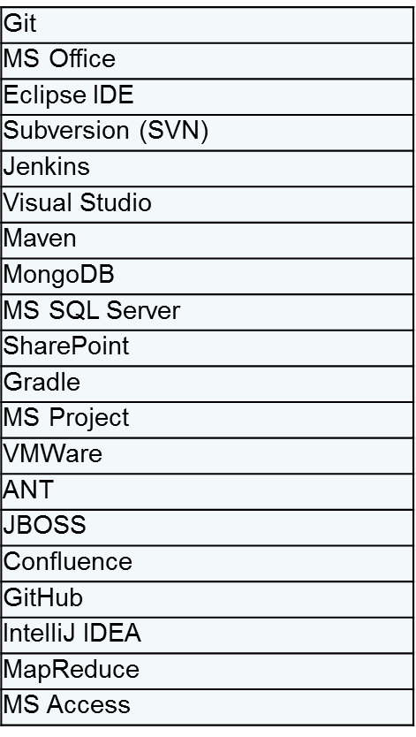
2018 Needs Assessment Data: Applications/Toolkits
Top 20 Apps/Toolkits by Unique Resume Citations

Slide 44
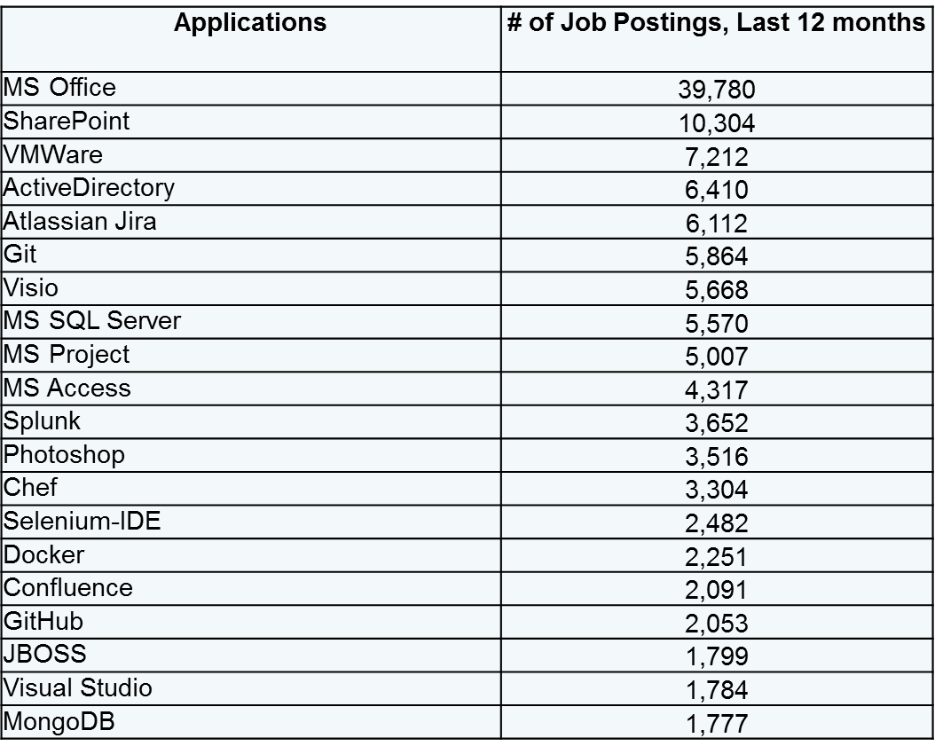
2018 Needs Assessment Data: Applications/Toolkits
Top 20 Apps/Toolkits by Unique Job Ad Citations

Slide 45
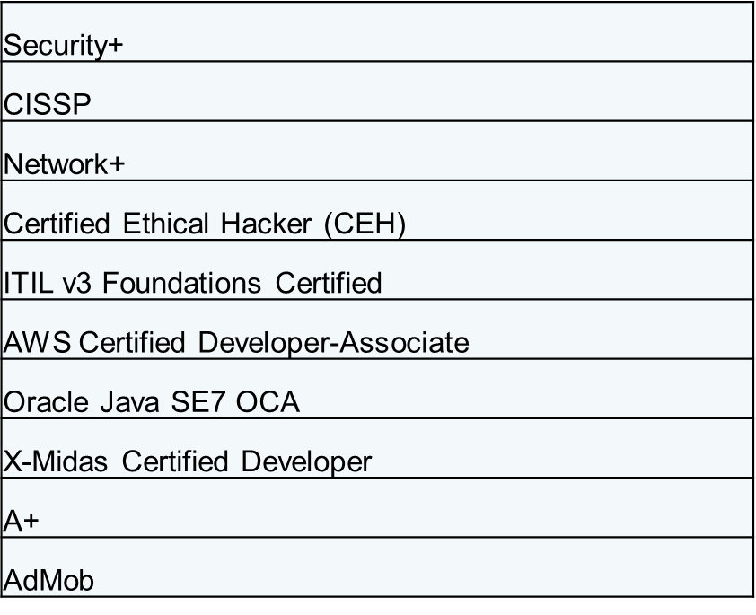
2018 Needs Assessment Data: Certifications
Top 10 Certifications by Unique Resume Citations

Slide 46
Software Development Job Profile

Slide 47
Data Analytics Job Profile

Slide 48
Network Infrastructure Job Profile

