Slide 1
Building Your Toolbox for Success: Program Design and WIOA Resource Spotlights
September 14, 2018

Slide 3
Michelle Lee-Jones
Workforce Analyst
U.S. Department of Labor

Slide 4
Consuela Greene
Senior Director, DOL YouthBuild Program Impact
YouthBuild USA
Mary McRae
Technical Assistance Coach
YouthBuild USA

Slide 5
Kurt von Stetten
Director, Data Services
YouthBuild USA
Lisa Reddy
Associate Director, Knowledge Management
YouthBuild USA

Slide 6
Understand how to navigate Workforce GPS to find resources to strengthen programming and WIOA alignment
Identify continuous quality improvement strategies ensure quality programming and positive performance outcomes
Explore data management strategies to address common data and performance management challenges

Slide 7
My Role at my YouthBuild Program
Executive Director
Program Director
Job Developer
Case Manager
Construction or Construction Plus Instructor
Academic Instructor
Other

Slide 8
Tools for DOL YouthBuild Program Management and Program Design

Slide 9
How does your Statement of Work (SOW) guide program management?
THIS IS WHAT YOU SAID YOU WOULD DO!

Slide 10
PROGRAM MANAGEMENT TIPS TO ENSURE COMPLIANCE
ENROLLMENTS
RESOURCES
Know the # of enrollments you agreed to
Know the population your are drawing these enrollments from (including zip codes)
DOL Compliance Documentation and Key Guidance
YB WIOA FAQ Sheet
TEN 13-11 YouthBuild Participant Documentation
TEGL 14-09 Mental Toughness/Orientation Allowable Costs in a YouthBuild Program

Slide 11
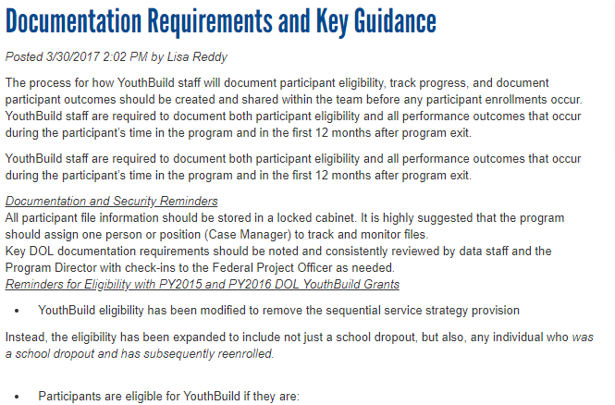
PROGRAM MANAGEMENT TIPS TO ENSURE COMPLIANCE- Highlight Documentation and Key Guidance

Slide 12
PROGRAM MANAGEMENT TIPS TO ENSURE COMPLIANCE- Highlight YB WIOA FAQ Sheet

Slide 13
PROGRAM MANAGEMENT TIPS TO ENSURE COMPLIANCE
Construction
RESOURCES
Know the # of housing units you agreed to fulfill during the 2 years of program time – and whether gut rehab and/or new build
Be sure Construction staff are certified in the curriculum you indicated in your SOW
Are you using partners?
Construction Training at a YouthBuild Program Handbook_Updated2017
TEGL 35-12: Definition and Guidance on Allowable Construction Credentials for YouthBuild Programs
TEGL 5-10: Match and Allowable Construction and Other Capital Asset Costs for the YouthBuild Program
TEGL 6-15: Qualifying Work Sites and Construction Projects for YouthBuild Grantees and Their Role in Training

Slide 14
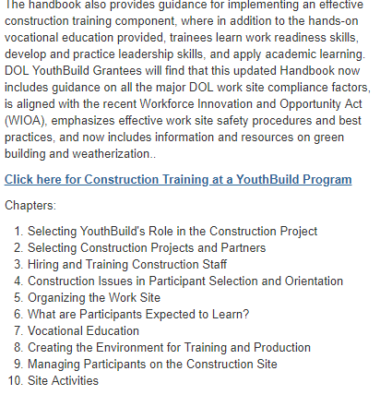
PROGRAM MANAGEMENT TIPS TO ENSURE COMPLIANCE – Highlight Construction at a Youthbuild Program

Slide 15
PROGRAM MANAGEMENT TIPS TO ENSURE COMPLIANCE
Education
RESOURCES
Are you instructing in GED or other state High School Equivalency curriculum?
Do you have a separate High School Diploma track?
Are you using TABE or CASAS?
Are you using partners?
Education at a YouthBuild-Program
Test of Adult Basic Education (TABE)
CASAS
TEGL 15-10: Increasing Credential, Degree, and Certificate Attainment
TEGL 18-11: Improving Literacy and Numeracy Gains of Workforce Investment Act (WIA)

Slide 16
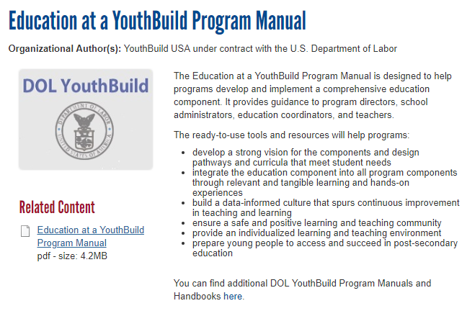
PROGRAM MANAGEMENT TIPS TO ENSURE COMPLIANCE – Highlight Education at a YouthBuild Program

Slide 17
PROGRAM MANAGEMENT TIPS TO ENSURE COMPLIANCE
Partnerships
RESOURCES
Are you using partner for any core programming?
If so, are MOUs/sub-contracts in place (and evaluated regularly)?
Do you have an MOU with your local American Job Center?
Partnering with Employers Manual
Rethinking Recruitment- Partnerships and Strategies
A Guide to Effective DOL YouthBuild and American Job Center Partnerships

Slide 18
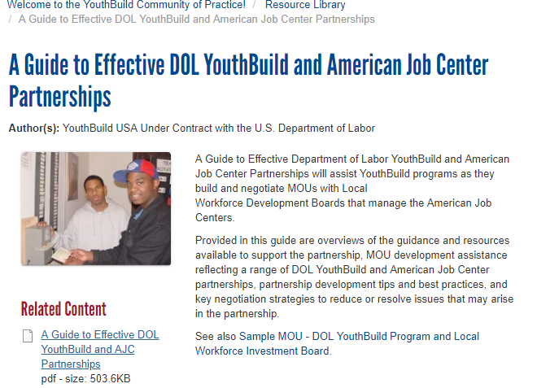
PROGRAM MANAGEMENT TIPS TO ENSURE COMPLIANCE – Highlight A Guide to Effective DOL YouthBuild and American Job Center Partnerships

Slide 19
PROGRAM MANAGEMENT TIPS TO ENSURE COMPLIANCE
Construction Plus
RESOURCES
What is your occupational skills credential and curriculum?
Who is teaching curriculum and are they certified?
How many enrollments did you indicate?
Construction Plus Framework for a Quality Pre-Apprenticeship Experience
TEGL 07-14: Guidance for Implementing Construction Plus Component of the YouthBuild Program

Slide 20
PROGRAM MANAGEMENT TIPS TO ENSURE COMPLIANCE – Highlight Construction Plus Framework

Slide 21
PROGRAM MANAGEMENT TIPS TO ENSURE COMPLIANCE
Planning and Compliance
RESOURCES
Read and understand the DOL/YB TENs and TEGLs
Read and understand the DOL YouthBuild Toolbox
YouthBuild-Related TEGLs and TENs
DOL YouthBuild Toolbox

Slide 22
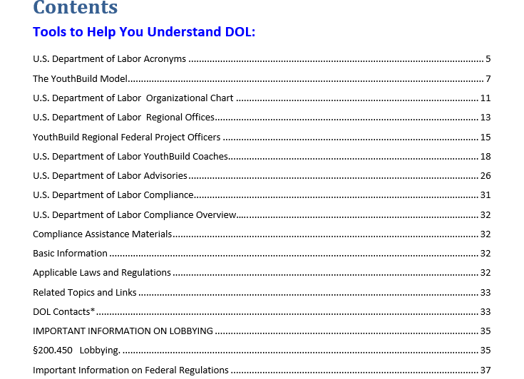
PROGRAM MANAGEMENT TIPS TO ENSURE COMPLIANCE – Highlight DOL YouthBuild Toolbox

Slide 23
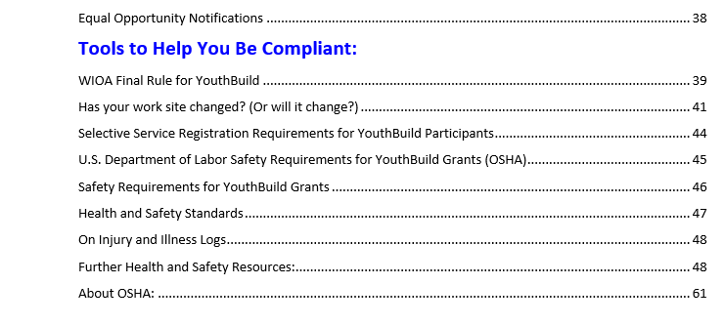
PROGRAM MANAGEMENT TIPS TO ENSURE COMPLIANCE – Highlight DOL YouthBuild Toolbox

Slide 24
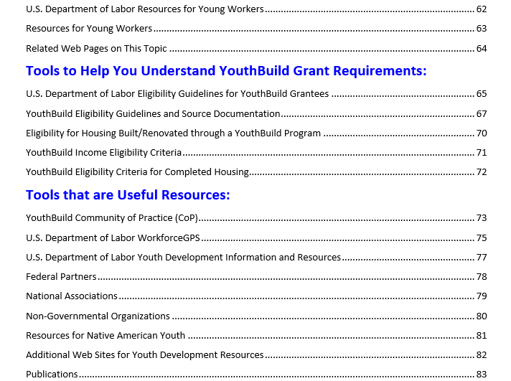
PROGRAM MANAGEMENT TIPS TO ENSURE COMPLIANCE – Highlight DOL YouthBuild Toolbox

Slide 25
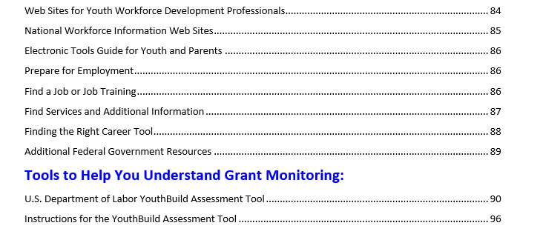
PROGRAM MANAGEMENT TIPS TO ENSURE COMPLIANCE – Highlight DOL YouthBuild Toolbox

Slide 26
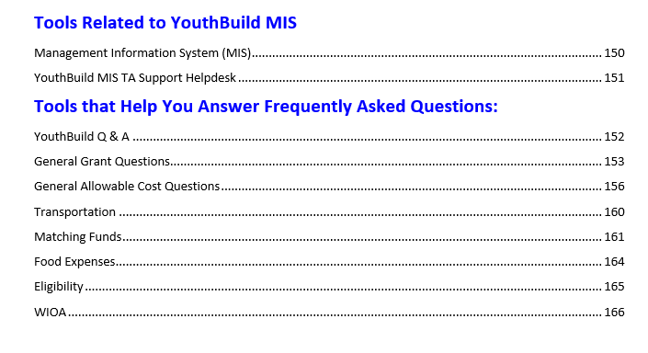
PROGRAM MANAGEMENT TIPS TO ENSURE COMPLIANCE – Highlight DOL YouthBuild Toolbox

Slide 27
Program Management – Planning tools
Planning
Resources
If you are just starting out use the 4-month planning tool to assist in getting your program up and running
If you are mid-stream in your contract – use the 2nd year planning tool to keep you on target
If you are coming to the end of the 2nd year use the 3rd year follow up planning tool to finish off strongly
Grantee Planning Period – Guidance & Best Practices TA Toolkit
First Year YouthBuild Program Planning Checklist
Transition/Third Year DOL YouthBuild Program Checklist

Slide 28
Staffing - Onboarding and Development
Tips
Resources
Be sure your staff have read and understand the SOW
Be sure your staff are certified and ready to teach
Download and have staff read YouthBuild Manuals
DOL YouthBuild Program Manuals
DOL YouthBuild Staffing for Placement Toolkit

Slide 29
Key Steps to Building a Quality Team
Hire Right before hiring Quick
Hire (some) staff with past YouthBuild experience
Utilize YouthBuild Technical Assistance resources- TA coaching, trainings, MIS Helpdesk, webinars, and electronic resources
Utilize local staffing and staff development resources for professional development
Maximize talent of own staff (i.e. in-service trainings)
Screen well, pay well, and support the team

Slide 30
Staff Development Planning What Does Your Team Do?
Program Management
Construction Training
Education Training
Case Management
Leadership Development
Placement/Follow Up

Slide 31
Program Design
This is the blueprint for ultimately meeting your performance outcomes

Slide 32
Recruitment and Orientation
Tips
Resources
Develop:
Key strategies for bringing the youth who are a good fit for your program and staff
Concrete plan for roles, responsibilities and resources needed
Timeline
Have strong Mental Toughness component
Rethinking Recruitment Partnerships and Strategies
Youth Recruitment, Orientation, and Selection
Planning for Successful Recruitment and Mental Toughness

Slide 33
Recruitment and Orientation – Highlight Planning for Successful Recruitment and Mental Toughness

Slide 34
Program Retention and Youth Engagement
Tips
Resources
Develop key activities for program retention
Develop a strong case management system
Have your instructors utilized best practice models of instruction
Pathways to Long Term Success
Case Management and Participant Success
Instructional Practice Techniques Tip Sheets
Creating a Creative Classroom Tip Sheet
Increased Learner Engagement Strategies for Education Credential Attainment

Slide 35
Program Retention and Youth Engagement – Highlight Pathways to Long-Term Success

Slide 36
Program Retention and Youth Engagement – Highlight Pathways to Long-Term Success

Slide 37
Program Retention and Youth Engagement – Highlight Pathways to Long-Term Success

Slide 38
Program Retention and Youth Engagement – Highlight Pathways to Long-Term Success

Slide 39
Program Retention and Youth Engagement – Highlight Case Management and Participant Success

Slide 40
YouthBuild is a Pre-Apprenticeship Program
Tips
Resources
Ensure your vocational training (construction and construction plus) aligns with a quality pre-apprenticeship model
Develop apprenticeship and industry partnerships to strengthen the bridge for participants from the YouthBuild program into apprenticeship and career opportunities
Registered Apprenticeship Toolkit
Apprenticeship Resource Guide
Construction Plus Framework for a Quality Pre-Apprenticeship Experience

Slide 41
YouthBuild is a Pre-Apprenticeship Program – Highlight Registered Apprenticeship Toolkit

Slide 42
Work and Career Readiness Design
Tips
Resources
Provide each youth with a good career assessment
Assist the youth to develop career/work goals and connect these goals with program activities
Develop an Individual Development Plan/Transition Plan (IDP) - this is a living document so update regularly
Be intentional with work readiness and life skills programming from orientation through the follow-up period
Crucial Questions to Ask When Planning for Placement
Strategic Post Secondary and Employer Partners
Career One-Stop Assessment Resources
Career One-Stop Toolkits
Financial Capability Factsheet

Slide 43
Work and Career Readiness Design – Highlight - Career One Stop Website

Slide 44
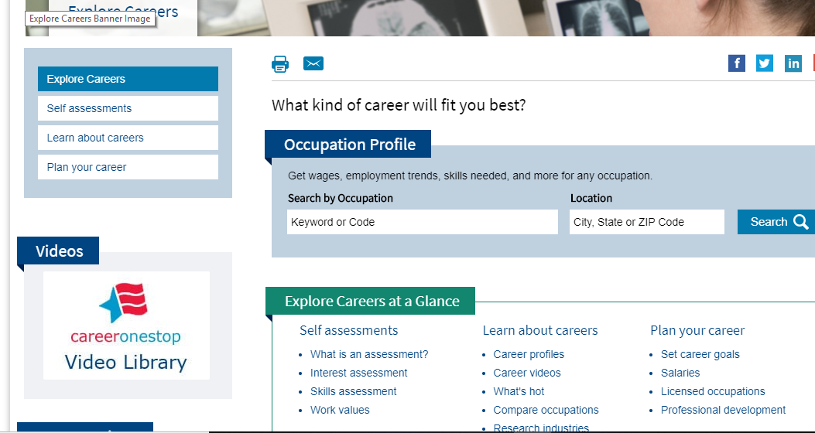
Work and Career Readiness Design – Highlight - Career One Stop Website

Slide 45
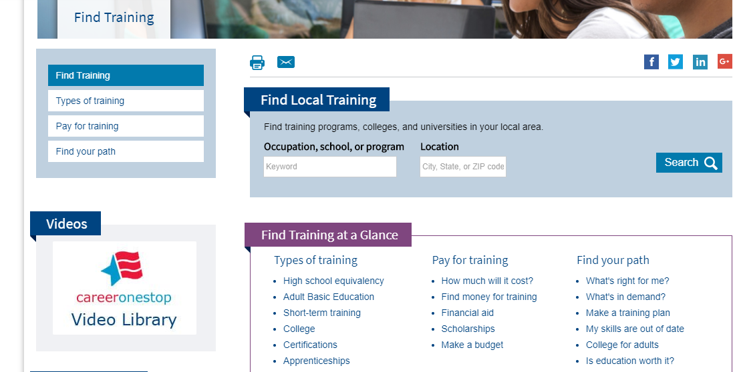
Work and Career Readiness Design – Highlight - Career One Stop Website

Slide 46
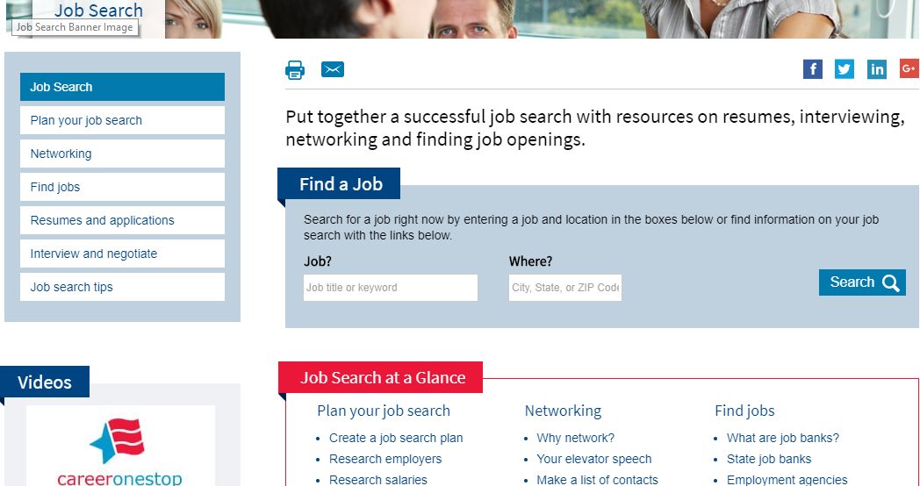
Work and Career Readiness Design – Highlight - Career One Stop Website

Slide 47
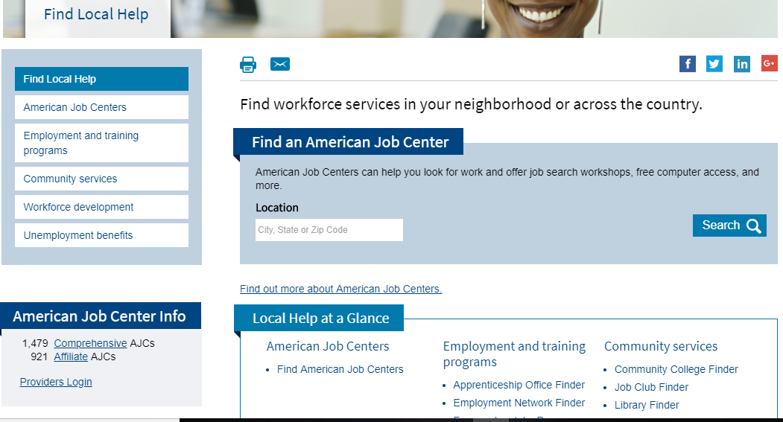
Work and Career Readiness Design – Highlight - Career One Stop Website

Slide 48
Kurt von Stetten
Director, Data Services
YouthBuild USA

Slide 49
Tools for WIOA Performance and Data Management

Slide 50
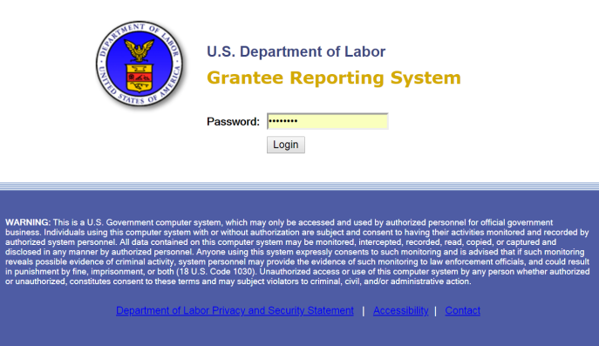
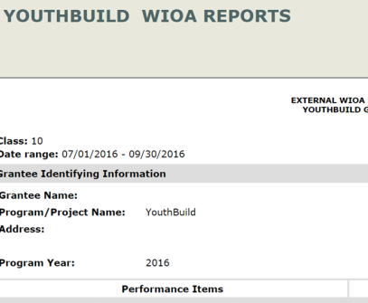
Your Data Management Toolbox
Understanding WIOA Performance Indicators
Understanding Reporting Requirements in the MIS
Getting Help

Slide 51
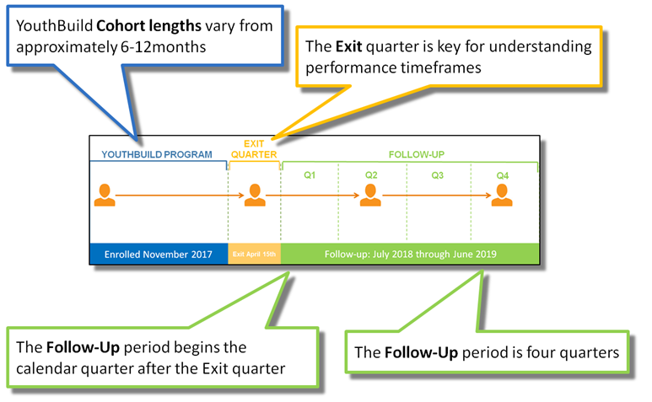
Understanding WIOA
1

Slide 52
WIOA Performance Indicators
Performance Indicator
Time Frame
Placement in Q2
Placement in Q4
Median Earnings in Q2
Credential Attainment
Measurable Skill Gains
Effectiveness in Serving Employers
2nd Quarter of Follow-up
4th Quarter of Follow-up
2nd Quarter of Follow-up
Enrollment - 1 year from Exit
Gains within Program Year
Baseline assessment

Slide 53
WIOA Performance Indicators: Resources
WorkforceGPS
MIS Help Desk
DOL YouthBuild WIOA Performance Indicators
QNPR narrative template
TEGL
10-16 Change 1
26-16
WIOA Credential Attainment E-Learning Modules
Weekly Trainings
MIS Data Entry
MIS Report Training
WIOA reporting: 9/12/18 @ 3pm
Quarterly Training: Wednesday 10/17/18 @ 1pm ET
Median Earnings and Measurable Skill Gains template and user guide

Slide 54
Understanding Reporting Requirements in the MIS
2

Slide 55
MIS and WIOA Reporting Requirements for 2016 and 2017 Grantees
Report
Systems and Skills
Quarterly Performance Report
Median Earnings and Measurable Skill Gains Report
WIOA Supplemental Report
Joint Quarterly Narrative Report
Financial Reports*
MIS Main Grantee Access
MIS Data Review/Checks
MS Excel Proficiency
Report Archive
Case File Documentation

Slide 56
MIS and WIOA Reporting Resources
WorkforceGPS
MIS Help Desk
DOL YouthBuild WIOA Performance Indicators
QNPR narrative template
TEGL
10-16 Change 1
26-16
Weekly Trainings
MIS Data Entry
MIS Report Training
WIOA reporting: 9/12/18 @ 3pm ET
Quarterly In Depth Training: Wednesday 10/17/18 @ 1pm ET
Median Earnings and Measurable Skill Gains template and user guide

Slide 57
Getting Help: The MIS Help Desk
3
Monday-Friday 9am -5pm ET
866-680-0855 or MISsupport@youthbuild.org
Weekly MIS Data Entry
Tuesdays @ 2pm ET and Fridays at 10am ET
Email MISsupport@youthbuild.org to register
Weekly MIS Report Trainings
Wednesdays @ 3pm ET
Email MISsupport@youthbuild.org to register
MIS Newsletter
First Friday of every month
Email MISsupport@youthbuild.org to be added to list

Slide 58
Weekly MIS Trainings MIS Data Entry: Tuesdays @ 2pm ET MIS Report Training: Wednesdays @ 3pm ET
Quarterly MIS Trainings
In depth webinar training reviewing performance reporting, MIS data entry, and reporting requirements.
October 17, 2018 @ 1pm ET
WIOA Report Training
Webinar training reviewing MIS WIOA reporting requirements.
September 12, 2018 @ 3pm ET
Email MISsupport@youthbuild.org to register!

Slide 59
Lisa Reddy
Associate Director, Knowledge Management
YouthBuild USA

Slide 60
Tips to Navigate Workforce GPS

Slide 61
Have you searched WorkforceGPS for Resources?
Yes, I have used the search capability
No, I access WorkforceGPS resources through links on the newsletter, weekly e-lerts, etc.
What is WorkforceGPS?

Slide 62
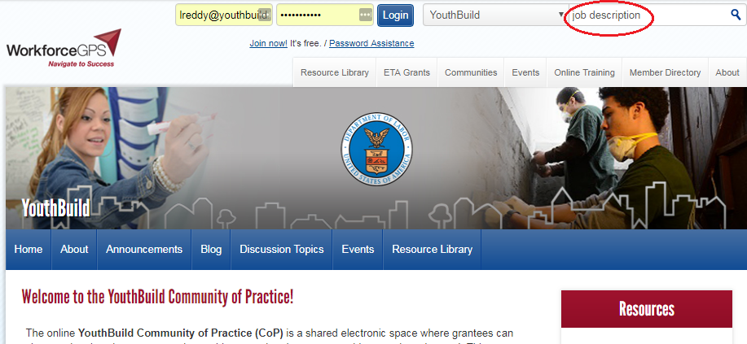
Effective Searching in WorkforceGPS

Slide 63
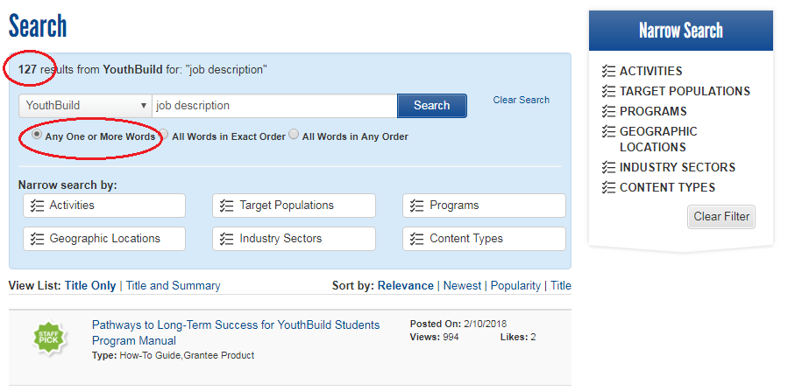
Searching for Job Descriptions

Slide 64
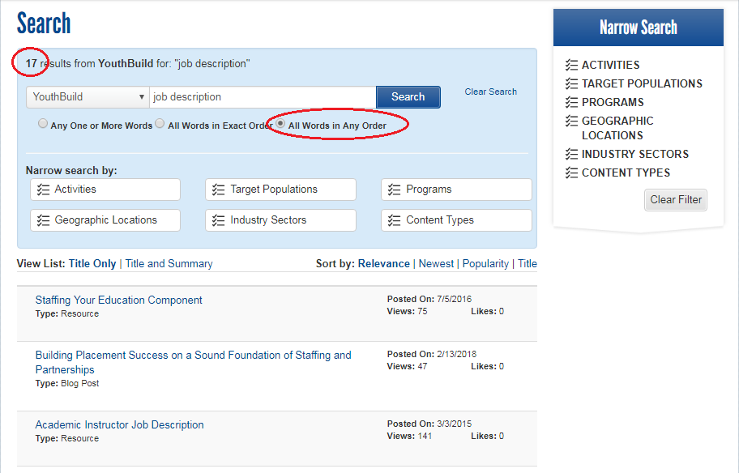
Searching for All Words in Any Order

Slide 65
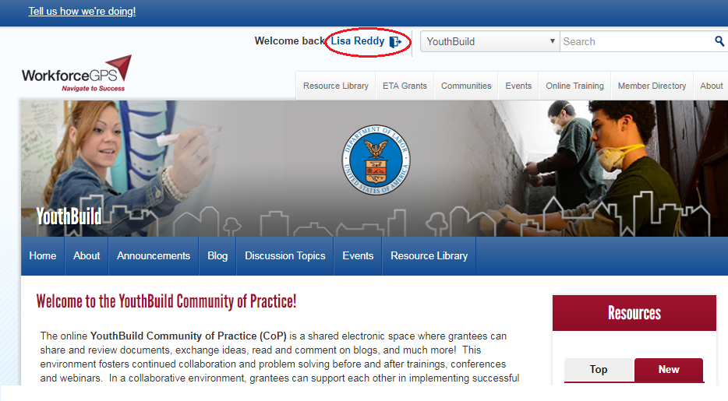
WorkforceGPS Member Directory – Making your Profile Visible

Slide 66
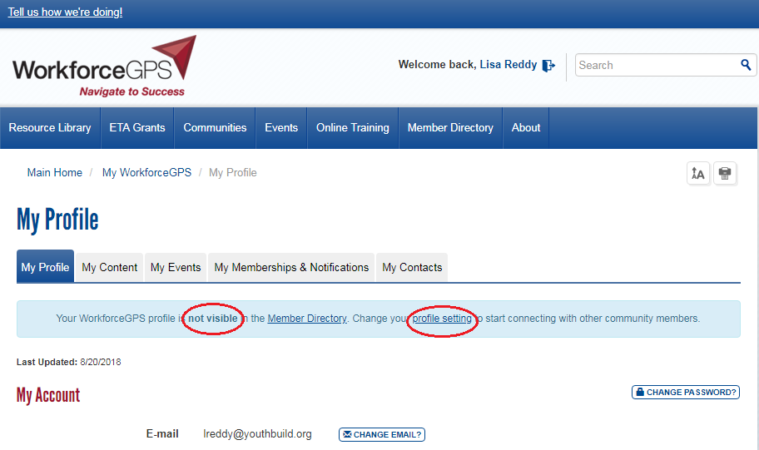
WorkforceGPS Member Directory – Making your Profile Visible

Slide 67
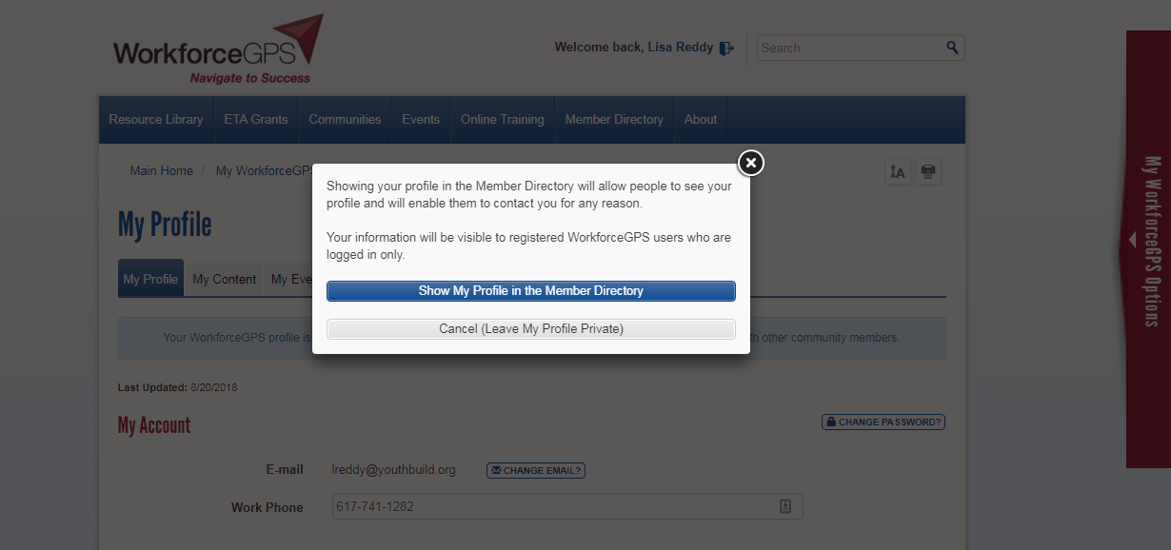
WorkforceGPS Member Directory – Making your Profile Visible

Slide 68
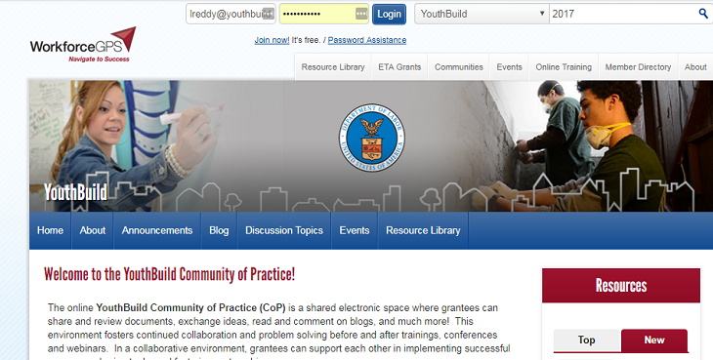
Searching the Member Directory

Slide 69
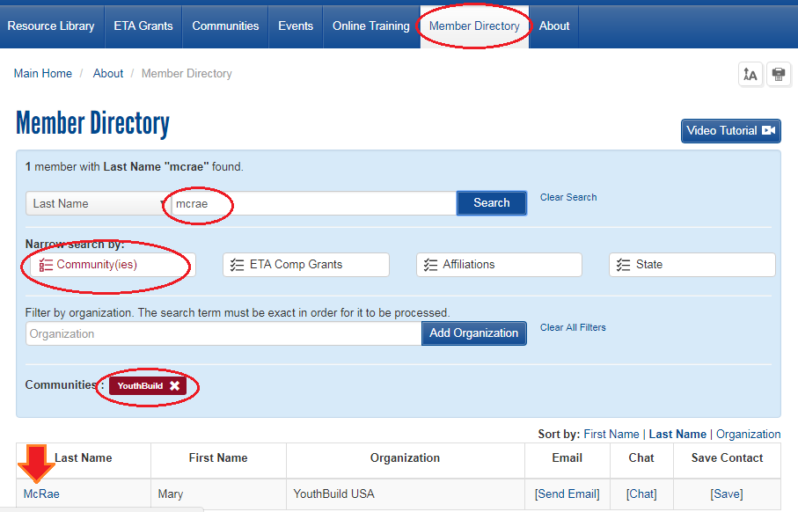
Searching the Member Directory

Slide 70
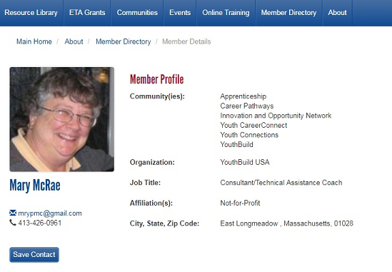
Member Directory Profile

Slide 72
YouthBuild Webinar Series - Maximizing the Construction Curriculum October 2, 2018, 2-3:30pm ET

Slide 73
Consuela Greene
Director, DOL YouthBuild Program Impact
YouthBuild USA
cgreene@youthbuild.org
(617) 741-1251
Mary McRae
DOL TA Coach
YouthBuild USA
mrypmc@gmail.com
(413) 426-0961
Kurt Von Stetton
Director, Data Services
YouthBuild USA
kvonstetten@youthbuild.org
(617) 741-1270
Lisa Reddy
Associate Director for Knowledge Management
YouthBuild USA
lreddy@youthbuild.org
(617) 741-1282

