Slide 1
Polling Question
?
What kind of organization are you coming from?
College
Workforce Board/American Job Center
Community Service Provider
Other
?
?
?
?

Slide 2
Polling Question
?
Do you use Open Educational Resources at your organization?
Yes, frequently!
Yes, just starting to explore
No, what is OER?
?
?
?
?

Slide 3
Discussion Question
?
How does your organization try to meet the needs of workforce stakeholders?
?
?
?
?

Slide 4
SkillsCommons Field Guide of Exemplary Practices
Webinar Series Part 1:
Aligning Workforce Development Stakeholders
September 12, 2018
Innovations Leading to Career Success Webinar Series
Employment and Training Administration
Office of Career, Technical, and Adult Education

Slide 5
Moderators
Cheryl Martin, Trade Adjustment Assistance Community College and Career Training (TAACCCT) Program Manager, Division of Strategic Investments, Employment and Training Administration, U.S. Department of Labor
Erin Berg, Community College Program Specialist, Office of Career, Technical, and Adult Education, U.S. Department of Education

Slide 6
The TAACCCT Grant Program
The U.S. Department of Labor’s Trade Adjustment Assistance Community College and Career Training (TAACCCT) grant program is a major investment to increase the ability of community colleges to address the challenges of today’s workforce.
The TAACCCT Program:
$1.9 billion awarded; grant projects active from 2011-2018
Over 700 colleges across the nation participated, in partnership with over 2,500 employers
Over 2,600 industry-aligned programs of study developed or enhanced
More than 475,000 individuals enrolled to date
Resources developed by grantees made freely available on SkillsCommons.org

Slide 7
About this Webinar
This webinar showcases strategies and resources developed by community colleges that are of broad interest to educational institutions engaged in career-focused education and training.
The Skills2Work (S2W) IMPACTcommunity, and the many other resources available on SkillsCommons, were produced by grantees of the Trade Adjustment Assistance Community College and Career Training (TAACCCT) program, a collaboration between the US Department of Labor and the US Department of Education.

Slide 8
Innovations Leading to Career Success Webinar Series
This webinar series showcases strategies and resources that are of broad interest to educational institutions engaged in career-focused education and training.
August 22:
Jumpstart to Successful Instruction: A Deeper Dive into an Accelerated Course for New Instructors
September 12:
Aligning Workforce Development Stakeholders
September 26:
Increasing Student Support Services to Improve Student/Worker Outcomes
October 10:
Increasing Academic Achievement
October 24:
Adult Learning Strategies at Community Colleges
For more information, please visit:
Innovations Leading to Career Success Webinar Series

Slide 9
.org An online library of 12,000+ free workforce development resources ready to be downloaded, adapted, and used

Slide 10
.org
Capture and preserve instructional and program support materials produced by over 700 colleges across the US through the TAACCCT program
Enable discovery of content materials so others can easily reuse the materials to accelerate and expand access to workforce development programs
Build sustainable communities of practice of colleges, businesses, and local, state, and national organizations to assure the quality and continued use of content

Slide 11
SkillsCommons Field Guide of TAACCCT Innovations
Innovative Approaches to Common Challenges Found in Higher Education and Workforce Development
Video interviews
Dawn Busick-Drinkard https://youtu.be/yD0LGw5PJXM
Kaye Norris - https://youtu.be/drecdr2o-9E
Links to solutions-based materials located on SkillsCommons
Descriptors of designs and implementation plans
An in-depth look at project leadership

Slide 12
Presenters
Dawn Busick-Drinkard, Grant Director, MoWINs Missouri Community College Association
Kaye Norris, Project Director, HealthCARE Montana Missoula College, Montana
9

Slide 14
MoSTEMWINS data grant
Funding to implement noncredit system
Good Partnerships in Place
Missouri Community College Association (MCCA) and Community Colleges
Missouri Department of Economic Development
Missouri Economic Research and Information Center (MERIC)
Division of Workforce Development
Missouri Education Departments (DHE and DESE)
Missouri Departments of Labor and Social Services

Slide 15
MoSCORES
Outcomes for noncredit and credit programs
Usable system for counselors, students, parents, public
Noncredit Program Data Collection (Noncredit Supplemental Data File)
Collecting noncredit student records beginning July 2016
Program Upload for ETPS (Eligible Training Provider System) and EMSAS (Enhanced Missouri Student Achievement Study)
Replaces data entry process for WIOA programs
Up-to-date consumer information on post-secondary education programs
Labor Market Information
Sustainable system for reporting program results
Project will outlive the grant
Automation!
Enhanced security of the longitudinal database

Slide 16
Live Demo of the MOSCORES Website: https://scorecard.mo.gov/scorecard/

Slide 17
Super Agency MOU renewed another 4 years
New MOU Partners: Dept. of Social Services, Dept. of Corrections
Missouri Connections for Adult Users
Career Exploration
Reporting Tools
Access to DHE and ETPS program inventories
Report Builder
WIOA Report
Downloadable program file
Printable Summary Page
Users can print a program-specific summary from the system on the programs of interest
Securities/Access

Slide 19
HealthCARE Montana

Slide 20
HealthCARE MT—By the Numbers
~3600 students directly served; over 5000 students enrolled
1 semester reduction for each Practical Nursing (PN), Associate of Science in Nursing (ASN) and Bachelor of Science in Nursing (BSN) completion
Distance delivered practical nursing program
39 graduates; 98% National Council Licensure Examination – Practical Nursing (NCLEX PN) pass rate
49 new or enhanced programs
51 facilities across the state with 21 Registered Apprenticeship occupations with 204 apprentices

Slide 21
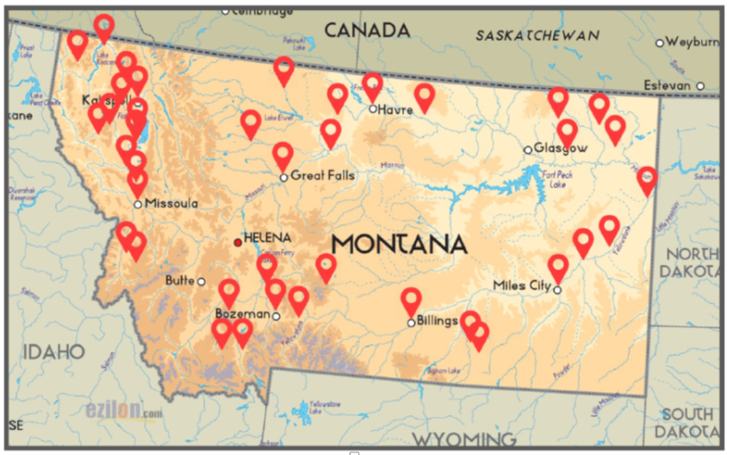
Montana Registered Apprenticeship Programs

Slide 22
Strategies for Success
Curriculum & Apprenticeship
Employer driven
Rural focus
Partnership with Licensing Boards, Professional Organizations, other Workforce Development Stakeholders
State level leadership support
Statewide scaling and sharing best practices
Apprenticeships
Program Development – all new materials – toolkit
Partner with Education Providers – Give options

Slide 23
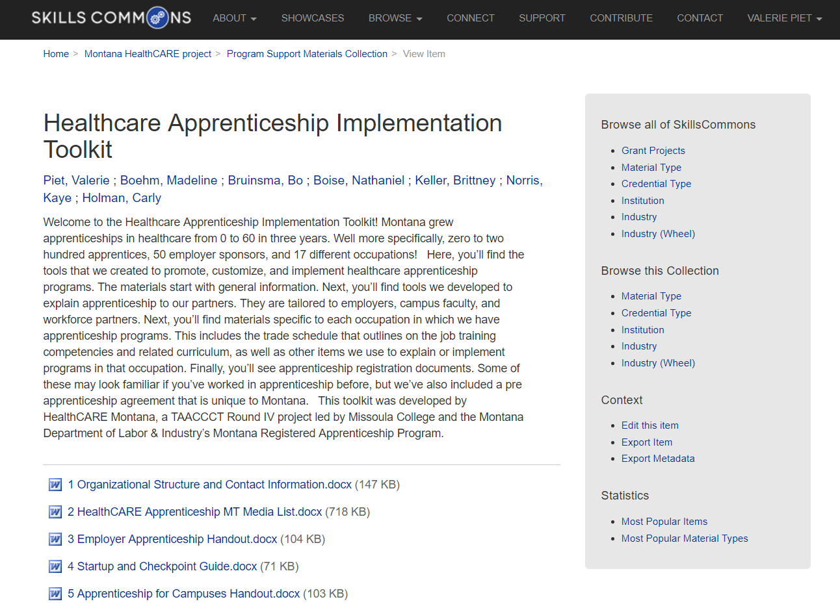
Healthcare Apprenticeship Implementation Toolkit
Toolkit Includes:
General Information
Outreach (campuses partners, workforce, employers, sponsors)
Occupation Specific Information
Registration Documents
Full Curriculum
67 total documents
https://www.skillscommons.org//handle/taaccct/15216

Slide 24
Apprenticeship for Facilities
https://www.skillscommons.org//handle/taaccct/15216

Slide 25
Apprenticeship for Campuses
https://www.skillscommons.org//handle/taaccct/15216

Slide 26
Trade Schedule
https://www.skillscommons.org//handle/taaccct/15216

Slide 27
Apprenticeship At-A-Glance Model
LPN (Licensed Practical Nurse) Grid Model presents complicated apprenticeship timelines in a quick-to-understand format for employers and others.
Pre-Apprenticeship period is indicated in blue.
Apprentices complete on-the-job (OJT) training hours as the program proceeds.
Licensed Practical Nurse GRID Model At-A-Glance.docx

Slide 28
Competency Checklists by Occupation
Optional, complementary materials employers can use to guide and track apprenticeships
Reflects evolving relationship between registration agency and employers
For example, https://bit.ly/2FRxJog

Slide 29
New Curriculum
Restorative Care
8 instructor guided units:
Case studies
Reflective journaling
Skills assessments
Offered to nurse aides with >6 months of experience
Taught by a practical nurse or registered nurse
Curriculum: https://www.skillscommons.org/handle/taaccct/14784
Corresponding items in Apprenticeship Implementation Toolkit:
Trade Schedule (On-the-job training competencies and related instructional outline) https://bit.ly/2rvNs7w
Talking Points https://bit.ly/2K3MZB8
Employer Curriculum Guide https://bit.ly/2rrM5GS
Competency Checklist https://bit.ly/2K4s4h8

Slide 30
Employer Response
Glendive Medical Center
“The facility is writing a new job description for a C.N.A. Restorative Coordinator which I feel the students will apply for and likely be selected for and this will offer an increase in wage for each, though they have already both received increase as a result of this education as they advance on the C.N.A. Career Ladder.”
Eastern Montana Veterans Home
“The Medication Aides are simply “rocking” their program. All have completed the online portion of the training and most have begun their clinical hours. The facility developed a Nurse Mentor program for the students support and guidance and 5 nurses volunteered to participate.”
North Valley Hospital
The apprenticeship program has been a positive experience our facility and our apprentice. We have been able to utilize this person in a variety of roles within our Revenue Cycle and we continue to look at other opportunities where NVH can promote growth with the apprenticeship program.

Slide 32
Connect with SkillsCommons Communities
Follow SkillsCommons on social media:
www.skillscommons.org/Facebook
www.twitter.com/SkillsCommons
www.linkedin.com/company/6650163
SkillsCommons Basecamp
Join others in this online resource-sharing and problem-solving community. Send an email to
connect@skillscommons.org, and we’ll get you connected right away!
MERLOT Voices
Join a Voices Industry Sector & IMPACTcommunities forum. Stay informed and get involved in
leadership. Participate in the online communities where you can engage in online dialogs, post
materials, and get connected with colleagues.
SkillsCommons Connect Center Get all the latest SkillsCommons news and feeds!
http://bit.ly/IE2ET

Slide 33
SkillsCommons’ Future
In January 2019, SkillsCommons plans to expand our services and customize workforce development services for education, industry, and workforce organizations.
Want to know more? Email us at connect@skillscommons.org
http://bit.ly/IE2ET

Slide 34
Thank you!
For more information, please visit http://support.skillscommons.org/connect/impact-communities/
If you have further questions, you can contact the SkillsCommons team at:
SkillsCommons Support
support@skillscommons.org
This work is licensed under a Creative Commons Attribution 4.0 International License.
This workforce solution was created through a cooperative agreement between the U.S. Department of Labor's Employment and Training Administration and the California State University-Multimedia Educational Resource for Learning and Online Teaching (MERLOT).

Slide 35
Innovations Leading to Career Success Webinar Series
This webinar series showcases strategies and resources that are of broad interest to educational institutions engaged in career-focused education and training.
August 22:
Jumpstart to Successful Instruction: A Deeper Dive into an Accelerated Course for New Instructors
September 12:
Aligning Workforce Development Stakeholders
September 26:
Increasing Student Support Services to Improve Student/Worker Outcomes
October 10:
Increasing Academic Achievement
October 24:
Adult Learning Strategies at Community Colleges
For more information, please visit:
Innovations Leading to Career Success Webinar Series

