Slide 1
MEETING THE WORKFORCE CHALLENGES OF THE WATER SECTOR A Competency Model Approach
September 13, 2018 – 1:00-2:30 PM (EST)
Employment and Training Administration
United States Department of Labor

Slide 2
Pam Frugoli
O*NET/CareerOneStop/Competency Model Team Lead
U.S. Dept. of Labor, Employment & Training Administration
Jim Horne
Sustainability Program Manger
Environmental Protection Agency
Bill O’Connell
Manager, Training & Technical Assistance Program
National Rural Water Association

Slide 3
Today’s Objectives
Explore Water Sector Workforce Challenges
Discuss How Competency Models Help
Learn About Key Elements of the Water and Wastewater Competency Model
Engage with the National Rural Water Association
Hear how the model helped meet their needs to develop apprenticeships
Active dialogue

Slide 4
Poll Question #1
Let us know which type of agency you represent:
Click on the answer below that best describes
Water and wastewater utilities
States and primacy agencies
Technical assistance providers
State/local workforce boards, one-stop operators, career services providers
State/local apprenticeship agencies
Private Business
Other (please describe in chat window)

Slide 5
Water Sector Workforce Challenges

Slide 6
Water Sector Workforce Challenges
Water workers are needed in every state and area of the country
Thousands of water workers are aging and expected to retire from their positions in coming years.
Some water occupations are significantly older than the national median (42.2 years old), including water treatment operators (46.4 years old).

Slide 7
Water Sector Workforce Challenges
Water workers often are able to earn higher than average hourly wages than workers in other sectors
Apprenticeship is a well-suited strategy for the water sector
Most water workers require less formal education, with about half having a high school diploma or less
Instead, they require more extensive on-the-job training and familiarity with a variety of tools and technologies

Slide 8
Water Sector Workforce Challenges
“Ultimately, locally-driven actions are crucial to develop new strategies and target new investments, but the scale of the issue demands broader regional collaborations and national support to build additional financial, technical, and programmatic capacity.” –Brookings, 2018

Slide 9
Brookings Recommendations
1. Utilities and other water employers need to empower staff, adjust existing procedures, and pilot new efforts in support of the water workforce
Develop competency models—or customize existing models—to promote continued learning and skills development among staff

Slide 10
Poll Questions #2
How familiar are you with Competency Models?
Select the answer below that best describes you
I’m an expert, I work with them all the time
I am experienced, but still learning
I’ve heard of a competency model before but never used
What is a competency model?

Slide 11
Competency Models
What is a competency?
The capability to apply a set of related knowledge, skills, and abilities to successfully perform functions or tasks.
What is a competency model?
Collection of competencies that together define successful performance in a particular industry or field
Resource, not an end-product

Slide 12
Who Uses Competency Models?
Private Industry Leaders
Trainers and Educators
Human Resources Professionals
Public Workforce Professionals
Economic Developers

Slide 13
Why Competency Models?
Competency Models can help…
Identify and communicate industry needs
Improve employee training programs
Develop industry-defined performance indicators
Develop resources for career exploration
Provide national/regional framework to inform state certification programs

Slide 14
Competency Model Features
Competency Model
National, crosscutting, and industry-wide
Represent broad industry level
Do not describe a standard of performance
Workers do not have every skill at the same level

Slide 15
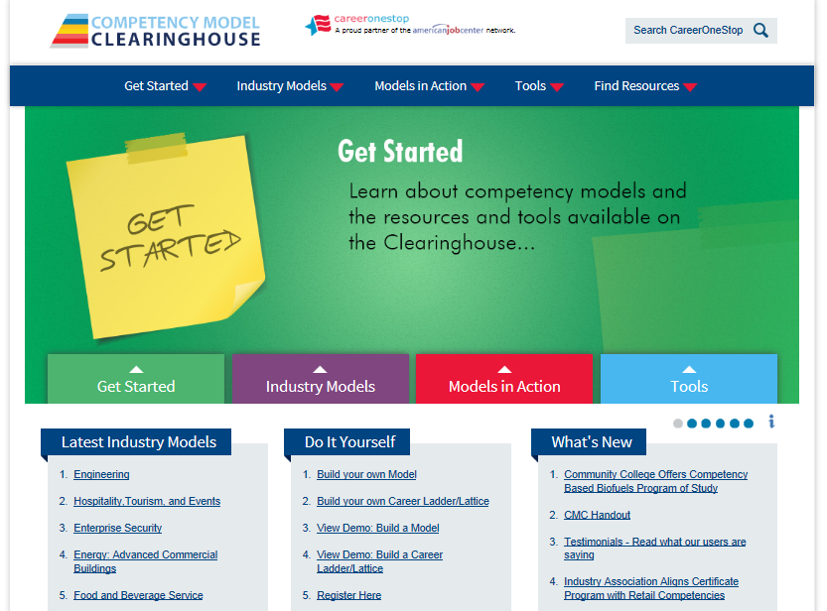

Slide 16
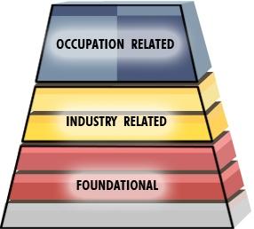
Competency Model Framework
Tier Groupings

Slide 17
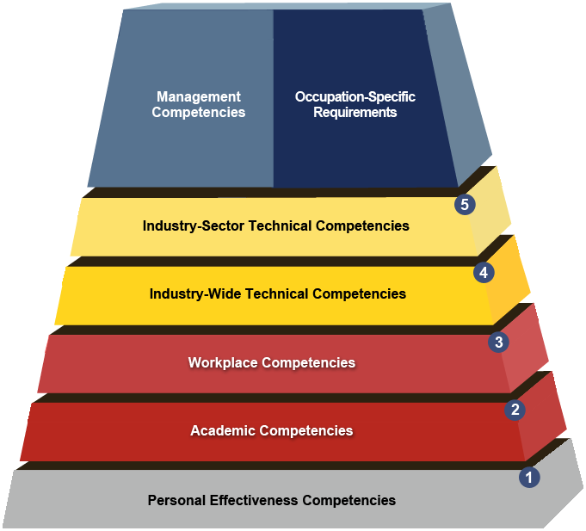
Competency Model Tiers
Tiers

Slide 18
Water and Wastewater Competency Model

Slide 19
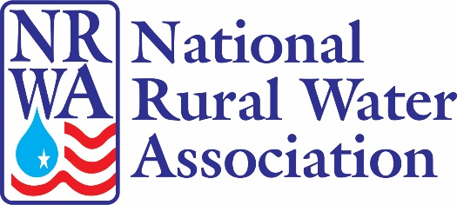
Model Industry Champions

Slide 21
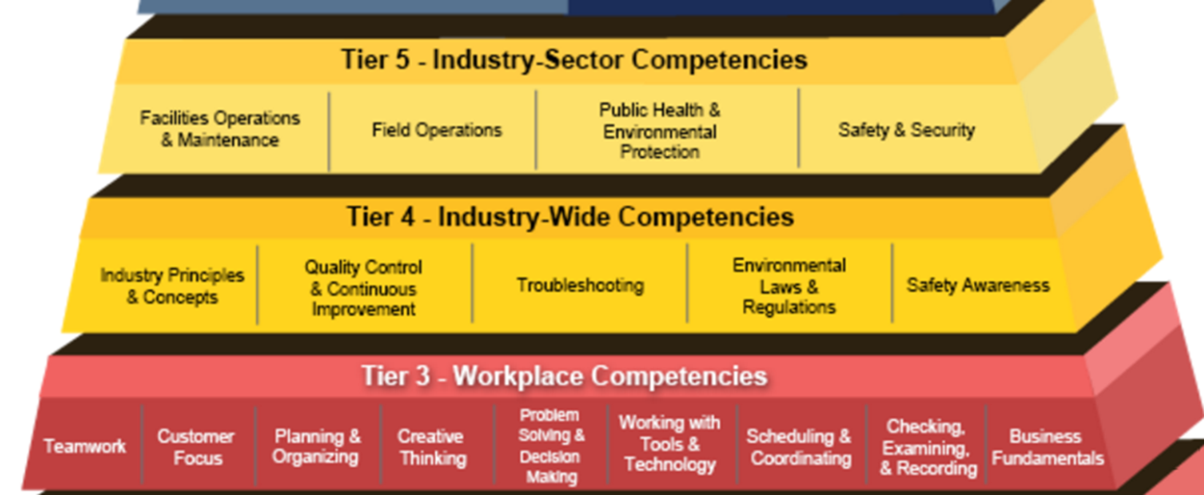
Workforce Content Addressed in Model Update
Automation/Supervisory Control and Data Acquisition (SCADA) Systems
Integrated Water Resources Management
Cybersecurity and Information Security
Decentralized Wastewater Treatment Systems
Environmental Regulations and Laws
Water Resilience

Slide 22
Competency Model In Action- Colorado

Slide 23
Competency Model In Action- Colorado
Conducted a Root Cause Analysis to Identify Where State Systems Struggle
Held a series of roundtables
To bring together water industry training partners
Community colleges
Industry organizations,
Non-profits,
For-profit training firms
And government agencies
Industry operators
With a goal to determine how to improve training for water occupations in the state

Slide 24
Competency Model In Action-Colorado
Areas of Focus
Define Core Curriculum
Identify training gaps

Slide 25
Tools They Used

Slide 27
National Rural Water Association
Developing Apprenticeship Program for Water and Wastewater Operations Specialist

Slide 28
National Rural Water Association
NRWA Trade Organization with +30,000 Water/Wastewater Utility Members
1978 Began Working with EPA on SDWA Training for Small & Rural Water Systems
2015 EPA Recommends NRWA to DOL

Slide 29
Apprenticeship Program Timeline
October 2015
Water Sector Competency Model Update
July 2016
DOL Energy sector meeting
November 2016
Work Force Advancement Center
January through July 2017
National Guidelines Standards Certified by DOL
August 2017
AIRW: 1st Registered Apprenticeship Program

Slide 30
Establish a nationally-recognized certificate;
Build a trained workforce that will improve service to rural customers;
Develop a systematic approach to OJT
Create a nationwide clearinghouse for training resources;
Enhance workforce participation in rural America
Improve retention of water workers in small and rural communities
Increase emergency preparedness and resiliency through a well-trained workforce.

Slide 31
5 Core Components
Utility Involvement
Employers are the foundation of every Registered Apprenticeship program
Structured On-the-Job Training with Mentoring
Two years (2000 hours/year) with an experienced mentor
Related Training and Instruction
Technical education
Reward for Skill Gains
Wage increases as skills increase over time
National Occupational Credential
Nationally recognized-guarantee to employers that apprentices are fully qualified for the job

Slide 32
Workforce Content Addressed in Model Update
On-the-Job-Training - 4,000 hrs
Safety
System O&M
Quality Control
Water Resilience

Slide 33
Water Sector Competency Model
Related Training & Instruction – 288 hrs
Safety
System O&M
Quality Control
Laws & Environmental
Operator Math
Security & Emergency Response

Slide 34
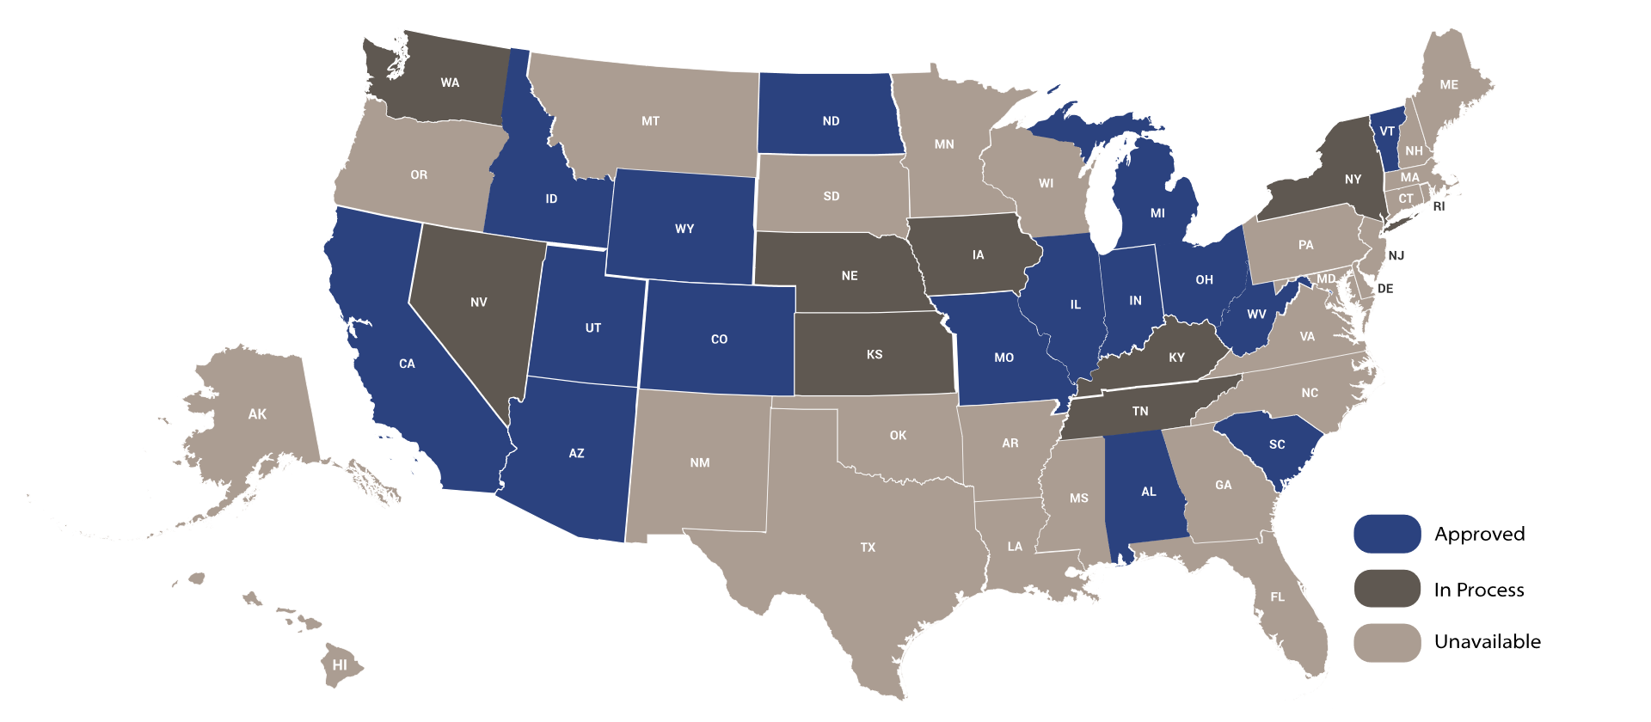
Registered Apprenticeship

Slide 35
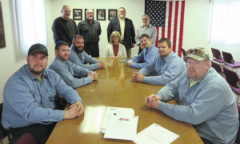
Alliance of Indiana Rural Water Apprenticeship Program
1st Apprentices
Alliance of Indiana Rural Water

Slide 37
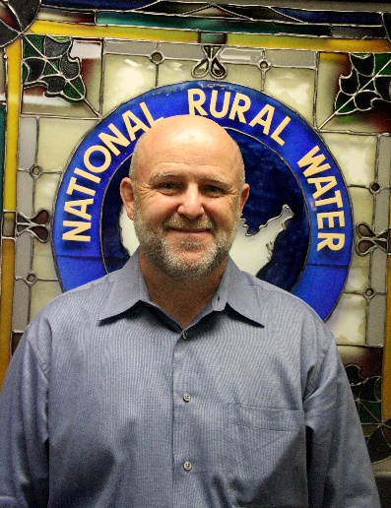
Thanks and Contact Us!
Pam Frugoli
O*NET/CareerOneStop/Competency Model Team Lead
U.S. Dept. of Labor, Employment & Training Administration
Frugoli.pam@dol.gov
Bill O’Connell
Manager, Training & Technical Assistance Program
National Rural Water Association
billo@nrwa.org
Add photo here

