Slide 1
Telling Your Story: Communicating Impact and Effectiveness to Stakeholders
High Impact Partners on behalf
of the Employment and Training
Administration, DOL
September 25, 2018

Slide 3
Gregory Scheib
Workforce Analyst
U.S. Department of Labor,
Employment and Training
Administration

Slide 4
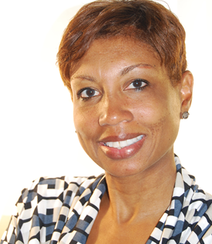
Erika Humphrey
TA Coach
High Impact Partners

Slide 5
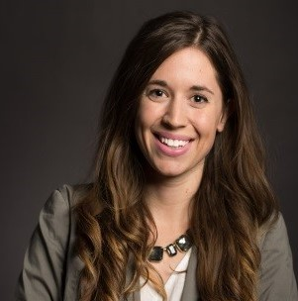
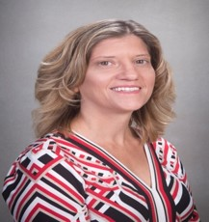
Grantee Presenters:
Kristin Maccarrone
Outreach Specialist
MiraCosta College
Haley Medved Kendrick
Program Director
University of Alabama at Birmingham
Christina Bakewicz
Program Manager
Monroe Community College

Slide 6
Distinguish between a program story and a participant story
Understand the importance of developing a “Program Success Story” and why its important
Highlight the components of a good “Program Success Story”
Identify key audiences with whom to share your “Program Success Story”
Grantee Sharing: promising practices on “Telling Their Story”

Slide 7
Grantee Polling Question
Let’s get to know who is on the call today. Using the poll, select the role that you play in your America’s Promise grant
Choose the answer that best reflects you (or your group):
Authorized Representative
Program Director/Manager
Training Partner
4. Employer Partner
5. Service Provider
6. Other (please specify!)

Slide 8
Program Story vs. Participant Story
Program Story: Describes the overall impact of your program
Participant Story: Describes impact on a specific participant

Slide 9
Program Success Story
A Program Success Story is defined as a narrative highlighting the achievements, progress, and impact of the entire program/activity.

Slide 10
Recognizing Why Success Stories Are Important
Specific reasons for developing and sharing success stories may include:
Capturing progress over time
Educating decision makers about the impact of your program
Demonstrating responsible use of resources to stakeholders
Sharing best practices with other similarly-funded programs
Attracting new partners for collaboration
Priming funders to continue funding the program

Slide 11
Grantee Polling Question
Which Statement is More Memorable?
Grantee D works closely with employer recruiting teams to identify open positions.
Grantee A’s MEP program trained 280 participants. Of the 280 trained 240 individuals earned a credential and 180 were placed into employment.
Grantee Z’s On-the-Job Training program provides in-demand training for healthcare career pathway occupations across 26 counties in central Wisconsin.

Slide 12
A Few Good Tips

Slide 13
TIPS In choosing a program/activity to highlight:
1
Remember that most programs undergo varying stages of capacity, maturity, and accomplishment.
In the early stages, you might want to provide a description of the proposed activities and the anticipated outcomes.
Highlight partnerships that are created.
Document important policy changes achieved as a result of the program, or illustrate the population being served by the program.
Emphasize short-term outcomes when highlighting accomplishments in early-stage activities.

Slide 14
TIPS
2
As your program/activity advances:
Share your promising practices--you will want your partners and funders to know about your progress.
You may have some preliminary data from your program to show that you are definitely making progress. You can also demonstrate how and to what extent your program is reaching or serving a specific population.

Slide 15
Example of Program Progress
Name of Grantee | Topic | Short-term Outcomes | Intermediate outcomes
Northern Maine JobRight | On-the-Job Training | A new bio-fuel on-the-job training program was developed from the ground up with the guidance of Northern Maine’s employer partners. This field is in high demand in Northern Maine. | In the first year after the training, 15 JobRight participants attained industry-recognized credentials as “Biomass Technicians”

Slide 16
Grantee Polling Question
Program Success Stories are important because they:
Educate decision makers about the impact of your program.
Attract new partners for collaboration.
Share “best practices” with other similarly-funded programs.
Increase your visibility and credibility.
Prime funders to continue funding the program.
All of the above

Slide 17
Components of a Good
“Program Success Story”

Slide 18
A Good “Performance Outcome Story” includes the following:
A headline
The hook
A description of the grant program
Main partners/collaborators
Specific goals of the program and current results against goals
Impact on the community
View Program Story Example

Slide 19
A headline
Captures the overall message of the story, includes an action verb and captures the reader’s attention.
The hook
Introductory sentence that highlights the program in a compelling way and captures the reader’s interest.
A description of the grant program
Describes the program/activity being implemented, including where and when it takes place and how it addresses an issue or problem.
Main partners/collaborators
Identify who is involved, include all of your partners.

Slide 20
The specific goals of the program and current results against goals.
Use current data to frame the impact.
The impact on the community
Share how your program is impacting the community. Example, “our program has put 100 unemployed individuals back to work.”

Slide 22
Example: Partnership Program Story
A good “Partnership Program Story” incorporates the following:
A headline
A hook
A description of the grant program
Main partners/collaborators
The impact on the community
View Program Story Example

Slide 24
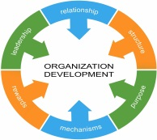
Example: Organizational Development Program Story
A good “Organizational Development Program Story” incorporates the following:
A headline
A hook
A description of the issue
A description of the benefits of the organizational change
The impact on the organization
View Program Story Example

Slide 26
National Infographic

Slide 27
Let’s look at one other smaller program story

Slide 28
Grantee Polling Question What’s Missing?
The Drake Employment Council has seen great success in conducting hiring events at their employer partners’ location. They work closely with employer recruiting teams to identify open positions and the core skills needed for their positions. To date, Drake Employment Council’s partnership with employers supporting hiring events has led to several jobs.

Slide 29
Identifying Key Audiences to Share Your Program Success Story

Slide 30
Before you write your Program Success Story, consider who are your primary audiences
Who is your audience?
What is important to them?
What do they care about?
What type of outcomes will be meaningful to them?
How will they use your program success story?
What is the goal of the story?
Is the story timely?
Share your answers in
the chat box

Slide 31
Grantee Presentations

Slide 32
MiraCosta College
Kristin Maccarrone
Outreach Specialist

Slide 33
Strategies We Use to Tell Our Story:
Press Releases
Getting involved in local/large events
Use local statistics: surprise them!
Make presentations exciting/use videos
Pitch people

Slide 35
University of Alabama at Birmingham
Haley Medved Kendrick
Program Director

Slide 36
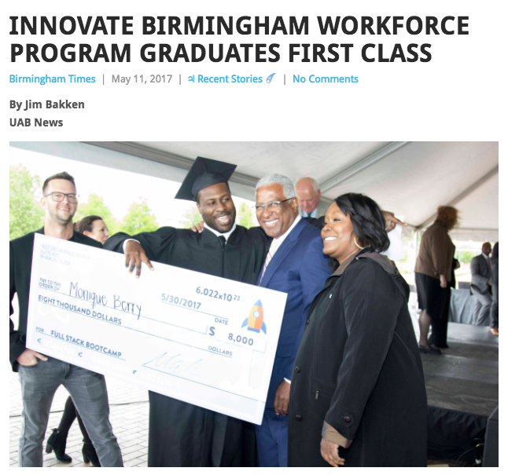
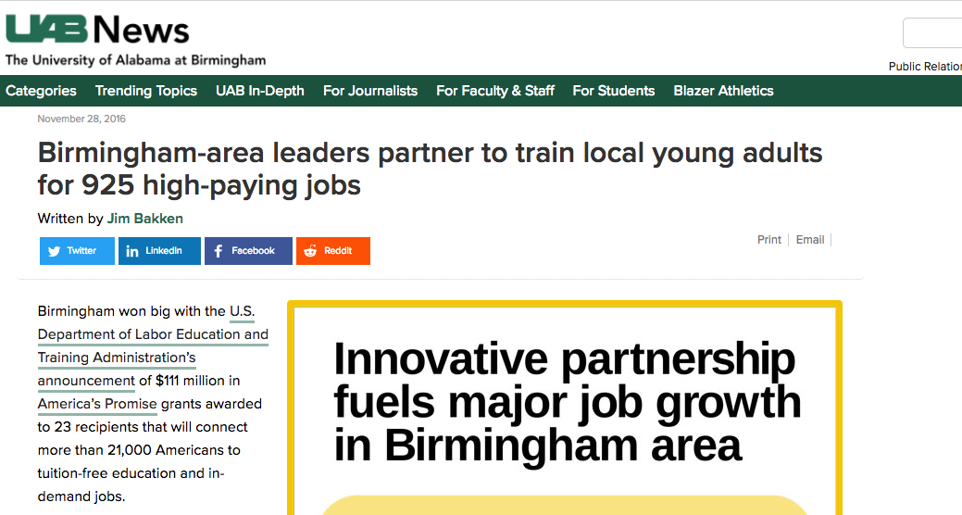
Strategies We Use to Tell Our Story:
Relationships, relationships, relationships
Have some success stories in your back pocket
You don’t have to go it alone
Know your audience(s)
Make it easy for others to share your story

Slide 38
Monroe Community College
Christina Bakewicz
Program Manager
Ann Kuhn
Program Coordinator

Slide 39
Strategies We Use to Tell Our Story:
Partnerships are essential
Leverage existing relationships and community presence
Let our students tell the story
Collaboration with industry experts
Get people excited about these industries

Slide 41
All Group Webinar: Innovative Support Service
October 2018

Slide 42
Resources:
America’s Promise Community of Practice
Your home for all of AP’s online resources, including the National Infographic.
https://h1bap.workforcegps.org/
StoryTelling Network
The StoryTelling Network - IMPACTcommunity formed out of the idea that many TAACCCT projects had achieved numerous successes and had overcome great challenges. The Storytelling Network created a platform for projects to tell their own stories of successes and challenges
http://support.skillscommons.org/connect/impact-communities/story-telling/

Slide 43
America’s Promise TA Mailbox
U.S. Department of Labor
AmericasPromise@dol.gov
202.693.3949

