Slide 1
Polling Question
?
What kind of organization are you coming from?
College
Workforce Board/American Job Center
Community Service Provider
Other
?
?
?
?

Slide 2
Polling Question
?
Do you use Open Educational Resources at your organization?
Yes, frequently!
Yes, just starting to explore
No, what is OER?
?
?
?
?

Slide 3
Increasing Student Support to Improve Outcomes: SkillsCommons Field Guide of TAACCCT Innovations
September 26, 2018
Innovations Leading to Career Success Webinar Series
Employment and Training Administration
Office of Career, Technical, and Adult Education

Slide 4
Moderators
Evan Burke, Trade Adjustment Assistance Community College and Career Training (TAACCCT) Program Analyst, Division of Strategic Investments, Employment and Training Administration, U.S. Department of Labor
Erin Berg, Community College Program Specialist, Office of Career, Technical, and Adult Education, U.S. Department of Education

Slide 5
The TAACCCT Grant Program
The U.S. Department of Labor’s Trade Adjustment Assistance Community College and Career Training (TAACCCT) grant program is a major investment to increase the ability of community colleges to address the challenges of today’s workforce.
The TAACCCT Program:
$1.9 billion awarded; grant projects active from 2011-2018
Over 700 colleges across the nation participated, in partnership with over 2,500 employers
Over 2,600 industry-aligned programs of study developed or enhanced
More than 475,000 individuals enrolled to date
Resources developed by grantees made freely available on www.SkillsCommons.org

Slide 6
About this Webinar
This webinar showcases strategies and resources developed by community colleges that are of broad interest to educational institutions engaged in career-focused education and training.
The Skills2Work (S2W) IMPACTcommunity, and the many other resources available on SkillsCommons, were produced by grantees of the Trade Adjustment Assistance Community College and Career Training (TAACCCT) program, a collaboration between the US Department of Labor and the US Department of Education.

Slide 7
Innovations Leading to Career Success Webinar Series
This webinar series showcases strategies and resources that are of broad interest to educational institutions engaged in career-focused education and training.
August 22:
Jumpstart to Successful Instruction: A Deeper Dive into an Accelerated Course for New Instructors
September 12:
Aligning Workforce Development Stakeholders
September 26:
Increasing Student Support Services to Improve Student/Worker Outcomes
October 10:
Increasing Academic Achievement
October 24:
Adult Learning Strategies at Community Colleges
For more information, please visit:
Innovations Leading to Career Success Webinar Series

Slide 8
.org An online library of 12,000+ free workforce development resources ready to be downloaded, adapted, and used

Slide 9
SkillsCommons Field Guide of TAACCCT Innovations
Innovative Approaches to Common Challenges Found in Higher Education and Workforce Development
The SkillsCommons Field Guide: The Gallery Edition is a collection of innovative and successful workforce development strategies developed by community colleges with funding from the TAACCCT Program. Included in the field guide, you will find:
Video interviews
Links to solutions-based materials located on SkillsCommons
Descriptors of designs and implementation plans
Podcasts of project directors explaining their innovative programs
An in-depth look at project leadership

Slide 10
Presenters
Katy Brooke Grant Coordinator, RevUP Montana Great Falls College, Montana University
Kristen Krell Project Director SUNPATH Consortium Santa Fa Community College, New Mexico

Slide 11
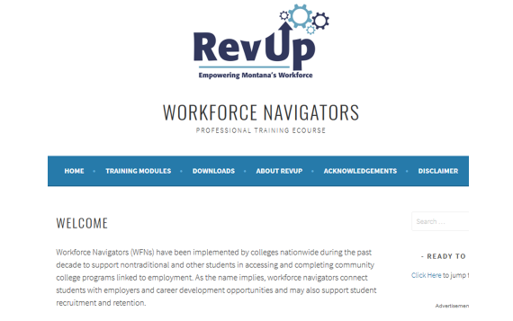
Workforce Navigator Training eCourse

Slide 12
Curriculum
12 Modules
30-60 minutes in length
Take as one long course or individually
Topics include:
Introduction to Workforce Navigators – Course Assumptions – What is a Workforce Navigator – Recruitment – Strength-Based Assessment – Strength-Based Tools – Case Management – Business Outreach – The Two-Year College System – The Job Service System – Measuring Success– Tools & Resources

Slide 13
Curriculum
Live site share:
https://revupnavigator.wordpress.com/modules/

Slide 14
Why Workforce Navigators?

Slide 15
Features
Interactive
Accessible
Best Practice

Slide 16
Features
Interactive
Accessible
Best Practice

Slide 17
Features
Interactive
Accessible
Best Practice

Slide 18
Resources

Slide 19
Supporting Documents

Slide 20
Questions?

Slide 21
SUN PATH
Skill Up Network: Pathways Acceleration in Technology and Healthcare (SUN PATH)
Innovation: Job Development Career Coaches
Department of Labor’s Trade Adjustment Assistance Community College and Career Training (TAACCCT)

Slide 22
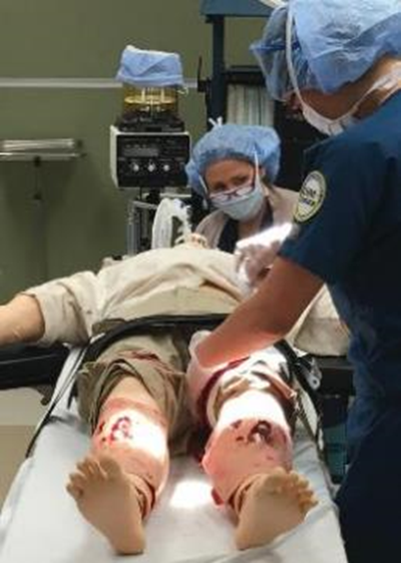
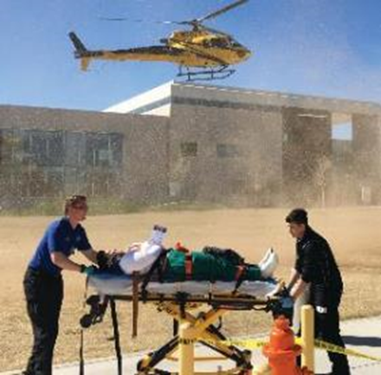
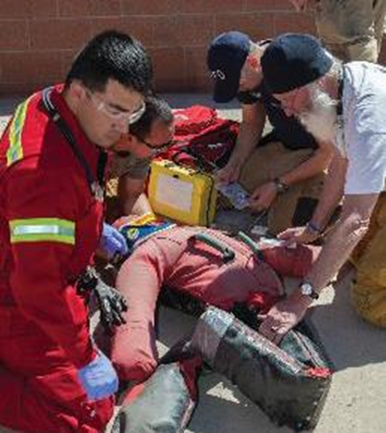
New Mexico SUN PATH Consortium: Improving Lives Strengthening Healthcare

Slide 23
NM SUN PATH Goals
Expand capacity and systemic improvements in the delivery of healthcare career pathways that align with industry needs;
Increase the attainment of degrees, certifications, and industry-recognized credentials; and
Create strategic alignment between education and workforce systems, resulting in improved employment outcomes, retention, and average earnings.

Slide 24
The Workforce/College Partnership
SUN PATH contracts with the Department of Workforce Solutions (DWS) to hire, train, and supervise Job Development Career Coaches (JDCC) on each campus
DWS hires a JDCC Manager to provide training and oversight
At least one part-time JDCC is located at each college depending on size
The college provides the office space, phone, and computer
The JDCC becomes a part of the SUN PATH team at each college
Regular communication of JDCC and SUN PATH college staff is key to success!

Slide 25
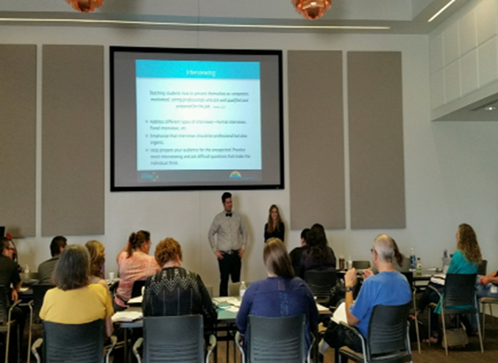
Job Development Career Coaches
Provide career readiness workshops Resources: https://www.sfcc.edu/jdcc-2017-resources/
Resume development
Professionalism training (soft skills)
Graduation checklist
Mock interviews
Organizes job fairs
Assists with job placement
Connect with employer partners

Slide 26
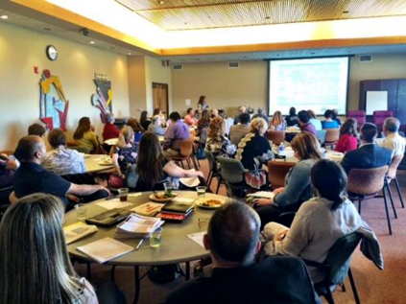
Leveraging Workforce Partnerships
Workforce Innovation Opportunity Act
JDCCs assist with connecting students with WIOA scholarships
Regional Workforce Boards
Trade Adjustment Act (TAA)
Human Service Department, SL Start
Northern Regional SUN PATH Employer Meeting

Slide 27
The Role of Employer Partners
Serving on SUN PATH Statewide Advisory Council and Regional Councils
Provide input on key skills and competencies needed for relevant job training programs
Identify healthcare jobs that are in demand
Offer internship, mock interviews and job placement support
Mock interviews with SUN PATH employer partner

Slide 28
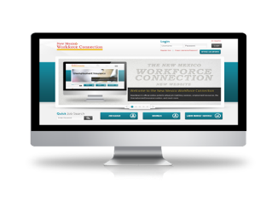
Workforce Online Connection System
www.jobs.state.nm.us
This site can be accessed via the internet or at any New Mexico Workforce Connection Center statewide.
The site is available in English and Spanish
It is the most powerful job searching system in New Mexico
The site typically contains over 10,000 jobs daily with new opportunities all the time.

Slide 29
Using Labor Market Data
Occupational Information Report
Labor Market Facts
Answers commonly asked questions about the local labor market.
Area Profile
Summary of labor market in a selected area.
Industry Profile
Labor market information on industries in a selected area.
Occupational Profile
Labor market information on occupations in a selected area including wages.
Education Profile
Labor market information on education programs in a selected area.

Slide 30
Sustaining the Innovation
New Mexico Department of Workforce Solutions (DWS) has realigned workforce funding to sustain Job Development Career Coaches located on college campuses, after the TAACCCT funds expire.
Colleges have agreed to provide office space for the workforce employee.
JDCCs will continue to integrate into the college campus after the grant.

Slide 31
Data Collection, Analysis, Evaluation and Reporting

Slide 32
Data Collection, Analysis, Evaluation and Reporting

Slide 33
SUN PATH Comparison Study Findings
SUN PATH students completed a certificate or degree at a 34 percent higher rate, when compared to similar non-participants
SUN PATH participants who were unemployed at enrollment, became employed after program completion at a 14 percent higher rate when compared to similar non-participants
The average overall gain in salary for SUN PATH students was almost $1000 per quarter compared to $700 for non-participants

Slide 34
Essential Components of a High Performing Collaboration
Structure the system for success
Individual and distributed leadership that inspires
Set a clear vision and generate enthusiasm for it
Clear direction and communication about the goals and strategies to achieve excellence
Creating a culture of trust and support

Slide 35
Essential Components of a High Performing Collaboration
“Love your employees” and provide honest feedback
Always stay student centered
Clear systems to measure, analyze, and manage results
Take time for fun, humor, and celebration!

Slide 36
Tips for Effectiveness as Change Agents
Prioritize – pick your battles
Trust others – assume the best and you’ll get the best
Use reason and thoughtfulness – minimize drama
Seek to understand the perspective of others
Propose ideas and seek input
Request rather than complain

Slide 37
Tips for Effectiveness as Change Agents
Seek the Win-Win in any situation
Approach problems with kindness
Be persistent, patient, and positive!
Let go of what you can’t control
Seek to bring joy and tranquility to the situation and those around you

Slide 38
SUN PATH Grant-funded Resources Available at: https://www.skillscommons.org/handle/taaccct/15177

Slide 39
Questions?

Slide 40
Connect with SkillsCommons Communities
Follow SkillsCommons on social media:
www.skillscommons.org/Facebook
www.twitter.com/SkillsCommons
www.linkedin.com/company/6650163
SkillsCommons Basecamp
Join others in this online resource-sharing and problem-solving community. Send an email to
connect@skillscommons.org, and we’ll get you connected right away!
MERLOT Voices
Join a Voices Industry Sector & IMPACTcommunities forum. Stay informed and get involved in
leadership. Participate in the online communities where you can engage in online dialogs, post
materials, and get connected with colleagues.
SkillsCommons Connect Center Get all the latest SkillsCommons news and feeds!
http://bit.ly/IE2ET

Slide 41
Thank you!
For more information, please visit http://support.skillscommons.org/connect/impact-communities/
If you have further questions, you can contact the SkillsCommons team at:
SkillsCommons Support
support@skillscommons.org
This work is licensed under a Creative Commons Attribution 4.0 International License.
This workforce solution was created through a cooperative agreement between the U.S. Department of Labor's Employment and Training Administration and the California State University-Multimedia Educational Resource for Learning and Online Teaching (MERLOT).

Slide 42
Innovations Leading to Career Success Webinar Series
This webinar series showcases strategies and resources that are of broad interest to educational institutions engaged in career-focused education and training.
August 22:
Jumpstart to Successful Instruction: A Deeper Dive into an Accelerated Course for New Instructors
September 12:
Aligning Workforce Development Stakeholders
September 26:
Increasing Student Support Services to Improve Student/Worker Outcomes
October 10:
Increasing Academic Achievement
October 24:
Adult Learning Strategies at Community Colleges
For more information, please visit:
Innovations Leading to Career Success Webinar Series

