Slide 2
An Evaluation Readiness Assessment— Prioritizing Efforts to Measure Effectiveness
October 2, 2018
Evaluations and Research Hub Flash Webinar Series [#1-Oct. 2, 2018]
3:00 PM – 3:30 PM

Slide 3
Gloria Salas-Kos
Senior Research and Evaluation Analyst
Employment and Training Administration [ETA]
U. S. Department of Labor [DOL]

Slide 4
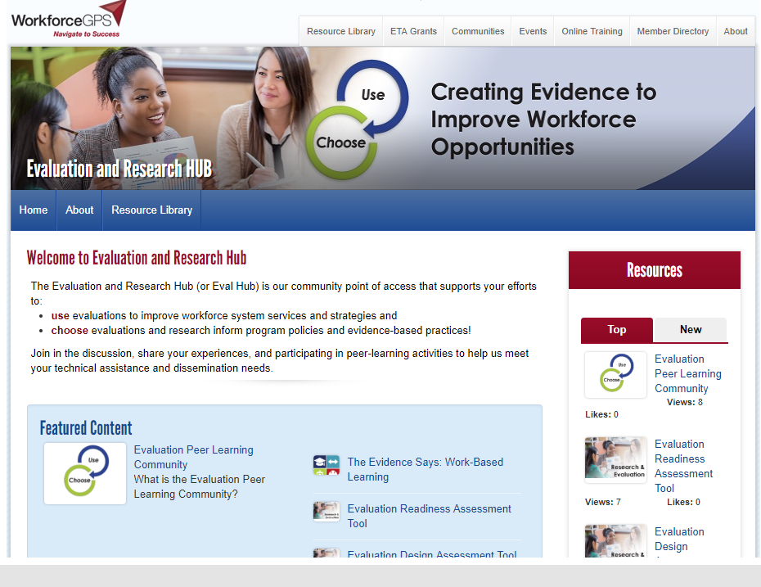
New Community of Practice
Access to evaluation and research tools and resources
Tailored to meet your needs!
Flash Webinars
Peer Learning Opportunities

Slide 5
What’s your level of experience with research and evaluation?
I have little to no experience and would like to learn more.
I am familiar with evaluation and research methods but I don’t work directly with evaluation.
I work with data but not specifically to conduct research or evaluation.
Part of my job is to support research and evaluation projects.
I manage research and evaluation projects.

Slide 6
Evaluation Readiness Assessment
Background: Setting the Context
What is the Evaluation Readiness Assessment Tool?
Assessing Evaluation Readiness: A State’s Perspective
Why and how this tool is helpful?
Accept the Evaluation Readiness Assessment Challenge!

Slide 7
Wayne Gordon
Director, Division of Research and Evaluation/ Office of Policy Development and Research
DOL-ETA
Karen Armstrong
Project Director, Dissemination and Technical Assistance
IMPAQ International
Gary Kamimura
Policy Manager
Washington State Employment Security Department

Slide 8
Evaluation Readiness Assessment: Background and Context
Wayne Gordon
Director, Division of Research and Evaluation/ Office of Policy Development and Research
DOL-ETA

Slide 9
Setting the context
New Legislation and Regulations
WIOA Section 169
Regulations 682.220
Tiered Evidence Models
WIF
TAACCCT
WIOA State Plans and Annual Reports
Chief Evaluation Office
Planning Cycle
Evaluation Priorities
Evaluation Principles
Rigor
Relevance
Transparency
Independence
Ethics
Bi-partisan Commission on Evidence-Based Policy-Making

Slide 10
Mission: Support state workforce agencies in their efforts to use and choose evaluation and research
Identify Needs
Tools and Resources
Identify
Disseminate
Apply
Create Evidence
Disseminate Evaluation Results
Use
Choose
TA Products for Evaluation Practices
Peer Learning Community
Shared Wisdom

Slide 11
To what extent do you use research and evaluation to inform decisions?
Agency staff and partners are familiar with available resources for evidence-based research and evaluation and regularly review recent reports to inform decisions.
Not at all
Making progress but a long way to go
We have some of this, sometimes
Yes, in place now
In place and exceeding our plans

Slide 12
To what extent do you choose to integrate research and evaluation in your program activities?
When planning to implement new or revamped programs and services, agency staff and partners regularly consider effective evaluation strategies.
Not at all
Making progress but a long way to go
We have some of this, sometimes
Yes, in place now
In place and exceeding our plans

Slide 13
What is the Evaluation Readiness Assessment Tool?
Karen Armstrong
Project Director, Dissemination and Technical Assistance
IMPAQ International

Slide 14
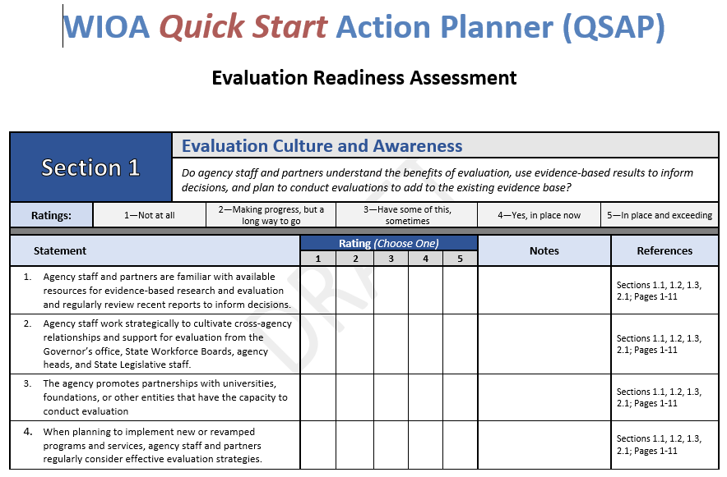
What is the assessment tool?
One of three new DOL resources to support discussion and learning around research and evaluation

Slide 15
Rely on assessing evaluation capacity
Purpose
Identify evaluation elements or activities that support or expand capacity to use rigorous evaluations as evidence
Determine next steps to meet WIOA evaluation requirements
Primary target audience
State/local workforce agencies
WIOA partner agencies

Slide 16
Let’s tour the tool! A quick start…
Multiple sections
Each tied to a unique topic/ question

Slide 17
Let’s tour the tool! Key evaluation elements
SECTION 1
Evaluation culture and awareness
Do agency staff and partners understand the benefits of evaluation, use evidence-based results to inform decisions, and plan to conduct evaluations to add to the existing evidence base?
SECTION 2
Funding strategies
Does the state or region actively pursue funding for and invest in evaluations?
SECTION 3
Data management
Does the agency have adequate operational capacity, IT infrastructure, and policies and procedures for collecting and using data for evaluations?
SECTION 4
Staff skills, capacity, and knowledge
Does the agency have sufficient staff with the skills, knowledge and experience needed to conduct or oversee third-party evaluations?
SECTION 5
Strategic planning
Does the state have a comprehensive strategic plan that includes evaluation as an integral part of the plan?

Slide 18
Let’s tour the tool! Rate progress
Statements assess extent to which key evaluation issues are addressed
Use ratings to indicate your level of activity
Note section provides opportunity to describe your rating
To learn more, refer to the sections identified in the tool kit
4. When planning to implement new or revamped programs and services, agency staff and partners regularly consider effective evaluation strategies.

Slide 19
Let’s tour the tool! Rate progress
Statements assess extent to which key evaluation issues are addressed
Use ratings to indicate your level of activity
Note section provides opportunity to describe your rating
To learn more, refer to the sections identified in the tool kit

Slide 20
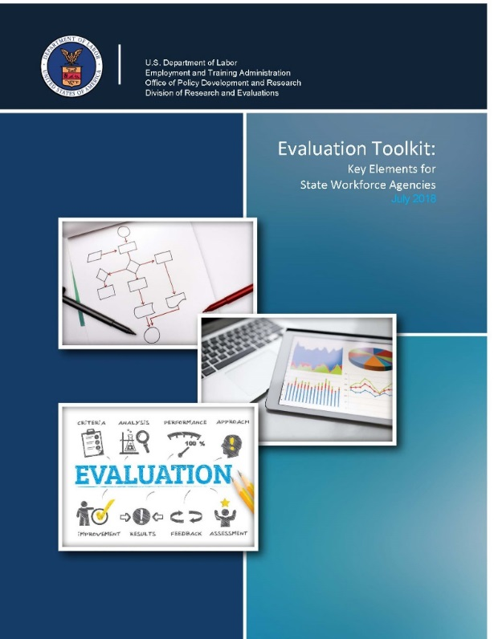
Let’s tour the tool! Use references
Statements assess extent to which key evaluation issues are addressed
Use ratings to indicate your level of activity
Note section provides opportunity to describe your rating
To learn more, refer to the sections identified in the tool kit

Slide 21
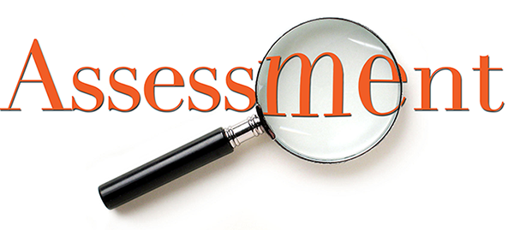
How to use assessment
Share with your staff and partners
Independently complete the tool (no wrong answers)
Meet to compare and explore responses
Discuss next small and achievable steps
Source: https://sites.google.com/site/rtisurveyofexceptionalities/home/c-assessment

Slide 22
Assessing Evaluation Readiness: A State’s Perspective

Slide 23
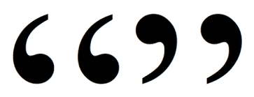
Reactions to the assessment
“Wow, I didn’t quite understand what it meant to do rigorous research and evaluation. This was a real eye opener. This isn’t just about meeting targets.”
— Contract Manager
“Yes, we definitely understand how important this is. However, we just don’t have the capacity to do this routinely. We need more resources.
— Research & Evaluation Manager

Slide 24
How we used the evaluation readiness assessment tool
Partner agencies—both program and evaluation staff at the SWA and SWDB
Rationale for conducting the assessment
We’re aware of DOL’s expectation of more evaluative research (e.g., RESEA, Opioid Grant)
Wanted to assess our current state in light of that expectation
Wanted to understand what we needed to do to get to a better future state (i.e., ratings of 4 or 5)

Slide 25
What we learned from our assessment
What we learned
Assessment confirmed (high ratings)
We have the right (research and evaluation) staff with the right knowledge and skills
We have access to the data we need (State longitudinal data, including education data, and are part of the Workforce Data Quality Initiative (WDQI)
Assessment highlighted (mixed or low ratings)
Program staff had a different understanding of research and evaluation and what it requires
We don’t have the capacity to build evaluative research into every new initiative
Overall takeaway
Two different worlds (program and researchers)—The tool served as a great opportunity to educate and bring staff together around a common understanding of research and evaluation
Program folks now realize that researchers need to be at the table when we are designing projects
But we recognize that doing evaluative research correctly and routinely is a big lift from a capacity and resource standpoint

Slide 26
What’s next?
Elevate the conversation to the leaders of SWA and SWAB about the importance and value for research.
Encourage the leadership, including the Governor, to adequately fund research and evaluation to ensure that the states’ investments are making a difference.
For example, new and innovative workforce activities have been initiated, but research and evaluation are not included in the program design
Make evaluation and research “top-of-mind” in project design

Slide 27
Accept the
Use the evaluation readiness assessment tool to prioritize your efforts to measure effectiveness.

Slide 28
Test your organization’s capacity to plan and conduct evaluations
General Audience
Peer Learning Community
Tool to build or enhance your knowledge
Give us your feedback on these tools
Share with your organization
If you are a state workforce agency representative, you are invited to join the Peer Learning Community
In the next two weeks:
Share this tool with your staff and partners
Ask agency representatives to complete it
Find time to discuss findings
Select one or two elements that need improvements
Identify actions to improve
Attend Oct 16 forum to discuss with other states

Slide 29
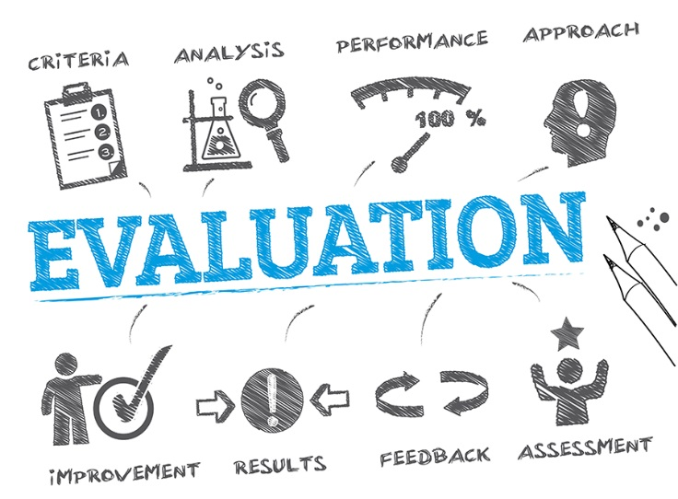
The challenge…
State and local workforce agency representatives
You are invited to participate in the PLC forum
To let us know if you are interested, please send an email to: workforcepractices@dol.gov
The PLC forum is limited to 40 participants – if there is a lot of interest, we may schedule an additional forum to accommodate additional participants
Source: Image used under license from shutterstock.com

Slide 30
Evaluation and Research PLC Forum
For new and existing PLC members, meet with one or two other states to discuss what you learned from the assessment tool, and next steps.
October 16, 2018 3:00-4:30 PM (EST)
Webinar: Evaluation Design and Implementation Assessment Tool
For all who are interested, learn about the next assessment tool that guides workforce partners through the steps of conducting an evaluation.
November 28, 2018 3:00-3:30 PM (EST)
Evaluation and Research PLC Forum
For new and existing PLC members, meet with one or two other states to discuss what you learned from the assessment tool, and next steps.
December 13, 2018 3:00-4:30 PM (EST)

Slide 31
Evaluation and Research Hub
A community point of access to support policymakers and program managers with their efforts to use evaluations to improve services and choose evaluations and research to inform program policies and evidence-based practices.
TBD – on workforcegps.org
Workforce System Strategies
Contains over 1200 profiles of workforce development research and evaluation studies, toolkits, and other resources to support program management and operations, education and training, and employment, retention or advancement activities.
https:strategies.workforcegps.org
USDOL-ETA Division of Research and Evaluation
Manages ETA’s rigorous research and evaluation approach under Section 169 of the Workforce Innovation and Opportunity Act
https://www.doleta.gov/research/
CLEAR
CLEAR identifies and summarizes many types of research on labor topics, including descriptive statistical studies and outcome analyses, implementation, and causal impact studies
https://clear.dol.gov
USDOL Evaluation Policy Statement
Presents the key principles that govern the Department of Labor’s approach to planning, conducting, and using program evaluations
https://www.dol.gov/asp/evaluation/EvaluationPolicy.htm

Slide 33
Gloria Salas-Kos
Sr. Research and Evaluation Analyst Office of Policy Development and Research
USDOL-ETA/Workforce System Strategies
workforcepractices@dol.gov
Karen Armstrong
Project Director, ETA Evaluation Dissemination and Technical Assistance
IMPAQ International
ETA_ResearchDisseminationPLC@impaqint.com

