Slide 1
Polling Question
?
What kind of organization are you coming from?
College
Workforce Board/American Job Center
Community Service Provider
Other
?
?
?
?

Slide 2
Polling Question
?
Do you use Open Educational Resources at your organization?
Yes, frequently!
Yes, just starting to explore
No, what is OER?
?
?
?
?

Slide 3
SkillsCommons Field Guide of Exemplary Practices:
Increasing Academic Achievement
October 10, 2018
Innovations Leading to Career Success Webinar Series
Employment and Training Administration
Office of Career, Technical, and Adult Education

Slide 4
Moderators
Cheryl Martin, Trade Adjustment Assistance Community College and Career Training (TAACCCT) Program Manager, Division of Strategic Investments, Employment and Training Administration, U.S. Department of Labor
Erin Berg, Community College Program Specialist, Office of Career, Technical, and Adult Education, U.S. Department of Education

Slide 5
The TAACCCT Grant Program
The U.S. Department of Labor’s Trade Adjustment Assistance Community College and Career Training (TAACCCT) grant program is a major investment to increase the ability of community colleges to address the challenges of today’s workforce.
The TAACCCT Program:
$1.9 billion awarded; grant projects active from FY 2011-2018
Over 700 colleges across the nation participated, in partnership with over 2,500 employers
Over 2,600 industry-aligned programs of study developed or enhanced
More than 475,000 individuals enrolled to date
Resources developed by grantees made freely available on www.SkillsCommons.org

Slide 6
About this Webinar
This webinar showcases strategies and resources developed by community colleges that are of broad interest to educational institutions engaged in career-focused education and training.
The Skills2Work (S2W) IMPACTcommunity, and the many other resources available on SkillsCommons, were produced by grantees of the Trade Adjustment Assistance Community College and Career Training (TAACCCT) program, a collaboration between the US Department of Labor and the US Department of Education.

Slide 7
Innovations Leading to Career Success Webinar Series
This webinar series showcases strategies and resources that are of broad interest to educational institutions engaged in career-focused education and training.
August 22:
Jumpstart to Successful Instruction: A Deeper Dive into an Accelerated Course for New Instructors
September 12:
Aligning Workforce Development Stakeholders
September 26:
Increasing Student Support Services to Improve Student/Worker Outcomes
October 10:
Increasing Academic Achievement
October 24:
Adult Learning Strategies at Community Colleges
For more information, please visit:
Innovations Leading to Career Success Webinar Series

Slide 8
.org An online library of 15,000+ free workforce development resources ready to be downloaded, adapted, and used
Notes:
https://www.doleta.gov/taaccct/pdf/TAACCCT_Fact_Sheet_SkillsCommons_Open_Educational_Resources_11.4.2016.pdf

Slide 9
SkillsCommons Field Guide of TAACCCT Innovations
Innovative Approaches to Common Challenges Found in Higher Education and Workforce Development
The SkillsCommons Field Guide: The Gallery Edition is a collection of innovative and successful workforce development strategies developed by community colleges with funding from the TAACCCT Program. Included in the field guide, you will find:
Video interviews
Links to solutions-based materials located on SkillsCommons
Descriptors of designs and implementation plans
Podcasts of project directors explaining their innovative programs
An in-depth look at project leadership

Slide 10
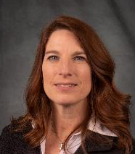
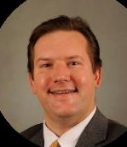
Presenters
Anne Kamps Dean, Learning Solutions Northeast Wisconsin Technical College
Matthew Cloud
Assistant Professor & Department Chair School of Information Technology
Ivy Tech Community College of Indiana

Slide 11
Scaling Credit for Prior Learning (CPL) through TAACCCT Investment
Anne Kamps
Dean, Learning Solutions
Northeast Wisconsin Technical College

Slide 12
16 college -two-year technical college system
Northeast Wisconsin Technical College – lead round two
Focus - manufacturing

Slide 13
CPL Building Blocks
Department of Labor TAACCCT Round two Credit for Prior Learning (CPL) deliverable
Result: Welding Prior Learning Assessment tool
Strategic approach by project manager generated interest in WI; led to buy-in across colleges.
Build opportunities for investigation of CPL best practices
Solicit support from Wisconsin Technical College System office
Created a State-wide Summit
Council Adult and Experiential Learning Conference Attendance
Build vision of what and why of CPL
Investigate successful models
Individual Colleges Strategic Plans
Process mapping to identify who needs to be involved
Identify how to grow CPL at individual institutions
Explore how to share best practices among colleges

Slide 14
Foundational Elements for Scaling
Goal: create a systematic simple, speedy, seamless process
Leadership Buy-in
Business Model Design
Foundation supporting Scaling
Training Across-the Board

Slide 15
Sustainability
College Administration buy-in foundation
Creating Positions/Redesign Positions
Centralized versus individual department
Quality Assurance of Process
Where are student requests not resulting in CPL award
Faculty support for college business model

Slide 16
Best Practices in Training
Faculty view “classroom assessment” different from “CPL assessment”
Faculty trust of evidence in support of CPL
Upholding quality of standards
Student’s ability to communicate learning
Authenticity of evidence
Moving from measuring experience to prior learning
Measurable curriculum competencies necessary

Slide 17
Promising Practices in Student Communication
https://www.witc.edu/admissions/preparing-for-college/credit-for-prior-learning
https://www.nwtc.edu/admissions/student-records/transfer-of-credit/credit-for-prior-learning
https://www.swtc.edu/academics/programs/trades-industry/welding

Slide 18
Promising Practices for Substantive Changes
Policy – state and local integration
State-wide pricing framework
Marketing
Web information clarity
Processes
Data tracking system and definitions

Slide 19
Promising Practices in Analytics
Notes:
The speaker will provide a brief overview of the resources available in this project’s entry in SkillsCommons.org., regarding the Promising Practices in Analytics.

Slide 20
Data: Early Indicators of Wisconsin Technical College System Success
Notes:
The speaker will present the number of students receiving CPL compared to the student headcount enrollment for years 2012 through 2017.

Slide 21
OCCRL Brief: Implementing a State-Wide Model for Granting Credit for Prior Learning

Slide 22
Ivy Tech Community College Information Technology (IT) Pathways for Indiana “Compete for the IT Job”
10/10/2018
Matthew Cloud, Asst. Prof. and Dept. Chair School of Information Technology – Lake County, Project Director TAACCCT Grant

Slide 23
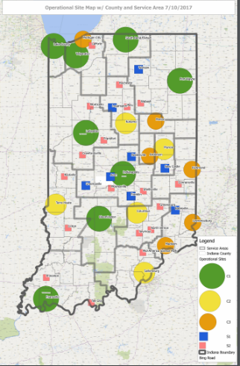
IT Pathways Grant Overview
Eight Degree Programs
Supplies and Equipment
Online Virtual Data Center Upgrade
Nineteen Mock Data Centers
State to local boards
Statewide Competition

Slide 24
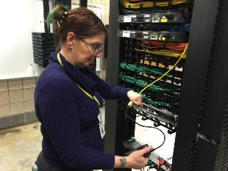
Model to Start
Phase 3 Education to Career Paths
https://www.Microsoft.com/en-ca/learning/default.aspx (2014)

Slide 25
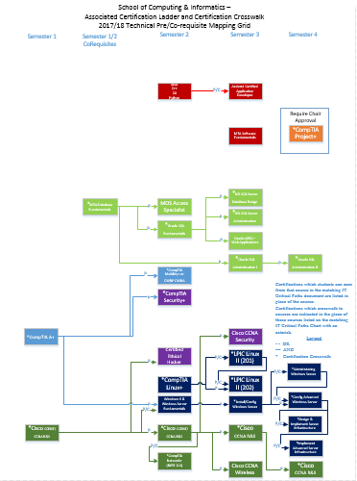
Laddered Credentials to Industry
Industry Certifications
Industry Certifications pairing three to four Credit Hours (CH) with one CH cert prep
Cross walked for credit
Certificate programs 16-29 CH
Technical Certificates (TC) 30-33 CH and first year of an Associate of Applied Science degree
Associate of Applied Science (AAS) (45 Technical CH with 15 General Education CH)
Associates of Science (AS) (30 Technical CH with 30 General Education CH)

Slide 26
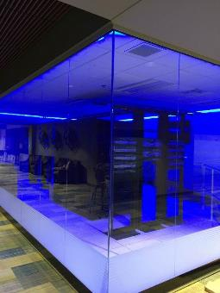
Simple start with wide array of endings
First semester (same for all paths)
INFM 109 – Informatics Fundamentals
SDEV 120 – Computer Logic
ITSP 135 – Hardware/Software Support
IVYT 115 – College Success
ENGL 111 – English Composition
Second semester - two paths
Now matched in K12
Third and fourth semesters highly individual and local with hundreds of combinations possible
Notes:
8 Degree programs with three math pathways
Math Fundamentals
IT Support
Network Infrastructure
Server Administration
Informatics AAS/TC/CT
College Algebra
Informatics AS
Cybersecurity/Information
Assurance
Database Management
Software Development
Calculus
Computer Science

Slide 27
It did not start this way
Eight very independent paths
Brought in Industry
IT Challenge competition
Year 1 – Not allowed by DOL
Year 2 – Allowed by DOL, Maybe Ivy Tech
Year 3 – Realized courses were not at level we wanted, but allowed to run with max budget of $10,000
2017 IT Challenge based on the first semester courses
Industry funded hotels and food for one day
105 students attending statewide
Changed curriculum

Slide 28
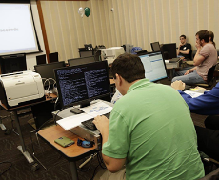
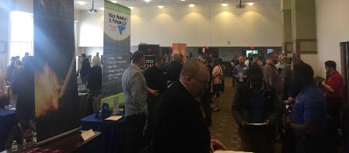
IT Expo 2018
IT Challenge 2018
Two days funded by industry: $25,000 in prizes
Easily added new programs: Visual Communications
College $24,000 in scholarships
Doug Arthur - Transform Consulting in Cincinnati, Ohio
IT Networking/Career Fair on first afternoon
Only hold forty employers
Each hiring tens to thousands!
More than 300 students
Offered jobs on the spot

Slide 29
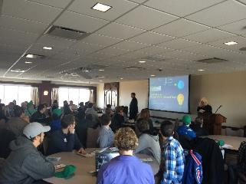
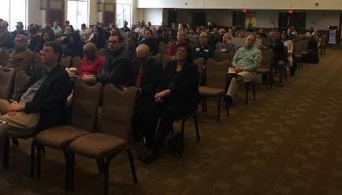
More IT Expo 2018
CISCO/Cybersecurity Conference for two days and nights
Instructor Training in the evenings for three nights
Businesses/Government spin offs

Slide 30
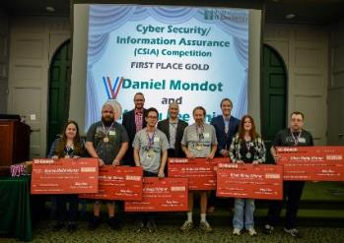
Where does it go?
IT Challenge may become Indiana IT Apprentice Challenge for 2019
Courses now modified to go beyond what industry and faculty originally hoped for 2 years prior
Cohorts of students Monday/Wednesday or Tuesday/Thursday and work other days and Fridays for full Apprentice program

Slide 32
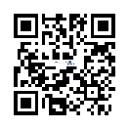
Connect with SkillsCommons Communities
Follow SkillsCommons on social media:
www.skillscommons.org/Facebook
www.twitter.com/SkillsCommons
www.linkedin.com/company/6650163
SkillsCommons Basecamp
Join others in this online resource-sharing and problem-solving community. Send an email to
connect@skillscommons.org, and we’ll get you connected right away!
MERLOT Voices
Join a Voices Industry Sector & IMPACTcommunities forum. Stay informed and get involved in
leadership. Participate in the online communities where you can engage in online dialogs, post
materials, and get connected with colleagues.
SkillsCommons Connect Center Get all the latest SkillsCommons news and feeds!
http://bit.ly/IE2ET

Slide 33
Thank you!
For more information, please visit http://support.skillscommons.org/connect/impact-communities/
If you have further questions, you can contact the SkillsCommons team at:
SkillsCommons Support
support@skillscommons.org
This work is licensed under a Creative Commons Attribution 4.0 International License.
This workforce solution was created through a cooperative agreement between the U.S. Department of Labor's Employment and Training Administration and the California State University-Multimedia Educational Resource for Learning and Online Teaching (MERLOT).

Slide 34
Innovations Leading to Career Success Webinar Series
This webinar series showcases strategies and resources that are of broad interest to educational institutions engaged in career-focused education and training.
August 22:
Jumpstart to Successful Instruction: A Deeper Dive into an Accelerated Course for New Instructors
September 12:
Aligning Workforce Development Stakeholders
September 26:
Increasing Student Support Services to Improve Student/Worker Outcomes
October 10:
Increasing Academic Achievement
October 24:
Adult Learning Strategies at Community Colleges
For more information, please visit:
Innovations Leading to Career Success Webinar Series

