Slide 1

Checking In!
Let’s get to know who is on the call today. Using the poll, select your H-1B Grant Program
Choose the answer that best reflects you (or your group):
H-1B America’s Promise Grant
H-1B Strengthening Working Families Initiative (SWFI) Grant
H-1B TechHire Partnership (TechHire) Grant
I’m not sure!

Slide 2
Checking In!
Let’s get to know who is on the call today. Using the poll, select the role that you play in your H-1B grant program. Choose the answer that best reflects you (or your group):
For this grant initiative I am the:
  Authorized Representative
  Program Director/Manager
  IT/Data Manager or staff
  Training Partner
  Case Manager
  Other

Slide 3
H-1B Performance Reporting Webinar 3.0: Enhancing Your WIPS Performance Experience
October 16, 2018
H-1B TechHire Partnership
Strengthening Working Families Initiative
America’s Promise Grantees
3

Slide 4




MODERATOR
Megan Baird, Program Manager, H-1B Grants
Employment and Training Administration
US Department of Labor
PRESENTERS
Ayreen Cadwallader, Workforce Analyst
Employment and Training Administration
Timmy Dudley, Workforce Analyst
ICF International
Gregory Scheib, Workforce Analyst
Employment and Training Administration

Slide 5
OBJECTIVES
Provide a Performance Policy Refresher
Review Amended ETA-9172 DOL PIRL for H-1B Grants for Quarter ending September 30, 2018
Review H-1B Performance Outcomes and WIOA Primary Indicators of Performance
Review the Quarterly Narrative Report (QNR) Submission Process
Responding to Q&A – We will be stopping after each section to answer your questions!

Slide 6
What are you most excited about learning today?
Identifying the employment status of participants
Submitting your participant data for the quarter ending September 30, 2018
Reviewing WIOA Primary Indicators of Performance
Previewing the Quarterly Narrative Report (QNR) submission process in WIPS

Slide 7
H-1B Performance Reporting Guidance and Policy Overview
Reporting Extension: Quarter ending Sept 30, 2018
WIPS Functionality
Amended ETA-9172 PIRL

Slide 8
H-1B 9/30/2018
Quarterly Reporting Deadline EXTENDED to 11/30/2018
Reporting Deadline EXTENDED to 11/30/2018
H-1B Grantee Access to WIPS 11/1/2018
Enhancements to WIPS:
  The addition of 5 new PIRL data elements to the H-1B schema, bringing the total number of H-1B data elements to 89
  The QNR will now be submitted through the WIPS system.
  The QPR will now certified by selecting the certify button in WIPS in place of using the certifying language from previous quarters.
This extension only applies to quarterly performance reporting and does not apply to the quarterly financial reporting deadline of November 14, 2018
HOT TIP!

Slide 9
Performance Reporting Guidance for September 30, 2018
Reporting Deadline November 30, 2018
Reporting Deadline Extension
Rollout of WIPS Functionality November 1, 2018
Submit New 89 column CSV data file
Use Certify button for QPR form
Submit Quarterly Narrative Report via WIPS
Data File
QPR
WIPS
QNR
HOT TIP!
You will now be Submitting and Certifying your QPR and QNR in WIPS for the quarter ending 9/30/18

Slide 10
Amended ETA-9172: PIRL 1813 and 2126
DOL has received OMB-approval for the
Amended ETA-9172 DOL PIRL
PIRL DE # | Data Element Name
PIRL 1813 | Date Completed, During Program Participation, an Education or Training Program Leading to a Recognized Postsecondary Credential or Employment (WIOA)
PIRL 2126 | Entered Training-Related Employment
Grantees are responsible for:
Collecting PIRL 1813 and 2126 now that the Amended ETA-9172 is approved
Reporting PIRL 1813 and 2126 in for September 30, 2018 reporting quarter
Not required:
Retroactive collection of PIRL 1813 and 2126 for participants exiting the program before the September 30, 2018 reporting quarter.

Slide 11
Which QPR Outcomes are affected by the
additions of PIRL 1813 & PIRL 2126?
These QPR Outcomes will be recorded for the first time with the addition of PIRL 1813 & PIRL 2126
  Number Completed Education/Job Training Program Activities
  Completed Education/Job Training Program Activities and Obtained a Credential
  Entered Unsubsidized Training‐Related Employment
These QPR Outcomes will be calculated differently with the addition of PIRL 1813
  Incumbent Workers that Retained Current Position
  Incumbent Workers that Advanced into New Position

Slide 12
For the reporting quarter ending September 30, 2018, grantees are required for collecting PIRL 1813 and 2126 for all participants.
PIRL DE # | Data Element Name
PIRL 1813 | Date Completed, During Program Participation, an Education or Training Program Leading to a Recognized Postsecondary Credential or Employment (WIOA)
PIRL 2126 | Entered Training-Related Employment
True
False
HOT TIP!
Grantees should review Tab 2 in Amended ETA-9172 DOL PIRL for H-1B Grants

Slide 13
Amended ETA-9172: PIRL 105, 106, 107
Special Project ID Codes
Additions:
Reporting Guidance:
These PIRL data elements are to be recorded as blank fields for H-1B grantees.
Grantees CSV files should have a total of 89 columns
PIRL 105 | Special Project ID - 1
PIRL 106 | Special Project ID - 2
PIRL 107 | Special Project ID - 3

Slide 14
For the reporting quarter ending September 30, 2018, H-1B Grantees should record what value for PIRL 105, 106, and 107 Special Project Id?
PIRL 105 | Special Project Id - 1
PIRL 106 | Special Project Id - 2
PIRL 107 | Special Project Id - 3
20180930
1
These values should be left blank

Slide 15
Summary of H-1B Schema in WIPS Reflected in the Amended ETA-9172
Additions:
Tab 2 (H-1B Only PIRL) – Addition of PIRL 1813 and 2126 and PIRL 105, 106, 107 plus changes to PIRL DE descriptions and code values noted below
Tab 6 (H-1B Logic Rules) – The following logic rules were added: 101A, 923A, 1307A, 1312A, 1317A, 1813A/B/C, 2126A
Tab 7 (H-1B QPR Aggregation Rules) – Aggregation rules for E.1, E2 and F.1.a are now effective
Changes to Definitions/Code Values
Tab 1/Tab 2 (ETA-9172 DOL Amended PIRL & H-1B Only PIRL): PIRL 802, PIRL 907, PIRL 935, PIRL 1303, PIRL 1310 and PIRL 1315
  (Changes have minimal impact for H-1B grantees, but should be updated in data systems)
Tab 4 (H-1B Valid Values) – Valid value checks added for PIRL 1813 and 2126, and PIRL 105, 106, 107

Slide 17
WIPS Showcase: Certifying QNR & QPR in WIPS
Submitting/Certifying a Quarterly Performance Report Form
Submitting/Certifying Joint Quarterly Narrative Performance Report

Slide 18
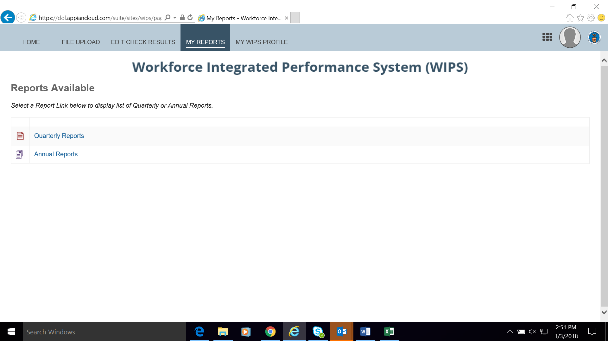
Certify: Quarterly Performance Report Form

Slide 19
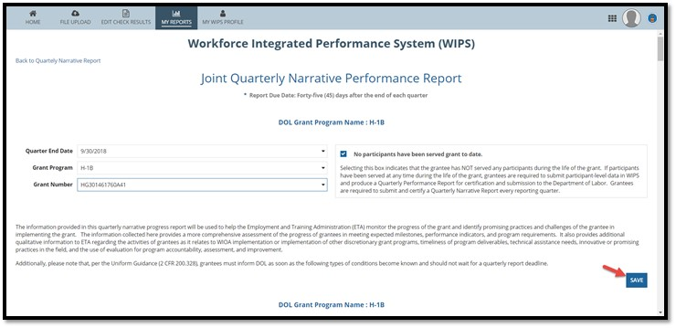
Submit: Joint Quarterly Narrative Performance Report

Slide 20
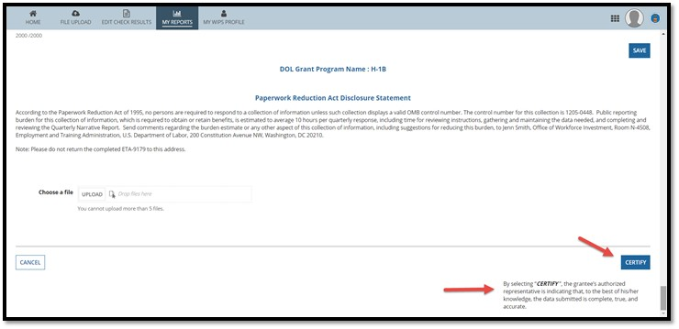
Certify: Joint Quarterly Narrative Performance Report

Slide 21
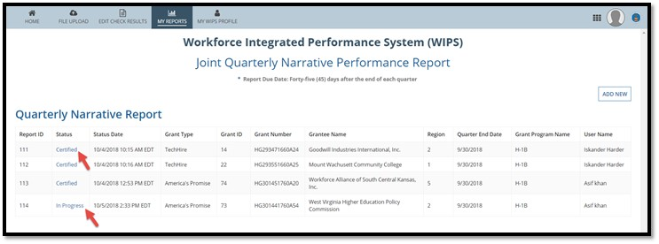
Verify Certification: Joint Quarterly Narrative Performance Report

Slide 22
Joint Quarterly Narrative Performance Report (ETA-9179) template: Evidence and Evaluation
Required Template
H-1B grantees are required to submit a quarterly narrative report using the approved Joint Quarterly Narrative Performance Report (ETA-9179) template for the quarter ending September 30, 2018.
Section X: Evidence and Evaluation
Please note a key change to the ETA-9179 template includes the addition of an “Evidence and Evaluation” section.
This section is intended to provide information to DOL on how evidence and evaluations are being developed and applied to the grant and should be completed as appropriate.

Slide 24
WIOA Primary Indicators of Performance
How do we calculate these outcome measures appear on my QPR?
What outcome measures is ETA tracking for H-1B grantees?!

Slide 25
Refresher: WIOA Indicators of Performance
1. Employment Rate – 2nd Quarter After Exit | Percentage of participants who are in unsubsidized employment during the second quarter after exit from the program.
2. Employment Rate – 4th Quarter After Exit | Percentage of participants who are in unsubsidized employment during the fourth quarter after exit from the program.
3. Median Earnings – 2nd Quarter After Exit | Median earnings of participants who are in unsubsidized employment during the second quarter after exit from the program.
4. Credential Attainment | Percentage of participants enrolled in an education or training program who attain a recognized postsecondary credential during participation in or within one year after exit from the program.
5. Measurable Skills Gains | Percentage of program participants who, during a program year, are in an education or training program that leads to a recognized postsecondary credential or employment and who are achieving measurable skill gains.
6. Effectiveness in Serving Employers | Retention with the same employer in the 2nd and 4th quarter after exit.

Slide 26
H-1B WIOA Primary Indicators of Performance on QPR
CSV Data File
Grantees Report DEs
DOL Uses SSNs
Measurable Skills Gains
Credential Attainment
Employment Rate – 2nd Quarter After Exit
Employment Rate – 4th Quarter After Exit
Median Earnings – 2nd Quarter After Exit
Effectiveness in Serving Employers
Learn how Measurable Skills Gains and Credential Attainment Indicators are calculated here:
WIOA Primary Indicators of Performance E-Learning Modules
HOT TIP!

Slide 28
Performance Policy FAQs
Employment Status at Program Entry
Internships and Work Experience
Reporting Apprenticeships
Reporting Types of Services

Slide 29
Employment Status at Program Entry
To be eligible for services, an individual must be unemployed, underemployed, or an incumbent worker, as defined in the Funding Opportunity Announcement (FOA) and as it aligns with a grantee’s grant Statement of Work (SOW).
  Unemployed: (PIRL 400: Employment Status at Program Entry)
  Underemployed: (PIRL 2101: Underemployed Worker)
  Incumbent Worker: (PIRL 907:Recipient of Incumbent Worker Training )
  Employed (PIRL 400: Employment Status at Program Entry)
    SWFI is the only H-1B Program in which a participant may be employed and not fall under the underemployed or incumbent worker categories

Slide 30
Employment Status Differences
Underemployed Workers Should not be recorded as Incumbent Workers
  There is no grantee relationship with Employer (where training is NOT developed with an employer or employer association to upgrade skills training)
Employed Workers are not necessarily Incumbent Workers
  An employed worker is and individual whose employer does not have a training agreement with the grantee (where training is developed with an employer or employer association to upgrade skills training)

Slide 31
Reporting Incumbent Worker Employment Outcomes
Incumbent Workers that Retained Current Position
  Employment Retention Outcome
  An individual must keep their current position for three consecutive quarters after program completion
  PIRL 2119, 2121, and 2123: Incumbent Workers Retained Current Position in Quarters 1, 2, and 3 must = 1, Yes.
Incumbent Workers that Advanced into a New Position
  New Employment Outcome
  An individual gets a new job at any quarter after program completion
  PIRL 2120, 2122, 2124: Incumbent Workers Advance into a New Position in the 1st, 2nd or 3rd Quarter must = 1

Slide 32
Sam is a Cybersecurity Specialist for ARC Security Services and recently completed their H-1B training program and received a Bachelor’s Degree. In the first quarter after program completion,
Sam did not find a new job. But in the second quarter after program completion, Sam got a new job as a Cybersecurity Consultant.
USE the CHAT WINDOW to record your answers!
How do you record Sam’s employment in your data file?
  Q 9.30 PIRL 2119 Incumbent Workers Retained Current Position in Quarters 1 = 1, Yes
  Q 12.31 PIRL 2122 Incumbent Workers Advance into a New Position in the 2nd Quarter = 1, Yes
How is this outcome reported on your 12.31 QPR?
  F. 2 Incumbent Workers Retained Current Position = 0
  F. 3 Incumbent Workers Advanced into New
  Position = 1

Slide 33
Reporting Internships and Work Experience
PIRL 1203 - Most Recent Date Received Internship or Work Experience opportunities
  Record date when individual is first enrolled (or start) their internship/work experience opportunities.
  Per H-1B FOA: Incumbent Workers are excluded from Internship and Paid Work
PIRL 1205 - Type of Work Experience
  Allowable H-1B Code Values
    2 = Employment opportunities, including internships, not limited to summer months
    3 = Pre-apprenticeship programs
    4 = Job shadowing
    7 = Other work experience activities
    0 = Did Not Participate in these activities

Slide 34
Paid Work vs Registered Apprenticeship
PIRL 1203 and 1205 (Paid Work Experience)
Registered Apprenticeship (PIRL 931)
These code values are distinct – a participant should not be reported in more than one work experience, unless they participate in each one
  PIRL 931 Registered Apprenticeship Program
  PIRL 2109 – 2117 H-1B PIRL Data Elements to Report Training Activity Types
    Code Value 8 = Registered Apprenticeship

Slide 35
Supportive Services vs Specialized Services
Supportive Services
  Transportation & Housing
  Child care and Dependent care
  Needs-related payments that are necessary to enable an individual to participate in education and training activities funded through this grant
Specialized Services
  Specialized Participant Services are defined as group-based or one-on-one services that address specific barriers to employment facing the targeted population(s).
    Appropriate assistive technologies and Personal assistance services including attendants
    Interpreters for individuals with disabilities
    Community orientation and mobility training (e.g. accessible transportation, bus routes, housing, health clinics)
    Benefits-planning counseling, including information that will help participants
    in the transition from public assistance to self-sufficiency
    Financial assistance consultation, Behavioral health counseling, mentoring,
    and relocation assistance, job coaching, networking, and job search
    assistance

Slide 37
WIPS TIPS
Correct Number of Columns
Reset Password in WIPS
Change Authorized representative

Slide 38
89 is the Correct number of Columns
WIPS Snapshot CSV Data File
10000000000001 | GA |  |  |  | 19981106 | 0 | 0 | 1 | 0 | 0 | 1
10000000000002 | GA |  |  |  | 19960420 | 0 | 0 | 0 | 0 | 0 | 0
10000000000003 | GA |  |  |  | 19970730 | 9 | 9 | 9 | 9 | 9 | 0
10000000000004 | GA |  |  |  | 19900603 | 1 | 0 | 0 | 0 | 0 | 0
H-1B grantees will upload a data file that includes 89 columns for PIRL data elements.
CK is the last column for PIRL 2700 Social Security Number
HOT TIP!
Sample Case Management and Data File for a full data file example.

Slide 39
Reset Password in WIPS
Resetting Your Password Select the Reset Your Password link on the WIPS login screen. Then enter your email address in the Username field and select Request Password Reset.
You will receive an email with a temporary password that you will have to change the next time you log in. Your new password must be at least eight (8) characters and have at least one (1) of each of the following:
Uppercase letter
Special character
Lowercase letter
Number
AFTER CHANGING YOUR PASSWORD,
YOU MUST LOG OUT AND LOG IN AGAIN.

Slide 40
Change Authorized Representative
Any Authorized Representative change needs to go through the grant modification process, assisted by your FPO.
  The modification, signed by the Grant Officer, is the formal approval of the Authorized Representative change.
  Please note that after submitting the request to your FPO, it could take 1-2 weeks for the modification to be signed by the Grant Officer and transmitted to you.

Slide 41
Next Steps Action Items
What should we do …

Slide 42
Quarter Ending 9/30/18
H-1B Reporting Reminder
Important Dates
  H-1B Grantee Access to WIPS 11/1/2018
  Reporting Deadline EXTENDED to 11/30/2018
Next steps for grantees
  Review performance reporting technical assistance materials on the H-1B CoP
  Prepare your data file/csv submission, including the new PIRL elements, for submission November 1 through November 30, 2018
  Attend H-1B Performance Office Hours (invites coming out soon)
    Friday, November 2, 2018 from 2:00 p.m. – 3:00 p.m.
    Wednesday, November 7, 2018 from 1:00 p.m. – 2:00 p.m.
    Wednesday, November 14, 2018 from 2:00 p.m. – 3:00 p.m.
  After November 1, submit and certify your grant’s quarterly performance report and quarterly narrative report in WIPS.
  Contact your grant mailbox for performance reporting technical
  assistance. Please make sure to cc your FPO.

Slide 43
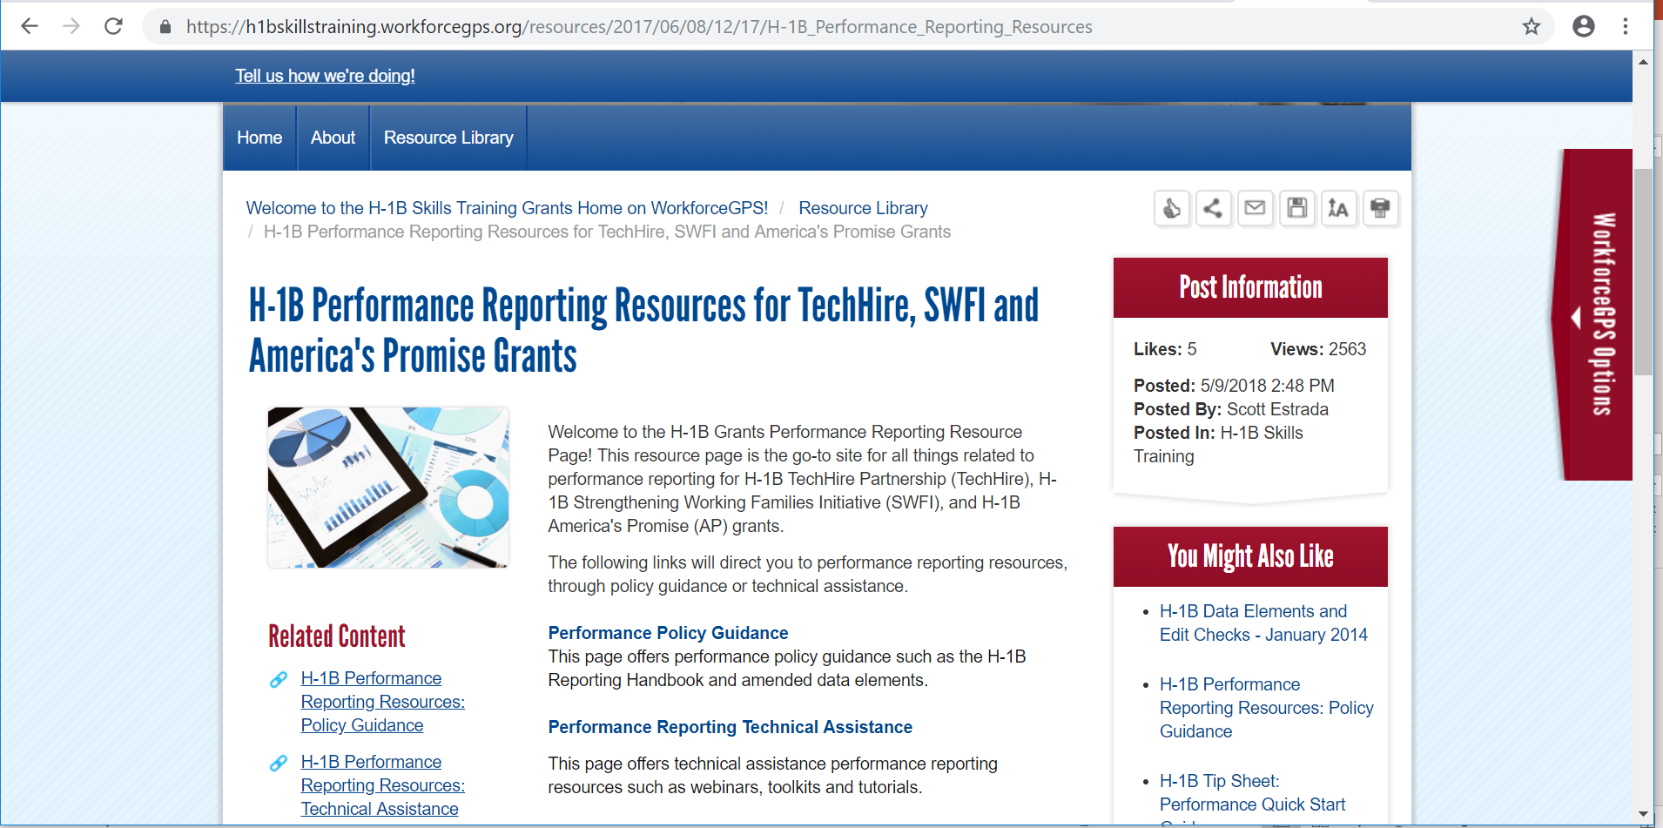
H-1B Performance Resources
Recently Updated Performance Resources
  Updated Amended ETA-9172 DOL PIRL for H-1B Grants
  Updated H-1B Grants Performance Reporting Handbook & WIPS Reporting Guidance
  Updated Sample Case Management and Data File
  Updated H-1B Training Activities and Outcomes Diagram:
  Updated H-1B WIPS TIPS
  New WIOA Primary Indicators of Performance Learning Modules

Slide 45
Thank you for all your hard work!

