Slide 2
Checking In!
Let’s get to know who is on the call today. Using the poll, select the organization that you belong to.
Choose the answer that best reflects you (or your group):
State Workforce Agency
Workforce Development Board
American Job Center
Training Provider
Service Provider
Other

Slide 3
Implications of Substance/Opioid Misuse and Addiction for the Workforce Development System
October 18, 2018
Webinar: Thursday, October 18, 2018; 2:00 p.m. EST

Slide 4
Amanda Ahlstrand
Administrator
U.S. Department of Labor, Employment and Training Administration

Slide 5
Walker Reed Forman, MSW
Lead Public Health Advisory, U.S. Department of Health and Human Services,
Organization Substance Abuse and Mental Health Services Administration
Holly Hagle, PhD
Co-Director of the Addiction Technology Transfer Center (ATTC) Network Coordinating Office (NCO)
University of Missouri, Kansas City (UMKC)

Slide 6
Patrick L. McNeil, M.Ed.
Associate Director of Substance Use Intervention
YouthBuild USA, Inc.
David Clauss, LMSW
Program Director – YouthBuild Austin, Texas
American YouthWorks, Inc.

Slide 7
Starting the Conversation
Impacts to the Workforce System
Understanding the Landscape
Describe the current epidemiology of the opioid crisis
Resources to Support Your Community
Explore evidenced-based tools for assessing risk for substance use disorders
Discuss Screening, Brief Intervention and Referral to Treatment (SBIRT) and its application in multiple settings

Slide 8
Starting the Conversation
Substance Abuse Disorders and Opioid Misuse Impacts to the Workforce System

Slide 9
Is substance abuse or opioid misuse/addiction a problem in your community?
No, it’s not a problem that I’m aware of.
Yes, it’s a problem but it hasn’t impacted my work as a workforce development professional.
Yes, it’s a problem and it has somewhat impacted my work as a workforce development professional.
Yes, it’s a problem and it has significantly impacted my work as a workforce development professional to the point that my organization is addressing the issue.

Slide 10
Substance Abuse/Misuse Impact on Individuals
Usually a slow decline, from misuse to abuse
Diminished physical and mental health, loss of homes and jobs, social and family separation
Road to recovery requires a continuum of care
Employment is one key to recovery

Slide 11
Considerations for Employers
National Safety Council Study
70% of employers have seen some impact
20% of employers felt prepared to deal with issues related to addiction
Drug testing limited
Immediate dismissal of employment
Many employers are looking for new ways to support their workforce needs.

Slide 12
Challenges for the Workforce System
Program Design
Extensive orientation and participant screening process
Referrals to drug counseling sessions and links to supportive services
Develop accelerated training programs for Behavioral Health Counselors

Slide 13
Let’s Chat!
What else are you challenged with when serving participants with perceived or known substance use/abuse issues?

Slide 14
Federal Initiatives and Resources
White House Declaration: National Public Health Emergency
DOL Investments: National Health Emergency Demonstration Projects
Test innovative approaches to address the economic and workforce-related impacts of the opioid epidemic;
Provide training and support activities to dislocated workers (including displaced homemakers), new entrants in the workforce, and incumbent workers, including individuals in these populations who are or have been impacted by the opioid crisis; and,
To provide training that builds the skilled workforce in professions that could impact the causes and treatment of the opioid crisis, including addiction and substance-abuse treatment, mental health, and pain management.
Employers: Federal Bonding Program
Employers: WOTC Tax Credits

Slide 15
Understanding the Landscape
Facts and Data: The Current Epidemiology of the Opioid Crisis

Slide 16
Opioid Statistics Across the U.S.
1.8 million Americans have an Opioid Use Disorder related to opioid pain killers
Over 625 thousand have a heroin related Opioid Use Disorder
Opioid-related emergency department visits nearly doubled from 2005 – 2014
Opioid-related inpatient hospital stays increased 64% nationally from 2005 - 2014

Slide 17
Rapid Jump in Overdose Deaths
“There were almost 64,000 drug overdose deaths in 2016, the largest annual jump ever recorded in the United States, according to the CDC.”
Drug overdose deaths reached 72,000 in 2017 – CDC 2018

Slide 18
SAMHSA’s Efforts are Aligned with the HHS Five-point Opioid Strategy
Strengthening public health surveillance
Advancing the practice of pain management
Improving access to treatment and recovery services
Targeting availability and distribution of overdose reversing drugs
Supporting cutting edge research

Slide 19
Affirming Language
1

Slide 20
Surgeon General Report on Addiction
Source: U.S. Department of Health and Human Services (HHS), Office of the Surgeon General, Facing Addiction in America: The Surgeon General’s Report on Alcohol, Drugs, and Health. Washington, DC: HHS, November 2016.

Slide 21
Substance Use and Behavior
SUD and Mental Health
18.7 million people age 18 or older had a SUD
8.5 million18 or older had both a SUD and mental illness
46.6 million people aged 18 or older had a mental illness and 1 in 4 have a Serious Mental Illness (SMI)
Serious Mental Illness (SMI) is rising in the 18-25 year olds – 2.6 million
Increase in 2016 data in those with SMI receiving treatment – 1.5 million
Leaves @43% not getting treatment

Slide 23
Substance Use and Wellbeing

Slide 24
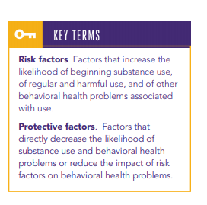
Increase Primary Prevention
Well-supported scientific evidence exists for robust predictors (risk and protective factors) of substance use and misuse from birth through adulthood
Source: U.S. Department of Health and Human Services (HHS), Office of the Surgeon General, Facing Addiction in America: The Surgeon General’s Report on Alcohol, Drugs, and Health. Washington, DC: HHS, November 2016.

Slide 25
Many Paths to Wellness
Understanding
Recovery
It can take the brain a long time to return to health following long periods of heavy substance use
Both substance misuse and substance use disorders harm the health and well-being of individuals and communities. Addressing them requires implementation of effective strategies
People can and do recover
The recovery movement offers a valuable opportunity for people with substance use disorders and their loved ones to get the support

Slide 26
Examples of SAMHSA Resources to Address the Opioid Crisis
Resources
Resources
SAMHSA’s Behavioral Health Treatment Services Locator is a confidential and anonymous source of information for persons seeking treatment facilities for substance use disorders or mental health problems
Provider’s Clinical Support System for Medication-Assisted Treatment (PCSS-MAT) is an online national training and mentoring project providing resources on evidence-based practices for addressing the opioid crisis to health professionals at no cost, including free DATA waiver trainings
Addiction Technology Transfer Center (ATTC) is a resource to develop and train providers and create regional training alliances among agencies and organizations that provide substance use disorder treatment and recovery services
Treatment Improvement Protocol (TIP #63): Medications for Opioid Use Disorder Toolkit is a guide to educate providers about assessment and strategies for providing medication-assisted treatment (MAT), pharmacotherapy practices, and supporting ongoing recovery (in development)
Opioid Overdose Prevention Toolkit equips individuals and healthcare providers on ways to prevent and respond to opioid overdose
Clinical Guidance for Treating Pregnant and Parenting Women with Opioid Use Disorder and their Infants describes for providers the appropriate interventions and behavioral/social services to promote the best possible outcome for both mother and child (in development)
A Collaborative Approach to the Treatment of Pregnant Women with Opioid Use Disorder is a manual that offers best practices and MAT for pregnant women living with opioid use disorder (OUD)
Healthy Pregnancy Healthy Baby: Opioids in Pregnancy is a manual for families that addresses the treatment of OUD in pregnancy, postpartum concerns, and neonatal abstinence syndrome (in development)
Neonatal Abstinence Syndrome Technical Expert Panel examined developmental effects related to neonatal exposure to opioids with the goal of identifying research gaps and strategies for practice

Slide 27
Community Resources

Slide 28
Early Intervention
Get people help earlier in their course of use
Do not wait to “hit rock bottom”

Slide 29
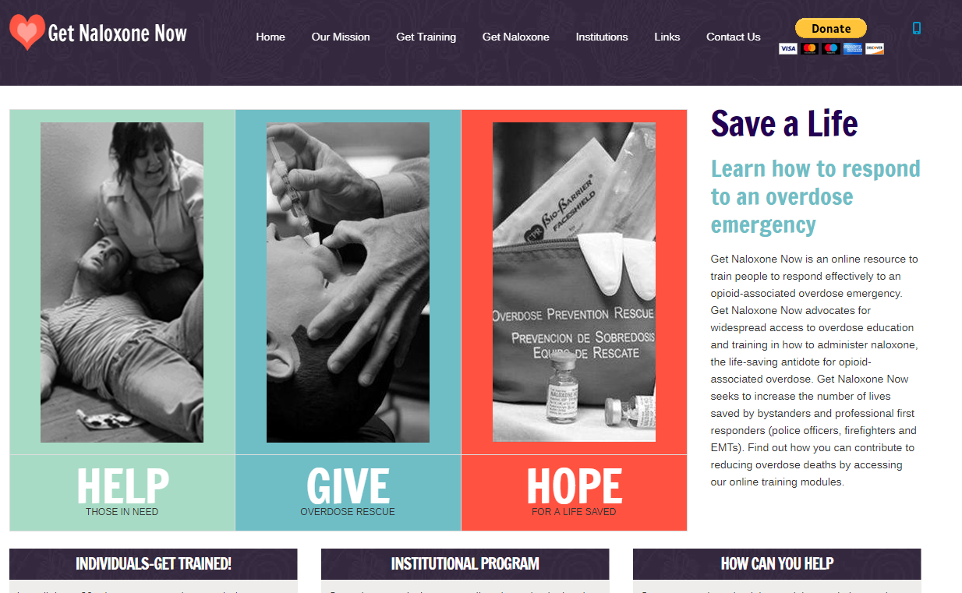
Increase Safety
Naloxone - is a medication designed to rapidly reverse opioid overdose.
Safe use – less risk

Slide 30
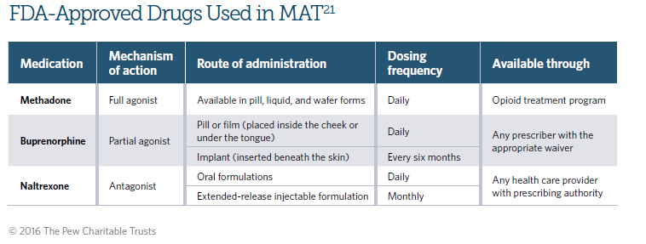
Medications for Opioid Use Disorders
Source: The PEW Charitable Trusts: Medication-Assisted Treatment Improved Outcomes for Patients with Opioid Use Disorder. 2016. http://attcnetwork.org/userfiles/file/MidAmerica/MAT_Improves_Outcomes_OUD.pdf

Slide 31
Assess Risk
Screening Brief Intervention and Referral to Treatment (SBIRT)
Comprehensive, integrated, public health approach to the delivery of early intervention and treatment services for persons with substance use disorders, as well as those who are at risk of developing these disorders.

Slide 32
Substance Use
Prevention & Intervention
Patrick L. McNeil, M.Ed.
Associate Director of Substance Use Intervention
YouthBuild USA, Inc.

Slide 33
YouthBuild USA, Inc.
YouthBuild USA, Inc. leads a network of 250 domestic YouthBuild programs across America that offer disconnected young people (16-24) the opportunity to gain education, career, and leadership skills to build a pathway out of poverty.

Slide 34
YouthBuild USA, Inc.
YouthBuild and other similar job training programs struggle with how to best address substance use/abuse among its participants.

Slide 35
Introduction and Context
The majority of YB programs report that substance use/abuse serves as a serious impediment to:
Program retention of students;
A safety issue on the worksite;
Barriers to achieving outcomes in the classroom;
Successful post program placement;

Slide 36
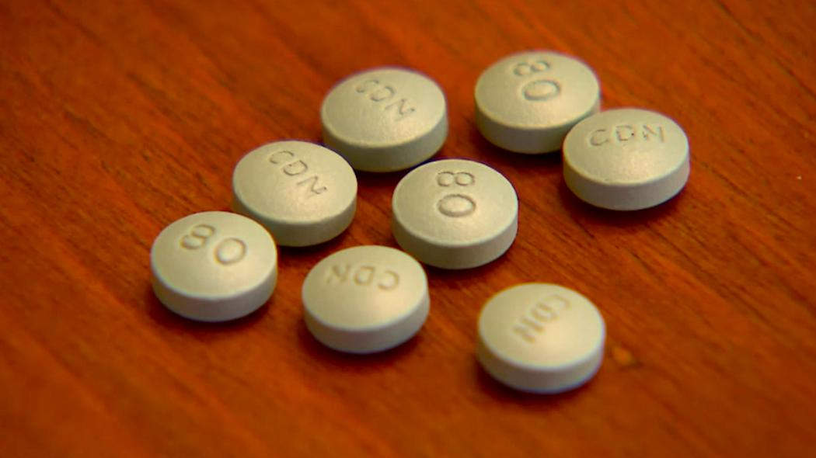
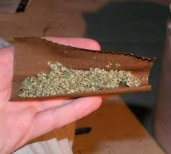
Substance Use/Abuse in YB
YouthBuild participants that use illicit substances periodically or have a substance use disorder (SUD) are generally masking hidden problems and use the drugs as a “coping” mechanism, most often from childhood trauma;

Slide 37
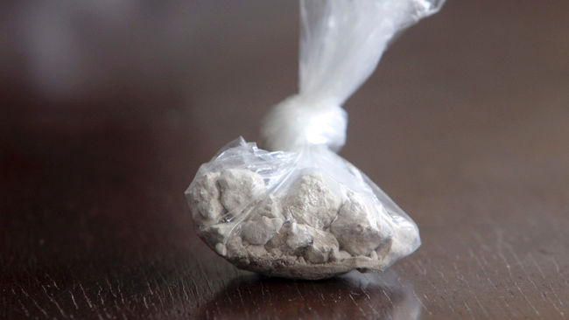
Why are Participants Using?
Coping mechanism
Escape from school and family
To be accepted by their Peers
Family influence/environment
Everybody does it
Curiosity/Just Bored
Pill-popping society
Gang influence
To feel “normal”
Ethnic culture influence

Slide 38
Commonly Used Illicit Drugs
Marijuana
Opioids/Pills (Oxycontin, Hydrocodone, Fentanyl, Vicodin, etc.)
Cocaine
Hallucinogens (LSD, Ketamine, Cough syrup, etc.)
Methamphetamine
Heroin
Club Drugs (Ecstasy, Mollys, Special K, etc.)
Other (K-2, SPICE, Inhalants, etc.)

Slide 39
Marijuana Update
With marijuana now legal for “recreational use” in Colorado, Washington, Oregon, Alaska, California, Nevada, Massachusetts, Maine, and Washington D.C. …
Legal for “medical use” in 30 states and Washington DC … and effectively decriminalized in almost every state …
It’s clear that society’s norms and attitudes toward marijuana have changed dramatically.

Slide 40
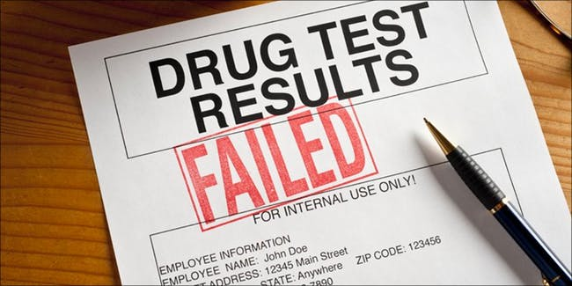
Marijuana Use Messaging
Our goal is to move participants into a career pathway that will offer a living wage and growth potential. If drugs and alcohol are an issue, none of this is possible. We must convey that they will not get hired and/or will lose employment if they consistently fail drug tests or show up to work under the influence of substances.
The legalization of marijuana does not change this!

Slide 42
SBIRT
An Evidence Based Prevention and Intervention Strategy

Slide 43
What is SBIRT?
Screening: routine, universal administration of validated questions to identify potential risks related to alcohol and drug use, followed by positive reinforcement for those who indicate “no current use” at the time of screening.
Brief intervention: one or more short, motivational conversations, typically incorporating feedback, advice, and goal-setting around decreasing risk related to sporadic and more-frequent substance use (i.e., “low” to “moderate” risk).
Referral to treatment: the process of connecting individuals with problematic use (“high” risk) to appropriate assessment, treatment, and/or additional services based on their level of need.

Slide 45
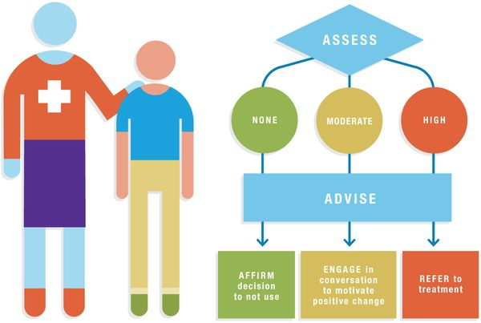

Slide 46
SBIRT Results …

Slide 47
SBIRT Results …

Slide 48
Substance Use
Prevention & Intervention
David Clauss, LMSW
Program Director – YouthBuild Austin, Texas
American YouthWorks, Inc.

Slide 49
SBIRT in Action …
Started as a literacy program in the 70’s
Became a GED program that incorporated service learning
YouthBuild program, Casa Verde Builders, started in 1994
Texas Conservation Corps started in 1995

Slide 50
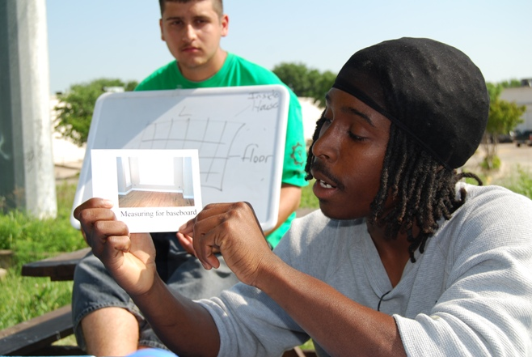
SBIRT in Action …
Even as we’ve changed and grown, some things remain the same: substance use and abuse by young adults remains a constant.

Slide 51
SBIRT in Action …
Over the years we’ve tried many different approaches…
We evolved to from a zero tolerance, law enforcement attitude to seeing substance abuse through a mental health and harm reduction lens. And then we found SBIRT…

Slide 52
SBIRT in Action …
Why SBIRT works for YouthBuild
It’s all about relationships
It’s about keeping it real
It’s about what works
Keys to success:
Non-judgmental curiosity
Really listening
Giving choices
Build Coping Skills

Slide 53
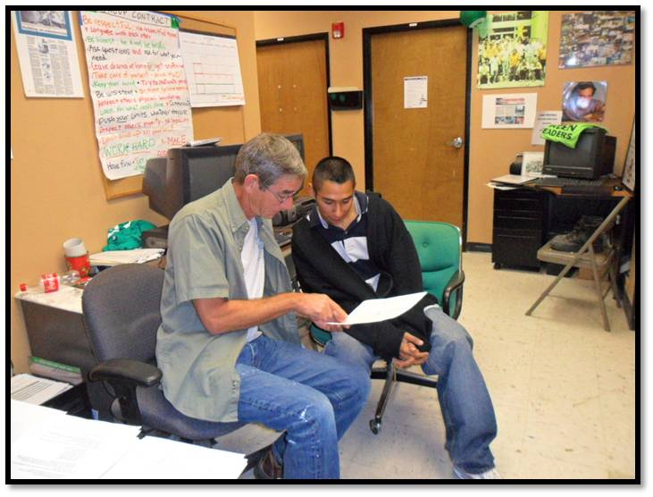
SBIRT in Action …
For AYW-YouthBuild Austin SBIRT is part of a comprehensive approach to Positive Youth Development
Trauma-Informed Care
Restorative Justice Practices
Motivational Interviewing
Mindfulness Training

Slide 54
Tips for Consideration
Change is difficult for almost everyone. It takes some time!
Counseling is not possible while someone is high. Under these conditions, only try to manage behavior until the chemical effects have worn off.
Stopping the use of drugs is not just about having information and using willpower. Think of how hard people find losing weight despite all the information about the negative effects of being overweight.
There is no one approach to solving the problem of substance use. But change is most likely to occur if the client owns their change (intrinsic) and the caseworker is supportive.

Slide 55
SAMHSA
https://www.samhsa.gov/
Surgeon General’s Report
https://addiction.surgeongeneral.gov/
Addiction Technology Transfer Center – Get specific information on SBIRT
http://attcnetwork.org/national-focus-areas/content.aspx?rc=sbirt&content=STCUSTOM2
Substance Abuse and Mental Health Services Administration. Medications for Opioid Use Disorder
https://store.samhsa.gov/shin/content/SMA18-5063FULLDOC/SMA18-5063FULLDOC.pdf
National Survey on Drug Use and Health
https://www.samhsa.gov/data/sites/default/files/NSDUH-FFR1-2016/NSDUH-FFR1-2016.pdf
IRETA – SBIRT specific information
https://ireta.org/?s=SBIRT

Slide 57
Our community has been impacted by this national epidemic. These are some of the things that we’ve done to address the problem:
We’ve assembled a taskforce(s) in our community to tackle this problem.
We’ve identified resources in our community and referring people that need support.
We’re providing training services specifically for individuals impacted by this crisis.
We’ve developed training programs for behavioral health occupations and peer counselors to tackle this crisis in our community.

Slide 58
Holly Hagle
Co-Director of the Addiction Technology Transfer Center (ATTC) Network Coordinating Office (NCO)
ATTC at UMKC
hagleh@umkc.edu
412-478-5429
Walker Reed Forman, MSW
Lead Public Health Advisory, U.S. Department of Health and Human Services,
SAMHSA
reed.forman@samhsa.hhs.gov
240-276-2416

Slide 59
Patrick L. McNeil, M.Ed.
Associate Director of Substance Use Intervention
YouthBuild USA, Inc.
pmcneil@youthbuild.org
214.384.1618
David Clauss, LMSW
Program Director – YouthBuild Austin, Texas
American YouthWorks, Inc.
dclauss@americanyouthworks.org
512.431.2605

