Slide 1
Polling Question
?
What kind of organization are you coming from?
College
Workforce Board/American Job Center
Community Service Provider
Other
?
?
?
?

Slide 2
Polling Question
?
How do you and your organization serve adult learners? Choose all that apply.
Changes to Teaching Approaches
Contextualized Learning
Scheduling Changes
Competency Based Education
Credit for Prior Learning
Wraparound Student Services
Navigators/Career Advisors
Other (add in chat)
?
?
?
?

Slide 3
Trade Adjustment Assistance Community College and Career Training (TAACCCT) Learning Network
Adult Learning Strategies at Community Colleges
October 24, 2018
Innovations Leading to Career Success Webinar Series
Employment and Training Administration
Office of Career, Technical, and Adult Education

Slide 4
Moderators
Cheryl Martin, Trade Adjustment Assistance Community College and Career Training (TAACCCT) Program Manager, Division of Strategic Investments, Employment and Training Administration, U.S. Department of Labor
Erin Berg, Community College Program Specialist, Office of Career, Technical, and Adult Education, U.S. Department of Education

Slide 5
The TAACCCT Grant Program
The U.S. Department of Labor’s Trade Adjustment Assistance Community College and Career Training (TAACCCT) grant program is a major investment to increase the ability of community colleges to address the challenges of today’s workforce.
The TAACCCT Program:
$1.9 billion awarded; grant projects active from fiscal years (FYs) 2011-2018
Over 700 colleges across the nation participated, in partnership with over 2,500 employers
Over 2,600 industry-aligned programs of study developed or enhanced
More than 475,000 individuals enrolled to date
Resources developed by grantees made freely available on www.SkillsCommons.org

Slide 6
About this Webinar
This webinar showcases strategies and resources developed by community colleges that are of broad interest to educational institutions engaged in career-focused education and training.
These strategies were produced by grantees of the Trade Adjustment Assistance Community College and Career Training (TAACCCT) program, a collaboration between the US Department of Labor and the US Department of Education.

Slide 7
Innovations Leading to Career Success Webinar Series
This webinar series showcases strategies and resources that are of broad interest to educational institutions engaged in career-focused education and training.
August 22:
Jumpstart to Successful Instruction: A Deeper Dive into an Accelerated Course for New Instructors
September 12:
Aligning Workforce Development Stakeholders
September 26:
Increasing Student Support Services to Improve Student/Worker Outcomes
October 10:
Increasing Academic Achievement
October 24:
Adult Learning Strategies at Community Colleges
For more information, please visit:
Innovations Leading to Career Success Webinar Series

Slide 8
Presenters
Sandy Crist, State Director for Adult Education and High School Equivalency Mississippi Community College Board
Rebecca Elmore, InTech Center Manager Chaffey College, CA
Anne Willaert, Director of Grants and Special Projects South Central College, MN

Slide 9
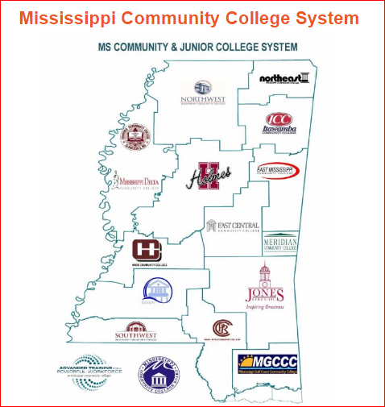
Mississippi Community College Board
7

Slide 10
Trade Adjustment Assistance Community College and Career Training Grant Program (TAACCCT) 2013
SIGNIFICANT IMPACTS
POLICY SHIFT
01
NAVIGATOR/TRANSITION SPECIALIST ROLE
02
MS Adult High School Equivalency
Options
PATHWAY DEVELOPMENT
03
MIBEST
CAREER TECHNICAL EDUCATION
WORKFORCE DEVELOPMENT
04
GED©, TASC©, or HiSET©
COMPETENCY-BASED HIGH SCHOOL EQUIVALENCY DIPLOMA
Success
Competency-Based Diploma
8

Slide 11
Mississippi Integrated Basic Education and Skills Training (MIBEST)
One of Mississippi Association of Community & Junior Colleges’ (MACJC) legislative priorities for the past ten years:
Drop-Out Recovery – Adult Basic Education (ABE)/General Equivalency Diploma (GED) prep combined with a skills training component; each community college receives $200,000 per year of discretionary funds to support drop out recovery.
TAACCCT Projects at seven Mississippi community colleges
(Co-Lin, Meridian, Mississippi Delta, Northeast, Pearl River, Hinds and Mississippi Gulf Coast);
Mississippi Community College Board policy change (Dec. 2013) allowing students without a high school diploma or GED enrolled in approved credit pathway programs to be counted in a college’s reimbursable full-time equivalency (FTE).
9

Slide 12
Mississippi Integrated Basic Education and Skills Training (MIBEST)
All 15 Mississippi community colleges
Concurrently enroll students in connected adult education and eligible postsecondary programs leading to a secondary school diploma or its recognized equivalent and at least a one-year college-level certificate/credential and beyond;
Provide students with intrusive counseling and supportive services to attain academic and career goals, support services such as academic and career counseling, tutoring, child care, transportation, access to entitled public benefits, subsidized jobs, etc.;
Navigator/Transition Specialist
Include at least a 25 percent instructional overlap in ABE and Career and Technical Education (CTE) courses.
10

Slide 13
Mississippi Integrated Basic Education and Skills Training (MIBEST)
Student Benefits:
No cost to students
Ability-to-Benefit provision allows access to federal financial aid
Tuition waived by community college (utilize FTE allotment)
Earn high school equivalency diploma and a credential
$200 Completion Incentive
Student Navigator
Intrusive support services
Contextualized and team-taught classes
Credit for prior learning (CPL)
Work based learning opportunities
11

Slide 14
Mississippi Integrated Basic Education and Skills Training (MIBEST)
12

Slide 15
13

Slide 16
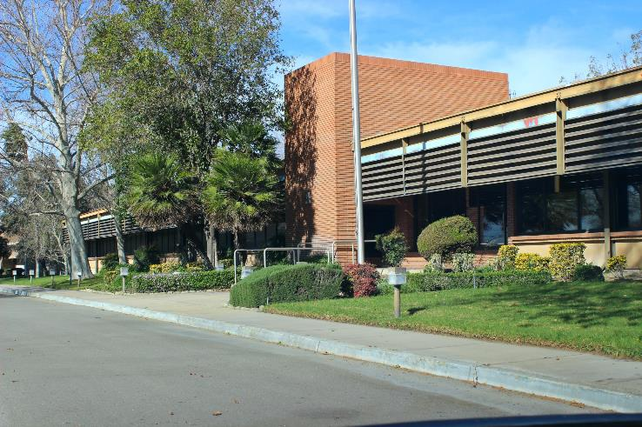
CHAFFEY COLLEGE / INTECH CENTER
14

Slide 17
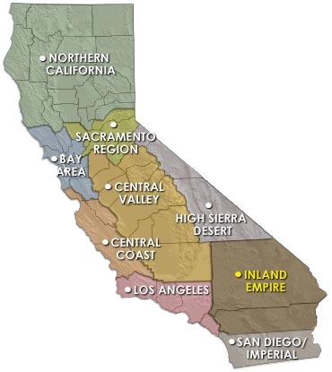
BACKGROUND INFORMATION
Inland Empire Regional Training Consortium
Total Award: $14,980,284
Partners: 12 Institutions
- 10 Community Colleges
- 2 Universities
Service Area: Inland Empire
- 27,000 square miles
- Population of 4.3 Million
Population to be served:
Trade Adjustment Assistance (TAA) eligible workers, long-term unemployed, veteran populations, and incumbent workers
15

Slide 18
CURRENT REGIONAL METRICS (Pending final submission of data for Year 4 from partner colleges)
2,501 Completers
184 Wage Increases
1,519
Incumbent Workers
184 Job Placements
5,602
Students Served
Note: Metrics are being re-calculated to capture additional numbers that were under-reported for years 1-3.
16

Slide 19
Chaffey College / InTech Center Student Flow At-a-Glance
Meet w/Career Hub Team Throughout Program
Soft Skills Class and Supportive Services
Focused on Job Matching, Internships, and Work-based Learning
Consistent Case Management, Attendance Tracking, and Contact
Program Referral /
Recruitment
Info Session
- Program Overview
- Pre-assessment (CASAS)
- Interview
One-on-One Info Sessions/Assessment
Or
Small Group
Program Selection
Follows same flow as the Info Session
Begin Training
17

Slide 20
RELATIONSHIPS
Constant Contact
Gentle but relentless pressure
Constant communication
Nurture relationships
Needs assessment
Employment Training
Panel (ETP)training
Site tours
Recruitment / Outreach
EDD / TAA / AJCC ●
Veteran Orgs. ●
Foster Care ●
Career Fairs ●
Social Media ●
Orientations ●
Student Selection
Case Mgmt.
Job Placement
Employer Relations
Relationship Building
Engagement
Outcome form
Email job leads
Resume building
Ongoing follow-up
Touches start on day one
Before/During/After hours
Constant Touches
Job matching ●
Open door policy ●
Refer to WIOA, etc. ●
Email / Phone / Text ●
Classroom instruction ●
Assess personal needs ●
18

Slide 21
PLACEMENT SUCCESS
Hire dedicated staff who remember the “why” through all the ups and downs
Understand each student, company culture, and program curriculum and take the time to match all three… focus on quality over quantity. Truly listen to your students and provide career and life skills counseling
Be willing to go above and beyond—this is not an 8 to 5 job!
Stay up-to-date on workforce development, labor laws, hiring practices, application and interview trends, and industry needs
19

Slide 22
20

Slide 23
21

Slide 24
Minnesota State System
396,000 Students
260,000 in credit classes
136,000 in non-credit programs
58 percent in greater Minnesota
133,000 from underrepresented groups
50,000 first generation students
10,500 veterans
37 Colleges and Universities
54 Campuses
seven universities
30 colleges
47 Communities across the State
From International Falls to Worthington
Enrollment ranges from 445 to 32,131
22

Slide 25
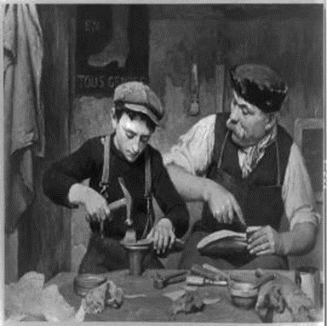
Learn Work Earn Apprenticeships
3 Apprenticeship Models
Academic
Work Learn Earn 3/2 model
Non-Credit
Company Based - Customized Learning
3. On-Line
+Connect
Funding Streams
Minnesota Apprenticeship Initiative
Pipeline Project – Legislative funding
Partnerships
23

Slide 26
Integrated Student Support Redesign
24

Slide 27
Career Pathways
25

Slide 28
Credit for Prior Learning
Student Benefits:
Accelerates Completion*
Reduces Duplication of Learning
Lowers Investment in Education
More Likely to Graduate*
Institution Benefits:
Recruit Adult Students Who May Not Otherwise Enroll
Students Persist at Higher Rate Than Non-CPL Students
Results in More Full Year Equivalents (FYEs) *
Higher Completion Rates*
* Council for Adult and Experiential Learning (CAEL): Fueling the Race, 2010
26

Slide 29
Veterans Education Transfer System (VETS)
27

Slide 30
28

Slide 31
SkillsCommons Field Guide of TAACCCT Innovations
Innovative Approaches to Common Challenges Found in Higher Education and Workforce Development
The SkillsCommons Field Guide: The Gallery Edition is a collection of innovative and successful workforce development strategies developed by community colleges with funding from the TAACCCT Program. Included in the field guide, you will find:
Video interviews
Links to solutions-based materials located on SkillsCommons
Descriptors of designs and implementation plans
Podcasts of project directors explaining their innovative programs
An in-depth look at project leadership
29

Slide 32
SkillsCommons Resource Pages
Retraining the Gulf Coast Workforce through IT Pathways Consortium
https://www.skillscommons.org/handle/taaccct/519
Inland Empire Regional Training Consortium (IERTC)
https://www.skillscommons.org/handle/taaccct/4076
Learn, Work Earn
https://www.skillscommons.org/handle/taaccct/4079
30

Slide 33
Innovations Leading to Career Success Webinar Series
This webinar series showcases strategies and resources that are of broad interest to educational institutions engaged in career-focused education and training.
August 22:
Jumpstart to Successful Instruction: A Deeper Dive into an Accelerated Course for New Instructors
September 12:
Aligning Workforce Development Stakeholders
September 26:
Increasing Student Support Services to Improve Student/Worker Outcomes
October 10:
Increasing Academic Achievement
October 24:
Adult Learning Strategies at Community Colleges
For more information, please visit:
Innovations Leading to Career Success Webinar Series
31

