Slide 2
TAA
Case Management 101
November 15, 2018
…And Beyond

Slide 4
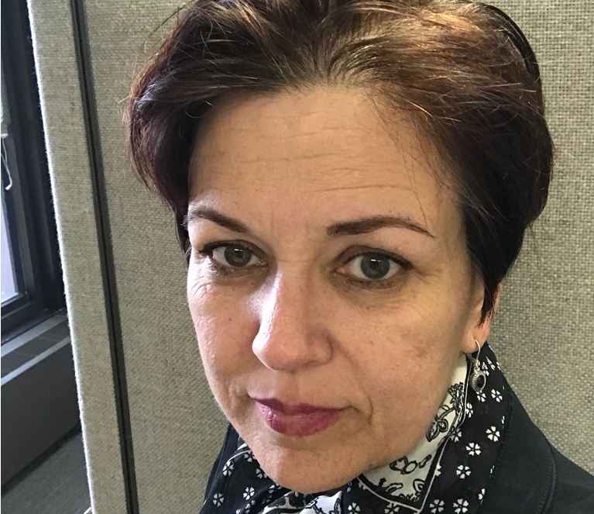
Susan Worden
  Program Analyst
    USDOL/ETA/OTAA
    worden.susan@dol.gov

Slide 5
Amanda Poirier
  Regional TAA & TRA Lead
    Boston Regional Office
    poirier.amanda@dol.gov

Slide 6
POLLING QUESTION: WORD CLOUD
In one or two words, what is your biggest challenge for implementing and maintaining successful case management?
Examples:
  Enrolling-participants
  Keeping-participants
  Coordinating services

Slide 7
Overview of Case Management Principles
Best Practices
Q and A: What works in your state?

Slide 8
Why Case Management Matters?
The Data Says So
It’s the Heart of Our Work
Thoughts from the Monitors

Slide 9
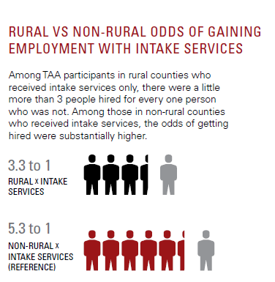
The Data: 2016 Evaluation
Intake services: Employment and case management only once, at intake

Slide 10
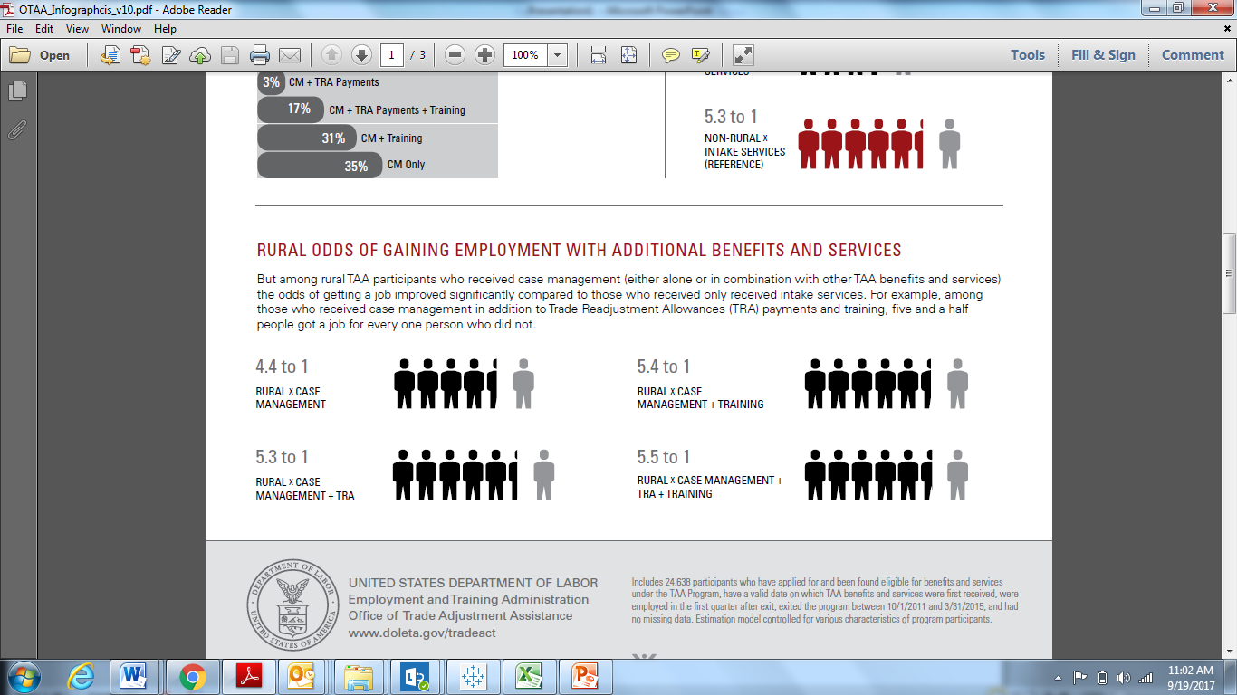
2016 Evaluation

Slide 11
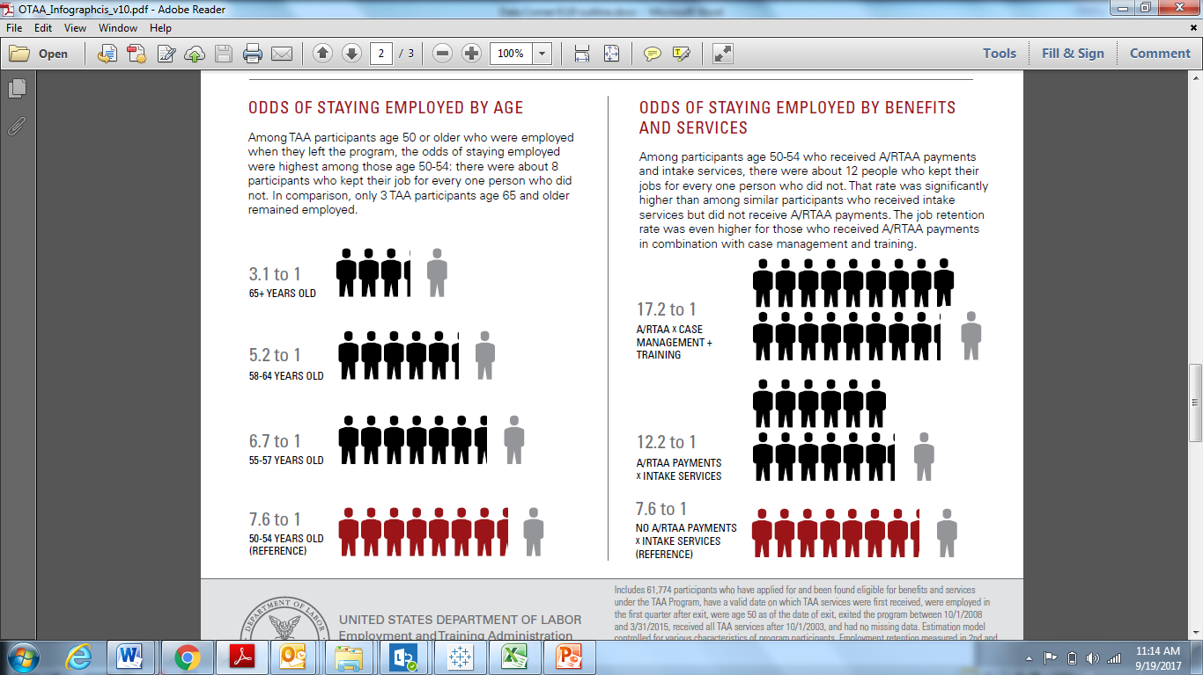
2016 Evaluation

Slide 12
What is
Case Management?
The Basics
Thoughts from the Monitors

Slide 13
The Basics
TEGL 5-15, Change 1 notes eight case management services that must be made available to AAW and AAIWs:
  Assessment of skills and services needs
  Development of an IEP
  Information on training available, what training is suitable, and how to apply for training
  Access and referrals to financial aid
  Short-term prevocational services
  Career planning
  Provision of LMI
  Information and referrals to supportive services

Slide 14
Evaluating the 6 Criteria for TAA Training Approval
No suitable employment is available.
You would benefit from appropriate training.
There is a reasonable expectation of employment following completion of training.
Training is reasonably available.
You are qualified to undertake and complete such training.
Training is available at a reasonable cost

Slide 15
Post Training Approval
Benchmark check-ins
Refer back to IEP, as appropriate, and or modify/revise IEP
Follow-up is required if co-enrolled with Title I (good practice if not co-enrolled)
Help with resume, interviewing, and or work with business services, job club support to help secure employment
Referrals to AJC or partner agencies

Slide 16
Special Notes
Case management is never really over
Employment search is continuous – don’t have to wait until training is over!

Slide 17
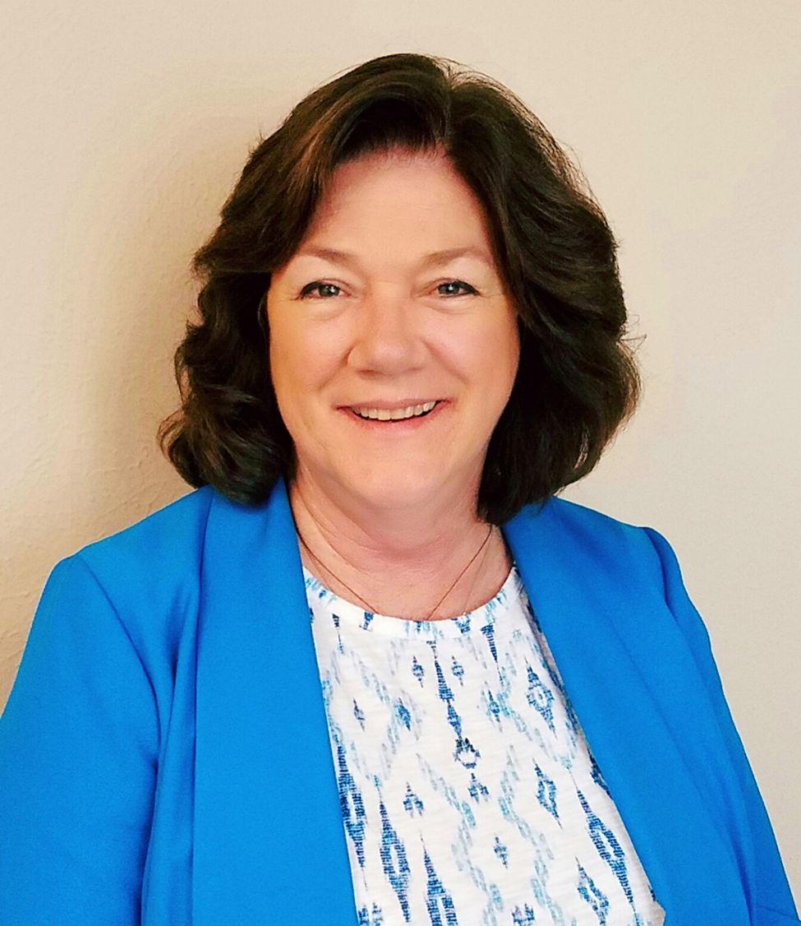

Kathy McDonald
  Regional TAA & TRA Lead
    Dallas Regional Office
    mcdonald.kathryn.j@dol.gov
Jason Hudson
  Regional TAA & TRA Lead
    Chicago Regional Office
    hudson.jason.m@dol.gov

Slide 18
Thoughts from the monitors.
It’s how AAWs and AAIWs get reemployed
It tells a story: If it wasn’t documented, did it happen?
It’s not a one-size fits all; there is no check box for it!
It’s continuous and hard work!
There are systems to help (electronic, policies/procedures, trainings)

Slide 19

Stephen Duval
  Chief, Division of Workforce Investment
    Philadelphia Regional Office
    duval.stephen@dol.gov

Slide 20
It’s the Heart of Our Work
A Story from Region 2
It proves that ETA’s investment worked
It ensures customers don’t fall through the cracks
It provides opportunity to those that have lost their jobs (and careers’ work)
Ensure that the participant understands all the services that are available to help the participant succeed

Slide 21

Rachel Floyd-Nelson
  Regional TAA Lead
    Atlanta Regional Office
    floyd-nelson.rachel@dol.gov

Slide 22
What is “Good” Case Management?
“Good, Better, Best…”
Thoughts from the Monitors

Slide 23
Components of Good Case Management
Tells a Story
Early Intervention/ Prompt Notification (Outreach) of Services
Leverages and Uses Case Management Systems
Triage/ Common Intake of Customers
Includes training
Includes Policies and Procedures (widely available)
Uses the 6 Criteria (not just a check box!) and the benchmarks as an opportunity
Includes follow-ups and referrals
It’s continuous and evolving

Slide 24
State Best Practices
The Real Deal

Slide 25
State Presentations –
Ideas for Discussion
  States to discuss:
    How do you help the counselors to provide case management to customers?
    How are case managers trained? How often?
    How do you communicate and work with partner programs for the participant’s benefit?
    What tools are used for case management?
    How do states monitor the local staff around case management?
    How is case management money leveraged to support the case management of clients?

Slide 26
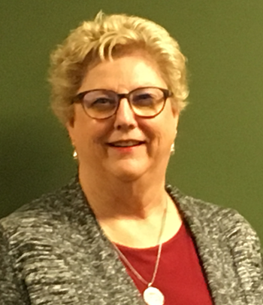
Robin Wright
  TAA State Coordinator
    Tennessee Department of Labor and Workforce Development
    robin.v.wright@tn.gov

Slide 27
Case Management in Tennessee
TAA is a part of Tennessee’s Combined State Plan
Staff and Provider Training – Conferences, Regionals, Webinars, conference calls

Slide 28

Natalie Knudson
  Senior Business Analyst
    Utah Department of Workforce Services
    nkudson@utah.gov

Slide 29

Utah
Build foundation of skills
  Coaching and Motivational Interviewing
  Executive functioning

Slide 30
Utah
Implementation Science (IS)
  Define change
  Plan change
  Implement with supervisors and support staff
  Implement with all staff
  Track performance and outcomes

Slide 31


Sheila Bouloubassis
  TAA State Coordinator
    Maryland Department of Labor
    sheila.bouloubassis@maryland.gov
Vicki Zimmerlee
  Job Service Specialist/Trade Supervisor
    Baltimore County AJC
    vicki.zimmerlee@maryland.gov

Slide 32
How Maryland Monitors the Case Management of our Local Staff

Slide 33
Methods for Monitoring
Maryland uses several methods to ensure proper case management is occurring in the local areas.
  Formal review by the Monitoring and Compliance Unit from the Central office
  Random reports/data checks in our Maryland Workforce Exchange
  Results of PIRL TAADI Self Check feature
  Questions that are generated by the staff in the field

Slide 34
Our Process
During the onsite review, the Monitor will:
  Review the file in its entirety
  Identify findings and areas of concern
  Look for best practices and program successes
  Generate a written report
  Report reviewed by Trade Program manager

Slide 35
Action Taken
Report is sent to the local Labor Exchange Administrator (LEA) and AJC Supervisor
LEA is given 30 days to address any findings or areas of concern
Responses to findings are sent back to the Trade Program Manager
Trade Program Manager or designee will verify any corrective actions that may be required

Slide 36
Results and Training
During this time, the Trade Program Manager or Coordinator will:
  Schedule time to meet with local Trade Staff to provide a complete training on the Trade Program
  Provide technical assistance on areas of concern
  Conduct quarterly Trade training for all Trade staff
    Technical Assistance
    Best Practices
    New information or changes regarding Trade
    Share results of PIRL TAADI performance measures

Slide 37
Example of Best Practices
Local area in Baltimore County
  By approx. 2,000 trade-impacted steel workers
  Communication with the Central Office
  Improvement of overall case management and data element validation and monitoring reports

Slide 38
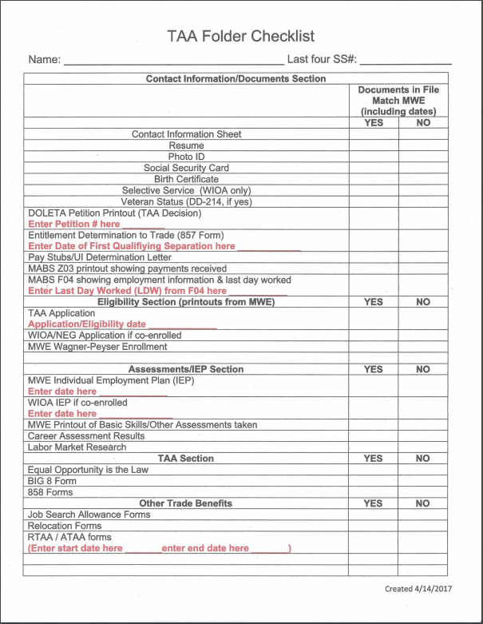
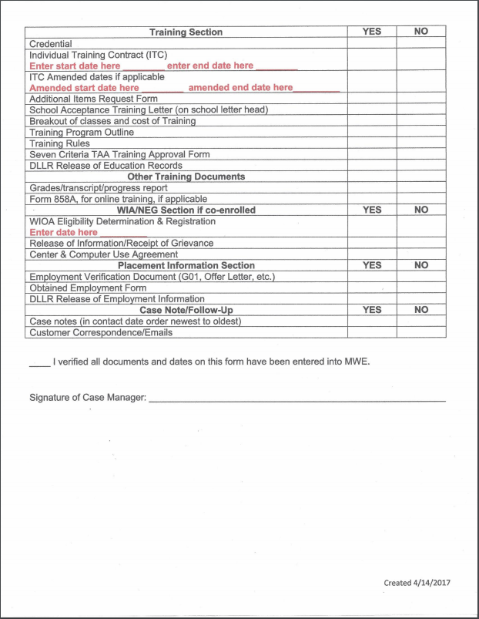

Slide 39
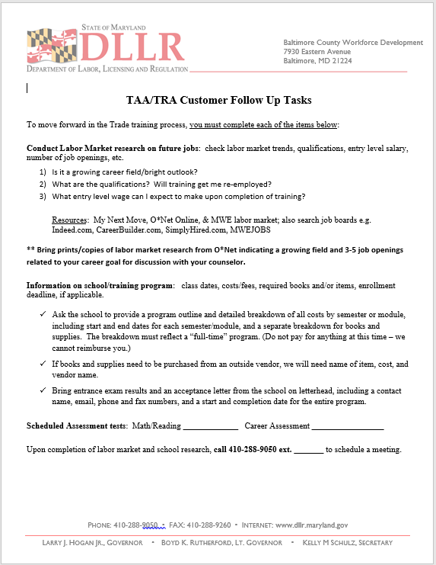

Slide 40
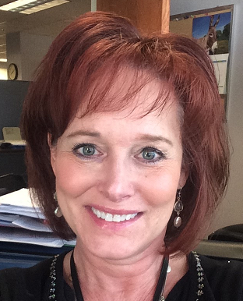
Susan Standen
  TAA/TRA State Coordinator
    Arizona Department of Economic Security
    sstanden@azdes.gov

Slide 41

Case Management Based on Lean Principles

Slide 42
Lean Management Background
Arizona Management System – results driven management system that focuses on delivering customer value and vital mission outcomes for our program participants
Based on the principles of Lean Management; requires every state employee at every level to reflect daily on performance, while always seeking a better way
Employees are empowered to make data driven decisions and use a common problem solving process, which affords them greater creativity and control while expanding their capacity to do more good for the individuals we serve

Slide 43
Arizona TAA Case Management Overhaul
Determined the need to examine Case Management practices based on:
Implementation of a TAA Scorecard
  Weekly reporting of TAA case statuses on shared drive / monthly roll-up of statewide activity
    Helped in developing metrics to track TAA participation and progress on all levels
      Discovered a low number of in-person contacts
      Individuals were staying in Job Search status for extended periods of time
Participants could easily slip through the cracks

Slide 44
How could we increase staff/customer engagement for better outcomes?
Develop better tracking of TAA participants
Counselors to play a more active role in getting the TAA participants in their caseload back into suitable work, as quickly as possible
Counselors participate in determining new TAA business practices

Slide 45
Lean Components
Adapted For Case Management
Standardized Work
Visual Process Adherence – Flow Boards
Problem Solving

Slide 46
I. TAA Standard Works
Current least waste method of carrying out normal business activities
Step-by-step instructions necessary for Counselors to complete a task
Establishes consistency across the state
In the absence of a Counselor, allows another staff person to assist with various program functions by following the Standard Works

Slide 47
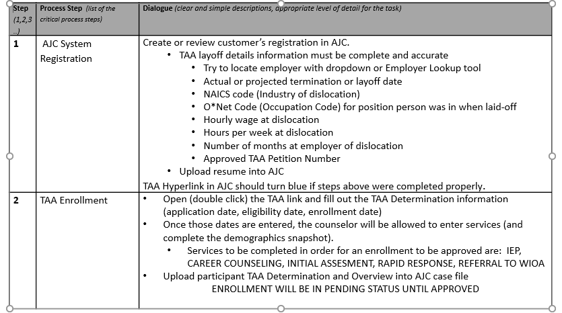
Standard Work
Process Name – TAA Enrollment Date/Version – 09/12/18
Purpose – To detail the process for enrolling an individual in the TAA program via the Arizona Job Connection (AJC) computer system

Slide 48
Counselor Testimonials:
I am thoroughly enjoying the standard works because they let me know exactly what the TAA supervisor is looking for and the tasks required to submit something for approval; no additional clarification is needed.
(Judy V., TAA Counselor)
Having the Standard Works with the clear and descriptive steps to follow for the TAA benefits has made my job easier, so I am able to complete what is needed…and know I did it correctly.
(Julie T., TAA Counselor)

Slide 49
II. Visual Management = Flow Boards
Visual indicators enable a quick, informed assessment of how a process is performing
Creates a visual flow of the services and status of all TAA participants
Personalized by each Counselor based on a Standard Work developed with team consensus

Slide 50
Flow Boards for TAA Case Management
Wall chart categorized by TAA Service currently receiving, and the targeted industry of the employment goal
  Job Search – 3 columns designating length of time in activity: 30, 60 or 90 days
  In Training
  RTAA
A proxy card (Yellow sticky note) is created for each new participant, to include: participant’s first name, last initial, participant ID number, date enrolled, job goal, date current activity is to be completed and the training enrollment/TRA deadline date:
    Bill S. Part ID: 123456
    Date enrolled: 5/25/18
    Job goal: Dental Hygienist
    30 day: 6/24/18
    60 day: 7/24/18
    90 day: 8/23/18
    TRA Deadline Date:7/21/18

Slide 51
Flow Board Operation:
Job Search: proxy card shall be placed on the flow board in the row (designated by industry) appropriate for the type of work the participant is seeking.
  During the first 30 days of job search, the proxy card is placed in the 30-day column. Once the 30-day follow-up is completed, the proxy card is moved to the 60-day column, etc. (if reach 90 day follow-up and still not employed, re-visit IEP to determine different course of action)
In Training: once a participant enters training, the proxy card will be moved from the Job Search column to the In Training column. Create a new card with the following:
  Client First name and last initial
  Part ID
  Training start and end date
  Status of TRA, if applicable
  **All individuals receiving TRA are designated by a blue proxy card for ease of tracking
RTAA: once eligibility for RTAA is confirmed, the proxy card will be moved to the RTAA column. Create a new proxy card in GREEN that includes
  Client first name and last initial
  Part ID
  RTAA eligibility period

Slide 52
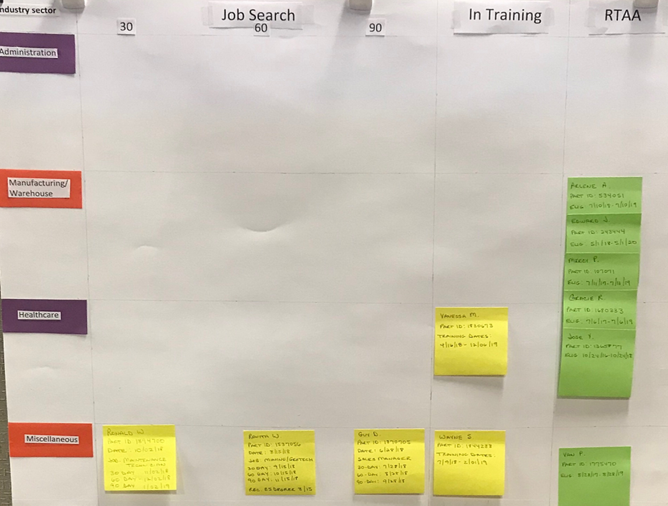

Slide 53
Examples of Flow Boards:

Slide 54
Counselor Testimonials:
I feel the flow board is an efficient tool that I use daily to visually manage my customers, helping them move thru the process from job search to employment or if they need training to help them become reemployed. At a glance, I can visually see their progress and issues.
(Julie T., TAA Counselor)
The flow board is a good, quick glance of my case load. I do imagine if management were to stop by my cubicle and see my flow board, they could get a glimpse of my daily work.
(Judy V., TAA Counselor)

Slide 55
III. Lean Management Technique:
Problem Solving
Through Lean Management Principles, we have learned:
Problems are Treasures – they require we take a step back and examine what is, or is not happening; what do we think should be happening?
Problem Solving is Everyone’s Job – Involves all levels of staff to evaluate the problem and determine a possible resolution
  Staff engagement!

Slide 56
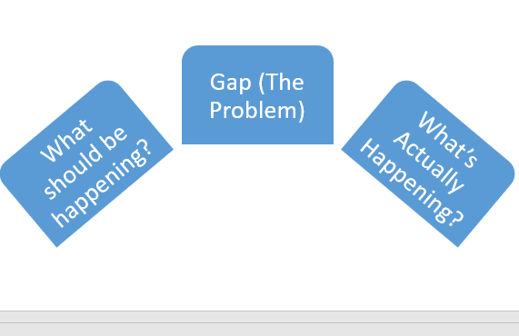
Evaluate the Problem:

Slide 57
Problem Solving Process:
“Continuous improvement is better than delayed perfection.” Mark Twain
Define the Problem:
What should be happening?
What is really happening?
2) Causes:
Explore the potential causes
Brainstorm (why or why not is something happening?)
3) Countermeasures:
Explore countermeasures (How can we eliminate or at least mitigate the cause?)
Consider impact & effort, urgency & priority

Slide 58
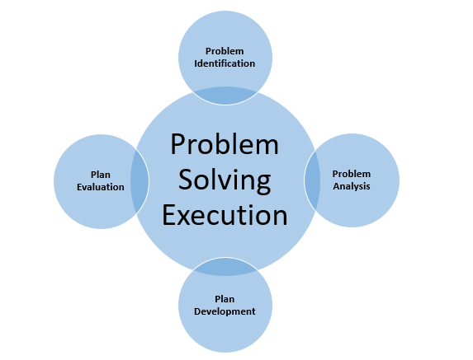

Slide 59
Problem: Low number of TAA eligible individuals are returning their applications
What should be happening?
What could be the cause?
Should be receiving more TAA applications, resulting in more individuals enrolling and participating in the TAA program
Case loads should be higher
What is actually happening?
Very few applications are being returned
Number of inquiries has substantially dropped
Individuals are finding employment
Misunderstanding or lack of trust about the program / benefits
TAA application was revised; the phone number to call with inquiries was hidden in too much verbiage
Issue with the mail?
TAA missed out on Rapid Response session

Slide 60
Problem Resolution
Possible Countermeasures:
Counselors can conduct outreach to those individuals who did not return their applications
Examine TAA packet sent to potential TAA applicants
  Intimidating?
  Too wordy?
  Too much information?
  Is the application easy to understand and complete?
Create an e-mail account as an alternative for returning a completed application
Try to increase Rapid Response participation
Resolution Execution:
Create an Outreach Standard Work
Revise TAA Packet/Application to a more “user friendly” format
After 6 month trial, evaluate what we learn from the outreach project and adjust, if necessary

Slide 61
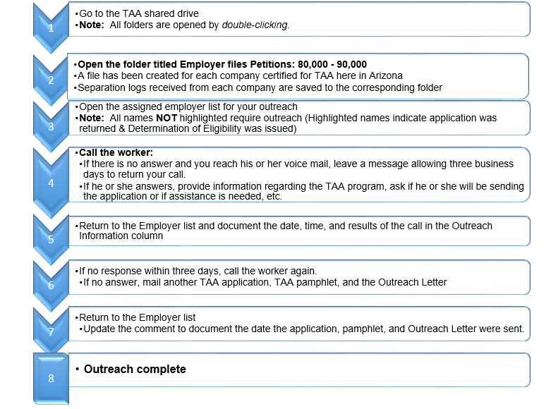
Standard Work – Outreach when TAA Application Has Not Been Returned

Slide 62
Recap of State Presentation
Stakeholder involvement & training
  Vendors, local staff, etc.
Importance of personal connections
  Outreach, coaching
Regular monitoring of local staff activities
Tools & Strategies
  Implementation Science
  Lean Management
  Problem Solving
  Checklists
  Standard Works
  Flow Boards

Slide 63
And Still There’s More
The Good News!

Slide 64
The Good News!
There’s money to support case management
5 percent is the minimum that can be used to support case management
Some examples of how to leverage case management to support continuous improvement:
  Invest in case management systems
  Invest in current Trade and AJC staff
  Invest in new staff

Slide 65
Questions and Answers

Slide 66
USITC-Related Petitions for TAA Program
  Learn how USITC decisions relate to TAA, and understand the differences between USITC-related petitions and other petition types.
    December 18, 2018
Reporting “Efforts to Improve Outcomes” in PIRL for the TAA Program
  Learn how to write high-quality narratives for “Efforts to Improve Outcomes” in PIRL, what information to include, and what not to include.
    January 24, 2019

Slide 67
Practices from the Field for Improving Case Management Webinar
    https://strategies.workforcegps.org/resources/2014/08/11/16/32/practices-from-the-field-for-improving-case-management-and-increasing-workforce-system-integration-iaddress.com
Practices from the Field for Improving Case Management Policy Paper
    https://wdr.doleta.gov/research/FullText_Documents/ETAOP_2013_12.pdf
Effective Case Management Brief
    https://www.mathematica-mpr.com/-/media/publications/pdfs/labor/case_management_brief.pdf

Slide 69
Susan Worden
  Program Analyst
    DOL/ETA/OTAA
      Worden.Susan@dol.gov
        202.693.9998
Amanda Poirier
  Regional TAA & TRA Lead
    Boston Regional Office
      Poirier.Amanda@dol.gov
        617.788.0124
Tim Theberge
  Senior Policy Analyst
  DOL/ETA/OTAA
      Theberge.Timothy@dol.gov
        978.566.1859

