Slide 2


GRANT MANAGEMENT ESSENTIALS
December 11, 2018

Slide 3

    Susanna Troxler
    Workforce Analyst
    Office of Workforce Investment
    Older Workers Unit

Slide 4

Debbie Strama
Supervisor Grant Management Policy
Office of Management and Administrative Services
Office of Grants Management
Avery Malone
Closeout Resolution Specialist (Grant Officer)
Office of Management and Administrative Services
Office of Grants Management

Slide 5
Subject matter experts will provide an essential overview of several key federal grant and financial management topics. You will gain a better understanding of DOL’s financial and grants management processes and your responsibilities as federal grantees.
At the end of the training, you will have a better understanding of the following:
  How to apply the different financial and grant management requirements applicable to your grant
  Standards for Financial and Program Management
  Financial Reporting using the ETA-9130
  Procurement Standards
  Match Requirements
  Subrecipient Management and Oversight
  Discover how to prepare for closeout
  Learn about the elements of the grant closeout package
  Learn about common issues which can delay closeout

Slide 6
Who is Responsible for Financial Management?
Senior Executives/Managers
All Employees
Middle Managers
Funders
Accountants

Slide 7
1
Financial Grants Management
for
SCSEP Grant Recipients & Subrecipients
Office of Grants Management

Slide 8
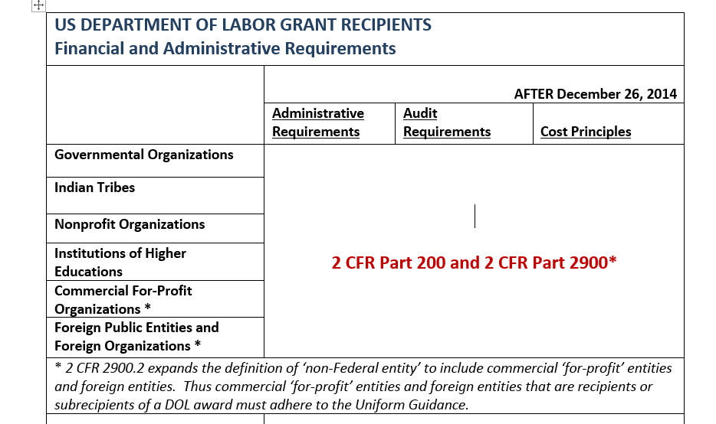
Applicability
2 CFR 200 and 2 CFR Part 2900 may be found at www.ecfr.gov.

Slide 9
Authorization vs. Appropriation
Authorizing legislation such as the Older Americans Act of 1965 through Public Law (P.L.) 89–73 and amended on April 19, 2016 through P.L. 114–144 or WIOA P.L. 113 -128 establishes policies and funding limits for programs and agencies.
Appropriations legislation gives Departments authority to obligate and expend federal funds related to the program authorizations. Appropriations can further restrict the purpose, time, and amount of the program authorizations.
  Through the Anti-Deficiency Act, Departments are prohibited from overobligating or overspending an appropriation.

Slide 10
DOL Exceptions
The Department of Labor’s (DOL) adoption of the Office of Management and Budget (OMB) Guidance in the Uniform Administrative Requirements, Cost Principles, and Audit Requirements for Federal Awards is found at 2 CFR 2900.
  except to the extent that an agency can demonstrate that any conflicting agency requirements are required by statute or regulations, or consistent with longstanding practice and approved by OMB.
    22 exceptions were approved for DOL

Slide 11
Non-Federal Entity
Only applicable to DOL grants
  Non-Federal Entity (NFE): Defined in 2 CFR 2900.2 as a State, local government, Indian tribe, institution of higher education (IHE), for-profit entity, foreign public entity, foreign organization or nonprofit organization that carries out a Federal award as a recipient or subrecipient.

Slide 12
Pass Through Entity & Subrecipient
    Pass-Through Entity (PTE):
      a non-Federal entity that provides a subaward to a subrecipient to carry out part of a Federal award.
      2 CFR 200.74
    Subrecipient:
      a non-Federal entity that receives a subaward from a pass-through entity to carry out part of a Federal program, but does not include an individual that is a beneficiary of a such program. 2 CFR 200.93

Slide 14
Standards for Financial and
Program Management

Slide 15
Standards for Financial and Program Management
200.300 Statutory and national policy requirements
200.301 Performance measurement
200.302 Financial management
200.303 Internal controls
200.304 Bonds
200.305 Payment
200.306 Cost sharing or matching
200.307 Program income
200.308 Revision of budget and program plans
200.309 Period of performance.

Slide 16
Financial Management Systems
Must adhere to 7 separate standards
  Financial Reporting
  Accounting Records
  Internal Controls
  Budget Controls
  Allowable Costs
  Source Documentation
  Cash Management

Slide 17
Are You Ready To Implement The SCSEP Grant?
Is your staff trained on the program objectives and grant requirements?
Do you have policies and procedures in place to properly track performance and spending?
Are your MIS and accounting systems to reflect the FOA and Uniform Guidance requirements?
Look to the Checklist Handout – Uniform Guidance Quick Start Action Planner (QSAP)

Slide 18
Standards for Financial and Program Management (2)
200.300 Statutory and national policy requirements
  All Federal awards must be expended and in compliance with U.S. statutory and public policies
    FFATA, salary limits, SAM, whistleblower protection and more
200.301 Performance measurement
  Require performance metrics/goals to improve program outcomes and use cost effective practices

Slide 19
Standards for Financial and Program Management (3)
200.302 Financial systems must provide:
  Identification of all Federal cash receipts and expenditures
    By CFDA title and number, grant number, year and name of entity awarding the funds
    By obligations, unobligated balances, assets, income and interest
    Accurate, current, and complete disclosure including accruals
  Comparison of expenditures to budgets and performance
  Written procedures for payments and allowablilty of costs
  States continue to follow their laws in expending federal awards

Slide 20
Internal Controls & Payments
200.303 Internal controls
  Must establish adequate internal controls using sound management practices that may include:
    Standards for Internal Control in the Federal Government (Green Book) or “Internal Control – Integrated Framework (COSO)”
200.304 Bonds - No change
200.305 Payments
  Incorporates IPERA improper payments requirements
  Remittance of interest income of $500 annually
  DOL Exceptions 2900.6 and 2900.7
    Impose restrictions on advances depending on specific conditions
    Requires liquidation of existing advances before new request

Slide 21
Standards for Financial and Program Management (4)
200.306 Cost sharing or matching
  Higher standards for documentation
  Must be verifiable through adequate records
  2900.8 DOL exceptions requires that contributions/funds received for match purposes must be expended on program purposes.
200.307 Program income
  Addition method required for ETA grants (Deduction is default in Uniform Guidance)

Slide 22
Budget and Program Plans and Period of Performance
200.308 Revision of budget and program plans
  If Federal award is over the Simplified Acquisition Threshold, prior approval is needed for any cumulative change of 10% of the total budget
  2 CFR 2900.9-12 - DOL Exceptions
    No blanket approval
    Submission 30 days before effective date
    Must be writing
    Only approving official is the Grant Officer
200.309 Period of performance

Slide 24
Financial Reporting

Slide 25
What is a 9130?
A versatile pre-main amplifier
ETA Financial Report
Quarterly Narrative Progress Report

Slide 26
Financial Reporting Quarterly ETA-9130
2 CFR 2900.14 - DOL exception
    ETA requires accrual reporting using the ETA-9130
Reports are due 45 calendar days after quarter end
A FINAL 9130 is due 45 calendar days after the end of the grant’s POP (expiration)
A CLOSEOUT 9130 is due 90 calendar days after grant’s expiration

Slide 27
Financial Report - ETA-9130 (K) SCSEP Changes
Updates the instructions for the following reporting fields:
  Administration – Headquarters
  Administration – Local
  Other Enrollee Expenditures

Slide 28
What is the cost limitation for Administrative Cost?
11.5%
10.0%
13.5%
15.0%
I don’t know
There isn’t any

Slide 29
Administrative Costs
SCSEP Definition -- 20 CFR 641.856 & .859
  Not related to direct services
    Either to clients or employers
List of specific functions
  Unlike traditional definitions
Limitation is 13.5% (in grant agreement)
Measured at conclusion of grant period

Slide 30

Financial reporting website
For line-by-line directions on how to complete quarterly financial reports, please refer to the applicable program/fund stream’s instructions at: https://www.doleta.gov/grants/financial_reporting.cfm
For additional information, you may also refer to TEGL 02-16, Updated ETA-9130 Financial Report, Instructions, and Additional Guidance.

Slide 31
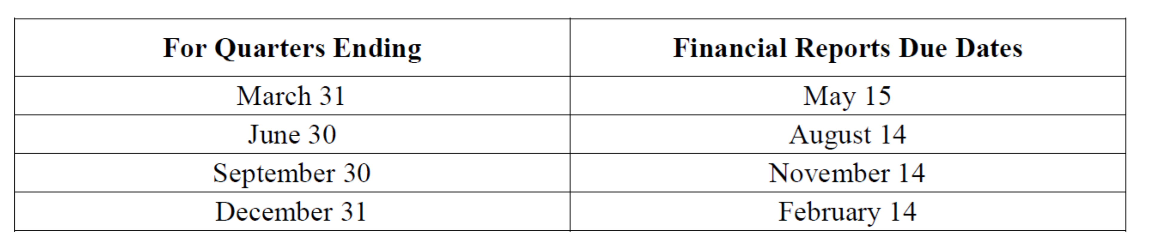
Financial Reporting Deadlines

Slide 32
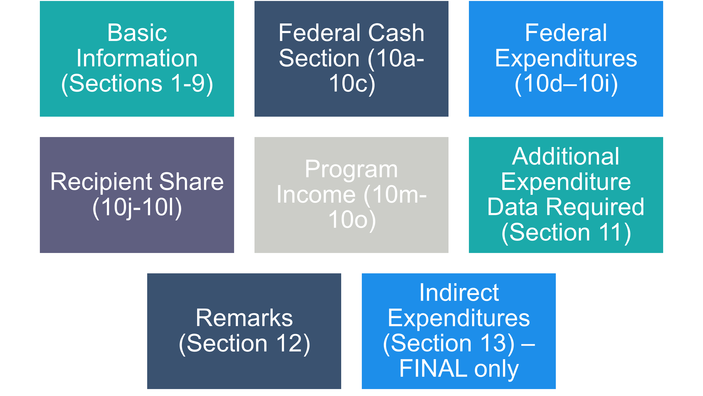
ETA-9130 Report

Slide 33
Cost Sharing or Match
RECIPIENT SHARE
  Section updated to reflect DOL’s exception to the Uniform Guidance at 2 CFR 2900.8 Cost Sharing or Matching.
Report matching funds when EXPENDED.

Slide 34
Expenditures and Obligations
Accruals
  Accruals (according to GAAP): matching principles.
  Amount owed for good and/or service received or rendered
  Line 10e = Cash outlays + accruals
Obligations
  Obligations (2 CFR 200.71): orders placed for property and services, contracts and subawards made, and similar transactions during a given period that require payment by the non-Federal entity during the same or a future period.
  Reported on line 10g

Slide 35
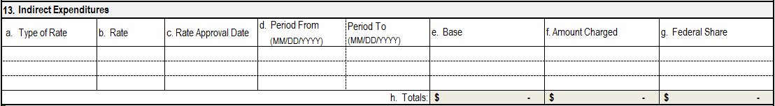
New Section - Indirect Costs
Indirect cost reporting line items have been added.
Indirect cost expenses are only to be reported by the non-federal entity receiving direct awards from DOL.
Indirect cost expenses are only reported annually.

Slide 36
Accounting Records & Source Documentation
    Accounting Records
    Must demonstrate the ability to maintain records that adequately identify the source and application of funds for approved financial activities aligned with the FOA and grant agreement.
The General Ledger is the official books where all transactions are posted and this information is transferred to ETA’s Quarterly ETA-9130 Report.
Source Documentation
Accounting records and payments must be supported by documentation such as actual invoices, canceled checks, time and attendance records, reimbursement to employers for OJT, eligibility for stipends, justification for needs-related payments.

Slide 37
PROCUREMENT STANDARDS

Slide 38
Procurement Standards
200.317 to 200.326
  New or expanded items
    Micro-purchases
    Conflict of Interest
    Simplified acquisition threshold
    Consultants
States continue to follow state standards
  Subrecipients of states follow the Uniform Guidance standards

Slide 39
Contractual Provisions
200.326 Contract provisions
All contracts made must contain 10 possible contractual provisions at Appendix II
  Simplified acquisition threshold determines which provisions are applicable
  December 19, 2014 Federal Register
    Contractual provisions from H to K are reordered and the Energy Policy and Conservation Act (42 U.S. 6201) is removed

Slide 41
MATCH REQUIREMENTS

Slide 42
What is a Match?
Match is an instrument used to spark a fire
Match is the non-federal share of costs that grantees are required to contribute
Match is the dating website
Match is a contest which people or teams compete against each other
All of the above

Slide 43
  What is Match?
  2 CFR 200.29
Cost-Sharing or Matching
  The portion of project costs that are not paid from Federal funds (unless authorized by Federal statute)
  See also 2 CFR 200.306
  Spent to support grant activities and grant objectives
  When required by statute, or in the Funding Opportunity Announcement (FOA), as a condition of funding
  Must be spent on allowable grant activities

Slide 44
SCSEP Match Requirements
At least 10% non-Federal funds
Except…. can not require match as a condition of a:
  Subrecipient or host agencies agreement (20 CFR 641.809(e))
    Can volunteer or offer
  502(e) grants, disasters, or distressed areas

Slide 45
Basic Criteria for Match (cont.)
Costs that are not allowable to a grant cannot be used to fulfill a match requirement.
  Like Federal costs, match must met ALL seven factors for allowable grant costs under 2 CFR 200.403(a-g):
    Necessary and reasonable
    Conform to any limitations or exclusions
    Consistent with policies and procedures
    Consistent treatment
    In accordance with GAAP
    Not included as a cost or used to meet cost-sharing or matching of any other Federally–financed program
    Adequately documented

Slide 46
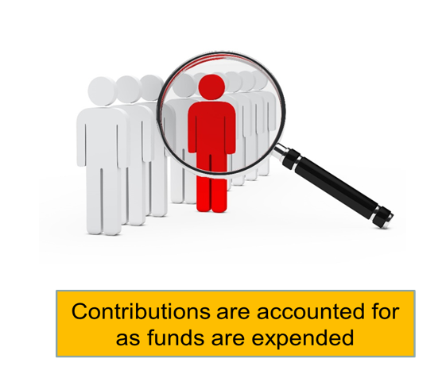
Basic Criteria for Match?
DOL exception 2 CFR 2900.8

Slide 47
Two Types of Match
Non-Federal Cash Expenditures:
  Funds or services provided and paid for by direct grant recipient or subrecipient non-Federal funds.
  Payment for services or goods that are allowable under the grant.
  Can include 3rd party cash contributions to the direct grant recipient and spent on allowable costs.
In-Kind Contributions:
  Products, space, or service provided by the direct grant recipient, subrecipient, or 3rd party and not funded by Federal funds.
  These contributions allow the grant to achieve its objectives.

Slide 48
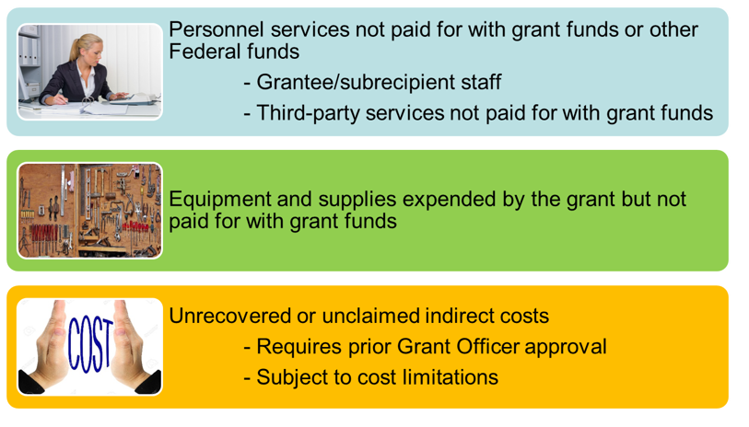
Match Examples

Slide 49
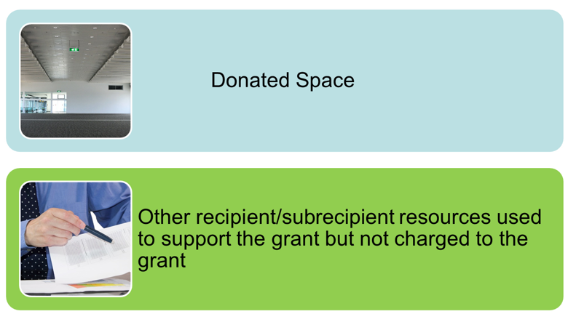
Match Examples (cont.)

Slide 50
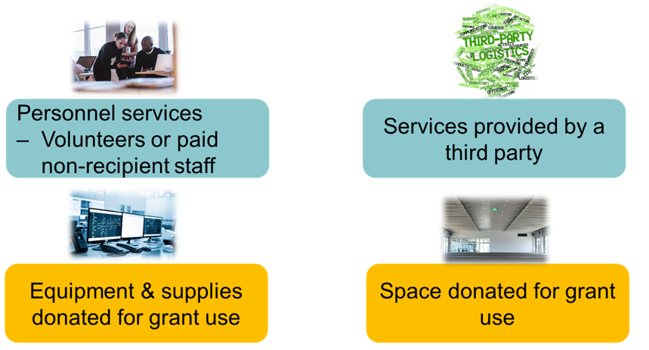
In-Kind Contribution Examples

Slide 51
Valuation Standards for Match
2 CFR 200.306 & 200.434
Uniform Guidance narrowed and strengthened valuation standards.
Donated real and personal property, supplies, etc:
  Fair market value at the time of the donation
  Appraisal required for donated buildings and space use

Slide 52
Valuation Standards for Match cont.
Donated services
  Integral and necessary part the grant/ project
  Rate consistent with those paid for similar work
  Same documentation as regular personnel services
Non-profits: if value of donated series material and supported by indirect costs, donated service must receive allocable share of indirect costs

Slide 53
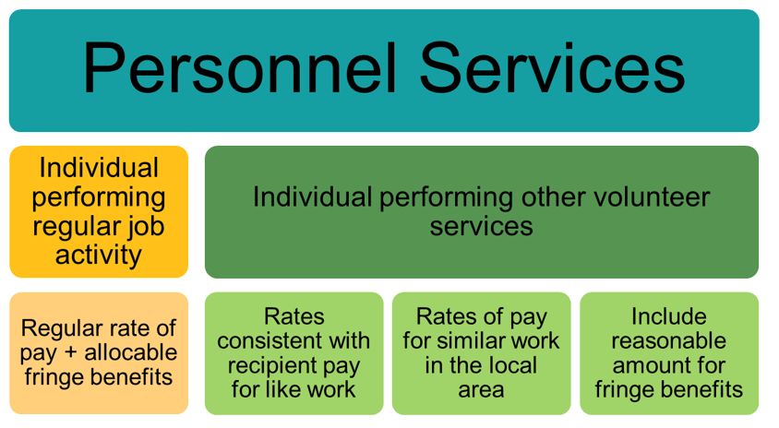
Valuation of In-Kind

Slide 54
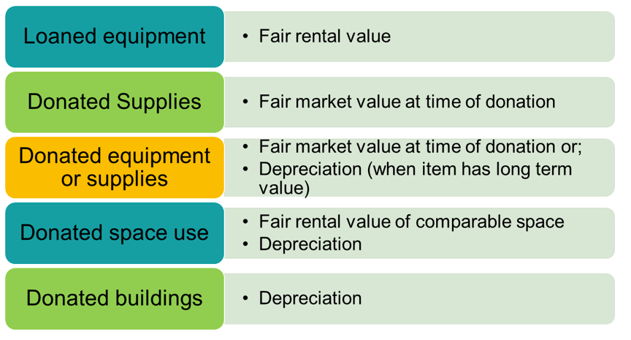
Valuation of In-Kind cont.

Slide 55
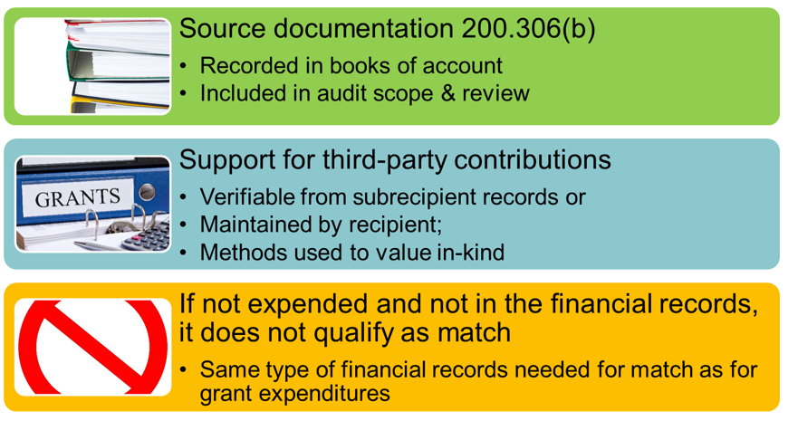
Documentation

Slide 56
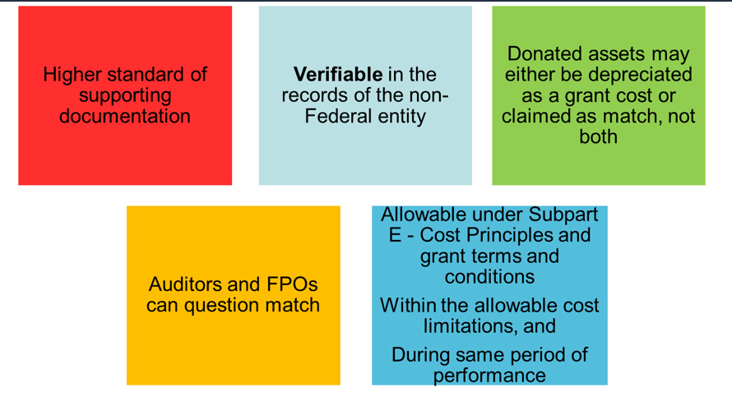
Summary Uniform Guidance Provisions

Slide 58
Subrecipient Management

Slide 59
Subrecipient Monitoring and Management
Ensure subawards appropriately identified
  Identify financial and performance reporting requirements
  Establish a system/platform to ensure timely receipt of financial and performance data.
Specifies required information for each award
  Includes Federal Award Identification Number (FAIN) and DUNS numbers
  CFDA Number and dollar amount of each
Evaluate risk of non-compliance
Monitor subaward activities
  Specified actions
Verify audit coverage as required

Slide 60
Selection of Subrecipients
Evaluate risk of non-compliance when awarding to a subrecipient (2 CFR 200.331(b)):
  Prior experience with same or similar activities
  Past Performance
  New personnel or new systems
  Results of Federal agency
  Monitoring and results of previous audits
Other factors to consider: qualifications of staff, timeliness and accuracy of past reports.
Selecting a responsible subrecipient(s) will mitigate potential risk of non-compliance.

Slide 61
Oversight and Monitoring
Grantee’s responsibilities of subrecipients
  2 CFR 200.331(d) – Monitor the activities of the subrecipient as necessary to ensure that the subaward is used for authorized purposes, in compliance with Federal statutes, regulations, and the terms and conditions of the subaward; and that subaward performance goals are achieved.

Slide 62
Subrecipient Management
IF THEY FAIL, YOU FAIL
  No entity receives a “pass” on accountability.
  Funds to subrecipients are provided to meet the pass-through entity’s program and performance objectives.
  Pass-through entity is as accountable as if it were providing the service itself.

Slide 63
How Can Staff Help In Effectively Managing Their SCSEP Grant?
SUMMARY
Share & Coordinate
  Share statement of work with project manager and subrecipients. Coordinate collection and submission of program and fiscal reports between program and fiscal staff
Periodic status checks
  Provide regular updates to program staff on meeting performance goals, budgets, modifications, deadlines, and cost allocation processes
Establish an open line of communication
  Maintain an open dialogue with FPO

Slide 64
Need More Training
WORKFORCEGPS.org
  Community of Practice (COP)
  Grants Application and Management
Uniform Guidance Training Modules Such As:
  Financial Reporting
  Subrecipient management and oversight
  Indirect cost rates
  Policies and Procedures
  Procurement and Performance Based Contracts
  Capital assets and more
https://grantsapplicationandmanagement.workforcegps.org/

Slide 65

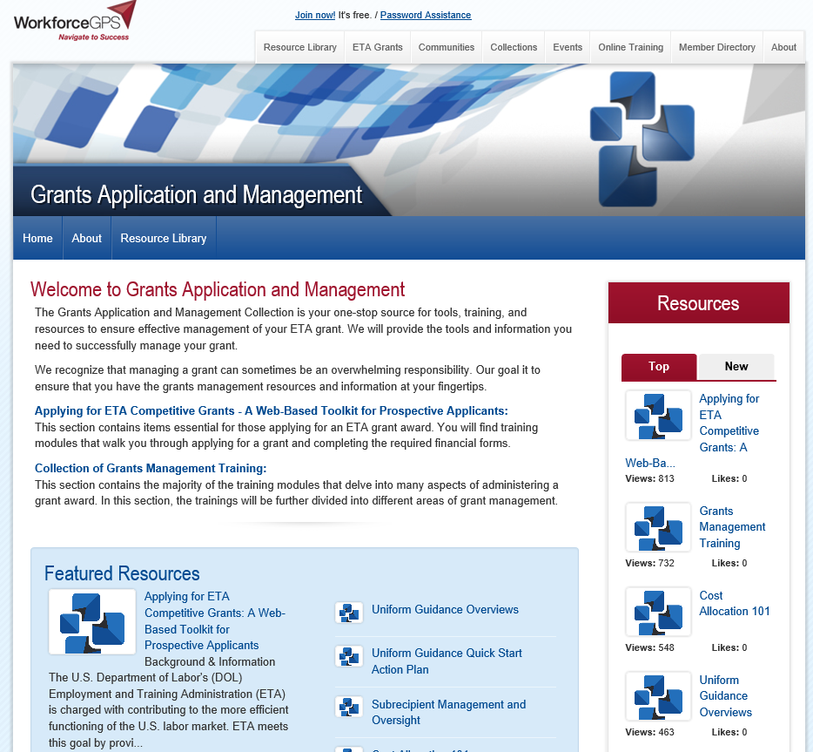
WorkforceGPS
https://grantsapplicationandmanagement.workforcegps.org/

Slide 67
Debbie Strama
Supervisor Grant Management Policy
Office of Management and Administrative Services
Office of Grants Management
Strama.Deborah@dol.gov

Slide 68
Are you aware there is a grant closeout process?
Not sure – but I will after this session
Yes- I am very aware of the closeout process
No – never knew there was such a thing
I thought it meant there was a closeout sale at the end of each program year

Slide 69
2
GRANTS CLOSEOUT PROCESS
FOR SCSEP GRANT RECIPIENTS
Division of Policy Review and Resolution
ETA Office of Grants Management

Slide 70
What is Grant Closeout?
The completion of the grant life cycle
The official end of the government’s relationship with the grantee
2 CFR 200.343: Closeout
2 CFR 200.344: Post-closeout adjustment
2 CFR 200.345: Collection of Amounts Due
2 CFR 2900.15 and 2 CFR 2900.17
Post Federal Award Requirements

Slide 71
Who We Are
Office of Grants Management
  Division of Policy, Review and Resolution
  Latonya Torrence, Division Chief
  Policy Unit
  Debbie Strama, Supervisor + 3 Specialists
  Closeout Unit
  Meron Assefa, Grant Officer + 7 Resolution Specialists
  Audit Unit
  Ana Mulero, Grant Officer + 5 Resolution Specialists

Slide 72
Preparing for Closeout
We track anticipated workload one year out
Not less than quarterly, Office of Information System & Technology (OIST) runs a report that identifies grants whose period of performance end date is approaching
The OIST report is then compared against information identified in the E-Grants Closeout System
Not Less than 7 days prior to POP end date – Closeout specialist sends out initial closeout notification letter to grantee

Slide 73
Closeout Begins
Within 45 days after period of performance (PoP) end date - Grantee must submit final 9130 for last quarter. Checks box 6 as “Final.”
Approx. 70-75 days after PoP end date – Specialist sends follow up reminder to grantee to submit all documents.
Grantee must submit all remaining closeout documentation - No later than 90 calendar days after the end date of PoP
    2 CFR 200.343
    Grantee may not direct charge staff time to work on closeout of grant after PoP end date.

Slide 74
Closeout Continues
91+ days after POP end – Compliance and reconciliation
All grants should be closed within 1 year of expiration (DLMS-2 Chapter 800)
Under new Uniform Guidance (UG), awards must be closed within one year of receipt and acceptance of all required final reports
Grants Oversight and New Efficiency Act (GONE Act) (Public Law 114-117) requires agencies to report federal grant awards which have not yet been closeout for the period of performance has elapsed for more than two years.

Slide 75
Closeout Deadline
June 30, 2018 – Grant expires, closeout begins.
August 14, 2018 – Final quarterly 9130 due.
September 30, 2018 – Closeout 9130 and remaining closeout documents due. Last day to draw down funds without permission from closeout unit.

Slide 76
Initial Notification Letter
Dear Grantee,
This email is to notify you that your grant number AB222441460A0 with the Employment and Training Administration (ETA) will expire/expired on 06/30/17.
If you agreed with the expiration, as specified at 2 CFR 200.343, 2 CFR 2900.15, 29 CFR 97.40(b)(1), 97.41(b)(1), 97.50(b), you are required to submit electronically all the closeout forms in your specified closeout package in the Grant Closeout System (GCS) no later than 90 days from the expiration date.
NOTE: After you have completed the final expenditure report(s) Form 9130, you must certify the
closeout financial report(s) as well. The Grant Closeout System (GCS) is accessed via the following URL:
http://www.etareports.doleta.gov/grant_closeout.cfm
Please enter the password assigned to you for your financial reporting to log into your Financial Reporting System home page, and then click on the Grant Closeout System menu on this page to
go to the GCS system.
You will receive the Grant Closeout System End User's manual in another email shortly. Please use
the End User's Manual and the Closeout Instructions posted in the Grant Closeout System to assist you in doing your closeout reporting.
Inquiries should be directed to the Resolution Specialist.

Slide 77
End User Manual
Dear Grantee,
Please find the Grant Closeout System (GCS) End User’s Manual in the attachment and use it to assist you in doing your closeout reporting in the GCS system. the URL for GCS system is:
  https://www.doleta.gov/grants/grant_closeout.cfm
Inquiries should be directed to the Resolution Specialist.

Slide 78
Elements of the Grant Closeout Package
Documents to be submitted:
  Final Quarter 9130 and Closeout 9130
  Grantee’s Detailed Statement of Costs
  Grantee’s Release
  Government Property Inventory Certification
    Inventory List
    NICRA & breakdown
  Grantee’s Assignment of Refunds, Rebates and Credits
  Grantee’s Close-out Tax Certification

Slide 79
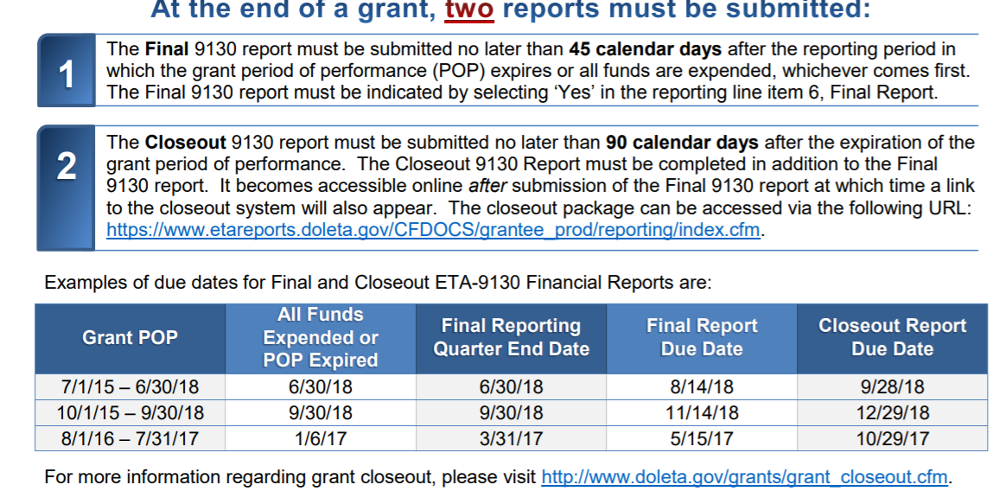
ETA-9130 Forms: Final & Closeout

Slide 80
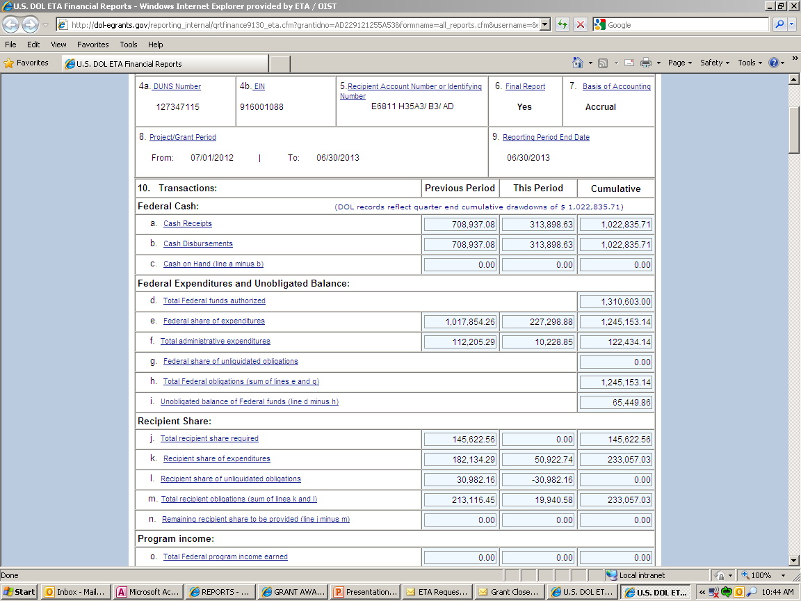
Final Quarterly 9130

Slide 81
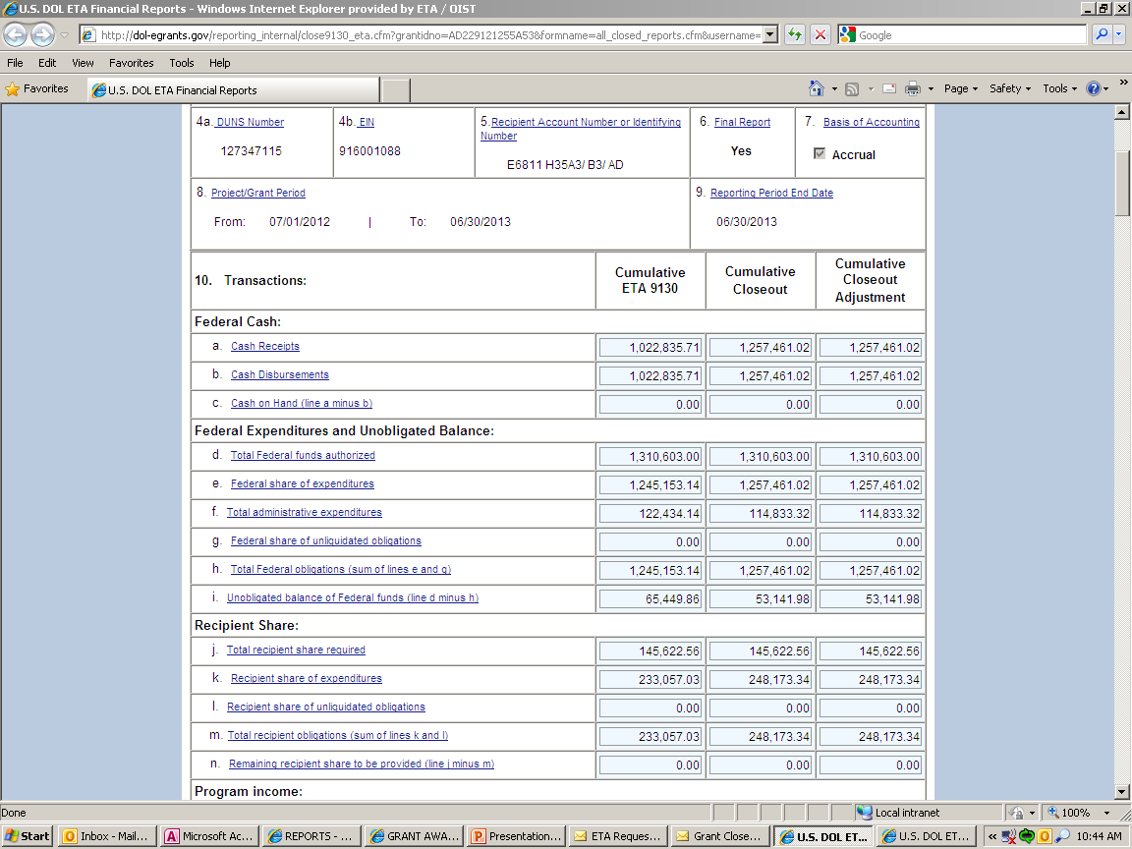
Closeout 9130 Financial Report

Slide 82
Final vs Closeout ETA 9130 Forms
2 separate reports
FINAL is due 45 calendar days after the reporting period in which the grant’s POP expires
  Or all funds are expended, whichever comes first
  Marked “Yes” in line item 6 of the final report
CLOSEOUT is due no later than 90 calendar days after the expiration of POP
  Accessible online after final 9130 is submitted
  Closeout unit in National Office reviews docs

Slide 83
Final Quarterly 9130 | Closeout 9130

Slide 85
Indirect Costs
Indirect cost reporting line items have been added.
Indirect cost expenses are only to be reported by the non-federal entity receiving direct awards from DOL.
Indirect cost expenses are reported only on the FINAL ETA-9130 report.

Slide 86
Liquidation of Accrued Expenditures
2 CFR 2900.15
No new obligations may be incurred.
The only liquidation that can occur during closeout is the liquidation of accrued expenditures (NOT obligations) for goods and/or services received during the grant period.
Grant recipients may not direct charge staff time to work on closeout of grant after PoP end date.

Slide 87
Compliance: Drawdowns & Administrative Costs
  There is a 13.5% limitation on administrative costs.

Slide 88
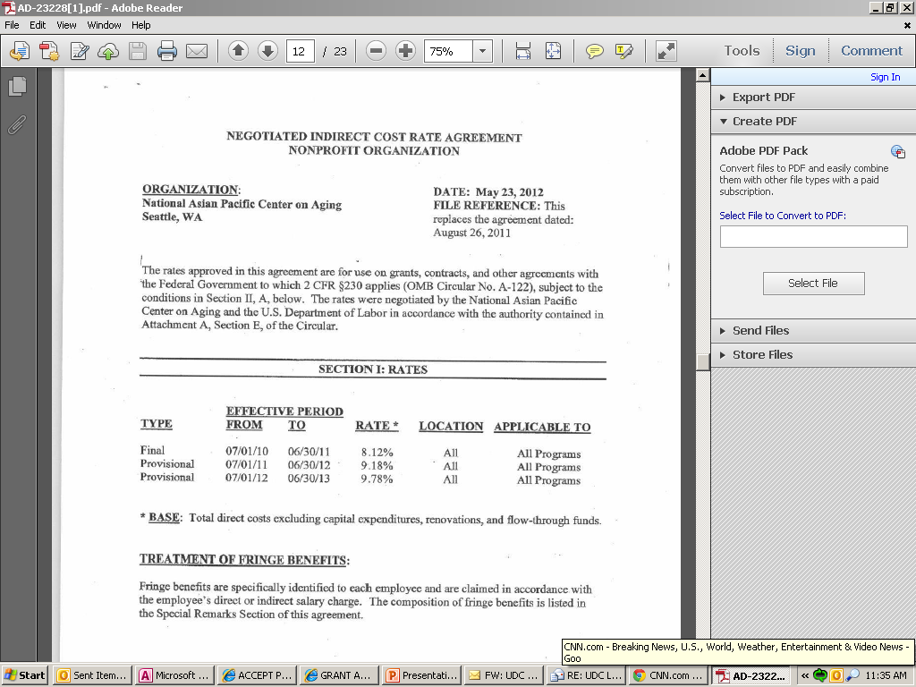
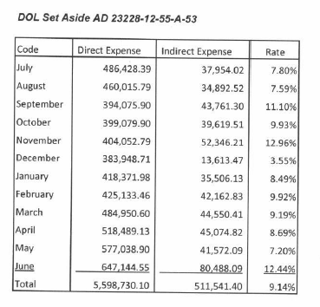
Compliance: Indirect Costs
Have indirect costs been reported on the FINAL 9130?

Slide 89
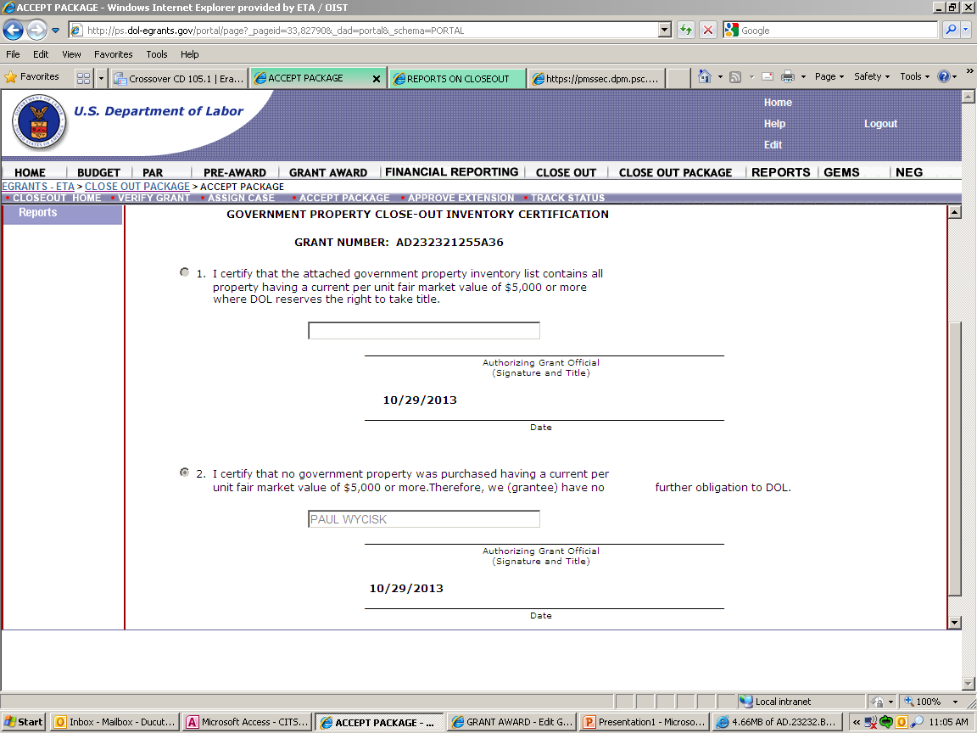
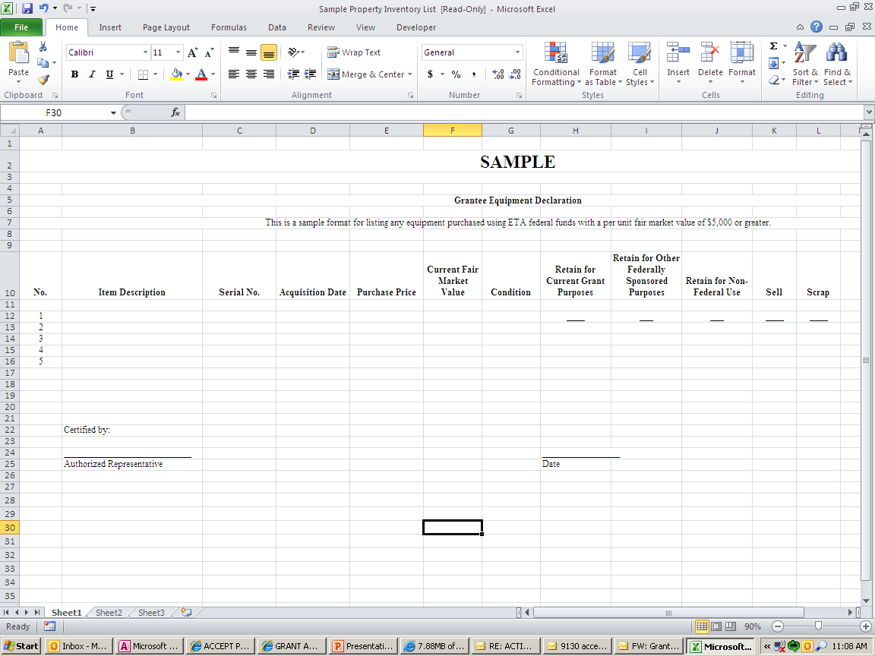
Property Certification Form

Slide 91
Match Requirement
OAA Sec. 502(c)(2)
    Non Federal Share (Match): The non-federal share shall be in cash or in-kind.
If match is not met by the end of the period of performance end date, the unmet match will be disallowed and repay back with non-federal fund
Shortfall may affect future award potential.
Remember that required match must be reported on the ETA 9130 under line 10j (Total recipient share required)
  Match

Slide 92
SCSEP Statutory & Regulation Requirements
OAA Sec. 502(c)(2)
    Non Federal Share (Match): The non-federal share shall be in cash or in-kind.
  OAA Sec. 502(c)(3)
  Administrative Costs: not to exceed 13.5 percent shall be available for any fiscal year to pay the administrative costs
      Sec. 502 (c)(3)(A): the Secretary may increase the amount available to pay the admin. Costs to an amount not to exceed 15 percent of the grant amount if the Secretary determines, based on information submitted by the grantee
  OAA Sec. 502(c)(6)(B)(i) and (ii)
    Use of Funds for Wages & Benefits: Not less than 75 percent of SCSEP funds made available through a grant must be used to pay PWFB.
    Waiver: obtain prior approval to use not less than 65 percent of the grant funds to pay PWFB

Slide 93
Submission Confirmation Letter
From: etareporting.auto-email@dol.gov [mailto:etareporting.auto-email@dol.gov]
Sent: Thursday, February 08, 2018 9:27 AM
To: Mathew, Joe - ETA
Subject: Submission confirmation of Closeout Report
Please do not respond to this message!!!
Closeout Report
Grant Number: AD222441460A0
Has been successfully submitted on 9/30/17 09:26A.M.
And is now certified

Slide 94
Preliminary Settlement Letter
Dear Grantee,
This letter is to notify you that the Department of Labor has closed grant number AD222441460A0 and no further costs may be charged to this agreement. The total amount of allowed Federal cost at the time of close is $21963109.4. At this time, no action is required by your organization. As specified at 29 CFR 95.72, 2 CFR 200.343 and 2 CFR 2900.15, this closeout does not affect:
1) ETA's right to disallow costs and recover funds on the basis of a later audit or other review; or
2) Your obligation to return any funds due to the Federal Government as a result of later refunds, corrections, or other transactions; or
3) Your responsibilities for retention and access requirements, real property and equipment management, and audit requirements, as specified at 2 CFR 200.343, 2 CFR 2900.15 , 29 CFR 95.53, 95.32, and 95.26 respectively.
Inquires regarding this closeout may be directed to the Resolution Specialist.
Sincerely,

Slide 95
Closeout Actions
The grantee must perform the following during closeout:
  Liquidate all accrued expenditures
  Submit all required closeout documents
  Refund any obligated funds/ cash
  Account for all real or personal property

Slide 96
Common Misunderstandings
Expenditure amount higher than drawdown amount.
*They need to match*
Completing the equipment form correctly.
All required forms and documents to be submitted.

Slide 97
Common Issues That Delay Closeout
Non-responsive grantees
Refunds
Equipment disposition
9130 issues
Administrative cost issues
Indirect cost issues
Question and disallowed costs/ID’s and FD’s

Slide 98
Refunds
2 CFR 200.343 (d)
Grant closeout does not affect recipients obligation to return funds due to DOL as a result of refund.
Prompt refund of any balances of unobligated funds.
Refunds may require revising final expenditure report.
Refunds can be submitted electronically through PMS or Pay.Gov

Slide 99
Frequently Asked Questions
Does marking “Yes” on Box 6 on the ETA 9130 trigger the closeout process?
Grant ends June 30, 2019, when does the grantee need to submit the final 9130 and the Closeout 9130?
    August 14, 2019/September 30, 2019
When is the last time I can draw down funds?
    September 30, 2019

Slide 101
Did you learn something new from this session
Yes
No
Not sure, let me think about it

Slide 102
    Avery Malone
    Closeout Resolution Specialist (Grant Officer)
Office of Management and Administrative Services
Office of Grants Management
    Malone.Avery@dol.gov

