Slide 2
Reemployment Services and Eligibility Assessment Grants (RESEA)
January, 2019
FY 2019 Funding Allotments and Operating Guidance

Slide 3
  Gloria Salas-Kos
  Senior Program Analysis
  Office of Policy Development and Research
  ETA/U.S. DOL
Gay Gilbert
  Administrator
  Office of Unemployment Insurance
  ETA/U.S. DOL
  Serena Boyd
  Grant Officer
  Office of Grant Management
  ETA/U.S. DOL
Lawrence Burns
  Reemployment Coordinator
  Office of Unemployment Insurance
  ETA/U.S DOL
  Megan Lizik
  Senior Evaluation Specialist
  Chief Evaluation Office
  U.S. DOL

Slide 4
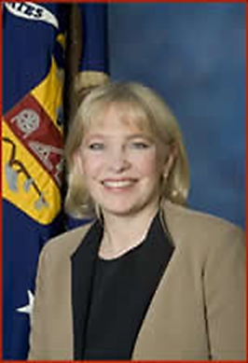
Opening Message
Gay Gilbert
Administrator
Office of Unemployment Insurance
Employment & Training Administration
U.S. Department of Labor

Slide 5
Short Overview of Bipartisan Budget Act of 2018
Walk-Through of FY 2019 RESEA Operating Guidance (UIPL 7-19)
Available Tools and Resources
Introduction to Grants.gov
Q&A

Slide 6
RESEA Legislation
Bipartisan Budget Act of 2018 (BBA)
Social Security Act (SSA), Section 306
Consolidated Appropriations Act of 2018
Department of Defense and Labor, Health, and Human Services, and Education Act, 2019 and Continuing Appropriations Act, 2019

Slide 7
Laws You Should Know
Bipartisan Budget Act of 2018 (BBA) enacted new Section 306 of the Social Security Act (SSA)
  Establishes a permanent authorization for the RESEA program
  Maintains RESEA as a voluntary program
  Requires a tiered-evidence approach
  Phased implementation starting at enactment
  Includes multiple new program requirements

Slide 8
BBA/SSA: New Requirements
Use of evidence-based strategies or required evaluations.
Increased state discretion in participant selection.
Submission and approval of annual RESEA state plan (FY 2020)
Formula allocation of funding and new funding requirements (FY 2021)

Slide 9
Social Security Act (SSA)
Section 306
RESEA Goals
“To improve employment outcomes and reduce benefit duration, or that the intervention or service delivery strategy are being evaluated to determine their effectiveness in achieving these goals.
To strengthen program integrity and reduce improper payments of unemployment compensation.
To promote integration with the vision of the Workforce Innovation and Opportunity Act.
Establish RESEA as an entry point to other workforce system partners

Slide 10
Laws You Should Know
Consolidated Appropriations Act of 2018
  Postponed the immediate implementation of the new RESEA program established by the BBA.
Department of Defense and Labor, Health, and Human Services, and Education Act, 2019 and Continuing Appropriations Act, 2019
  Provides FY 19 Funding
  Clarifies RESEA Eligibility

Slide 11
Funding and
Award Limits
FY 2019 Provides $150 million
  25 percent increase over FY 2018
FY 2019 Funding Caps (UIPL 7-19, Attachment I)
  ATB 25% increase
  New states level based primarily on workload
Beginning in FY 2021- Transition to Formula

Slide 12
Implementation of
Evidence-Based Strategies and Evaluation Requirements
Definitions and Approach
Implementation
Support for States

Slide 13
Evidence-Based Strategies and Evaluation Requirements
General Requirements:
  Funds must only be used for interventions or service delivery strategies demonstrated to reduce the average number of weeks participants receive benefits by improving employment outcomes, including earnings.
Moderate or High Causal Evidence Rating
  Defined by the Secretary of Labor

Slide 14
Evidence-Based Strategies and Evaluation Requirements-Cont.
Evaluations
  Interventions and strategies not backed by evidence (moderate or high causal evidence rating) must be under evaluation while in use.
  Up to 10 percent of a State’s RESEA funds may be used for evaluations.
  States are encouraged to consult with DOL and, when possible, partner with other states to conduct evaluations.

Slide 15
Formula Allocation and Funding Requirements
Beginning in FY 2023 states will be required to use a percentage of their grant funds on evidence-based strategies with high or moderate causal evidence ratings.
This rate will increase over time from 25% to 50%
Fiscal Year | 2023 | 2024 | 2025 | 2026 | 2027
Evidenced- Based | 25% | 25% | 40% | 40% | 50%

Slide 16
Evaluation Resources
Accessible and Easy to Use Evidence and Tools for your Programs

Slide 17
About the RESEA Evaluation
Contract from DOL/CEO to Abt Associates-led team (w/Urban Institute, Capital Research Corporation)
  Working in close collaboration with OUI and OPDR
To provide support to DOL and states on implementing statute. Includes:
  Developing options for evidence standards and building the evidence base
  Describing states’ current RESEA programs
  Providing evaluation technical assistance to states
Period of performance: Sept 2018-Sept 2021

Slide 18

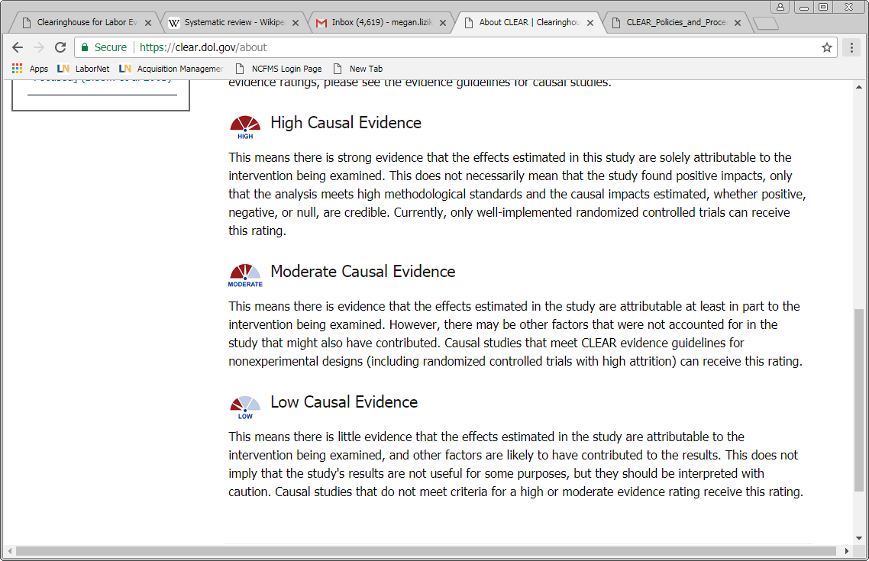
Clearinghouse for Labor Evaluation and Research (CLEAR)
1
CLEAR’s mission: to make research on labor topics more accessible to practitioners, policymakers, researchers, and the public so that it can inform decisions about labor policies and programs
CLEAR does this by conducting systematic evidence reviews of research and evaluation reports on labor topics
  How much research is out there? What does it say? Where are the gaps?
All studies in CLEAR have:
  Profiles with summaries of study design and findings
  Links to original publications
Causal studies are rated based on the strength of the methods used and study quality
Syntheses provide an overall look at the state of the evidence
https://clear.dol.gov/

Slide 19
CLEAR Reemployment Topic Area
Focuses on interventions designed to promote faster reemployment of unemployment insurance (UI) claimants.
CLEAR identified causal research (impact studies) that looked at whether interventions focused on UI claimants reduced their UI benefit receipt, increased their reemployment rate, or improved their longer-term employment and earnings outcomes.
Includes summaries (profiles) of 43 reports of studies published from 1978 to August 2018
Find it: https://clear.dol.gov/topic-area/reemployment#

Slide 20
Other CLEAR Resources
Reemployment Topic Area Synthesis
  Highlights key findings from studies identified through CLEAR’s systematic evidence review
  Provides an overview of the evidence base
  Find it: https://clear.dol.gov/sites/default/files/CLEAR%20Reemployment%20Synthesis%20November%202018.pdf
Reemployment Topic Area Supplement
  Companion to the research synthesis
  Provides a brief description of the findings for all reports reviewed in the reemployment topic area
  Find it: https://clear.dol.gov/sites/default/files/CLEAR%20Reemployment%20Synthesis%20Supplement%20November%202018.pdf
Causal evidence guidelines
  Causal evidence ratings tell you something about the quality of the study, or how confident you should be in study findings
  Can serve as a guidepost for new studies being designed; more on this in future webinars
  Find it: https://clear.dol.gov/sites/default/files/CLEAR_EvidenceGuidelines_V2.1_12312015.pdf

Slide 21
WorkforceGPS Evaluation Tools and Resources
2
Workforce System Strategies
  Research clearinghouse that profiles evidence-based and emerging practices in workforce development
  Resource Library contains more than 1,200 profiles including evaluation reports, policy and practice briefs, and how-to guides
  Find it: https://strategies.workforcegps.org/announcements/2018/05/04/20/17/Connect-Your-Peers-to-Workforce-System-Strategies
Evaluation and Research Hub
  Community point of access to support workforce development professionals in their efforts to
    use evaluations to improve workforce system services and strategies and
    choose evaluations and research to help inform program policies and evidence-based practices
  Find it: https://evalhub.workforcegps.org/about

Slide 22
WIOA Evaluation TA Tools
3
Peer Learning Cohort
  Share ideas and disseminate helpful products that build towards increasing the quantity and quality of research and evaluations of workforce development programs
  Develop tools and resources that increase Workforce Development organizations’ capacity toward these goals
Resources address questions like, “Where and how do we start?”
  Evaluation Readiness Assessment Tool: https://evalhub.workforcegps.org/resources/2018/09/07/19/45/Evaluation-Readiness-Assessment-Tool
  Evaluation Design Assessment Tool: https://evalhub.workforcegps.org/resources/2018/09/07/19/53/Evaluation-Design-Assessment-Tool
  Evidence Says: Work-based Learning: https://evalhub.workforcegps.org/resources/2018/09/07/16/10/The-Evidence-Says-Work-Based-Learning

Slide 23
General Program Requirements
Targeted Populations
Worker Profiling and Reemployment Service Program
Required RESEA Services
General Program Requirements
Performance Reporting

Slide 24
Targeted Claimant Population
1
States may identify target groups from UI claimants.
  No longer limited to WPRS and UCX
Flexibility to target claimants from a variety of backgrounds or lengths of time receiving UI benefits.
Targeted claimant population must be supported by local labor market information, economic trends, and other available data.

Slide 25
Worker Profiling and Reemployment Service Program (WPRS) Considerations
2
WPRS remains a separate stand-alone program authorized under Section 303(j)of the SSA.
Historically states operating RESEA were exempt from WPRS because participants were the same.
States that opt to no longer include a profiling model in RESEA design will be subject to WPRS.

Slide 26
RESEA Required Services
3
Unchanged from FY 2018 (See UIPL 8-18)
UI eligibility assessment, including review of work search activities, and referral to adjudication if an issue or potential issue is identified
Provision of labor market and career information, customized for the claimant
Enrollment in Wagner Peyser Act funded employment services
Support in the development of individual reemployment plan
Provide information and access to AJC services, and referrals to reemployment services and training

Slide 27
General Program Requirements (Caps & Limits)
4
Administrative Cost Cap
  15 percent of total grant award
  Applies definition of WIOA administrative costs at 20 CFR 683.215, excluding 683.215(c)(6)
Evaluation Cap
  10 percent of total grant award
  Report using ETA 9130 comment section
Initial and Subsequent RESEA Cost Limits
  Discontinued in FY 19
  Expected averages: Initial: $155-$175 Subsequent: $80-$100

Slide 28
General Program Requirements
4
Due Process Assurance
  Procedures in place to provide claimants with proper notifications, including consequences of not attending
  Reasonable rescheduling.
Period of Performance
  January 1, 2019- September 30, 2020
  Funds liquidated by December 28, 2020

Slide 29
Performance Reporting
5
Required Reports:
  ETA 9128: Reemployment Services and Eligibility Assessments (RESEA) Workload Report
  ETA 9129: Reemployment Services and Eligibility Assessments (RESEA) Outcome Report
  ETA 9178: Quarterly Narrative Progress Report
9128x and 9129x (UCX specific) will be discontinued
Wagner-Peyser funded Employment Services
  Appropriately document RESEA participants in case management and performance systems.

Slide 30
Application Submission Requirements
Transition to Grants.gov

Slide 31
Application Submission Process
  Applicants registration with the System for Award Management (SAM) must be active before an application can be submitted in Grants.gov.
  Applicants must register with Grants.gov to submit the required application package. https://www.grants.gov/web/grants/applicants/appy-for-grants.html.
  Registration is a one time process, and applicants who already have a Grants.gov account do not need to register again.

Slide 32
Application Submission Process
  To submit, States must
    Go to grants.gov and click on the blue applicants tab
      Scroll to applicant actions/apply for grants and click
      then click on the “Get Application Package” red button on the right
    Or navigate directly to:
    https://www.grants.gov/web/grants/search-grants.html
  DO NOT search through “Find Grants” which is for discretionary awards only
Applications will be received until
February 11, 2019.

Slide 33
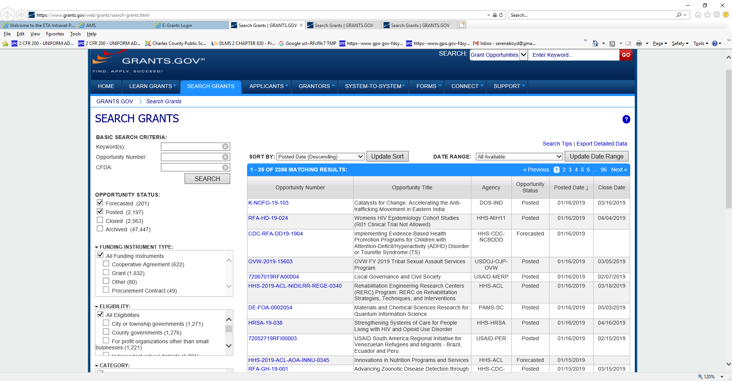
Submitting Application – Grants.gov
To submit the required application package, applicants must:
Select the SEARCH GRANTS tab on the Grants.gov homepage.

Slide 34
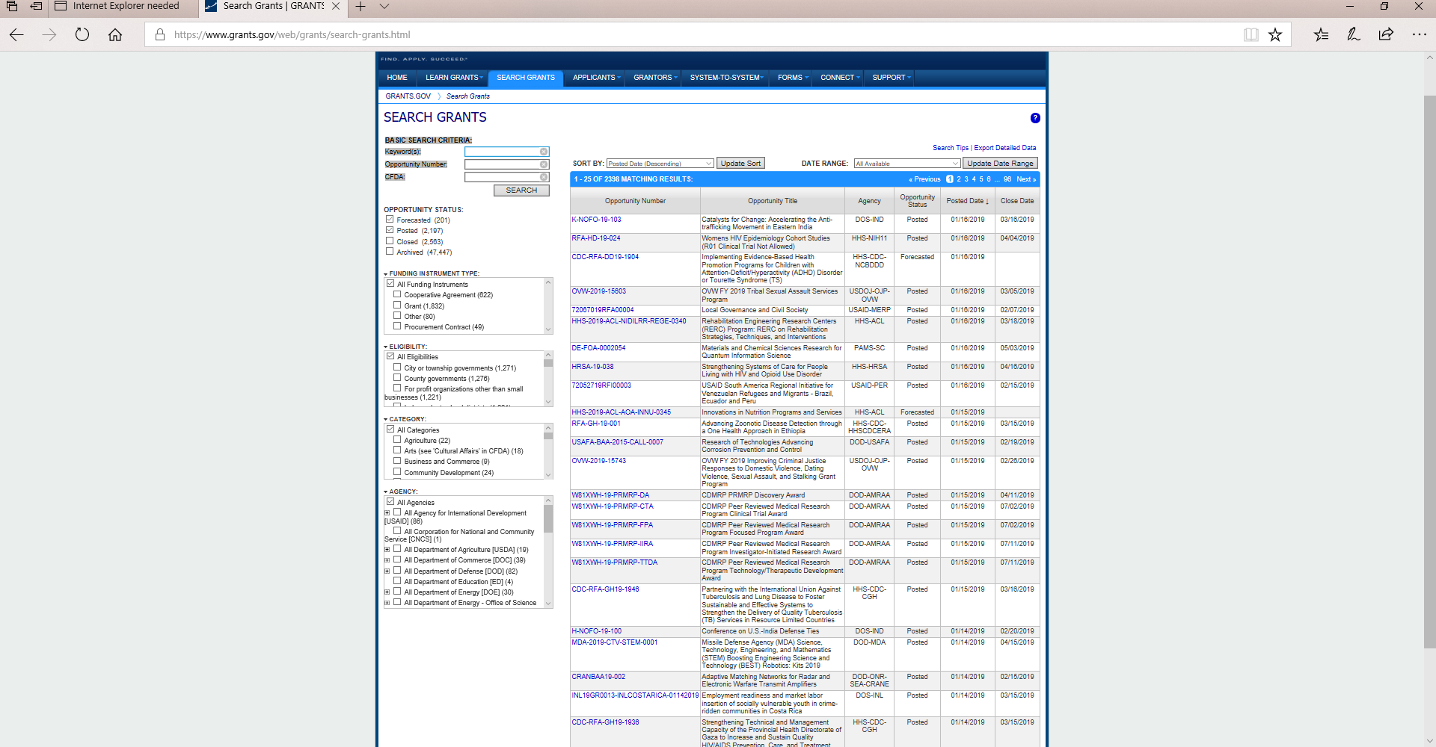
Submitting Application – Grants.Gov
Under the Section, Basic Search Criteria, enter the Funding Opportunity Number: ETA-UIPL-07-19

Slide 35
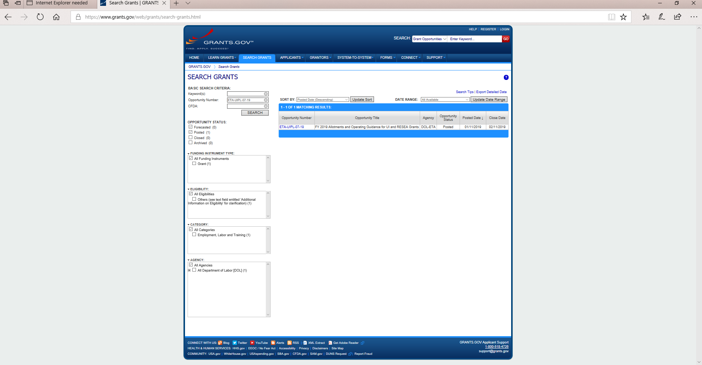
Submitting Application – Grants.Gov
Select the link to the applicable Opportunity Number provided in the search results.

Slide 36
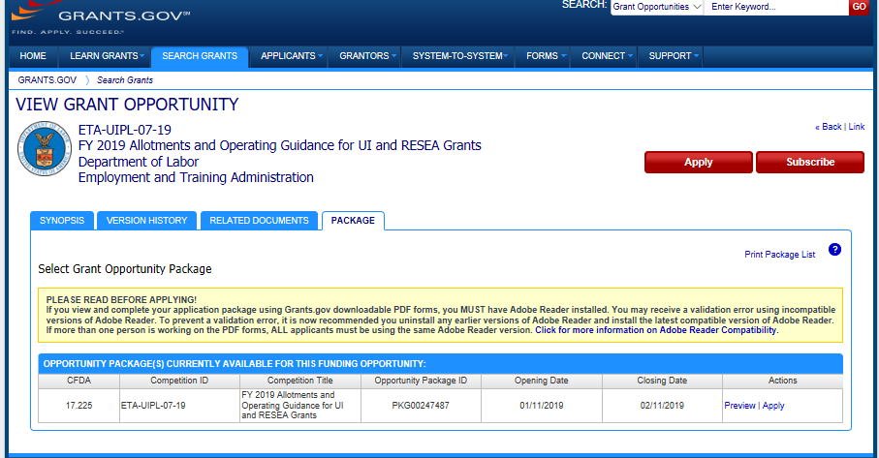
Submitting Application – Grants.Gov
Select the PACKAGE tab.

Slide 37
Submitting Application – Grants.Gov
Under the ACTIONS column (lower right hand column), select APPLY.

Slide 38
Application Requirements
Part I – SF-424 Application for Federal Assistance
OMB No. 4040-0004 – Expiration Date 12/31/2019
Part II – SF-424A
OMB No. 4040-0006 – Expiration Date 01/31/2019
Current Indirect Cost Rate Agreement
Attachment II - Elements of an Unemployment Insurance Reemployment Services and Eligibility Assessment (RESEA) Grant Proposal Summary

Slide 39
SF-424
SF-424: Application for Federal Assistance
  Applicant must supply their Data Universal Numbering System
  (D-U-N-S) on line 8c.
  Include the announcement number ETA-UIPL-07-19 on line 12
  Funding Opportunity Number.
  Provide the ENTIRE award amount on line 18. (See Attachment I)
  Additional guidance for completing the SF424 is provided in Attachments III and IV in the UIPL.

Slide 40
SF424A and Indirect Cost Rate
Project Budget
  SF-424A: Budget Information Form
Indirect Cost Rate
_ Applicants that include indirect costs in the budget must include
either:
(a) The approved indirect cost rate with a copy of a current
Indirect Cost Rate Agreement (NICRA), a description of the
base used to calculate indirect costs along with the amount of
base, and the total indirect costs requested; OR (b) For those
applicants that meet the requirements to use the 10 percent
de minimis rate as described in 2 CFR 200.414(f), a description of
the modified total direct cost base (see 2 CFR 200.68 for definition)
used in the calculation along with the amount of the base, and the
total indirect costs requested based on the based on the 10 percent
de minimis rate.

Slide 41
Attachment II
Attachment II – Elements of an Unemployment Insurance Reemployment Services and Eligibility Assessment (RESEA) Grant Proposal Summary

Slide 42

Grants Management Specialist Contact
:
Chanta Ferrell
Grants Management Specialist
Ferrell.Chanta@dol.gov
(202) 693-3622

Slide 43
Important Dates
RESEA Submissions: Due February 11th via grants.gov
Webinar: Evaluation Information and Resources for RESEA Programs – Tuesday, January 22nd
  Overview of RESEA evaluation
  More on evaluation resources and tools, including the CLEAR evaluation resources and WIOA TA tools
  Deeper dive into the evidence base
  Hearing from you about what you need from the evaluation TA

Slide 44
Opportunities for Public Comment
RESEA State Plan Information Collection Request
Formula Methodology
Performance Measures

Slide 46
Lawrence Burns
  Reemployment Coordinator
    U.S. DOL, Office of Unemployment Insurance
      Burns.Lawrence@dol.gov
Megan E. Lizik
  Senior Evaluation Specialist and Project Officer for RESEA Evaluation
    U.S. DOL, Chief Evaluation Office
      Lizik.megan@dol.gov
Gloria Salas-Kos
  Senior Evaluation Program Analyst
    U.S. DOL, Office of Policy Development and Research
      Salas-Kos.Gloria@dol.gov

