Slide 1



Evaluation Information and Resources for RESEA Programs
January 22, 2019
U.S. Department of Labor – Larry Burns, Megan Lizik, Gloria Salas-Kos
Abt Associates – Andrew Clarkwest and Siobhan Mills De La Rosa

Slide 2
Lawrence Burns
  Reemployment Coordinator
    DOL Office of Unemployment Insurance
Andrew Clarkwest
  RESEA Evaluation Project Director
    Abt Associates
Megan Lizik
  Senior Evaluation Specialist
    DOL Chief Evaluation Office
Siobhan Mills De La Rosa
  RESEA Evaluation Technical Assistance Task Leader
    Abt Associates
Gloria Salas-Kos
  Senior Program Analyst
    DOL Office of Policy Development and Research

Slide 3
What is your level of experience using research and evaluation evidence to help you design or improve your programs?
  Not much – I’m new to this and here to learn!
  Some – I have used evidence like data or information from studies to help inform my work.
  A lot – I regularly use evaluation data or findings from studies to inform my work/decisions. I know where to look for and how to interpret research and evaluations.
  Expert – I always use evaluation findings and evidence reviews from studies to inform my work/decisions. I know where to find evaluation findings and evidence, how to synthesize it, and how to apply it. (Ex. develop statements of work for evaluations, use independent evaluators, make decisions about program strategies and/or policies, share with decision makers)
  Other – Enter your response in the Chat window.

Slide 4
Today’s Agenda
Introductions
About the RESEA Program Evaluation
Background – a quick look at the requirements
Evidence Resources for States
  The current evidence base
  Other evaluation tools and resources
Early Evaluation Technical Assistance

Slide 5
About the RESEA Evaluation
Current Plans and Expectations for States

Slide 6
About the RESEA Evaluation
Contract from DOL/CEO to Abt Associates-led team (w/Urban Institute, Capital Research Corporation)
  Working in close collaboration with OUI and OPDR
To provide support to DOL and states on implementing statute. Includes:
  Developing options for evidence standards and building the evidence base
  Describing states’ current RESEA programs
  Providing evaluation technical assistance to states
Period of performance: Sept 2018-Sept 2021

Slide 7
What Should States Expect?
Implementation study will include:
  Clarifying calls with select states (Dec 2018-Jan 2019);
  Phone interviews with RESEA leadership from 25 states in late spring/early summer 2019;
  Site visits to 10 states in summer 2019; and
  Surveys of all 51 RESEA programs in fall 2019.
Reports and other resources
E-TA/Evaluation Technical Assistance to help:
  Build evaluation capacity
  Understand the evidence base
  Support states’ explorations and implementations of new evaluations
We also want to ask you about your TA needs!

Slide 8
A Quick Look at the Evaluation Requirements
RESEA Outcomes that Demonstrate Impacts

Slide 9
What States Must Do
States need to:
  Select proven interventions, and/or
  Conduct evaluations

Slide 10
What States Must Do
… interventions demonstrated to reduce the number of weeks for which program participants receive unemployment compensation by improving employment outcomes for program participants.
Bipartisan Budget Act of 2018
States need to:
  Select proven interventions, and/or
  Conduct evaluations
That
  Reduce weeks of UI
  Increase employment—when would otherwise be on UI

Slide 11
Crucial Concept is “Impact”
… interventions demonstrated to reduce the number of weeks for which program participants receive unemployment compensation by improving employment outcomes for program participants.
Bipartisan Budget Act of 2018
“Reduce” and “Improv[e]”
Impacts = Are outcomes different than they would have been without the service?
More on “impact”—what it is and how to estimate it—soon

Slide 12
Evidence Resources for States
Where can I find them?
What does that evidence say?

Slide 13

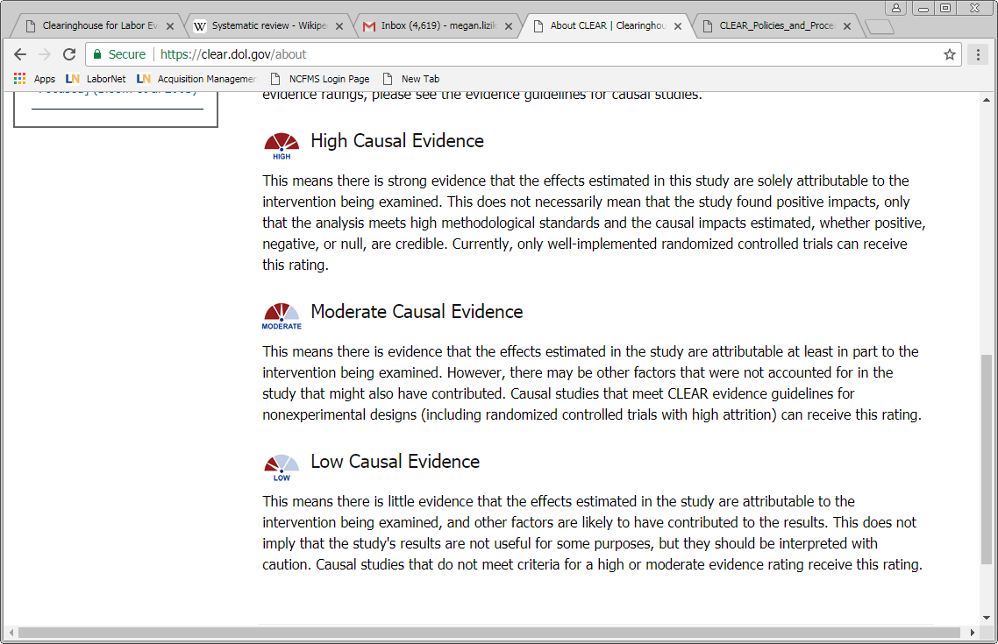
Clearinghouse for Labor Evaluation and Research (CLEAR)
CLEAR’s mission: to make research on labor topics more accessible to practitioners, policymakers, researchers, and the public so that it can inform decisions about labor policies and programs
CLEAR does this by conducting systematic evidence reviews of research and evaluation reports on labor topics
  How much research is out there? What does it say? Where are the gaps?
All studies in CLEAR have:
  Profiles with summaries of study design and findings
  Links to original publications
Causal studies are rated based on the strength of the methods used and study quality
Syntheses provide an overall look at the state of the evidence
https://clear.dol.gov/

Slide 14
CLEAR Reemployment Topic Area
Focuses on interventions designed to promote faster reemployment of unemployment insurance (UI) claimants.
Specifically, includes causal research (impact studies) that examine whether interventions reduced claimants’ their UI benefit receipt, increased their reemployment rate, or improved their longer-term employment and earnings outcomes.
Includes summaries (profiles) of 43 reports of studies published from 1978 to August 2018
  See Appendix for screenshots of how to navigate CLEAR
Find it: https://clear.dol.gov/topic-area/reemployment#

Slide 15
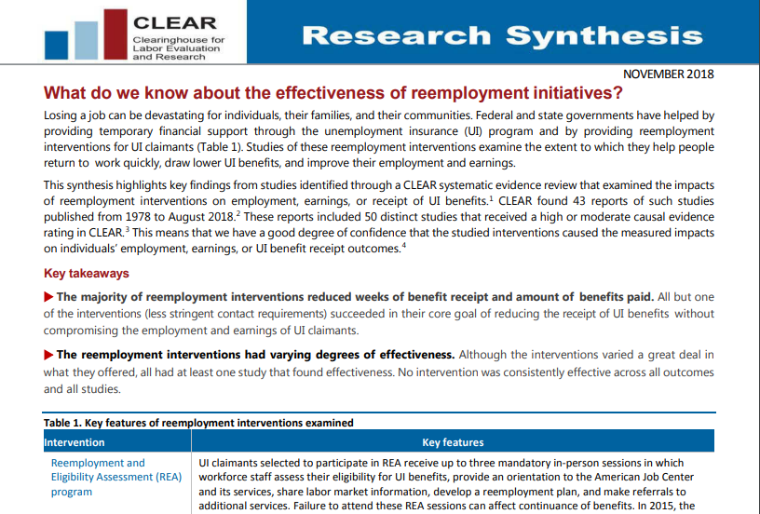
CLEAR’s Reemployment Synthesis
Highlights key findings
from studies identified through CLEAR’s systematic evidence
review
Provides an overview
of the evidence base
Identifies gaps in the research
Find it:
https://clear.dol.gov/sites/default/files/CLEAR%20Reemployment%20Synthesis%20November%202018.pdf

Slide 16
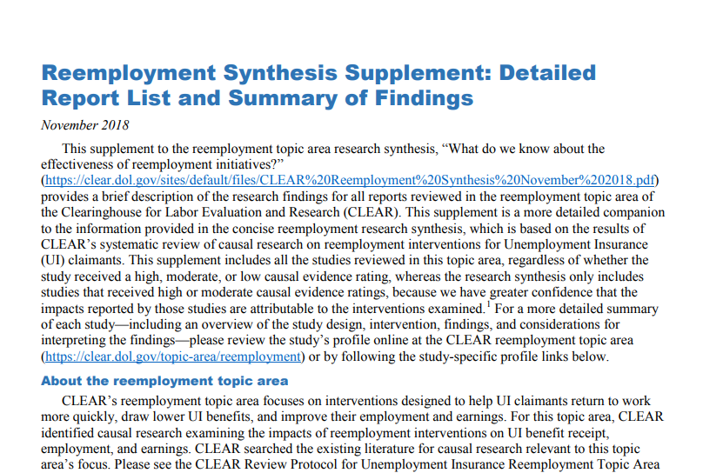
CLEAR’s Reemployment Supplement
Supplement to the research synthesis
Provides a brief description of the findings for all reports reviewed in the reemployment topic area
Links to the study’s profiles where you can learn more
Find it:
https://clear.dol.gov/sites/default/files/CLEAR%20Reemployment%20Synthesis%20Supplement%20November%202018.pdf

Slide 17
Digging in to the evidence base…
CLEAR’s reemployment topic area has reviewed over 50 studies
CLEAR groups the interventions studied into various types
  REA
  Profiling
  More Employer Contacts
  Fewer Employer Contacts
  Job Search Assistance
  Reemployment Bonuses
  Other

Slide 18
Winnowing to Relevant, Strong Studies
Omit studies of interventions using strategies not included in RESEA programs
  REA
  Profiling
  More Employer Contacts
  Fewer Employer Contacts
  Job Search Assistance
  Reemployment Bonuses
  Other
Omit studies CLEAR rates as “low” quality

Slide 19
Focus on Studies Showing Positive Program Impacts
Studies showing positive impacts on both UI and employment
  Nevada REA
  Florida REA
Few studies find employment impacts. Look at those as well:
  Florida WPRS
  Maine WPRS
  Texas JSA

Slide 20
But What Should I Do with those Studies?
Review CLEAR’s profiles of the studies
Consider consulting the full text of the studies
Learn what the programs studied consisted of
  Were they similar to what your state does?
    If yes, that evidence may support your RESEA program’s approach
  Do they involve approaches/elements that might inform changes to your states program?
    If yes, that evidence may support new elements of your RESEA program

Slide 21
Links to Selected Studies
REA/Nevada
  https://clear.dol.gov/study/impact-reemployment-and-eligibility-assessment-initiative-poe-yamagata-et-al-2011-1
REA/Florida
  https://clear.dol.gov/study/impact-reemployment-and-eligibility-assessment-initiative-poe-yamagata-et-al-2011
Profiling/Florida
  https://clear.dol.gov/study/labor-market-effects-us-reemployment-programs-during-great-recession-michaelides-mueser-2016
Profiling/Maine
  https://clear.dol.gov/study/evaluation-worker-profiling-and-reemployment-services-systems-final-report-dickinson-et-al
JSA/Texas
  https://clear.dol.gov/study/back-work-testing-reemployment-services-displaced-workers-bloom-1990

Slide 22
Example – Details of Nevada REA
Date conducted: 2009
Key program elements:
  Integration of REA & RES (provided by the same staff)
  Participants selected within 2-3 weeks of the claim
  Immediate hold placed on “no shows’” claims
RESEA population: First time claimants with no return-to work date or current training participation
Setting:
  State with small population, highly dispersed
  EUC was in effect, reflecting weak labor market

Slide 23
Other Things to Keep in Mind…
Additional studies in CLEAR could be relevant
A study answers questions about whether an intervention worked in a specific context.
A single study’s findings aren’t definitive
More insights about evidence on the effectiveness of interventions will be shared for FY2020.
The evidence base will grow and change in the future as more studies are conducted.

Slide 24
Evaluation Resources for States
What if my state is considering conducting an evaluation of our program? Where can I start?

Slide 25
WorkforceGPS Evaluation Tools and Resources
Workforce System Strategies
  Research clearinghouse that profiles evidence-based and emerging practices in workforce development
  Resource Library contains more than 1,200 profiles including evaluation reports, policy and practice briefs, and how-to guides
  Find it: https://strategies.workforcegps.org/announcements/2018/05/04/20/17/Connect-Your-Peers-to-Workforce-System-Strategies
Evaluation and Research Hub
  Community point of access to support workforce development professionals in their efforts to
    use evaluations to improve workforce system services and strategies and
    choose evaluations and research to help inform program policies and evidence-based practices
  Find it: https://evalhub.workforcegps.org/about

Slide 26
WIOA Evaluation TA Tools
Peer Learning Cohort
  Share ideas and disseminate helpful products that build towards increasing the quantity and quality of research and evaluations of workforce development programs
  Develop tools and resources that increas Workforce Development organizations’ capacity toward these goals
Resources address questions like, “Where and how do we start?”
  Evaluation Readiness Assessment Tool: https://evalhub.workforcegps.org/resources/2018/09/07/19/45/Evaluation-Readiness-Assessment-Tool
  Evaluation Design Assessment Tool: https://evalhub.workforcegps.org/resources/2018/09/07/19/53/Evaluation-Design-Assessment-Tool
  Evidence Says: Work-based Learning: https://evalhub.workforcegps.org/resources/2018/09/07/16/10/The-Evidence-Says-Work-Based-Learning

Slide 27
CLEAR Causal Evidence Guidelines
Causal studies are rated according to the causal evidence guidelines, based on the strength of the methods used
Causal evidence ratings tell you something about the quality of the study, or how confident you should be in study findings
Can serve as a guidepost for new studies being designed; more on this in future webinars
Find it: https://clear.dol.gov/sites/default/files/CLEAR_EvidenceGuidelines_V2.1_12312015.pdf

Slide 28

Evaluation Technical Assistance
What’s next?

Slide 29
Evaluation-TA for States
DOL and the evaluation team will develop technical assistance to help states with the new evaluation requirements
E-TA will include a mix of:
  Written materials (e.g., overviews of evaluation evidence, “Evaluation Toolkits,” etc.)
  Webinars
  State-specific or small group consultations
  (i.e., conference calls)
  Review of state materials (e.g., proposals, design or final reports)
Driven by your RESEA proposals and your TA needs

Slide 30
Potential E-TA topics
Evaluation Capacity Building, such as:
  Evaluation 101/Basic Evaluation Concepts
  Understanding the Evidence Base
  Assessing Program Readiness for Evaluation
  Types of Evaluations (and what they can tell us…)
More on Impact Evaluations
  The kind of evaluations required by BBA 2018
  Randomized Controlled Trials and other methods
Planning and Conducting Evaluations
  Design, procurement, budget, timeline and other issues
More on the statute’s evaluation requirements

Slide 31
Which key elements of program evaluations and evidence are the most important to you?
1
Planning and Capacity Building
  Evaluation Culture and Awareness
  Funding Strategies
  Data Management
  Staff Skills, Capacity and Knowledge
  Strategic Planning
Evaluation Design and Implementation
  Evaluation Design and Research Questions
  Data Collection and Analysis Plan
  Evaluator Selection
  Participant Rights
  Reporting

Slide 32
What E-TA resources would be most helpful to you?
2
Extensive written guidance (toolkits, evidence reviews)
Short written guidance (desk guides, check lists)
Webinar series
Roundtables and group Q&A sessions
Peer learning community
One on one conference calls with E-TA staff
E-TA staff review of your written materials (Evaluation RPFs, Evaluation Design Plans, etc.)

Slide 33


Questions and Discussion
What are your questions, thoughts or ideas about the RESEA evaluation requirements, implementation study, Evaluation-TA, or the evaluation resources?

Slide 34
Contact
Larry Burns, DOL ETA OUI, burns.lawrence@dol.gov
Megan Lizik, DOL CEO, Lizik.megan@dol.gov
Gloria Salas-Kos, DOL ETA OPDR,
salas-kos.gloria@dol.gov
Andrew Clarkwest, Abt Associates, Andrew_Clarkwest@abtassoc.com
Siobhan Mills De La Rosa, Abt Associates, Siobhan_Mills@abtassoc.com
Evaluation Helpline – resea@abtassoc.com

Slide 35
Appendix
Summary of evaluation resources
Navigating CLEAR
More on WSS and the Evaluation and Research Hub

Slide 36
Summary of Evaluation Resources
On the current evaluation evidence base, see DOL’s Clearinghouse for Labor Evaluation and Research (CLEAR): https://clear.dol.gov/
  CLEAR’s syntheses of reemployment evidence: https://clear.dol.gov/synthesis-report/reemployment-synthesis
    The synthesis is a high level overview of what we know from studies examining reemployment interventions and gaps where new studies could add important information to the evidence base
    The supplement provides a brief description of the research findings for all reports in the topic area
  CLEAR profile summaries of all individual reemployment studies, see: https://clear.dol.gov/topic-area/reemployment#
    To see just the Job Search Assistance studies: https://clear.dol.gov/taxonomy/term/522
    To see just the REA studies: https://clear.dol.gov/study-summary-relationships/reemployment-and-eligibility-assessment
  CLEAR’s Policies and Procedures provides more information about CLEAR and its evidence reviews: https://clear.dol.gov/reference-documents/policies-and-procedures-version-31
See other Appendix slides on how to use and navigate CLEAR

Slide 37
Summary of Evaluation Resources (con’t)
On planning for your own evaluation:
  For WorkforceGPS Evaluation and Research Hub: https://evalhub.workforcegps.org/
  CLEAR’s Causal Evidence Guidelines: https://clear.dol.gov/sites/default/files/CLEAR_EvidenceGuidelines_V2.1_12312015.pdf
    Tells you how impact studies are rated (“high,” “medium,” or “low”)
    Gives you parameters for a high-quality impact study

Slide 38
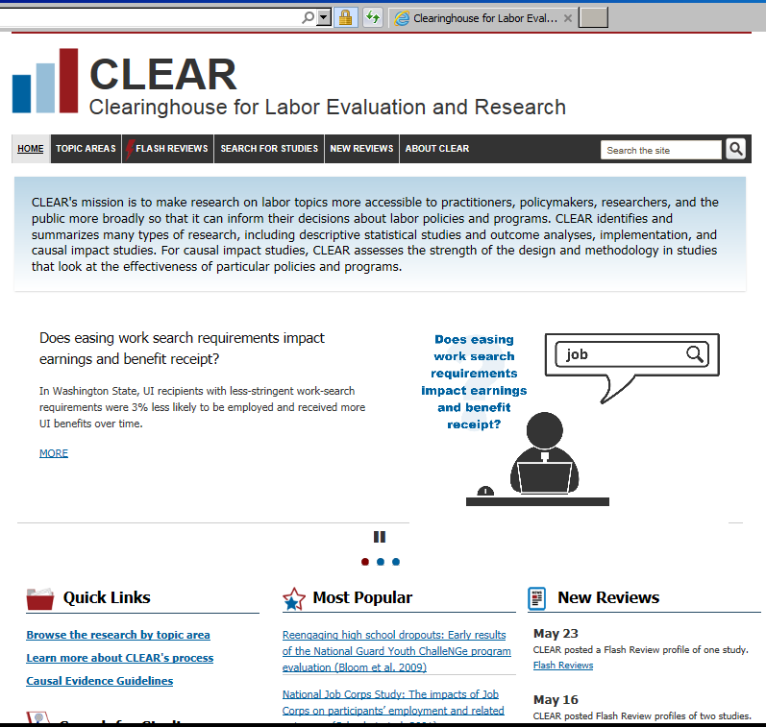
More on CLEAR
Find CLEAR at https://clear.dol.gov/

Slide 39
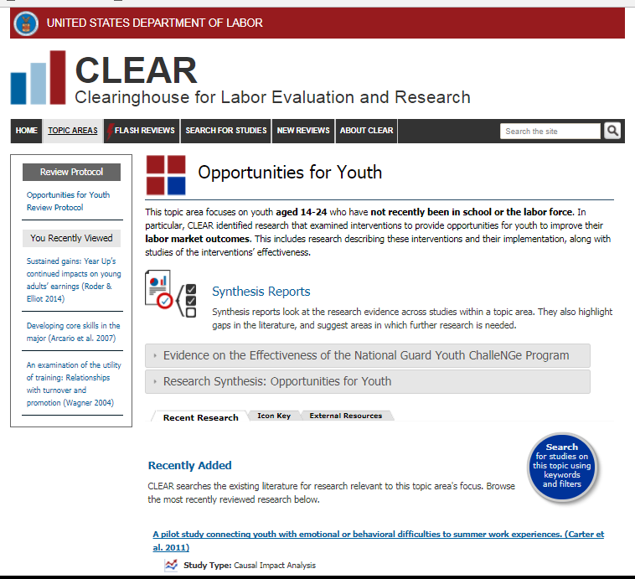
Navigating a CLEAR topic area
Navigate around CLEAR from the top bar
Topic area protocol
Name of topic area
Syntheses
Tabs with list of research for this topic area, icon key, and related external resources
Scroll down and click to see individual study profiles

Slide 40
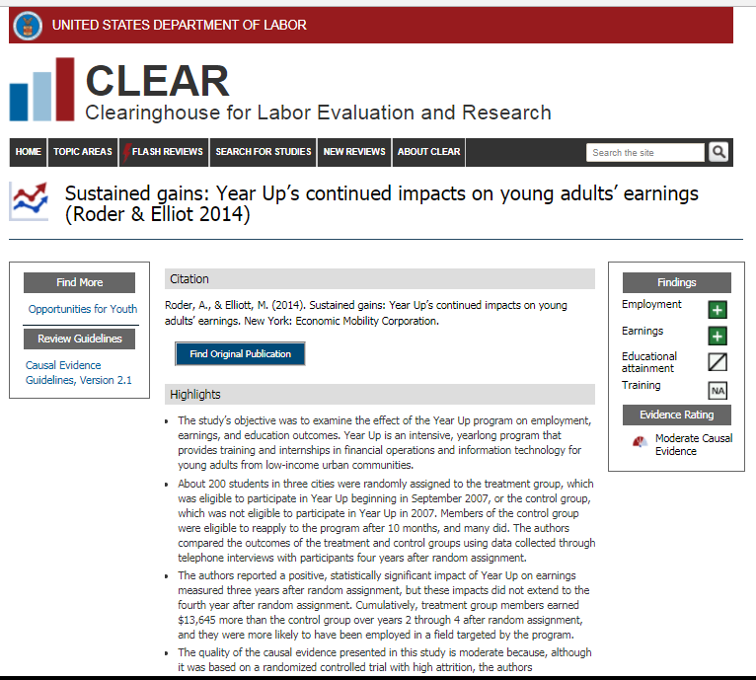
Navigating a CLEAR profile
One study profile under the “Opportunities for Youth” topic area
Citation and link to original publication
Link to guidelines
Snapshot of findings and evidence rating
Scroll down to read the full profile summary of the study (highlights, features of the intervention, features of the study design, findings and considerations for interpreting findings)

Slide 41
Ways to use CLEAR
Search CLEAR’s study database
  How much research is out there?
Review topics of interest
  Read profiles summarizing individual studies, and link to the original publications
  Consider the strength of the evidence and whether favorable impacts were found
  Check if the topic has a research synthesis of findings
“Search the site” more broadly for keywords of interest that might be in multiple topic areas or studies

Slide 42
Ways to use CLEAR (con’t)
Review syntheses to learn about what the evidence base says and identify gaps in the research
Use the evidence guidelines to design high quality studies
  Causal evidence guidelines - https://clear.dol.gov/sites/default/files/CLEAR_EvidenceGuidelines_V2.1_12312015.pdf
  Quantitative descriptive study guidelines - https://clear.dol.gov/sites/default/files/CLEAROperationalDescriptiveStudyGuidelines.pdf
  Implementation study guidelines - https://clear.dol.gov/sites/default/files/CLEAR_Operational%20Implementation%20Study%20Guidelines.pdf

Slide 43
Workforce System Strategies
Level 1 resources are impact analyses that include experimental (randomized controlled trials) and non-experimental analyses.
Level 2 resources include quantification analyses, cost analyses, implementation/ process analyses, literature reviews, and outcome/performance analyses.
Level 3 resources are supporting resources that provide insights into effective strategies and practices or describe current workforce system initiatives, organizations, and services.
Find it: https://strategies.workforcegps.org/announcements/2018/05/04/20/17/Connect-Your-Peers-to-Workforce-System-Strategies

Slide 44
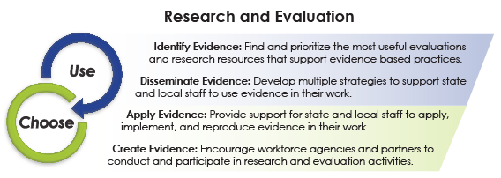
Evaluation and Research Hub
Find it: https://evalhub.workforcegps.org/about

