Slide 3
H-1B TechHire Grants Webinar From Training to Working: Strategies to Support Employment Placement for TechHire Participants
September, 5, 2018
Presented By: DOL/ETA

Slide 4
Grantee Polling Question
Compared to your project’s plan, how many of your total TH participants are now employed?
Choose the answer that best reflects your project’s actual performance versus total planned goal
More than we planned!
Pretty close to plan.
We’re a little behind our planned goals…
5. We’re so far behind, we can’t see our goals from here – HELP!
6. Wait – there’s a plan?

Slide 5
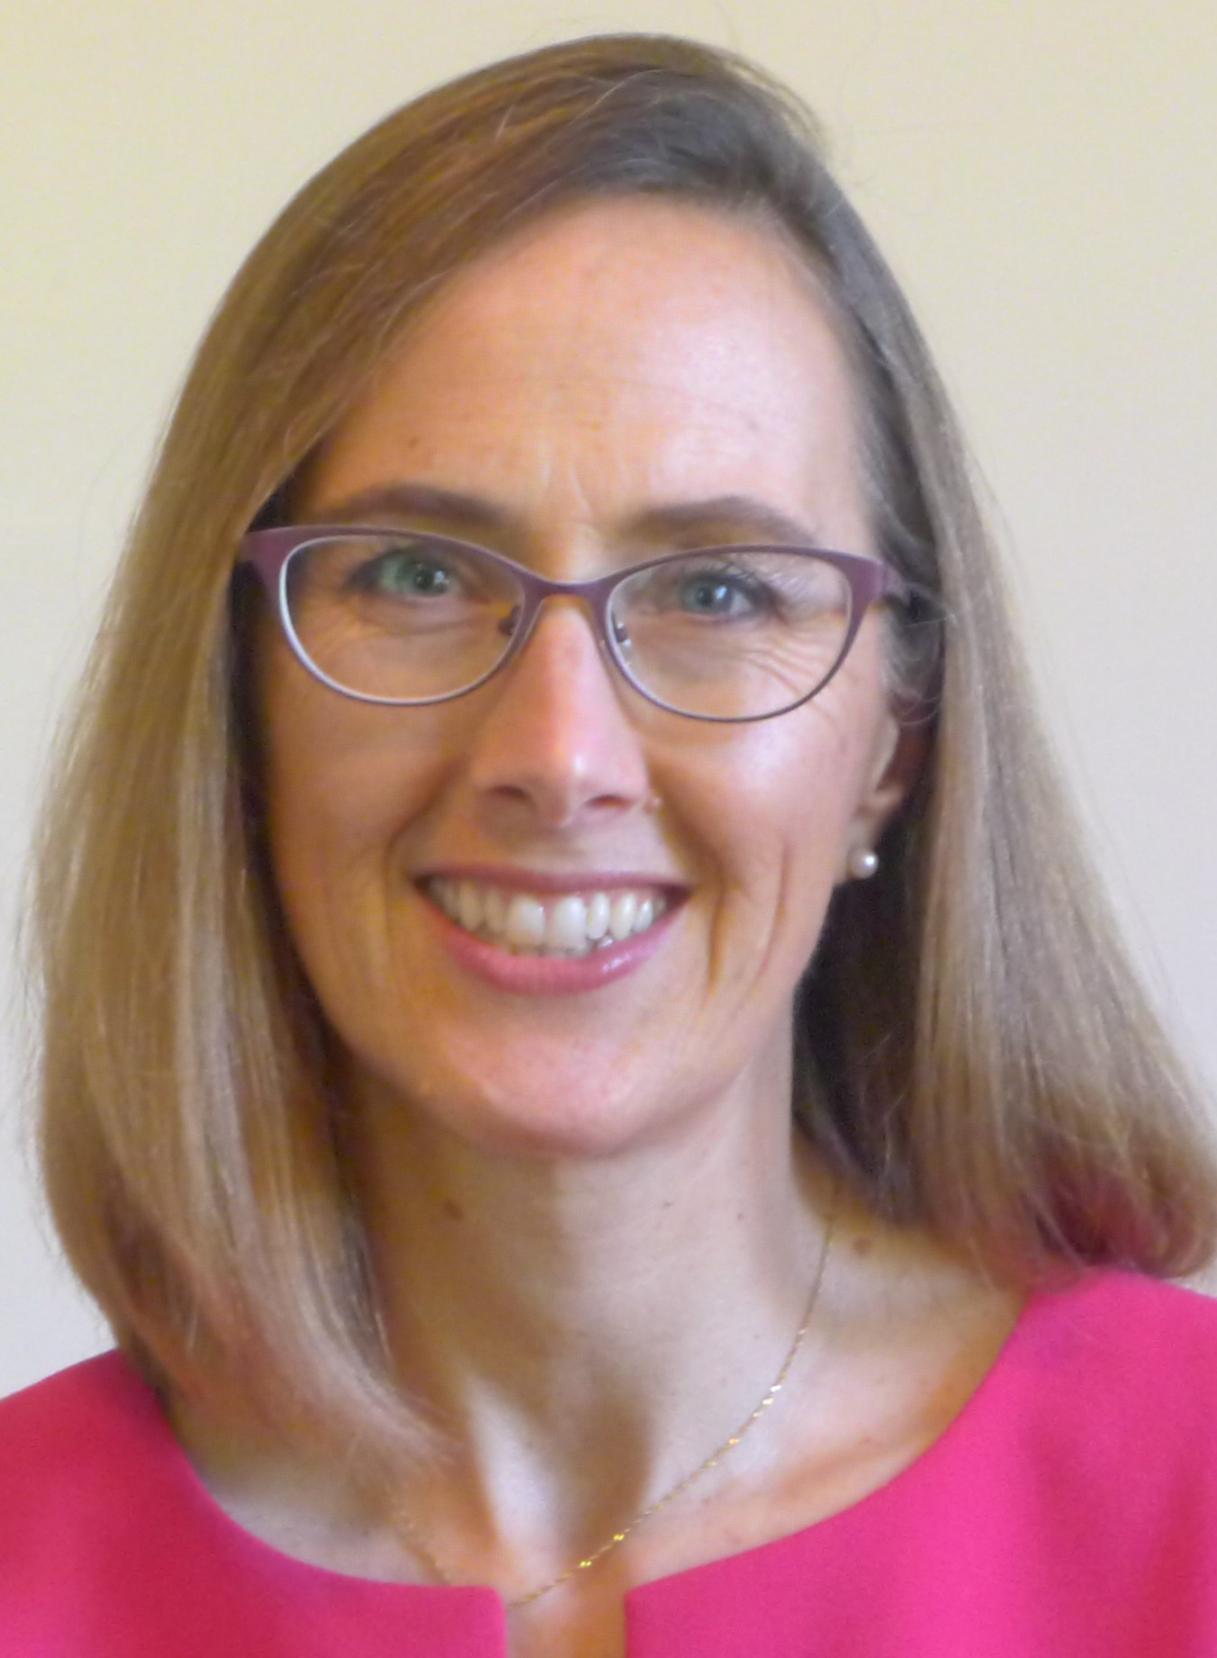
Megan Baird
H1-B Grants Program Manager
U.S. Department of Labor, Employment and Training Administration
Your Facilitator:
Ingrid Schonfield, MA, GCDF
TechHire Grantee Coach
Maher and Maher

Slide 6
Cindy Andersen
TechHire Program Manager
Employ Milwaukee, WI
Tori Strickland
TechHire Program Manager
Montgomery College, MD

Slide 7
Raymond Barbosa, TechHire Program Manager, Jobs for the Future (JFF)
Sarah Conte Wessel
TH Program Manager, Per Scholas
Macia Batista
TH Program Manager, General Assembly

Slide 8
Let’s Chat: reflect and enter your thoughts into the chat box on the following two questions – be specific!
What’s one thing you’d like to hear / learn about TechHire participant placement into employment in the next 60 minutes?
What’s one thing you’d like to share with your peers in the next 60 minutes pertaining to participant placement into employment?

Slide 9
Learn concrete strategies for working with businesses to employ TechHire participants
Learn key programmatic fixes that better prepare participants for employment
Meet peers who can partner with you to refine your own approach to connecting participants with employment

Slide 10
Today’s Agenda
3:00 p.m. | Welcome
3:10 | Employ Milwaukee, Inc.
Qs & As
3:25 | Montgomery College
Qs & As
3:40 | JFF
Qs & As
3:55 | Discussion, Next Steps, and Closing

Slide 11
Employ Milwaukee, Inc.
Cindy Andersen: “Don’t take any knowledge base for granted”
Training Curricula Supports Successful Employment Outcomes
Job Search Skills Training
Broker Relationships with Hiring Managers

Slide 12
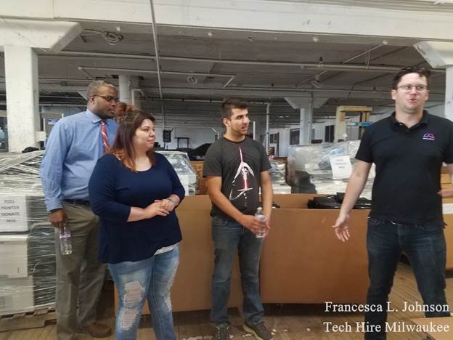
Employ Milwaukee, Inc., cont’d

Slide 14
Montgomery Technical College
LaToria Strickland: “Targeted Outreach + Dedicated Job Developers = Successful Employment Outcomes”
Design your program to:
Screen in appropriate participants
Identify support needs
Pair participants with dedicated job development staff

Slide 16
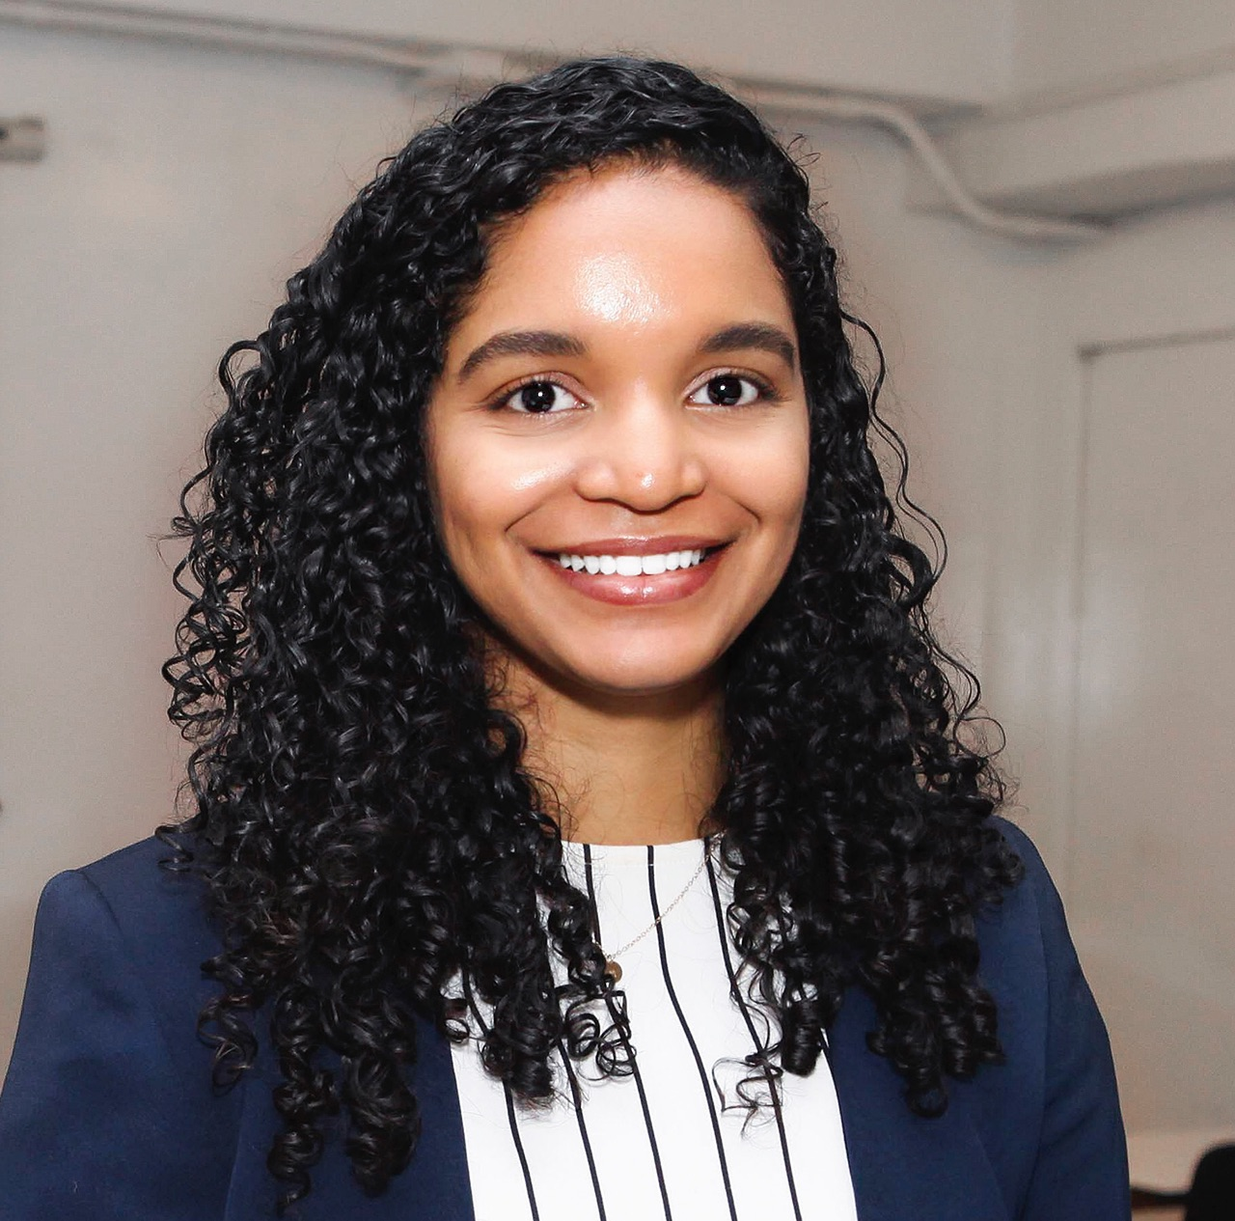
Jobs For the Future
Raymond Barbosa: It’s all about the service providers!
JFF Service Providers Sarah Conte Wessel (Per Scholas) & Macia Batista (General Assembly): “Comprehensive, long-term participant support are the keys to placement and retention success!”

Slide 18
Enter one word or phrase that springs to mind as you reflect on your peers’ presentations today into the chat box.

Slide 19
What two ideas that you heard today will you apply to your own project?

Slide 20
Upcoming TA Next Steps
Please stay tuned for upcoming TA Events, including:
February 21, 2019 @ 12:30PM EST – Data-Driven Decision-Making: Tools to Review and Manage Performance. Registration is now open.

Slide 22
TechHire Grantee Mailbox TechHire@dol.gov

