Slide 1




    An Overview of the Guidance for Validating Jointly Required Performance Data Submitted under the Workforce Innovation and Opportunity Act (WIOA)
    February 6, 2019
Technical Assistance Webinar
Employment and Training Administration
U.S. Department of Labor
Rehabilitation Services Administration
U.S. Department of Education
Office of Career, Technical, and Adult Education
U.S. Department of Education

Slide 2

Christina Eckenroth
Chief, Division of Workforce Investment
    Employment and Training Administration
    U.S. Department of Labor

Slide 3

Toquir Ahmed
Workforce Analyst
    Employment and Training Administration
    U.S. Department of Labor

Slide 4

Christopher Pope
WIOA Implementation Team Facilitator
    Rehabilitation Services Administration
    U.S. Department of Education

Slide 5

Jay LeMaster
Education Program Supervisor
    Office of Career, Technical, and Adult Education
    U.S. Department of Education

Slide 6

Overview
Joint Data Validation Guidance
  WIOA section 116(d)(5) requires the States to establish procedures, consistent with guidelines issued by the Departments to ensure that the data reported is valid and reliable.
  These guidelines were developed jointly between the Department of Education (ED) and Labor (DOL).
    Workgroup representing three core programs – Employment and Training Administration (ETA), Office of Career, Technical, and Adult Education (OCTAE), and Rehabilitation Services Administration (RSA)
DOL Specific Guidance
  DOL will issue guidance specifically for DOL programs. It is currently being developed.

Slide 7

Background
Prior to WIOA, ETA, RSA, and OCTAE had separate mechanisms for ensuring data reported by State agencies is valid and reliable.
Clarification about this guidance:
  No specific statistical validation methodology provided by Federal agencies (e.g. No performance report as in the past for DOL programs. However, reports on aspects of processes or about other issues may be required.)
  No specific data validation software identified or required.
  This guidance sets parameters for ensuring data quality consistent with the Departments’ guidelines to assist State agencies to develop their own data validation procedures as required by section 116(d)(5) of WIOA.

Slide 8

What is the Purpose of Data Validation?
To verify that the performance data reported by States to the Departments are valid, accurate, reliable, and comparable across programs.
To identify anomalies in the data and resolve issues that may cause inaccurate reporting.
To outline source documentation required for common data elements.
To improve program performance accountability through the results of data validation efforts.

Slide 9


What must Data Validation Procedures include?
Written procedures for data validation that contain a description of the process for identifying and correcting errors or missing data, which may include electronic data checks.
Regular data validation training for appropriate program staff ( e.g., at least annually).
Monitoring protocols to ensure that program staff are following the written data validation procedures and take appropriate corrective action if those procedures are not being followed.

Slide 10

What must Data Validation Procedures include? (continued)
A regular review of program data (e.g., quarterly) for errors, missing data, out-of-range values, and anomalies.
Documentation that missing and erroneous data identified during the review process have been corrected.
Regular assessment of the effectiveness of the data validation process (e.g., at least annually) and revisions to that process as needed.

Slide 11

Required and Optional
Data Validation
States must include regular data element validation through core program monitoring on 24 common data elements in the joint WIOA Participant Individual Record Layout (PIRL) which are listed in Attachment I of the guidance.
States may:
  Maintain supporting documentation for program-specific data elements not included in this joint guidance.
  Conduct additional source document validation on more data elements.
  Require additional source documentation in their procedures.

Slide 12


Which Common Data Elements Require Source Documentation?
Date of Program Entry
Date of Program Exit
Other Reasons for Exit
Type of Training Service #1
Type of Training Service #2
Type of Training Service #3
Participated in Postsecondary Education During Program Participation
Enrolled in Secondary Education Program
Date Enrolled in Post Exit Education or Training Program Leading to a Recognized Postsecondary Credential
Employed in 1st Quarter After Exit Quarter
Employed in 2nd Quarter After Exit Quarter
Employed in 3rd Quarter After Exit Quarter
Employed in 4th Quarter After Exit Quarter
Wages 2nd Quarter After Exit Quarter
Type of Recognized Credential
Date Attained Recognized Credential
Date of Most Recent Measurable Skill Gains: Educational Functioning Level (EFL)
Date of Most Recent Measurable Skill Gains: Postsecondary Transcript/Report Card
Date of Most Recent Measurable Skill Gains: Secondary Transcript/Report Card
Date of Most Recent Measurable Skill Gains: Training Milestone
Date of Most Recent Measurable Skill Gains: Skills Progression
Date Enrolled During Program Participation in an Education or Training Program Leading to a Recognized Postsecondary Credential or Employment
Youth 2nd Quarter Placement (Title I)
Youth 4th Quarter Placement (Title I)

Slide 13
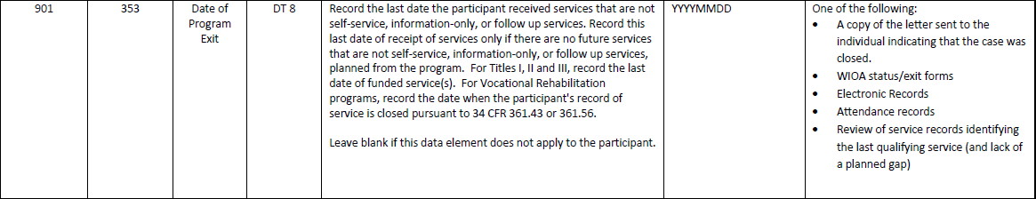

Source Documentation Example #1
Date of Program Exit
The State program may choose any of the source documents listed, as appropriate.
13

Slide 14
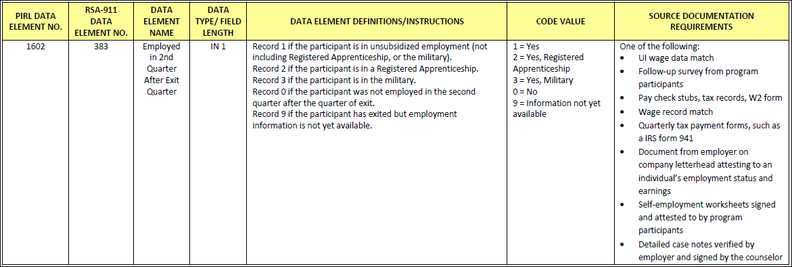
Source Documentation Example #2
Employed in the 2nd Quarter after Exit
The State program may choose any of the source documents listed, as appropriate.

Slide 15
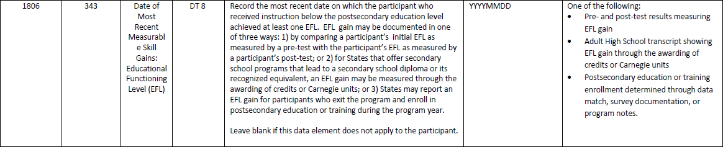
Source Documentation Example #3
Date of Most Recent Measurable Skill Gains: Educational Functioning Level (EFL)
The State program may choose any of the source documents listed, as appropriate.
15

Slide 16

Data Validation – Federal Review
ETA, RSA, and OCTAE will review data validation procedures of State agencies, in accordance with established procedures.
Federal reviews may include:
  Review of state agency policies, procedures, protocols, training, and their deployment.
  Review of reporting and validation process, including state data systems.
  Review of the state agency’s data validation methodology.

Slide 17


State Sharing and Discussion
(Please enter your responses in the chat box. )
Do you have written procedures for data validation in your State? How have you adapted those procedures, based on your experience in implementing them?
Does your State agency conduct regular data validation training for appropriate program staff? If so, how often?
What are your State agency’s monitoring protocols to ensure that program staff are following the written data validation procedures?
How does your State agency review program data for errors, missing data, out-of-range values, and anomalies? Who does that in your program?
How do you regularly assess the effectiveness of your State agency’s data validation process?
What challenges do you see for implementing data validation procedures in the future?

Slide 18
Questions?

Slide 19


Feel free to contact us! We’re here to help!
RSA
RSAData@ed.gov
ETA
ETAperforms@dol.gov
OCTAE
NRS@ed.gov

