Slide 1
Polling Question
Polling Question # 1
Let’s get to know who is on the call today. Using the poll, select the role that you play in your H-1B SWFI grant.
For this grant initiative I am the:
  Authorized Representative
  Program Director/Manager
  IT/Data Manager or staff
  Training Partner
  Employer Partner
  Service Provider
  Other (case manager, job developer or employment specialist)

Slide 3
Data-Driven Decision Making Webinar: Tools to Review and Manage Grant Performance
H-1B SWFI Grants
February 20, 2019

Slide 4
Monica Evans Antonio, Ph.D.
  SWFI Grant Program Lead
    Employment and Training Administration, DOL
Kristen Milstead, Ph.D.
  SWFI Performance Lead
    Employment and Training Administration, DOL
Timmy Dudley
  Workforce Analyst
    Employment and Training Administration, DOL

Slide 5
Mollie Dowling
  Executive Director
    OAI, Inc.
Amanda Allen
  Senior Director Operations
  OAI, Inc.
Sandra Dafiaghor, Ph.D.
  Director
    OAI Chicago Southland
Sue Gilbert
  SWFI Program Coordinator
    OAI Chicago Southland

Slide 6
Christina Yancey, Ph.D.
  Evaluation Team Manager
    Chief Evaluation Office, DOL
Jenn Daley
  Evaluation Specialist
    Chief Evaluation Office, DOL
Joseph Gasper, Ph.D.
  Associate Director
  Westat

Slide 7
The Benefits of Using Your Data Effectively
SWFI Performance Data To Date
Data Analysis Tips and Strategies
Performance Progress Indicator Tool
Grantee Profile: OAI, Inc.
Performance Data for Evaluation Purposes

Slide 8
The Benefits of Using Your Data Effectively

Slide 9
The Value of Performance Reporting
Performance data is used to:
Illustrate Success
Show Continuous Improvement
Promote your Programs for Employer and Partner Engagement
Ensure Sustainability and Evaluate Effectiveness
Identify Areas for Opportunity
Great Programs + Great Data + Great Outcomes =
Greater Success for American Workers!

Slide 10
Data- Driven Decision Making
Team Effort
Effective
Attainable
Map in Your Glove Box
Grantee Assessment
Program Analysis
Goals Achievement

Slide 11

Quarterly Stoplight Q’s
It’s OK to Ask For Directions!
What should you already know?
What are your target outcomes?
How is your performance to date?
What else do you need to know?

Slide 12
Participant Polling Question
We review our performance data…
(Select which answer is most applicable)
Every week
Bi-weekly
Every month
Quarterly
Never

Slide 13
SWFI Grants
Performance To Date

Slide 14
SWFI Participants
Who Are We Serving?
(Total Served: 2,760)

Slide 15
SWFI Participant Breakdown
Who Are We Serving?

Slide 16
SWFI Participants
Who Are We Serving?

Slide 17
SWFI Grants – Quarter Ending 9.30.18
Training and Program Completion Outcomes

Slide 18
SWFI Grants – Quarter Ending 9.30.18
Employment Placement Outcomes

Slide 19
Grantee Training Goals Reached

Slide 20
Percent of Year 3 Target Achieved
SWFI Grantee | Participants Began Receiving Education/Job Training Activities
OAI Inc. | 115%
Memphis Bioworks Foundation | 78%
Alachua Bradford Regional Workforce Board d/b/a CareerSource | 73%
Action for Boston Community Development Inc. | 57%
The WorkPlace | 54%
Total Action Against Poverty in the Roanoke Valley Inc | 53%
Community College of Aurora | 52%
Moore Community House | 45%
OIC of Broward dba OIC of South Florida | 38%
City of Phoenix | 23%
Rochester Rehabilitation Center | 20%
Vermont Technical College | 12%
City of Long Beach | 11%
Totals: | 43%
Data as of 9/30/2018 for year ending 6/30/2019

Slide 21
Performance Data Analysis
Tips and Strategies

Slide 22
Participant Polling Question #3
After reviewing this performance data, I am … (Select which answer is most applicable)
Not surprised. I knew exactly where we are to meeting our target outcomes.
Surprised! I didn’t know where we stood on these outcome measures.
Not sure…I need more information.

Slide 23
Data Assessment Questions
What is happening with this data?
What area needs improvement?
How would you address these areas for improvement?
What have you done or will do resolve it?

Slide 24
Making Decisions Based on Data
Program Factors
Recruitment and Enrollment
Length of Training Design
Program Completion
Credential Attainment
Challenges to Employment
Industry and Occupations

Slide 25
Performance Data Feedback Loops
Process Improvements
Program Design
Program Management
A modification to your Statement of Work takes careful consideration and should be discussed with your Federal Project Officer (FPO).

Slide 26
Performance Data Progress Indicator Tool

Slide 27
Performance Data Progress Indicator Tool
Using spreadsheet software, including MS Excel and others, you can track your progress towards outcomes targets, and/or internally set targets.
The following resource is an example of a performance data indicator tool that can help you track progress, and inform data-driven decision-making.

Slide 28
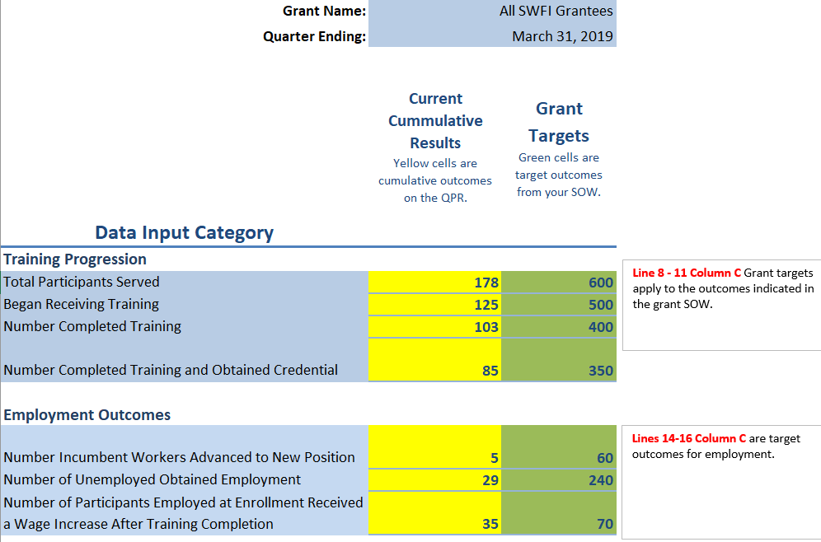
Enter outcomes targets and results to date…

Slide 29
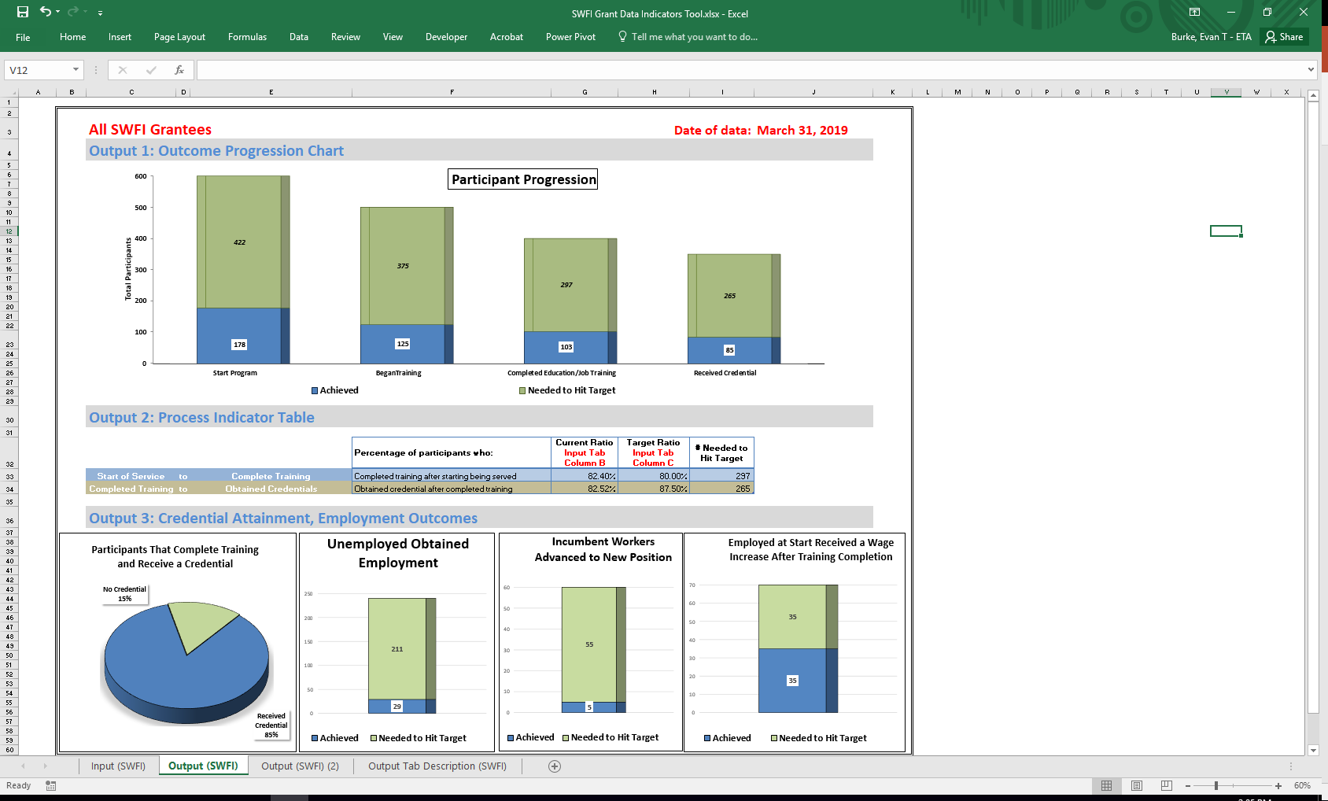
…and see your performance data visualized.

Slide 30
Output 1: Outcome Progression Charts
Participant Progression
  The Participant Progression Chart shows the number of people that have achieved each type of grant-funded service in blue, and the number of additional participants needed to reach the target goals of the grant as indicated in the grant Statement of Work (SOW).

Slide 31
Output 2: Process Indicator Table
Process Indicators are used to measure outcomes for the number of participants that Complete Training after Starting Training and Obtained Credential after Completing Training.
Current Ratio vs. Target Ratio: For each of the indicators, two ratios are provided:
  The first is titled the “Current Ratio” and represents the percent of participants that have successfully moved from the first service listed to the second (for example, from starting training to completing training).
  The second is titled the “Target Ratio” and represents the percent of participants who were targeted in the grant’s SOW, or the grantee’s internal records, to successfully move from the first service listed to the second.

Slide 32
Output 3: Credential Attainment and Employment Outcomes Chart
The first of four charts at the bottom compares the percentage of participants who complete training both with and without receiving a credential.
The second chart compares the number of participants that were unemployed when they entered the program and subsequently obtained employment.
The third chart compares the number of participants who are employed workers at the start of the program and advanced to new position.
The fourth chart compares the number of participants who were employed workers at the start of the program and received a wage increase after training completion. Grantees can also use these chart formats to track progress against other targets set internally.

Slide 33
SWFI Grantee Profile: OAI, Inc.

Slide 34



Chicago-based OAI is a nationally recognized pioneer in workforce development. Our work opens career pathways; fuels business success; promotes health, safety, and the environment; and supports community development. For more than 40 years, we’ve been delivering real economic benefit to individuals, employers, and communities across the country.
Our primary goal is simple:
To ensure that everyone has the knowledge and skills necessary to work well, work safely, earn a living wage, and build a good life.
www.oaiinc.org

Slide 35





Five key strategies define our approach:
1. We identify and target employer needs in key growth sectors.
2. We develop high-quality training that leads to marketable skills and credentials.
3. We provide services that close the gap between wanting a job and getting one.
4. We partner with communities and organizations to build on strengths, avoid waste, and increase impact.
5. We measure that impact in real terms: credentials earned; skills learned; placement, retention, and promotion; wage growth.

Slide 36
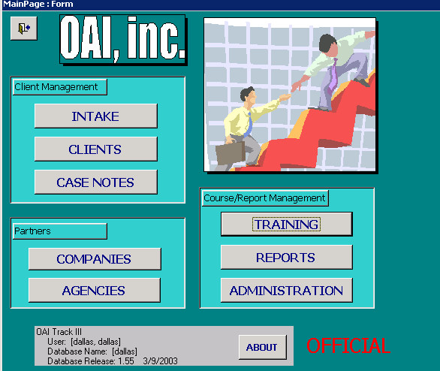

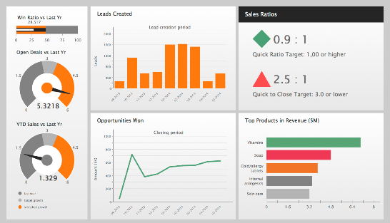
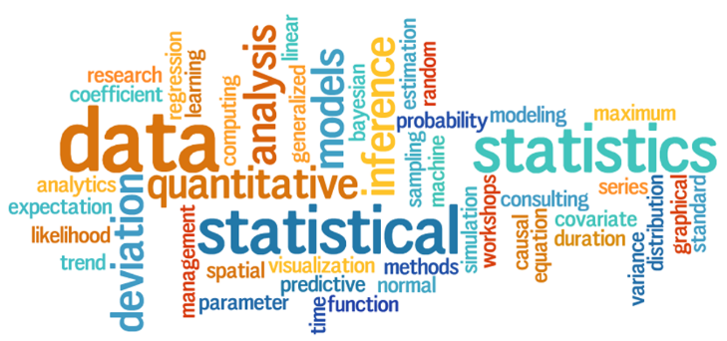
Data Management Evolution at OAI
CRM Components Needs:
Customizable system
Cloud based
Full integration for grant management, participant info & tracking, courses, goals
Reporting and dash boarding
App feature
Access Database OAITrack
CRM Customization and Integration
Dash Boarding and Reporting
Next Steps:
Optimize reporting and data collection
Data Analysts Fellow
Impact and ROI Studies
Online enrollment and evaluation forms

Slide 37

Data Driven Decision Making
salesforce dashboards and reports
weekly team meetings
monthly finance and program update meeting

Slide 38
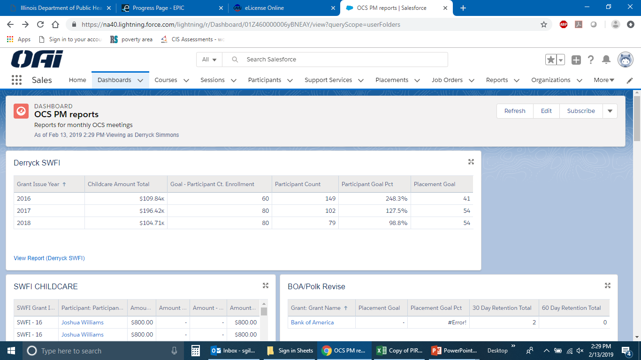
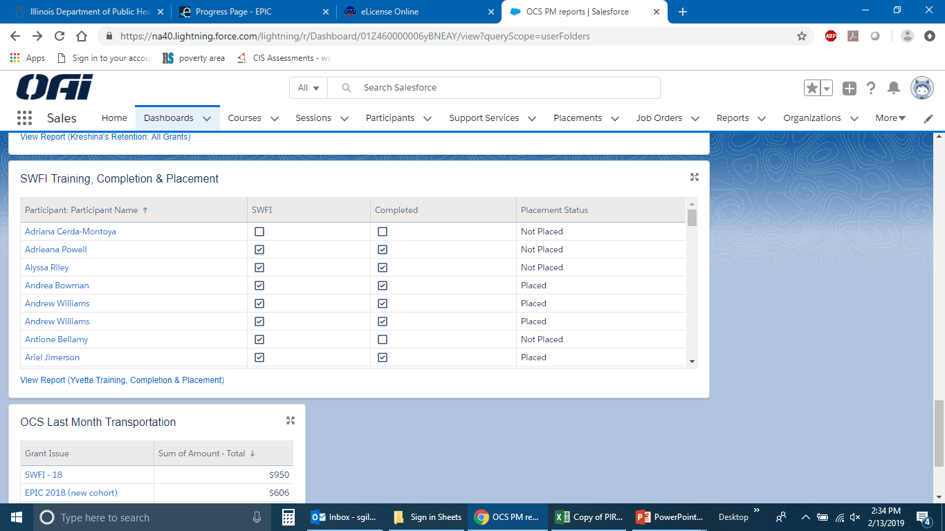
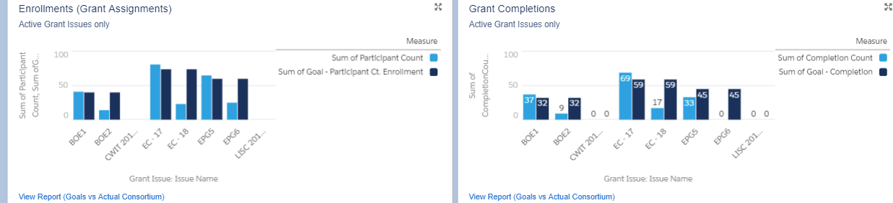
Dashboards offer reporting at a glance. If detailed information is needed, it’s a click away. Straight from the Dashboard

Slide 40
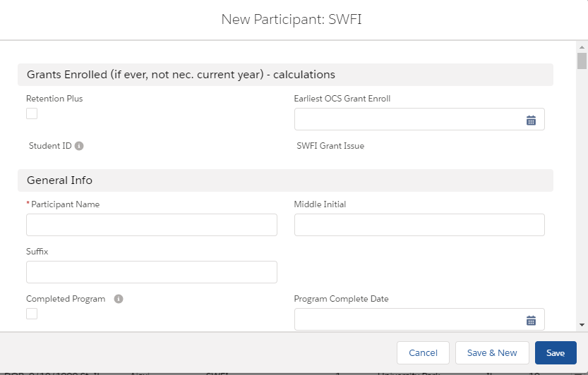
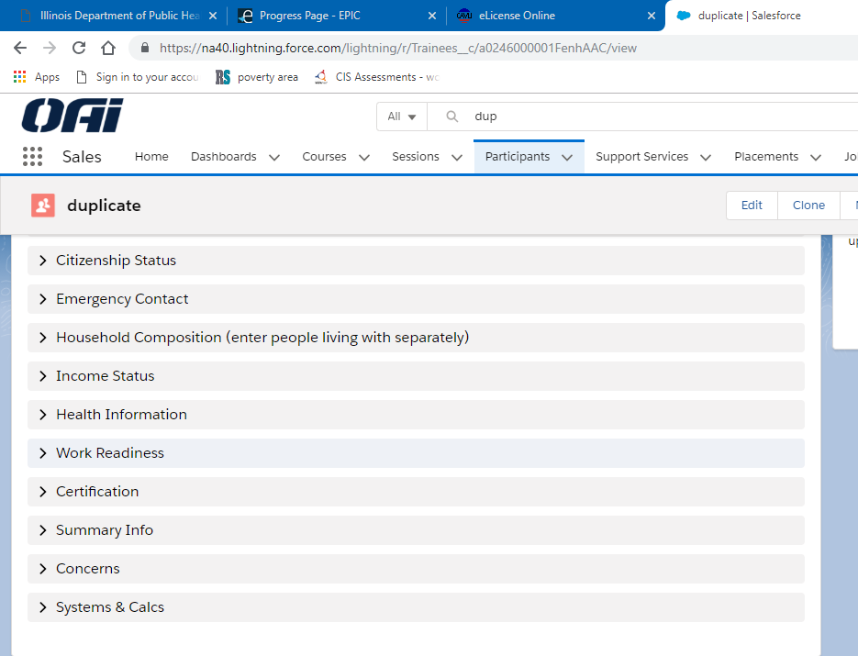
Enter New Participant into Salesforce

Slide 41
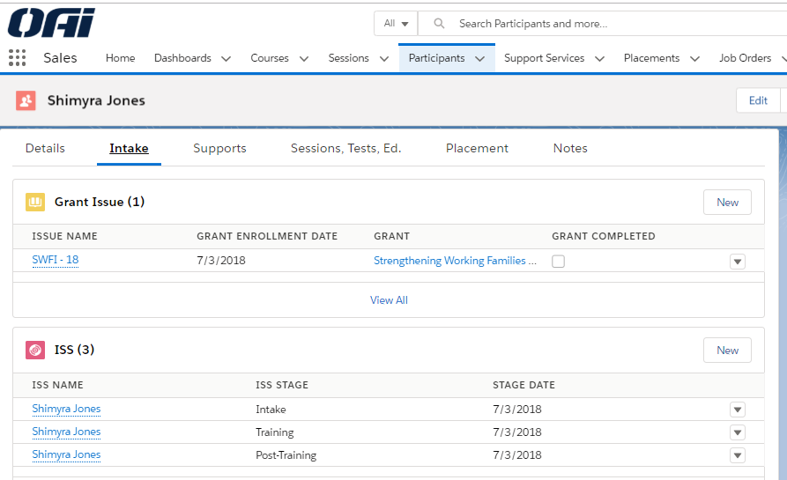
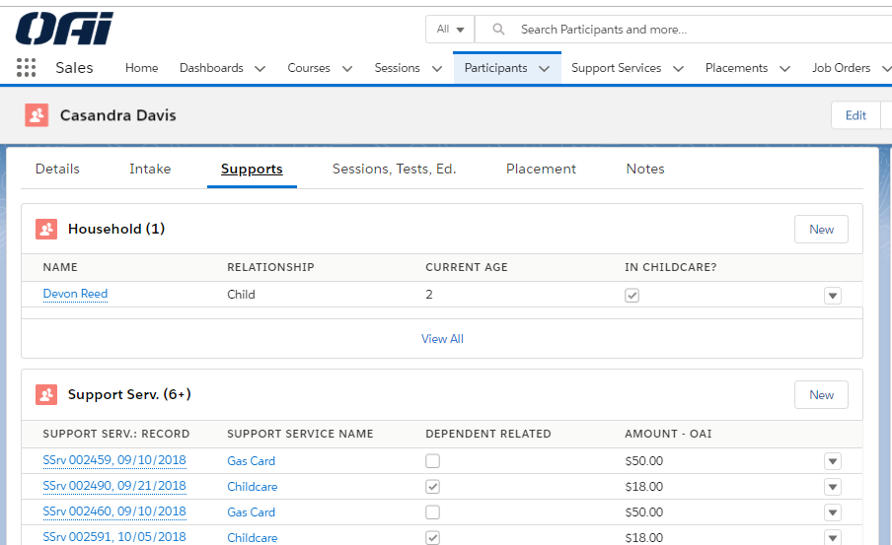
Intake tab is where we Enter the assigned grant to Participant
Supports Tab is where we enter all Supportive Services

Slide 42
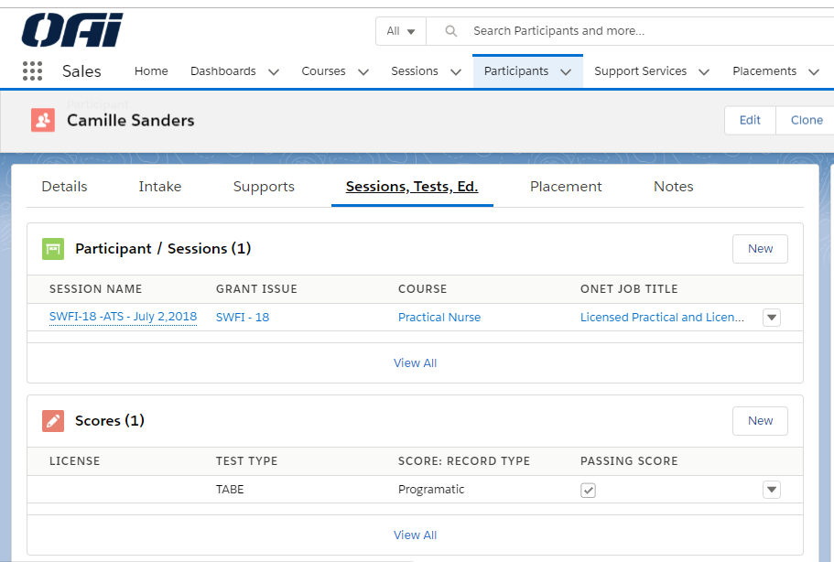
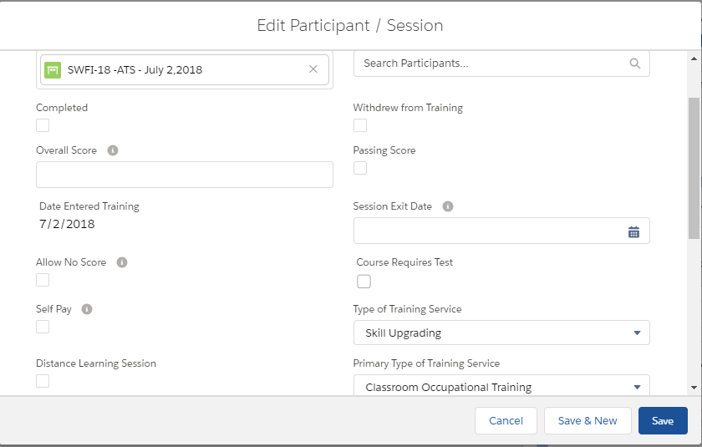
Training Sessions, Credentials and Completion

Slide 43
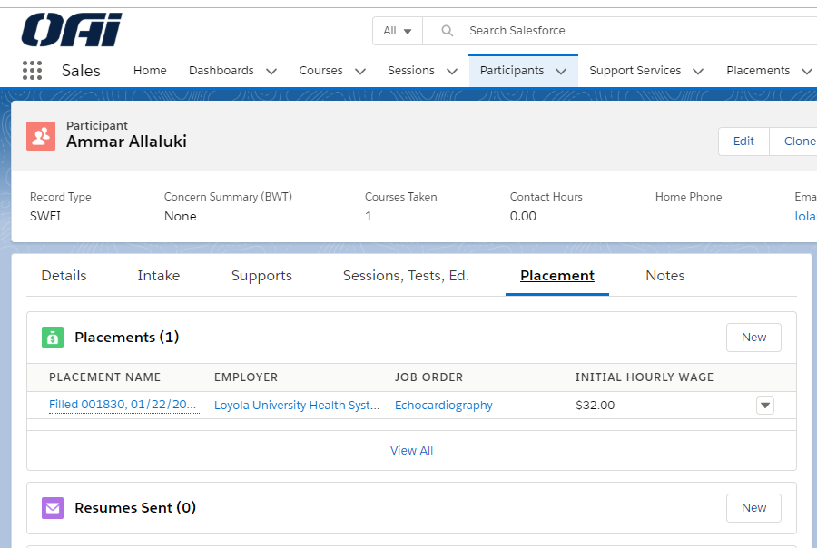
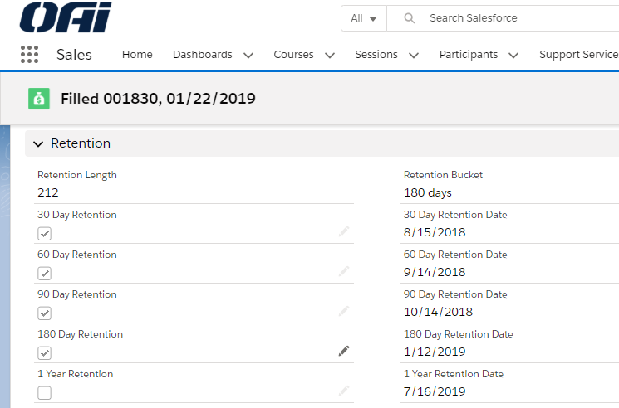
Employers, Placements & Retention

Slide 44
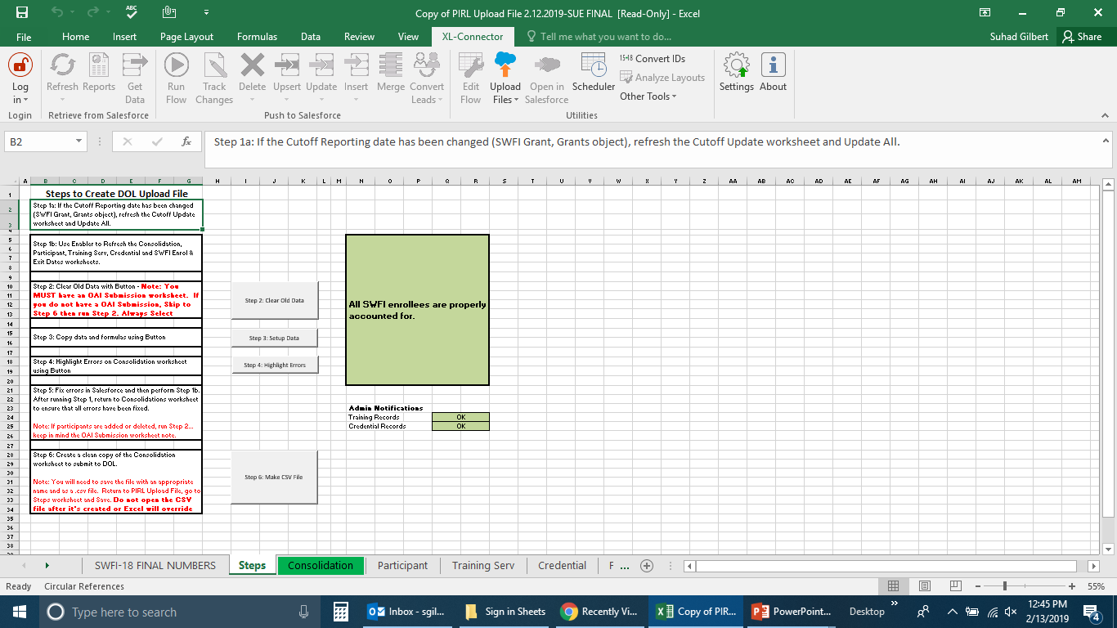
XL-Connector is used within EXCEL to transfer the data from SALESFORCE into an up loadable CSV file for DOL reporting.

Slide 45
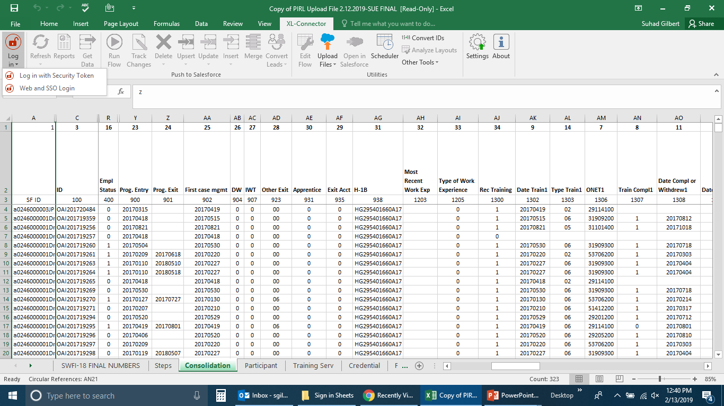
PIRL data Elements

Slide 46
SWFI Policy and Performance FAQ

Slide 47
Performance FAQs
Request to change the definition of Performance Outcome Measures on the QPR
Participants Served vs Participants who Began Training
Recording Grant Funded Services
Reporting Participants exiting the H-1B program
Reporting Credentials and Measurable Skill Gains

Slide 48
PIRL 1813: Date Completed, During Program Participation, an Education or Training Program Leading to a Recognized Postsecondary Credential or Employment (WIOA)
PIRL 1813: Report the date an H-1B participant completes the final training they participated in during the grant. The data element does not reflect either that a participant has successfully received a recognized postsecondary credential, or employment.
Credential attainment is captured by PIRL 1800, 1802 and 1804 “Type of Recognized Credential (WIOA),” and PIRL 1801, 1803, 1805 “Date Attained Recognized Credential (WIOA)”
Employment is captured in PIRL 2118 “Date Entered Employment (Discretionary Grants)” and PIRL 2126 “Entered Training-Related Employment”
Please also refer to the diagram available at H-1B Training Activities and Outcomes Diagram for guidance on PIRL data elements related to training, credential attainment and employment.

Slide 50
Performance Data for Evaluation Purposes

Slide 51
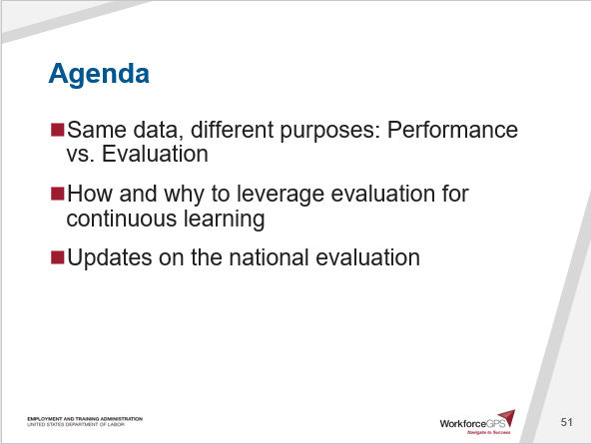
Agenda
Same data, different purposes: Performance vs. Evaluation
How and why to leverage evaluation for continuous learning
Updates on the national evaluation

Slide 52
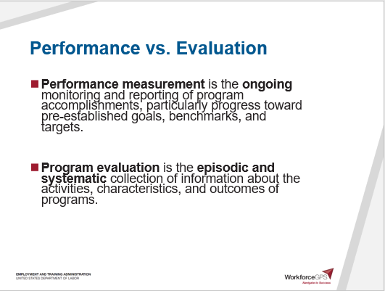
Performance vs. Evaluation
Performance measurement is the ongoing monitoring and reporting of program accomplishments, particularly progress toward pre-established goals, benchmarks, and targets.
Program evaluation is the episodic and systematic collection of information about the activities, characteristics, and outcomes of programs.

Slide 53
Performance vs. Evaluation
Dimenson | Performance Measurement | Program Evaluation
Coverage | Covers most programs | Covers one or a few programs at a time
Depth of information | Helps tell “the score,” not why | Seeks to understand reasons for poor/good performance
Cost | Costs tend to be spread out | Larger investment in individual studies
Utility | Monitors ongoing, continuous program improvement | Major program decisions/builds evidence base

Slide 54
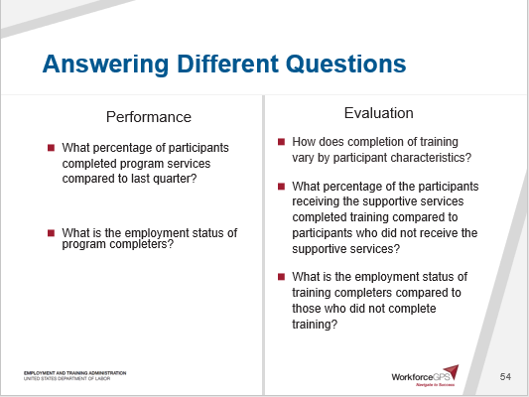
Answering Different Questions
Performance
What percentage of participants completed program services compared to last quarter?
What is the employment status of program completers?
Evaluation
How does completion of training vary by participant characteristics?
What percentage of the participants receiving the supportive services completed training compared to participants who did not receive the supportive services?
What is the employment status of training completers compared to those who did not complete training?

Slide 55
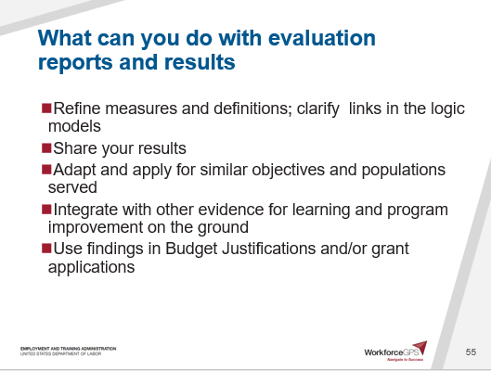
What can you do with evaluation reports and results
Refine measures and definitions; clarify links in the logic models
Share your results
Adapt and apply for similar objectives and populations served
Integrate with other evidence for learning and program improvement on the ground
Use findings in Budget Justifications and/or grant applications

Slide 56
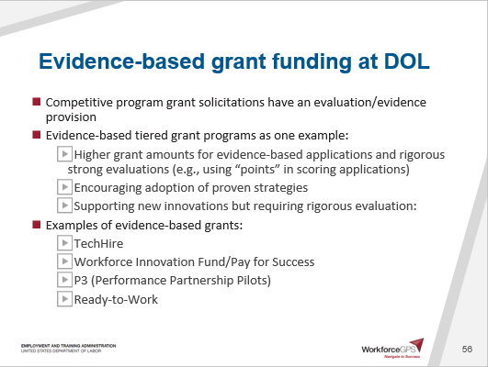
Evidence-based grant funding at DOL
Competitive program grant solicitations have an evaluation/evidence provision
Evidence-based tiered grant programs as one example:
  Higher grant amounts for evidence-based applications and rigorous strong evaluations (e.g., using “points” in scoring applications)
  Encouraging adoption of proven strategies
  Supporting new innovations but requiring rigorous evaluation:
Examples of evidence-based grants:
  TechHire
  Workforce Innovation Fund/Pay for Success
  P3 (Performance Partnership Pilots)
  Ready-to-Work

Slide 57
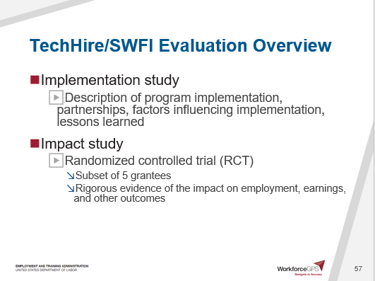
TechHire/SWFI Evaluation Overview
Implementation study
  Description of program implementation, partnerships, factors influencing implementation, lessons learned
Impact study
  Randomized controlled trial (RCT)
    Subset of 5 grantees
    Rigorous evidence of the impact on employment, earnings, and other outcomes

Slide 58
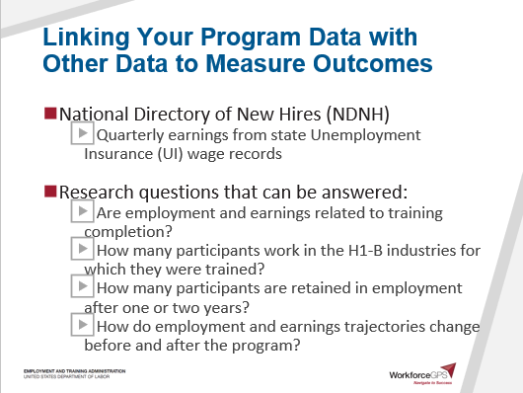
Linking Your Program Data with Other Data to Measure Outcomes
National Directory of New Hires (NDNH)
  Quarterly earnings from state Unemployment Insurance (UI) wage records
Research questions that can be answered:
  Are employment and earnings related to training completion?
  How many participants work in the H1-B industries for which they were trained?
  How many participants are retained in employment after one or two years?
  How do employment and earnings trajectories change before and after the program?

Slide 59
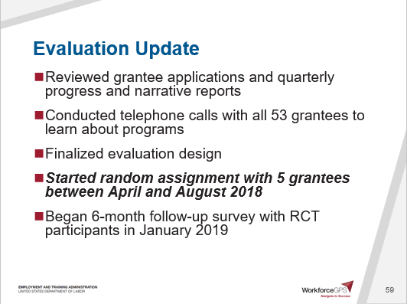
Evaluation Update
Reviewed grantee applications and quarterly progress and narrative reports
Conducted telephone calls with all 53 grantees to learn about programs
Finalized evaluation design
Started random assignment with 5 grantees between April and August 2018
Began 6-month follow-up survey with RCT participants in January 2019

Slide 60
Updated Data Collection Schedule
 | Activity | Target Date
All Grantees | DOL WIPS data, QPRs | Quarterly
 | Grantee web survey | 5/2019
 | Partner Information Form | 6/2019
 | Partner web survey | 7/2019
 | Grantee in-depth telephone interview | 10/2019
 | Partner in-depth telephone interview | 10/2019
Only RCT-Grantees | Random assignment | Started between 4/2018 and 8/2018
 | First round of grantee site visits | Q1 2019
 | Second round of grantee site visits | Q 2 2020
 | 6-month follow-up participant survey | 1/2019-6/2020
 | 18-month follow-up participant survey | 1/2020-6/2021

Slide 61
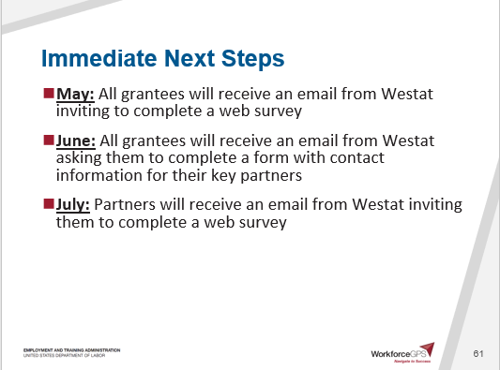
Immediate Next Steps
May: All grantees will receive an email from Westat inviting to complete a web survey
June: All grantees will receive an email from Westat asking them to complete a form with contact information for their key partners
July: Partners will receive an email from Westat inviting them to complete a web survey

Slide 62
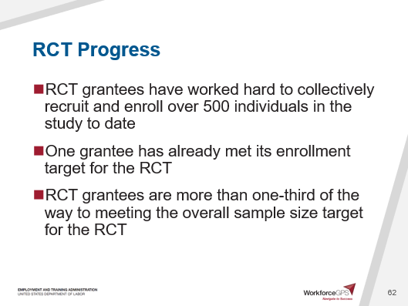
RCT Progress
RCT grantees have worked hard to collectively recruit and enroll over 500 individuals in the study to date
One grantee has already met its enrollment target for the RCT
RCT grantees are more than one-third of the way to meeting the overall sample size target for the RCT

Slide 64
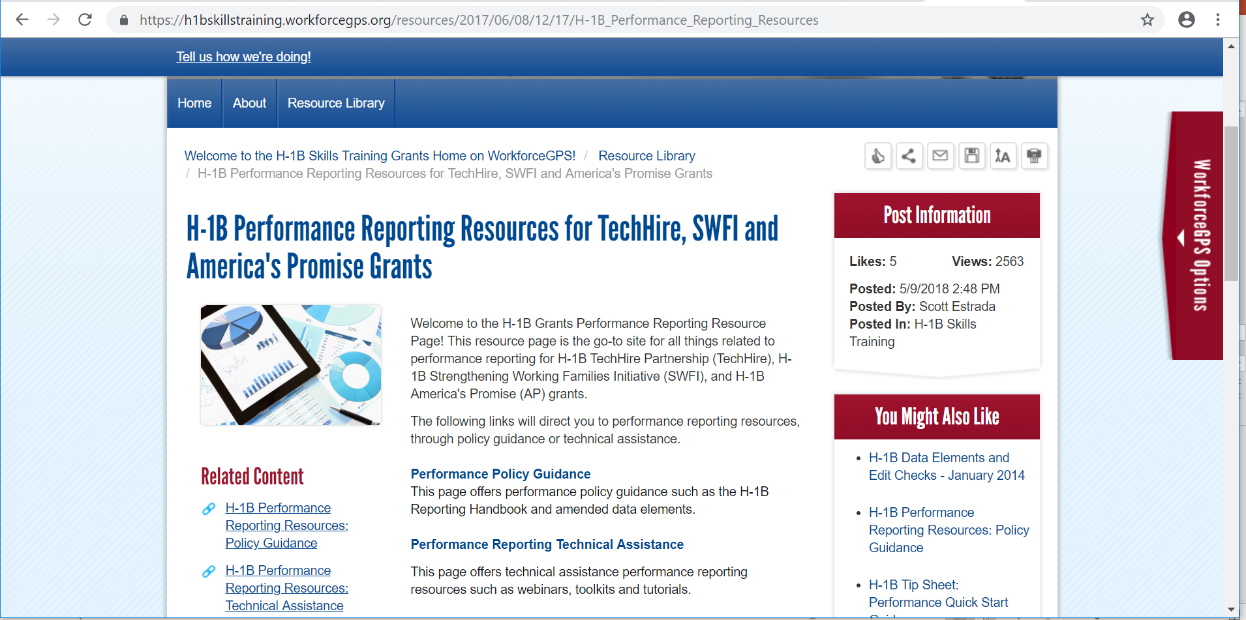
H-1B Performance Resources
Recently Updated Performance Resources
  Amended ETA-9172 DOL PIRL for H-1B Grants
  H-1B Grants Performance Reporting Handbook & WIPS Reporting Guidance
  Sample Case Management and Data File
  H-1B Training Activities and Outcomes Diagram:
  H-1B WIPS TIPS
  WIOA Primary Indicators of Performance Learning Modules

Slide 65
SWFI Grantee Mailbox
SWFI@dol.gov
To reach DOL National Office and Technical Assistance Providers
Please copy your FPO on any correspondence.

