Slide 2
Polling Question
Polling Question # 1
Let’s get to know who is on the call today. Using the poll, select the role that you play in your H-1B TechHire grant.
For this grant initiative I am the:
  Authorized Representative
  Program Director/Manager
  IT/Data Manager or staff
  Training Partner
  Employer Partner
  Service Provider
  Other (case manager, job developer or employment specialist)

Slide 4
Data-Driven Decision Making Webinar: Tools to Review and Manage Grant Performance
H-1B TechHire Grants
February 21, 2019

Slide 5



Ayreen Cadwallader
  Workforce Analyst
  Department of Labor
Brian Smith
  Workforce Analyst
  Department of Labor
Timmy Dudley
  Sr. Associate
  ICF

Slide 6



Christina Yancey, Ph.D.
  Evaluation Team Manager
  Department of Labor
Jenn Daley, Ph.D.
  Evaluation Specialist
  Department of Labor
Joe Gaspar, Ph.D.
Associate Director
Westat

Slide 7
Jeff M. Magada
  Project Director
  Flying High, Inc.
Gretchen Hammond
  CEO
  Mighty Crow
Kathleen Gallant
  Project Manager
  Mighty Crow

Slide 8
Learn numerous ways your performance data can benefit your TechHire grant
Learn how to use the H-1B Grantee Performance Data Indicators Tool
Learn how TechHire Grantee Flying High, Inc. tracks their performance outcomes
Learn about the action steps you can take to start using the data for your organization benefits
Discuss strategies for incorporating the data to help with employer engagement and partnership

Slide 9
Why Data? Data-Driven Decision Making
TechHire Grants Performance Data To Date
Performance Progress Indicator Tool
Grantee Profile: Flying High
Performance Data for Evaluation Purposes
Performance Reporting FAQ

Slide 10
The Value of Performance Reporting
Performance data is used to:
Illustrate Success
Show Continuous Improvement
Promote your Programs for Employer and Partner Engagement
Ensure Sustainability and Evaluate Effectiveness
Identify Areas for Opportunity
Great Programs + Great Data + Great Outcomes =
Greater Success for American Workers!

Slide 11
Data- Driven Decision Making
Team Effort
Effective
Attainable
Map in Your Glove Box
Grantee Assessment
Program Analysis
Goals Achievement

Slide 12

Quarterly Stoplight Q’s
It’s OK to Ask For Directions!
What should you already know?
What are your target outcomes?
How is your performance to date?
What else do you need to know?

Slide 13
Participant Polling Question
We review our performance data…
(Select which answer is most applicable)
Every day
Every other week
Every month
Quarterly
Never

Slide 15
Performance Data Progress Indicator Tool
Sample Template for Analyzing Your Data

Slide 16
Performance Data Progress Indicator Tool
Using spreadsheet software, including MS Excel and others, you can track your progress towards outcomes targets, and/or internally set targets.
The following resource is an example of a performance data indicator tool that can help you track progress, and inform data-driven decision-making.

Slide 17
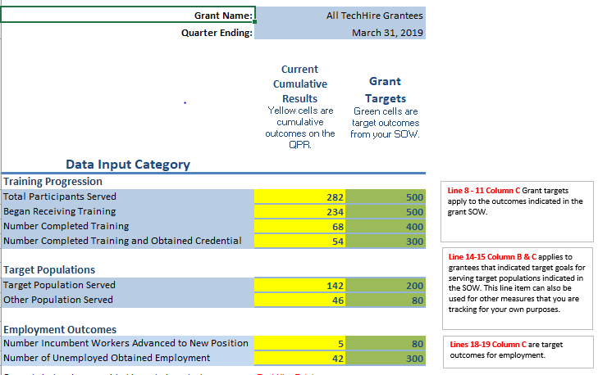
Enter outcomes targets and results to date…

Slide 18
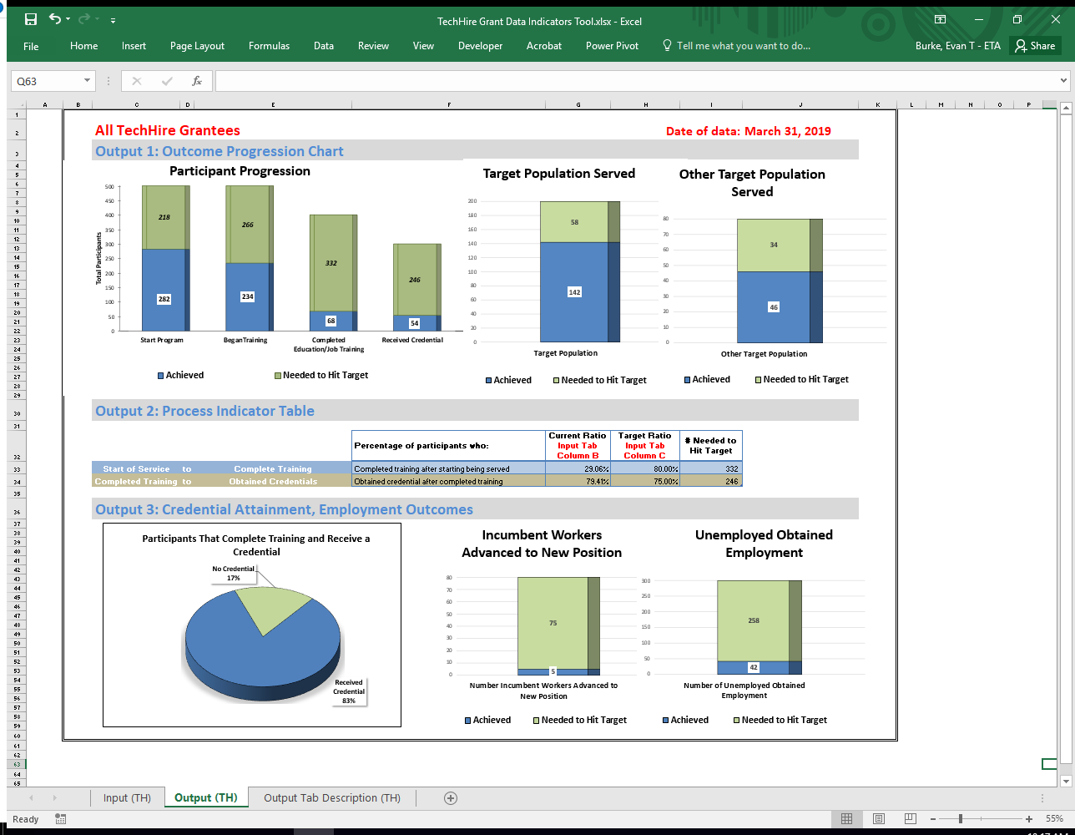
…and see your performance data visualized.

Slide 19
Output 1: Outcome Progression Charts
Participant Progression
  The Participant Progression Chart shows the number of people that have achieved each type of grant-funded service in blue, and the number of additional participants needed to reach the target goals of the grant as indicated in the grant Statement of Work (SOW).
Target Populations
  The two columns on the right measures outcomes for target populations. Participants in each group are in blue, and the remaining number of participants needed to reach the target goal are in green.

Slide 20
Output 2: Process Indicator Table
Process Indicators are used to measure outcomes for the number of participants that Complete Training after Starting Training and Obtained Credential after Completing Training.
Current Ratio vs. Target Ratio: For each of the indicators, two ratios are provided:
  The first is titled the “Current Ratio” and represents the percent of participants that have successfully moved from the first service listed to the second (for example, from starting training to completing training).
  The second is titled the “Target Ratio” and represents the percent of participants who were targeted in the grant’s SOW, or the grantee’s internal records, to successfully move from the first service listed to the second.

Slide 21
Output 3: Credential Attainment and Employment Outcomes Chart
The first of three charts at the bottom compares the percentage of participants who complete training both with and without receiving a credential.
The second chart compares the number of participants who are employed workers at the start of the program and advanced to new position.
The third chart compares the number of participants that were unemployed when they entered the program and subsequently obtained employment. Grantees can also use these chart formats to track progress against other targets set internally.

Slide 23
Participant Polling Question #3
Do you use any tools to review and analyze your data?
(Select which answer is most applicable)
Yes, we use a proprietary tool customized to meet our needs.
Yes, we use an Excel spreadsheet, and it works just fine.
No, I’d like some help in tailoring something to meet our needs.

Slide 24
TechHire Grants
Performance To Date
Cumulative Grant to Date Outcomes for the
Quarter Ending September 30, 2018

Slide 25
TechHire Participants: National Aggregate Totals Q 9.30.18

Slide 26
TechHire Grants – Quarter Ending 9.30.18
Training and Program Completion Outcomes

Slide 27
TechHire Grants – Quarter Ending 9.30.18
Employment Placement Outcomes

Slide 28
TechHire Grants Performance Outcomes
TechHire Grantee | Began Training % to Target Outcomes (Year 3) | Number Completed Training Program % to Target Outcomes (Year 3)
% QPR Outcome compared to cumulative to Year 3 Target Outcomes from Statement of Work (SOW)
Every grantee has different Year 3 Target Outcomes
Grantees are ranked from highest to lowest using their Began Training or Education % to their Year 3 Target Outcomes
This chart allows TechHire grantees to see where they stand in comparison to reaching their target outcomes
Program Completion Outcomes are low for a variety of reasons.
Percentage Rate of Cumulative YR 3 Targets for Quarter Ending 9.30.18

Slide 29
TechHire Grantee | Began Training % to Target Outcomes (Year 3) | Number Completed Training Program % to Target Outcomes (Year 3)
Pellissippi State Community College | 202% | 27%
Atlanta Technical College | 175% | 26%
Miami Dade College | 116% | 117%
Flying HIGH Inc. | 102% | 75%
Daytona State College | 98% | 0%
Tampa Bay Workforce Alliance, Inc. dba CareerSource Tampa Bay | 97% | 24%
Chippewa Valley Technical College | 95% | 46%
Everett Community College | 90% | 35%
BridgeValley Community & Technical College | 85% | 0%
Citadel Community Development Corporation | 85% | 47%
Midlands Technical College | 83% | 69%
James Sprunt Community College | 81% | 22%
Polk State College | 81% | 55%
Suffolk County Community College | 78% | 0%
Workforce Connection Of Central New Mexico | 74% | 55%
Westchester County Dept. of Social Services | 73% | 7%

Slide 30
TechHire Grantee | Began Training % to Target Outcomes (Year 3) | Number Completed Training Program % to Target Outcomes (Year 3)
Jobs for the Future, Inc. | 68% | 53%
Wake Technical Community College | 67% | 34%
Montgomery College | 66% | 49%
Mount Wachusett Community College | 64% | 61%
State Technical College of Missouri | 59% | 18%
North Central Texas College | 58% | 13%
Employ Milwaukee | 53% | 45%
Northwest Regional Workforce Investment Board | 53% | 30%
UAW-Labor Employment and Training Corporation | 51% | 0%
Full Employment Council, Inc. | 48% | 13%
Waukesha-Ozaukee-Washington Workforce Development Board, Inc. | 46% | 27%
United Migrant Opportunity Services/UMOS, Inc. | 44% | 0%
Goodwill Industries International, Inc. | 43% | 0%
Clackamas Community College | 35% | 10%
Worksystems, Inc. | 30% | 0%
Youth Policy Institute | 29% | 0%

Slide 31
TechHire Grantee | Began Training % to Target Outcomes (Year 3) | Number Completed Training Program % to Target Outcomes (Year 3)
Research Foundation of CUNY on behalf of LaGuardia Community College | 29% | 7%
Coastal Counties Workforce Inc. | 26% | 10%
Seattle Central College | 19% | 0%
Indiana AFL-CIO Labor Institute for Training, Inc. | 16% | 0%
Atlanta Workforce Development Agency | 2% | 0%
Ivy Tech Community College of Indiana | 0% | 0%

Slide 32
Grantee Training Outcomes Progress
Percentage Rate of Cumulative YR 3 Targets for Quarter ending 9.30.18

Slide 34
Participant Polling Question # 4
After reviewing this performance data, I am … (Select which answer is most applicable)
Not surprised. I knew exactly where we are to meeting our target outcomes.
Surprised! I didn’t know where we stood on these outcome measures.
Not sure…I need more information.

Slide 35
Performance Data Analysis
Tips and Strategies

Slide 36
Data Assessment Questions
What is happening with this data?
What area needs improvement?
How would you address these areas for improvement?
What have you done or will do resolve it?

Slide 37
Making Decisions Based on Data
Program Factors
Recruitment and Enrollment
Length of Training Design
Program Completion
Credential Attainment
Challenges to Employment
Industry and Occupations

Slide 38
Performance Data Feedback Loops
Process Improvements
Program Design
Program Management
A modification to your Statement of Work takes careful consideration and should be discussed with your Federal Project Officer (FPO).

Slide 39
TechHire Policy and Performance FAQ

Slide 40
Performance FAQs
Request to change the definition of Performance Outcome Measures on the QPR
Participants Served vs Participants who Began Training
Recording Grant Funded Services
Reporting Participants exiting the H-1B program
Reporting Credentials and Measurable Skill Gains

Slide 41
Reporting Program Completion, Credential Outcomes and Employment Outcomes
PIRL 1813: Date Completed, During Program Participation, an Education or Training Program Leading to a Recognized Postsecondary Credential or Employment (WIOA)
  Report the date an H-1B participant completes the final training they participated in during the grant. The data element does not reflect either that a participant has successfully received a recognized postsecondary credential, or employment.
Credential attainment is captured by PIRL 1800, 1802 and 1804 “Type of Recognized Credential (WIOA),” and PIRL 1801, 1803, 1805 “Date Attained Recognized Credential (WIOA)”
Employment is captured in PIRL 2118 “Date Entered Employment (Discretionary Grants)” and PIRL 2126 “Entered Training-Related Employment”
Refer the H-1B Training Activities and Outcomes Diagram for guidance

Slide 42
TechHire Grantee Profile Flying High

Slide 43

MVPE Project:
Data Driven Decision Making
Presented by:
Jeffrey M. Magada, Project Director, Flying HIGH Inc.
Gretchen Hammond, CEO, Mighty Crow
Kathleen Gallant, Project Manager, Mighty Crow

Slide 44
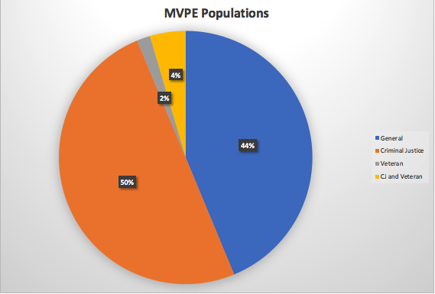
MVPE Project Information
The Mahoning Valley Partnership for Employment (MVPE) is a program of Flying HIGH, Inc. in Youngstown, OH that provides accelerated job training in two industries: Healthcare and Manufacturing.
Employment Tracks:
  Healthcare tracks includes an on-site STNA and CDCA training program, and partnerships with local training providers for LPN & RN programs.
  Manufacturing tracks includes a on-site certified Welding School and a fast-track Machining certification program through a local community college.

Slide 45
Performance Management Tools
Tools are interconnected:
  Web-based participant survey collects PIRL demographic elements.
  Internal spreadsheet tracks all PIRL elements.
    Data from participant survey is inputted into this document.
  Spreadsheet feeds into dashboard that updates in real-time.
    The same spreadsheet is used for WIPS uploads and the dashboard- staff time does not have to be duplicated.
  Yearly deep-dive into data.

Slide 46
Using Performance Data for Ongoing Process Improvements
Dashboard allows staff to see performance outcome measures in real-time and track progress throughout the quarter.
Dashboard visualizations parallel WIPS measures:

Slide 47
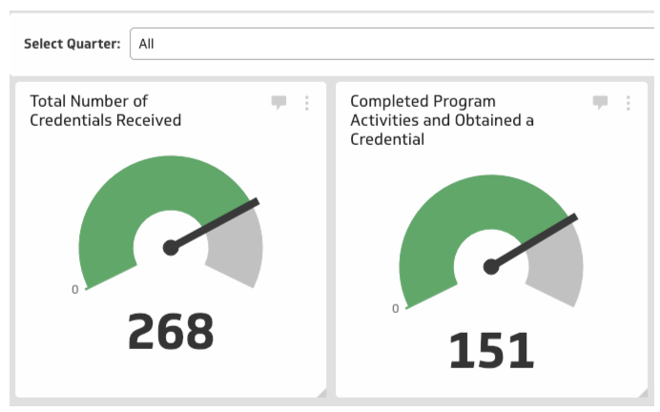
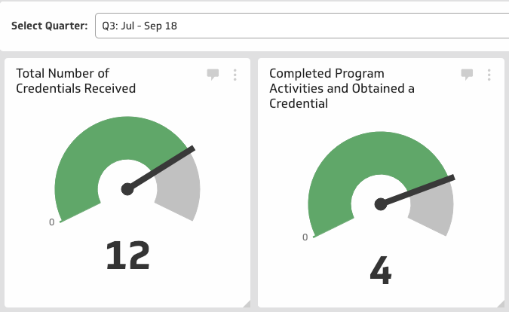
Using Performance Data for Ongoing Process Improvements
Dashboard can track progress-to-date, or an individual quarter.
Additions to outcomes measures were added to dashboard based on staff needs.
  Eg. WIPS report gives ”Credential Rate.” A klip was added to see what programs were earning credentials and when.

Slide 48
Using Performance Data for Ongoing Process Improvements
Hired a third-party evaluator (Mighty Crow)
  Meet regularly to review data.
Set up whiteboard to track clients
Staff use dashboard to inform their work:
  Evaluate trends – demographics
  Reveals where trainings are lacking
  Effectiveness of support services
  Identifies client success indicators

Slide 49
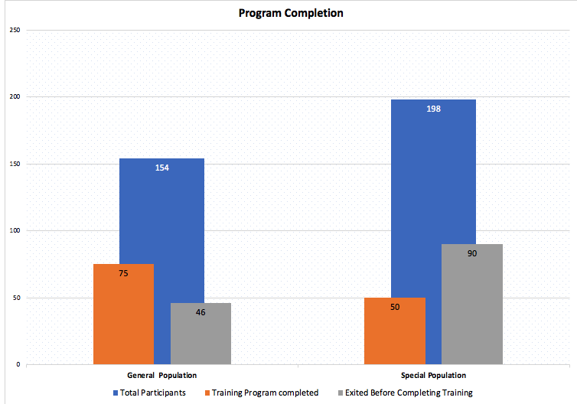
Using Performance Data for Ongoing Process Improvements
Deep dives into data spot trends are done yearly. Information is used to adjust programming going forward:
E.g. 1:
Special populations are more likely to exit before completing training and complete training at a lower rate than the general population.
Increased vetting prior to program enrollment (ie. Career Match Assessment to evaluate career suitability, Welding Bootcamp to evaluate Aptitude, Attitude, and Attendance)
Increased engagement by case manager and use of support services

Slide 50
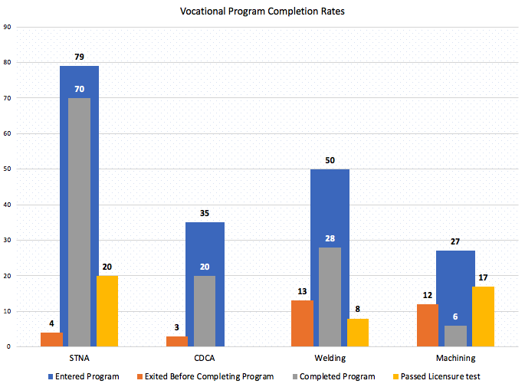
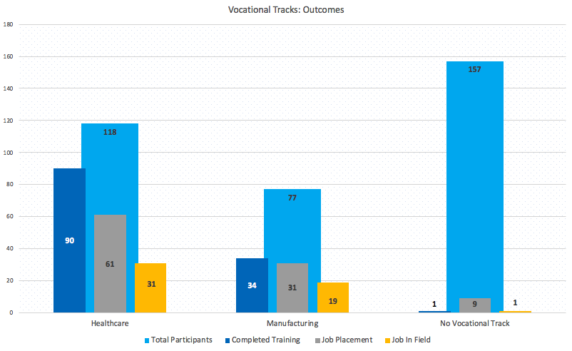
Using Performance Data for Ongoing Process Improvements
E.g. 2
STNA is most popular program, but credential attainment rate is low. Machining has fewer participants, but higher credential attainment.
STNA program added test-taking courses and staff support to improve exam results.
E.g. 3
Participants who come in with no identified vocational track are unlikely to engage in the program.
Staff began working to identify a track before entering clients in program.

Slide 52
Performance Data for Evaluation Purposes

Slide 53
Agenda
Same data, different purposes: Performance vs. Evaluation
How and why to leverage evaluation for continuous learning
Updates on the national evaluation

Slide 54
Performance vs. Evaluation
Performance measurement is the ongoing monitoring and reporting of program accomplishments, particularly progress toward pre-established goals, benchmarks, and targets.
Program evaluation is the episodic and systematic collection of information about the activities, characteristics, and outcomes of programs.

Slide 55
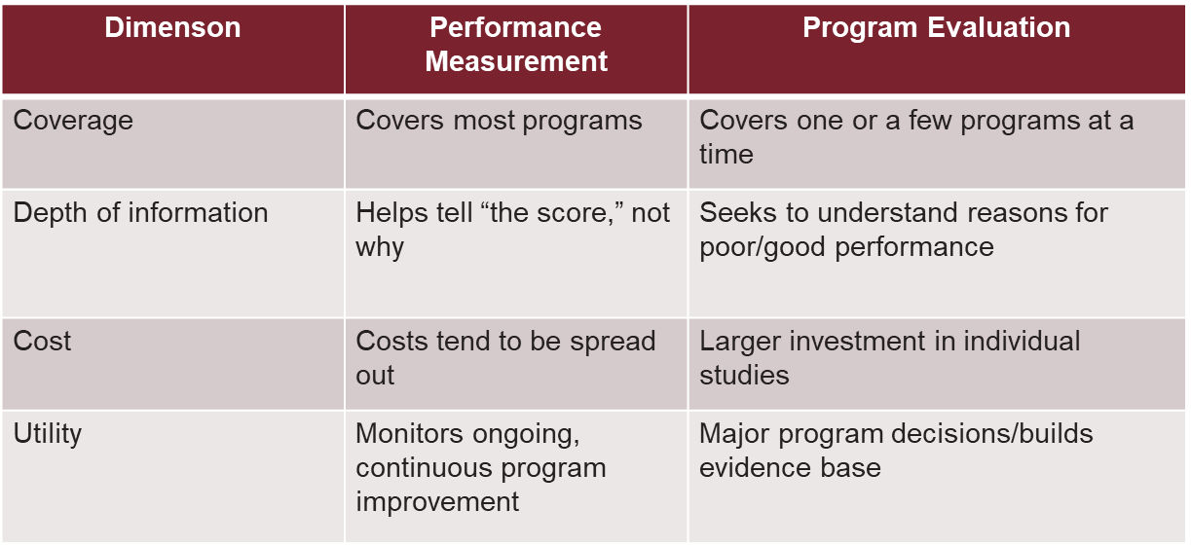
Performance vs. Evaluation

Slide 56
Answering Different Questions
Performance
What percentage of participants completed program services compared to last quarter?
What is the employment status of program completers?
Evaluation
How does completion of training vary by participant characteristics?
What percentage of the participants receiving the supportive services completed training compared to participants who did not receive the supportive services?
What is the employment status of training completers compared to those who did not complete training?

Slide 57
What can you do with evaluation reports and results
Refine measures and definitions; clarify links in the logic models
Share your results
Adapt and apply for similar objectives and populations served
Integrate with other evidence for learning and program improvement on the ground
Use findings in Budget Justifications and/or grant applications

Slide 58
Evidence-based grant funding at DOL
Competitive program grant solicitations have an evaluation/evidence provision
Evidence-based tiered grant programs as one example:
  Higher grant amounts for evidence-based applications and rigorous strong evaluations (e.g., using “points” in scoring applications)
  Encouraging adoption of proven strategies
  Supporting new innovations but requiring rigorous evaluation:
Examples of evidence-based grants:
  TechHire
  Workforce Innovation Fund/Pay for Success
  P3 (Performance Partnership Pilots)
  Ready-to-Work

Slide 59
TechHire/SWFI Evaluation Overview
Implementation study
  Description of program implementation, partnerships, factors influencing implementation, lessons learned
Impact study
  Randomized controlled trial (RCT)
    Subset of 5 grantees
    Rigorous evidence of the impact on employment, earnings, and other outcomes

Slide 60
Linking Your Program Data with Other Data to Measure Outcomes
National Directory of New Hires (NDNH)
  Quarterly earnings from state Unemployment Insurance (UI) wage records
Research questions that can be answered:
  Are employment and earnings related to training completion?
  How many participants work in the H1-B industries for which they were trained?
  How many participants are retained in employment after one or two years?
  How do employment and earnings trajectories change before and after the program?

Slide 61
Evaluation Update
Reviewed grantee applications and quarterly progress and narrative reports
Conducted telephone calls with all 53 grantees to learn about programs
Finalized evaluation design
Started random assignment with 5 grantees between April and August 2018
Began 6-month follow-up survey with RCT participants in January 2019

Slide 62
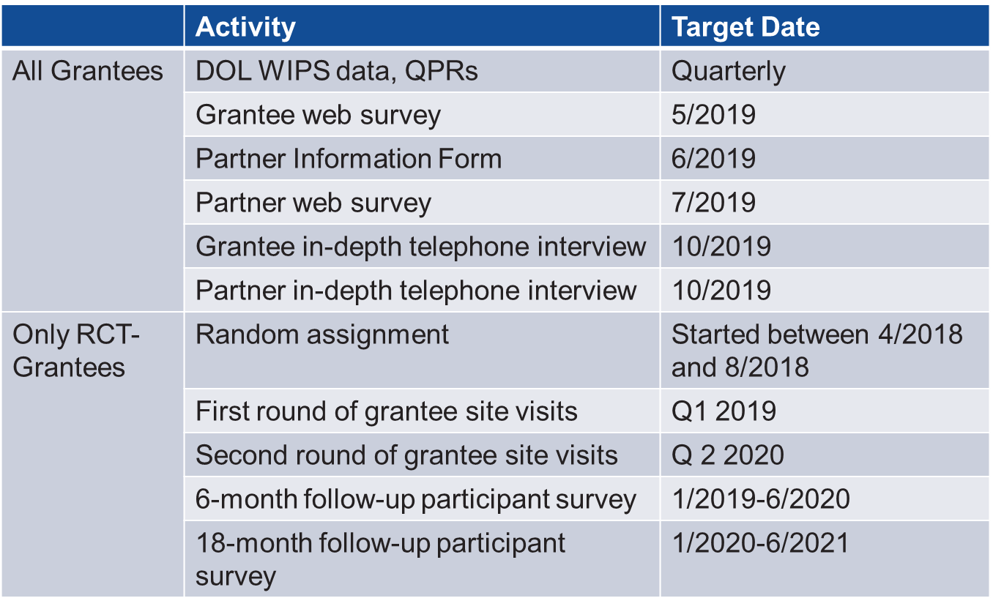
Updated Data Collection Schedule

Slide 63
Immediate Next Steps
May: All grantees will receive an email from Westat inviting to complete a web survey
June: All grantees will receive an email from Westat asking them to complete a form with contact information for their key partners
July: Partners will receive an email from Westat inviting them to complete a web survey

Slide 64
RCT Progress
RCT grantees have worked hard to collectively recruit and enroll over 500 individuals in the study to date
One grantee has already met its enrollment target for the RCT
RCT grantees are more than one-third of the way to meeting the overall sample size target for the RCT

Slide 66
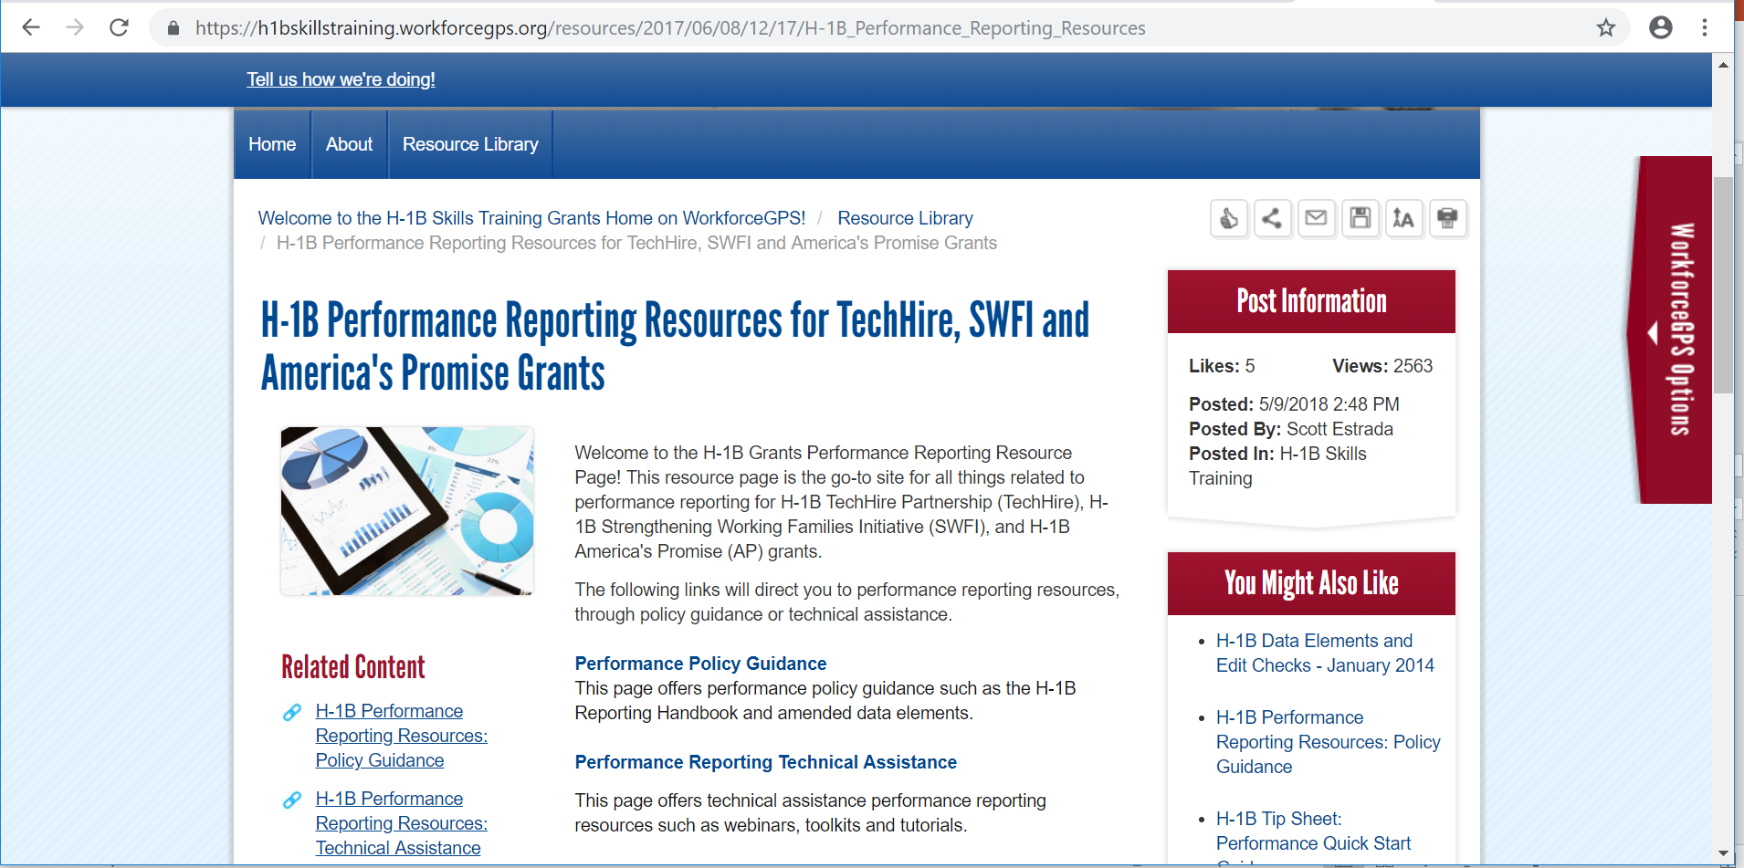
H-1B Performance Resources
Recently Updated Performance Resources
  Amended ETA-9172 DOL PIRL for H-1B Grants
  H-1B Grants Performance Reporting Handbook & WIPS Reporting Guidance
  Sample Case Management and Data File
  H-1B Training Activities and Outcomes Diagram:
  H-1B WIPS TIPS
  WIOA Primary Indicators of Performance Learning Modules

Slide 67
TechHire Grantee Mailbox
TechHire@dol.gov
To Reach your Federal Project Officer, DOL National Office and Technical Assistance Providers

