Slide 1



TAACCCT Learning Network
Sustaining Employer Partnerships for Students’
Long-Term Success
March 20, 2019
Innovations Leading to Career Success Webinar Series
Employment and Training Administration
Office of Career, Technical, and Adult Education

Slide 2
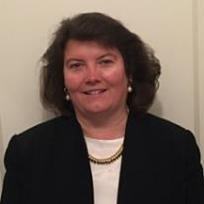


Moderators
Robin Fernkas
Manager, Division of Strategic Investments, Employment and Training Administration, U.S. Department of Labor
Erin Berg
Community College Program Specialist, Office of Career, Technical, and Adult Education, U.S. Department of Education

Slide 3

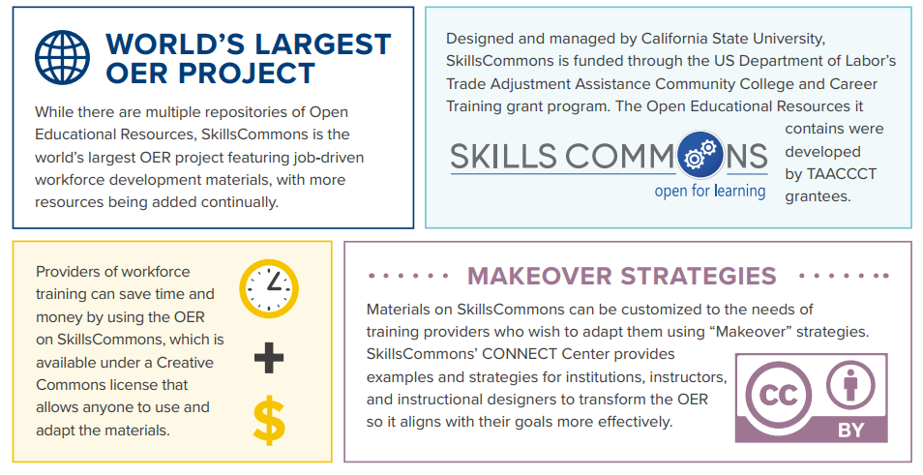

.org
An online library of 65,000+ free workforce development resources ready to be downloaded, adapted, and used
Find Open Educational Resources at www.skillscommons.org

Slide 4
About this Webinar
This webinar showcases strategies and resources developed by community colleges that are of broad interest to educational institutions engaged in career-focused education and training. Specifically:
  Presenters will discuss strategies for building long-lasting and scalable partnerships across multiple employers within an industry sector for the benefit of colleges, the business community, and students.
These strategies were produced by grantees of the Trade Adjustment Assistance Community College and Career Training (TAACCCT) program, a collaboration between the US Department of Labor and the US Department of Education.

Slide 5
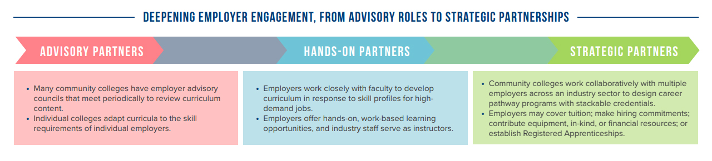
Employer Engagement Model
Advisory Partners
Many community colleges have employer advisory councils that meet periodically to review curriculum content.
Individual colleges adapt curricula to the skill requirements of individual employers.
Hands-on Partners
Employers work closely with faculty to develop curriculum in response to skill profiles for high-demand jobs.
Employers offer hands-on, work-based learning opportunities, and industry staff serves as instructors
Strategic Partners
Community colleges work collaboratively with multiple employers across an industry sector to design career pathway programs with stackable credentials.
Employers may cover tuition, make hiring commitments; contribute equipment, in-kind, or financial resources, or establish Registered Apprenticeships

Slide 6
Polling Question
?
How would you describe the role of employers in your college-employer partnership? Choose all that apply.
Primarily advisory
Primarily hands-on
Primarily strategic
?
?
?
?

Slide 7



Presenters
Dr. Sunita Cooke President, Miracosta College
Sandra Sisco Director, InTech Center, Chaffey College
Molly M. Scott Senior Research Associate, Metropolitan Housing and Communities Policy Center, Urban Institute

Slide 8
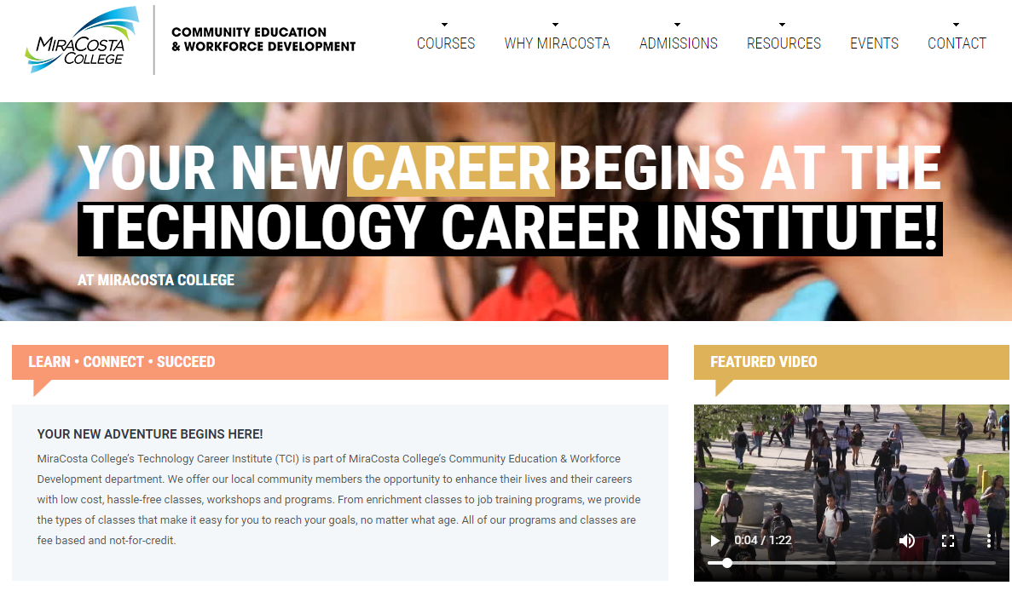

Slide 9
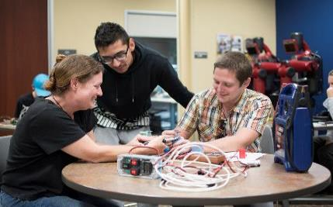
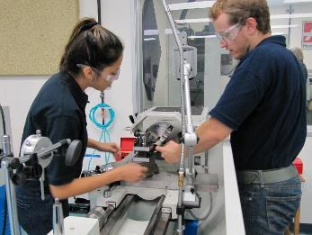
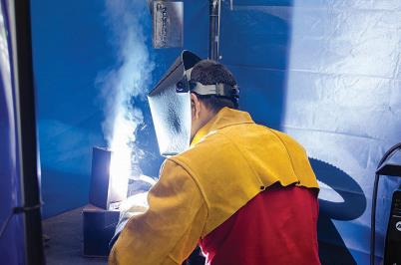
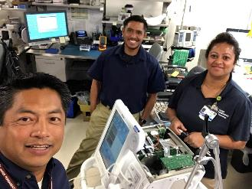
Engineering Technician
Machining Technology
Welding Certification
Biomedical Equipment Technician

Slide 10

DESIGNED BY INDUSTRY FOR INDUSTRY
ECONOMIC DEVELOPMENT

Slide 11
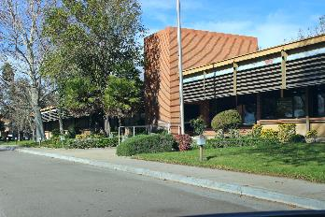
Industrial Technical Learning Center (INTECH)
First Public-Private Partnership in California
$15M TAACCCT Award Oct. 2014 / Grand Opening March 2016
        10 Community Colleges / 2 Universities / 2 Workforce Boards = $7.6M
Funding Breakdown ($7.4M)
        $2.2M Renovations
        $2.7M Operations
        $1.1M Equipment
        $1M Evaluator
        $388K Indirect
      Business/Industry Engagement
        CSI - $1.9MM investment
        MCIE
        150 Employers

Slide 12
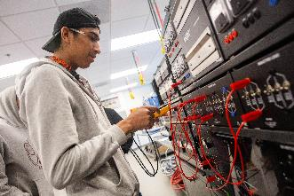
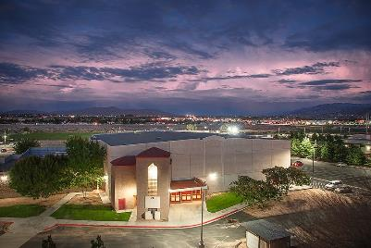
SCALING INTECH
Collaboration with Victor Valley College
    Technical training center
    Deliver registered apprenticeship training to High Desert manufacturers

Slide 13

TRAINING PROGRAMS
Construction Laborer – Dormant
Conventional / CNC Machining – Coming Soon!
Computer Skills
Forklift - Dormant
HVAC/R & Plumbing - Noncredit
Industrial Electrical & Mechanical - Pre-Apprenticeship (noncredit)
Industrial Maintenance Electrician- Registered Apprenticeship (noncredit)
Industrial Mechanic- Registered Apprenticeship
Mechatronics / Industrial Automation – Associate Degree!
Office Occupations
Pre-Engineering / Additive Manufacturing
Youth / Tour of Manufacturing – Summer Boot Camp
Welding
Professional Skills
Resume Writing
Interview Skills

Slide 14
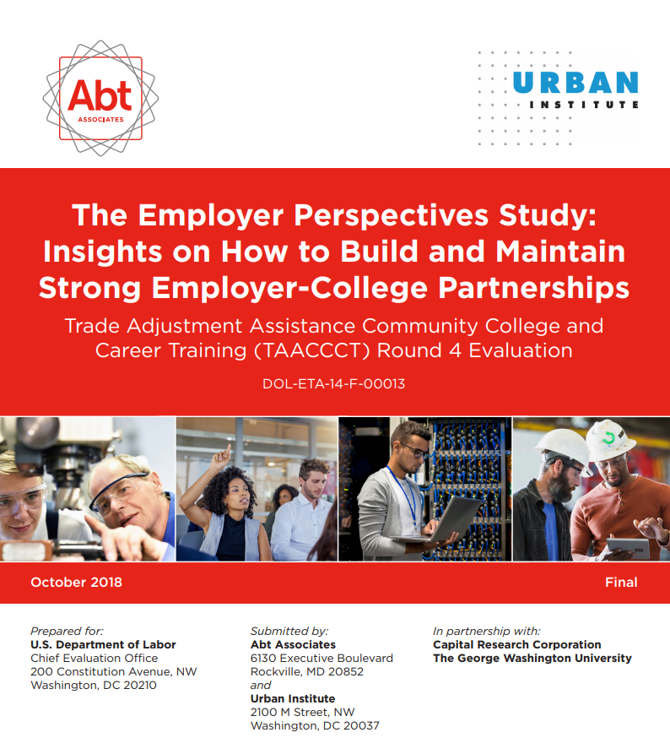

Slide 15
Strong Relationships are Diverse
LENGTH
  Range in length from a few years (21) to decades (12)
SCOPE
  More than half (29) of partnerships focus on a single education and training program
STAFFING
  Almost two-thirds (27) involve more than one staff person
FINANCIAL SUPPORT
  Fewer employers (5) make financial contributions, or
  Help the college apply for grants (7)

Slide 16
How do these relationships develop?
Colleges initiate most relationships
Employers value colleges meeting them where they were–in their offices, industry associations
Up-to-date facilities and the chance to shape programs are important to attract employers
Industry-savvy college staff with a customer service orientation are critical to maintaining relationships

Slide 17
What is the value of these relationships to employers?
New hires, reduced time for on-boarding, retention
Perception of positive return on investment (ROI), but not formal calculations
Opportunity to leverage these relationships to build a strong business case for more skeptical, potential employer partners

Slide 18
Presenters
Dr. Sunita Cooke President, Miracosta College
Sandra Sisco Director, InTech Center, Chaffey College
Molly M. Scott Senior Research Associate, Metropolitan Housing and Communities Policy Center, Urban Institute

Slide 19


Slide 20
Innovations Leading to Career Success
Webinar Series
This webinar series showcases strategies and resources that are of broad interest to educational institutions engaged in career-focused education and training. Past webinar topics include:
Jumpstart to Successful Instruction: A Deeper Dive into an Accelerated Course for New Instructors
Aligning Workforce Development Stakeholders
Increasing Student Support Services to Improve Student/Worker Outcomes
Increasing Academic Achievement
Adult Learning Strategies at Community Colleges
To see these and other past recordings, please visit:
Innovations Leading to Career Success Webinar Series

Slide 21
RESOURCES
Find more resources on strategies and successes like those featured on this webinar on the TAACCCT Community of Practice on WorkforceGPS such as:
Accelerating Pathways to Careers for Adult Learners
Effective Employer Engagement Strategies Showcase
The Employer Perspectives Study
From Programs to System Change Series:
  Statewide Employer Engagement in Iowa
  When Commitment Leads to Transformative Change: How Partnerships Pave the Road to Careers for High-Needs Students
  The Case for Expanding Navigators in Mississippi to Support Adult Learners
Field Guide of TAACCCT Innovations

