Slide 2
Polling Question
Polling Question # 1
Let’s get to know who is on the call today. Using the poll, select the role that you play in your H-1B America’s Promise grant.
For this grant initiative I am the:
Authorized Representative
Program Director/Manager
IT/Data Manager or staff
Training Partner
Employer Partner
Service Provider
Other (case manager, job developer or employment specialist)

Slide 3
Data-Driven Decision Making: Using Data for Strategic Planning
America’s Promise Grants
April 24, 2019

Slide 4
Gregory Scheib
America’s Promise, Program Lead
U.S Department of Labor

Slide 5
Timmy Dudley
Senior Technical Project Management Analyst
ICF
Kevin Mauro
H-1B Performance Lead
High Impact Partners

Slide 6
Deborah Waymire
Chief Operations Officer
Region 4 Workforce Board
Lafayette, IN
Megan Lizik
Evaluation Team Manager
U.S Department of Labor
Robert Santillano
Mathematica Policy Research

Slide 7
Review the America’s Promise mid-grant data
Explore ways your performance data can inform your program implementation and design
Share an H-1B grantee performance data Indicator tool
Hear how one of our grant partners is using data
An update on our national evaluation
Answer your questions

Slide 8
The Value of Performance Reporting
Performance data is used to:
Illustrate program accomplishments
Identify improvement areas
Support continuous improvement
Promote your programs for employer and partner engagement
Evaluate effectiveness

Slide 9
Data-Driven Decision Making
Grantee Assessment
Program Analysis
Goals Achievement

Slide 10
Questions to Ask
And it’s OK to Ask For Directions!
What should you already know?
What are your target outcomes?
How is your performance to date?
What else do you need to know?

Slide 11
Participant Polling Question
We review our performance data…
(Select which answer is most applicable)
Every day
Every other week
Every month
Quarterly
Never

Slide 12
Participant Polling Question
Do you use any tools to review and analyze your data? (Select which answer is most applicable)
Yes, we use a proprietary tool customized to meet our needs.
Yes, we use an Excel spreadsheet, and it works just fine.
No, I’d like some help in tailoring something to meet our needs.

Slide 13
America’s Promise Grants Performance To Date
Cumulative Grant to Date Outcomes for the
Quarter Ending December 31, 2018

Slide 14
Participants: National Aggregate Totals Q 12.31.18

Slide 15
Participants Served Over Time

Slide 16
Participants Began Training Over Time

Slide 17
Special Populations Served vs Targets

Slide 18
America’s Promise Year 2 Targets: Participants Served
Grantee Name | Percentage of Target
Greater Memphis Alliance for a Competitive Workforce | 37%
Delaware Technical Community College | 49%
Montgomery College | 61%
Florida State College at Jacksonville | 69%
Brevard Workforce Development Board, Inc. | 75%
The University of Alabama at Birmingham | 76%
Southeast Michigan Community Alliance (SEMCA) | 82%
Alamo Community College District | 83%
Employ Milwaukee | 90%
Workforce Alliance of South Central Kansas, Inc. | 97%
City of Springfield | 108%
Illinois Manufacturing Excellence Center | 109%
Worksystems, Inc. | 111%
New River Mount Rogers Workforce Investment Area Consortium | 134%
Northern Wyoming Community College District | 137%
West Virginia Higher Education Policy Commission | 145%
Rhode Island Department of Labor and Training | 157%
United Way of Central Iowa | 158%
RFCUNY on behalf of CUNY OAA-CEWP | 161%
Tecumseh Area Partnership, Inc. d/b/a Region 4 Workforce Board | 171%
Grand Rapids Community College | 186%
Monroe Community College | 209%
MiraCosta Community College District | 216%
All Grant Programs | 125%

Slide 19
Participant Polling Question
After reviewing this performance data, I am …
(Select which answer is most applicable)
Not surprised. I knew exactly where we are to meeting our target outcomes.
Surprised! I didn’t know where we stood on these outcome measures.
Not sure…I need more information.

Slide 21
Completed Training: by Race

Slide 22
Completed Training: Veterans

Slide 23
Completed Training: Education Levels

Slide 24
Completed Training: Employment Type

Slide 25
Training Service

Slide 27
Performance Data Progress Indicator Tool
Using spreadsheet software, including MS Excel and others, you can track your progress towards outcomes targets, and/or internally set targets.
The following resource is a simple example of a performance data indicator tool that can help you track progress, and inform data-driven decision-making.

Slide 28
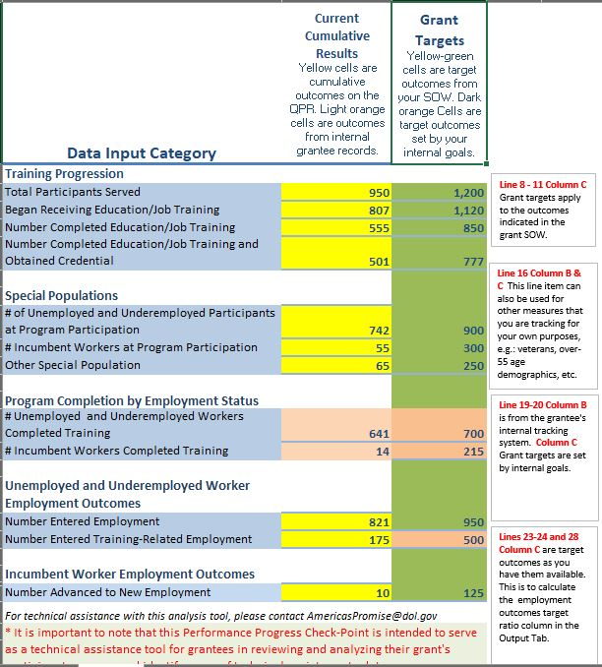
Enter outcomes targets and results to date…

Slide 29
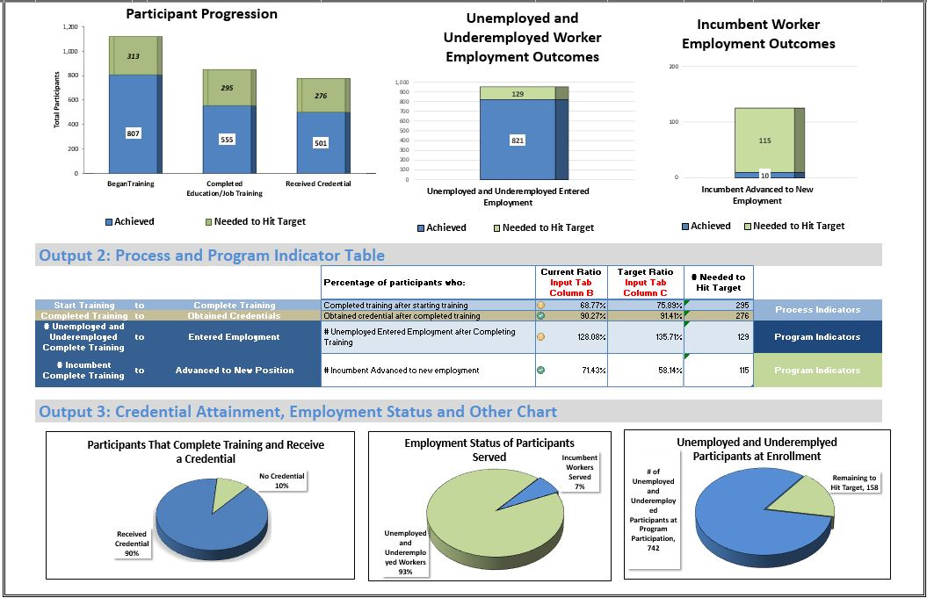
…and see your performance data visualized.

Slide 30
Performance FAQs
Participants Served vs Participants who Began Training
Recording Grant Funded Services
Reporting Participants exiting the H-1B program
Reporting Credentials and Measurable Skill Gains

Slide 31
Reporting Program Completion, Credential Outcomes and Employment Outcomes
PIRL 1813: Date Completed, During Program Participation, an Education or Training Program Leading to a Recognized Postsecondary Credential or Employment (WIOA)
Report the date an H-1B participant completes the final training they participated in during the grant. The data element does not reflect either that a participant has successfully received a recognized postsecondary credential, or employment.
Credential attainment is captured by PIRL 1800, 1802 and 1804 “Type of Recognized Credential (WIOA),” and PIRL 1801, 1803, 1805 “Date Attained Recognized Credential (WIOA)”
Employment is captured in PIRL 2118 “Date Entered Employment (Discretionary Grants)” and PIRL 2126 “Entered Training-Related Employment”
Refer the H-1B Training Activities and Outcomes Diagram for guidance

Slide 32
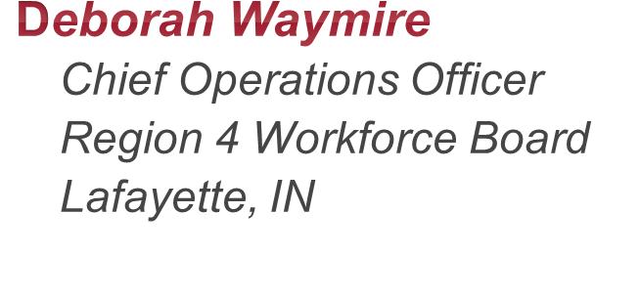
Grantee Profile Region 4 Workforce Board Lafayette, Indiana

Slide 33
Cohort Data

Slide 34
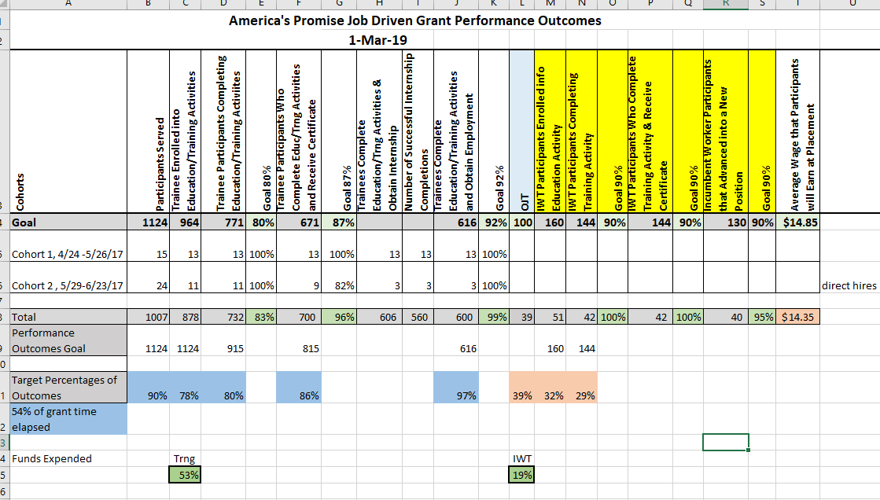
Goals Tracking Summary

Slide 35
Goals Tracking Summary Chart

Slide 36
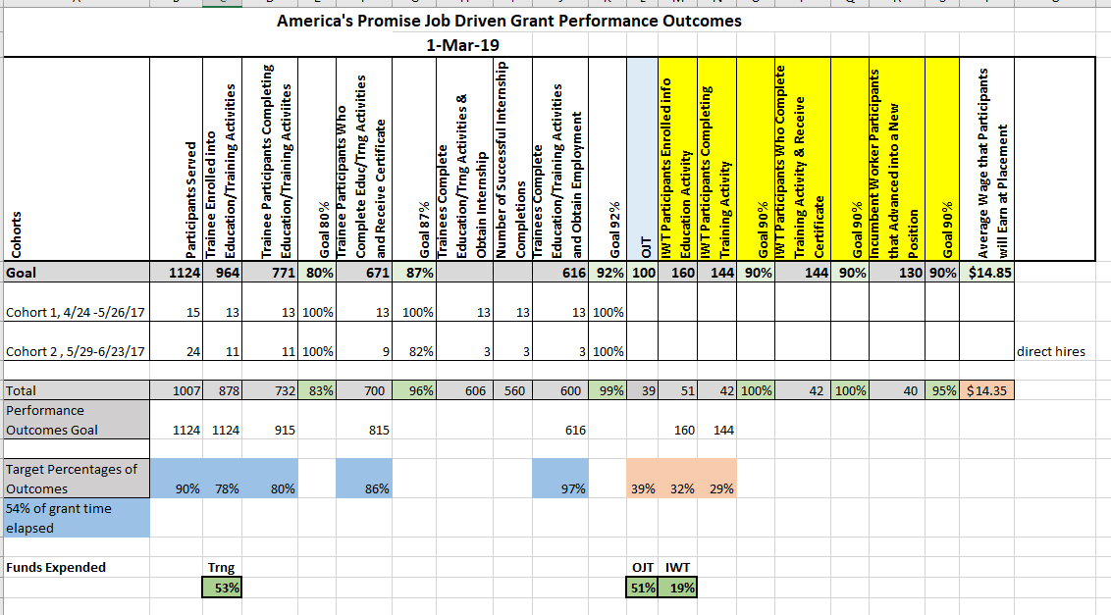
Goals Tracking with Budget

Slide 38
Performance Data for Evaluation Purposes

Slide 39
America’s Promise Evaluation
Implementation study
How were regional partnerships developed and maintained?
What are the types and combinations of services and approaches provided? How were they implemented?
What are the characteristics of those served?
What is the community context of America’s Promise grantees?
Impact study
What effect did America’s Promise have on education, training, and skill development? On labor market outcomes?
Did effects vary by participant characteristics or program components?

Slide 40
Data collection activities
Summer 2017
through
Winter 2020
Document review
(23 grantees)
Spring 2019
Grantee survey
(23 grantees)
Outreach to states for administrative records
Spring 2019
and
Spring 2020
Partner network survey
(6 grantees)
Late 2019/
Early 2020
Site visits
(12 grantees, including partner network survey grantees)
Phone interviews
(11 grantees)

Slide 42
Performance Reporting Office Hours
For the Quarter Ending 3/31/19:
Thursday, April 25, 2019
3:00 – 4:00 PM EST
Wednesday, May 1, 2019
1:00 – 2:00 PM EST
Tuesday, May 7, 2019
2:00 – 3:00 PM EST

Slide 43
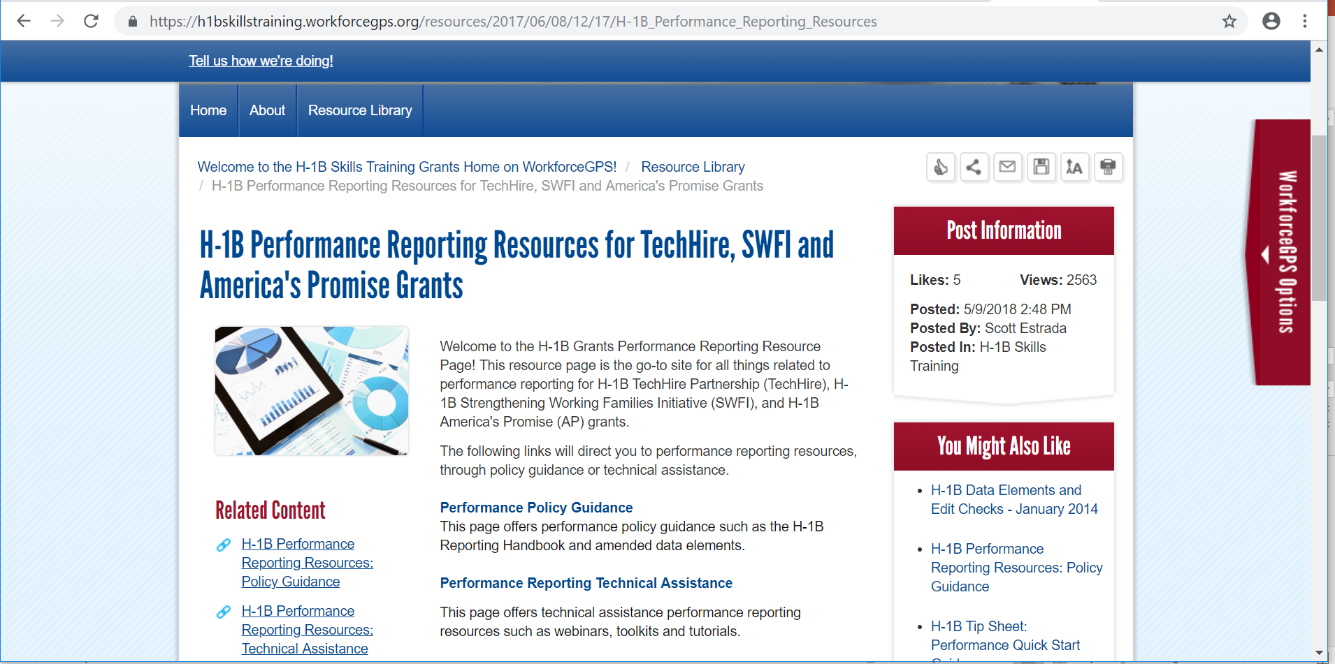
H-1B Performance Resources
Recently Updated Performance Resources
Amended ETA-9172 DOL PIRL for H-1B Grants
H-1B Grants Performance Reporting Handbook & WIPS Reporting Guidance
Sample Case Management and Data File
H-1B Training Activities and Outcomes Diagram:
H-1B WIPS TIPS
WIOA Primary Indicators of Performance Learning Modules

Slide 44
America’s Promise Grantee Mailbox AmericasPromise@dol.gov To Reach your Federal Project Officer, DOL National Office and Technical Assistance Providers

