Slide 2
Let’s get to know who is on the call today. Using the poll, select the role that you play.
State Workforce Agency Staff
State Workforce Development Board Staff
Local Workforce Development Board Staff
Local WIOA Youth Service Provider Program Management
Case manager, job developer or employment specialist
Federal Staff
Other

Slide 3
A WIOA Youth Program Technical Assistance Conversation: What do we have and what do we need?
April 29, 2019
Division of Youth Services
USDOL/ETA

Slide 4
Sara Hastings
Youth Policy and Performance Team, Division of Youth Services

Slide 5
Maisha Meminger
Youth Policy and Performance Team, Division of Youth Services
Evan Rosenberg
Youth Policy and Performance Team, Division of Youth Services

Slide 6
Our Team: Youth Policy and Performance, Division of Youth Services
LaSharn Youngblood
Renee Browne
Adrienne Bailey

Slide 7
Share what Technical Assistance (TA) has been produced
Explore what TA is still needed
Share the plans for the next phase of TA

Slide 8
Polling Question
Rate your knowledge of the WIOA Youth Program:
I’m an expert!
I know a good amount
I know a little bit, but would love to learn more
Never heard of it

Slide 9
Webinars
Enough is Known for Action series (2015)
Our Journey Together Series (2017-2018)
Designed to inspire strategic planning and encourage the workforce system to take action during the early implementation of Workforce Innovation and Opportunity Act (WIOA)
This on going technical assistance series was created to support the workforce system in their programming efforts to improve outcomes for youth.

Slide 10
Do you know all the WIOA Youth Program resources that exist ?

Slide 11
Who is a member of the Youth Community of Practice
Yes
No

Slide 12
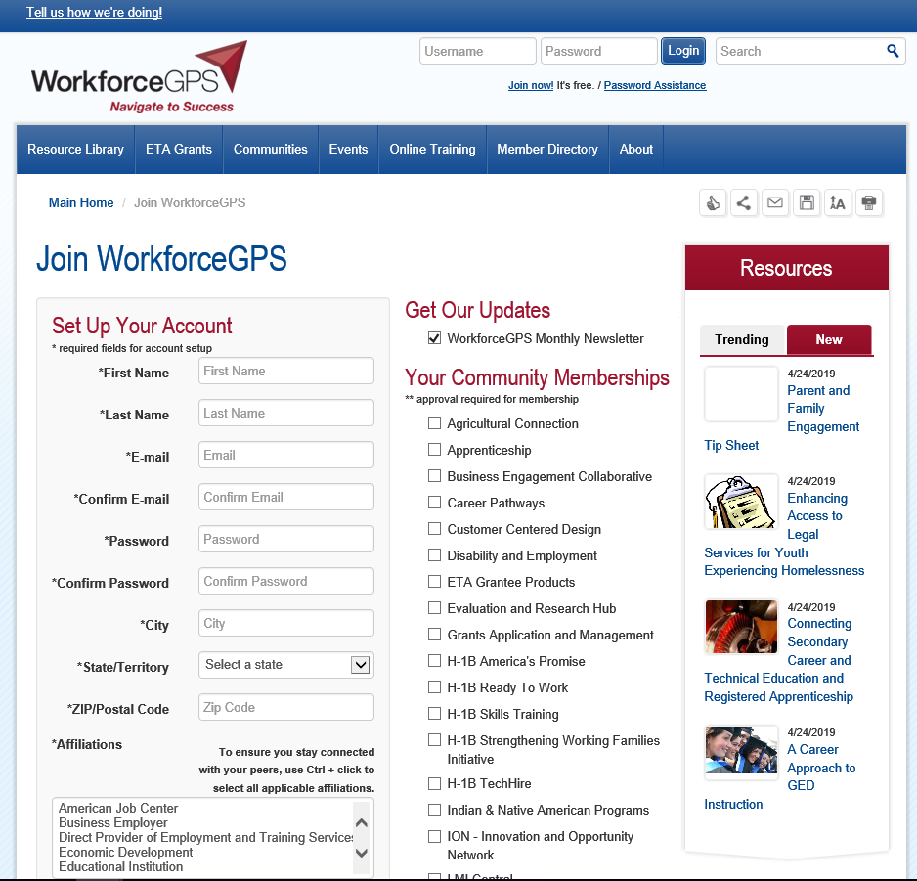

Slide 13
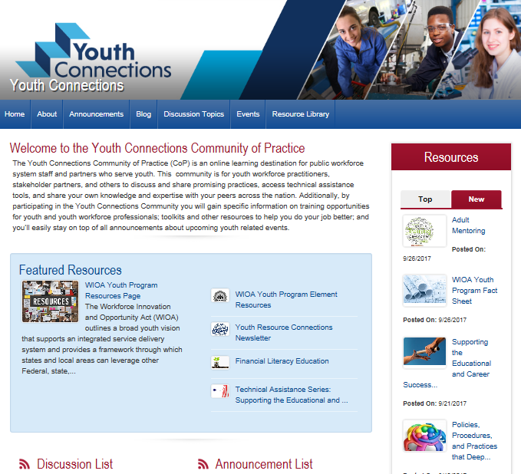
youth.workforcegps.org

Slide 14
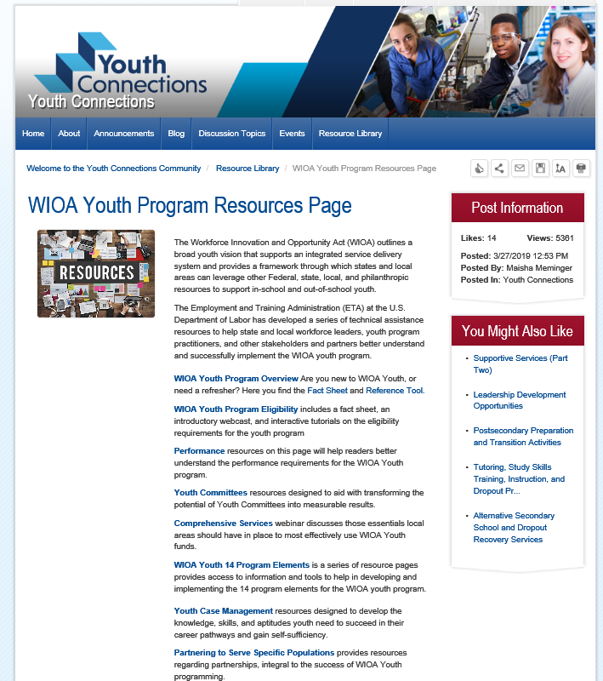

Slide 15
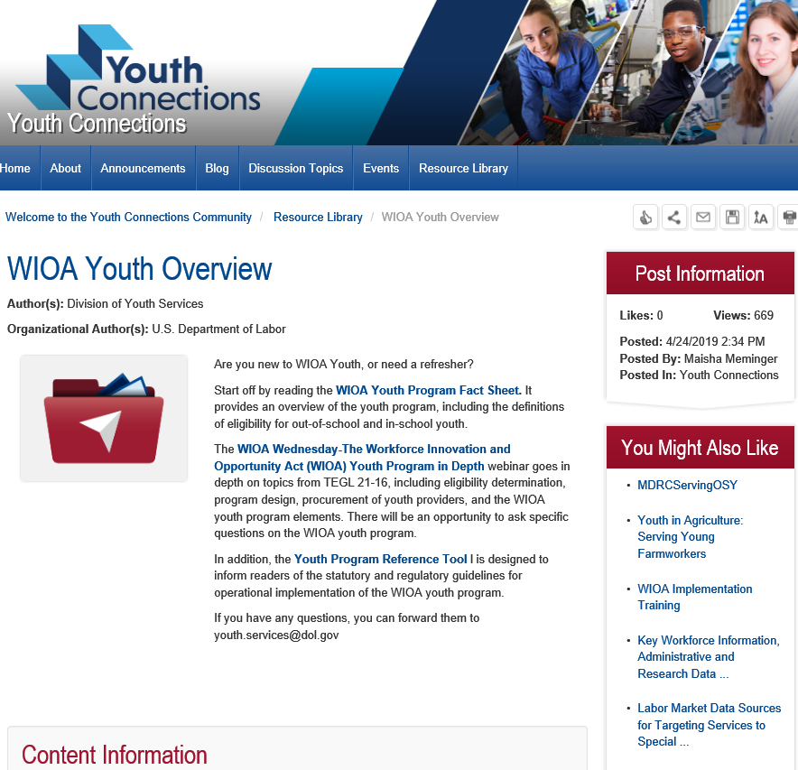

Slide 16
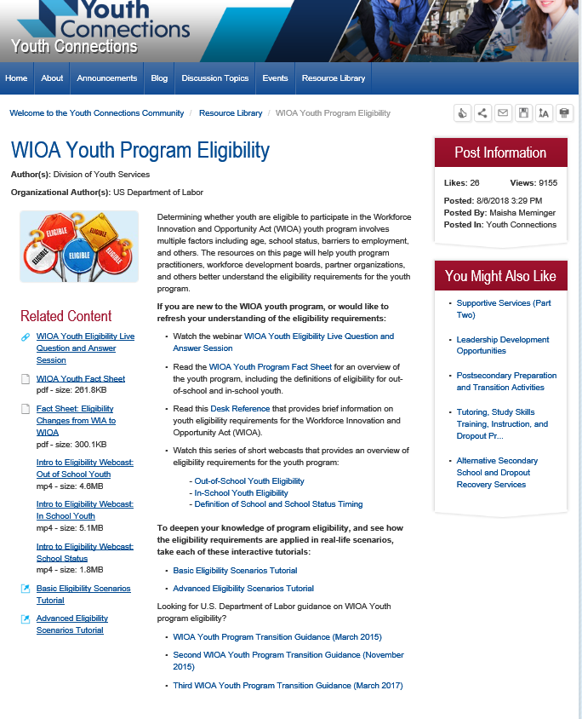

Slide 17
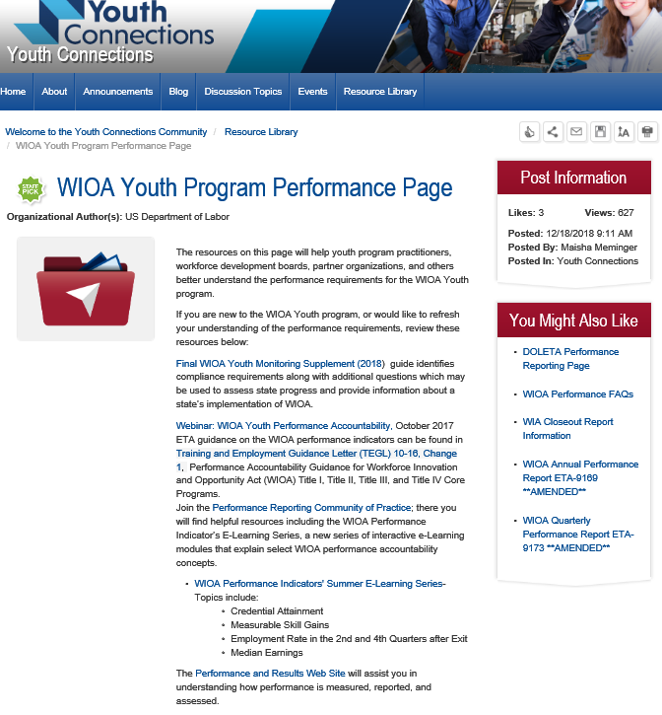

Slide 18
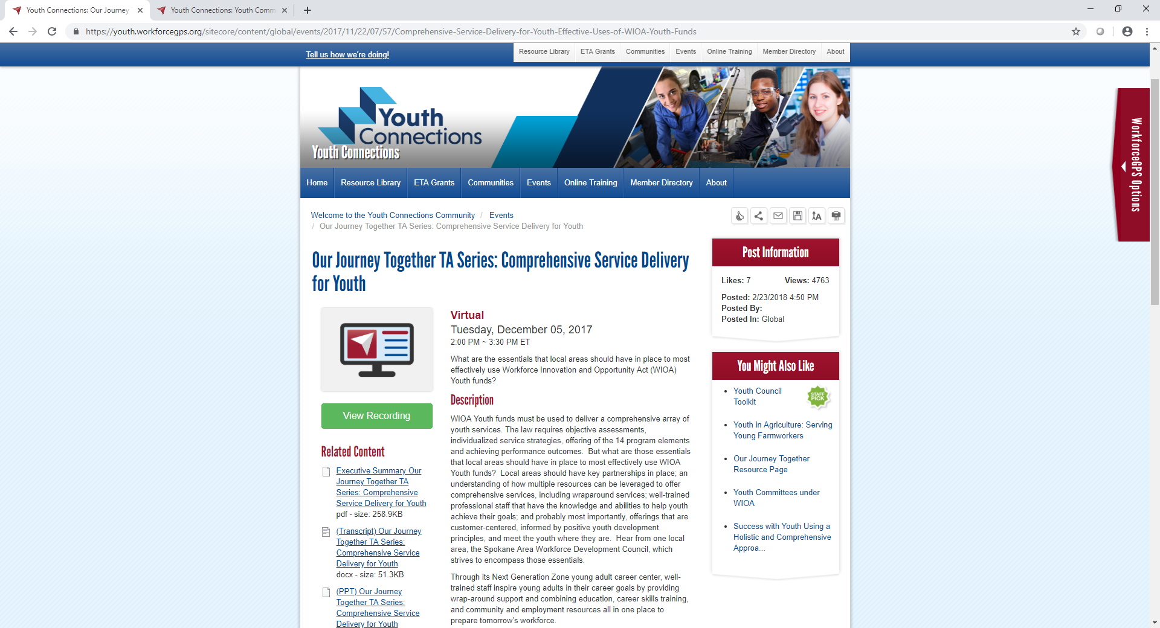

Slide 19
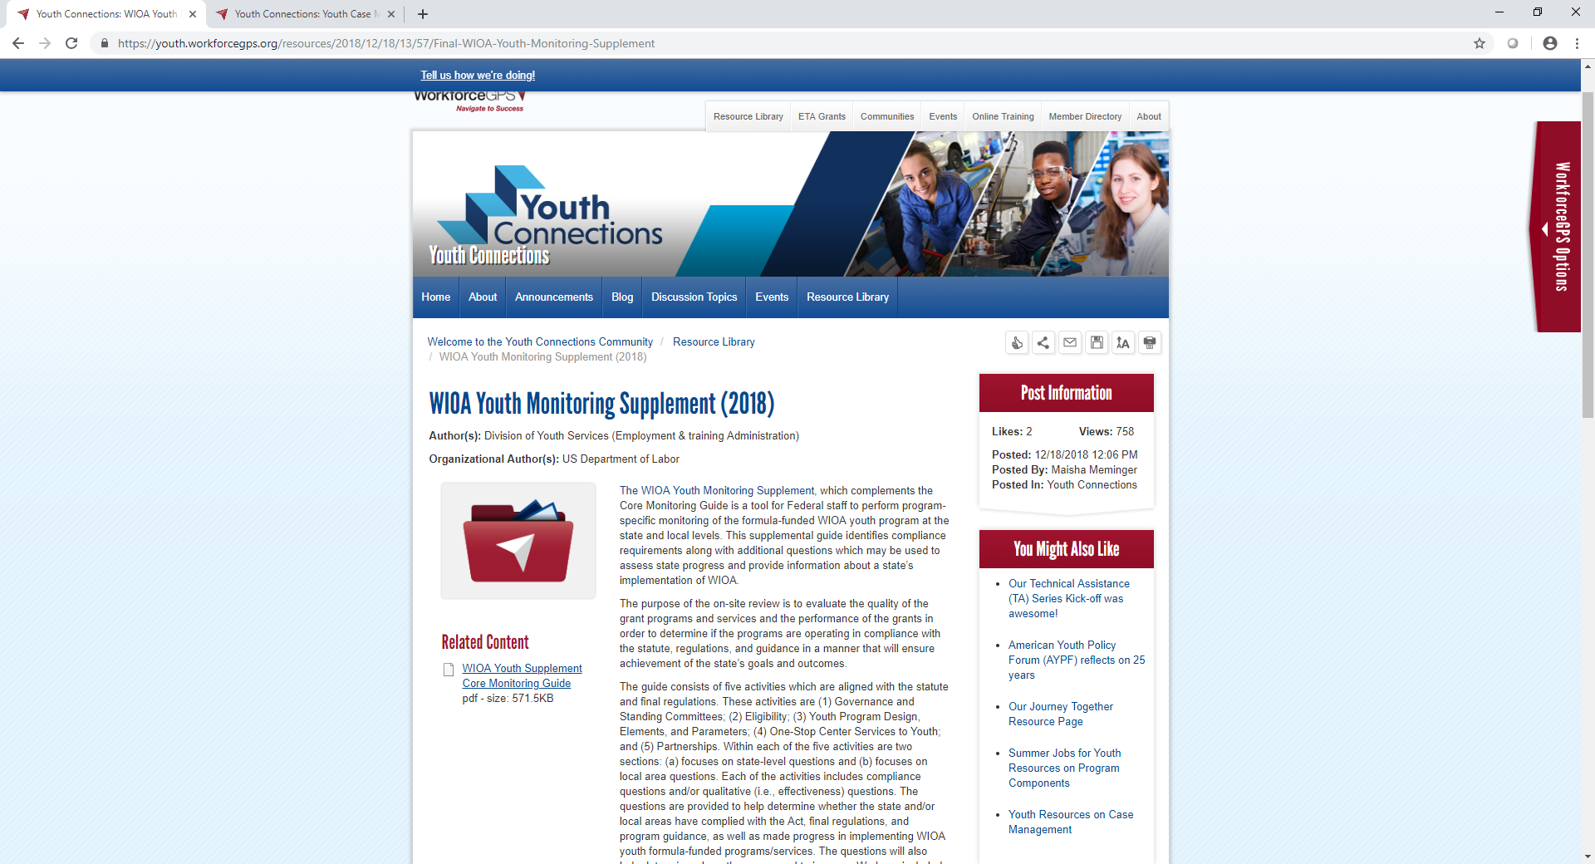

Slide 20
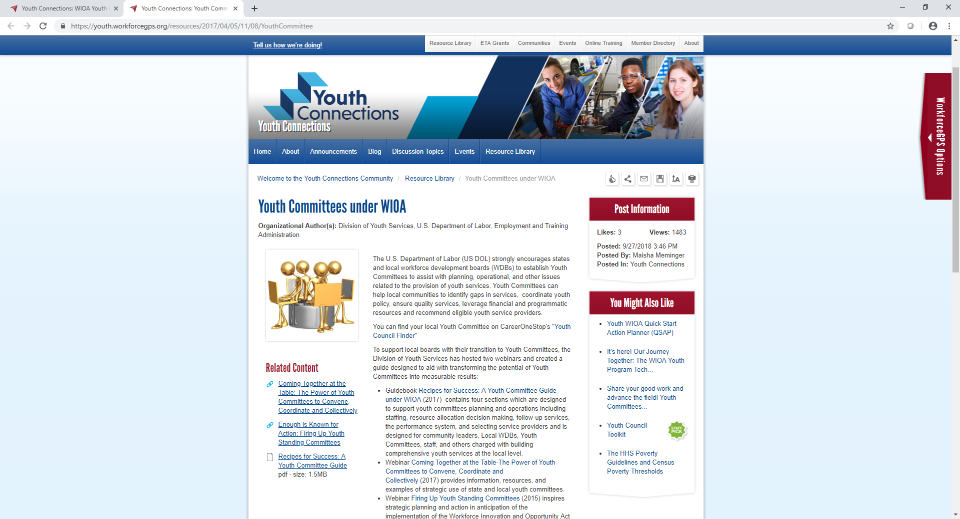

Slide 21
The 14 WIOA Youth Program Elements
Academic
Tutoring, study skills training, and evidence-based dropout prevention and recovery strategies
Alternative secondary school services
Education concurrent with workplace training
Vocational
Work experience year round and during the summer months
Occupational skills training
Leadership development activities

Slide 22
Services under the WIOA Youth Program (con’t)
Support
Supportive services
Adult mentoring
Follow-up services
Comprehensive guidance and counseling
Financial literacy education
Entrepreneurial skills training
Services that provide labor market information, such as career awareness, career exploration and career counseling
Preparation and transition to post-secondary education activities

Slide 23
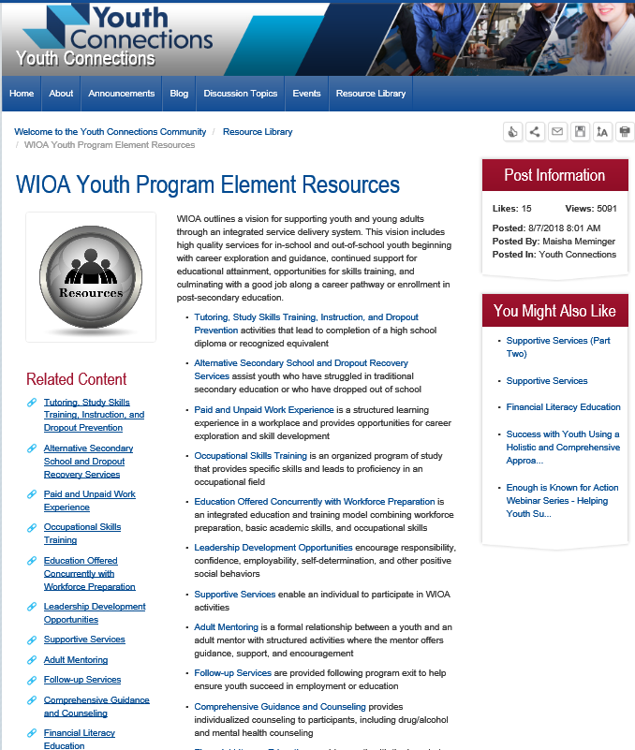

Slide 25
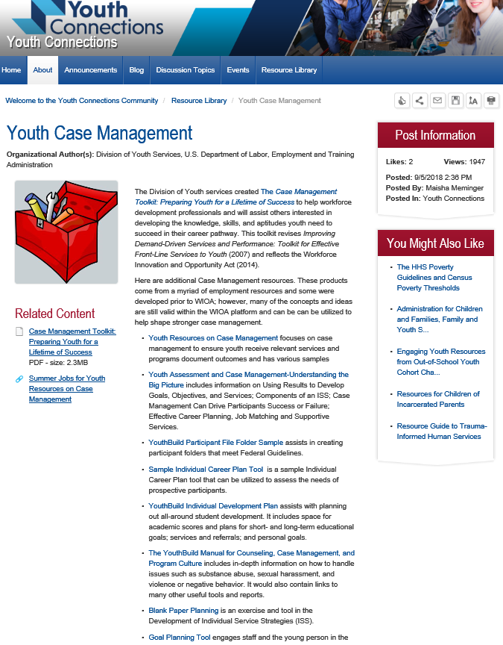

Slide 26
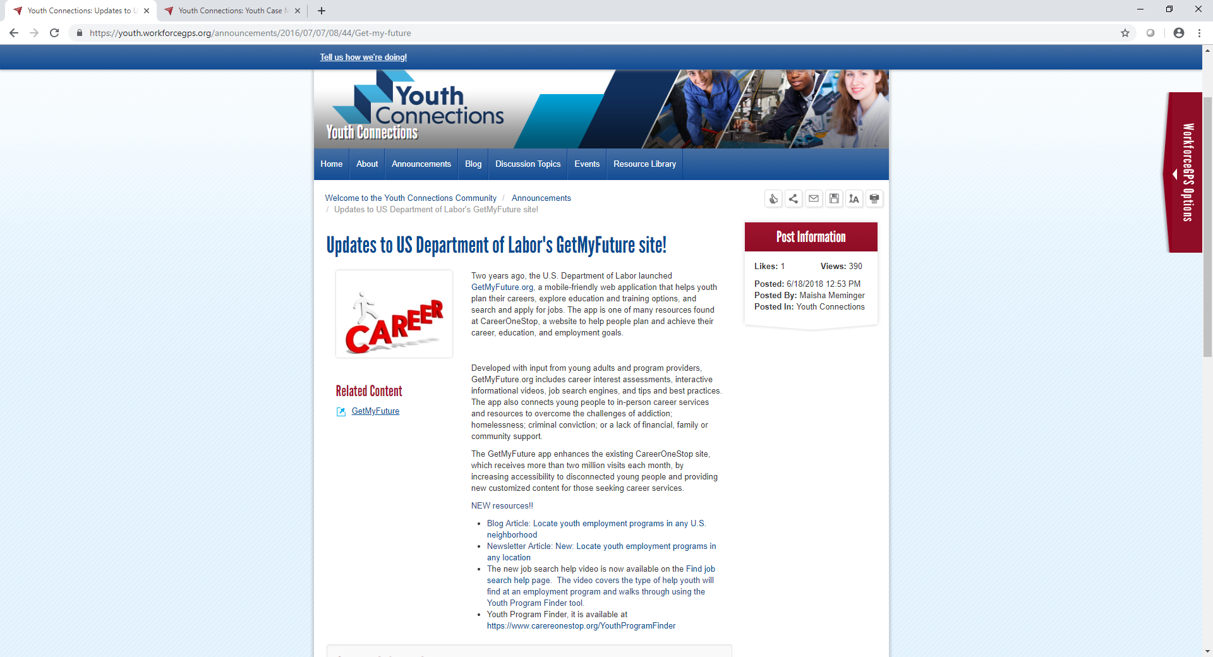

Slide 27
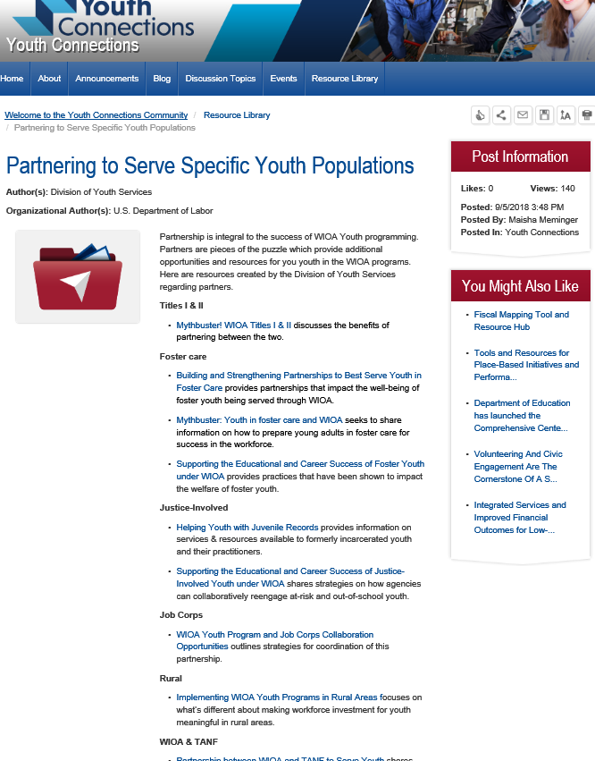

Slide 28
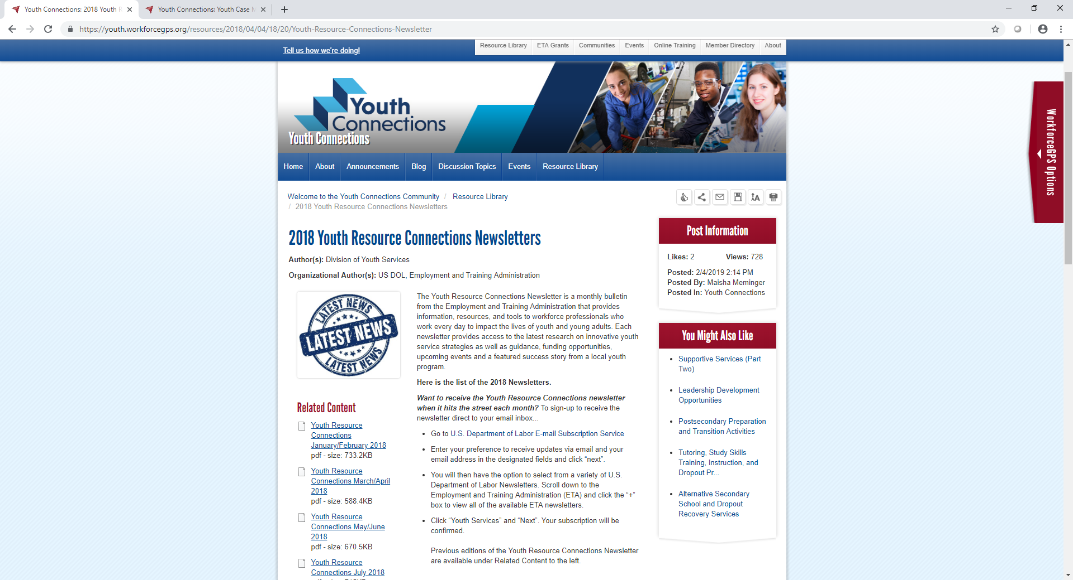

Slide 29
Technical Assistance Needs

Slide 30
Current TA Areas to Address (Click on all that apply)
Eligibility
Assessment/ISS/Case Management/Program Design
Out of School Youth and Work Experience Expenditures
Program Elements
Tracking/Reporting/Performance
Admin/Procurement/Monitoring of Local Areas or Service Providers
Policies Not Created or Followed

Slide 31
What other TA needs do you have?
Enter TA Needs into chat

Slide 32
What Method of Delivery Do You Prefer?
Webinar
Briefs/Documents
On-line Chats/Office Hours
Other? (please describe in chat feature)

Slide 33
What’s Next?
Driving the next phase of TA

Slide 35
Division of Youth Services
youth.services@dol.gov

