Slide 1
Supporting Military spouses in Licensed Occupations
Webinar
May 29, 2019, 3:00 p.m. EDT

Slide 2
Webinar Moderators
Pam Frugoli
O*NET/CareerOneStop/Competency Model Team Lead
Employment and Training Administration
Joe Quick
Consultant
Maher & Maher

Slide 3
Webinar Speakers
Nathan Batchelder
Director of External Affairs
Division of Professions & Occupations State of Colorado
Laura Bravo
Policy Analyst
Division of Professions & Occupations State of Colorado

Slide 4
Webinar Speakers
Mike Arismendez
Deputy Executive Director
Texas Department of Licensing & Regulation State of Texas
Jennifer Schultz
Program Principal
National Conference of State Legislatures Staff to NCSL Task Force on Military & Veterans Affairs

Slide 5
need for military Spouse occupational license Recognition Options
In October 2018, there were over 630,000 military spouses in the United States.
Military spouses are 10 times more likely to have moved to a new state in the last year due to military relocation.
License recognition challenges can result in :
Gaps in employment for military spouses
Financial instability for military families
Negative impacts to health and well-being
Decrease in military readiness of service members

Slide 6
“You've done your duty for your country. Now you're focused
on your own career. The Department of Regulatory Agencies
(DORA)… is committed to providing professional support and
customer service to military personnel, including Active Duty,
Reserves, National Guard, military spouses and Veterans.”
Colorado Department of Regulatory Agencies
https://www.colorado.gov/dora-military

Slide 7
Supporting Military Spouses in Licensed Occupations
Military spouses are a highly-educated, skilled talent pool.
35% of military spouses work in licensed occupations.
Challenges that arise from frequent relocation with an occupational license:
Differences in state laws and requirements
Multiple application fees
Inconsistent processes and timelines

Slide 8
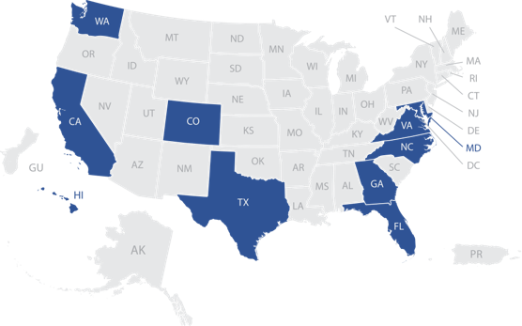
Project Background
State scan of top 10 states for number of military spouses, with focus on promising practices in effective implementation of license recognition options.

Slide 9
Three Audiences
State Licensing Boards
Military Spouses
Workforce Investment System

Slide 10
State Legislative Engagement and Trends
Jennifer Schultz

Slide 11
What is NCSL?
National Conference of State Legislatures
38,000 members (state legislators and staff)
We provide…
Support
Connections
Ideas
Strong voice in Washington, D.C.
www.ncsl.org

Slide 12
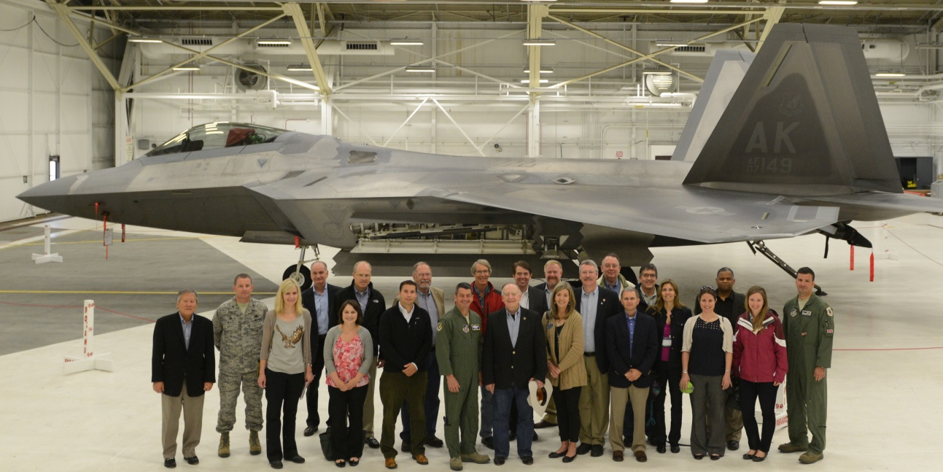
Task Force on Military and Veterans Affairs
44 members from 22 states and D.C.
Co-chairs
Rep. Tina Orwall (D-WA);
Rep. Dean Dohrman (R-MO)
Examines issues affecting
Military-community relations
The health and well-being of service members, veterans and their families
History of action on occupational licensing

Slide 13
Primary Objectives
Identify licensing criteria to ensure that existing and new licensing requirements are not overly broad, burdensome or restrictive, and that they do not create unnecessary barriers to labor market entry.
Improve the portability and reciprocity provisions for selected occupations across state lines.

Slide 14
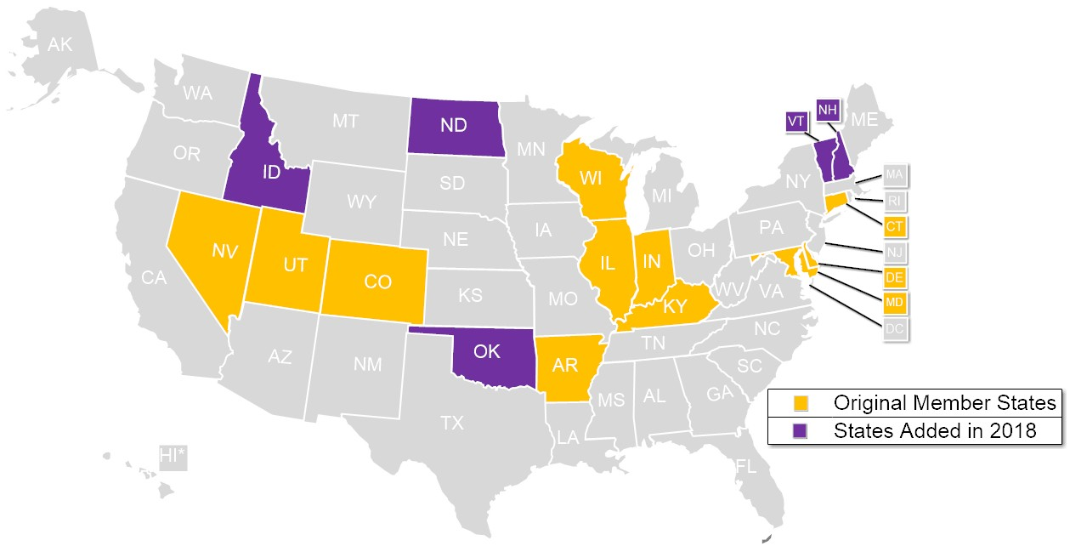
Occupational Licensing Learning Consortium

Slide 15
Recent State Legislation
100+ bills introduced in 2018-2019 state legislative sessions
Categories:
Fee waiver (2019 NE LB 112; 2019 OK SB 670)
Physical Therapy Licensure Compact (many states)
Teacher licensure (2018 NM SB 97; 2019 ND SB 2306)
Expedited licensure (2019 MS SB 2452)
Exemption from licensure
2018 UT SB 227
2019 AZ HB 2569
2019 AR SB 564
2019 SD HB 1111

Slide 16
Resources
NCSL Report, Barriers to Work: Veterans and Military Spouses (July 2018)
NCSL Military and Veterans Affairs State Legislation Database
NCSL Occupational Licensing webpage
NCSL Task Force on Military and Veterans Affairs webpage
Jennifer Schultz | jennifer.schultz@ncsl.org | 303-856-1353

Slide 17
State efforts: Colorado and Texas
Nathan Batchelder, Laura Bravo, and Mike Arismendez

Slide 18
Colorado Efforts and Commitment

Slide 19
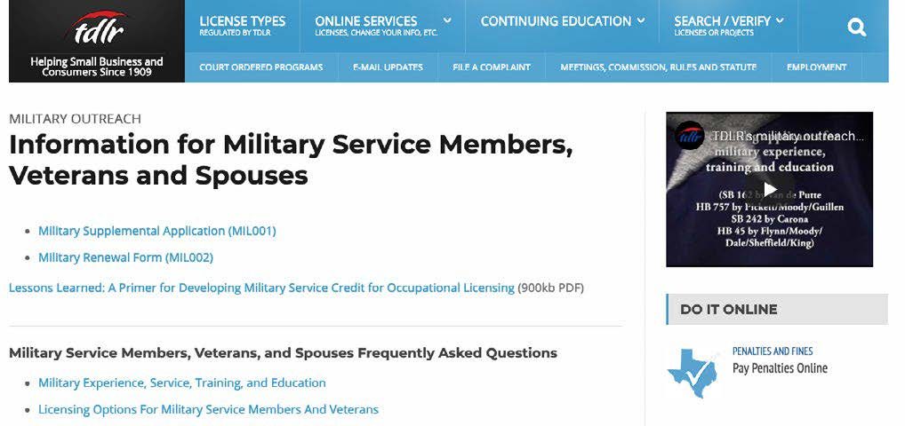
Texas Efforts and Commitment

Slide 20
PROMISING PRACTICES for LICENSE RECOGNITION FOR MILITARY SPOUSES
Adopting license recognition options for military spouses
Clearly explaining the license recognition options available for military spouses
Creating a simple application process
Waiving application fees
Training licensing board staff
Providing a knowledgeable point of contact

Slide 21
Promising Practice: Adopting license Recognition options for Military Spouses
State Legislation Providing Flexibilities to Military Spouses
48 states have legislation
Interstate Licensing Compacts and Agreements
Nursing (33 states)
Physical Therapy (25 states)
EMS (18 states)
Teaching (46 states)
Lawyers (36 states)
https://www.veterans.gov/milspouses/

Slide 22
Promising Practice: Adopting license Recognition options for Military Spouses
LICENSING BY ENDORSEMENT (also known as “recognition”). Licensing board issues a permanent license to applicants who hold a valid license in another jurisdiction with similar standards, without further examination.
TEMPORARY LICENSING. Allows an individual to practice their profession for a designated period of time, while fulfilling the requirements to qualify for a permanent license in their new state.
EXPEDITED APPLICATION REVIEW. Expedited review of applications allows military spouses to begin work in their field quickly, upon relocation to a state.

Slide 23
Promising Practice: Clearly Explaining the Options Available for Military Spouses
Prominently display info about options
Use the phrase “military spouse” in menu items and links
Provide clear links to applications
Use plain language to describe processes

Slide 24
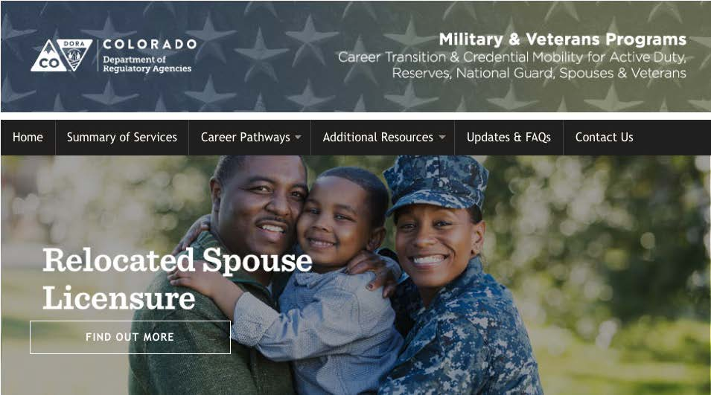
Clearly Explaining the Options Available for Military Spouses

Slide 25
Clearly Explaining the Options Available for Military Spouses

Slide 26
Promising Practice: Creating a Simple Application Process
Modify existing applications
Using supplemental application forms
Include easily located and comprehensive FAQs, fact sheets and scenarios

Slide 27
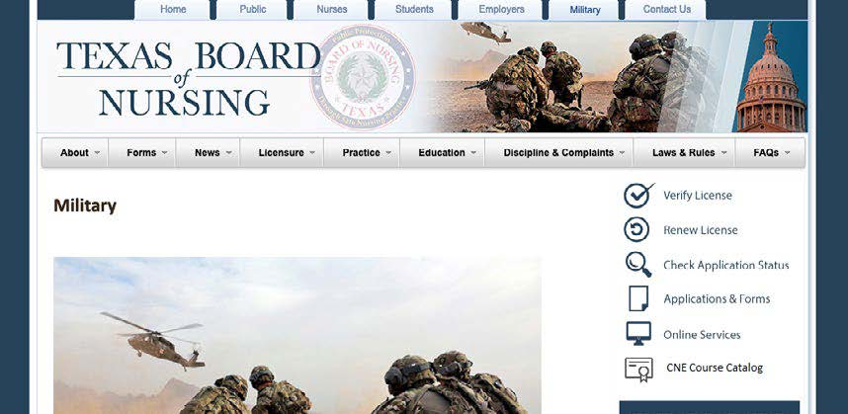
Creating a Simple Application Process

Slide 28
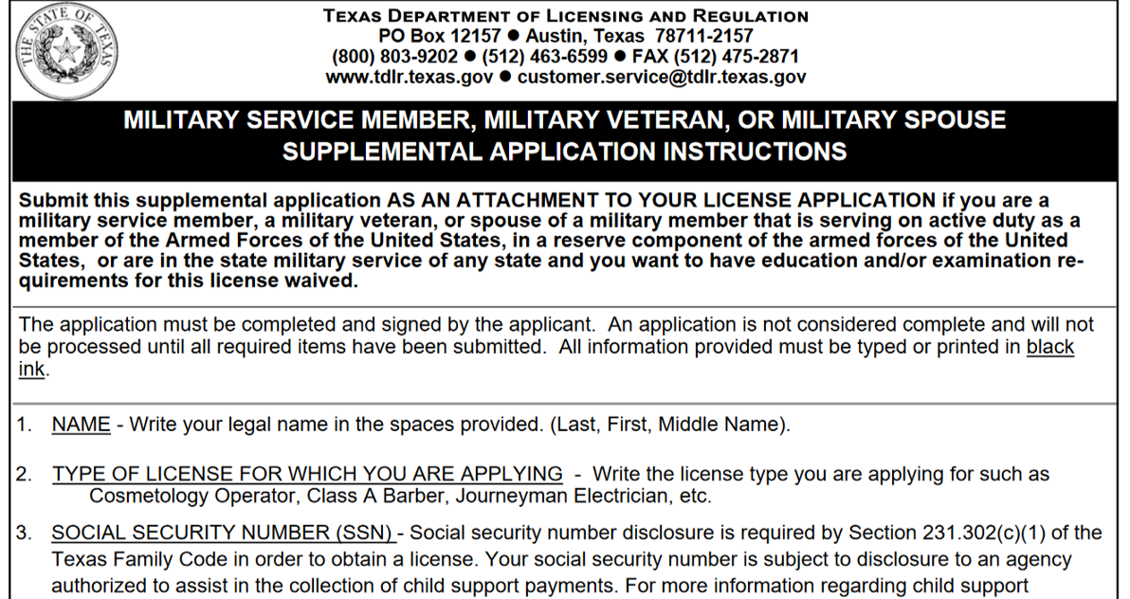
Creating a Simple Application Process

Slide 29
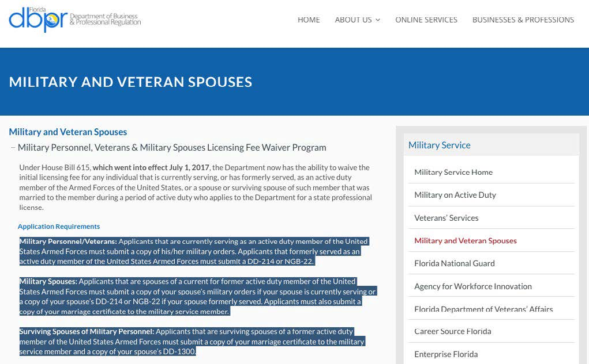
Promising Practice: Waiving Application Fees

Slide 30
Promising Practice: Training Licensing Board Staff
Full implementation of recognition options includes adequately training staff to create awareness and understanding of military spouse license recognition options.

Slide 31
Promising Practice: Providing a knowledgeable Point of Contact
Have experts on hand to answer questions and provide consistent support across multiple agencies and boards. These contacts can provide support to military spouses directly and to licensing board staff.

Slide 32
Questions & Discussion
PROMISING PRACTICES FOR LICENSE RECOGNITION FOR MILITARY SPOUSES
Adopting license recognition options for military spouses
Clearly explaining the license recognition options available for military spouses
Creating a simple application process
Waiving application fees
Training licensing board staff
Providing a knowledgeable point of contact

Slide 33
additional resources coming summer 2019

Slide 34
One-on-One Technical Assistance for Licensing Boards & Agencies
Promising practice consultation
Website and resource review
Contact Joe Quick at jquick@mahernet.com to request assistance

