Slide 2
Who are you?
Trade Program Staff
Reporting Staff
Fiscal Staff
Other (write in comments)

Slide 4
Promising Practices that Support Accurate Fiscal Tracking and Reporting
June 21, 2019
June 18, 2019

Slide 5
Tim Theberge
Lead Policy Analyst
USDOL/ETA/OTAA

Slide 6
OTAA Overview
Accrual Reporting: why it matters and where to find resources for doing it correctly
Promising Practices from the Field
Massachusetts – Local office accrual reporting for training expenditures
Florida – State presentation
Georgia – State presentation
Resources for Developing Systems
Leveraging case management funds
Identifying Changes you can latch onto in your state
Related technical Assistance

Slide 7
Fiscal Overview

Slide 8
Why Accrual Reporting?
Regulatory formula for allocation of TaOA funding
TRA budgeting projections and allocation of funds
Reporting to Congress on cost of training per participant

Slide 9
Why Align Fiscal and Program?
TAA was the first program to combine line item financial reporting and performance reporting
Requires cross-validation and communication between program and financial offices
Data is used in reauthorization efforts and therefore must be accurate

Slide 10
SMART Training Resources
SMART 3.0 Training: https://grantsapplicationandmanagement.workforcegps.org/resources/2019/06/03/14/09/2019-Dallas-SMART-Training-PowerPoint-Presentations

Slide 11
Uniform Guidance
2 CFR 200.400 [emphasis]
(a) The non-Federal entity is responsible for the efficient and effective administration of the Federal award through the application of sound management practices.
2 CFR 200.302 [excerpt]
… systems … must be sufficient to permit the preparation of reports … to a level of expenditures adequate to establish that such funds have been used according to the Federal statutes, regulations…
… Accurate, current, and complete disclosure of the financial results…
…Effective control over, and accountability for, all funds…

Slide 12
Contract Tracking Database
A better way to track Training Contracts, Obligations, Accruals and Expenditures

Slide 13
Steve Trueman
Vice President of Workforce Operations
MassHire Hampden County Workforce Board, Inc.

Slide 14
WHAT WAS OUR MOTIVATION FOR CREATING THE DATABASE?
Multiple staff using separate spreadsheets
Same information repeated multiple times
Different purposes
Contract Facilitator-Contract Tracking by Vendor and by Grant
Senior Accountant-Obligation and Accrual Tracking by Grant
Senior Accounts Payable-Payment Tracking by Grant
Highly inefficient and time consuming
How can we improve efficiency and accuracy while maintaining checks and balances?

Slide 15
STAKEHOLDERS
INTERNAL - STAFF
Reduce Duplication of Effort while maintaining/improving ability to accomplish individual required tasks and roles
EXTERNAL – FUNDERS AND VENDORS
Funders
Reporting accuracy
Vendors
Contracting and payment efficiency

Slide 16
STAKEHOLDERS
Consultant-Database Expert
Consultant-spent time with each staff understanding:
What their role is in the process- Tracking and Reporting
How they are currently performing that role
Why they do what they do
Where the information is currently entered
Concept Development
Database Forms and Tables-Reduce duplication & Increase accuracy
Move from Data entry to Data verification

Slide 17
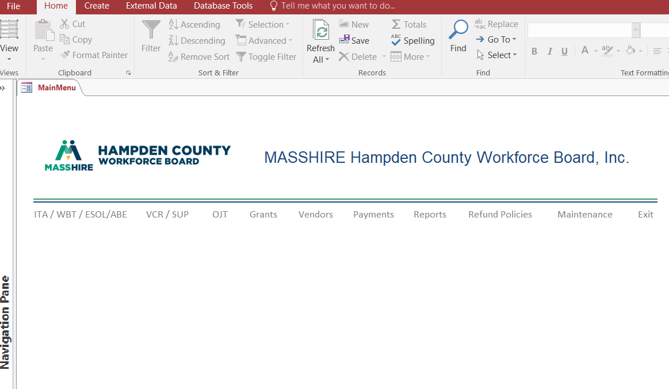
Contract Tracking Database - Microsoft Access

Slide 18
Grant Tracking Form

Slide 19
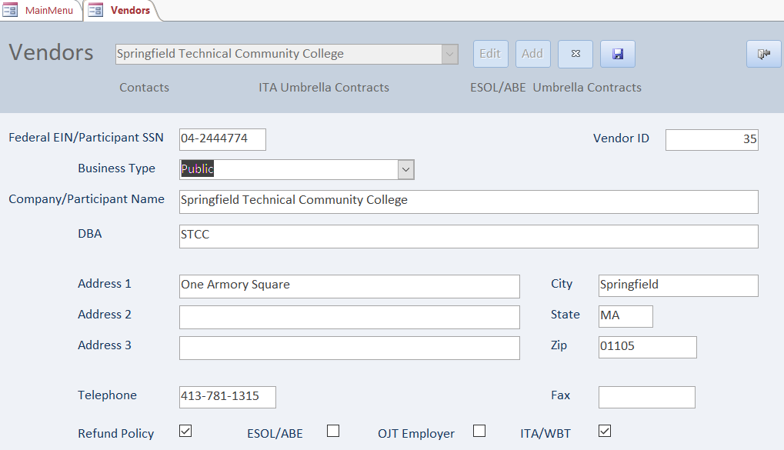
Vendor Tracking Form

Slide 20
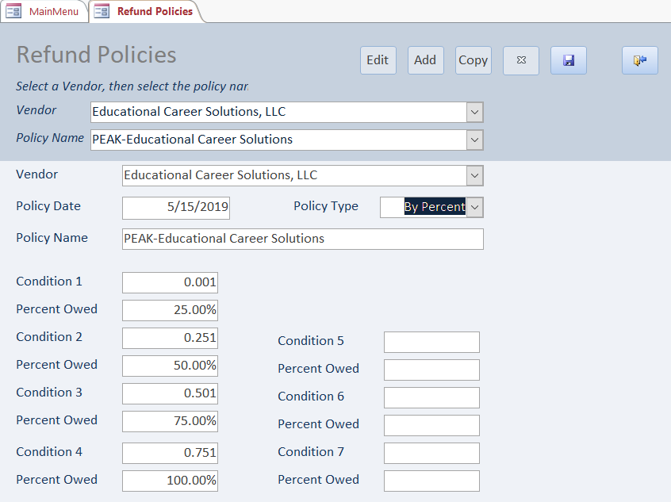
Vendor Refund Policy Form

Slide 21
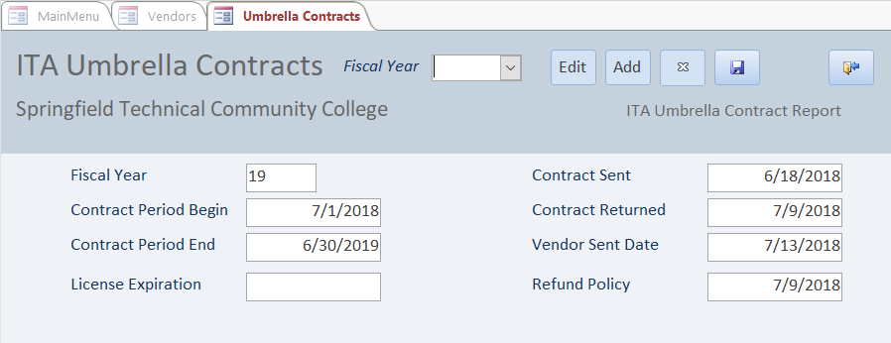
Umbrella Contract

Slide 22
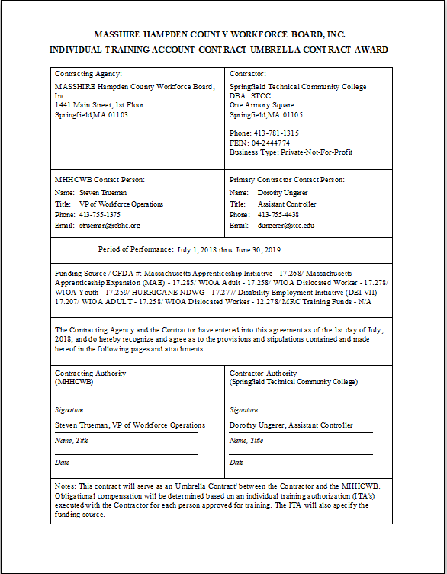
ITA Umbrella Contract Face Sheet

Slide 23
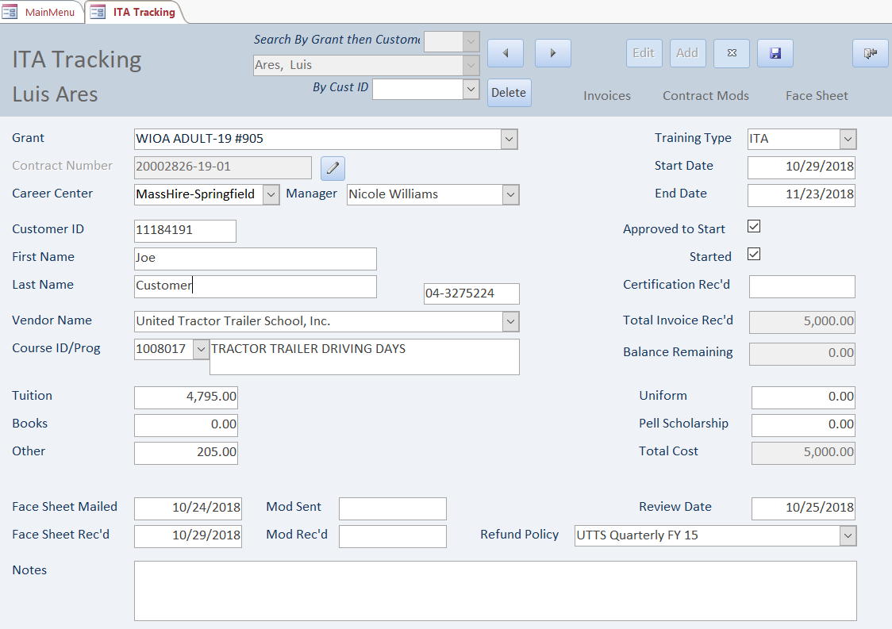
ITA Tracking Form

Slide 24
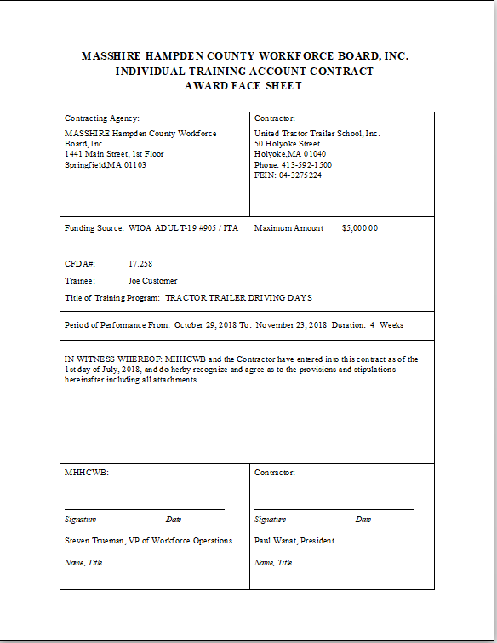
ITA Face Sheet

Slide 25
Payment Tracking Form

Slide 26
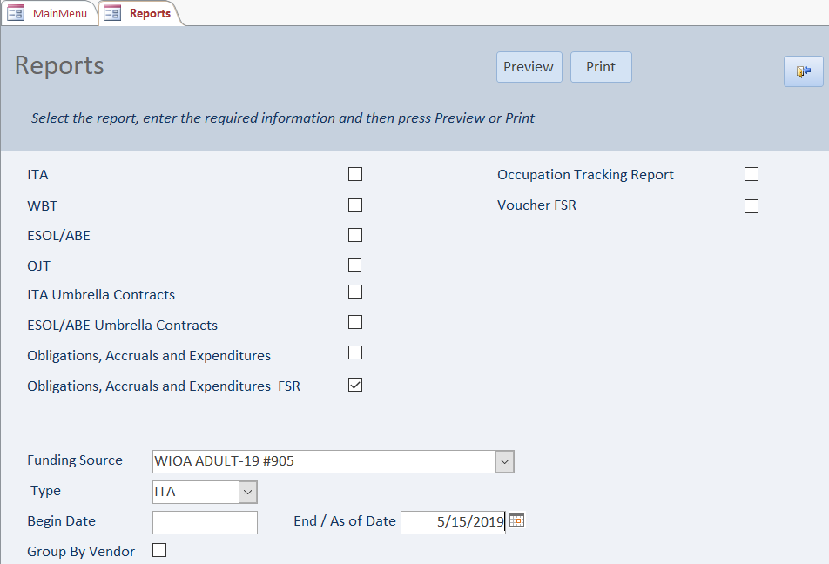
REPORTS FORM

Slide 27
Obligations, Accruals and Expenditures
Database Calculates for each training contract
Obligations – Fully obligated as of Start Date of Training
Expenditures – Sum of payments made as of the report date
Accruals – Amount owed based on Vendor Refund Policy given amount of training completed as of report date less any payments made

Slide 28
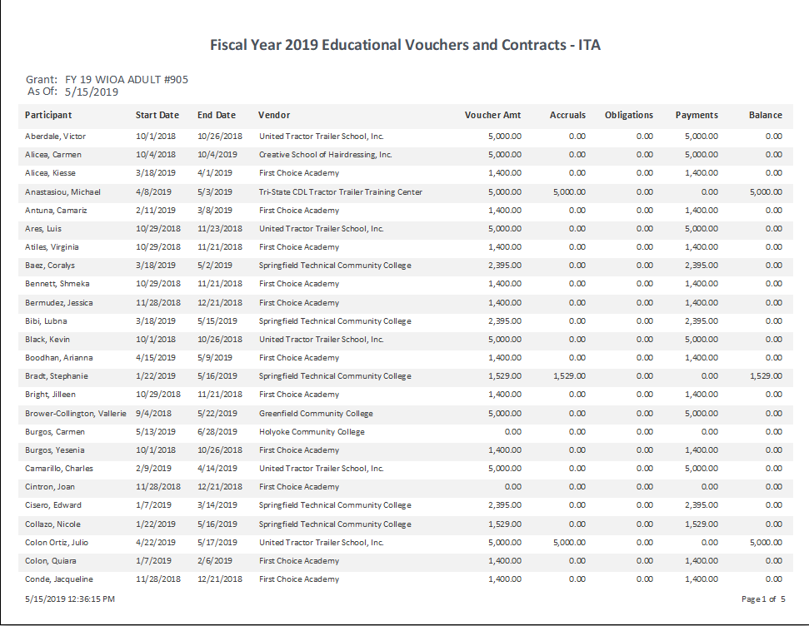
Obligations, Accruals and Expenditure

Slide 29
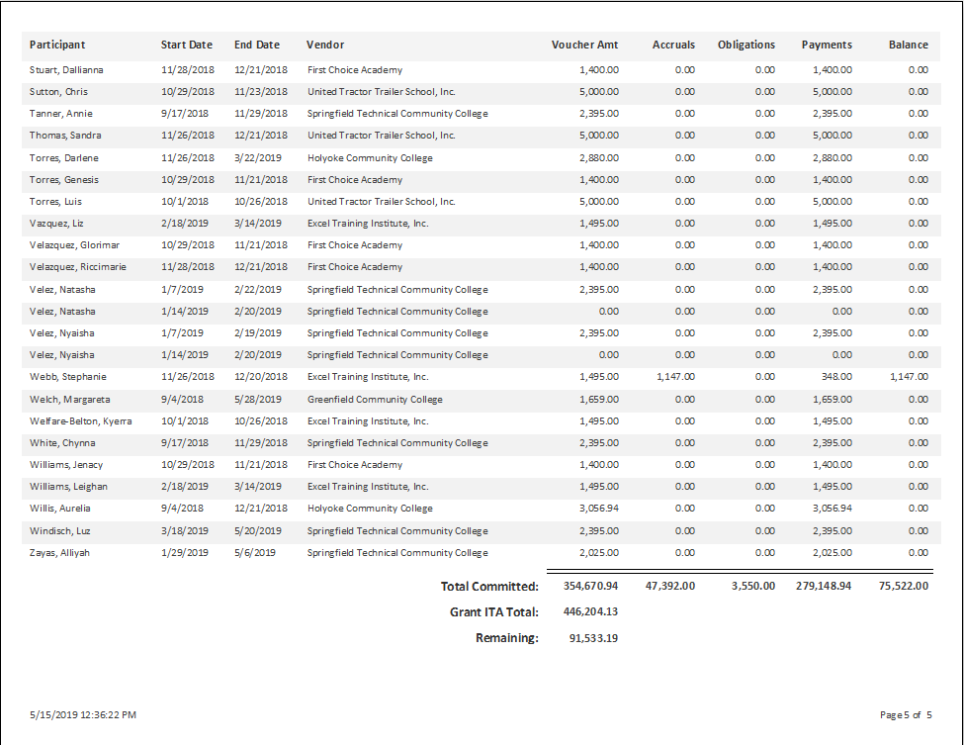
Obligations, Accruals and Expenditure

Slide 30
Other Benefits of Database
Ad Hoc Reporting
Vendors
Contract Tracking
SEFA – CFDA
Accrued Expenditures not yet Invoiced
Pell/Scholarship
Career Centers/Local Areas
Training reports for Follow-up
Targeted Occupations – In Demand Labor Market
# of training contracts and investment by Occupation

Slide 31
Fiscal TAADI Results
Florida
Measure | FY18 Q1 | FY18 Q2 | FY18 Q3 | FY18 Q4 | FY19 Q1 | FY19 Q2
Training Expenditures | Pass | Pass | Pass | Adjustment | Pass | Pass
TRA Expenditures | Pass | Pass | Pass | Pass | Pass | Pass
A/RTAA Expenditures | Pass | Pass | Pass | Pass | Pass | Pass
Job Srch / Reloc Exp | Discrepancy | Pass | Pass | Pass | Pass | Pass
Georgia
Measure | FY18 Q1 | FY18 Q2 | FY18 Q3 | FY18 Q4 | FY19 Q1 | FY19 Q2
Training Expenditures | Discrepancy | Pass | Pass | Pass | Pass | Pass
TRA Expenditures | Pass | Pass | Pass | Pass | Pass | Pass
A/RTAA Expenditures | Pass | Pass | Pass | Pass | Pass | Pass
Job Srch / Reloc Exp | Discrepancy | Pass | Pass | Pass | Pass | Pass

Slide 32
Steven Gustafson
State Trade & Rapid Response Coordinator
Florida Department of Economic Opportunity

Slide 33
Communication, Guidance and Coordination The Foundation of Trade Adjustment Assistance (TAA) Fiscal Integrity
“In this age, I don't care how tactically brilliant you are…if you cannot create harmony across coalition and national lines you need to go home, because your leadership is obsolete.”
― Ret. USMC General James Mattis

Slide 34
Florida’s workforce structure
Communication to ensure fiscal integrity
Fiscal training and guidance
Coordination and the reconciliation process

Slide 35
Florida’s Workforce Structure
DEO administers programs and provides technical assistance
CareerSource Florida acts as the statewide workforce policy and investment board
24 Distinct Local Workforce Development Boards (LWDB) oversee the one-stop delivery system within their respective geographic area

Slide 36
Communication
Weekly
Monthly
Quarterly
Program & Performance
Program & Financial Management
Program, Performance & Financial Management

Slide 37
Guidance

Slide 38
TAA Funding Policy
Provides consolidated guidance to all partners
Identifies when and where to report training costs
Explains cost categories
Defines accrual accounting with relation to TAA
Creates consistency

Slide 39
Coordination

Slide 40
PIRL (Denominators)
1
Trade Readjustment Allowance (TRA)
Reemployment Trade Adjustment Allowance (RTAA)
Training
Job Search
Relocation

Slide 41
9130(M) (Numerator)
2

Slide 42
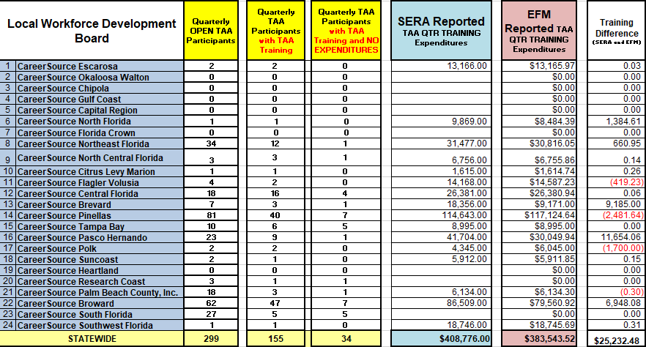
Reconciliation
3

Slide 43
Reconciliation Overview
4
Financial Management
Program
Performance
Coordinate with LWDB program management
Develop long-term strategies to mitigate issues identified by TAADI
Financial data from the numerator (Participant Individual Record Layout (PIRL) value)
Identify anomalies (Self-Check tool)
Financial data from the denominator (9130 value)
Coordinate with LWDB financial management

Slide 44
Fiscal Reporting in Georgia

Slide 45
Damon Weller
Performance & Reporting Supervisor
Georgia Department of Labor

Slide 46
Georgia’s Planning for TAADI
1
Teams involved:
Finance Staff
Performance Reporting Staff
TAA Program Staff
Items reviewed:
Overview of TAADI financial measures discussed
Each team presented what their current role was in Trade reporting
Group reviewed possible options to matching financial cumulative data to individual level quarterly reporting

Slide 47
Georgia’s Implementation of TAADI
2
Accounting system was modified to include SSN for matching to individual level records
A process was implemented by which TAA program staff entered information directly into the financial system to determine proper account usage (i.e. books, tuition, relocation, etc.)

Slide 48
Georgia’s Financial Approval Process
3
Vendor
Submit Invoices
Program Staff
Enter requisitions directly into financial system
Program Manager
Verifies and approves requisitions

Slide 49
Georgia’s Financial Approval Process
4
Budget
Approval based on available funds
Special Accounting
Process paperwork for payment
Accounts Payable
Issue payment to vendors

Slide 50
Georgia’s Implementation of TAADI
5
Finance staff created a means by which reporting staff can validate Trade-related accruals/expenditures at any point for record reconciliation
The various teams met together for the first quarterly submissions to review the results and ensure processes were working effectively

Slide 51
Georgia’s Ongoing Process
6
Monthly review of accruals/expenditures is conducted to ensure a match between individual record and ETA-9130 based cumulative reporting
ETA-9130 is validated with the Trade PIRL before final submission, each quarter.
Performance Reporting staff is notified when any financial adjustments are made between funding years

Slide 52
Henry Ford
If everyone is moving forward together, then success takes care of itself.

Slide 53
Money Projected to be Returned on September 30, 2019 (as of March 31, 2019 report quarter)
$148,618,037.39

Slide 54
SMART 3.0 Training
ETA’s Latest Training on Financial and Administrative Management for Grantees
https://grantsapplicationandmanagement.workforcegps.org/resources/2019/06/03/14/09/2019-Dallas-SMART-Training-PowerPoint-Presentations
Reporting Training in PIRL FAQ
FAQ that details how to report Training in PIRL
https://www.doleta.gov/tradeact/taa-data/participant-reporting/docs/PIRL_Training_Reporting_FAQ.pdf
Reporting TRA and A/RTAA in PIRL FAQ
FAQ that details how to report TRA and A/RTAA activities in PIRL
https://www.doleta.gov/tradeact/taa-data/participant-reporting/docs/PIRL_TRA_ARTAA_Reporting_FAQ.pdf

Slide 55
Trade Adjustment Assistance (TAA) Fiscal and State Best Practices Webinar
This 2013 webinar discusses fiscal and state best practices.
https://www.workforcegps.org/events/2014/07/08/13/59/trade-adjustment-assistance-taa-fiscal-and-state-best-practices-webinar
The TAA 9130 Report: Changes and Common Questions
Webinar on reporting on the ETA-9130 forms
https://www.workforcegps.org/events/2016/08/19/08/17/The_TAA_9130_Report-_Changes_and_Common_Questions
Applying “Lean” Strategies to Case Management
This webinar focuses on how “lean” strategies can be used to help make case management more effective and efficient.
https://www.workforcegps.org/events/2019/04/22/19/49/Applying-Lean-Strategies-to-Case-Management
TAA Case Management
This webinar focuses on the importance of case management and provides state promising practices.
https://www.workforcegps.org/events/2018/10/11/14/17/TAA-Case-Management
Additional TAA Webinars
Find more webinars presented by the Office of Trade Adjustment Assistance
https://www.doleta.gov/tradeact/taa-webinars/

Slide 57
Serving English Language Learners under the Trade Adjustment Assistance (TAA) Program
July 19, 2019, 1-2:30PM Eastern

Slide 58
Tim Theberge
Lead Policy Analyst
Office of Trade Adjustment Assistance
Theberge.timothy@dol.gov
202-693-3401
Steve Trueman
Vice President of Workforce Operations
MassHire Hampden County Workforce Board, Inc.
strueman@masshirehcwb.com
413-755-1375

Slide 59
Steven Gustafson
State Trade & Rapid Response Coordinator
Florida Department of Economic Opportunity
Steven.gustafson@deo.myflorida.com
850-245-7477
Damon Weller
Performance and Reporting Supervisor
Georgia Department of Labor
Damon.weller@gdol.ga.gov
404-232-3783

