Slide 2
YouthBuild Series: Supporting Second-Chance Students Through Universal Design for Learning
July 16, 2019

Slide 3
Jenn Smith
YouthBuild Program Director
U.S. Department of Labor

Slide 4
Paladin Jordan, Jr.
Graduate Professor of Education/School Consultant/ Business Owner
EDGE-ucational Media Company, LLC

Slide 5
Participants will be:
Introduced to the fundamentals of the Universal Design for Learning (UDL) Framework
Able to communicate why infusing UDL practices into their learning space has positive impacts on learning environments
Provided an overview of connecting YouthBuild programming to the UDL Framework
Introduced to upcoming Education Toolkit resources for program staff
Introduced to a Sample YouthBuild Curriculum unit that incorporates UDL

Slide 6
Context Setting

Slide 7
Have you heard of Universal Design for Learning before today’s webinar?
Yes
No
I’m unsure

Slide 8
Discussion Question: What made you sign up for today’s session? Describe some of the takeaways you’re looking to have from our webinar.
(type your answer in the chat box below)

Slide 9
What is Universal Design?

Slide 10
What is Universal Design
Universal design means simply designing all products, buildings, and exterior spaces to be usable by all people to the greatest extent possible. Universal design is not a design style, but an orientation to design, based on the following premises:
Disability is not a special condition of a few;
It is ordinary and effects most of us for some part of our lives;
If a design works well for people with disabilities, it works better for everyone;
Usability and aesthetics are mutually compatible.
Source - http://www.accessiblesociety.org/topics/universaldesign/

Slide 11
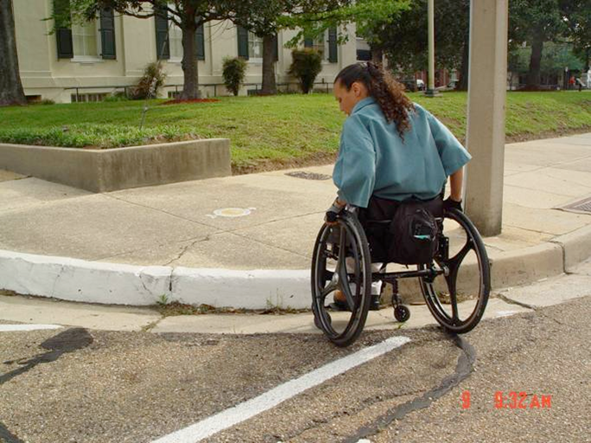
The Curb Cut Effect
How will this individual meet their daily needs if they have to face so many obstructions to their ability to engage in society independently?

Slide 12
What is Universal Design?
There’s an ingrained societal suspicion that intentionally supporting one group hurts another; that equity is a zero sum game.
In fact, when the nation targets support where it is needed most—when we create the circumstances that allow those who have been left behind to participate and contribute fully—everyone wins.
Standford Social Innovation Review
https://ssir.org/articles/entry/the_curb_cut_effect#

Slide 14
Rights to an Appropriate Education

Slide 15
Rights to an appropriate education
The Section 504 regulation requires a school district to provide a “free appropriate public education” (FAPE) to each qualified person with a disability who is in the school district’s jurisdiction, regardless of the nature or severity of the person’s disability.
SOURCE: Free Appropriate Public Education for Students With Disabilities: Requirements Under Section 504 of The Rehabilitation Act of 1973

Slide 16
Enter Universal Design for Learning (UDL)

Slide 17
Enter Universal Design for Learning
Universal Design for Learning (UDL) brings the curb cut effect into the educational/vocational program.
UDL movement has been spear-headed by the CAST organization. CAST stands for the Center for Applied Special Technology.

Slide 18
Enter Universal Design for Learning
CAST has spent decades researching the neuroscience of learning and the study of media to develop the concept of UDL.
“The central premise of UDL is that a curriculum should include alternatives to make it accessible and appropriate for individuals with different backgrounds, learning styles, abilities, and disabilities in widely varied learning contexts.
The “universal” in universal design does not imply one optimal solution for everyone.
Rather it reflects an awareness of the unique nature of each learner and the need to accommodate differences, creating learning experiences that suit the learner and maximize his or her ability to progress.
SOURCE -
Teaching Every Student in the Digital Age, by: David H. Rose, Anne Meyer, Nicole Strangman and Gabrielle Rappolt
http://www.ascd.org/publications/books/101042/chapters/What-Is-Universal-Design-for-Learning%C2%A2.aspx

Slide 19
Universal Design for Learning (UDL) Framework

Slide 20
Universal Design for Learning Framework
The Universal Design for Learning Framework is a robust rubric aimed at describing the various actions educators can take to make their lessons and curricula accessible to all learners.
★ We understand YouthBuild educators represent a wide spectrum of skillsets and ability levels. UDL as a framework can support the novice teacher just as much as the master teacher at your site.

Slide 21
UDL Principle Overview

Slide 22
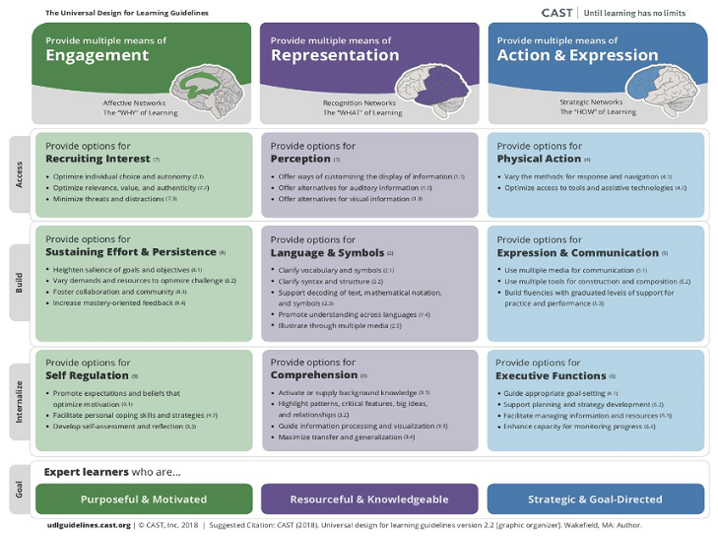

Slide 23
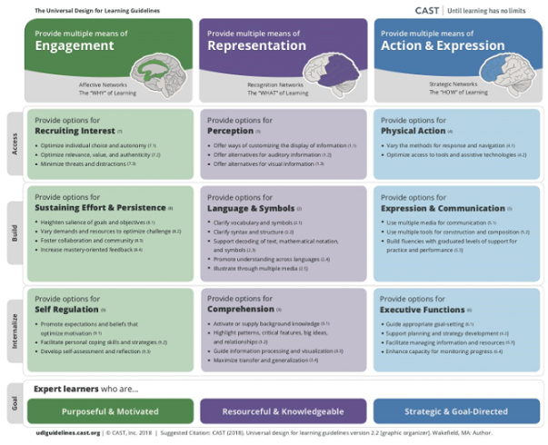
Principles of UDL
1
2
3

Slide 24
Principles of UDL

Slide 25
Principles of UDL

Slide 26
Principles of UDL

Slide 27
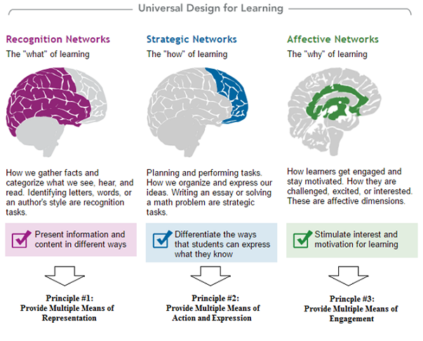
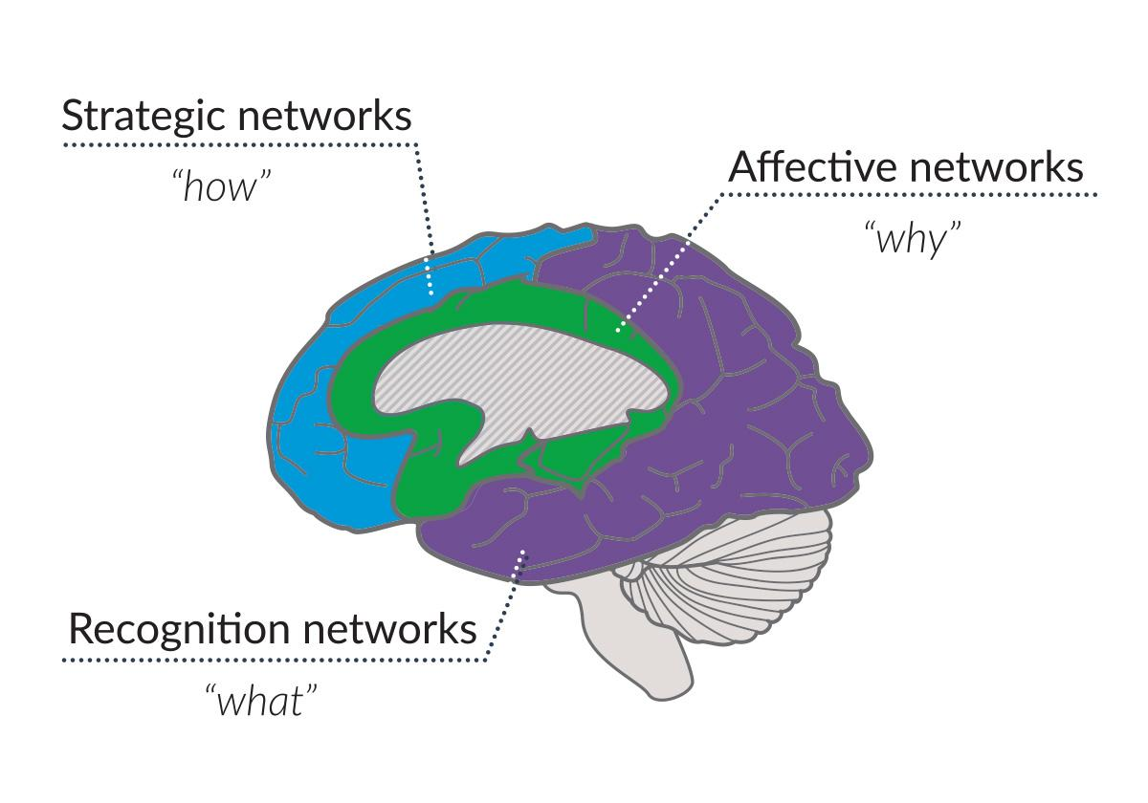
Principles of UDL

Slide 28
UDL Domain Overview

Slide 29
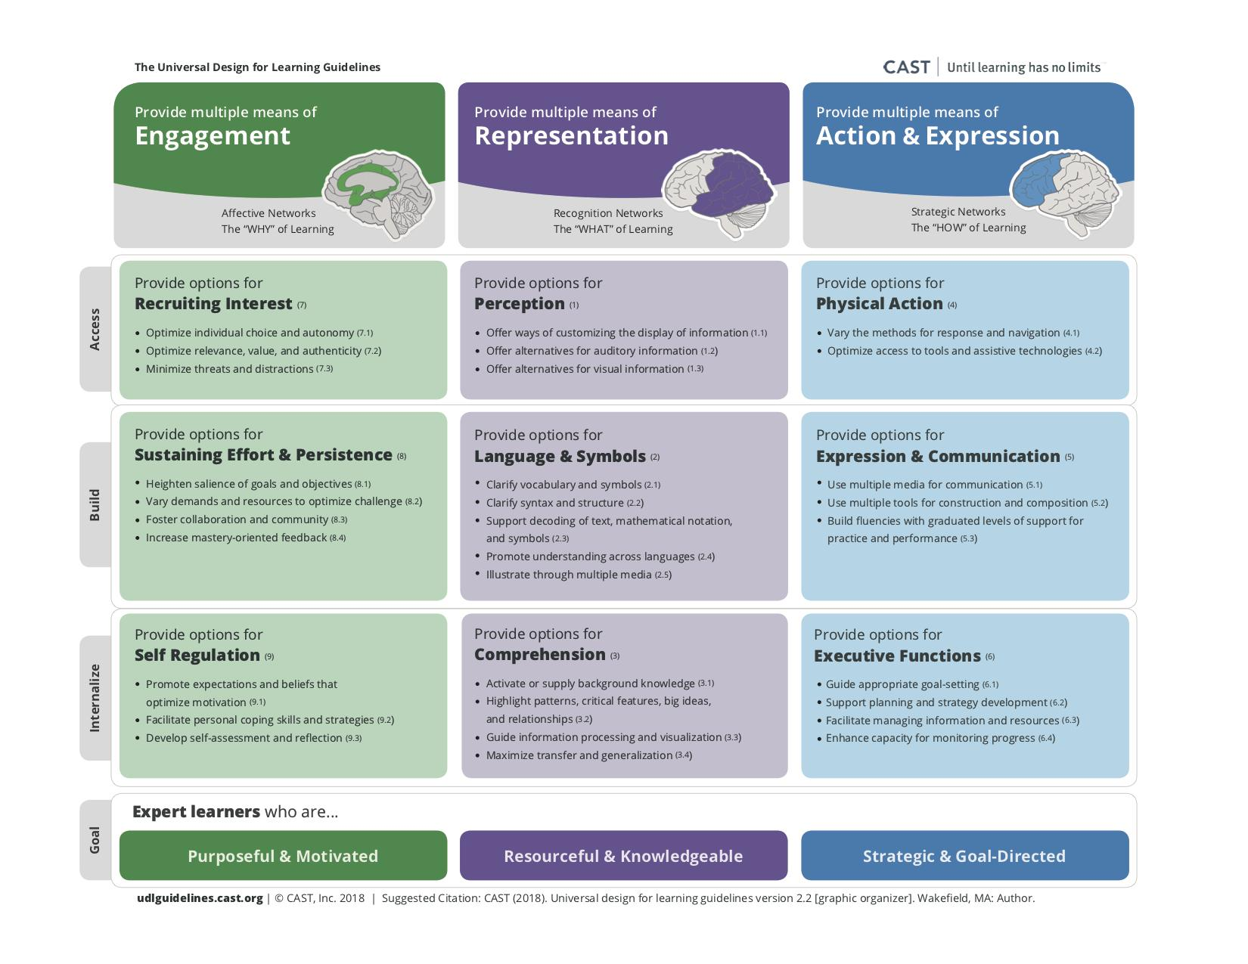
9 Domains of UDL
1
4
7
2
5
8
3
6
9

Slide 30
9 Domains of UDL
1
4
7
2
5
8
3
6
9

Slide 31
9 Domains of UDL
1
4
7
2
5
8
3
6
9

Slide 32
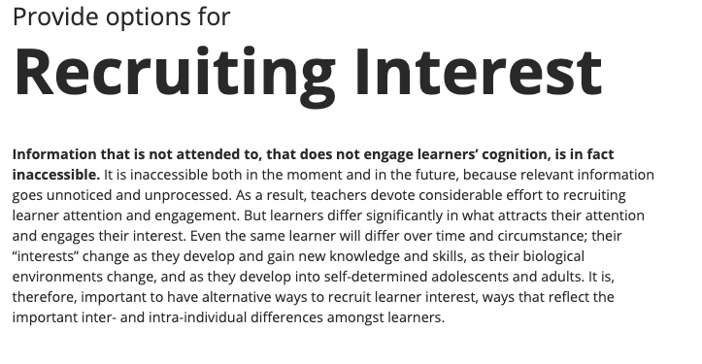
9 Domains of UDL
Processing Prompt:
How does this domain show up in your practice?
What immediate programming thoughts come to mind here?

Slide 33
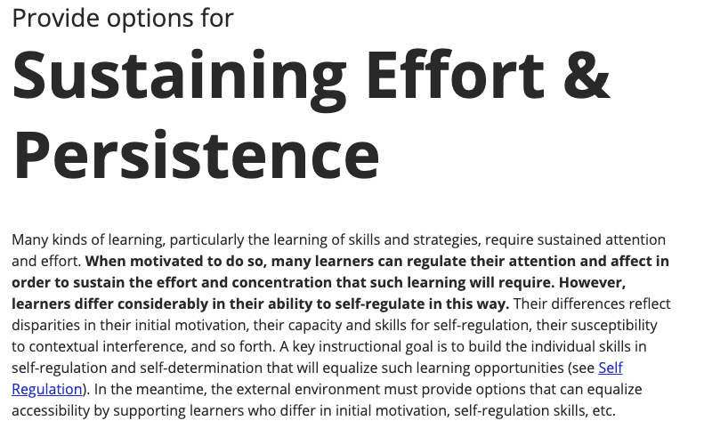
9 Domains of UDL
Processing Prompt:
How does this domain show up in your practice?
What immediate programming thoughts come to mind here?

Slide 34
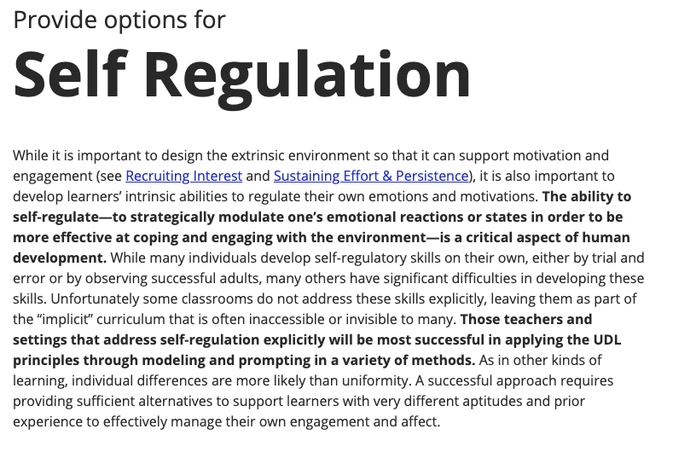
9 Domains of UDL
Processing Prompt:
How does this domain show up in your practice?
What immediate programming thoughts come to mind here?

Slide 35
9 Domains of UDL
1
4
7
2
5
8
3
6
9

Slide 36
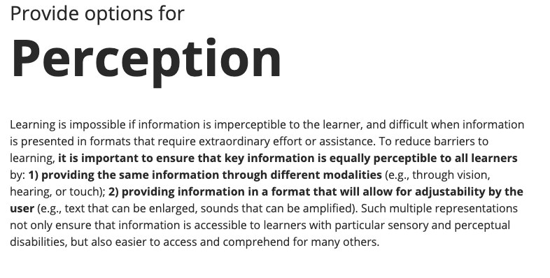
9 Domains of UDL
Processing Prompt:
How does this domain show up in your practice?
What immediate programming thoughts come to mind here?

Slide 37
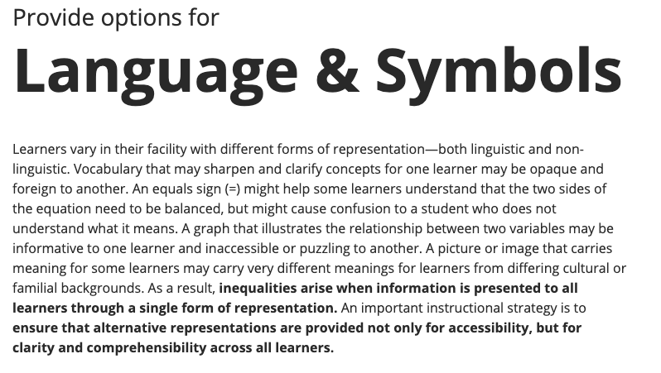
9 Domains of UDL
Processing Prompt:
How does this domain show up in your practice?
What immediate programming thoughts come to mind here?

Slide 38
9 Domains of UDL
Processing Prompt:
How does this domain show up in your practice?
What immediate programming thoughts come to mind here?

Slide 39
9 Domains of UDL
1
4
7
2
5
8
3
6
9

Slide 40
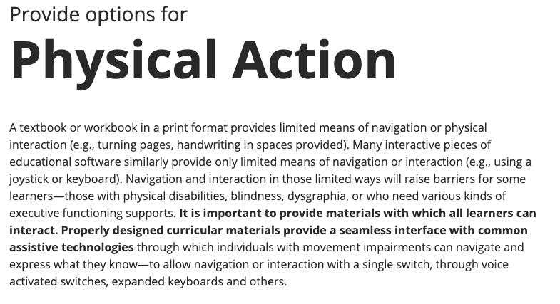
9 Domains of UDL
Processing Prompt:
How does this domain show up in your practice?
What immediate programming thoughts come to mind here?

Slide 41
9 Domains of UDL
Processing Prompt:
How does this domain show up in your practice?
What immediate programming thoughts come to mind here?

Slide 42
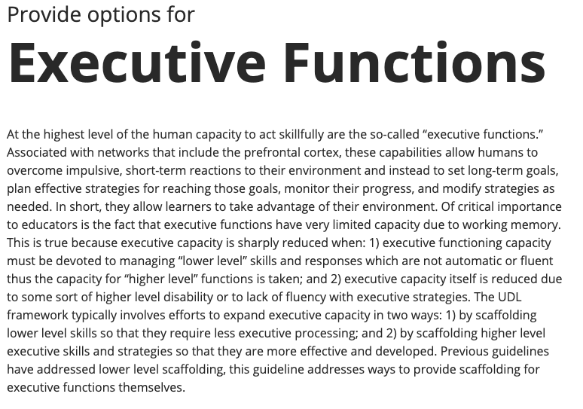
9 Domains of UDL
Processing Prompt:
How does this domain show up in your practice?
What immediate programming thoughts come to mind here?

Slide 43
UDL Checkpoint Overview

Slide 44
9 Domains of UDL
1
4
7
2
5
8
3
6
9

Slide 45
Checkpoints of UDL
Each domain houses anywhere from 2 – 5 check points
1
2
3

Slide 46
Checkpoints of UDL

Slide 47
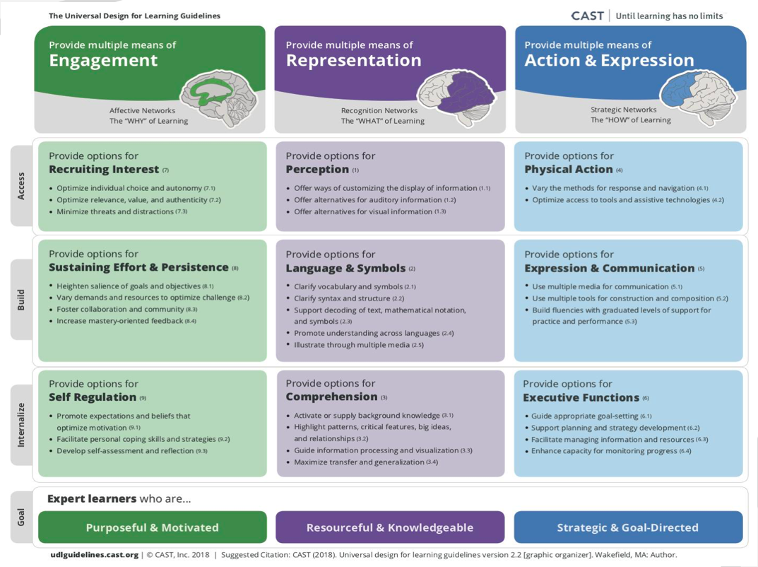

Slide 48
What UDL domains do you currently see in your program?
You may choose more than one answer.
Recruiting Interest
Sustaining Effort & Persistence
Self Regulation
Perception
Language & Symbols
Comprehension
Physical Action
Expression & Communication
Executive Functions

Slide 49
In what UDL domains do you see space for growth at your program?
You may choose more than one answer.
Recruiting Interest
Sustaining Effort & Persistence
Self Regulation
Perception
Language & Symbols
Comprehension
Physical Action
Expression & Communication
Executive Functions

Slide 50
Examples of UDL in Practice

Slide 51
Examples of UDL in Practice
UDL challenges educators to incorporate flexibility and multiple on-ramps into their routine instructional practice, instructional methods, and instructional materials as a way to accommodate every student in the classroom.
To accommodate a broad spectrum of learners, universally-designed curricula require a range of options for accessing, using, and engaging with learning materials. Like universal design in architecture, with its stairs, ramps, and elevators, these alternatives reduce barriers for individuals with disabilities but also enhance opportunities for every student.

Slide 52
Examples of UDL in Practice
EXAMPLE: Suppose Mr. Costa is teaching a civics unit on elections and wants to convey the importance of voter participation.
He chooses to use a chart—an ideal means of representation for some kinds of information and for some students, but a medium that presents learning barriers for other students.
Obviously, a student who is blind cannot learn from a visual chart, nor can students who have difficulty discerning colors, interpreting keys and symbols, or deciphering the significance of spatial relationships between elements. For these students, charts actually present a barrier.
SOURCE - Teaching Every Student in the Digital Age. David H. Rose, Anne Meyer, Nicole Strangman and Gabrielle Rappolt

Slide 53
Examples of UDL in Practice
What could Mr. Costa do about that barrier? In this case, both his teaching goal and the barriers in the medium he has chosen (images) relate to recognition, the learning networks addressed by UDL Principle 1. Principle 1 recommends that the teacher provide multiple representations of the same information.
A verbal description of the chart, a tactile graphic representation, or an e-text version read by the computer would all make the key concepts accessible to students who are blind or otherwise visually impaired. The verbal description would have the additional advantage of helping other students in the class by providing complementary information not contained within the chart and offering a different context and emphasis. This option would also help students who have difficulty interpreting graphically displayed data.
These are just a few of the ways that providing two representations of the data instead of one allows Mr. Costa to create a richer cognitive learning environment for all his students.
SOURCE - Teaching Every Student in the Digital Age. David H. Rose, Anne Meyer, Nicole Strangman and Gabrielle Rappolt

Slide 54
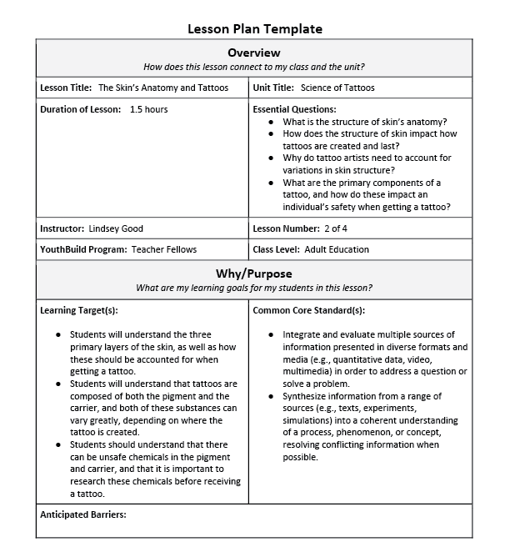
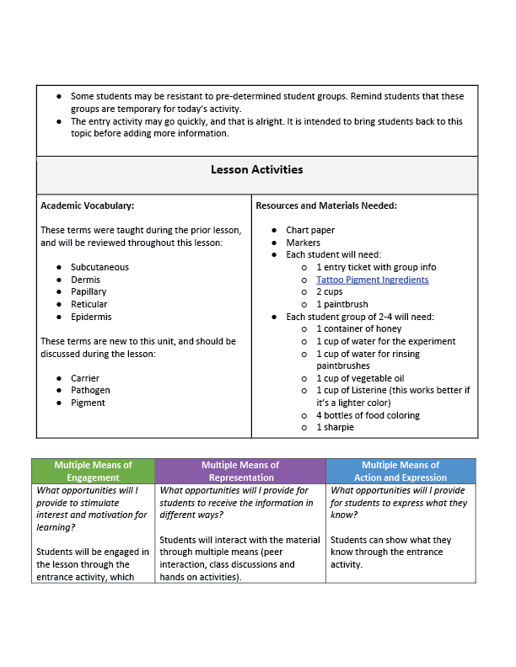
Lindsay Good, Science of Tattoo, Lesson 4
Examples of UDL in Practice

Slide 55
Examples of UDL in Practice
Lindsay Good, Science of Tattoo, Lesson 4

Slide 56
Examples of UDL in Practice: Principle Reflection Prompts
Principle | Reflection Prompt
Engagement | What opportunities will I provide to stimulate interest and motivation for learning?
Representation | What opportunities will I provide for students to receive information in different ways?
Action & Expression | What opportunities will I provide for students to express what they know?

Slide 57
Application of UDL

Slide 58
Application of UDL
The UDL Guidelines are not meant to be a prescription.
They can be mixed and matched according to your specific learning goals and community.
In many cases, educators find that they are already incorporating some aspects of these guidelines into their practice; however, barriers to the learning goal may still be present.
We see the guidelines as a tool to support the development of a shared language in the design of goals, assessments, methods, and materials that lead to accessible, meaningful, and challenging learning experiences for all.
SOURCE - Teaching Every Student in the Digital Age. David H. Rose, Anne Meyer, Nicole Strangman and Gabrielle Rappolt

Slide 59
Application of UDL
Assessing Progress
Good pedagogy also includes effective and ongoing assessment, not only to measure a student's progress, but also to adjust instruction and to evaluate the effectiveness of instructional methods and materials.
Ongoing assessment enables teachers to ensure that the goals they have set and the methods and materials they are using continue to support students' progress.

Slide 60
UDL as an Area of Professional Focus

Slide 61
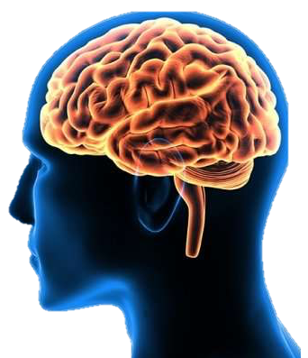
UDL is YouthBuild

Slide 62
UDL as an Area of Professional Focus for Your Staff
Some suggestions include:
Identifying a specific UDL principle/domain for focus during professional development time.
Creating site/program specific definitions and language tied to each principle/domain/check point.
Running a site/program inventory based on the 9 UDL domains.

Slide 63
Education Toolkit & UDL Video Series

Slide 64
Education Toolkit & UDL Video Series
UDL 9-Domain Video Series
UDL Video Series Presentation Files
UDL Planning Documents
Lindsay Good’s 4-Lesson Science of Tattoos Curriculum Unit

Slide 65
Resource Folder – 9 UDL Domain Video Tutorials

Slide 66
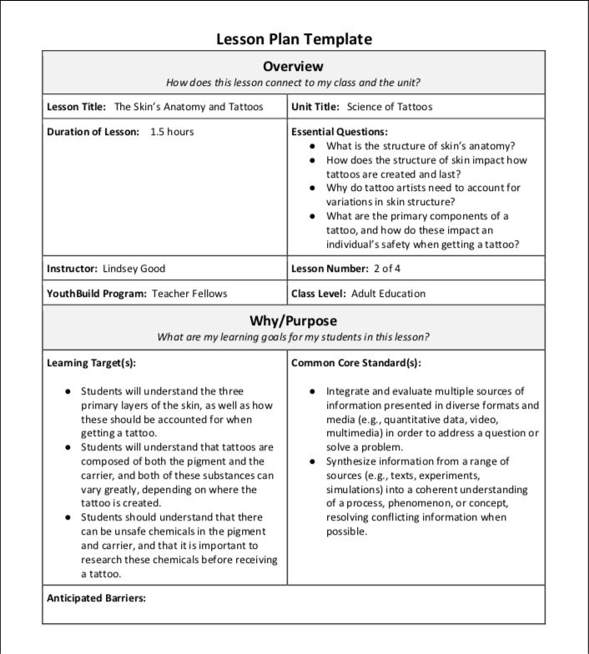
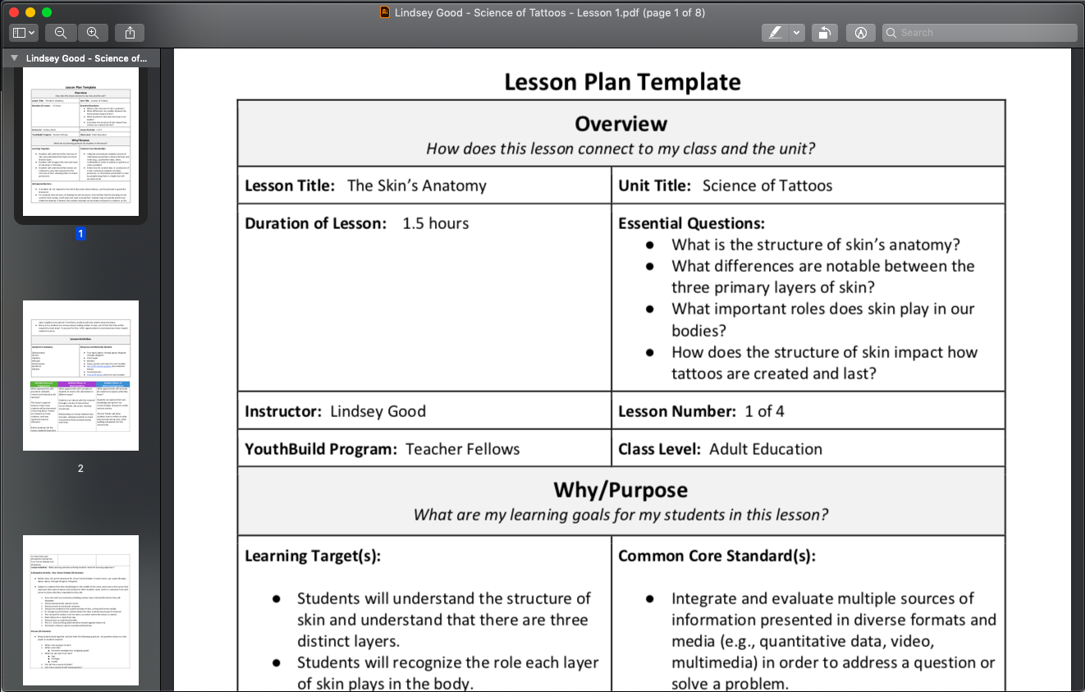
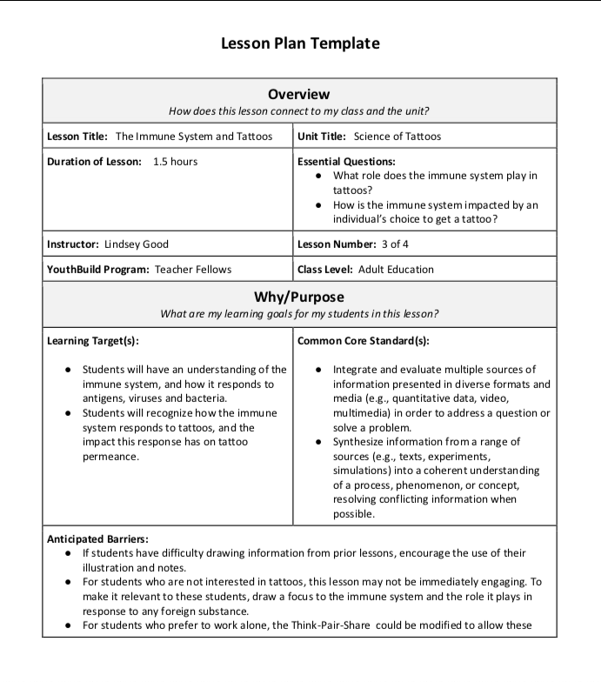
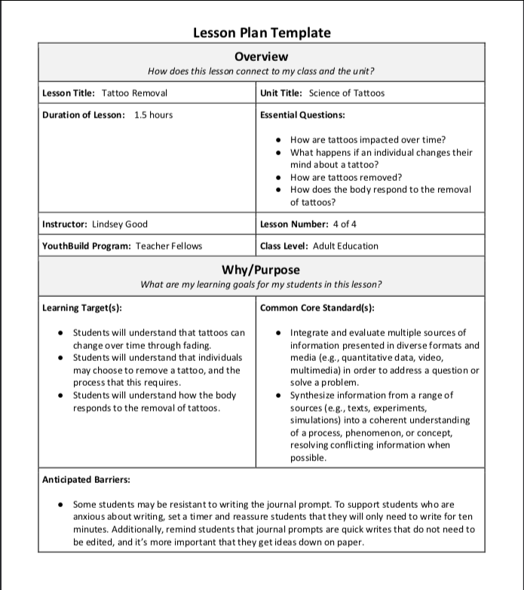
Resource Folder - Lindsay Good - Science of Tattoos Unit
Lindsay Good, YouthBuild Teaching Fellow, Science of Tattoos 4-Day curriculum plan.
Lesson 2
The Skin’s Anatomy & Tattoos
Lesson 1 - The Skin’s Anatomy
Lesson 3
The Immune System & Tattoos
Lesson 4
Tattoo Removal

Slide 67
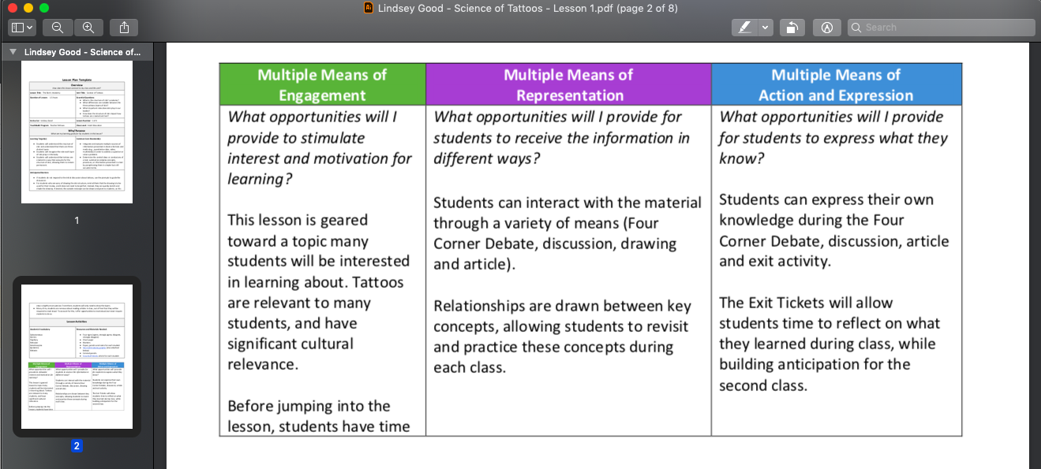
Resource Folder - Lindsay Good - Science of Tattoos Unit
Lindsay Good provides a breakdown of how she accomplishes a Universally Designed for Learning Unit for her students.

Slide 68
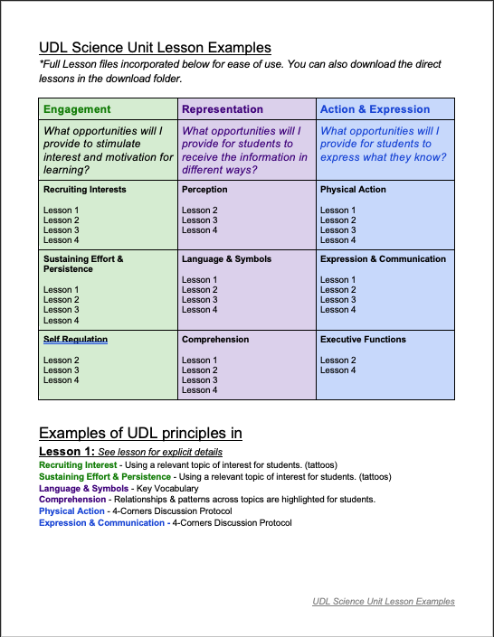
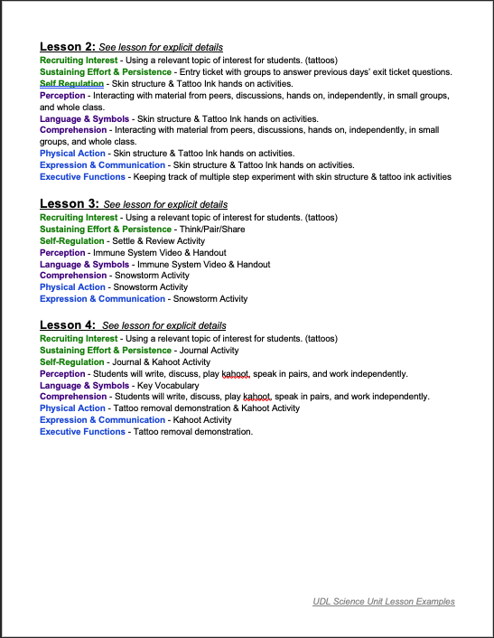
Resource Folder - UDL Science Unit Lesson Examples

Slide 69
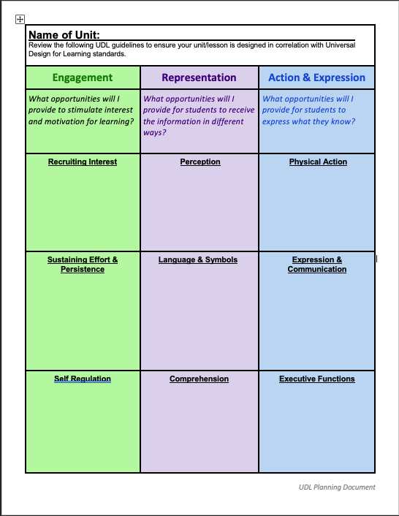
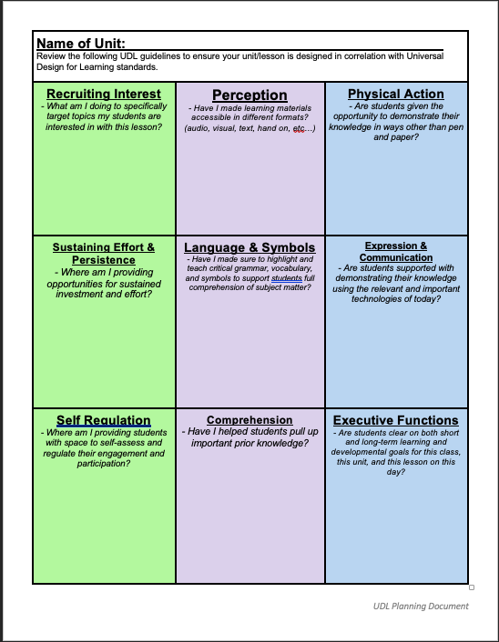
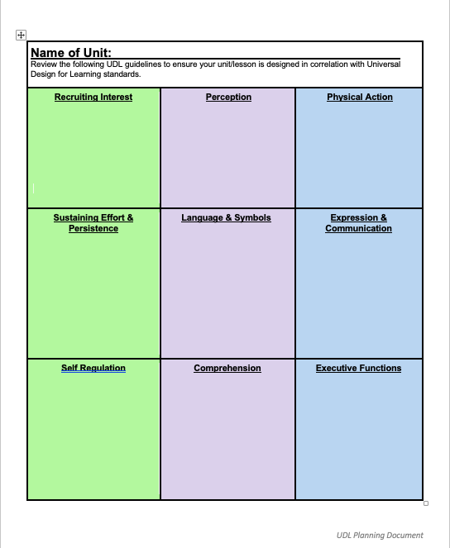
Resource Folder - UDL Planning Documents
Lindsay Good’s Science Unit UDL Planning Template | Guiding Question UDL Planning Template | Customizable UDL Assessment Template
Objective - YB Staff are able to engage with Universal Design for Learning framework in a way that they walk away knowledgeable and confident in their ability to infuse the 9 domains into their classroom and vocational practice.

Slide 71
Education Toolkit and Universal Design for Learning Video Series
https://youthbuild.workforcegps.org/resources/2019/07/11/16/00/Education_Toolkit_and_Universal_Design_for_Learning_Video_Series
The Universal Design for Learning Guidelines
http://udlguidelines.cast.org/
Lesson Plans and Classroom Activities
https://youthbuild.workforcegps.org/resources/2018/08/20/13/24/Lesson_Plans_and_Classroom_Activities
Education at a YouthBuild Program
https://youthbuild.workforcegps.org/resources/2015/05/04/10/36/Education-at-a-YouthBuild-Program-Manual
Differentiated Instruction and Universal Design for Learning
https://youthbuild.workforcegps.org/resources/2016/06/07/16/10/Differentiated-Instruction-and-Universal-Design-for-Learning

Slide 72
YouthBuild Webinar Series: A Day in the Life of a DOL YouthBuild Job Developer
August 6, 2019
OSHA 510/500 In-Person Training
Gallatin, TN
August 19-30, 2019

Slide 73
Paladin Jordan, Jr.
Graduate Professor of Education/
School Consultant/Business Owner
EDGE-ucational Media Company, LLC
myedgemedia@gmail.com
267-485-1008
Jenn Smith
National YouthBuild Director
U.S. Department of Labor
smith.jenn@dol.gov
202-693-3597

