Slide 2
Procuring and Selecting an Independent Evaluator
July 16, 2019
RESEA Evaluation Technical Assistance

Slide 3
Gloria Salas-Kos
Senior Program Analyst and RESEA Evaluation TA Coordinator
Office of Policy Development and Research, ETA, U.S. DOL

Slide 4
Cycles of learning and doing…
Plan Evaluation of Program
Refine Program or Evaluation
Conduct Evaluation
Reflect on & Communicate Evaluation Findings

Slide 5
In Our Last Webinar, We…
Described key steps in planning your evaluation
Discussed the length of time each step may take
Discussed potential hurdles and strategies for addressing them
To find the webinar recording of “What Evaluation Details Do I Need to Plan for and How Long Will the Evaluation Take?” please visit:
https://www.workforcegps.org/events/2019/05/30/13/54/What-Evaluation-Details-Do-I-Need-for-a-Plan-and-How-Long-Will-It-Take

Slide 6
We will review:
Types of potential evaluators
Appropriate evaluator qualifications and experience;
Request for Proposals (RFP) process;
Bid assessment and evaluator selection; and
University Partnerships
Note: This session covers basic evaluation selection and procurement information

Slide 7
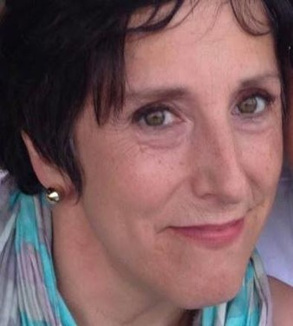
Siobhan Mills De La Rosa
Associate
Abt Associates
Hannah Engle
Senior Analyst
Abt Associates
Lesley Hirsh
Assistant Commissioner, Research & Information
New Jersey Department of Labor & Workforce Development

Slide 8
Has your RESEA staff ever worked with an independent evaluator?
Yes – we do this all the time!
Yes – but only occasionally.
No.
I’m not sure.

Slide 9
Does your agency work with an outside organization or university partner to evaluate its programs?
Yes!
No.
I’m not sure – how can I find out?

Slide 10
Where can I find expert evaluators?
University Research Centers
Research and Evaluation Firms
Individual Research Consultants
Research and Evaluation Teams in your Agency or Another State Agency

Slide 11
What can my internal RESEA team do?

Slide 12
What are the benefits to working with an experienced independent evaluator?
Experienced evaluators do this all the time!
They have special experience and expertise in:
Research methods
Statistical analysis and data collection
Protection of human subjects
Their findings are independent and transparent
No undue influence
Can potentially be replicated

Slide 13
Tips for Overseeing Evaluation Efforts
Designate a primary point of contact
Establish regular communication with your evaluator
Regular calls
Progress reports
Notify your evaluator about changes to:
Program implementation
Evaluator procedures

Slide 14
Considerations in Selecting an Evaluator
Evaluator Qualifications and Funding

Slide 15
What qualifications should we look for?
Experience conducting evaluations of the design type you are planning? On workforce programs?
Lead staff with advanced (i.e., post-graduate) degree and considerable experience (e.g., 5+ years)
Junior and mid-level staff to support study activities, may have less education and/or experience
Capacity and resources
Other specialized knowledge

Slide 16
Additional qualifications for Impact Studies
Random Assignment (RA) Studies
Leading RA studies of similar size
Incorporating RA into claimant selection algorithm in existing data systems
Monitoring RA in complex service delivery environments
Quasi-experimental designs
Creating comparison groups using your preferred methods
Analyzing large datasets created using multiple data sources

Slide 17
Considerations of Evaluation Budget
Budget
Evaluator Qualifications
Data Collection
Travel and Other Costs
Writing and Revisions
Sample Size
Data Complexity

Slide 18
RESEA Funds for Evaluation
Can use up to 10% of their funds
May not be sufficient for larger, multi-year impact evaluations
Discreet tasks that match funding period
Optional tasks
Pooled evaluations

Slide 19
Evaluator Procurement
Competitive vs Non-Competitive Processes

Slide 20
Competitive Evaluator Procurement
Writing your Request for Proposals (RFP)
Advertising Your RFP
Assessing Bids and Selecting an Evaluator

Slide 21
Non-Competitive Evaluator Procurement
Existing evaluation partnerships
Research organizations
State universities
Internal evaluation unit in the workforce agency or in another agency in the state
Always follow state and local procurement rules when selecting your evaluator!

Slide 22
Writing a Request for Proposals
Competitive Procurement: Step 1

Slide 23
What are Requests for Proposals (RFP)?
Formal announcement inviting qualified organizations to bid on the evaluation contract
Should provide guidance on:
Scope of Work
Evaluator Qualifications
Proposed Budget
Project and Application Timelines
Legal requirements

Slide 24
The Scope of Work (SOW) Should Describe…
Your initial thoughts on research questions and evaluation design
Tasks, activities, and deliverables you expect your evaluator to complete
Level of effort and timeline associated with each task and deliverable
Desired evaluator qualifications
May also be called Performance Work Statement
We strongly recommend that procurement and legal staff review the SOW and RFP!

Slide 25
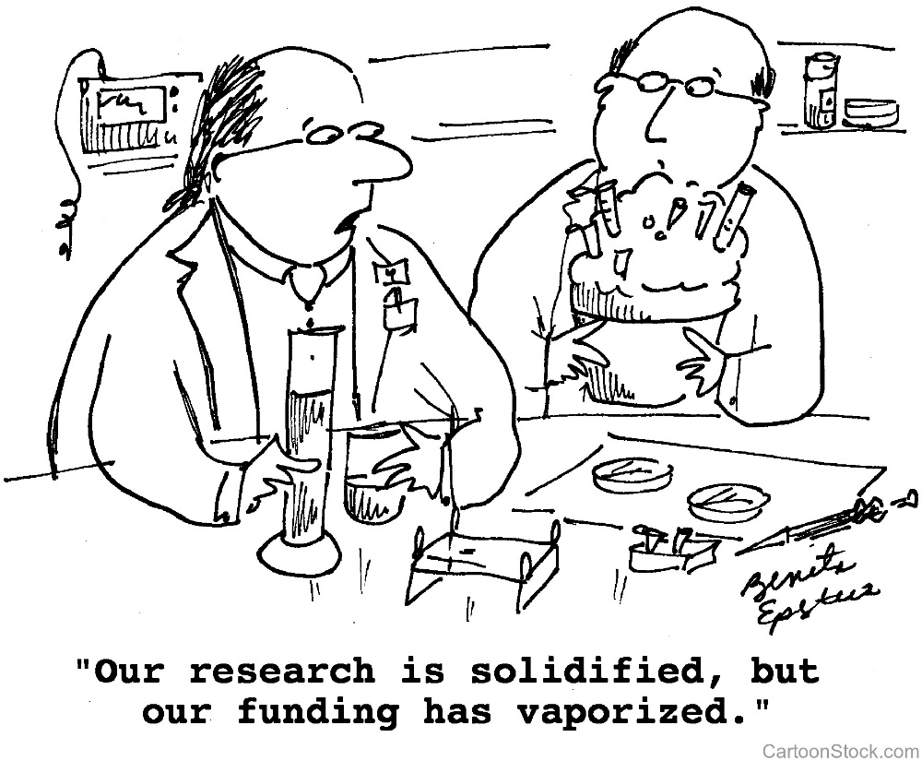
Include your Evaluation Timeline and Budget
For more information on evaluation timelines, see “What Evaluation Details Do I Need to Plan for and How Long Will It Take?”

Slide 26
Evaluations Take Time
Evaluations are often multi-year efforts
Implementation & outcomes studies may take 1.5+ years
Impact studies may take 4+ years
Illustrative Example of Impact Study Timeline
Year 1
Year 2
Year 3
Year 4
Evaluation planning, design, and launch
Assign claimants to an intervention group or control group until target sample size is reached
Track claimant outcomes
(2 quarter follow-up period after claim approval)
Collect outcomes data as it becomes available
Data analysis
Complete final report

Slide 27
Sample Impact Study Level of Effort
Staff Title | Tasks | Annual Est FTE
Principal Investigator | Refine RQs Design the study and impact models Oversee analysis | .15 FTE
Project Director | Project management Oversee all tasks Review materials and data collection instruments | .25 FTE
Mid-level Analyst | Design study procedures \ Serve site point of contact Train RESEA staff on procedures Analyze data | .3 FTE
Junior-level Analyst | Collect and clean data Support Project as necessary | .25 FTE

Slide 28
How can my evaluator demonstrate their qualifications?
Descriptions of previous evaluation work
Biographies and CVs of proposed staff
Descriptions of company’s institutional capacity
Other information required by your state
Request and check references!

Slide 29
Advertising Your RFP
Competitive Procurement: Step 2

Slide 30
Getting the Word Out
You can advertise through a number of avenues:
Your state or agency website listing contract opportunities
Evaluation websites (e.g., www.eval.org, www.appam.org)
Direct communication with evaluators from your evidence base (letters, emails)
University websites
Social media (Facebook, LinkedIn, Twitter, etc.)
Local, state, and other relevant newsletters or publications
Make sure your RFP, advertisement, and procurement process all align with local, state, and federal rules regarding procurement!

Slide 31
Assessing Bidder Responses
Competitive Procurement: Step 3

Slide 32
Assessing Bidder Applications
Systematically assess each application, using a rubric or points system
Determine and codify the most important application factors
Assign points to each factor
Rate applications on these factors
Selecting evaluators in the top range of scores
Cost is important, but not the only factor you should consider!

Slide 33
If it sounds too good to be true…
…It probably is!
Ask clarifying questions!
Check references!
Ask for documentation of previous work!

Slide 34
Selecting Your Evaluator
Once you have made a selection, follow state procurement rules for:
Notifying the selected bidder of the award
Negotiating any final contract details
Signing the contract and beginning work
Make it a high priority to keep the process moving.
In some states, these final steps can take several months!

Slide 35
University Partners
An Alternative to Third-Party Evaluators

Slide 36
What are university partnerships?
Established relationships with research universities for the purposes of evaluation
Relationship is on-going
University partners develop relationships with state workforce agencies
University partners come to learn state data and workforce systems in depth
State workforce agencies can update evaluation priorities from year to year as needs change

Slide 37
Case Study: NJ and Heldrich Center for Workforce Development at Rutgers University
NJ Department of Labor and Workforce Development has an evaluation partnership with the John J. Heldrich Center for Workforce Development at Rutgers University
The Heldrich Center is located in the School of Public Policy and Planning

Slide 38
Evaluation Partnership Origin
John J. Heldrich Center for Workforce Development at the Edward Bloustein School of Public Policy and Planning, Rutgers University developed a baseline data warehouse in the 1990s and early 2000s
Wage matching used for Eligible Training Provider “Consumer Report Card” in 2004

Slide 39
Evaluation Partnership Evolution
2012
WDQI Grant Round 2
2014
WDQI Grant Round 4
Mapping workforce system relative to customers
UI worker profiling and reemployment service (WPRS) initiative, replicated by GAO in 2018
Balanced scorecard metrics
2015
Evaluated sector-strategy training outcomes
2016
Interactive dashboards (higher education and State WIA)
2017
CTE employment and earnings outcomes study
Interactive data visualization tools for jobseekers
Established New Jersey Education to Earnings Data System (NJEEDS)
SLDS Grant
Analyzed post-college earnings by major and distributed results to 39 colleges
WIOA Adult and Dislocated Worker evaluation

Slide 40
2018 to Present
WDQI Round VII
Build out infrastructure and add data sources
Improve agency and research access to linked data
Conduct evaluations (e.g., state-funded apprenticeships)
Task Order Memorandum of Understanding supported by state dollars
Accelerate learning and capacity building around partnership and expand portfolio of evaluation activity.
NJCareer Network: developing online tools to aid jobseekers on their journey from career exploration through job placement
RESEA evaluation planning and execution.

Slide 41
Closing Remarks
Lawrence Burns
Reemployment Coordinator
Office of Unemployment Insurance, ETA, U.S. DOL

Slide 42
Using CLEAR – A Demonstration
August 19, 2019 at 2pm Eastern

Slide 44
Gloria Salas-Kos
Evaluation Technical Assistance Coordinator
U.S. DOL – Office of Policy Development and Research
Salas-Kos.Gloria@dol.gov
Lawerence Burns
Reemployment Coordinator
U.S. DOL – Office of Unemployment Insurance
Burns.Lawrence@dol.gov
Siobhan Mills De La Rosa
Associates
Abt Associates
Siobhan_Mills@abtassoc.com
301.968.4405
Hannah Engle
Senior Analyst
Abt Associates
Hannah_Engle@abtassoc.com
301.347.5796
RESEA EvalTA Inbox
RESEA@abtassoc.com

