Slide 1
Who are you?
National office staff
Regional office staff
State Trade staff
State WIOA/RR staff
Other

Slide 3
Challenges and Best Practices in Serving English Language Learners (ELL)
June 19, 2019
ELL and Trade Adjustment Assistance (TAA)

Slide 4
Julie S. Baker
Supervisory Program Analyst
DOL-ETA Office of Trade Adjustment Assistance

Slide 5
Consuelo Hines
Trade Act and DUA Programs Coordinator
DOL-ETA Region 6

Slide 6
Jesse Johnson
Program Analyst
DOL-ETA Office of Trade Adjustment Assistance

Slide 7
Data shows a need to improve services to Trade Adjustment Assistance (TAA) English Language Learners (ELLs)
All regions have TAA ELL participants
Peer shared practices can assist and inspire states to adopt new methods of serving TAA ELL participants
TAA employment and case management funds can be used to implement new strategies
WIOA and other partners are valuable resources in improving service delivery

Slide 8
“The reason for this webinar is due to examining TAA training non-completions and states responding that participants with English language barriers are not completing training or not gaining the skills to be successful in completing training.”
Training Completion %
Training Completion %
TAA ELL compared to All TAA Exiters
TAA Remedial Training compared to All TAA Training
Note: ELL Training Exiters are 7.6% of All Training Exiters. ELL Exiters are 7.5% of All Exiters, meaning that those reported as ELL participants enter training at the same rate as all Exiters.
Note: In the period 4/1/18-3/31/19, there were 734 ELL Exiters who had received training and 1157 Exiters who received Remedial Training. However, there were only 208 Exiters who were both ELL Exiters and received remedial training.

Slide 9
National Data
English Language Learners in the TAA Program
By state (as of July 12, 2019)

Slide 10
1. Does your state exclusively rely on existing English Language Acquisition/ELL/ESL/ESOL programs to serve workers with English language barriers from Trade dislocations? 2. Does your state use any contextualized English Language Acquisition/ELL/ESL/ESOL programs that combine English and occupational training?
Enter your responses in the chat window
CHAT QUESTIONS

Slide 11
State of Minnesota

Slide 12
Sarah Saito
TAA Supervisor
Sarah.Saito@state.mn.us
MN Employment and Training Programs
Jerry Mulhern
TRA Manager
Gerald.Mulhern@state.mn.us
MN Unemployment Insurance

Slide 13
MN – Main Languages
Census Data 2015 – Language Spoken at Home
English 89% as only language
Spanish 3.8% (English “very well” 57%)
Hmong 1.2% (English “very well” 57%)
Somali* 1.5% (English “very well” 56%)
Unemployment Insurance – “How to Apply” brochures, some website information in Hmong, Spanish, and Somali. Interpreters used as needed for phone calls.
TAA tries to have Hmong, Spanish, and Somali speakers on staff.
*Data for African languages as a group.

Slide 14
MN - Structure
TAA, Rapid Response, TRA all centralized
TAA works with Rapid Response to identify potential TAA affected layoffs
Rapid Response
Asks employer and uses interpreters for events
Surveys ask about primary language; TAA uses survey results
Interpreters provided at TAA Informational Sessions
All TAA customers are co-enrolled in WIOA Dislocated Worker Program
Language Line for DW, UI, and TAA staff to use

Slide 15
MN TAA - Training
DW and TAA staff make sure customers are ready for training
Provide assessments
Set expectations
Follow up
DW check-in every 30 days
TAA 60-day progress report
In the past two years, MN TAA served 80 people whose primary language was not English

Slide 16
MN TAA - Taking Advantage of Existing Programs
Training available in Spanish
Bus driver/farmer training available in Hmong
Health care/construction/customer service training in English, but intentional about offering preliminary training in other languages
Looking ahead:
TAA is having brochures translated to the top 3 languages
TAA is producing videos in multiple languages for the website

Slide 18
National Able Network - Illinois

Slide 19
Angela Lopez
Senior Director, TAA
alopez@nationalable.org
National Able Network
Rob Bermingham
Program Quality Manager, TAA
rbermingham@nationalable.org
National Able Network

Slide 20
First Steps
Variety in English Language Skills
Outreach in both English and Spanish
Invitation Letters
Outbound Calls
Orientation Events
Tell-a-Friend Cards

Slide 21
Material Examples
Tell-a-Friend Card
Outreach Postcard

Slide 22
Application Process
Outreach & Responsiveness
Assessments
TABE & Our Approach
Skills & Interest Survey
Training Guidance Workshop
One-on-one Support
“You are welcome here.”

Slide 23
Success in Training
Skills Gains
Objective Assessment & Motivation
Link to Vocational Training
Case Management During Training
Pre-training Meeting
English Support
Cohorts
ELL & Basic Computer Skills Instruction

Slide 24
Support Through Partners
Referrals
English/Spanish
Ease of Access/Submission

Slide 25
Support Through Partners, cont.
Careers de Mayo
Job & Resource Fair
Spanish Workshops
Lotería

Slide 27
Illinois Community College Board

Slide 28
Jennifer K. Foster
Deputy Executive Director
Jennifer.Foster@Illinois.gov
Illinois Community College Board

Slide 29
IL Community College Board Overview
Coordinating agency for the Illinois Community College System
48 Community Colleges in 39 Districts
Approximately 80 Adult Education Providers including English as-a-Second Language
Community Based Organizations, Community Colleges, Local Education Agencies, Universities, and the Illinois Department of Corrections
Strategic Plan for Adult Education

Slide 30
IL Community College Board English as-a-Second Language
Services to ELL population:
English Language Instruction and Civics Education
Competencies, Workforce Preparation, Career Awareness
Integrated English Literacy and Civics Education
Integrate Education Training
Bridge Programs

Slide 31
FY2018 Illinois Data

Slide 32
IL Community College Board Integrated Education and Training (IET)
Integrated Education and Training
Integrated Career and Preparation System (ICAPS)
Blended basic skills instruction with Career Technical Education/Training
Labor Market Data
College Credit, Certificates degrees, High School Equivalency
Industry Recognized Credentials
Team taught instruction – 50% overlap
Support Classes

Slide 33
Illinois Community College Board Integrated English Literacy and Civics Education
Integrated English Literacy and Civics Education (IEL/CE)
Integrated Education and Training
Adult Education Activities
Training
Civics Education
25 programs

Slide 34
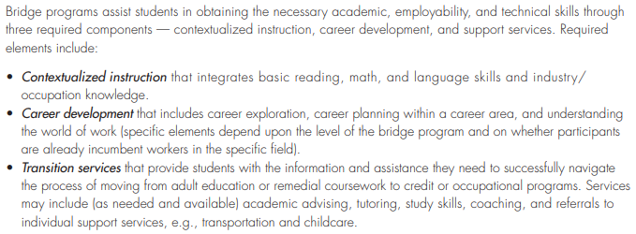
IL Community College Board Bridge Programs

Slide 35
IL Community College Board IET and Bridge Programs Data
IET | FY2018 |  | FY2019 | Total
Total Enrolled | 438 | 458 |  | 896
ABE/ASE | 335 | 326 |  | 661
ESL | 103 | 132 |  | 235
Completed (Credential) | 185 | 202 |  | 387
Providers offering programming | 16 | 20
Industry Sectors | 11 | 15
Occupational Focus | 35 | 48
BRIDGE Programs | FY2018 | FY2019 | Total
Enrolled | 4,180 | 3,970 | 8,150
ABE/ASE | 2,306 | 2,261 | 4,567
ESL | 1,874 | 1,703 | 3,557
Completed (Credential) | 115 | 82 | 197
Providers offering programming | 41 | 45

Slide 36
Resources
Bridge Programs and Integrated Education and Training:
https://www.iccb.org/iccb/wp-content/pdfs/shiftinggears/ICCB_2012BridgeGuide_web_REV_FEB13.pdf
https://icsps.illinoisstate.edu/pd/icaps/
Strategic Plan for Adult Education
https://www.iccb.org/iccb/wp-content/pdfs/adulted/strategic_plan/ICCB_Adult_Education_Strategic_Plan_2018-2023.pdf

Slide 38
State of Massachusetts

Slide 39
Beth Goguen
Central and TAA Programs Manager
Elizabeth.M.Goguen@state.ma.us
MassHire Department of Career Services

Slide 40
MA and ELL/ESOL Best Practices
Issue RFP tailored to demographics of workers
Programs must be competency-based and vocationally oriented
designed to alleviate the client’s barriers to employment by upgrading his/her functional language skills and by exposing the client to work culture
Class sizes targeted to 12-15
Must offer at least 20 hours a week in ESOL
Vendor must define the remedial skills to be developed, the assessment process and tools used to determine the levels of competency that each individual possesses and to determine the extent of remedial services needed by each, and the core competencies to be achieved
Support and check-ins while in training

Slide 41
MA and ELL/ESOL Best Practices (con’t.)
Must work collaboratively with local Career counselors
Tutoring
Open entry/ open exit program design
Found use of Rosetta Stone very beneficial in past programs
Multiple levels offered based on testing
Short stints – 26 weeks at a time
Cohorts of the same workers starting at same time/skill level moving together
Testing showing progress after each stint to move ahead
Vendors are expected to achieve the following goals:
A documented increase in individual ESOL (and ABE levels or attainment of GED)
Successful transition of participants into unsubsidized employment or occupational training

Slide 42
MA ELL/ESOL Participants
The following data shows currently enrolled participants in ESOL training for each quarter across Massachusetts.
Qtr Ending March 31, 2018 166 participants
Qtr Ending June 30, 2018 194 participants
Qtr Ending September 30, 2018 137 participants
Qtr Ending December 31, 2018 149 participants
Qtr Ending March 31, 2019 160 participants

Slide 43
MA ELL/ESOL Training Completions
2017
Jan 1 – Dec 31
106 ESOL Training Completions
2018
Jan 1 – Dec 31
78 ESOL Training Completions
2019
Jan 1 – June 30
49 ESOL Training Completions

Slide 44
Sonoco Employees and ELL/ESOL Services
In 2010 Sonoco closed – 350 jobs lost (manufactured industrial and consumer packaging)
51% had limited English skills
44% were 45+ years old
72% had HS Diploma or less (50% HS) most in native country
53% made $11-$16 p/hour
77% had 5-15 years of service
129 of those workers entered ESOL training
81 workers completed, 62% completion rate
92 workers entered employment as of September 2016 (71.3% EE rate)
Approx. wages upon EE = $11.00 per hour

Slide 46
State of California
California For ALL:
Opening Doors of Opportunity to English Learners

Slide 47
Jennifer Hernandez
Associate Secretary, Farmworker & Immigrant Services
Jennifer.Hernandez@labor.ca.gov
Labor & Workforce Development Agency
Ricardo Favila
Deputy Division Chief, Workforce Services Division
Ricardo.Favila@edd.ca.gov
Employment Development Department

Slide 48
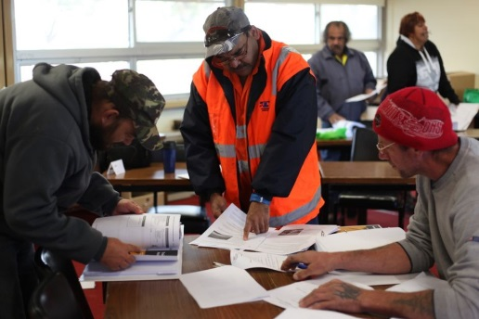
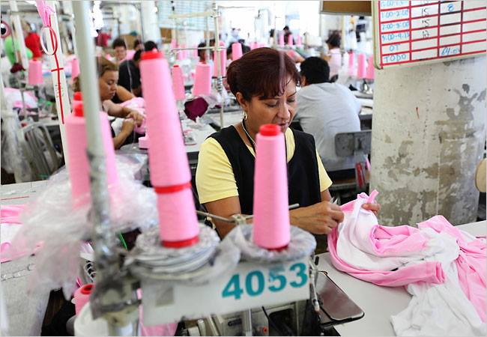

Slide 49
Workforce System
Community Service Block Grant
Native American Program
Youth Build
Job Corps
Title III
Wagner-Peyser Act
Veterans
TANF
Title II
Adult Education and Literacy
Title IV
Rehabilitation Act of 1973
Carl Perkins
MSFW
Title I
Workforce Development Activities
WIOA
Title V
General Provisions
UI
TAA
Second Chance
Housing and Urban Dev
49

Slide 50
TAA in Workforce System
Co-Enrollment
Dislocated Worker, Adult, Youth
WP
UI
Almost Any Core Program
Co-enroll to better serve jobseekers with barriers to employment
Co-enroll to get better outcomes across programs and the workforce system

Slide 52
The Roadmap: A California for ALL
Comprehensive approach using an immigrant integration framework
Informed our efforts with data to illustrate how ELLs were being underserved
We listened to the field
We invested early, funding pilots, technical assistance, and evaluation
Our efforts have informed co-enrollment and expansion of partner programs

Slide 53
Where We Started
Conducted one on one conversations to understand what people do and what problems they are facing
Held multi-stakeholder convenings oriented around information sharing and prioritizing work
Developed a 'Best Practices Policy Brief'
Invested 15% discretionary WIOA dollars in ELL Navigator pilot, technical assistance, and evaluation
Modelled partnership from the state to local areas
Continued to build on our learning, practices, and policies

Slide 54
Policy Priorities
15% LEP requirement in WIOA Regional/Local Plans
Leveraged policy brief to bring together state partners and stakeholders to collectively identify solutions
Increased community engagement requirements in WIOA State Plan modifications
Increased request for partnership information and service delivery strategies connecting to community/ELL serving partners (community and government)

Slide 55
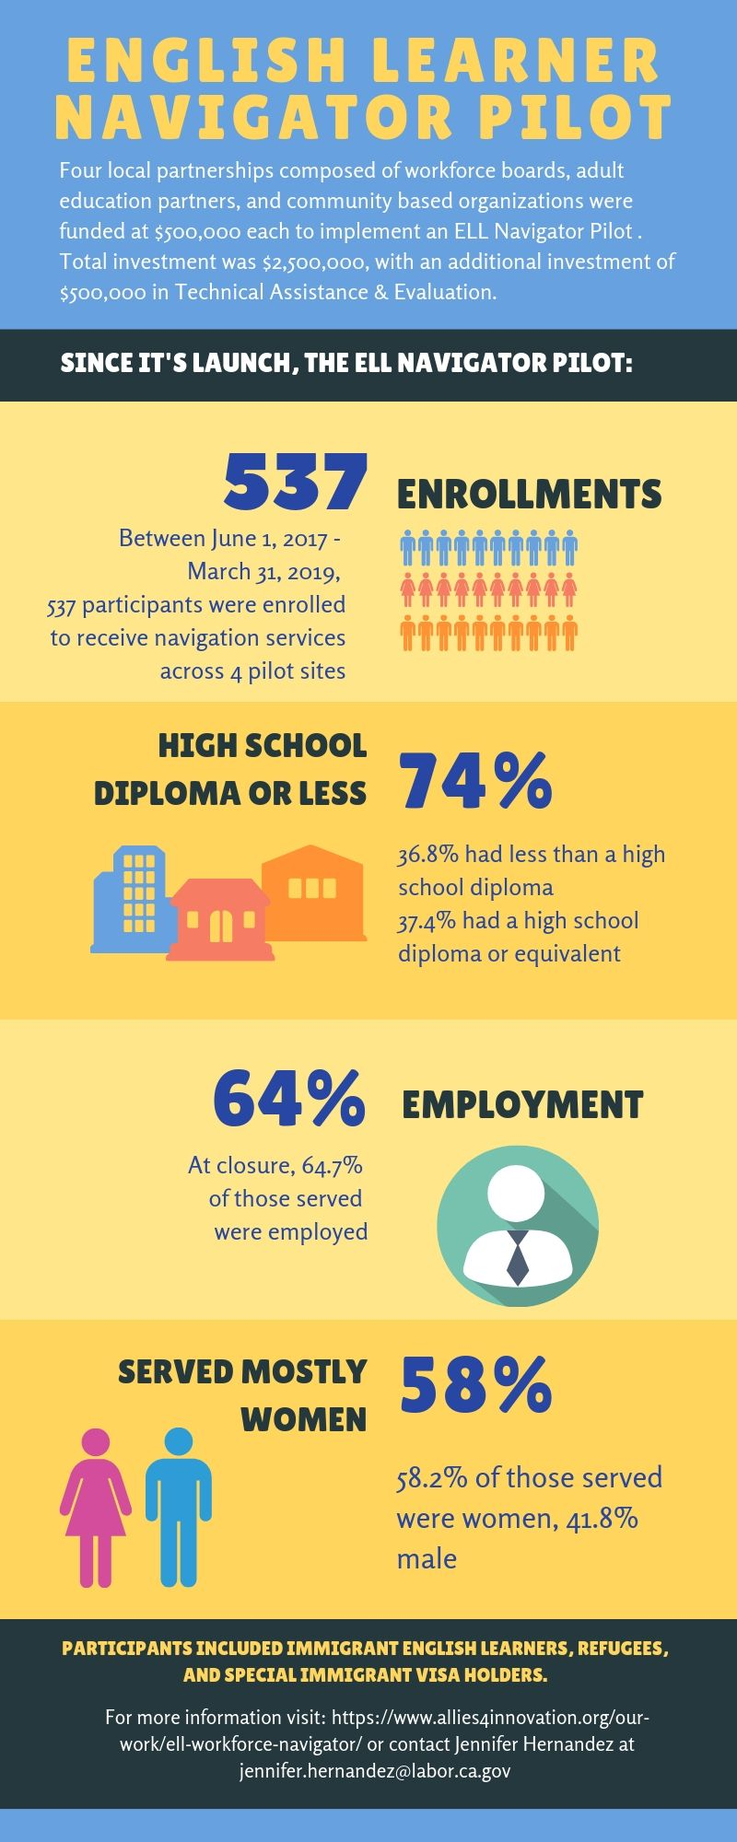
ELL Navigator Pilot
Reached hard to serve population
ELL Navigator made a huge difference
Reached people where they congregate
They had shared language, experiences, and cultural competency
ELL myths busted
Performance of ELLs was ‘on par with’ or ‘exceeded’ general WIOA population served
4

Slide 56
What’s Next
Continue to build on partnerships with Adult Education
Strengthen partnerships with social services programs
Implementing a co-enrollment policy framework
Leverage TAA
American Apparel and Ag Industry Examples
ELL population is diverse across the state and in various industries
RESOURCES
ELL Initiative Resource Page
Policy Brief: How to Serve ELLs
ELL Navigator Pilot Evaluation
ELL Workforce Navigator Resources
Making Sure WIOA Works for Populations with Barriers to Employment

Slide 58
Panel Discussion
Question
Panelists
In a few words, what is the first step for a state to start working on expanding their TAA ELL Program?
If time allows, other chat window questions...
Minnesota
Illinois National Able Network
Illinois Community College Board
Massachusetts
California
Enter your questions in the chat window!

Slide 59
Data shows a need to improve services to Trade Adjustment Assistance (TAA) English Language Learners (ELLs)
All regions have TAA ELL participants
Peer shared practices can assist and inspire states to adopt new methods of serving TAA ELL participants
TAA employment and case management funds can be used to implement new strategies
WIOA and other partners are valuable resources in improving service delivery

Slide 60
All Aboard! The Trade Adjustment Assistance for Workers Community of Practice has Launched!
Come learn about the TAA Community of Practice on Workforce GPS that was launched Summer 2019
September 13, 2019, 2-3PM ET
Seven Tips for Preparing Approvable TAA Program Reserve Funding Requests
This webinar explains what to do (and what to avoid) when preparing and submitting Requests for TAA Program Training and Other Activities Reserve Funds
September 18, 2019, 2-3PM ET

Slide 61
Training and Employment Notice No. 28-16, Change 2
Best Practices, Partnership Models, and Resources Available for Serving English Language Learners, Immigrants, Refugees, and New Americans
https://wdr.doleta.gov/directives/corr_doc.cfm?DOCN=5352
TAA for Workers Community of Practice (CoP) on Workforce GPS
The TAA CoP is designed to serve as a forum for all of the staffs that support TAA to provide information, ask questions, and share best and effective practices on compliant and robust TAA Program administration.
To continue discussing what you’ve learned on this webinar, visit the TAA CoP!
https://taa.workforcegps.org/
.

Slide 62
Julie S. Baker, Jesse Johnson
Office of Trade Adjustment Assistance
Baker.Julie.S@dol.gov; Johnson.Robert@dol.gov
202.693.3707
Consuelo Hines
ETA Region 6
Hines.Consuelo@dol.gov
415.625.7934

