Slide 1
Maximizing WIOA and non-WIOA Performance Data Cohort
Webinar
July 23, 2019

Slide 2
Today’s Moderator
Shelia Lewis
Workforce Analyst
U.S. Department of Labor
Employment and Training Administration

Slide 3
Today’s Presenters (Cohort Facilitators)
Cynthia Forland
Senior Consultant
Maher & Maher
Rosalyce Broadous-Brown
Senior Analyst
Maher & Maher

Slide 4
Today’s State Presenters
Megan Lamb
Rehab Program Manager
Arkansas Department of Workforce Services - Division of Services for the Blind
Drew Griffis
Director of Performance & Business Intelligence
Indiana Department of Workforce Development
Natalie Cummins
Senior Associate, Administration and Accountability
Kentucky Adult Education
Rachel Adams
Staff Assistant
Kentucky Department of Workforce Investment
Carrie Marsh
Performance Analyst
Minnesota Department of Employment and Economic Development (DEED)
Heidi Silver-Pacuilla
Adult Education Coordinator
Title II: Virginia Department of Education
Kirsten Rowe
Systems Development Specialist
Title IV: Virginia Department for Aging and Rehabilitative Services

Slide 5
Webinar Objectives
Provide Overview of Maximizing WIOA and non-WIOA Performance Data Cohort
Cohort Purpose/Goals
Cohort Highlights/Activities
Present Cohort Outcomes
Maximizing Performance Data Development Model
State Action Plans for Maximizing Performance Data

Slide 6
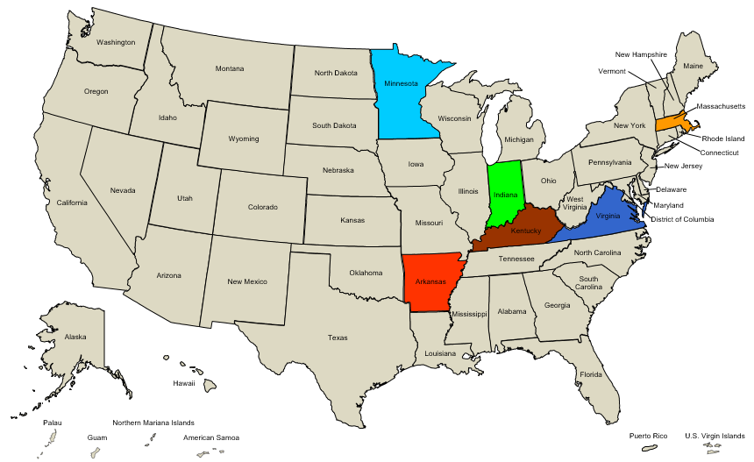
Cohort State Teams
Arkansas
Indiana
Kentucky
Massachusetts
Minnesota
Virginia

Slide 7
Cohort Challenge
Identifying and exploring different methods for using performance data to demonstrate programmatic achievements, challenges, and return on investment.

Slide 8
Cohort Goals
Strengthen state interagency partnerships and infrastructure
Identify and explore approaches to using WIOA and non-WIOA performance data to tell a state’s story
Develop a national resource that will assist states in using their performance data to demonstrate programmatic outcomes (capstone project)
Advance each cohort team’s state-specific action plan

Slide 9
Cohort Overview
Virtual Session 1 – Identified Common Challenges around Maximizing Performance Data
Virtual Session 2 – Explored Strategies for Addressing Identified Challenges
Virtual Session 3 – State Presentations on Current Practices that Enhance Data Maximization Efforts (e.g. Local Data Dashboards and State Longitudinal Data Systems)
In-Person Meeting – Federal Panel on Future and Existing TA to support Performance Data Maximization Efforts, Capstone Development, and State Team Networking
Virtual Sessions 4 & 5 – State Action Plan Presentations and Finishing Touches on Maximizing Performance Data Development Model

Slide 10
Highlights
Drew Griffis (Indiana Department of Workforce Development)
Carrie Marsh (Minnesota Department of Employment and Economic Development)
Megan Lamb (Arkansas Department of Workforce Services - Division of Services for the Blind)

Slide 11
Cohort Outcomes
1. Maximizing Performance Data Development Model
Tools & Resources
Self-Assessment Tool
Facilitation Guide
2. State Action Plans

Slide 12
Cohort Capstone
Opportunity for participants, working together as one team, to identify and develop a tool or resource to help national, state, and local colleagues address an identified challenge.

Slide 13
Challenge: Telling Your Story
This is not easy, but more important than ever
States at all levels can improve
We have a new resource to help states diagnose where they are, and how they can improve in telling their stories

Slide 14
Maximizing Performance Data Development Model
Resource to help states:
“Diagnose” where they are as organizations in using performance data to demonstrate programmatic achievements, challenges, and stakeholder return-on-investment (Self-Assessment Tool); and
Determine next steps for making progress in using performance data to demonstrate achievements, challenges, and ROI, drawing from targeted resources and tools (Resources and Tools).

Slide 15
Maximizing Performance Data: Self-Assessment Tool
Four multiple-choice questions focused on:
Leadership and Partners
Using and Integrating Data
Resource Needs
Data Governance
Set of five answer options corresponding to five levels

Slide 16
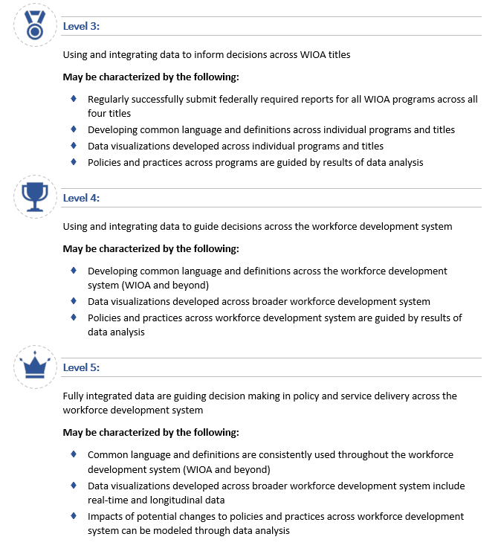
Maximizing Performance Data: Self-Assessment Tool

Slide 17
Survey Question #1
To what extent is your state using and integrating data to inform policy and operational decisions?

Slide 18
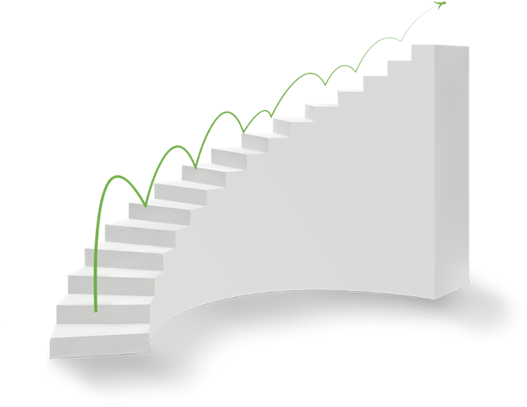
Maximizing Performance Data: Resources and Tools
Direction to states on next steps, including relevant Resources and Tools
Provides opportunity for states to develop a concrete improvement plan

Slide 19
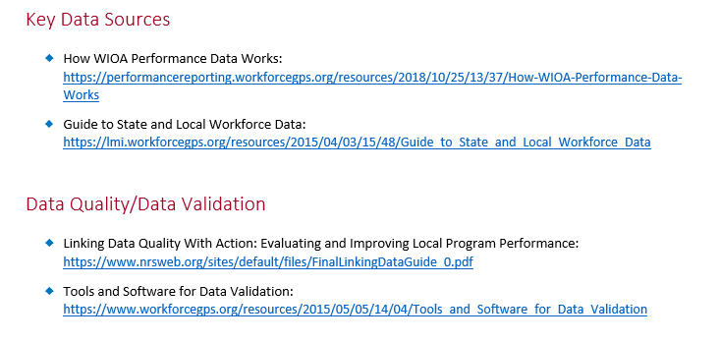
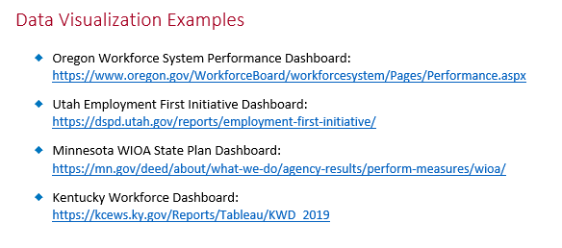
Maximizing Performance Data: Resources and Tools

Slide 20
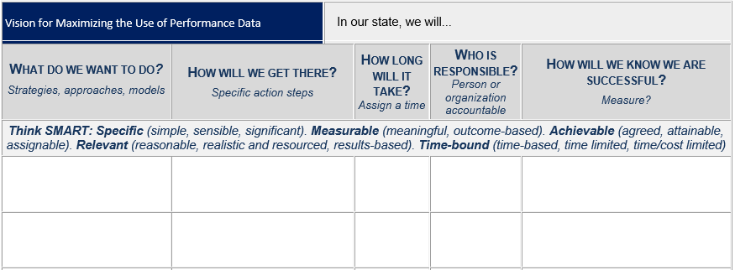
Maximizing Performance Data: Template for Next Steps

Slide 21
Maximizing Performance Data: Facilitation Guide
Step-by-step guidance for applying the Maximizing Performance Data Development Model, including convening a state team to:
Complete Self Assessment Tool
Determine concrete next steps for making progress within the state

Slide 22
Maximizing Performance Data: Facilitation Guide

Slide 23
Survey Question #2
Respond to the following statement:
This tool will be beneficial in your state’s efforts to maximize performance data

Slide 24
State Action Plans
State Action Plans

Slide 25
State Action Plan – Kentucky
Team building: Build the concept that the four Core partners are in the same “family” and share the same broad goals.
Data synthesis: Create more reports and dashboards using partners’ combined data
Regular examination of data by Core stakeholders (and other required partners as available)

Slide 26
State Action Plan – Virginia
Integrate the referral process among the four WIOA Titles by:
Developing a Common Referral Portal that will
Create real-time referrals between programs as clients log in or sign up for services
Create a linked, anonymized data set for use in analytics and dashboarding
Create a new web application, optimized for mobile use
Establishing a Virginia Workforce Data Trust for Data Governance of WIOA data

Slide 27
Any Questions?

Slide 28
Thanks for joining us!

