Slide 1
Military Spouses - A Priority Customer: What Your AJC Can Do
Thursday, August 22, 2019
4:00 PM ~ 5:00 PM EDT

Slide 2
Presenter
Pam Frugoli Workforce Analyst Office of Workforce Investment U.S. Department of Labor

Slide 3
Polling Questions
Our AJC actively conducts outreach and provides services to military spouses?
Yes
No
Our AJC is well informed about military spouse occupational license recognition.
A great deal
Some
Need to know more

Slide 4
Today’s Presenters
Pam Frugoli
Workforce Analyst
Office of Workforce Investment
U.S. Department of Labor
Frugoli.Pam@dol.gov
Kevin Williams
One Stop Operator
WorkSourceSpokane
KLWilliams@esd.wa.gov
C.C. Gallagher
Consultant & Military Spouse
Military Quality Life Consulting, LLC
CCGallagher@mqolc.com
Debbie Medlen
Workforce Specialist
WorkSourceSpokane
DMedlen@ESD.WA.GOV

Slide 5
Highlight the benefits of improving military spouse license recognition support.
Explore how one AJC established a supportive partnership with an adjacent military base.
Provide an opportunity for participants to share their experiences and ask questions.

Slide 6
The committee remains concerned about the employment difficulties military spouses face as a result of the rigors and requirements of military life. Whether their 1st or 20th move, many military spouses repeatedly encounter a costly and lengthy process to meet the professional licensure and credentialing requirements of their new State before they can seek meaningful employment in their chosen field.
Senate Report Sen. 115-262 accompanying the recent John S. McCain National Defense Authorization Act for FY 2019 (NDAA)

Slide 7
U.S. Department of Labor Military Spouse Technical Assistance Project
Military Spouses
AJCs and Career Coaches
State Licensing Boards

Slide 8
Presenter
C.C. Gallagher Consultant & Military Spouse Military Quality Life Consulting, LLC

Slide 9
Poll
I am affiliated with the military?
Yes
No

Slide 10
What AJCs should know about Military Spouses
Over 630,000 Military spouses
Military spouses are 10 times more likely to have moved in the past year.
Approximately 30% of employed military spouses work in licensed occupations.

Slide 11
What AJCs should know about Military Spouses
56 percent of employed military spouses stated they were underemployed. (2018 BSF Survey).
30 percent of military spouses reported they were unemployed and actively seeking work (2018 BSF Survey).

Slide 12
Need for Military Spouse License Recognition Options
License recognition challenges can result in:
Gaps in employment
Financial instability
Negative impact to health and well-being
Decrease in military readiness of service members

Slide 14
Resources You Can Use

Slide 15
All Military Spouse Resources @ WFGPS

Slide 16
Resources for Spouses
www.veterans.gov/milspouses

Slide 17
10 State FAQs

Slide 18
Presenter
Kevin Williams One Stop Operator WorkSourceSpokane

Slide 19
Polling question ??
Our AJC is within 50 miles of a military installation.
Yes
No
Our AJC coordinates services with a local military installation.
Yes
No

Slide 20
Spokane AJC & Fairchild AFB
Spokane AJC By the Numbers
One comprehensive center/campus w/23 connection sites
Campus serves over 12K per year in person/10K on-line
Business Team serves over 10K employers annually
FAFB By the Numbers
3K Active Duty, 900 Guard, 450 civilians, 17.5K retirees
# 1 Employer in Spokane, Economic Impact is 16%

Slide 21
Spokane AJC & Fairchild AFB
Base Leadership and Local WDC Partnership
Disabled Veterans Outreach Program (DVOP)
WorkSource Specialist (Military Spouses)
Military Spouse Empowerment Zone
Establishing a Relationship
Embedded into the Airman & Family Resource Center (A&FRC)
Installation Commander and Spouse
Force Multiplier & Cultural Competency

Slide 23
Presenter
Debbie Medlen Workforce Specialist WorkSourceSpokane

Slide 24
Polling question ??
I work on a military installation.
Yes
No

Slide 25
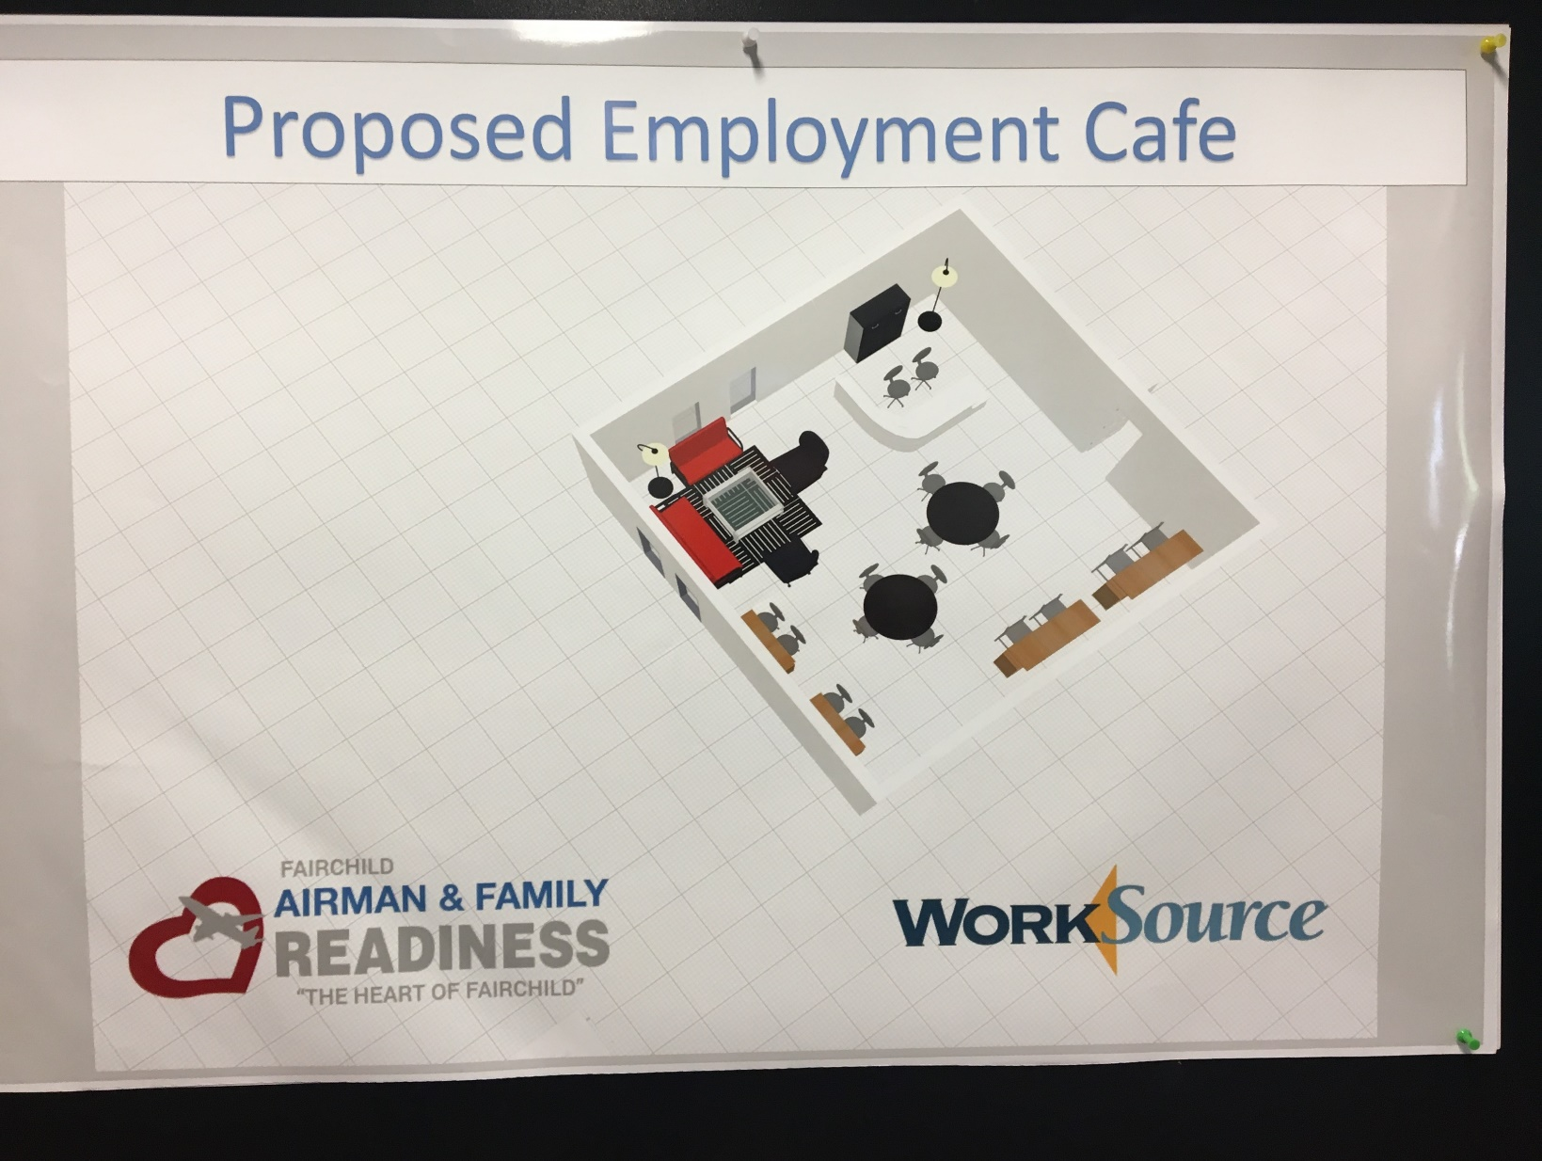
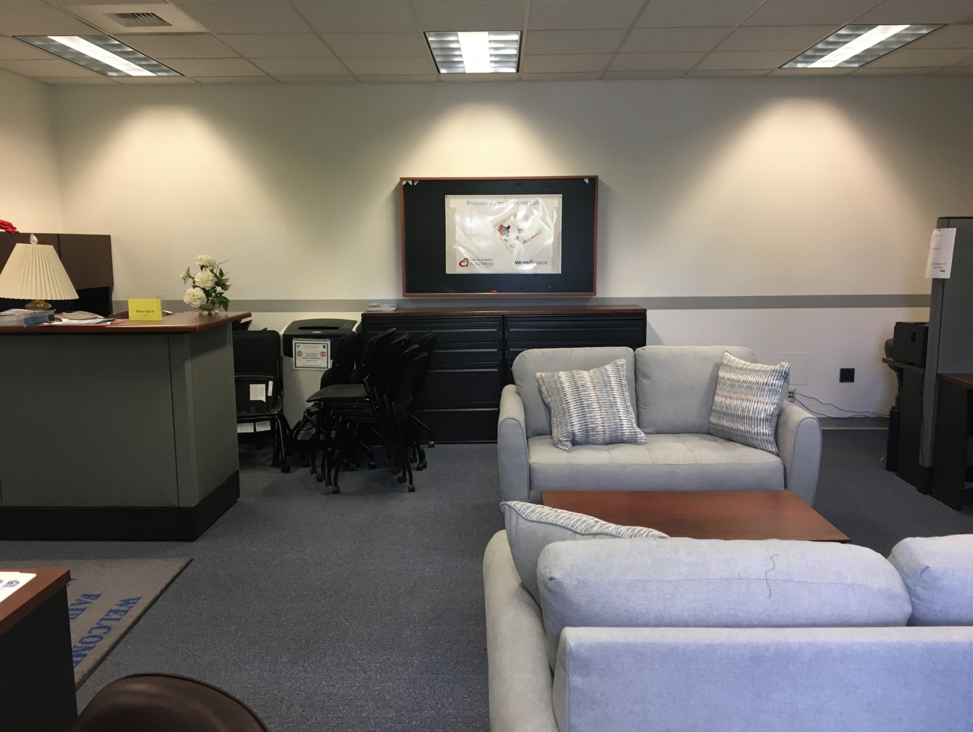
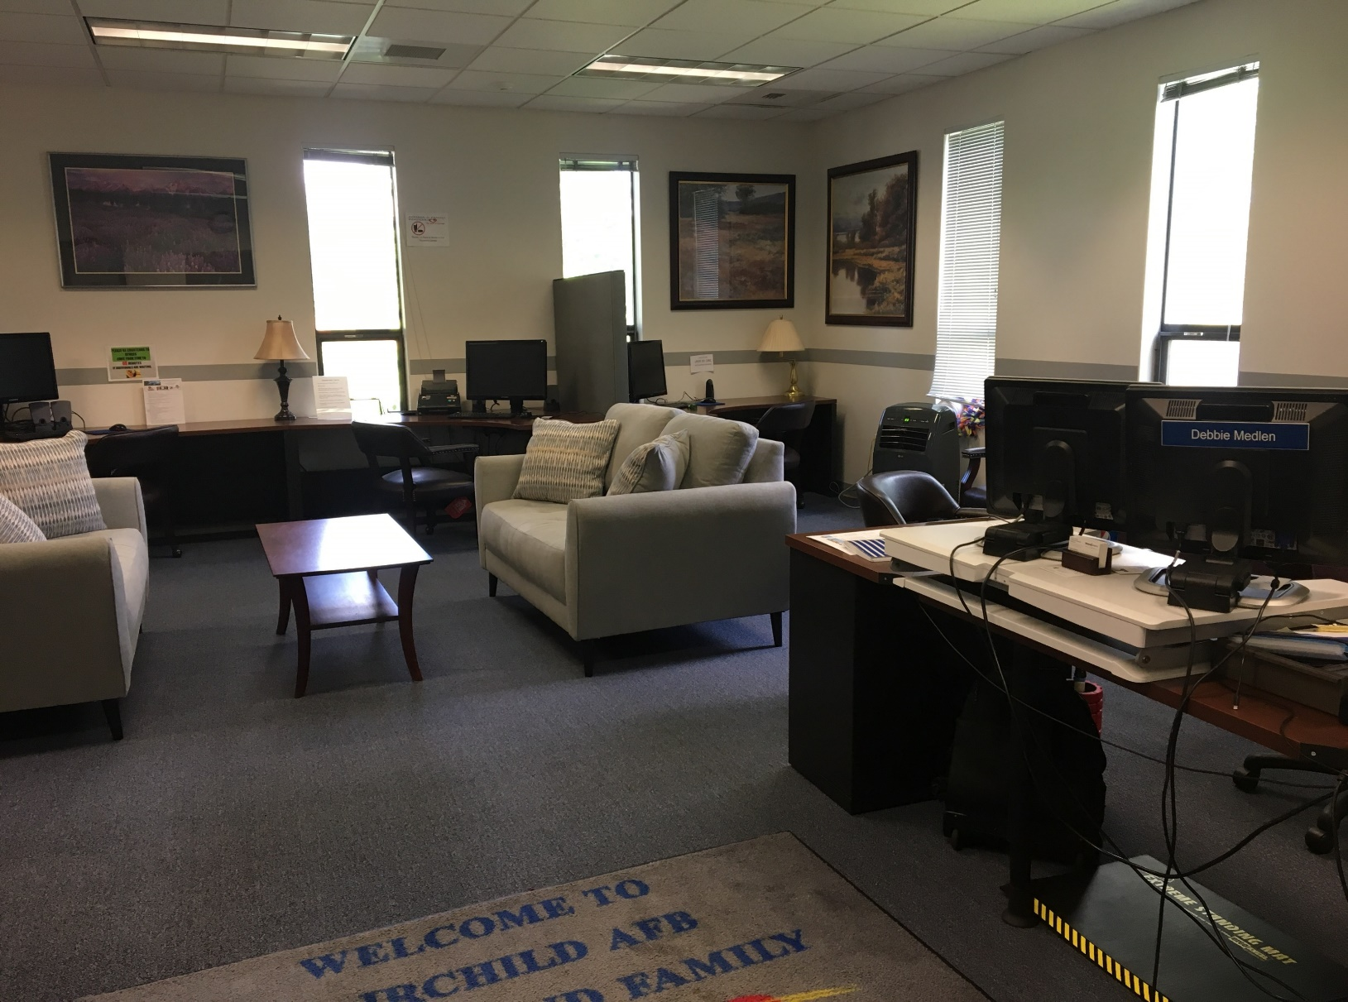
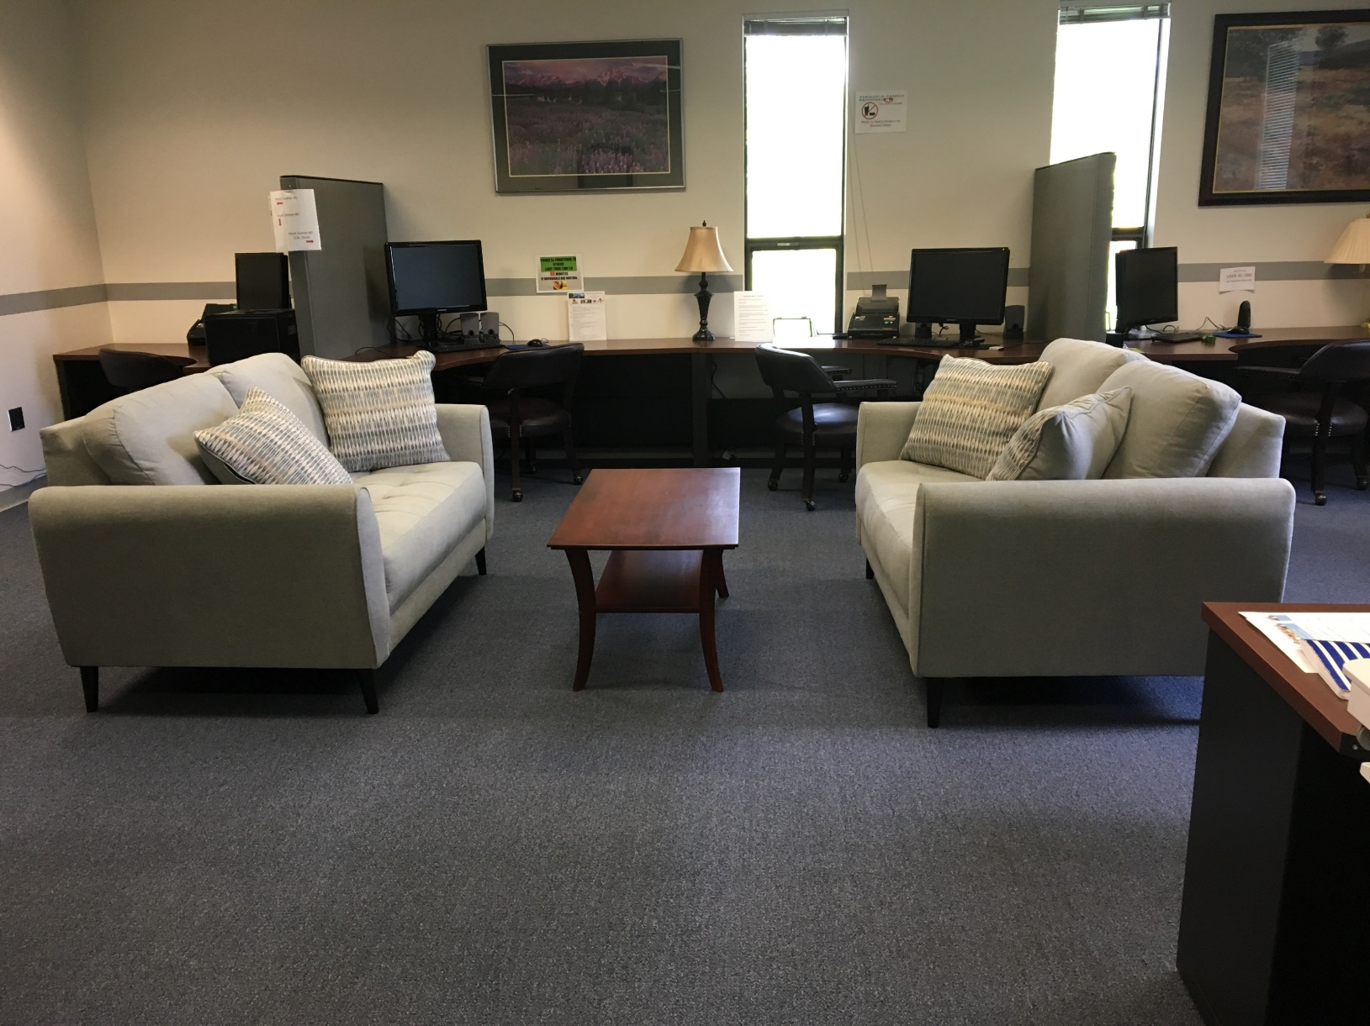

Slide 26
Spokane AJC & Fairchild AFB
Base Outreach
Part of the A&FRC Team
Attending/Presenting at key base meetings
FTAC, Right Start, Smooth Move, Transition Assistance Program (TAP)
Key Spouses Organization
Social Media

Slide 27
Spokane AJC & Fairchild AFB
One-On-One Career Coaching/Job Exploration
Identify local opportunities- Labor Market Information
Connect with LVER and/or AJC Business Team
Targeted resume assistance
Use assessments as a tool
On-line platform (CareerQuest)
Refer to local AJC for individualized WIOA services and more detailed workshops
AFRC Military Life Counselor & Financial Counselor
Use MilitaryOneSource & connect with closest AJC when PCSing

Slide 29
Action Steps
Specify/host a Military Spouse services page on your website.
Schedule a meeting with the nearest military installation to discuss your AJC services.
Establish a formal partnership
Conduct staff training to upscale their capacity to assist military spouses
Or encourage them to view this webinar recording.
Assign a military spouse point of contact
Access and use the resources on the Military Spouse License Recognition page at WorkforceGPS and CareerOneStop.

Slide 31
31

