Slide 1
Let’s get to know who is on the call today. Please select the role that you play in your America’s Promise grant.
For this Grant initiative I am the:
Authorized Representative
Program Director/Manager
IT/Data Manager or staff
Training Partner
Employer Partner
Service Provider

Slide 2
Successful Practices for Sustaining Your America’s Promise Grant
August 20, 2019
High Impact Partners on behalf
of the Employment and Training
Administration, DOL
August 21, 2019

Slide 4
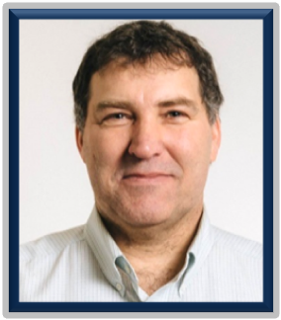
Gregory Scheib
Workforce Analyst
U.S. Department of Labor

Slide 5
Erika Humphrey
Technical Assistance Coach
High Impact Partners
Lyle Neumann
Technical Assistance Coach
High Impact Partners

Slide 6
Julie Parks
Grand Rapids Community College
Executive Director, Workforce Training
Christina Bakewicz
Monroe Community College
Program Manager

Slide 7
To provide strategies that will help support the sustainability planning of your program model and promising practices developed through the America’s Promise Grant.

Slide 8
Today’s Agenda
1
This webinar will focus on four areas to plan for sustainability:
Assessing Your Program
Developing a Succession Plan
Building and Maintaining Partnerships
Developing a Funding Plan

Slide 9
Sustainability Planning
Responses from Grantees
Have you created a timeline to work on sustainability planning with your team?
We will start in September.
We have started to have discussions about sustainability.
No
Yes - but still in the works - nothing finalized as of yet.
Our team meets on a weekly basis with our Dean to keep this moving in a positive direction.

Slide 10
Sustainability Planning
Responses from Grantees
What staff and/or partners are involved in your sustainability planning?
All staff
Economic Development Boards
Workforce Development Boards

Slide 11
Sustainability Planning
Responses from Grantees
How will you use the performance data to identify program components that will lead to future expansion or that need improvement?
We will use them to show our College, our Workforce Board and our employers the value of the work funded through this grant.
To inform the supply and demand for each job role.
We will identify areas to focus time and resources.

Slide 12
What areas of building a sustainability plan have you/your team completed? Choose all that apply
Documenting sustainable successes
Assessing what to sustain from our America’s Promise Grants
Identifying what resources are needed to sustain our project
Identifying key partners who will help achieve our project’s vision
Identifying potential funding sources for sustaining our project

Slide 13
Sustainability Strategy #1
Program Assessment
Begin by identifying the various activities that you have undertaken as a result of this grant and assess which ones have yielded or are yielding successful outcomes. Focus on activities that have the greatest impact or are producing desired outcomes.

Slide 14
Program Evaluation Strategies
Review project outcomes to determine what aspects of the program were successful and should be sustained. (How do your performance outcomes play into your determination?)
Make a list of promising practices that have been successful in your America’s Promise grant, especially new practices or protocols that were implemented because of the grant funding.

Slide 15
Program Evaluation Strategies
Review labor market statistics to determine if any elements of the project need to be modified to meet current industry needs.
Determine if program goals need to be updated to reach your vision for sustaining the program.

Slide 16
Program Assessment Worksheet Example:

Slide 17
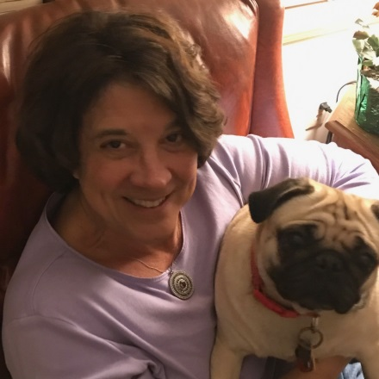
Grand Rapids Community College
Julie Parks, Executive Director, Workforce Training

Slide 18
How is your organization assessing which parts of the America's Promise program should be sustained
We are looking at our participants to see who has been the most successful as it relates to completion, placement and wages.
We are focusing on the areas of the program that has attracted employers to participate
We are assessing the curriculum and training and looking at participant completion and retention rates
We are asking our staff what has been their return on investment from this program

Slide 19
What are the strategies your organization is using or will use to sustain your program activities?
Apprenticeship model expansion – Leveraging State and Federal Dollars.
Tactics that improved colleges and workforce board metrics –
Re-direction of funds from other projects/programs that have
not been as successful.
(2) Integrate strategies learned into other sectors
(3) Shared software systems/tracking/intake.
New “products” – New program creation to generate revenue to cover costs (i.e., Sterile Processing, Surgical Technician, Culinary & Dietary Boot camp)
Value to employers –We have some “asks”.

Slide 20
Grantee Question:
Program Assessment
Type in the Chat Box
What is one component of your program that you would like to sustain?

Slide 21
Grantee Question:
Program Assessment
Type in the Chat Box
What have you learned from reviewing your program data that is informing your sustainability planning?

Slide 22
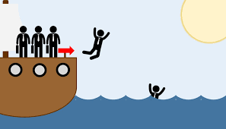
Sustainability Strategy #2
Developing a Succession Plan
The grant hasn’t ended and people are jumping ship!
Here are a few tips…

Slide 23
Developing a Succession Plan
Identify other funding streams to help keep staff in place as you look at areas of the grant you want to sustain.
Develop a transition plan in case staff members leave before the grant is complete.
Begin to identify strengths and challenges in your current team. Will other team members have the capacity to take on additional work?
Consider having multiple staff members trained on job placement strategies

Slide 24
Developing a Succession Plan
Name and train a backup person for each function.
Create and update a binder or digital file that includes key documents such as strategic /operational plans, annual and monthly calendars of your organizational activities.
Identify potential successors and assess individual and organizational gaps to determine developmental needs.

Slide 25
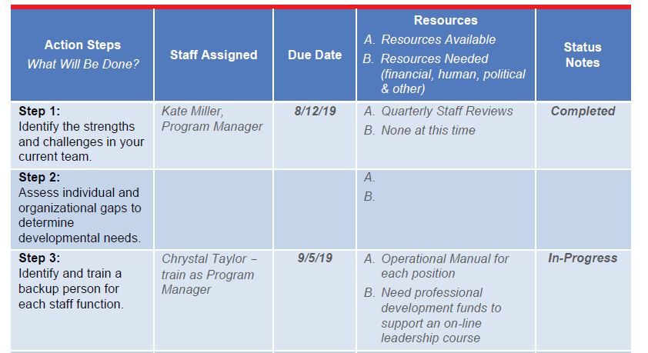
Succession Planning Worksheet Example:

Slide 26
Grantee Question:
Developing a Succession Plan
Type in the Chat Box
Have you developed a transition plan in case staff members leave before the grant is complete?
If so, what does it include?

Slide 27
The America’s Promise grant program was designed to build on the momentum of WIOA to develop and expand regional partnerships and training opportunities particularly for middle- to high-skilled H-1B industries and occupations, ensuring that communities fully maximize their Federal, state and local funds to build a competitive workforce.
One of the primary vehicles for driving these strategies is regional workforce partnerships that are:
creating sector-based career pathways and
offering tuition-free training to meet the needs of workers and businesses.

Slide 28
Sustainability Strategy #3
Building and Maintaining Partnerships
Partners play an important role in sustainability in several ways:
Connecting you to greater resources or expertise
Providing services if your program has to cut back
Advocating on behalf of your cause
*Partners can also help rally the community around your program and its goals.

Slide 29
Building and Maintaining Partnerships
Conduct a current partner or stakeholder analysis:
Which organizations or individuals will require time and energy to keep involved?
Determine if your partners have an interest in sustaining the benefits of the project and are willing to be part of the planning process.
Create a stakeholder management plan based on this analysis.
Meet with employer partners to determine if the training provided by the project is still relevant to their needs.
Identify organizations and individuals that are not currently involved in program efforts but are impacted by your program. Determine how they could contribute to or benefit from your work and engage them in your program.

Slide 30
Building and Maintaining Partnerships Worksheet Example:

Slide 31
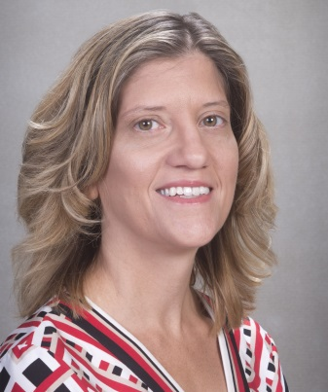
Monroe Community College
Christina Bakewicz
Manager

Slide 32
Who are your regional partners and how does your organization plan to sustain the relationship after the grant has ended?
Workforce Investment Boards
RochesterWorks!
Finger Lakes Works
GLOW Works
Other Community Colleges
Genesee Community College
Finger Lakes Community
NYS DOL
Community Based Agencies

Slide 33
How are regional partners involved in sustainability planning and what has been discussed thus far in relation to which activities they can help with sustaining?
Look for other projects on which to partner.
Develop and implement a standardized inter-agency referral form.
Offer regular staff cross-training opportunities.

Slide 34
Which partners are involved right now in your sustainability planning? Choose all that apply
Employer Partners
Regional Partners
Training Providers
Educational Partners
Supportive Service Providers
Other (List in the chat box)

Slide 35
Sustainability Strategy #4
Developing a Funding Plan
Planning for stable funding should be a strategic process that addresses the long-term needs of your program and adjusts to changing trends in economic cycles.

Slide 36
Developing a Funding Plan
Develop a funding plan to provide safeguards and ensure that key infrastructures are maintained (including an adequate number of qualified staff).
Determine the availability of other sources of financial support including local and state government funding, industry funding, and foundation support.

Slide 37
Funding Stability Worksheet Example:

Slide 38
What steps have you taken to secure other funding sources to sustain your promising practices? Choose all that apply
We have made contact with businesses or foundations that can help our organization sustain our project.
We are leveraging existing resources to sustain our project.
We are seeking other community-based organizations with similar missions/visions in order to consolidate community's resources.
We are seeking out other federal funding sources.
We are waiting to hear about the next DOL funding opportunity.

Slide 40
Recap
Keep in mind that it may not be possible for all activities to be sustained and focus on the ones that have the greatest impact or are producing desired outcomes.
Review labor market statistics to determine if any elements of the project need to be modified to meet current industry needs.
Consider having multiple staff members trained on job placement strategies.
Use the “Checklist” to conduct a current partner or stakeholder analysis.

Slide 41
September 2019
Change Management: Tips to Effectively Manage the Changing Lifecycle of the Grant

Slide 42
America’s Promise Mailbox:
AmericasPromise@dol.gov

