Slide 1
2018-28 Employment Projections
Michael Wolf
Employment Projections Program
9/17/2019

Slide 2
Employment Projections Background
2018-28 projections are the last set released on a biennial basis
Projections will be released annually beginning with the 2019-29 projections (scheduled to be released in 2020)
2018-28 projections cover more than 800 occupations and 290 industries
BLS projections prepared at the national level only
BLS projections serve as an input for state and local employment projections

Slide 3
Projections Users and Their Uses
Career counselors and students making career choice decisions
Jobseekers looking to find work or switch occupations
Education and training officials making decisions on policy, funding, and program offerings based on demand for occupations
Researchers interested in how the economy is changing

Slide 4
Employment Projections Process
Labor Force
Total and by age, sex, race and ethnicity
Aggregate Economy
GDP, total employment, and major demand categories
Industry Final Demand
Sales to consumers, businesses, government, and foreigners
Occupational Employment
Job openings due to growth & separations
Industry Employment
Labor productivity, average weekly hours, wage & salary employment
Industry Output
Use and Make Relationships, Total Requirements Tables
Notes:
4

Slide 5
Slowing Growth in Population and Labor Force
Annual rates of change
Source: U.S. Census Bureau and Bureau of Labor Statistics

Slide 6
The Labor Force is Aging
Percent distribution of the labor force

Slide 7
Slower Growth in Total Nonagricultural Wage and Salary Employment
Millions of nonagricultural wage and salary jobs
Recession year
Actual
Projected

Slide 8
Healthcare Occupational Groups are Projected to Grow Fastest
Percent employment growth, projected 2018-2028
Average, all occupations = 5.2%
(Continued on next slide)

Slide 9
Production, Office and Administrative Support, and Sales and Related Occupational Groups are Projected to Decline
Percent employment growth, projected 2018-2028
(Continued)
Average, all occupations = 5.2%

Slide 10
6 of the 10 Fastest Growing Occupations are Related to Healthcare
Median annual wages, May 2018
$42,680
$54,370
$24,200
$24,020
$60,220
$98,350
$108,610
$87,780
$107,030
$77,510
Percent change, projected 2018-28
Employment change, projected 2018-28 (in thousands)

Slide 11
Personal Care Aides and Combined Food Preparation and Serving Workers, Including Fast Food are Projected to Add the Most New Jobs
Employment change, projected 2018-28 (in thousands)
Percent change, projected 2018-28
Median annual wages, May 2018
$24,020
$21,250
$71,730
$24,200
$26,530
$103,620
$21,780
$100,930
$26,110
$33,610

Slide 12
Employment Growth and Occupational Openings
Workers who filled newly created positions
Workers who filled positions vacated by incumbents
Workers who remained in the occupation

Slide 13
Occupational Openings Due to Separations and Growth
Example: Registered nurses
Thousands of occupational openings, 2018-28 annual average
Separations
Growth

Slide 14
Total Annual Occupational Openings for One Occupation
Thousands of occupational openings, 2018-28 annual average
Occupational transfers
Labor force exits
Growth
210.4

Slide 15
Large, Low Skilled Occupations Have the Most Occupational Openings
Median Annual Wage 2018
$21,250
$22,430
$24,200
$21,780
$24,020
$28,260
$33,750
$32,730
$26,110
$25,700
Average occupational openings per year, projected 2018-28, in thousands

Slide 16
Occupations that Require More Education Pay More
Median annual wages, May 2018
$105,700
$73,580
$73,960
$53,700
$38,640
$35,820
$37,020
$24,430
Thousands of jobs, 2018

Slide 17
High School Occupations by Training Level
Median annual wages, May 2018
$51,130
$49,060
$30,750
$23,660
Thousands of jobs, 2018

Slide 18
Occupations that Need More Education for Entry are Projected to Grow Faster*
Projected 2018-28 growth rate in occupational employment by typical 2018 entry-level education
*Entry level education reflects 2018 requirements – BLS does not project education requirements
Average, all occupations = 5.2%

Slide 19
Useful Employment Projections Sites
Employment Projections data and publications
http://www.bls.gov/emp/
Occupational Outlook Handbook
http://www.bls.gov/ooh
Frequently asked questions
http://www.bls.gov/emp/frequently-asked-questions.htm
State employment projections
http://www.projectionscentral.com/

Slide 20
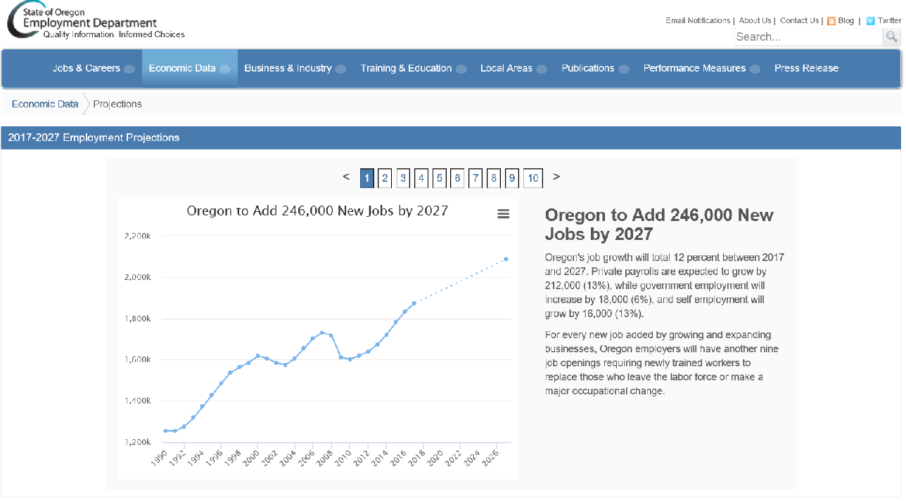

Slide 21
Q & A

Slide 22
Michael Wolf
Employment Projections Program
www.bls.gov/emp
202-691-5714
wolf.michael@bls.gov

