Slide 1
Managing Change to Maintain Grant Implementation Success
High Impact Partners on behalf
of the Employment and Training
Administration, DOL
September 23, 2019

Slide 2
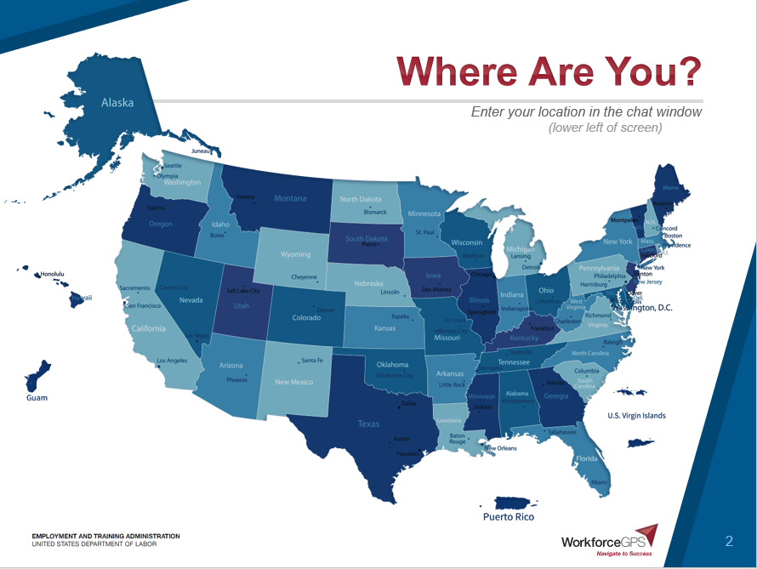

Slide 3
Gregory Scheib
Workforce Analyst
U.S. Department of Labor
Division of Strategic Investments
Employment & Training Administration

Slide 4
Your Facilitators:
Kelly Middleton Banks
TA Coach
National Association of Workforce Boards
Jan Bray
TA Coach
National Association of Workforce Boards

Slide 5
Gain an understanding of drivers of change.
Identify strategies for addressing change.
Learn how to evaluate progress and results of actions to address change.

Slide 6
Today’s Agenda
Welcome
Presenters' Overview of Change
Q & A – Grantee Sharing
Strategies and Tips
Wrap-up

Slide 7
Ron Painter
President and CEO
National Association of Workforce Boards
Jen Worth
Senior Vice President.
Workforce and Economic Development
American Association of Community Colleges

Slide 8
AACC and NAWB
Represents ~550 Workforce Development Boards and their 10,000+ business members.
Is the only association that advocates for WDBs.
Works closely with policy makers to inform national strategy as it relates to WDBs and our partners.
Represents ~1,000 2-year, associate degree-granting institutions and more than 12 million students.
Primary advocacy organization for the nation’s community colleges.
Provides technical assistance to colleges to promote the alignment of priorities, strategies, and resources with those of workforce and economic development partners.

Slide 9
What are the warning signs that signal changes are coming?
Staff will start transitioning out.
Dollars will get smaller and fundraising will become the focus versus productivity on the actual content.
Leadership and/or partners either leave or turns attention elsewhere.
Status of local industry/employers shifts operations, products, growth strategies.

Slide 10
How can change impact program management?
Adjusting roles and responsibilities
Reinforcing value and need for a program
Shifting resources

Slide 11
Who should be involved in identifying solutions when change happens?
Everyone - Champions to Case Managers
Stakeholders and Partners
Employers
Participants

Slide 12
Grantee Polling Question
What change has created the biggest challenge?
Choose the answer that best reflects the change that occured
Organizational
Partners and stakeholders
Employers
Funding

Slide 13
Things to DO to Plan Proactively for Change
Share information…and then tell them again.
Acknowledge wins and losses with your team.
Understand what truly matters for your stakeholders.
Source: Bridges, W. (2009). Managing transitions: Making the most of change. Philadelphia, Pa: Da Capo Press.

Slide 14
Things NOT to Do When Addressing Change
Immediately set higher goals.
Forget to uphold your values.
ex: If you value feedback, don’t make a policy that says “no criticism”.
Think you need to rebuild the project in an exact image.
Source: Bridges, W. (2009). Managing transitions: Making the most of change. Philadelphia, Pa: Da Capo Press.

Slide 15
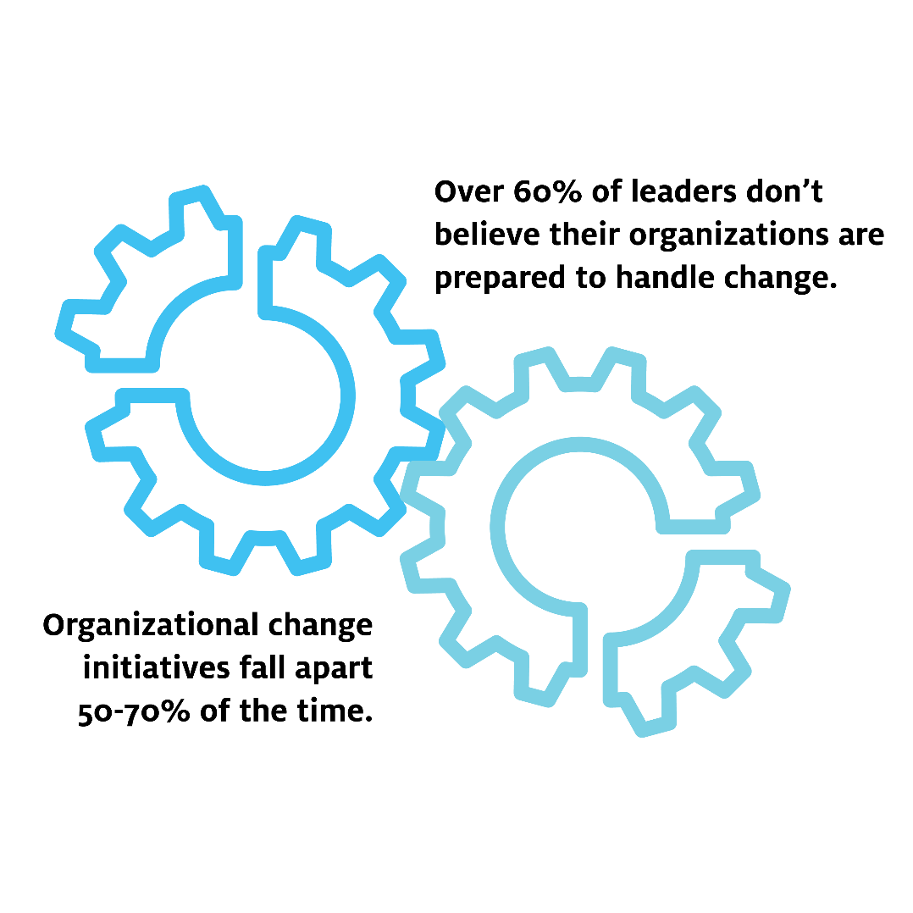
Change Endurance
What Research Shows
Ensure leaders follow the “3 Cs” of change leadership:
Communicate
Collaborate
Commit
Educate about rumination vs. resilience
Empower workers to manage stress in & out of work; model behaviors
©2018 Center for Creative Leadership

Slide 16
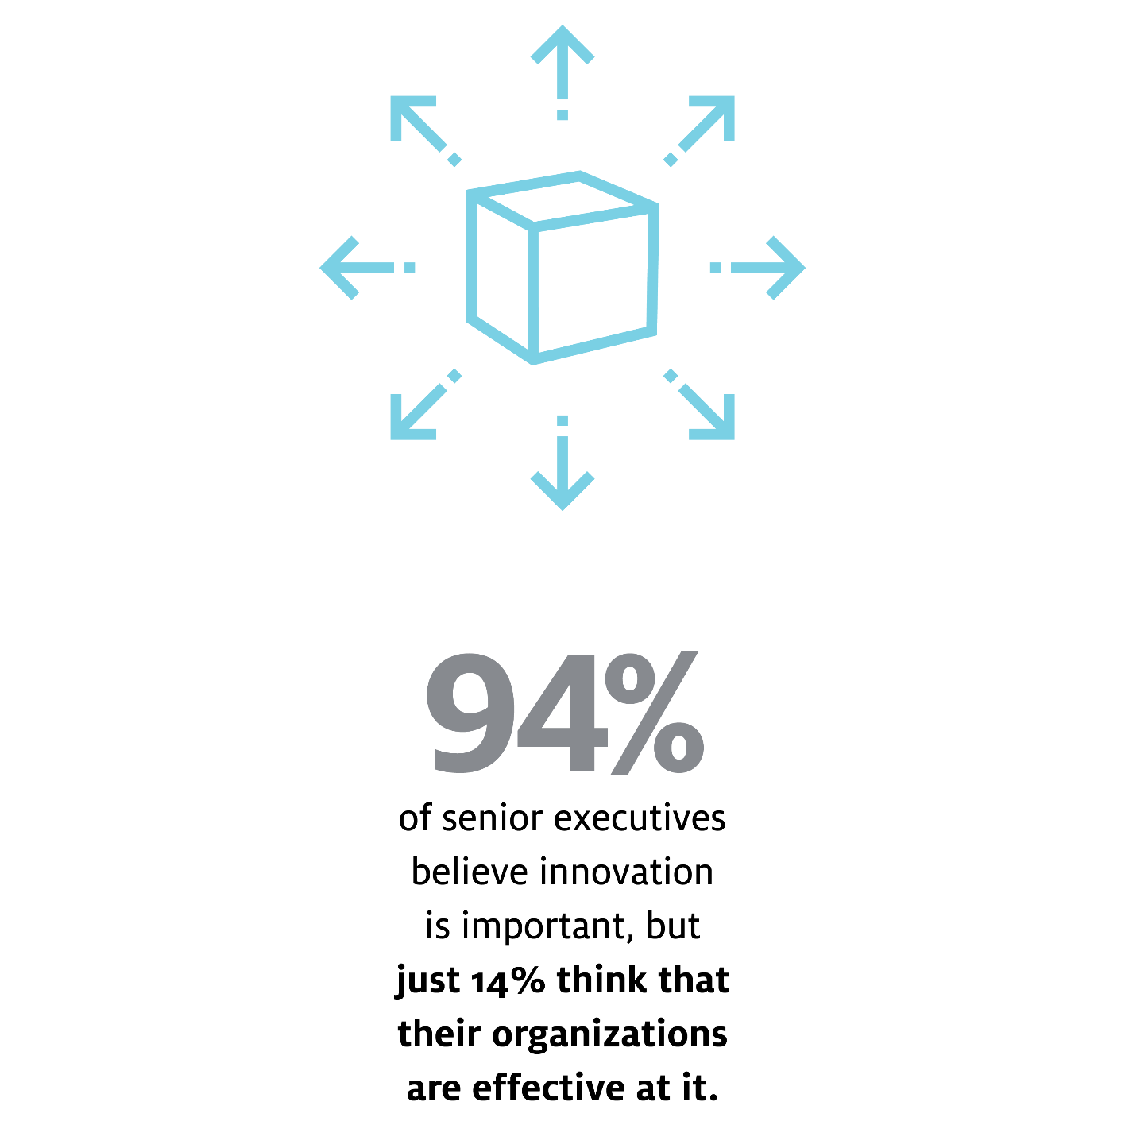
Embracing Disruption
Strategies to Supporttoupport
What Research Shows
Empower innovation using POINT.
(Praise, Opportunities, Issues, and New Thinking)
Recognize that innovation varies by role.
Discern the difference between “high potential” and “high professional” and develop your talent accordingly.
©2018 Center for Creative Leadership

Slide 17
Time for Your 3 Sentence Challenges
Please enter three sentences in the chat box for Mr. Painter and Ms. Worth to customize solutions for your community

Slide 19
H-1B Grantee Conference: Strengthening America’s Talent Pipeline
Washington, DC
This conference will bring together grantees from the America’s Promise Grants and the Strengthening Working Families Initiative (SWFI) to provide technical assistance (TA) from DOL staff, including FPOs, coaches, and subject matter experts as well as peer-to-peer sharing.
November 13-14, 2019

Slide 20
America’s Promise
U.S. Department of Labor
AmericasPromise@dol.gov
202.693.3949

