Slide 1
Uniform Guidance: Cost Principles and Cost Classification
SMART 3.0 Training
September 26, 2019

Slide 2
Today’s Speakers
Nancy Taylor
Senior Accountant, DFMAS
U.S. Department of Labor – Region 5
Chicago, IL
Taylor.Nancy@dol.gov
Chanel Castaneda
Grants Management Specialist
U.S. Department of Labor – OGM DPRR
Chicago, IL
Castaneda.Chanel@dol.gov

Slide 3
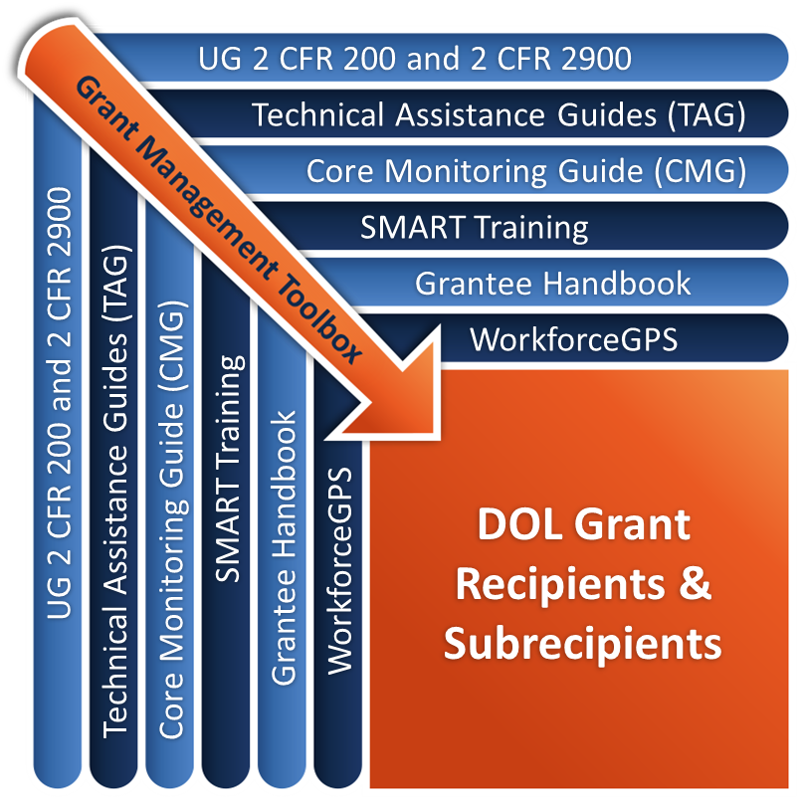
Grant Management Toolbox

Slide 4
Grant Management Toolbox References
SMART
SMART Training
Core Monitoring Guide
Technical Assistance Guides
ETA Grantee Handbook
WorkforceGPS Resources
CMG
TAG
Grantee Handbook
GPS

Slide 5
Module Overview
General Cost Principles
Identify applicability to recipients and subrecipients
Discuss cost principles standards for allowable costs
Discuss the importance of understanding the prior written approval requirements
Cost Classification
Identify types of costs in accounting system
Understand how costs are classified
Selected Items of Cost
Discuss the allowability of some specific items of costs relevant to DOL programs

Slide 6
General Cost Principles
Applicability
Standards for Allowable Costs
Prior Written Approval Requirements

Slide 7
Cost Principles
UG Cost Principles at 2 CFR 200 Subpart E
General provisions 2 CFR 200.400-200.401
Basic Considerations 2 CFR 200.402-200.411
Direct and Indirect (F&A) Costs 2 CFR 200.412-200.415
Special considerations for states, local governments, and Indian Tribes 2 CFR 200.416-200.417
Special considerations for institutes of higher education 2 CFR 200.418-200.419
General provisions for selected items of cost 2 CFR 200.420-200.475

Slide 8
DOL Exceptions
Prior written approval 2 CFR 2900.16
Adjustment of negotiated IDC rates 2 CFR 2900.17
Contingency provisions 2 CFR 2900.18
Student activity costs 2 CFR 2900.19

Slide 9
Applicability
States
Local governments
Non-profit organizations
Indian tribes
Institutions of Higher Education (IHE)
For-profit or commercial entities
Foreign organizations and foreign public entities

Slide 10
Application of Cost Principles
Must be used to determine allowable costs
Work performed by non-Federal entity under Federal award
Used as guide in pricing of fixed-price contracts and subcontracts
Exceptions
Fixed amount awards
Loans, scholarships, fellowships, etc.
Awards to Hospitals

Slide 11
Standards
Factors Affecting Allowability:
Necessary and reasonable
Conform with federal law, guidelines and grant terms
Consistent with policies and procedures
Accorded consistent treatment
In accordance with GAAP
Not used for cost sharing or matching funds
Adequately documented

Slide 12
Necessary and Reasonable – Requirements
The foundation for allowable costs
To be allowable under Federal awards a cost be necessary and reasonable for the performance of the Federal award and be allocable thereto under these principles 2 CFR 200.403(b)
Three basic requirements
Necessary
Reasonable
Allocable

Slide 13
Necessary and Reasonable
The foundation for allowable costs: To be allowable under Federal awards a cost be necessary and reasonable for the performance of the Federal award and be allocable thereto under these principles 2 CFR 200.403(b).
Reasonable means cost does not exceed what would be incurred by a prudent person under prevailing circumstances when decision was made to incur the cost 2 CFR 200.404(c).
Reasonableness considerations:
Necessary for the performance or administration of the grant
Follow sound business practices
Fair market prices
Act with prudence
No significant deviation from established prices

Slide 14
Necessary?
How does the purchase align with the objectives/goals of the program in which the Federal funds were awarded?
Is the cost necessary for the performance of the award?
Is this item or service needed to meet grant goals?
Practical aspects of reasonable
Do I have the capacity to use what I am purchasing?
Did I pay a fair rate?
If I were asked to defend this purchase, would I be comfortable?

Slide 15
Prudent Person
When providing such payments, the standards of reasonableness using the prudent person standards prevails. The concern seen throughout the system, it is when the cost becomes high, excessive or beyond the prudent person test that it becomes questionable.

Slide 16
Written Policy – What should it include?
It is important also to have a written policy on products and services that may be charged to a grant or Federal program.
How will the entity handle providing food in specific situations?
Do entertainment costs provide a programmatic purpose and have prior approval?
Written policies that establish the factors or criteria that would be considered before incurring such a cost must be established.
Define the parameters or limitations to establish reasonableness.
Must be applicable or consistent with similar policies for non-Federally funded grants and programs.
Should also outline instructions or steps to consider to provide consistency when classifying these costs as program or administrative.
The classification of such costs is important because of specified cost limitations contained in many of our programs.

Slide 17
Allocation
2 CFR 200.4 Allocation
Allocation means the process of assigning a cost, or a group of costs, to one or more cost objective(s), in reasonable proportion to the benefit provided or other equitable relationship. The process may entail assigning a cost(s) directly to a final cost objective or through one or more intermediate cost objectives.

Slide 18
Allocable Costs
2 CFR 200.405 Allocable costs
A cost is allocable to a particular Federal award or other cost objective if the goods or services involved are chargeable or assignable to that Federal award or cost objective in accordance with relative benefits received.

Slide 19
Adequately Documented
Amount of funds and how funds are used
Percentage of costs provided by other sources
Other records to facilitate an effective audit
Total cost of the project
Records that show compliance/performance
Allocable benefit to the grant

Slide 20
Additional Standards
Composition of Costs 2 CFR 200.402
Applicable Credits 2 CFR 200.406
Prior Written Approval 2 CFR 200.407
Limitation on allowance of costs 2 CFR 200.408
Special Considerations 2 CFR 200.409

Slide 21
Program Limitations
Salaries & Bonus Limitations 20 CFR 683.290
SESA Real Property 20 CFR 683.240
Public Service Employment Programs 20 CFR 683.250(a)(2)
Legal expenses for prosecution of claims, ALJ audit appeals or civil actions 2 CFR 200.435

Slide 22
WIOA Cost Limitations
WIOA – Section 181(e) Prohibits use of funds for:
Employment-Generating activities
Revolving loan funds
Business capitalization
Economic development
Foreign travel
Debarred or suspended parties 20 CFR 683.250
Persons falsely labeling products made in America 20 CFR 683.250

Slide 23
Shifting of Costs
2 CFR 200.405(c)
“Any cost allocable to a particular Federal award under the principles provided for in this part may not be charged to other Federal awards to overcome fund deficiencies, to avoid restrictions imposed by Federal statute, regulations, or terms and conditions of the Federal wards, or for other reasons.”
Examples of cost shifting include:
From one grant to another grant (exception below)
From administrative to program costs category
From direct to indirect cost or vice versa
2 CFR 200.405(c) goes on – “However, this prohibition would not preclude the non-Federal entity from shifting costs that are allowable under two ore more Federal awards in accordance with existing Federal statutes, regulations, or the terms and conditions of the Federal awards.

Slide 24
Prior Written Approval
Cost Principles specifically addresses prior written approval requirements 2 CFR 200.407
Grant Officer is the only authorized official to provide written approval 2 CFR 2900.12
Request for approval must be submitted not less than 30 days before requested action occurs 2 CFR 2900.16

Slide 25
Prior Written Approval
Prior approval does not exempt grantees from the requirements that purchases are reasonable, necessary and allocable
Purchases must be made prior to the last funded year of grant, even with prior approval
Must be approved by Grant Officer
Will be in written form
Before costs are incurred
Items included in the statement of work or budget as awarded does NOT constitute prior approval 2 CFR 2900.16

Slide 26
Prior Approval Applicability
States – Formula Grantee
Prior approval authority is delegated to the Governor for State and Local Workforce Investment Area (LWIA) costs
No additional ETA approval is required
States – Discretionary (non-formula) Grantee
Must obtain ETA prior written approval
Subrecipients request for ETA prior approval goes through the state
Other Non-Federal Entities
Must obtain ETA prior written approval
Subrecipients request for ETA prior written approval goes through the PT

Slide 27
Cost Classification
Identify types of costs in accounting system
Understand how costs are classified

Slide 28
Classification of Costs – UG
2 CFR 200.412
No universal rule
May be direct or indirect (F&A)
May be program or administrative
Consistent treatment in like circumstances
Avoid double-charging
Misclassification may result from accidental miscoding of costs within the accounting system or a lack of clear definitions for allowable and unallowable costs.

Slide 29
Examples of misclassification of costs
A nonprofit organization classified the costs of fundraising as meeting expenses that are added to the indirect cost pool, including meals and other donations. These costs were then allocated to all funding sources, including WIOA grants.
A SCSEP grantee runs out of monies to pay its rent for the last 3 months of its current grant. When it receives a new grant, it charges the late rent to new grant.

Slide 30
Classification of Costs
Chart of Accounts contain sufficient codes of revenue and expenses to adequately track spending of grant funds
Accounting system allow the tracking of grant activities that have an expenditure cap or threshold in accordance with the program’s regulations
In the capacity of a PTE, subrecipients’ Charts of Accounts are reviewed to ensure that they are reporting costs in the appropriate budget cost categories

Slide 31
Avoid Misclassification of Costs
Job title vs. Job Function
Duties related to more than one category or activity
Allocation based on time worked or equitable method
Not based on job title
Administrative vs. Program Costs
Track using Chart of Accounts

Slide 32
Knowledge Check 1 – Questions
True or False?
The UG 2 CFR 200 Subpart E Cost Principles contains the criteria for charging costs to a Federal award.
The necessary and reasonableness standards form the foundation for cost allowability.
The standards for documentation include performance information.
Salary and bonus restrictions no longer apply under the new cost principles.
Requests for approval must be submitted not less than 45 days before requested action occurs.
Prior approval authority is delegated to the Governor for all grants to a state.
Subrecipients of discretionary grantees request prior approval directly from the DOL Grant Officer.
Any non-Federal entity may charge the de minimis rate of 10 percent of modified total direct costs (MTDC) in lieu of a negotiated IDC rate.

Slide 33
Knowledge Check 1 – Answers
True or False?
The UG 2 CFR 200 Subpart E Cost Principles contains the criteria for charging costs to a Federal award. True
The necessary and reasonableness standards form the foundation for cost allowability. True
The standards for documentation include performance information. True
Salary and bonus restrictions no longer apply under the new cost principles. False
Requests for approval must be submitted not less than 45 days before requested action occurs. False
Prior approval authority is delegated to the Governor for all grants to a state. False
Subrecipients of discretionary grantees request prior approval directly from the DOL Grant Officer. False
Any non-Federal entity may charge the de minimis rate of 10 percent of modified total direct costs (MTDC) in lieu of a negotiated IDC rate. False

Slide 34
Selected Items of Cost
Discuss the allowability of some specific items of cost relevant to DOL programs

Slide 35
Considerations for Selected Items of Cost
2 CFR 200.420
The cost principles apply whether or not a particular item of cost is properly treated as direct cost or indirect (F&A) cost
Failure to mention a particular item of cost in the Selected Items of Cost section of Subpart E is not intended to imply that it is either allowable or unallowable
A determination as to allowability in each case should be based on the treatment provided for similar or related items of cost, and based on the principles described in Basic Considerations of Cost Sections 2 CFR 200.402 - 200.411

Slide 36
Types of Costs
Allowable
Training costs
Collection of improper payments
Health and welfare
Allowable with conditions
Personnel
Donations
Interest
(Most Costs)
Unallowable
Entertainment
Fines and penalties
Bad Debts

Slide 37
Advisory Councils
2 CFR 200.422
Unallowable unless the following conditions are met
Authorized by statute
Authorized by Federal agency
As an indirect cost where allocable

Slide 38
Advertising
2 CFR 200.421
Costs of media including electronic media
Allowable
The recruitment of personnel
The procurement of goods and services
The disposal of scrap or surplus materials
Program outreach and other specific purposes necessary to meet the requirements of the Federal award

Slide 39
Public Relations
2 CFR 200.421
Allowable
Specifically required by the Federal award
Communication costs; including community outreach
Program specific awards
General program liaison
Unallowable
Memorabilia
Organizational recognition
Promotional items

Slide 40
Capital Assets
2 CFR 200.12 applies to:
Equipment
Real Property
Major Renovations
Intellectual property
Expenditures capitalized in accordance with GAAP

Slide 41
Equipment
2 CFR 200.33 and 2CFR 200.439
Definition
Tangible personal property (use life > 1 year)
$5,000 cost or entity capitalization level
Computing devices IT systems
General and special purpose
Allowable with prior written approval
Expensed in period acquired

Slide 42
Intellectual Property
2 CFR 200.448 and 2 CFR 2900.13
Combines patent and royalties and other costs for use of patents and copyrights
Does NOT address licensing requirements
Further clarifies allowable and unallowable costs associated with each
Reference requirements for intangible property
DOL exception includes use of Creative Commons license
Allows subsequent use in manner specified by the awardee

Slide 43
Child Care (Included in Conference Costs)
2 CFR 200.432
Cost of actual child care is unallowable
Cost of searching for and obtaining child care is allowable

Slide 44
Collection of Improper Payments
2 CFR 200.428
New item of cost
Allowable
Either direct or indirect
Use of amounts collected specified

Slide 45
Contingency Provisions
2 CFR 200.433 and 2 CFR 2900.18
Generally unallowable
Allowable only under strict conditions:
Included in budgets
Broadly accepted cost estimating methods
For budget purposes only
Any type of “reserve” is unallowable

Slide 46
Conferences – Allowable Costs
Allowable costs with conditions
Primary purpose is dissemination of technical information beyond the non-federal entity
Necessary and reasonable
Allowable costs
Facilities rental
Speakers’ fees
Meals and refreshments
Local transportation
Other incidental items
Identifying child care providers (already discussed)
2 CFR 200.432 Conference costs are allowable, unless further restricted by the terms of the federal award.

Slide 47
Conferences – Discretion/Judgment
2 CFR 200.432
Must exercise discretion and judgment in ensuring conference costs are appropriate, necessary, and minimize costs to the federal award.

Slide 48
Fines and Penalties
2 CFR 200.441
Defined as fines, penalties, damages, violations of Federal and/or local laws
Unallowable
Examples are parking tickets, DUI equipment, late payment penalties

Slide 49
Employee Health and Welfare Costs
2 CFR 200.437
Allowable with conditions
Conditions
Health and welfare of staff
In accordance with documented policies
Must be allocated
Losses generally unallowable
Eliminates “morale costs”

Slide 50
Entertainment
2 CFR 200.438
Limited exceptions
Programmatic purpose AND
Authorized within budget OR
Authorized by awarding agency (prior approval)
Unallowable
Examples:
Sports event tickets
Gift cards
Movie tickets

Slide 51
Lobbying
2 CFR 200.450
Costs of lobbying are unallowable
Lobbying includes any actions
Designed to influence the obtaining of grants
Designed to influence or give special consideration to acting on an award or regulatory matter
Governed by multiple statutes

Slide 52
Participant Support Costs
2 CFR 200.456, 2 CFR 200.469, and 2 CFR 2900.19
Allowable as defined
Check your grant agreement
Student Activity fees are unallowable
DOL exception at 2 CFR 2900.19
Allowable if meet a program requirement
Have prior written approval

Slide 53
Knowledge Check 2 – Questions
True or False?
Advertising costs include electronic media.
Conference costs include the cost of meeting space.
DOL requires a Creative Commons license for intellectual property developed with grant funds.
The cost of collecting improper payments and bad debts are unallowable.
The cost of providing child care services for attendees at conferences is allowable.

Slide 54
Knowledge Check 2 – Answers
Advertising costs include electronic media. True
Conference costs include the cost of meeting space. True
DOL requires a Creative Commons license for intellectual property developed with grant funds. True
The cost of collecting improper payments and bad debts are unallowable. False
The cost of providing child care services for attendees at conferences is allowable. False

Slide 55
Core Monitoring Guide – Objective 3.f. Allowable Costs and Cost Classification
Indicator 3.f.1: Cost Principles
Do policies and procedures reflect the Uniform Guidance at Subpart E-Cost Principles?
Are the personnel property trained?
How does the grant recipient ensure that the grant is not charged unallowable costs based on the Cost Principles and the provisions of the grant agreement?
If applicable, how does the grant recipient, acting in the capacity of the PTE, ensure that its subrecipients are following appropriate cost guidelines and the policies of the Federal awarding agency? Has the PTE issued written cost policies to its subrecipients?
CMG
Notes:
55

Slide 56
SMART Checklist
Cost Principles
Develop or update written policy and procedures describing the allowability of costs in accordance with Subpart E – Cost Principles and have been issued to key personnel and, if applicable, subrecipients.
Incorporate the standards for documentation supporting the reasonableness, allocability, allowability, and consistent treatment of costs. [2 CFR 200.302]
Update the written policies/contracts to identify all unallowable costs.
Train staff and subrecipients on the principles of charging costs to Federal project or program and the seven factors affecting the allowability of costs.
Monitor the costs incurred by its contractors and subrecipients for reasonableness, allocability, and allowability.
TAG
Notes:
56

Slide 57
Module Review
The UG Cost Principles are found at 2 CFR 200.400-475
Cost Principles includes details on the allowability/unallowability of 55 cost items
The “necessary and reasonable” standard is the foundation for establishing cost allowability
Without adequate documentation costs may become improper payments
Prior approval means prior “written” approval.
The de minimis indirect cost rate of 10 percent of modified total direct costs is available in lieu of a negotiated IDC for eligible entities
Accurate cost classification is necessary to track administrative vs. program costs

Slide 58
ETA and Uniform Guidance Resources
Core Monitoring Guide
Objective 2.f: Subrecipient Management & Oversight
Grant & Financial Management Technical Assistance Guide
Chapter 12: Subrecipient Management and Oversight
WIOA Administrative Provisions 20 CFR 683.400-440
SCSEP Administrative Provisions 20 CFR Part 641
Uniform Administrative Requirements, Cost Principles, and Audit Requirements for Federal Awards 2 CFR Part 200
2 CFR 200.4
2 CFR 200.12
2 CFR 200.33
2 CFR 200.400-475
DOL Exceptions 2 CFR Part 2900
2 CFR 2900.12
2 CFR 2900.13
2 CFR 2900.16
2 CFR 2900.17
2 CFR 2900.18
2 CFR 2900.19
SMART
CMG
TAG
Grantee Handbook
GPS
Notes:
58

Slide 59
Web Resources
What is the best way to find your local American Job Center (AJC)?
See DOL’s Service Locator
Want More Information?
DOLETA.gov/Grants
Funding Opportunities
How to Apply
Manage Your Awarded Grant
Resources and Information
ETA Grantee Handbook
Annual Grant Terms Template
Core Monitoring Guide
Technical Assistance Guides
Uniform Guidance Quick Reference Sheet
Want More Training?
Workforce GPS’s Grants Application and Management Community of Practice
Financial Reporting
Subrecipient Management and Oversight
Indirect Cost Rates
Policies and Procedures
Procurement and Performance-Based Contracts
Capital Assets and More
WorkforceGPS
SMART
CMG
TAG
Grantee Handbook
GPS
Notes:
59

Slide 60
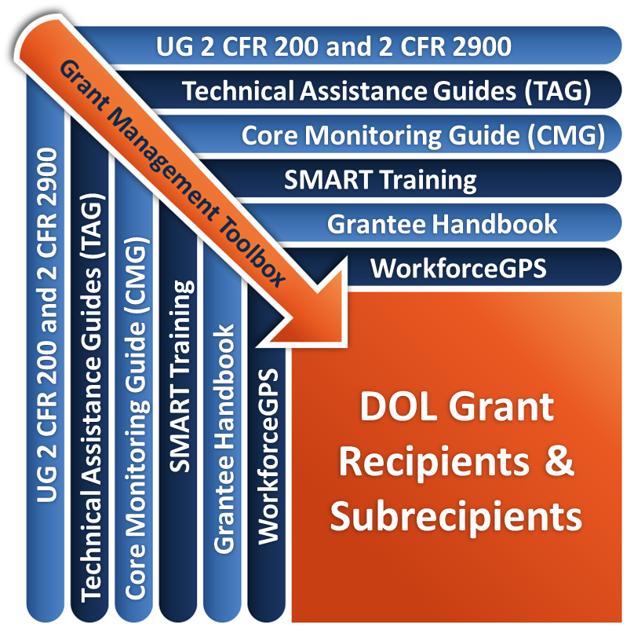
Remember the Grant Management Toolbox!

Slide 61
Questions?

Slide 62
Thank you.

