Slide 1
Conversation about Youth Individual Service Strategies
Thursday, July 25, 2019
2:00 PM ~ 3:30 PM ET

Slide 3


Sara Hastings
    Youth Policy and Performance Team, Division of Youth Services
Carmen Rodriguez
    Workforce Specialist
    Region 1

Slide 4
Overview of ISS Tool and how to use it
How to best use the ISS process to build relationships with Youth.

Slide 5
How did we get here?
Background

Slide 6
ISS Development and Technical Assistance
WIOA section 129(c)((1)(B) requires that all eligible youth have an ISS
  Directly linked to 1 or more WIOA indicators of performance
  Identifies career pathways that include education and employment goals, appropriate achievement objectives, and appropriate services for the participant.
Need for more technical assistance on the Individual Service Strategy (ISS).
Monitoring Reviews

Slide 7
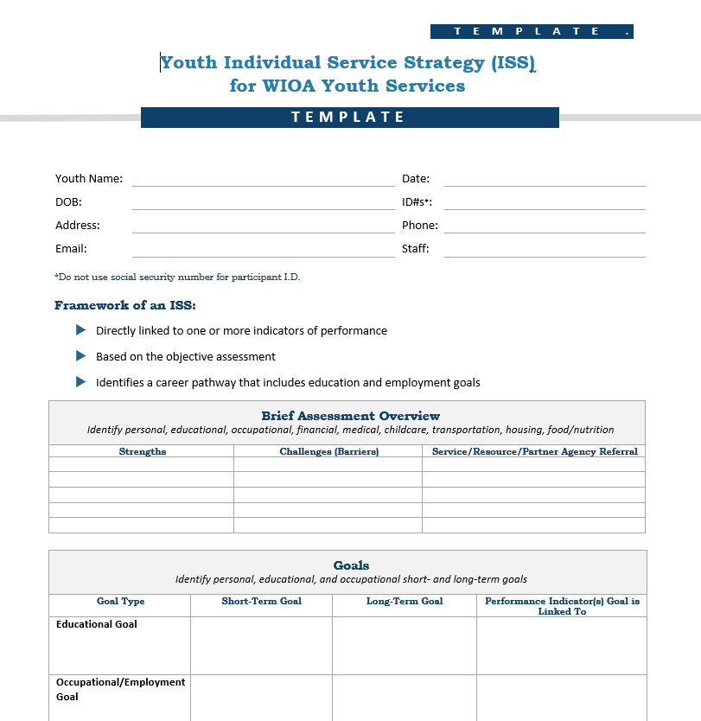
Walkthrough of Template

Slide 8
The Template
While there is no one example of the perfect Individual Service Strategy (ISS), strong examples
This sample ISS template developed by ETA from 39 ISS submissions from across the country.
This template compiles key elements, common themes, and best practices
Is not required
May be used and customized for WIOA Youth program case management.

Slide 9

Assessment

Slide 10

Goals outlined in ISS

Slide 11

Program Elements
Improving Educational Achievement
Preparing for and Succeeding in Employment
Supporting Youth
Developing the Potential of Young People as Citizens & Leaders

Slide 12

Webcast https://youth.workforcegps.org/resources/2019/07/31/16/53/Webcast-Youth-Individual-Service-Strategy
Division of Youth Services (DYS) has created a 6 minute Webcast to share the components of the Sample Youth Individual Service Strategy (ISS) from the Employment and Training Administration.

Slide 13
How should the template be used?

Slide 14
Use of template
This template is an optional tool and not mandatory in to use.
This template is a guide to inform practitioners of essential components for developing an ISS and can be tailored for a local areas use.
Local areas are encouraged to adapt the form that aligns with their context.
Keep sections that make sense, adding more where needed and even deleting what seems to be unrelated.
It may be used as a paper version or tailored for electronic submissions.
It is encouraged that staff and youth should have input on the final form.

Slide 15
Do you use the ISS process to begin building a relationship with youth?
Yes
No

Slide 16
How would you describe your ISS process?
It’s just required document
Helps me get to know the youth a little in the beginning but then I don’t really use it much after initial intake
I use it as a tool to have ongoing conversations about goals, service needs, and progress
Other

Slide 17

Share your thoughts
What is in your ISS that you like and that helps you make a plan with a young person?

Slide 18

Share your thoughts
What are challenges faced with completing/updating your ISS?

Slide 19

Share your thoughts
What are your ISS Best practices?

Slide 20


Slide 21


Slide 22
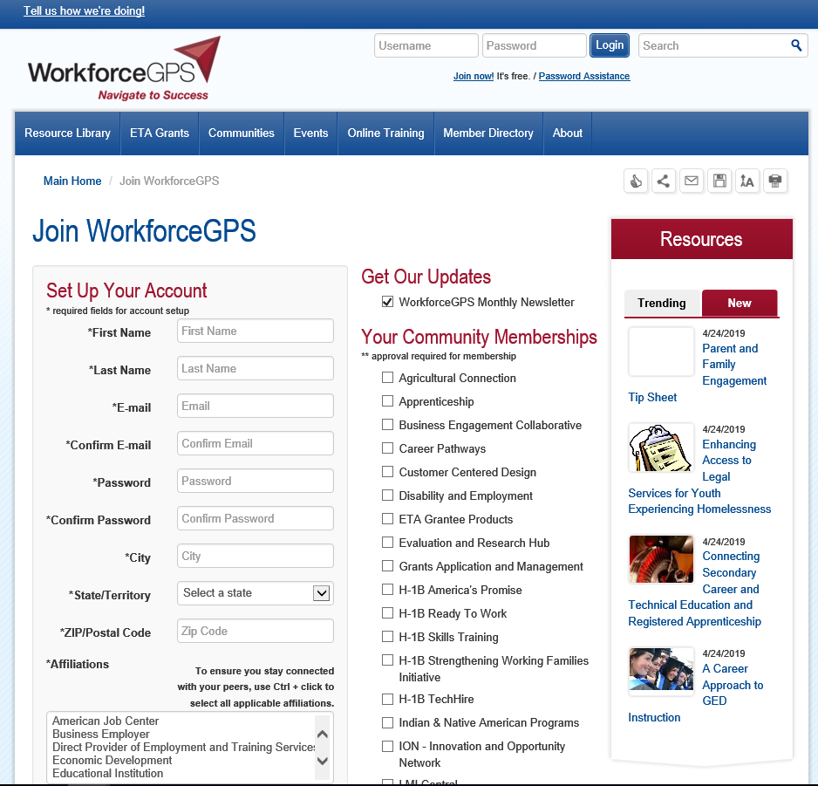

Slide 23
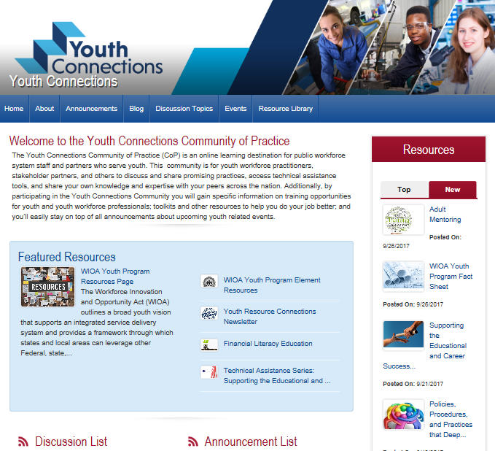
youth.workforcegps.org

Slide 24
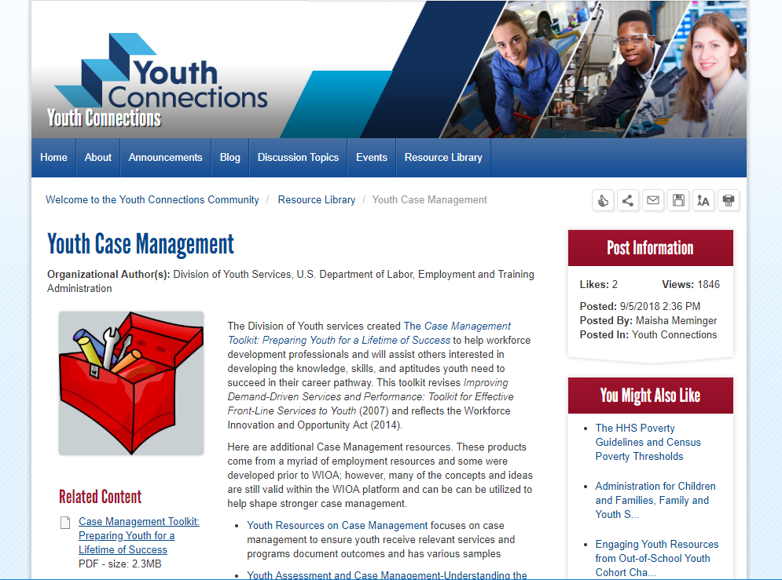

Slide 25
What’s Next?

Slide 27
Division of Youth Services
      youth.services@dol.gov

