Slide 1
Subrecipient Management and Oversight
SMART 3.0 Training
October 1, 2019

Slide 2
Today’s Speakers
Tom DiLisio
Senior Accountant, DFMAS
U.S. Department of Labor – Region 6
San Francisco, CA
Dilisio.Thomas@dol.gov
Debbie Strama
Fiscal Policy Unit Supervisor
U.S. Department of Labor
Office of Grants Management
Washington DC
Strama.Deborah@dol.gov

Slide 3
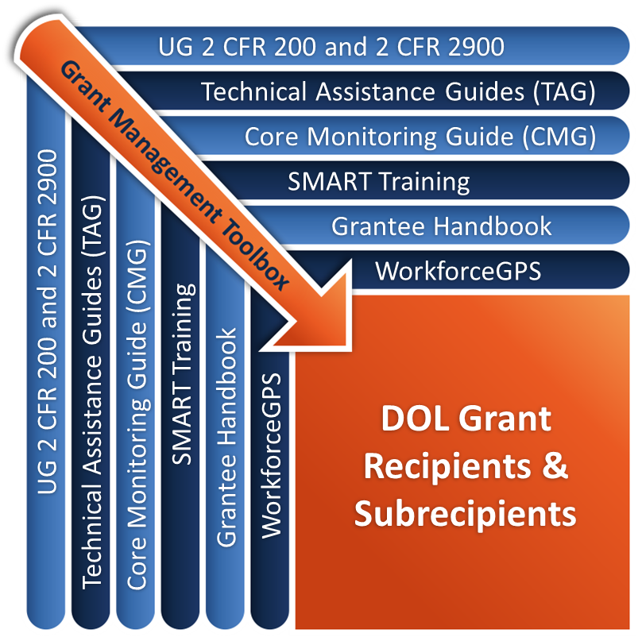
Grant Management Toolbox

Slide 4
Module Overview
Applicability, Definitions, and General Responsibilities
Pre-Subaward
Post-Subaward: Management of Subrecipients
Monitoring & Oversight
Post-Subaward: Resolution Process

Slide 5
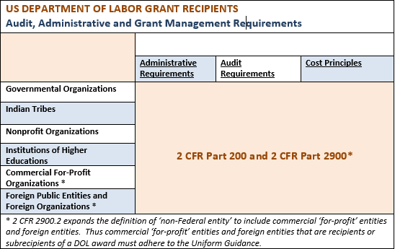
Applicability
2 CFR Part200 and 2 CFR Part 2900 may be found at www.ecfr.gov.

Slide 6
Definitions
Pass-through entity (PTE)
A non-Federal entity that provides a subaward to a subrecipient to carry out part of a Federal program 2 CFR 200.74
Subaward
Award provided by a pass-through entity to a subrecipient to carry out part of a Federal award 2 CFR 200.92
Subrecipient
A non-Federal entity that receives a subaward from a pass-through entity to carry out part of a Federal program; but does not include an individual that is a beneficiary of such program. A subrecipient may also be a recipient of other Federal awards directly from a Federal awarding agency 2 CFR 200.93

Slide 7
Subrecipient vs. Contractor – 2 CFR 200.330
Subrecipient
Contractor
Determines who is eligible to receive what Federal assistance
Performance is measured by whether objectives of Federal program are met
Has responsibility for programmatic decision making
Responsible for adhering to applicable Federal program requirements
Uses Federal funds to carry out a program for a public purpose
Funded by a subaward
Provides similar goods or services to many different purchasers
Provides the goods and services within normal business operations
Provides goods or services that are ancillary to the operation of the Federal program
Not subject to the compliance requirements of the Federal program
Provides goods and services for the non-Federal entity’s own use, creating a procurement relationship
Funded by a procurement contract

Slide 8
Pass-through Entities General Responsibilities
Select responsible subrecipients through risk assessment (2 CFR 200.331)
Conduct monitoring and issue management decisions
Ensure compliance with all grant and subaward terms and conditions
Ensure accurate financial and performance reporting
Meet performance and financial goals
Properly closeout the subaward

Slide 9
Accountability
THEY FAIL, YOU FAIL!
“Pass-through” does not give the entity a “pass” on accountability
Provide funds to a subrecipient to meet the pass-through entity’s program and performance objectives
Pass-through entity is as accountable as if it were providing the services itself

Slide 10
Risk Assessment
2 CFR 200.331(b)
For risk of non-compliance required factors:
Prior experience with same or similar activities
New personnel or new accounting systems
Results of Federal agency monitoring
Results of previous audits performed under Subpart F – Audit Requirements

Slide 11
Risk Assessment (cont.)
Other Factors to Consider:
History of performance and reporting
Findings, significant deficiencies, material weaknesses in compliance or audit reports
Adequacy of internal control structure and budget controls
Adequacy of written policies and procedures
Budget controls in place to ensure allowability of costs and analysis of results
Adequacy of accounting system to account for funds and report results in an accurate and timely manner
Financial stability (bankruptcy, liens, lawsuits)
Qualified and sufficient number of staff in place (High turnover in key positions)
Statement of work with measurable performance goals and timetables
If deemed at risk, consider imposing specific conditions to the agreement?

Slide 12
Core Monitoring Guide Tool S - Risk Assessment Worksheet
CMG

Slide 13
High-Risk – Adding Specific Conditions
2 CFR 200.207
Requiring payments as reimbursements
Withholding authority to proceed to the next phase
Requiring more detailed financial reports
Requiring additional monitoring,
Requiring the non-Federal entity to obtain technical or training assistance
Establishing additional prior approvals

Slide 14
Management of Subrecipients
System tracking of subawards and subrecipients
Discuss PTE Management Responsibilities
Discuss Reporting Requirements

Slide 15
Pass-through Entity Must Track
Subaward agreement should identify:
All Federal and PTE requirements to ensure compliance
Specific conditions per risk assessment
Any additional requirements imposed for the PTE to meet its own responsibility to DOL
Identify required financial and performance reports
Identity indirect cost rate
Access to records
Closeout terms and conditions
Remedies for non-compliance

Slide 16
Pass-through Entity Requirements
2 CFR 200.331
Identify agreement as subaward to subrecipient
Include 13 required items of information
Subrecipient name (which must match registered name in DUNS)
Subrecipient’s Data Universal Numbering System (DUNS number)
Federal Award Identification Number
Federal Award Date
Subaward Period of Performance
Amount of Federal Funds Obligated by this action
Total Amount of Federal Funds Obligated to the subrecipient;
Total Amount of the Federal Award;
Federal award project description
Name of Federal awarding agency, pass-through entity, and contact information for awarding official,
CFDA Number and Name;
Identification of whether the award is R&D; and
Indirect cost rate for the Federal award

Slide 17
Management of Subrecipients
Pass-through entities should provide the following to its subrecipients:
Technical assistance
Provide the necessary training.
Articulate and explain all Federal, local/State requirements and regulations applicable to the program or grant.
On-going performance and financial management
Monitor progress or program deliverables or performance goals.
Examine expenditures to ensure alignment with statement of work or approved budget.

Slide 18
Knowledge Check – Questions
The pass through entity is accountable and potentially liable for all of the actions of its subrecipients. T/F?
An effective oversight system needs to include the following:
Oversight policies and procedures
Tools and guides for conducting oversight activities
Adequate staffing, knowledgeable monitors and budgetary resources for travel and training
Access to information
All of the above

Slide 19
Knowledge Check – Answers
The pass through entity is accountable and potentially liable for all of the actions of its subrecipients. True
An effective oversight system needs to include the following:
Oversight policies and procedures
Tools and guides for conducting oversight activities
Adequate staffing, knowledgeable monitors and budgetary resources for travel and training
Access to information
All of the above

Slide 20
Monitoring & Oversight
Discuss PTEs’ requirements for monitoring of sub-recipients
Implement a process for monitoring of subrecipients
Discuss methods of monitoring
Issuing reports on monitoring findings

Slide 21
Oversight & Monitoring Requirement
2 CFR 200.331(d)
Monitor the activities of the subrecipient as necessary to ensure that the subaward is:
Used for authorized purposes
In compliance with Federal statutes, regulations, and the terms and conditions of the subaward; and
That subaward performance goals are achieved.

Slide 22
WIOA – Workforce Innovation & Opportunity Act
Contains several provisions related to monitoring requirements
Requires annual on-site monitoring by the State of local areas.
Requires each State, each local board, and each recipient receiving funds to make readily accessible such reports concerning its operations (performance) and expenditures.
Located at 20 CFR 683.400-440

Slide 23
Performance Monitoring
Non-Federal Entities must submit performance reports comparing
Actual accomplishments to award objectives;
Unit cost computations if useful;
Analysis of cost overruns or high unit costs if appropriate
Performance trend data and analysis if informative
Include reasons for slippage if objectives not met
Pass-through entities are required to monitor subrecipients to ensure that subaward performance goals are achieved

Slide 24
Monitoring & Oversight – What do I need?
Policies and procedures
Tools and guides
Staff and resources

Slide 25
Monitoring: Policies and Procedures
Methods (e.g., risk assessment, desk review, on-site), procedures, and activities
Specify who, what, where, when, and how:
Who: Who does the monitoring? Who gets monitored?
What gets monitored: Which functions? Which activities?
Where: What is done remotely? What is done on site?
When: How often? Timeframe for each stage of process?
How: What tools, guides, and formats will be used?
How: How do findings get resolved?
Remedies, sanctions, process for appeals and hearings

Slide 26
Monitoring: Tools and Guides
A risk assessment tool
Analytical tools that assist staff in reviewing financial and programmatic reports
Desk monitoring guides
Customized on-site monitoring guides
Consider uniform format for monitoring reports and monitoring-related correspondence

Slide 27
Monitoring: Staff and Resources
Knowledgeable Staff
Rules and regulations; award terms and conditions
Adequately trained
For documenting findings, corrective actions and resolution
Report writing skills
Roles and Responsibilities
Updated tools
Necessary resources
Access to documentation

Slide 28
Monitoring Methods
Desk monitoring
Reports review and analysis
On-site monitoring

Slide 29
Desk Monitoring
Extremely effective and cost efficient
Alternative to, preparation for, or supplemental to on-site monitoring
May lead to on-site monitoring
Review of collected subrecipient information
To get a better sense of ongoing operations
To identify and respond to rising issues
To focus future onsite reviews
Should be formally documented

Slide 30
Reports Review and Analysis
Assure timeliness and accuracy of reports
Assess progress in achieving goals
Identify trends
Predict progress
Uncover problems
Coordinate review of fiscal and program reports together
Can reveal a more complete picture of overall performance

Slide 31
On-Site Monitoring
2 CFR 200.331(d)
Non-Federal entities must monitor to ensure subaward is:
Used for authorized purposes
Operating in compliance with Federal laws and regulations
Consistent with the terms and conditions of subaward

Slide 32
Audit vs. Monitoring
An Audit…
Monitoring…
Is current and immediate
Is usually performed by pass-through entity staff
Is preventative
Occurs after the end of the fiscal period
Often takes place after the end of grant
Report is due not later than nine months after period of performance
Is corrective and curative

Slide 33
Pre-Review Collection of Data and Reports
Grant documents
Scope of work, budget, and narrative
Organizational chart
Chart of accounts
Policies and procedures
Performance reports
Expenditure reports and spending rates
Monitoring reports
Audit reports

Slide 34
On-Site Monitoring
Review systems
Review policies and procedures
Interview staff at entity or subrecipient level
Sample transactions
View source documents
Open-ended questions get better information
Test internal controls
Compare all information gathered

Slide 35
Finding
A finding is any “specific violation of”:
Program authorization/statue
Other applicable Federal statutes
Applicable appropriations
Implementing regulations
Executive Orders
OMB Circulars (including 2 CFR part 200 & 2 CFR part 2900)
DOL-ETA Directives
Terms and conditions of the award
Always require action to correct the violation
Documentation of non-compliance is required

Slide 36
Questioned Costs
2 CFR 200.84
Results from a violation or possible violation of:
Law
Regulation
Terms and conditions of a Federal award, or
Costs not supported by adequate documentation, or
Costs incurred appear unreasonable
2 CFR 2900.3 DOL exception
Includes a cost questioned by:
An auditor
A Federal project officer, or
A grant officer
Other authorized DOL representative

Slide 37
Observation or Area of Concern
Activities related to effectiveness objectives or indicators have not been met and could possibly result in a finding at some later point if not addressed.
Not specific compliance violations but may have negatively impacted program or could lead to a finding in the future.
Traditionally, no corrective action is specified but suggestion for improvement may be made.

Slide 38
Writing an Effective Monitoring Report
Be timely
Be specific
Be open
Be clear
Be consistent
Be correct
Be convincing

Slide 39
Structure of a Finding – the 4 C’s
The 4 C’s: Condition, criteria, cause, and corrective action
Condition: Describe the problem
Criteria: Specify regulation/policy in question
Cause: Explain why the problem exists
Corrective action: Propose needed remedy
Look to the CMG Page 25 for the 4 C’s discussion.
CMG

Slide 40
Finding: Condition
Condition: Describe and document any conditions that constitute a compliance violation that were found during the desk review and on-site monitoring visit.
For example:
No physical inventory of equipment and other capital assets was taken during the last three fiscal years.

Slide 41
Finding: Criteria
Criteria: Specify the statutory, regulatory, OMB guidance citation, or formal policy/procedure that was not met. Any gaps identified must be documented, along with recommendations for reconciliation.
For example:
The Uniform Guidance at 2 CFR 200.313(d)(2) states that at a minimum a physical inventory must be conducted every two years to account for and safeguard assets.

Slide 42
Finding: Cause
Cause: Determine and document the cause of each condition. If the immediate cause(s) are undeterminable, due to lack of verification/sufficient documentation, omit a description and state that the cause could not be determined.
For example:
The lack of written procedures and proper assignment of staff duties have resulted in the lack of compliance.

Slide 43
Finding: Corrective Action
Corrective Action: It is important to specify what corrective action the subrecipient must take to remedy the problem and the timeframe for completing the recommended changes.
For example:
The agency must implement a policy requiring an annual or biannual inventory of all equipment, identify the staff position responsible for conducting the inventory, and submit a copy of the policy and a completed inventory report to this office within 30 days.

Slide 44
Resolution Process
Discuss the resolution process
Define management decision
Identify remedies for resolving monitoring and audit findings

Slide 45
Resolution Process
Receive Corrective Action Plan from subrecipient
What will subrecipient do and when
Who will do it
What is the intended outcome
Questioned Costs
Provide missing documentation
Make repayment
Transfer cost to non-Federal source
Track until corrective action is completed. Verify on-site if appropriate.
If action is not completed within required timeframe, determine appropriate actions.

Slide 46
Management Decisions
2 CFR 200.521
The management decision must clearly state whether or not the audit finding is sustained, the reasons for the decision, and the expected auditee action to repay disallowed costs, make financial adjustments, or take other action.
This applies to audits and compliance monitoring reports

Slide 47
PTE Management Decision Responsibility
2 CFR 200.331(d)(3)
Ensure corrective action
Allow or disallow costs
Establish debt
Provide appeal rights
No prescribed system of resolution in UG
Issue management decision on audits within 12 months of audit acceptance by Federal Audit Clearinghouse (FAC) 2 CFR 2900.21 DOL exception

Slide 48
If Corrective Action Is Not Completed
Take formal action
Recommended process
Initial determination
Informal resolution
Final determination
Establish debt
Require corrective action
Determine liability, restitution, and sanctions
Opportunity for hearing

Slide 49
If Corrective Action Is Not Completed (cont.)
WIOA 20 CFR 683.420
The Governor or direct grant recipient is responsible for resolving findings that arise from the monitoring reviews, investigations, other Federal monitoring reviews, and audits.
A State or direct grant recipient must use the audit resolution, debt collection, and appeal procedures that it uses for other Federal grant programs to resolve audits, investigations, monitoring, and oversight findings.
If no such procedures exist, a State or direct grant recipient must prescribe standards and procedures to be used for the grant program.

Slide 50
Remedies for Non-compliance
2 CFR 200.338
Temporarily withhold cash payments
Disallow all or part of the cost of the activity or action not in compliance
Wholly or partly suspend or terminate the Federal award
Initiate suspension or debarment proceedings
Withhold further Federal awards
Take other remedies that may be legally available

Slide 51
Knowledge Check (2) – Questions
True or False?
The recipient is responsible for issuing management decisions on audit and monitoring findings.
Once the subaward has expired, there is no further need for resolution of findings.

Slide 52
Knowledge Check (2) – Answers
The recipient is responsible for issuing management decisions on audit and monitoring findings. True (2 CFR 200.66 and 200.331)
Once the subaward has expired, there is no further need for resolution of findings. False

Slide 53
Questions?

Slide 54
Web Resources
Want More Training?
Workforce GPS’s Grants Application and Management Community of Practice
Financial Reporting
Subrecipient Management and Oversight
Indirect Cost Rates
Policies and Procedures
Procurement and Performance-Based Contracts
Capital Assets and More
WorkforceGPS
What is the best way to find your local American Job Center (AJC)?
See DOL’s Service Locator
Want More Information?
DOLETA.gov/Grants
Funding Opportunities
How to Apply
Manage Your Awarded Grant
Resources and Information
ETA Grantee Handbook
Annual Grant Terms Template
Core Monitoring Guide
Technical Assistance Guides
Uniform Guidance Quick Reference Sheet
SMART
CMG
TAG
Grantee Handbook
GPS

Slide 55
Remember the Grant Management Toolbox!

Slide 56
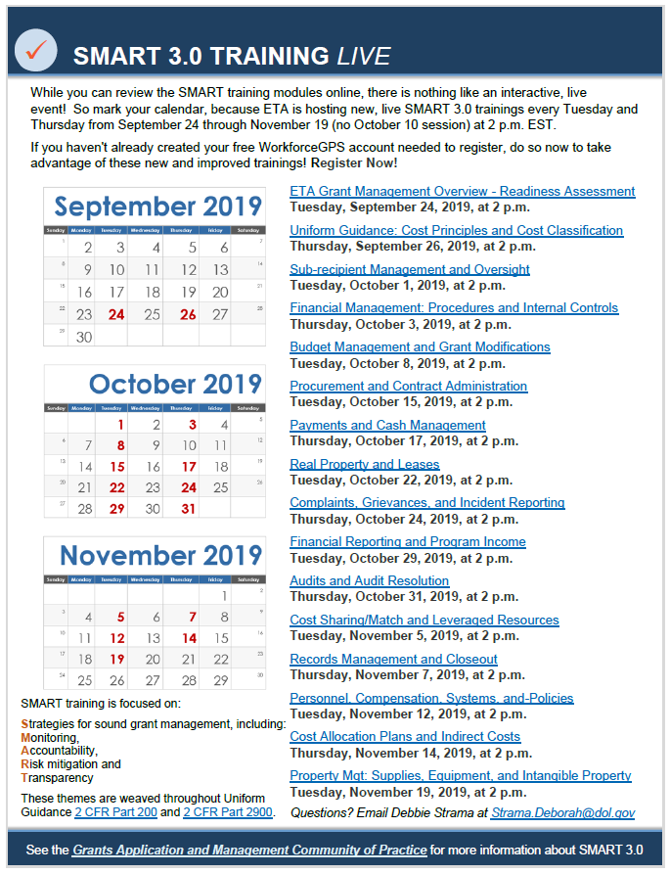

Slide 57
Thank you.

