Slide 3
Incorporating National Service into Your Construction Plus Programming and Placement Strategy
September 27, 2019

Slide 4
Toni Wilson Workforce Analyst/National Liaison U.S. Department of Labor

Slide 5
David Weatherly
AmeriCorps Portfolio Manager
YouthBuild USA
Lauren Troiano
AmeriCorps Portfolio Manager
YouthBuild USA

Slide 6
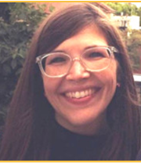
Jerry Farley
Director, YouthBuild Dayton
County Corp
Vanessa Bennett
Senior Manager, Career Pathways YouthBuild USA

Slide 7
This webinar will share information on:
Benefits of incorporating service into Construction Plus pathways
Best practices of adding service to your program
Benefits of national service placements
Opportunities in national service placement

Slide 8
Have you heard of AmeriCorps?
Choose the answer that best reflects you (or your organization)
We have an AmeriCorps grant
I have some knowledge of AmeriCorps
I have no knowledge of AmeriCorps
I googled it during this poll question, so yes!

Slide 9
Since 1994…

Slide 10
Why Focus on Service?
The context and benefits of embedding service into Construction Plus pathways

Slide 11
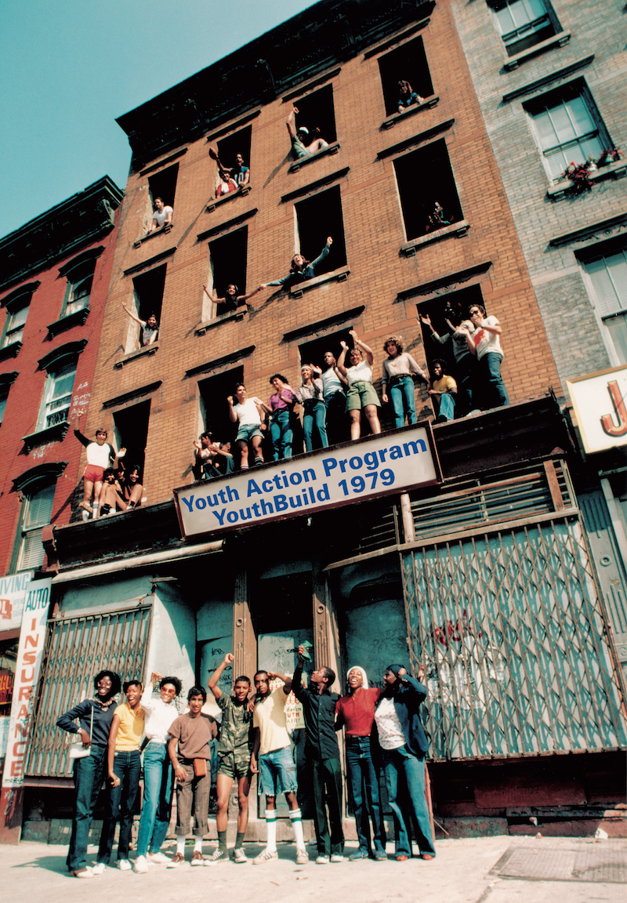
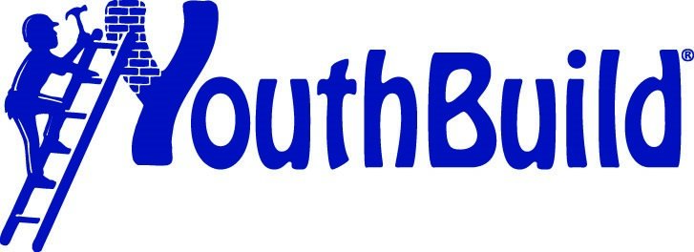

Slide 13
Benefits of Service
Increased civic engagement
Changes perspective of participants
Changes their perspective of the community

Slide 14
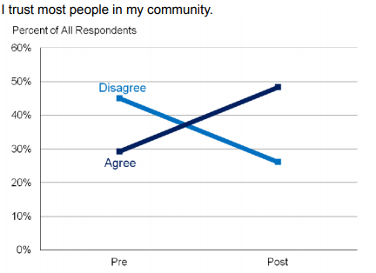
Youth Development Through Service*
*Youth Development Through Service:
A Quality Assessment of the YouthBuild AmeriCorps Program​
John Jay College of Criminal Justice​ Kathleen A. Tomberg ​ 2010 - 2013​

Slide 15
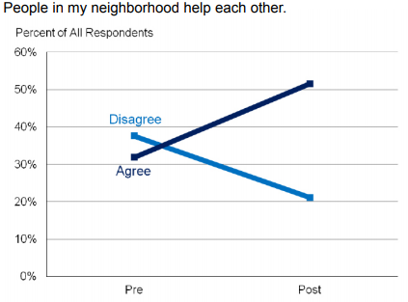
Youth Development Through Service*
*Youth Development Through Service:
A Quality Assessment of the YouthBuild AmeriCorps Program​
John Jay College of Criminal Justice​ Kathleen A. Tomberg ​ 2010 - 2013​

Slide 16
Construction vs. Non-Construction Study*
Overall there “are no consistent differences” in program experience or outcome based on service track
Program structure, context, and overall integration of AmeriCorps likely had a bigger impact on participants than the type of service
* Assessing the Impact of Construction and Non-Construction Service Experiences in the YouthBuild AmeriCorps Program: The YouthBuild AmeriCorps Service Pathways Evaluation​
The Center for Youth & Communities, Heller School of Social Policy & Management at Brandeis University​ Alan Melchior & Susan Lanspery​ 2013 – 2016​

Slide 17
How to Implement Service Tracks

Slide 18
What tracks does your program offer?
Choose the answer that best reflects you (or your organization)
Construction only
Construction Plus (one track)
Construction Plus (two tracks)
Construction Plus (three or more tracks)

Slide 19
What C+ pathways does your program offer?
Type your answer in the chat box

Slide 20
Defining Community Need
A need in the community that is not being fully met by existing services
Lack of sufficient low-income housing
Healthcare facilities lacking sufficient volunteers
Members of the community not having access to technology

Slide 21
Project Logic Model / Theory of Change
Community
Problem/Need
(Problem)
Project Resources
(Inputs)
Core Project Components
(Activities)
Evidence of Implementation
(Outputs)
Outcomes
Short
Medium
Long-Term

Slide 22
Construction Project Logic Model/Theory of Change
Community Need
Lack of Low-Income Housing
Project Resources
Participants Trained in Construction
Core Project Components
Developing or Repairing Low-Income Housing
Evidence of Implementation
Number of Houses Repaired or Developed
Outcomes
Individuals Placed in Housing

Slide 23
Healthcare Project Logic Model / Theory of Change
Community
Problem/Need
Lack of Volunteers in Healthcare Facilities
Project Resources
Participants Trained in Healthcare
Core Project Components
Volunteering at Healthcare Facility
Evidence of Implementation
Number of Individuals Served
Outcomes
Better Health Outcomes at Healthcare Facility

Slide 24
Best Practices for Implementing Service
Intentional Implementation
Clearly defined goals
Built-in feedback

Slide 25
Best Practices
Consistent Service Partnership
Ongoing activities with the same organization
MOU between organizations

Slide 26
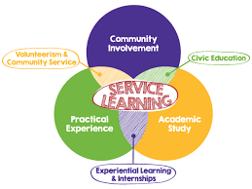
Best Practices
Aligned with learning
Skills directly translate to service activities
Service learning projects

Slide 27
Examples from the Field
Culinary (Community Teamwork – Lowell, MA)
Strong connection between learning and service

Slide 28
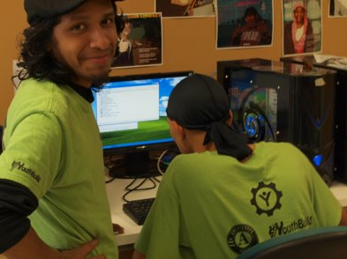
Examples from the Field
Media Corps (American YouthWorks - Austin, TX)
Pathway to employment

Slide 29
Examples from the Field
Logistics (Pathways VA – Petersburg, VA)
Finding a way to meet a community need

Slide 30
Jerry Farley
Director, YouthBuild Dayton
County Corp

Slide 31
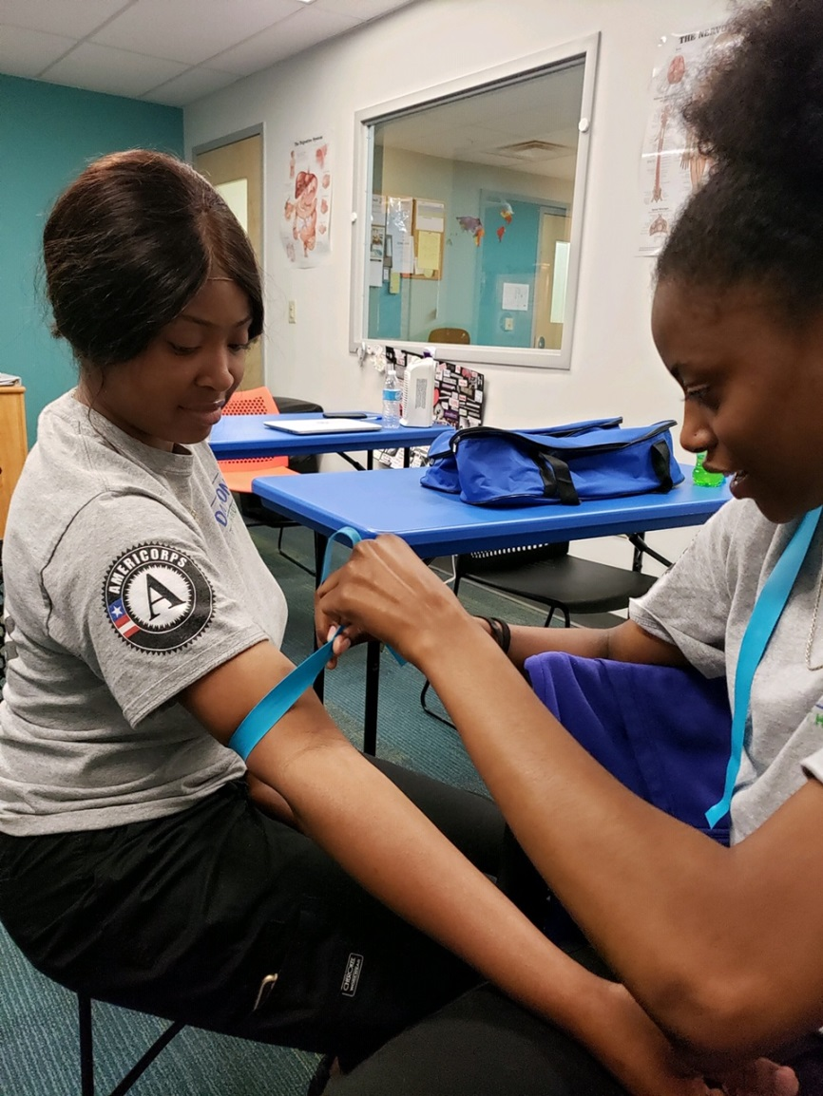
An Example from the Field
YouthBuild Dayton CountyCorps Healthcare Track

Slide 32
Service Activities Are Opportunities to Practice Craft Skills
Family Health Fair at Kiser Elementary – BP Screenings
Daybreak Homeless Shelter for Youth – Health Effects & Dangers of Cigarette Smoking
5 Rivers Health Center – Skin Integrity

Slide 33
Workforce Advisory Committee
Is our training up to date with best practices?
How do we prepare our youth to get jobs with your companies?
Will you help prepare our youth to enter the job market?
What will you offer our youth since they are specifically trained in your industry?

Slide 34
Final Thoughts
Teaching is One of the Best Ways to Improve Learning
Key Lesson for Youth: Healthcare is a service profession and service is about giving back, not about you

Slide 35
Vanessa Bennett
Senior Program Manager, Career Pathways YouthBuild USA
35

Slide 36
Have you placed young people in National Service?
Choose the answer that best reflects you (or your organization)
Yes
No
What's National Service?
If I select option 3, you're going to use that as a segue to the next part of the presentation, aren't you?

Slide 37
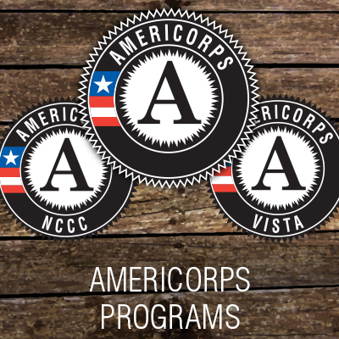
What Is Full-Time National Service?
A qualifying DOL placement
Categorized under "education-other"
Paid volunteer positions
Professional development in
Education
Environmentalism & conservation
Disaster relief & public safety
Nonprofit management
Grant writing & fundraising
A pathway to post-secondary education and careers, including in in-demand industries
​
37

Slide 38
The AmeriCorps Programs
State & National
Full-time service, 1700 hours
Direct service, working hands-on in the community
VISTA
Full-year service term
In-direct service focused on building capacity and sustainability at nonprofits and CBOs
NCCC
11-month, full-time residential service program
Direct service focused on conservation, disaster response, and emergency preparedness
Members serve in group and individual settings at nonprofits, in schools, at food banks, and other community-based organizations (CBOs)
Members travel around different regions to complete projects
Members design tools and resources to strengthen community services and supports
​
Professional development and skill building in project management, program design, communications, fundraising, construction, teaching, that can be applied to industries such as education, healthcare, agriculture, and housing, conservation.
38

Slide 39
The Placement Triangle
Career
Full-Time Service
Placement
Education

Slide 40
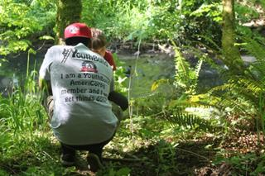
Service and Employment*
Volunteers have a 27% higher likelihood of finding a job after being out of work than non-volunteers
Volunteers without a HSD have a 51% higher likelihood of finding employment
American Youth Works MLK Day of Service 2016
Volunteers in rural areas have a 55% higher likelihood of finding employment
* Corporation For National & Community Service
Report on Volunteerism As a Pathway to Employment (2013)​

Slide 41
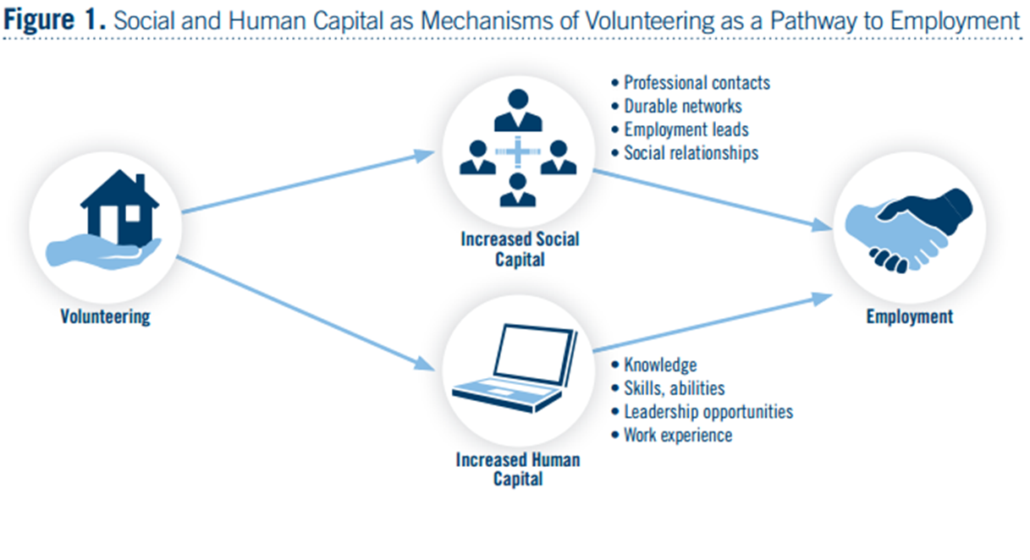
Service and Employment

Slide 42
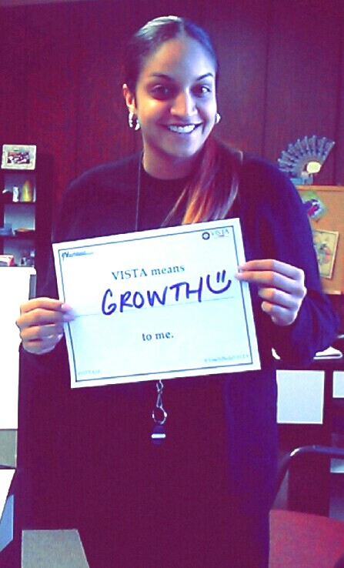
Service and Post-Secondary Education
National Service increases advanced degree attainment
79% of AmeriCorps members obtain a degree after service
B.A. or higher
Segal Education Award & matching institutions
$6,095
Award matching at colleges and universities across the country
7 years to use
Over $3.8 billion in awards used
Classes during service
Kirsys Soto
Graduate, YouthBuild Brockton
Alumni, YouthBuild USA, VISTA

Slide 43
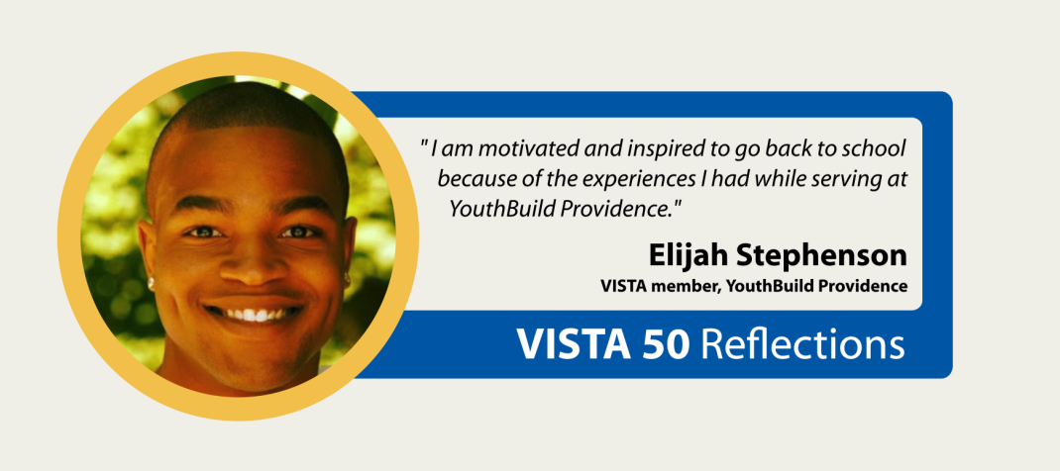
Leveraging Service to Support Career Pathways
Service learning provides an opportunity to connect service to job training and skills development
Continued opportunities for career planning and counseling
Opportunity to "try out" an industry and different jobs within it
Additional opportunities to attain training, certification, and credentials
Employer investment in recruiting national service alumni – Employers for National Service

Slide 44
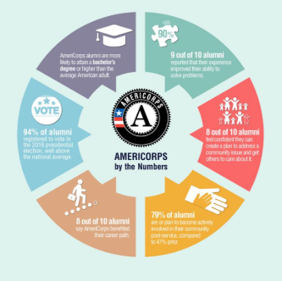
Strengthening National Service Placements at Your Program
Build partnerships with AmeriCorps programs in your area and invite staff and volunteers to
participate in service projects
attend job fairs
give presentations at your program
Invite graduates who have done a year of service to share their experience with current students
Develop a culture of service at your program
Embed service learning into the classroom and work site
Utilize the YouthBuild USA National Service Placement website

Slide 45
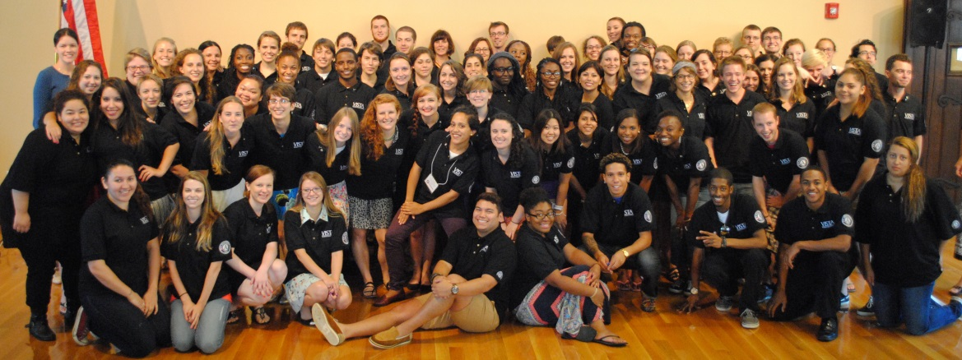
YouthBuild Graduates in National Service
Over 30 in National Civilian Conservation Corps (NCCC) since 2011
36 YouthBuild graduates in YouthBuild USA VISTA since 2009
38 into full-time direct positions in 2016

Slide 47
DOL YouthBuild NCCER Core Curriculum Construction Certification Training
Detroit, MI
October 21-25, 2019
YouthBuild Webinar Series: Registered Apprenticeship
November 5, 2019

Slide 48
Youth Development Through Service: A Quality Assessment of the YouthBuild AmeriCorps Program
Corporation for National & Community Service
Assessing the Impact of Construction and Non-Construction Service Experiences in the YouthBuild AmeriCorps Program: The YouthBuild AmeriCorps Service Pathways Evaluation
YouthBuild Graduate Service Stories
YouthBuild National Service Website
Corporation For National & Community Service Report on Volunteerism As a Pathway to Employment
AmeriCorps Alumni Outcomes Study
Construction Plus Framework for a Quality Pre-Apprenticeship Experience
DOL YouthBuild Construction Plus Framework Spotlights

Slide 49
David Weatherly
AmeriCorps Portfolio Manager
YouthBuild USA
dweatherly@youthbuild.org
857.523.0120
Lauren Trioano
AmeriCorps Portfolio Manager
YouthBuild USA
ltrioano@youthbuild.org
617.741.1323

Slide 50
Jerry Farley
Director, YouthBuild Dayton
County Corp
jfarleyedd@gmail.com
937.269.4043
Vanessa Bennett
Senior Manager, Career Pathways
YouthBuild USA
vbennett@youthbuild.org
617.684.3453

Slide 51
Toni Wilson
Workforce Analyst/National Liaison
U.S. Department of Labor
wilson.toni@dol.gov
202-693-2922

