Slide 1
Financial Management: Procedures and Internal Controls
SMART 3.0 Training
October 3, 2019

Slide 2
Today’s Speakers
Latonya Torrence
Division Chief, OGM DPRR
U.S. Department of Labor
Washington, DC
Torrence.Latonya@dol.gov
Glarion Webb
Grants/Financial Management Specialist
U.S. Department of Labor – Region 4
Dallas, TX
Webb.Glarion@dol.gov

Slide 3
SMART 3.0 Training Strategies
S
SMART 3.0 Training Series:
The training modules are focused on: Strategies for sound grant management that includes: Monitoring, Accountability, Risk mitigation and Transparency
These four themes are weaved throughout the OMB Uniform Administrative Requirements, Cost Principles, and Audit Requirements for Federal Awards also known as the Uniform Guidance (2 CFR Part 200 and 2 CFR Part 2900).
Strategies
M
Monitoring
A
Accountability
R
Risk Mitigation
T
Transparency

Slide 4
SMART 3.0 Purpose
To improve the success of our programs through better management of our grants at the ground level and to strengthen the connection between SMART 3.0 and the many grant management resources (CMG, TAG, and WorkforceGPS) available to the workforce development community.
Intended Audience: Grant management and/or fiscal staff operating an active formula and/or discretionary grant awarded by ETA.

Slide 5
SMART Webinar Series Schedule
Every Tuesday and Thursday (Sept. 24th to Nov. 19th) @ 2:00pm EST
Except for Oct. 10th
Different module presented every webinar
DAY | DATE | TIME | MODULE
Tues | 24-Sep | 2:00 PM EST | ETA Grant Management Overview – Readiness Assessment
Thurs | 26-Sep | 2:00 PM EST | Uniform Guidance: Cost Principles and Cost Classification
Tues | 1-Oct | 2:00 PM EST | Subrecipient Management and Oversight
Thurs | 3-Oct | 2:00 PM EST | Financial Management: Procedures and Internal Controls
Tues | 8-Oct | 2:00 PM EST | Budget Management and Grant Modifications
Tues | 15-Oct | 2:00 PM EST | Procurement and Contract Administration
Thurs | 17-Oct | 2:00 PM EST | Payments and Cash Management
Tues | 22-Oct | 2:00 PM EST | Real Property and Leases
Thurs | 24-Oct | 2:00 PM EST | Complaints, Grievances, and Incident Reporting
Tues | 29-Oct | 2:00 PM EST | Financial Reporting and Program Income
Thurs | 31-Oct | 2:00 PM EST | Audits and Audit Resolution
Tues | 5-Nov | 2:00 PM EST | Cost Sharing/Match and Leveraged Resources
Thurs | 7-Nov | 2:00 PM EST | Records Management and Closeout
Tues | 12-Nov | 2:00 PM EST | Personnel: Compensation, Systems, and Policies
Thurs | 14-Nov | 2:00 PM EST | Cost Allocation Plans and Indirect Costs
Tues | 19-Nov | 2:00 PM EST | Property Mgt: Supplies, Equipment, and Intangible Property
Module Topics Subject to Change

Slide 6
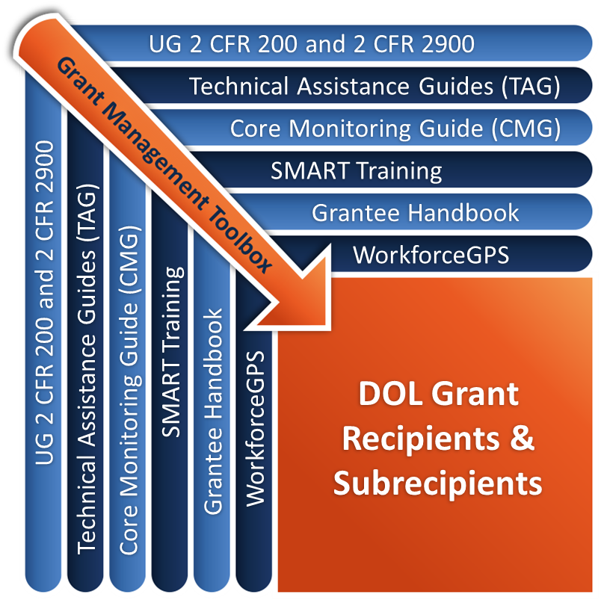
Grant Management Toolbox

Slide 7
Module Overview
Financial Management
Internal Controls
Policies and Procedures

Slide 8
Understanding the Uniform Guidance
Uniform Guidance has expanded the requirements and increased the focus on internal controls (2 CFR Part 200)
Internal controls are key to protecting and safeguarding grant assets
Internal controls help ensure compliance
Policies and procedures reduce risk that can impede the accomplishment of objectives

Slide 9
Financial Management
Sound Management Practices
Financial Management Standards
Effective Management Systems

Slide 10
Sound Management Practices
Policy Guide
Non-Federal entity is responsible for efficient and effective administration of award through use of sound management practices, and administering Federal funds in compliance with agreements, program objectives, and the terms and conditions of Federal award.
2 CFR 200.400

Slide 11
Sound Management Practices (cont.)
Policy Guide
The non-Federal entity has the primary responsibility for employing whatever form of sound organization and management techniques to assure proper and efficient administration of the Federal award, in recognition of its own unique combination of staff, facilities, and experience.
In other words, the grantee must establish an effective internal control structure, appropriate to its particular situation.
2 CFR 200.400

Slide 12
Financial Management Standards
Identify all Federal receipts and expenditures
Accurate, current, and complete disclosure
Records that identify source and application of funds
Effective control over and accountability for assets
Comparison of expenditures to budgets
Written procedures for payments
Written procedures for allowable costs
2 CFR 200.302

Slide 13
Effective Management Systems
Effective financial management systems include:
Clear delineation of roles and responsibilities
Written policies and procedures
Training
Internal controls
Effective oversight
Effective communication and information sharing

Slide 14
Effective Management Systems (cont.)
Financial systems that provide reliable and current information:
Accounting controls
Accurate, timely reports
Budget controls
Asset management
Record retention/access controls
CMG Objective 3.a: Internal Controls
Grants Management TAG 2.5: Internal Controls

Slide 15
Knowledge Check 1 - Question
Which of the following does the Uniform Guidance consider to be a part of effective grant management? (Check all that apply)
Segregation of duties
Written policies and procedures
Separate bank account for each grant
Training
Internal Controls
Accrual accounting system
Effective oversight
Effective communication and information sharing
All of the above
Notes:
15

Slide 16
Knowledge Check 1 - Answers
Which of the following does the Uniform Guidance consider to be a part of effective grant management? (Check all that apply)
Segregation of duties
Written policies and procedures
X Separate bank account for each grant
Training
Internal controls
X Accrual accounting system
Effective oversight
Effective communication and information sharing
X All of the above
All of these items are listed by the Uniform Guidance as part of effective grant management except separate bank accounts and accrual accounting system.
Notes:
16

Slide 17
Internal Controls
Identify the Uniform Guidance’s requirement for Internal Controls
Discuss Internal Control Framework
Review Key Internal Control Activities

Slide 18
What is the Goal of Internal Controls in the Federal Grant Environment?
To provide reasonable assurance that grant requirements are complied with in a timely and cost-effective manner
Completing work on the grant effectively and efficiently while staying in compliance with required by regulations

Slide 19
Internal Controls – Definition
2 CFR 200.61 Internal Controls: A process designed to provide reasonable assurance regarding the achievement of objectives in the following categories:
Effectiveness and efficiency of operations
Reliability of internal and external reporting
Compliance with laws and regulations

Slide 20
Internal Controls Over Compliance Requirements
2 CFR 200.62 Internal Controls Over Compliance Requirements: A process implemented by a non-Federal entity designed to provide reasonable assurance regarding the achievement of the following objectives for Federal awards:
Transactions are properly recorded and accounted for in order to
Prepare reliable financial statements/Federal reports
Maintain accountability over assets
Demonstrate compliance with Federal statutes, regulations, terms and conditions of the award
Transactions are executed in compliance with
Federal statutes, regulations, terms and conditions of the award
Any other Federal statutes/regulations that are identified in the Compliance Supplement
Funds, property, other assets are safeguarded against loss from unauthorized use/disposition.

Slide 21
Internal Controls Requirements
Have effective internal controls over Federal awards that provide reasonable assurance of compliance
Comply with Federal statutes, regulations, and grant terms and conditions
Evaluate and monitor compliance
Take prompt action when instances of noncompliance are identified
Safeguard protected personally identifiable information (PII) and other sensitive data.
2 CFR 200.303

Slide 22
Internal Controls – Subrecipient Level
Subrecipient responsibility
Must establish and maintain effective internal control over the Federal award
PTE responsibility
Review and understand subrecipient’s internal control system
Evaluate each subrecipient's risk of noncompliance with Federal statutes, regulations, and the terms and conditions of the subaward for purposes of determining the appropriate subrecipient monitoring
Monitor the activities of the subrecipient as necessary to ensure that the subaward is used for authorized purposes, in compliance with Federal statutes, regulations, and the terms and conditions of the subaward

Slide 23
Internal Control Framework
Describe the components and activities of an effective internal control framework
“Standards for Internal Control in the Federal Government,“ also known as the “Green Book,” issued by the Comptroller General of the United States, http://www.gao.gov/assets/670/665712.pdf
“Internal Control Integrated Framework“ issued by the Committee of Sponsoring Organizations of the Treadway Commission (COSO) http://www.coso.org/ic.htm
Identify the functions and operations for which non-Federal entities must have written policies and procedures

Slide 24
COSO View of Internal Controls
Internal controls is a process
Designed to provide reasonable assurance regarding the achievement of objectives relating to operations, reporting, and compliance.
Effected by an entity’s board of directors, management, other personnel
Carried out by individuals who must be given the tools and structure, and who must be held accountable.

Slide 25
COSO Internal Control Integrated Framework
Control Environment
Risk Assessment
Control Activities
Information and Communication
Monitoring
Internal Control Framework

Slide 26
COSO Component 1: Control Environment
Set of standards, processes, and structures that provides the basis for carrying out internal controls across the organization.
Pervasive influence on all the decisions and activities of an organization.
Effective organizations set a positive “tone at the top.”
Factors include integrity, ethical values, and competence of employees, and management’s philosophy & operating style.

Slide 27
COSO Component 1: Control Environment (cont.)
Organization demonstrates integrity and ethical values
Commitment to attract, develop, and retain competent individuals that align with the organization’s objectives
Board of Directors demonstrates independence from management and exercises oversight of the development and performance of internal controls
Management’s philosophy and foundation includes appropriate authorities and responsibilities in the pursuit of the organizations’ objectives

Slide 28
COSO Component 2: Risk Assessment
Risks are internal and external events that threaten the accomplishment of objectives.
Methods and processes used by organizations to manage risks and seize opportunities related to the achievement of their outcomes.
Identify risks
Assess risks
Prioritize risks
Respond to risks

Slide 29
Risk Assessment: Equipment – Example
2 CFR 200.313
Secure and restrict access to equipment to reduce the risk of loss or unauthorized use.
Perform periodic physical inventories to verify existence, quantities, location, condition, and utilization.
Base the level of security on the vulnerability of items being secured, the likelihood of loss, and the potential impact should a loss occur.
These principles apply to other assets as well: cash, credit cards, laptops, supplies, etc.

Slide 30
COSO Component 3: Control Activities
Tools (Policies, procedures, and processes)
Designed and implemented to help ensure that management directives are carried out.
Help prevent or reduce the risks that can impede the accomplishment of objectives.
Occur throughout the organization, at all levels, and in all functions.
Include:
Approvals
Authorizations
Verifications
Reconciliations
security of assets
reviews of operating performance
adequate separation of duties

Slide 31
Control Activities: Separation of Responsibilities
Authorizing
A separate person authorizes the transaction
Recording
A separate person records the transaction
Reconciling
A separate person reconciles the transaction
Custodian
A separate person holds or has custody of the asset

Slide 32
Segregation of Duties: Financial Management
Budgeting
Cash Management
Accounts Payable
Financial Reporting
Information Systems
Travel
Purchasing & Contracting
Property Management
Personnel & Payroll
Participant Related Payments

Slide 33
Control Activities for Grant Management
Formal written policies and procedures
Adequate monitoring, including of subrecipients
Reconciliation processes
Secured, safeguarded assets
Segregation of duties and responsibilities
Review and approval processes
Adequate documentation for all costs/activities

Slide 34
COSO Component 4: Communication and Information
Pertinent information must be captured, identified, and communicated on a timely basis
Effective information and communication systems enable the organization’s people to exchange the information needed to conduct, manage, and control its operations
Records and information systems must be sufficient to provide reliable reporting and demonstrate compliance with the Federal award
In a broader sense, effective communication must ensure information flows down, across, and up the organization
Quality of information
Effectiveness of communication

Slide 35
Communicating Policies and Procedures
To be effective, policies and procedures must be understood and used
Existing policies and procedures
Communicated through training to new board members, staff, subrecipients
Follow up to ensure implementation
Newly developed policies and procedures
Distributed by official issuance
Accompanied by appropriate training
Be prepared to deal with possible attitudes
Important to create ownership
Provide appropriate forums

Slide 36
COSO Component 5: Monitoring
Assess internal controls system’s effectiveness… Are they operating as intended?
Ongoing monitoring occurs in the course of everyday operations
React to changing conditions…Have controls become outdated, redundant, or obsolete?
Internal control deficiencies should be reported upstream, with serious matters reported to top management and the board
Includes monitoring subrecipient compliance and taking timely appropriate actions when necessary

Slide 37
Causes of Ineffective Internal Controls
Inadequate staff and subrecipient training and education
Outdated or nonexistent policies and procedures
Inadequate management systems
Lack of Understanding

Slide 38
Lack of Internal Controls
Fraud, Embezzlement and Theft
By management, employees, customers, vendors, or the public-at-large
Loss, Misuse or Destruction of Assets
Unintentional loss of physical assets such as cash, inventory, and equipment
Fraud Triangle
Opportunity
Motivation
Rationalization

Slide 39
Opportunity – Actual Case – Theft of UI Benefit Checks
Undelivered UI Benefit Checks
Maintained 60 days before cancelled
One clerk
Received checks, maintained the check log, custodian of checks in unlocked file cabinet, disposed of checks
Great opportunity for employee theft
Internal controls need to eliminate opportunity
Segregate duties of receipt, logging, custody, disposition
Physically cancel checks after 7-10 days
Maintain adequate logs of disposition actions
Witness to validate action
Fraud Triangle
Opportunity
Motivation
Rationalization

Slide 40
Consequences for Lack of Internal Controls
Business Interruptions
System breakdowns or catastrophes
Excessive re-work to correct for errors.
Erroneous Management Decisions
Inadequate, or misleading information

Slide 41
Knowledge Check 2 – Question
Internal controls are designed to provide reasonable assurance of achieving which of the following objectives?
Effectiveness and efficiency of operations
Identical system of internal controls for every type of organization
Reliability of reporting for internal and external use
Compliance with applicable laws and regulations
Absolute assurance of preventing wrongdoing
All of the above
CMG Objective 3.a Internal Controls

Slide 42
Knowledge Check 2 – Answer
Internal controls are designed to provide reasonable assurance of achieving which of the following objectives?
Effectiveness and efficiency of operations
X Identical system of internal controls for every type of organization
Reliability of reporting for internal and external use
Compliance with applicable laws and regulations
X Absolute assurance of preventing wrongdoing
X All of the above
Since the internal control environment varies by organization, it is not expected that each organization would have identical controls in place. Also, no internal control system will produce absolute assurance of preventing wrongdoing.

Slide 43
Policies & Procedures
Necessary for effective internal controls
Many required by UG to be formalized in writing
Others should be formalized as sound management practice
Other mandated by program statute/regulations

Slide 44
Policy vs. Procedure
POLICY
PROCEDURE
Guideline that regulates organizational activities; position statement
Description of the normal method for handling things; protocols, steps
Authority to establish, approve

Slide 45
What Policies and Procedures Does Your Organization Need?
Organizational Chart
Office responsibilities
Interactions between divisions, offices
Interactions with external entities
Job Descriptions
Grant Structure
Grant administration
Partners
Subrecipients
The roles and responsibilities of grant staff
Separation of duties/ processes

Slide 46
Establishing Policies & Procedures
Some are required
Sound management practices

Slide 47
Requirements for Written Policies and Procedures
Required written policies and procedures:
Payments 2 CFR 200.302(b)(6), and 2 CFR 200.305
Procurement 2 CFR 200.318
Competition 2 CFR 200.319
Method for evaluation and selection 2 CFR 200.320
Allowable costs 2 CFR 200.302(b)(7)
Compensation 2 CFR 200.430
Fringe Benefits 2 CFR 200.431
Employee relocation costs 2 CFR 200.464
Travel costs 2 CFR 200.474
Other Program Requirements (check regulations)
Put these into clearly written policies and procedures
All relevant parties should have copies

Slide 48
Recommended Policies and Procedures
Accounting System
Budget Controls and Modifications
Chart of Accounts
Receivables
Payables
Approvals
Documentation
Audits and Resolution
Small Purchase Process – Credit Card, Petty Cash
Drawdowns and Cash Management
Bank Reconciliation
Program Income
Interest Income
Human Resources – hiring and selection
Compensation and Fringe Benefits
Complaints/Grievances
Cost Policies - Allowable Costs, Indirect Costs
Staff Travel
Participant/Program Services
Purchasing
Monitoring
Incident Reporting
Property/Equipment Management
Record Retention
Match and Leveraged Resources
Reporting (Financial and Performance)
Internal Controls, Segregation of Duties
Policies and Procedures for the Board

Slide 49
Effective Policies and Procedures
Compliant
With rules and regulations
Clear
Precise, easy to understand, unambiguous
Complete
Addresses the process flow; appropriate level of detail; does not leave major unanswered questions
Current
Regular review, modify if needed
Communicated
To all levels of the organization

Slide 50
Core Monitoring Guide Checklist
Indicator 3.a.1: Effectiveness and Efficiency of Operations

Slide 51
Knowledge Check 3 - Questions
True or False
WIOA requires specific policies that are in addition to those identified in the Uniform Guidance.
The Uniform Guidance requires that policies on allowable costs, payments, competition, and the method for evaluation and selection of subrecipients must be in writing.
When policies are not explicitly required to be in writing, the non-Federal entity has total discretion in deciding which policies to develop.
Policies and procedures define for staff what authority they have to act and make decisions within their assigned duties and responsibilities.

Slide 52
Knowledge Check 3 - Answers
WIOA requires specific policies that are in addition to those identified in the Uniform Guidance. True
The Uniform Guidance requires that policies on allowable costs, payments, competition, and the method for evaluation and selection of subrecipients must be in writing. True
When policies are not explicitly required to be in writing, the non-Federal entity has total discretion in deciding which policies to develop. False
Policies and procedures define for staff what authority they have to act and make decisions within their assigned duties and responsibilities. True

Slide 53
Module Review
Financial Management
Internal Controls
Policies and Procedures

Slide 54
Core Monitoring Guide – Objective 3.a. Internal Controls
Indicator 3.a.1: Effectiveness and Efficiency of Operations
Are policies and procedures communicated to all levels of staff, and if applicable, subrecipients?
Indicator 3.a.2: Reliability of Reporting for Internal and External Use
Is access to the financial and performance reporting system limited to appropriate personnel?
Indicator 3.a.3: Compliance with Applicable Laws and Regulations
Does the grant recipient evaluate and monitor its compliance with statutes, regulations, and the terms and conditions of Federal Awards?
Indicator 3.a.4: Safeguard on Assets
How does the grant recipient safeguard physical and intangible assets?

Slide 55
SMART Checklist
Financial Management Standards and Internal Controls
Review and update the organization’s control environment, this includes its mission statement, personnel handbook, code of conduct policies, and any other materials that would address the functions and conduct of employees, management, and/or Board members.
Examine internal control processes and, if feasible, incorporate the internal control framework of the Comptroller General and the Committee of Sponsoring Organizations of the Treadway Commission (COSO). [2 CFR 200.303]
Obtain management and/or Board approval of all new or updated policies and procedures.
Communicate and train all staff on new and updated policies and procedures.

Slide 56
SMART Checklist (cont.)
Develop and test systems to permit the preparation of reliable financial statements and financial reports.
Incorporate the standards for documentation supporting the reasonableness, allocability, allowability, and consistent treatment of costs. [2 CFR 200.302]
Install or update control system to reasonably safeguard funds, cash-like assets, equipment, property, and other assets from theft, loss, or damage.
Install processes and update procedures that safeguard personally identifiable information.

Slide 57
ETA and Uniform Guidance Resources
Core Monitoring Guide
Objective 3.a Internal Controls
Grant and Financial Management TAG
Chapter 2: Financial Management Standards and Internal Controls
Uniform Administrative Requirements, Cost Principles, and Audit Requirements for Federal Awards 2 CFR Part 200
2 CFR 200.61
2 CFR 200.302
2 CFR 200.303
2 CFR 200.305
2 CFR 200.318
2 CFR 200.319
2 CFR 200.320
2 CFR 200.430
2 CFR 200.431
2 CFR 200.464
2 CFR 200.474

Slide 58
Web Resources
What is the best way to find your local American Job Center (AJC)?
See DOL’s Service Locator
Want More Information?
DOLETA.gov/Grants
Funding Opportunities
How to Apply
Manage Your Awarded Grant
Resources and Information
ETA Grantee Handbook
Annual Grant Terms Template
Core Monitoring Guide
Technical Assistance Guides
Uniform Guidance Quick Reference Sheet
Standards for Internal Control in the Federal Government (Green Book)
Want More Training?
Workforce GPS’s Grants Application and Management Community of Practice
Financial Reporting
Subrecipient Management and Oversight
Indirect Cost Rates
Policies and Procedures
Procurement and Performance- Based Contracts
Capital Assets and More
WorkforceGPS
Internal Control Integrated Framework issued by the Committee of Sponsoring Organizations of the Treadway Commission (COSO)

Slide 59
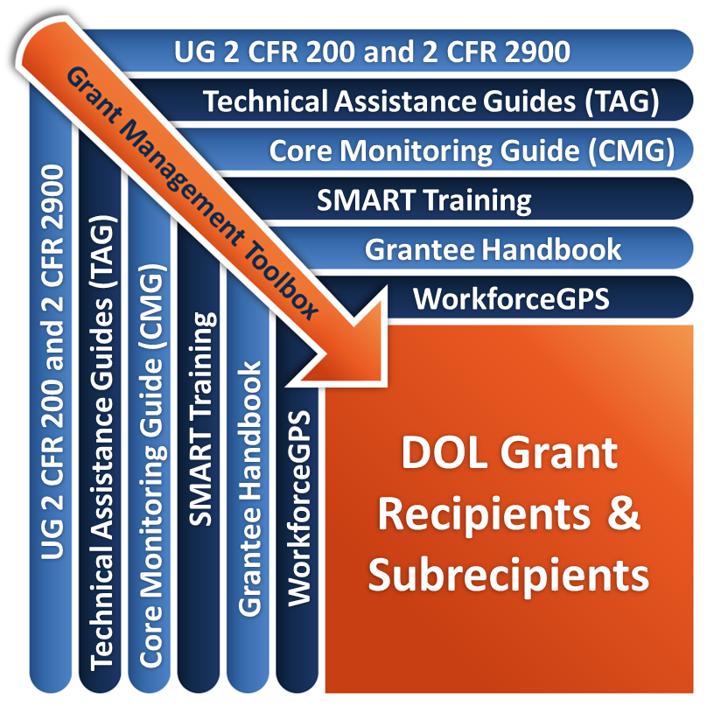
Remember the Grant Management Toolbox!

Slide 60
Questions?

Slide 61
Thank you.

