Slide 1
Budget Management
& Grant Modifications
SMART 3.0 Training
October 8, 2019

Slide 2


Today’s Speakers
Trevor Capon
Federal Project Officer
U.S. Department of Labor – Region 1
Boston, MA
Capon.Trevor@dol.gov
Ramona Melo
Systems Accountant
U.S. Department of Labor – Region 1
Boston, MA
Melo.Ramona.D@dol.gov

Slide 3
SMART 3.0 Training Strategies
S
SMART 3.0 Training Series:
The training modules are focused on: Strategies for sound grant management that includes: Monitoring, Accountability, Risk mitigation and Transparency
These four themes are weaved throughout the OMB Uniform Administrative Requirements, Cost Principles, and Audit Requirements for Federal Awards also known as the Uniform Guidance (2 CFR Part 200 and 2 CFR Part 2900).
Strategies
M
Monitoring
A
Accountability
R
Risk Mitigation
T
Transparency

Slide 4
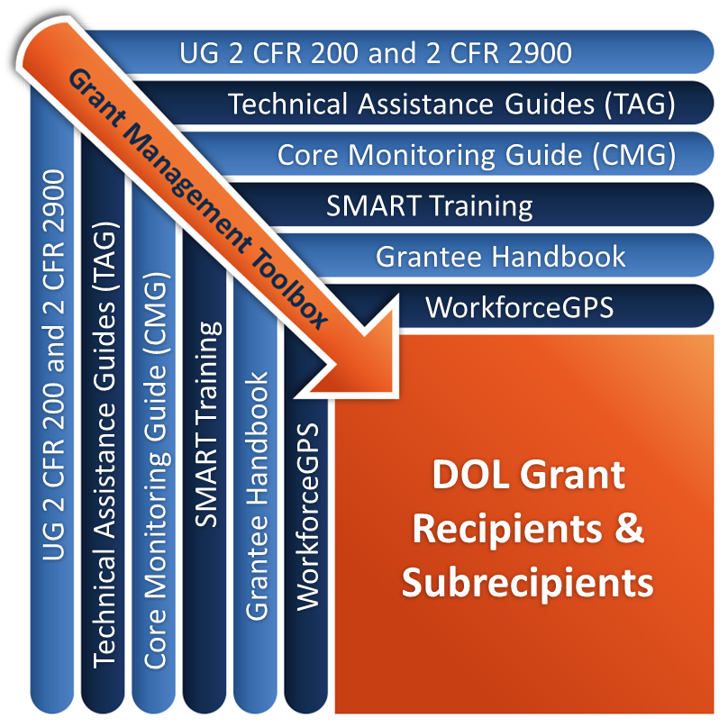
Grant Management Toolbox

Slide 5
Module Overview
Budget Management
  Purpose
  Controls and Analysis
  Budget Realignment Requirements
Grant Modifications
  Requirements
  Types
  Technical Information for Submission
Review Common Mistakes

Slide 6
Key Concepts – Budget Management
Purpose of the budget
Requirements for budget controls and analysis
Understand how the budget can be used to monitor program and financial activity
Tools available for use in performing budget analysis
Compare financial and program performance to achieve overall program effectiveness

Slide 7
The Budget’s Purpose
Quantify planned actions & activities
Facilitate communication between program and fiscal staff and management
Resource allocation
Benchmark in comparing actual results
Basis for evaluating and improving performance
Basis for course correction
Grant and Financial Management TAG Chapter 4.3 Purpose

Slide 8

What are Budget Controls?
Part of internal control system
Designed to provide methods to ensure costs are in line with projections
Require approval from Federal agency for certain items of cost
Identify problem areas

Slide 9
Budget Controls & Analysis – Basic Standards
2 CFR 200.302(b)(5)
2 CFR 200.308(b)
Comparison of expenditures with budget amounts for each Federal award.
Recipients are required to report deviations from budget or project scope or objective, and request prior approval from Federal awarding agencies for budget and program plan revisions, in accordance with this section.

Slide 10
Budget Controls
Accounting records need to track to budget categories
  Linking spreadsheets or chart of accounts
Spending according to budget estimates
Spending within approved line items
  Awardee level
  Subawardee level

Slide 11
Budget Controls (cont.)
Monitor costs and make adjustments
  Pass-through entity level
  Subrecipient levels
Possible modification needs
  To redirect unused funds for more effective utilization
  To make administrative adjustments for unanticipated changes

Slide 12
Discussion – How would you answer these questions?
When does the Budget Control process begin?
What types of budget analysis should be performed during the period of performance?
Whom should the planned vs. actual analysis be shared with?
How often should the analysis be performed?
What actions are taken when planned versus actual variances occur?

Slide 13
Other Factors to consider in applying controls
Cost Limitations: Limits placed on certain cost categories.
Indirect Costs: Costs are limited to the approved indirect cost rate or the 10 percent de minimis rate.
Match: Matching fund requirements of non-federal funds.
Budget Variances: Significant variance of actual and budgeted expenditures in any budget category or in total.
Budget Realignments: If recipient plans to transfer funds among the grant budget categories, it must receive prior approval from the Grant Officer when the cumulative amount of those transfers would exceed 10 percent of the total award.
Grant and Financial Management TAG Chapter 4.6 – Grant Modifications

Slide 14

Standard Form 424A (SF-424A)
Required budget form
  As contained in the grant agreement
Assists to ensure budget controls are in place
  By object class as linked to recipient expenditure records
Note that formula grants (UI, WP, and TAA) are not required to use the SF-424A form, they have bottom-line authority but the concepts are the same.

Slide 15
SF-424A Object Class Categories

Slide 16
Budget Narrative
Clearly written narrative
Links appropriate resources to meet project objectives
Budget in line with resources requested

Slide 17
Components of Budget Analysis
Compare actual results with budget plan categories
  At least quarterly but for each reporting period
  Identify significant variances and causes
  Identify and take appropriate corrective action
Conduct trend analysis over time
  Compare results from one period to the next
  Track impact of corrective actions
Combine the analysis of financial and program performance indicators

Slide 18
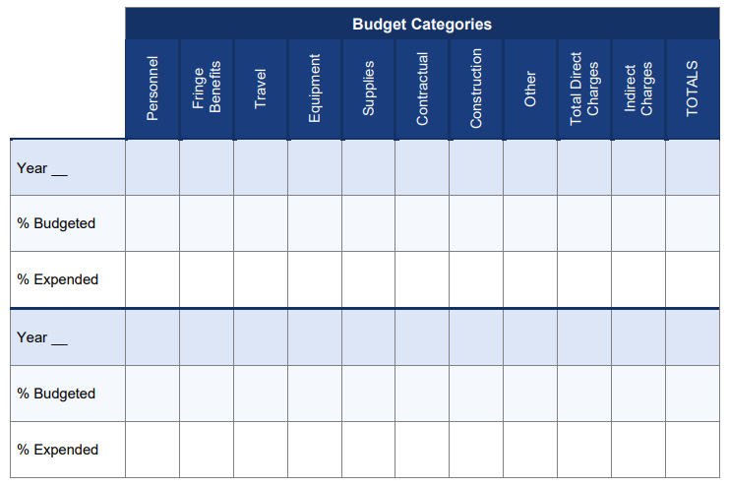
Budget comparison tools
Methods for budget analysis and tracking of key financial results compared to budget
2 CFR 200.302(b)(5) Financial Management requires:
  Comparison of expenditures with budget amounts
  Core Monitoring Guide Tool E: Budget Comparison Tool

Slide 19
Budget Analysis Worksheet compared with SF-424

Slide 20
Total Expenditure Analysis
20

Slide 21
Tracking Overall Expenditures
Overall expenditures
Where does the data come from?
Is the grant “on track”?
Spending too fast or too slow?
Are costs proportionate to outcomes?
Accounting records
Internal management reports

Slide 22
Administrative Cost Analysis

Slide 23
Tracking Administrative Expenditures
Administrative expenditures
Where does the data come from?
Are costs appropriately reported?
Are your costs within limitation?
Is your expenditure rate “too fast” or “too slow”?
Accounting records
Internal management reports

Slide 24
Match Expenditures

Slide 25
Tracking Match Expenditures
Match expenditures (if required)
  Are you reporting required match?
  Is match generated at an appropriate rate?
Where to find the requirement?
  SF-424
Where to find the data?
  Accounting records
  Internal management reports
  Not applicable to formula or most discretionary programs

Slide 26
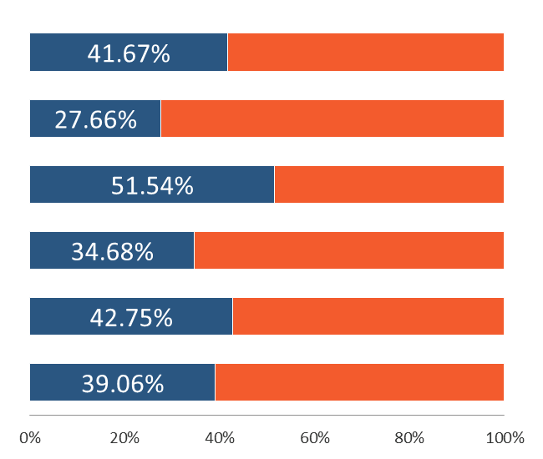
Combined Analysis
Combined analysis of financial and program results at the end of the 5th quarter of a 12-quarter period of performance
of grant time elapsed
of total award expended
of allowable admin costs expended
of required match expended
of total planned enrollments
of planned training enrollments

Slide 27
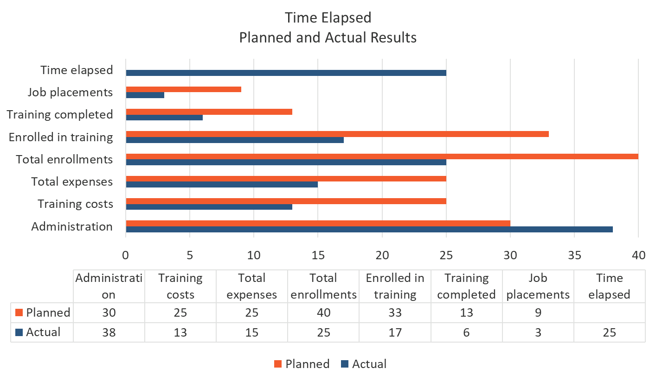
Time Lapse Comparison

Slide 28
Linking Budget and Performance Analysis
The guidance at 2 CFR 200.328(b)(2) requires that the recipient’s performance reports for each Federal award contain:
A comparison of actual accomplishments to the objectives of the Federal award established for the period
Where the accomplishments of the Federal award can be quantified, a computation of the cost (for example, related to units of accomplishment) if that information will be useful
Performance trend data and analysis as a performance reporting requirement, when informative to the Federal awarding agency
Reasons why established goals were not met, if appropriate
Additional pertinent information including, when appropriate, analysis and explanation of cost overruns or high unit costs
Specific Award Conditions being tracked

Slide 29
Consequences of Lack of Budget Controls
Loss of control by failing to compare planned expenditures to actual expenditures
Failure to have links between budget categories and chart of accounts
Failure to control expenditures
  Modifications not timely
  Over-or under-expenditure
  Failure to link financial and program performance
Failure to communicate

Slide 30
Knowledge Check 1 – Questions
True or False?
Program and fiscal personnel must routinely communicate performance and financial results for effective budget management.
Unobligated funds in a subaward of discretionary grant funds cannot be de-obligated and reprogrammed by the PTE to fund other subgrantees.
The entity’s accounting records need to track back to the approved budget and line item object class categories.

Slide 31
Knowledge Check 1 – Answers
Program and fiscal personnel must routinely communicate performance and financial results for effective budget management. True
Unobligated funds in a subaward of discretionary grant funds cannot be de-obligated and reprogrammed by the PTE to fund other subgrantees. False
The entity’s accounting records need to track back to budget and the line item object class categories. True

Slide 32
Key Concepts – Grant Modifications
Prior Approval Requirements
Modification Definition
Modification Types
Supporting and technical Information that is needed for each modification request
Request Process

Slide 33
Grant Modifications – Prior Approval
2 CFR 200.308(c) non-construction Federal award recipients must request prior approvals from Federal awarding agencies for one or more of the following program or budget-related reasons:
  Budget Realignment
  Administrative Changes
  Statement of Work Change
  Period of Performance Change (No Cost Extension)
  Equipment Purchase
  Change in Key Staff
  Administrative Changes

Slide 34
Grant Modifications – Prior Approval (cont.)
2 CFR 200 Subpart E – Cost Principles
General Provisions for Selected Items of Cost
Allowable, Unallowable, Allowable with Prior Approval
  Capital Expenditures
  And many others

Slide 35
Uniform Guidance—DOL Exception
Several DOL exceptions at 2 CFR 2900.9-12:
2 CFR 2900.9 – Revision of budget and program plans
  Award does not constitute prior approval of those items requiring prior approval
2 CFR 2900.10 – Prior approval requests
  Must request prior approval actions at least 30 days prior to the effective date of the requested action
2 CFR 2900.11-12 – Revision of budget and program plans
Must request prior approval for an extension to the period of performance
Unless otherwise noted in the Grant Agreement, prior written approval must come from the Grant Officer (See 200.308(d))

Slide 36
Grant Modification – What is it?
What is a Modification?
  A modification is a formal process used to make changes to your grant agreement that require Grant Officer approval.
Grant Officer Initiated (Internal) – Unilateral
Grantee Requested (External) – Bi-lateral needing prior approval

Slide 37
Modification Requirements
Internal Controls
Modification policies and procedures
Staff knowledge of policies and procedures

Slide 38
Types of Modifications
Budget Realignments
Administrative Changes
Statement of Work Changes
Period of Performance Extensions
Equipment Purchase Approval
Capital Expenditures
Key Staff (Signatory Changes)
Incorporation of Indirect Cost Rate Agreements

Slide 39
Budget Modifications – Formula/State Grantees
States have the authority and flexibility to shift dollar resources among allowable cost categories or budget line items. Unless specified in the grant agreement, for those items requiring prior approval in the UG (e.g., budget realignment), the authority to grant or deny approval is delegated to the Governor for Unemployment Insurance, WIOA Youth, Adult, and Dislocated Workers and under the Wagner-Peyser Act.

Slide 40
Budget Modifications - Discretionary Grant Recipients
Key Requirements
Requests for budget modifications must be submitted in writing at least 30 days before the effective date of any change
For grants exceeding the Simplified Acquisition Threshold and the cumulative amount of the transfers between line items on the budget exceeds or is expected to exceed 10 percent of the total budget as last approved by ETA, the grant recipient is required to go in for a budget modification 2 CFR 200.308(e)
Must submit a revised 424A

Slide 41
Identifying Modification Need
SF424A

Slide 42
Administrative Modification
Change in Key Personnel (signatory and point of contact)
Change of mailing address or phone number
Change of organization/institution name
Incorporation of the Negotiated Indirect Cost Rate Agreement (NICRA) into the award, or a change to the NICRA

Slide 43
Statement of Work Modifications
2 CFR 200.308 details SOW Mods
Work or training site/location of services
Training curriculum and/or timeline
Population target
Project scope
Performance goals and measurements
Credentials
Industry changes
Targeted service areas
Grant and Financial Management TAG Chapter 4.6: Grant Modifications

Slide 44
Period of Performance Modification
No cost extensions
1 time extension to the period of performance end date up to 1 year
Must obtain prior approval to extend POP as early as possible but no later than 30 days from ending date from the Grant Officer
May not be exercised merely for the purpose of using unobligated balances
Must provide supporting reasons and revised POP

Slide 45
Equipment Modification - Definition
Equipment means tangible personal property (including information technology systems) having a useful life of more than one year and a per-unit acquisition cost which equals or exceeds the lesser of the capitalization level established by the non-Federal entity for financial statement purposes, or $5,000.

Slide 46
Equipment Modification – Discretionary Grants
State and non-State recipients of competitive or discretionary awards must obtain prior approval before purchasing equipment under a DOL award. Approval of the award by itself does not automatically confer approval on the equipment purchase, even if there is information submitted in the SOW, budget narrative, or SF424A. This requirement applies to equipment purchased directly by the recipient as well as by its subrecipients.

Slide 47
Equipment Modification – Formula Grants
A state must use, manage and dispose of equipment acquired under a Federal award by the state in accordance with state laws and procedures 2 CFR 200.313(b).
Normally, prior approval is delegated to the Governor.

Slide 48
Equipment Modification Requirements
Equipment Modification must include:
Item name
Item description and basic specifications
Estimated useful life of the equipment
Per-unit cost (actual or estimated) including the cost to put the asset in place and make it useable for the purposes acquired
Purpose of the acquisition: description of how the equipment will be used to support the grant
Contact name and telephone number

Slide 49

Equipment Modification - Conditions
Recipients may not purchase equipment in the last year of performance. If any approved acquisition has not occurred prior to the last year of performance, approval for that item(s) is rescinded.

Slide 50
Modification Request
What to include in all request
Request Letter on agency letterhead signed by the Authorized Representative
Date
Grantee name and grant number
Type of modification
Justification

Slide 51
Budget & Grant Modification Common Mistakes
Purchasing equipment without written Grant Officer approval
Making budget adjustments between line items that exceed 10 percent of the award, without prior approval
Charging indirect costs without an approved indirect cost rate or without using an acceptable de minimis rate
Making changes to key personnel, program service plans, performance goals, and SOW commitments, without prior approval
Revising commitments to provide match or leveraged resources, without prior approval
Approving subrecipient modifications when the revisions should first trigger a modification to the prime award, requiring Grant Officer approval
Grant and Financial Management TAG Chapter 4: Budget & Grant Modifications

Slide 52
Knowledge Check 2 – Questions
True or False?
Discretionary grantees must request prior approval actions at least 30 days prior to the effective date of the requested action.
Discretionary grant recipients must obtain their prior written approvals from the DOL grant officer.
If a discretionary grant recipient cannot expend all its grant fund by the end of the POP, the recipient is entitled to an extension of the POP.
If a discretionary grant award does not include indirect costs, but the recipient subsequently receives a negotiated IDC rate, indirect costs may be charged to the grant without grant modification.

Slide 53
Knowledge Check 2 - Answers
Discretionary grantees must request prior approval actions at least 30 days prior to the effective date of the requested action. True
Discretionary grant recipients must obtain their prior written approvals from the DOL grant officer. True
If a discretionary grant recipient cannot expend all its grant fund by the end of the POP, the recipient is entitled to an extension of the POP. False
If a discretionary grant award does not include indirect costs, but the recipient subsequently receives a negotiated IDC rate, indirect costs may be charged to the grant without grant modification. False

Slide 54
Core Monitoring Guide
Indicator 2.b.2: Budget Modifications
  Does the grant recipient have policies and procedures when grant/project modifications need to be made? Does the mechanism allow for a 30-day notice? Did the grant recipient receive prior approval from the Grant Officer?
  If the grant award exceeds the Simplified Acquisition Threshold, does the cumulative amount of any transfers exceed or is it expected to exceed 10 percent of the total budget as last approved by ETA?

Slide 55
SMART Checklist
Budget Management and Grant Modifications
  Develop or update the process to periodically review planned budget and performance goals against actual costs and actual levels of performance. [2 CFR 200.302(b)(5)]
  Develop a crosswalk and align chart of accounts to the budget categories identified on the SF-424A and any other reportable item listed on the ETA-9130 or performance report. [2 CFR 200.302]
  Schedule quarterly meetings with program and fiscal staff to analyze actual results against the approved budget to allow time for adjustments.
  Develop or modify procedures to obtain prior written approvals from the Grant Officer at least 30 days prior to the executable action. [2 CFR 2900.9 to 2900.12]
  Train program and fiscal staff on the budget and grant modification process including analysis of financial and performance data. [2 CFR 200.301]

Slide 56

Module Review
Budget Purpose
Budget Controls and Analysis
Budget and Performance Analysis
Budget Realignments
Grant Modifications

Slide 57
ETA and Uniform Guidance Resources
Core Monitoring Guide
  Objective 2.b Budget, Indicator 2.b.2: Budget Modification
Grant & Financial Management Technical Assistance Guide
  Chapter 4: Grant Modifications
Department of Labor Regulations for Grants and Agreements 2 CFR Part 2900
  2 CFR 2900.9
  2 CFR 2900.10
  2 CFR 2900.11
  2 CFR 2900.12
Uniform Administrative Requirements, Cost Principles, and Audit Requirements for Federal Awards 2 CFR Part 200
  2 CFR 200.12
  2 CFR 200.20
  2 CFR 200.33
  2 CFR 200.48
  2 CFR 200.58
  2 CFR 200.89
  2 CFR 200.94
  2 CFR 200.302
  2 CFR 200.308
  2 CFR 200.313
  2 CFR 200.328

Slide 58
Web Resources
What is the best way to find your local American Job Center (AJC)?
  See DOL’s Service Locator
Want More Information?
  DOLETA.gov/Grants
    Funding Opportunities
    How to Apply
    Manage Your Awarded Grant
    Resources and Information
      ETA Grantee Handbook
      Annual Grant Terms Template
      Core Monitoring Guide
      Technical Assistance Guides
      Uniform Guidance Quick Reference Sheet
Want More Training?
  Workforce GPS’s Grants Application and Management Community of Practice
    Financial Reporting
    Subrecipient Management and Oversight
    Indirect Cost Rates
    Policies and Procedures
    Procurement and Performance-Based Contracts
    Capital Assets and More
  WorkforceGPS

Slide 59
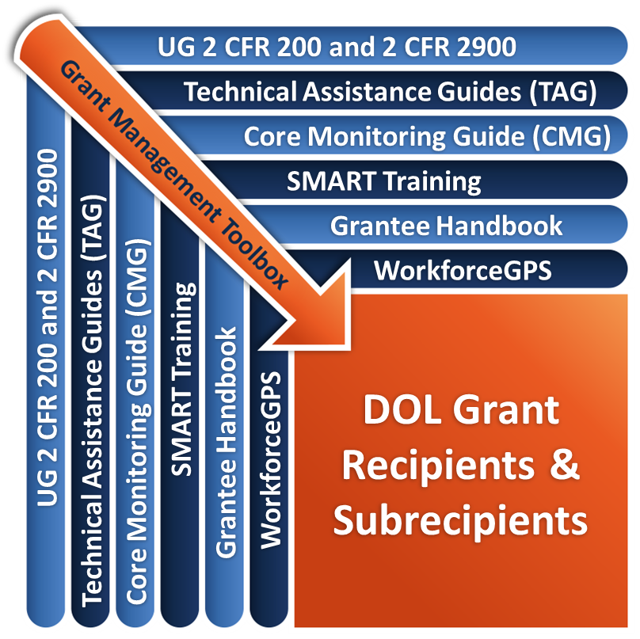
Remember the Grant Management Toolbox!

Slide 60
Questions?

Slide 61
Thank you.
This presentation was developed using Federal funds for training purposes and cannot be used by third parties to earn money or fees.

