Slide 2
Partnering with Conservation Corps for Out-of-School Youth and Young Adult Outcomes
October 9, 2019
Corps and Workforce Partnerships

Slide 3
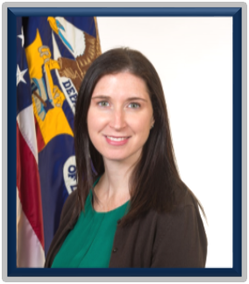
Sara Hastings, Unit Chief
Youth Policy and Performance
U.S. Department of Labor

Slide 4
Hear about The Corps Network and why corps programs can be good partners for workforce boards
Learn how corps programs collaborate with workforce development boards to create meaningful learning and work experiences for youth
Learn about two local corps programs that are successfully partnering with the WIOA youth program.

Slide 5

Conor Rooney
Government Relations Associate
The Corps Network

Slide 6
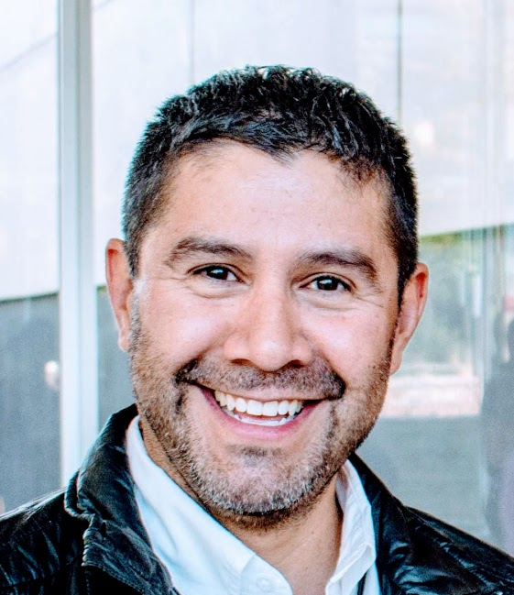

Maelly Oropeza
Corps Manager
Larimer County Conservation Corps
Mark Johnston
WIOA Center Manager
Larimer County Conservation Corps

Slide 7
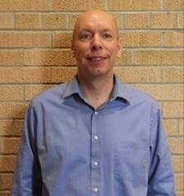

Gregory Markle
Executive Director
Operation Fresh Start
Danica Nilsestuen
Director of Business Services
Workforce Development Board of South Central Wisconsin

Slide 8
Introduction
Workforce and Corps Partnership

Slide 9
Who are we?
Workforce Development
Corps
Both Workforce Development and Corps
Other

Slide 10
Benefits of Partnership
Leverage resources to provide 14 program elements, including helping youth gain work experiences
Achieve Performance Outcomes
Create Career Pathway Opportunities

Slide 11
WIOA Work Experience

Slide 12
What is Work Experience?
Under WIOA, work experience is one of the fourteen (14) required elements local programs must offer youth
  Work experience is a planned, structured learning experience that takes place in a workplace for a limited period of time. 20 CFR 681.600
A work experience may take place in the private for profit sector, non-profit sector, or public sector
WIOA youth work experiences should be entry points to progress along the youth’s career pathway

Slide 13
Paid and Unpaid Work Experiences
The work experience program element consists of paid and unpaid work experiences which may include:
  1) summer employment opportunities and other work experiences available throughout the school year
  2) pre-apprenticeship programs
  3) internships and job shadowing
  4) on-the-job training opportunities
Compensation including wages, stipends, and incentives may be treated as income subject to IRS guidelines

Slide 14
Academic and Education Component
  Work experience must include an academic and occupational education component
    The educational component may occur concurrently or sequentially with the work experience.
    Academic and occupation education may occur inside or outside the work site
      It may be provided by the employer or separately in the classroom or by other means
    This component may also include learning which is industry- and occupation- specific

Slide 15
WIOA Priority for Work Experience
Expenditure requirement
  Not less than 20% of local youth formula funds must be used for this program element
  Tracking of funds?
  Allowable expenditures
    Employability skills or job readiness training
    Participant work experience orientation sessions
    Class room training or required academic component
    Wages and stipends
    Staff time for identifying and developing work experience opportunities, employer engagement, and evaluating the work experience
    Incentive payments

Slide 16
The Corps Network
Overview and Partnerships

Slide 17

The Corps Network
The Corps Network is the membership association for America’s 130 Service and Conservation Corps
We support Corps by advocating on their behalf, providing access to funding and projects, and offering expertise in Corps operations and programming
Our work helps Corps strengthen communities, address national needs, and engage over 25,000 young people annually

Slide 18
What is a Service and Conservation Corps?
Corps are locally-based organizations engaging young adults (generally ages 16 – 30) and veterans (up to age 35) to serve their country, advance their education, and obtain in-demand skills
Corps engage participants (Corpsmembers) in crews or individual placements on work-based service-learning projects on public lands, and in rural and urban communities
Corpsmembers perform important conservation, recreation, infrastructure, wildfire, disaster response, and community development work

Slide 19
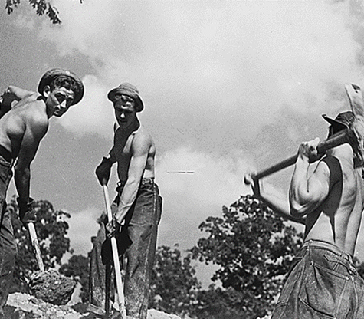
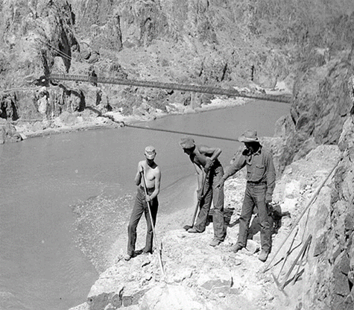
The Service and Conservation Corps History
Modern Service and Conservation Corps descend from the Civilian Conservation Corps…
  The CCC put >3 million young men to work improving public lands infrastructure during the Great Depression
  The CCC planted >3 billion trees and built park infrastructure still in use today
  Participants were provided a stipend, education, and job training
The CCC officially disbanded with the end of the Great Depression, but The Corps Model persisted
  State Conservation Corps
  Urban Conservation and Service Corps
  Federal National and Community Service Funds
  21CSC

Slide 20
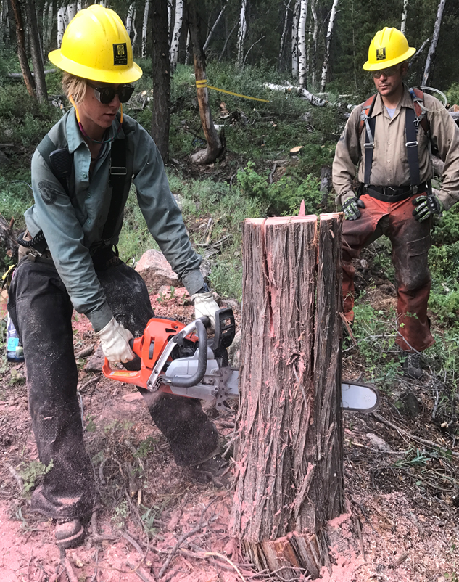
The Service and Conservation Corps Model
Service & Work-based Learning
  Accomplishing important projects
Workforce Development
  Hands-on work experience and in-demand skill development
  Credentials/certifications
  Career development services
Education
  HS diploma/GED
  College readiness curriculum
  Career development training
  Post-secondary placement and transition supports

Slide 21
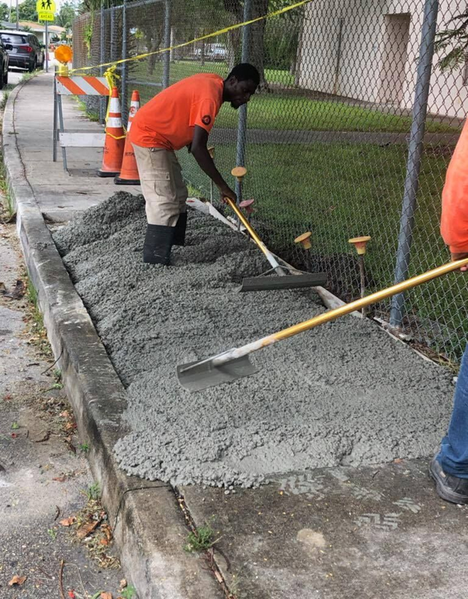
The Service and Conservation Corps Model
Wraparound Supports
  Transportation
  Childcare
  Case management
Compensation
  Stipend/living allowance
  AmeriCorps Education Award

Slide 22
Project Examples #CorpsWork
Outdoor Stewardship & Infrastructure
Construct & maintain multi-use trails & transportation infrastructure
Public lands access & development
Invasive species remediation
Fish & wildlife habitat improvements
Water quality and species monitoring
Watershed & coastal restoration
Fencing installation
Wildlife management & development
GIS & environmental monitoring
Enhancing Communities & Economic Development
Build & maintain parks/playgrounds
Urban forestry
Reclaim abandoned lots, brownfield remediation
Build & maintain urban farms and food systems
Recycling management
Constructing/improving park shelters, benches, signage
Disaster Resiliency, Response, Recovery
Erosion and flood control measures
Installing/maintaining storm water management infrastructure
Infrastructure resiliency and recovery
Wildfire mitigation and response
Debris removal, mucking/gutting
Conserving Natural Resources
Water infrastructure development
Weatherizing/retrofitting homes and public infrastructure
Conducting energy audits
Installing insulation, sealing air flow, replacing windows
Installing solar panels
Historic Preservation
Construction
Foundation stabilization
Masonry
Carpentry
Tuckpointing

Slide 23
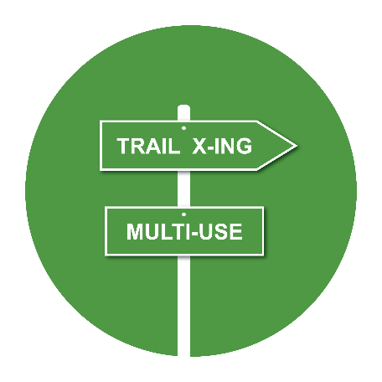







Corps Conservation, Recreation, and Infrastructure Outcomes - 2017
13,284
Miles of trail constructed/
improved
42,804
Acres of erosion and flood control
31,440,000
Pounds of waste collected
150,300
Acres of invasive species & hazardous fire fuels treated
2,551
Miles of waterway restored
1,663,143
Trees planted
14,230
low-income homes/public bldgs. audited/retrofitted
311,378
Acres of habitat restored

Slide 24






Community Development & Disaster Response Outcomes - 2017
Community Development & Response Outcomes - 2017
7,598
Community spaces built/improved
513,707
Volunteer hours through Corps-organized service opportunities
566
Disasters responded to, including fires, floods & storms
923,484
community members who benefitted from education programs provided by Corps
1,393,082
Square feet of graffiti removed
150
Historic structures restored

Slide 25
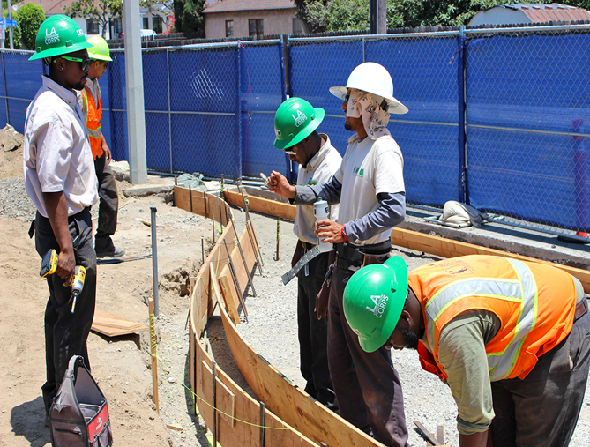
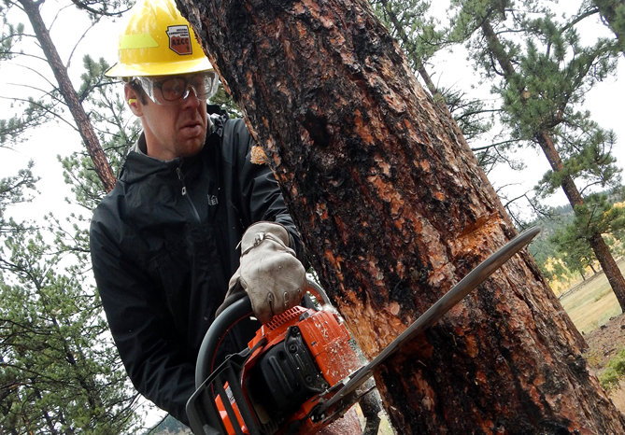
Service and Conservation Corps Serving Specific Populations
Opportunity Youth-serving Corps
  Recruitment
  Assessments and work experience
  HSD/GED attainment
  Wraparound supports
  Skill development and credential attainment
Veterans Corps
  Veterans serving with veterans
  Partnerships with organizations providing veteran-specific services
  Therapeutic benefits of the outdoors
  Intentional training and credential attainment (e.g. Wildland Firefighting)

Slide 26
Service and Conservation Corps and the Workforce System
Why Partner?
Significant workforce shortages across the country and 4.5 million Opportunity Youth
A mutual benefit…
  Corps can help WDBs meet enrollment requirements, and help WDBs provide a variety of required education and workforce development experiences
  WDBs can help fund Corps programming, provide support services, and help connect Corpsmembers to education and employment opportunities

Slide 27
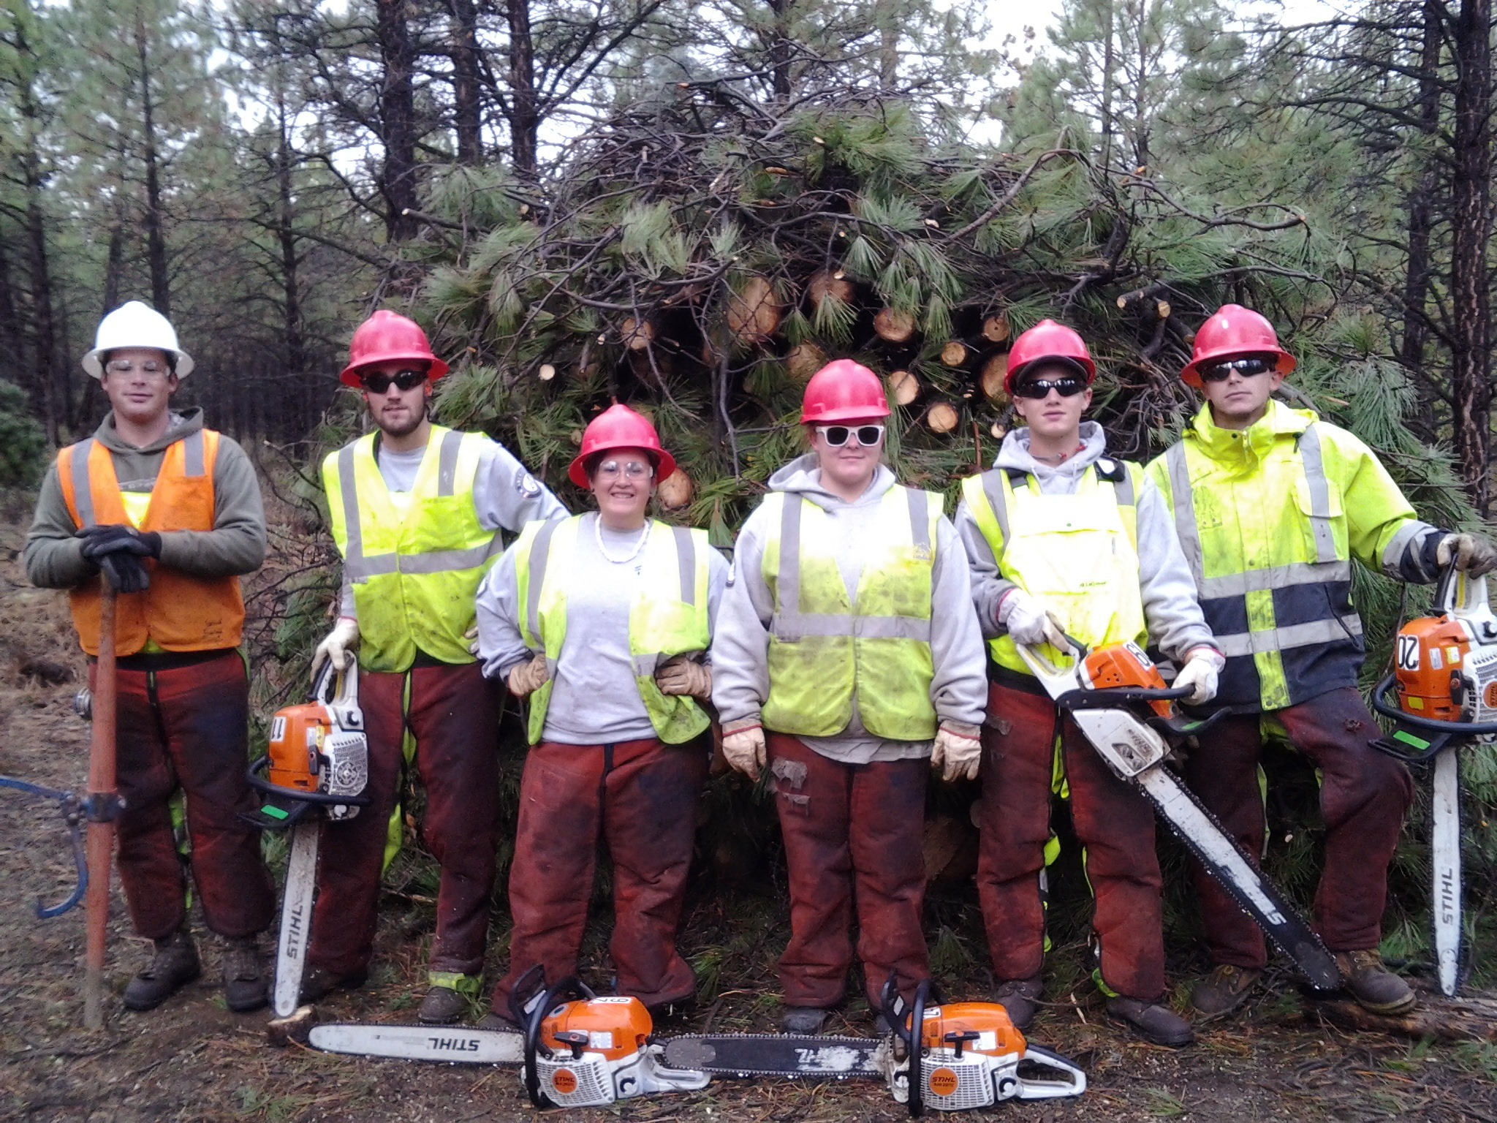
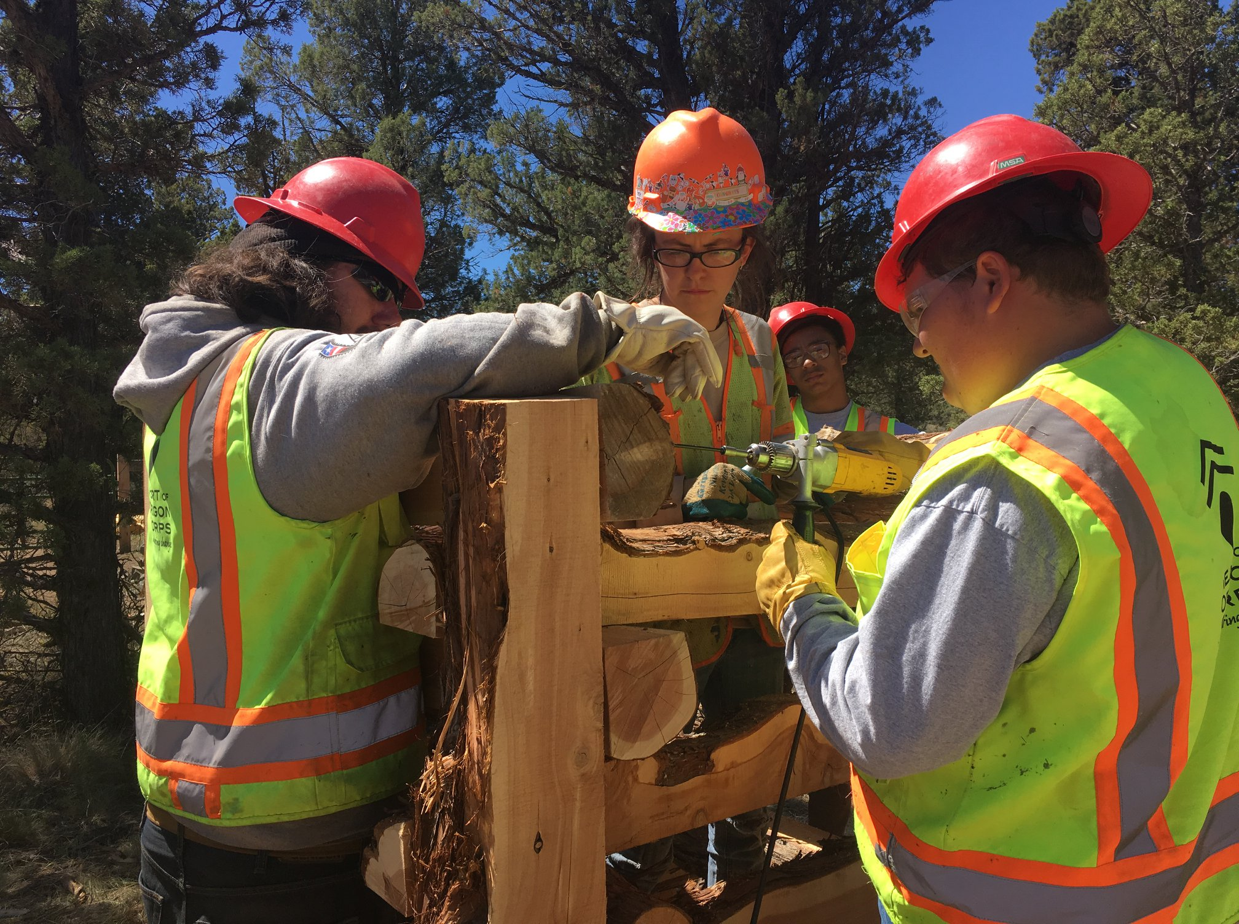
Service and Conservation Corps and the Workforce System
Co-enrollment: Heart of Oregon Corps - Bend, OR
  Heart of Oregon Corps (HOC) partners with its local Workforce Investment Board and the associate WorkSource One-Stops in rural Oregon
  The One-Stops refer young people to the Corps if the person could benefit from participation in HOC
  HOC refers young people needing more intensive services to the workforce system’s service providers
  Young people benefit from both the Corps experience and workforce system engagement

Slide 28
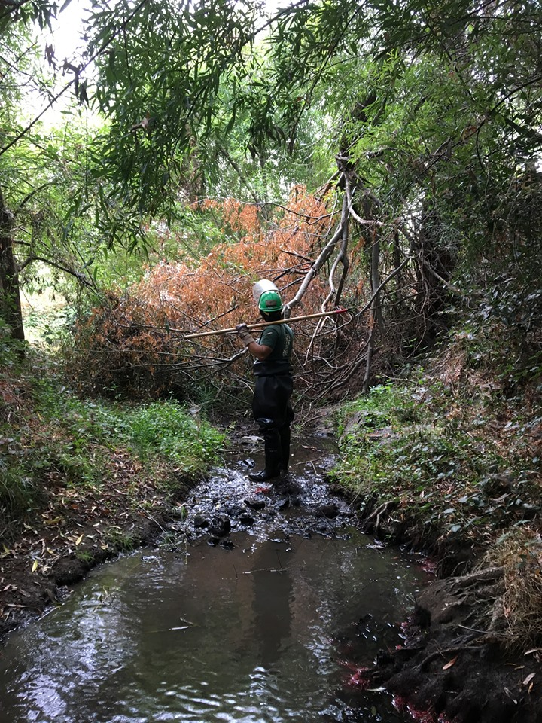
Service and Conservation Corps and the Workforce System
Leveraging Funding & Partnership: California Corps North Bay – San Rafael, CA
  California Corps North Bay (CCNB) partners with its WIB for its Youth Ecology Corps
  CCNB provides compensated workforce development through stream restoration and maintenance projects
  CCNB helps members obtain a Work Readiness Certificate through WIB-approved training.
  The WIB helps fund the program, and provides mentoring and career exploration activities

Slide 29
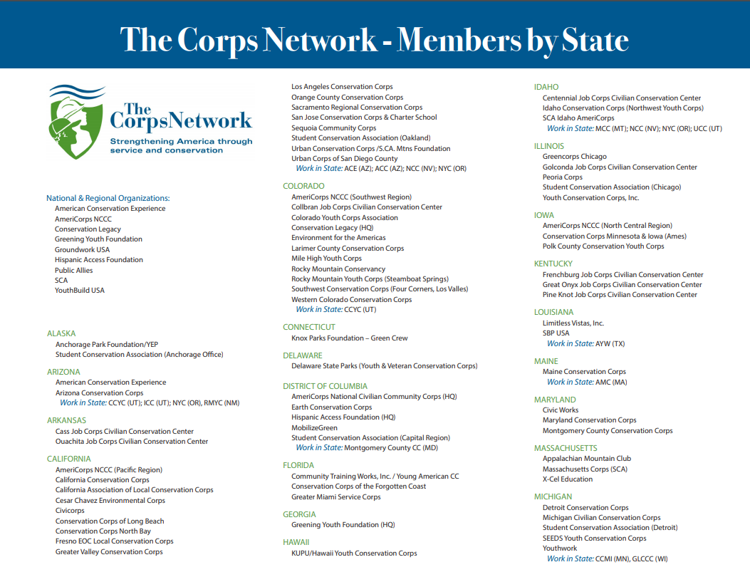
What is The Corps Network?

Slide 30
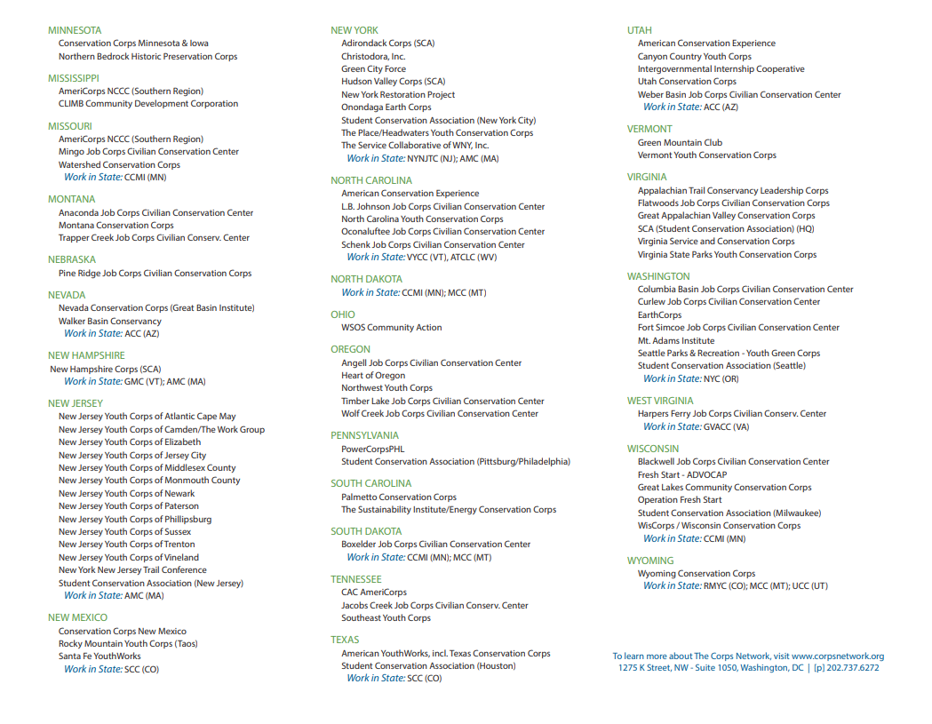
What is The Corps Network?
Corps operate in all 50 states, the District of Columbia, and multiple US territories.

Slide 31
Larimer County Conservation Corps
Local example of successful partnering and work experiences

Slide 32
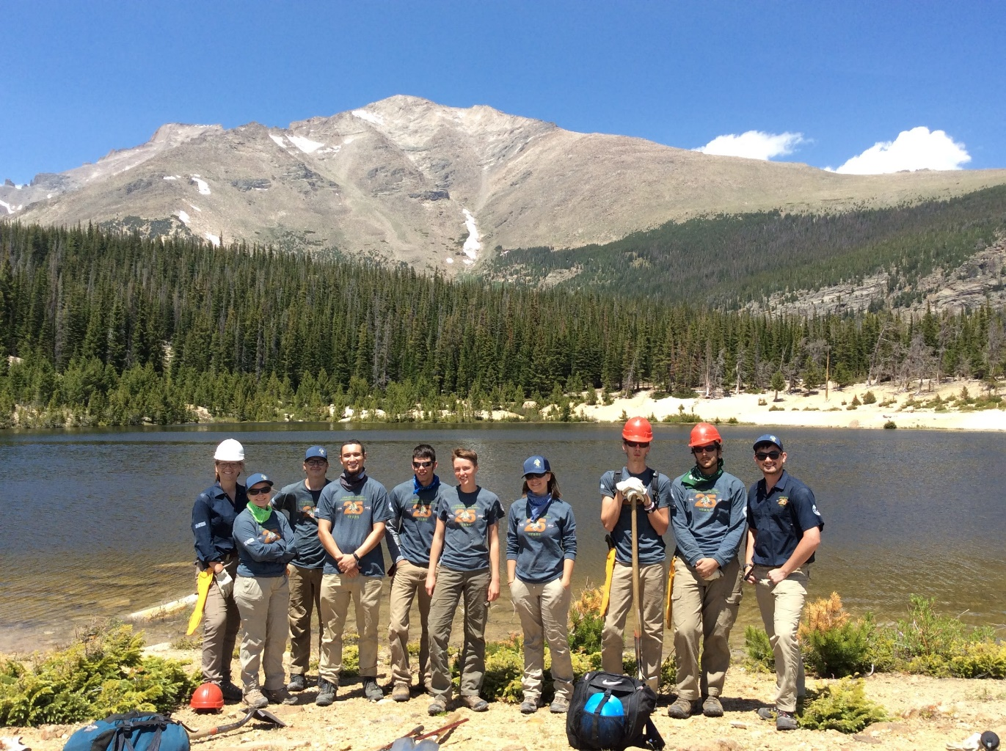


November 2018

Slide 33
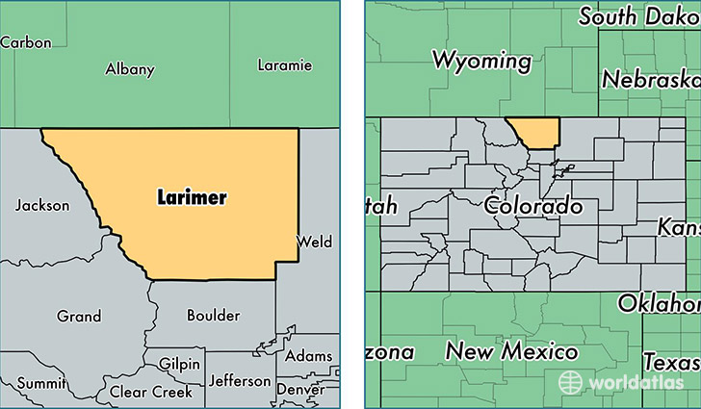
Larimer County Conservation Corps (LCCC)

Slide 34
Program Structure
Operated and supported by Larimer County Economic and Workforce Development (LCEWD) Fort Collins, Colorado.
Accredited by The Corps Network (TCN) and Colorado Youth Corps Association (CYCA).
Started in 1988 through initial resource investment from employer, Anheuser-Busch.
Featured program of LCEWD CareerRise Young Adult Team (WIOA Title I and Title III administrator).
Workforce Innovation and Opportunity Act (WIOA) Program Element provider.

Slide 35
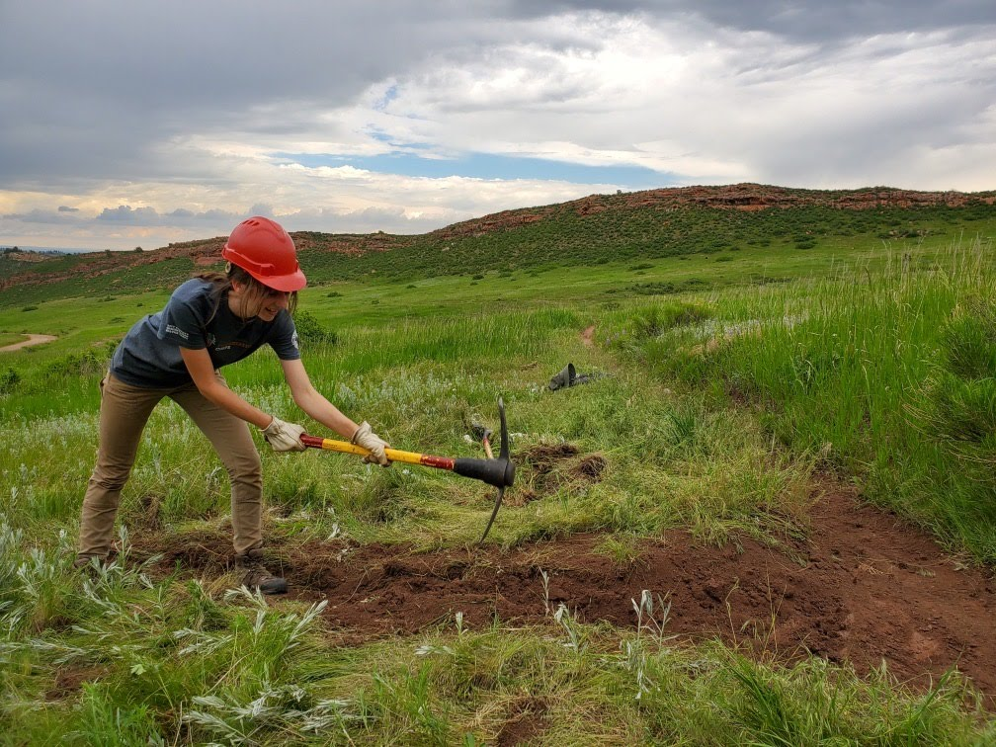
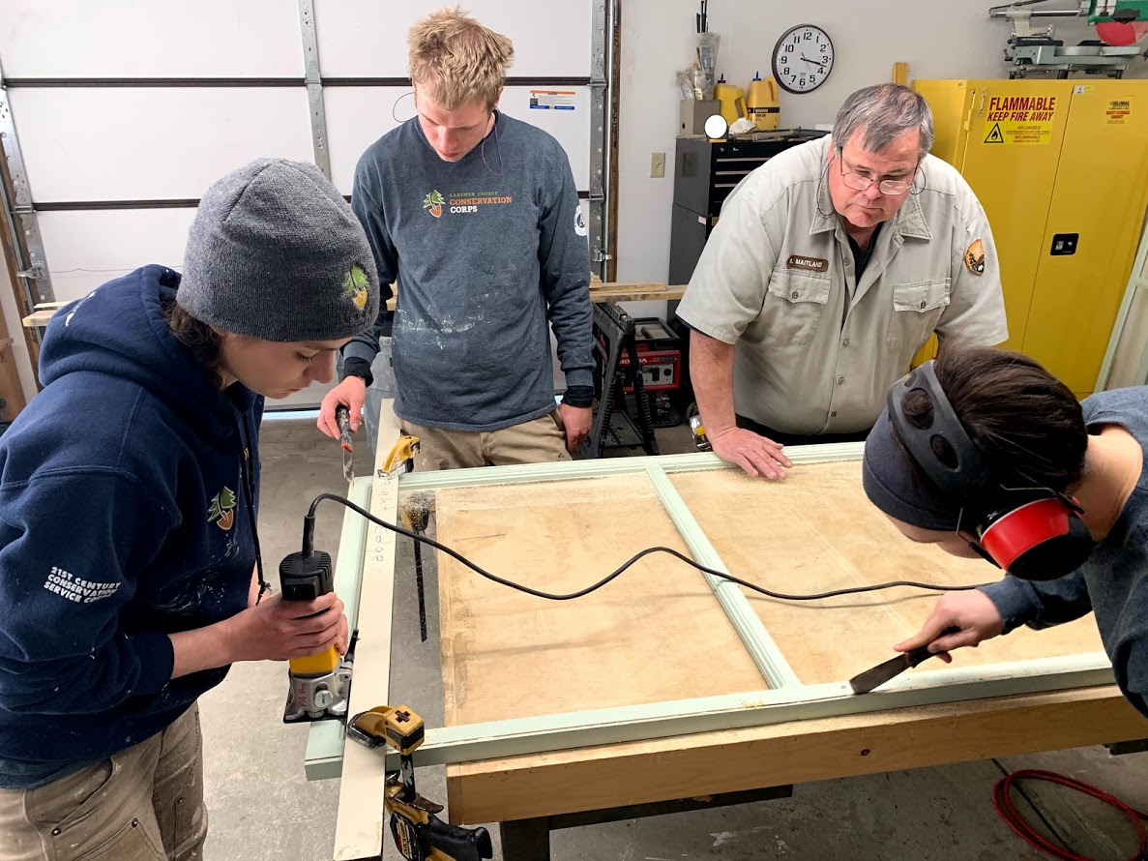
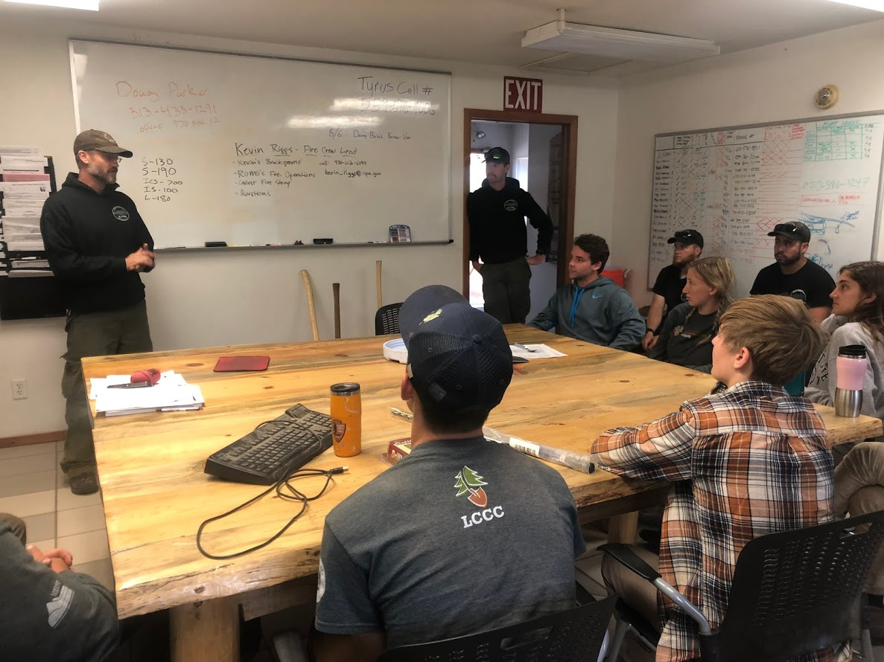
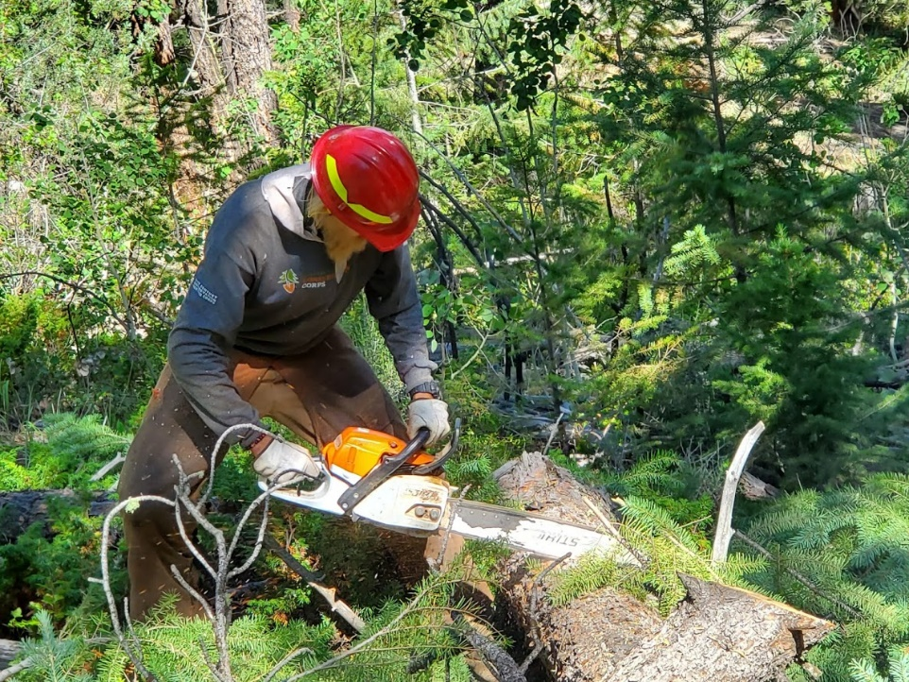
Larimer County Conservation Corps (LCCC)

Slide 36
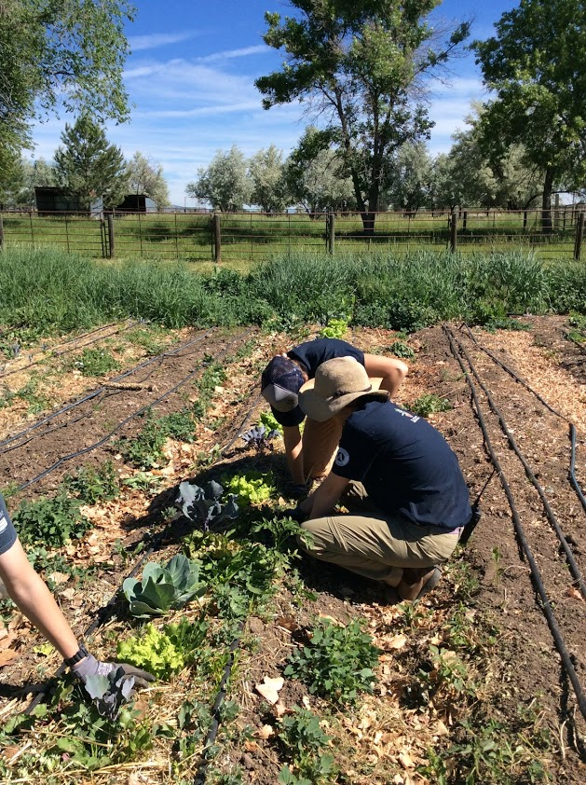
Menu of Programming
  AgriCorps
      4 week volunteer service learning/training model
      Agriculture and Horticulture focus
      Incentive based
      Ages 14-16
  Land
      10 week work based learning model
      Recreation and Wildlife Management focus
      Wage based
      Ages 16-18
  Forestry
      10 week work based learning model
      Fire Mitigation and Watershed focus
      Stipend based
      Ages 18-25
      AmeriCorps

Slide 37
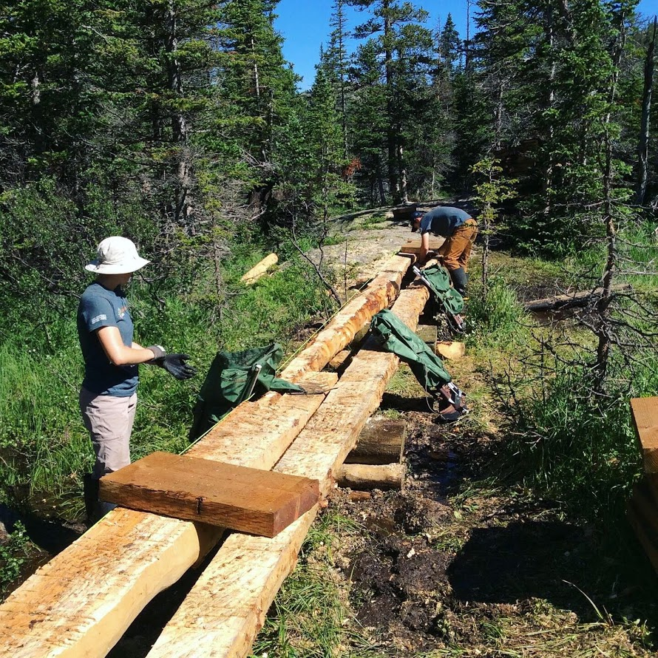
Menu of Programming
  RMNP Trails
      10 week work based learning model
      Trail Construction and Maintenance Focus
      Stipend based
      Ages 18-25
      AmeriCorps
  Water & Energy
      20 week work based learning model
      Residential Assessment Focus
      Stipend based
      Ages 18-25
      AmeriCorps
  RMNP Construction
      20 week work based learning model
      Trade Skills Focus
      Wage based
      Ages 18-25

Slide 38
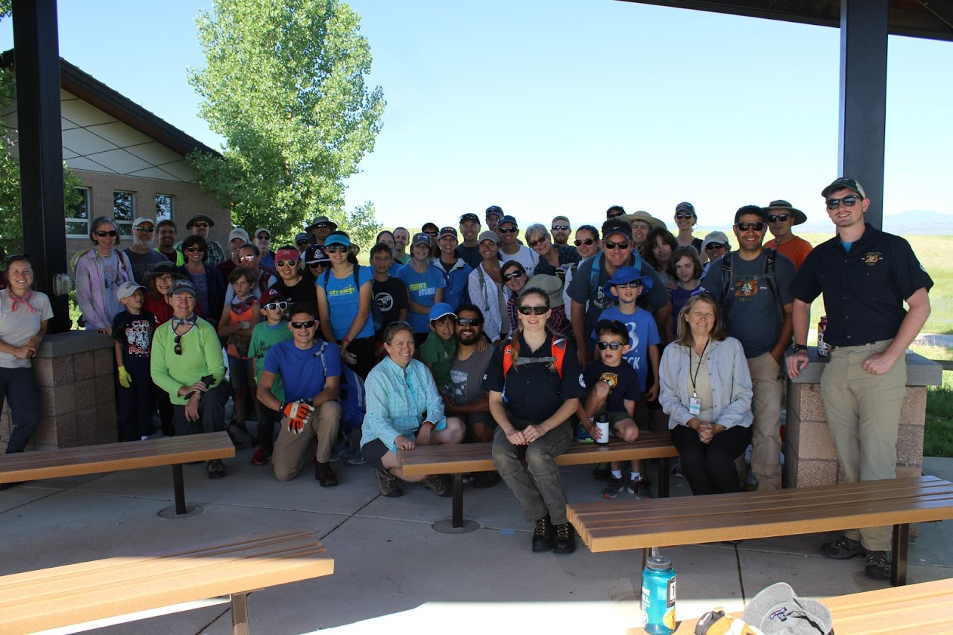
Funding Partnership Examples
  Land Agencies – Local, State, and Federal
    Loveland Parks and Recreation, Colorado Parks and Wildlife, US Forest Service, National Park Service
  Municipal Utility Providers
    Fort Collins Utilities, Loveland Water & Power, Platter River Power Authority
  Foundations and Corporate
    Great Outdoors Colorado (GOCO), Jax Mercantile, Patagonia
  Other
    Colorado State University – Warner College of Natural Resources, Community Services Block Grant (CSBG), Larimer County, Workforce Innovation and Opportunity Act (WIOA)
  *Larimer County Foundation act as the LCCC fiscal sponsor (501 c3)

Slide 39
Why the collaboration works
LCCC is an employment and training model that offers work-based learning and leadership opportunities.
LCCC values diversity. Our strength is working with diverse youth, often disconnected from supports.
Co-location at Larimer County Economic and Workforce Development allows for seamless referral of young adults to employment and training opportunities.
Partner program that meets WIOA Title I work based learning 20% spending requirement.
LCCC is a bridge towards successful WIOA Common Performance Measures including: 2nd and 4th Quarter Education/Employment Rate & Credential Attainment
Supports entry level career pathway development through an experiential work-based learning.
Develops opportunities for practical work readiness skill attainment in early, formative years.
WIOA Title III provides recruitment, pre-hiring, and post-corps experience support for LCCC corpsmembers.

Slide 40

November 2018
Our Vision:
All youth ages 16-24 are assets in our community.
Our Mission:
Operation Fresh Start provides disconnected youth a path to self-sufficiency.

Slide 41
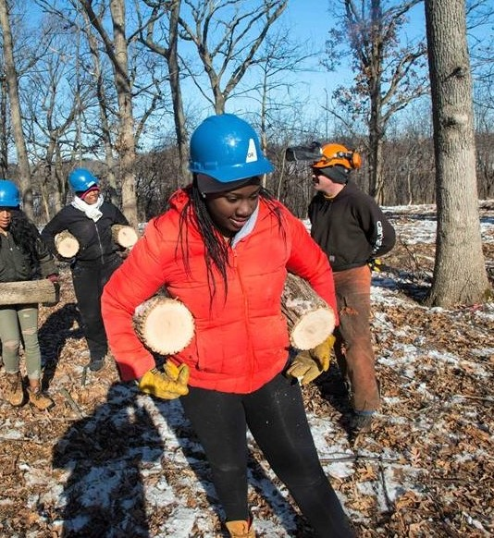
Operation Fresh Start
Over nearly 50 years, Operation Fresh Start has given 8,000 disconnected youth a second chance in life by providing a path forward to self-sufficiency. We are so grateful for our community’s support. This day couldn’t have happened without it!

Slide 42
Operation Fresh Start Programs
Legacy provides youth who are not on a path to complete high school a vocational track for completion. The program includes classroom education, construction and conservation pre-apprenticeship work experience and transition into employment in a program of personal growth.
Strive provides high school graduates age 18 to 24 with industry-specific training and credentials in high demand employment fields through cohort based trainings. Current training is in construction and health care.
Options is for youth who have left high school without completing working to re-engage them on a path to diploma. This program reaches out to each Madison youth who hasn’t completed high school and works with him/her to develop and follow through on a plan to complete.
Drive is for youth that are working towards a drivers license. In Dane County, a Driver’s License is the second most often used qualifier for employment. Through this program youth learn to drive, pass the test and earn their license.

Slide 43
Partnership with Workforce Development Board of South Central Wisconsin
  Resource Programming:
      Operation Fresh Start staff member funded through WIOA Out of School youth program funds provides Dane County WIOA OSY with connections and case management for basic needs including housing, food, health and mental health.
  Pre-Apprenticeship Training:
      Participants in Legacy and Strive programs engage in on-site training leading to State of Wisconsin Bureau of Apprenticeship Pre-Apprenticeship Certification in Arborist or Carpentry.
      Connection with registered apprenticeship pathway
      Other employability skills and certification including:
        High School Diploma
        OSHA-10 Certification
        Driver’s License

Slide 44
Operation Fresh Start Funding Mix
Operation Fresh Start uses a mix of diverse funding sources to leverage resources and provide depth of programming:
  AmeriCorps
  Local School District
  County and City community resources funding
  Corrections Funding
  Food Share 50/50 Funding

Slide 45
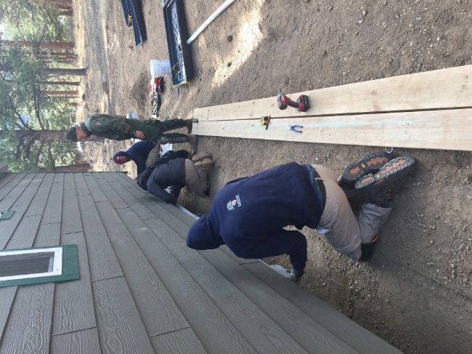
The Board
Partnership
  WIOA refocused funds to out of school youth - a traditionally difficult age
  group to recruit and serve.
  Organizations like OFS have experience and successes serving this
  population - why recreate the wheel?
Funding
  WIOA Out of School Youth training and support funds (and Adult funds when needed), pay for the pre-apprenticeship program through ITAs for individuals WIOA eligible.
  WIOA funded staff work in partnership with OFS staff to determine eligibility, collect paperwork and documents, and track in state reporting system. In addition to providing career services and placement help when needed.
Moving Forward
  WDBSCW will continue to work with organizations like OFS to align pre-apprenticeship training with new and existing registered apprenticeship programs, for example the new Forestry program or perhaps creating new conservation related programs.

Slide 46
Why the collaboration works
Operation Fresh Start is able to add additional resources from the WorkSmart Network for youth including Work Experience, Internships, equipment and transportation support.
Operation Fresh Start gains expertise from the Board in transitioning youth to employment.
Operation Fresh Start is able to engage in the Boards broad array of employers and both organizations work together to track former participants and record and measure outcomes

Slide 48
For Workforce Development, what’s your relationship with Corps?
We are great partners and leverage resources.
We do some partnering, but we are interested in doing more.
We don’t partner with Corps at this time, but would like to.

Slide 49
For Corps, what’s your relationship with Workforce Development?
We are great partners and leverage resources.
We do some partnering, but we are interested in doing more.
We don’t partner with the workforce system at this time, but would like to.

Slide 50
Conor Rooney
    The Corps Network
      crooney@corpsnetwork.org

Slide 51
Mark Johnston
  WIOA Center Manager
    Larimer County Economic and Workforce Development
      mjohnston@larimer.org
        970-498-6624
Maelly Oropeza
  Corps Manager
    Larimer County Conservation Corps
      moropeza@larimer.org
        970-498-6630

Slide 52
Gregory Markle
  Executive Director
    Operation Fresh Start
      GMarkle@operationfreshstart.org
        608-244-4721
Danica Nilsestuen
  Director of Business Services
    Workforce Development Board of South Central Wisconsin
      dnielsestuen@wdbsw.org
        970-498-6630

Slide 53
Division of Youth Services
      youth.services@dol.gov

Slide 54
WIOA Youth Program and Work Experience Activities brief
  This document provides a summary of the policies and program design considerations for developing work experience activities.
    https://youth.workforcegps.org/resources/2018/10/30/15/56/Work-Experience-Activities
Work Experience Program Element Webpage
  Details about resource here
    https://youth.workforcegps.org/resources/2017/01/19/14/27/Paid-and-Unpaid-Work-Experience
Technical Guidance Letter (TEGL) 21-16
  Defines the work experience program element
    https://wdr.doleta.gov/directives/corr_doc.cfm?docn=7159
Snapshot: Youth Corps and Workforce Partnerships
  The document provides information on how Corps and workforce systems can collaborate and best utilize resources to engage youth in comprehensive programming and reconnect to education and the workforce.
    https://corpsnetwork.org/wp-content/uploads/2015/07/Snapshot_Youth20Corps20and20Workforce20Partnerships_2.pdf
Enough Is Know for Action: Implementing Effective Work Experience Models for Youth
    https://ion.workforcegps.org/sitecore/content/global/events/2015/04/01/11/24/Enough_Known_Action_Implementing_Effective_Work_Experience_Models_Youth_20150325

