Slide 1
Payments and Cash Management
SMART 3.0 Training
October 17, 2019

Slide 2
Today’s Speakers
Tom DiLisio
Senior Accountant, DFMAS
U.S. Department of Labor – Region 6
San Francisco, CA
Dilisio.Thomas@dol.gov
Chanel Castaneda
Grants Management Specialist
U.S. Department of Labor – OGM/DPRR
Chicago, IL
Castaneda.Chanel@dol.gov

Slide 3
SMART 3.0 Training Strategies
S
SMART 3.0 Training Series:
The training modules are focused on: Strategies for sound grant management that includes: Monitoring, Accountability, Risk mitigation and Transparency
These four themes are weaved throughout the OMB Uniform Administrative Requirements, Cost Principles, and Audit Requirements for Federal Awards also known as the Uniform Guidance (2 CFR Part 200 and 2 CFR Part 2900).
Strategies
M
Monitoring
A
Accountability
R
Risk Mitigation
T
Transparency

Slide 4
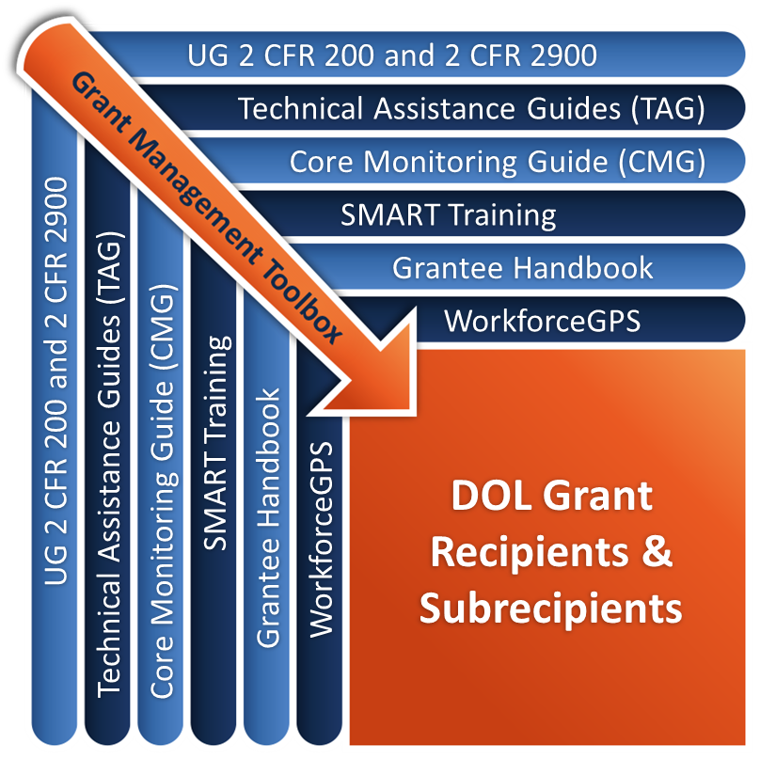
Grant Management Toolbox

Slide 5
Module Overview
Uniform Guidance standards and DOL exceptions related to managing cash and other assets
Interest income and program income
DOL payments process to recipients
Payment options for the pass-through entity’s payment system
Manage other cash equivalent items
Common mistakes and how to avoid them

Slide 6
Financial Management System Standards
2 CFR 200.302 Financial management system must provide for:
(b)(4) Effective control over, and accountability for, all funds, property, and other assets. The non-Federal entity must adequately safeguard all assets and assure that they are used solely for authorized purposes. See 2 CFR 200.303 Internal Controls.
(b)(6) Written procedures to implement the requirements of 2 CFR 200.305 Payment.

Slide 7
Written Procedures
Cash management procedures must be written
Should address the method for payments issued and received:
Authorized individuals and separation of duties
Miscellaneous receipts and petty cash
Control over cash and other cash equivalent assets
Reconciliations
Forecasting and daily cash balances
Payment transfers and advances (internal and external)

Slide 8
Internal Control Purpose
Cash requested only for immediate disbursement needs
Supporting documentation and justification
Improper payments avoided
Access limited to all cash-related assets
Interest income and program income are accounted for
Other cash equivalent assets are accounted for

Slide 9
Internal Controls – Cash & Cash Equivalent Items
Written policies and procedures
Segregation of Duties
Authorization of a transaction
Receipt and custody of the asset
Recording and reporting activity related to that asset
Taking periodic inventory and reconciling balances
Access limited to all cash-related assets
Passwords and PINs to bank deposit accounts
Agency credit cards, debit cards, gas cards
Transit cards or bus passes
Gift cards

Slide 10
Compensating Controls
Having managers or staff from the program offices perform specific cash-related functions.
Requiring two authorizing signatures on checks issued.
Requiring supervisory approval of each use of cash and cash equivalent assets.
Verifying usage and balances of logs through management information system reports.
Sharing fiscal responsibilities with neighboring local workforce areas or other grant recipients.

Slide 11
Standards for Cash Depositories
2 CFR 200.305(b)(7)
Cannot require separate depositories or establish any eligibility requirements for depositories
Separately account for receipt, obligation, and expenditure of funds by award or fund source
Maintained in insured accounts whenever possible

Slide 12
Interest-Bearing Accounts
2 CFR 200.305(b)(8)
Advances must be placed in an interest-bearing account except when:
Less than $120,000 in Federal awards per year
Best available account would earn less than $500 per year
Requirement for an average or minimum balance so high that it would be infeasible
Prohibited by a foreign government

Slide 13
Interest Income
States: Cash Management Improvement Act
Recipients and Subrecipients
Recipients and Subrecipients Remit annually through the appropriate method specified in 2 CFR 200.305(b)(9)
Interest amounts up to $500 per year may be retained for administrative expenses
WIOA 20 CFR 683.200(b)(8) - interest income earned on WIOA and Wagner-Peyser funds must be included as program income

Slide 14
Program Income
Income generated as a result of allowable grant activities
Program income must be:
Expended during the financial reporting period in which it was earned
Disbursed before requesting cash drawdowns of grant funds
Which means the non-Federal entity must:
Record and report program income at the time it is earned
Record and report the expenditure of that program income as soon as it is expended
Use the cash proceeds generated from program income to pay for grant-related costs before drawing down additional grant cash

Slide 15
Payments to Contractors
2 CFR 200.305(b)(1) The non-Federal entity must make timely payments to contractors in accordance with contract terms

Slide 16
Knowledge Check – Questions
True or False?
Non-Federal entities must maintain separate depositories for their Federal cash.
WIOA recipients and subrecipients must remit interest income to the Federal Treasury?

Slide 17
Knowledge Check – Answers
Non-Federal entities must maintain separate depositories for their Federal cash. False
WIOA recipients and subrecipients must remit interest income to the Federal Treasury? False

Slide 18
Payment Management System
HHS Payment Management System (PMS)
Funds available by grant number
If requested by 2 P.M., funds are deposited the next day
Before grants can be closed out, cash receipts, disbursements and expenditures must equal
Meets the requirement that non-Federal entities must be paid in advance of disbursement 2 CFR 200.305(b)(1)

Slide 19
States’ CMIA Requirements
Major programs—meeting a certain dollar threshold (varies State to State)
Governs transfer of funds between US Treasury and States
Provides techniques to manage funds
Interest earned by States

Slide 20
Consolidating Cash for Federal Programs
2 CFR 200.305(b)(2) Whenever possible, advance payments must be consolidated to cover anticipated cash needs for all Federal awards made by the Federal awarding agency to the recipient.

Slide 21
Advance Payments
2 CFR 200.305(b)(1) Non-Federal entity must be paid in advance provided it maintains written procedures minimizing time elapsing between receipt and disbursement, as well as financial management standards for fund control and accountability

Slide 22
Reimbursement Basis
2 CFR 200.305(b)(3) Reimbursement:
Possible consequence for failure to comply with cash advance requirements
Payments must be made within 30 calendar days after receipt of billing
Unless request is improper
Specific conditions authorized at 2CFR 200.207 for reimbursement payments
DOL exception 2 CFR 2900.6 on advance payments:
Due to risk assessment
Becomes a special condition of the grant

Slide 23
Working Capital Advance
When to use working capital advance:
Entity cannot meet the criteria for advance payments
Reimbursement not feasible because entity lacks sufficient capital
Advance process:
Disbursement needs for an initial disbursement cycle
Advance is liquidated with actual disbursements
Subsequent reimbursements only for actual cash disbursements of the advance payment
Must not use working capital advances because of unwillingness or inability to provide timely advance

Slide 24
Liquidation of Advances
DOL exception at 2 CFR 2900.7
Non-Federal entity should liquidate existing advances before it requests additional advances and disburse available cash balance of program income prior to drawing down additional grant funds

Slide 25
Cash Forecasting System
Develop disbursement schedule
Forecast cash needs by fund source
Track daily cash balances by fund source
Cash on hand MUST be used prior to requesting additional cash
Include transaction cycle time in the timing of cash request
These systems must be internally and externally monitored and adjusted as necessary

Slide 26
Pass-Through Entity Cash Systems
Should be centralized and secure
Subrecipients must be paid in advance of disbursement if they maintain effective cash management system [2 CFR 200.305(b)(1)]
Frequency of payments must coincide with timely disbursement
No electronic fund transfer system: at least monthly
Electronic fund transfer system: no limit
Reimbursement basis possible if failure to comply
Pass-through entities and subrecipients must separately account for receipt, obligation, and expenditure of funds by award or fund source
For subawards, the pass-through entity must identify the dollar amount made available under each award and the CFDA number at time of disbursement [2 CFR 200.331(a)(1)(xi)]

Slide 27
Withholding of Payments
2 CFR 200.305(b)(6)(iv)
Payments must not be made to a non-Federal entity for amounts withheld by the non-Federal entity from payments to contractors until satisfactory completion of work
Payments must be made when the non-Federal entity actually disburses the withheld funds to the contractor or to an escrow account established to assure satisfactory completion of the work

Slide 28
Withholding of Payments (cont.)
Payments must not be withheld at any time during the period of performance unless:
The entity failed to comply
The entity is delinquent in a debt to the United States
Reasonable notice
Payments withheld must be released upon subsequent compliance
Suspended awards:
Adjustments per 2 CFR 200.342

Slide 29
Improper Payments
Public Law 107-300
Requires program agencies with over $500 million annual expenses to recover
Provides agencies to recover any associated expense from amounts recovered
Requires Agency reporting
Every organization must have an improper payments recovery policy and procedures

Slide 30
Improper Payment Examples
Over-payments to subawards and contractors
Disallowed costs
Participant payments erroneously awarded
Uncollected tuition refunds
Double payments
Payments paid at the wrong rate
Unauthorized charges on fees and penalties paid in error
Overpayments on blanket P.O.s
…more

Slide 31
Knowledge Check (2) – Questions
True or False?
Pass-through entities are generally required to advance cash to their subrecipients to meet their immediate disbursement needs?
As a result, pass-through entities may never put their subrecipients on a cash reimbursement basis?

Slide 32
Knowledge Check (2) – Answers
Pass-through entities are generally required to advance cash to their subrecipients to meet their immediate disbursement needs? True
As a result, pass-through entities may never put their subrecipients on a cash reimbursement basis? False

Slide 33
Cash Equivalent Items
ATM PINs and PINs to checking accounts
Passwords to sensitive accounts
Credit cards and/or gas cards
Debit cards
Purchase cards
Blank check stock
Check-signing machines
Bus tokens and passes
Gift cards

Slide 34
Control Over These Assets
Written internal control procedures:
Petty cash
Inventory of tokens, passes, cards, etc.
Monitoring of subrecipients’ cash equivalent assets
Access limited to authorized individuals:
Secure storage
Passwords secured and changed regularly
Separation of duties
Logs for issuing bus tokens, passes, gift cards

Slide 35
Common Mistakes
Inadequate separation of duties
Cash receipts/deposits recorded in the wrong revenue account or for the wrong amount
Unreconciled cash balances—cash on hand not identified with particular funding sources and reconciled to bank statements
Excessive cash on hand and poor forecasting of cash needs

Slide 36
Common Mistakes (2)
Advances of Federal funds used for non-Federal purposes
Use of temporary checks that are out of the current check number sequence and not reflected in the revenue account or check register
Delayed deposit or receipts
Miscellaneous receipts not deposited in a timely manner or accounted for
No action or closing of long outstanding checks
Use of Federal funds to pay overdraft fees or other penalties

Slide 37
Common Mistakes (3)
Excess inventory of bus passes, etc.
No logs documenting the issuance of bus tokens and passes, petty cash, etc.
Petty cash, blank checks, check-signing equipment, credit and debit cards, passwords, tokens and passes not securely stored
Checks issued but never mailed or released
Failure to recognize the grant’s share of interest earned in joint accounts

Slide 38
Knowledge Check (3) – Questions
True or False?
The WIOA-funded grant’s share of interest earned on Federal funds deposited with other non-Federal funds in the same bank or treasury account must be treated as program income to the grant.
Since cash is fungible, Federal cash receipts may be used for non-Federal purposes as long as the Federal funds are eventually reimbursed.

Slide 39
Knowledge Check (3) – Answers
The WIOA-funded grant’s share of interest earned on Federal funds deposited with other non-Federal funds in the same bank or treasury account must be treated as program income to the grant. True
Since cash is fungible, Federal cash receipts may be used for non-Federal purposes as long as the Federal funds are eventually reimbursed. False

Slide 40
Core Monitoring Guide – Objective 3.c. Payment and Cash Management
Indicator 3.c.1: Cash Disbursements
What is the mechanism or tool used by the grant recipient to determine the amount of cash to draw down? How often is it performed and reviewed?
Indicator 3.c.2: Payment and Cash Management
Does the grant recipient have policies and procedures in place to identify and recapture improper payments?
Indicator 3.c.3: Deposit Insurance
Are DOL’s Federal dollars deposited in a deposit account and not in an investment account?

Slide 41
SMART Checklist
Cash Management and Payments
Install or update the control system to limit access and reasonably safeguard Federal funds, program income, revenues and cash equivalent assess such as credit cards, bus tokens, transit cards, debit cards, and gift cards from theft, loss, or damage.
Install a process or procedure to monitor cash and payments of a subrecipient or contractor deemed at ’risk’ or at high risk.
Conduct periodic reconciliations of all Federal funds, cash-equivalent assets, and items with a tangible monetary value (e.g., bus cards, gift cards, gas cards).
Install compensating controls or reasonable separation of duties in key functions or processes that pose a risk for misuse, mishandling, or theft in this area.
Develop or update procedures to ensure that grant funds or cash drawdown requests and disbursements are conducted timely in order to minimize cash on hand. Such procedures would liquidate any existing program income before requesting additional Federal funds.

Slide 42
SMART Checklist (cont.)
Develop or update instructions that provide cash advances and/or working capital to subrecipients.
Develop or update procedures to monitor the cash requests and expenses reported by subrecipients to ensure that cash on hand is minimal.
Develop or update policies to ensure the daily cash balances of the organization’s bank accounts are within the FDIC insured limits. In instances where daily balances exceed the insured limits, policies would address how additional collateral or s steps have been taken with the bank to minimize risk of loss.
Install a process or procedure to track, report, and collect improper payments. [2 CFR 200.305]

Slide 43
Module Review
Cash on hand must be limited to the amount needed for immediate disbursement
Subrecipient cash balances should be monitored for compliance with the Federal requirements
All non-Federal entities must have written cash management policies and adequate internal controls over cash and cash equivalent assets including improper payments
Identify the situations when payments may be withheld or when advances are not possible

Slide 44
ETA and Uniform Guidance Resources
Core Monitoring Guide
Objective 3.c Payment and Cash Management
Grant & Financial Management Technical Assistance Guide
Chapter 3: Cash Management and Payments
Department of Labor Uniform Guidance Exceptions 2 CFR Part 2900
2 CFR 2900.6
2 CFR 2900.7
Uniform Administrative Requirements, Cost Principles, and Audit Requirements for Federal Awards 2 CFR Part 200
2 CFR 200.207
2 CFR 200.302
2 CFR 200.303
2 CFR 200.305
2 CFR 200.331
2 CFR 200.342
WIOA Provisions 20 CFR Part 683
20 CFR 683.200

Slide 45
Web Resources
What is the best way to find your local American Job Center (AJC)?
See DOL’s Service Locator
Want More Information?
DOLETA.gov/Grants
Funding Opportunities
How to Apply
Manage Your Awarded Grant
Resources and Information
ETA Grantee Handbook
Annual Grant Terms Template
Core Monitoring Guide
Technical Assistance Guides
Uniform Guidance Quick Reference Sheet
Want More Training?
Workforce GPS’s Grants Application and Management Community of Practice
Financial Reporting
Subrecipient Management and Oversight
Indirect Cost Rates
Policies and Procedures
Procurement and Performance-Based Contracts
Capital Assets and More
WorkforceGPS

Slide 46
Remember the Grant Management Toolbox!

Slide 47
Questions?

Slide 48
Thank you.
This presentation was developed using Federal funds for training purposes and cannot be used by third parties to earn money or fees.

