Slide 1
Real Property and Leases
SMART 3.0 Training
October 22, 2019

Slide 2
Today’s Speakers
Ramona Melo
Systems Accountant
U.S. Department of Labor – Region 1
Boston, MA
Melo.Ramona.D@dol.gov
Lorraine Jamison
Accountant
U.S. Department of Labor – Region 5
Chicago, IL
Jamison.Lorraine@dol.gov

Slide 3
SMART 3.0 Training Strategies
S
SMART 3.0 Training Series:
The training modules are focused on: Strategies for sound grant management that includes: Monitoring, Accountability, Risk mitigation and Transparency
These four themes are weaved throughout the OMB Uniform Administrative Requirements, Cost Principles, and Audit Requirements for Federal Awards also known as the Uniform Guidance (2 CFR Part 200 and 2 CFR Part 2900).
Strategies
M
Monitoring
A
Accountability
R
Risk Mitigation
T
Transparency

Slide 4
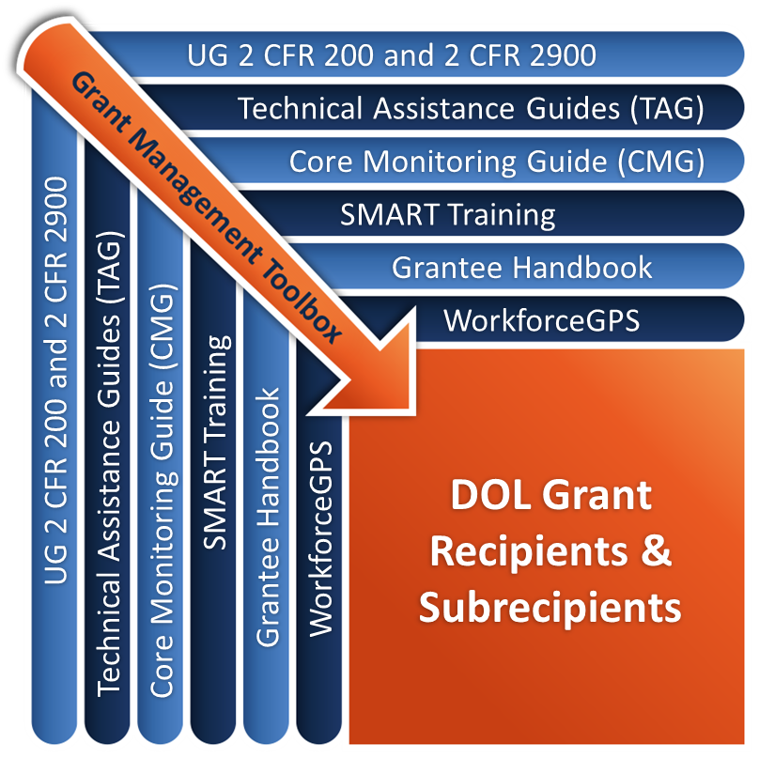
Grant Management Toolbox

Slide 5
Module Overview
Key Terms and Definitions
Types of Real Properties
Leases
Property Management

Slide 6
Key Terms and Definitions
Identify key terms and definitions related to real property
Discuss allowability of costs for real property and capital improvements to such property

Slide 7
Capital Assets
2 CFR 200.12
Capital assets means tangible or intangible assets used in operations having a useful life of more than one year which are capitalized in accordance with GAAP.
Land, buildings (facilities), and
Additions, improvements, modifications, replacements, rearrangements, reinstallations, renovations or alterations to capital assets that materially increase their value or useful life

Slide 8
Capital Expenditures
Requires Prior Approval from Grant Officer 2 CFR 200.13
Expenditures to acquire capital assets or to make additions, improvements or modifications, replacements, rearrangements, reinstallations, renovations, or alterations to capital assets (materially increase their value or useful life)
When approved as a direct charge:
Capital expenditures will be charged in the period in which the expenditure is incurred
For buildings and land
For improvements to land or buildings that materially increase their value or useful life
Normally not allowed
Seek out advice from FPO or PTE
If allowed, obtain prior approval from Grant Officer

Slide 9
Facilities
2 CFR 200.446(a)(1)
Facilities means land and buildings or any portion thereof, equipment individually or collectively, or any other tangible capital asset, wherever located, and whether owned or leased by the non-Federal entity

Slide 10
Real Property
2 CFR 200.85
Real Property means land, including land improvements, structures (buildings) and appurtenances thereto

Slide 11
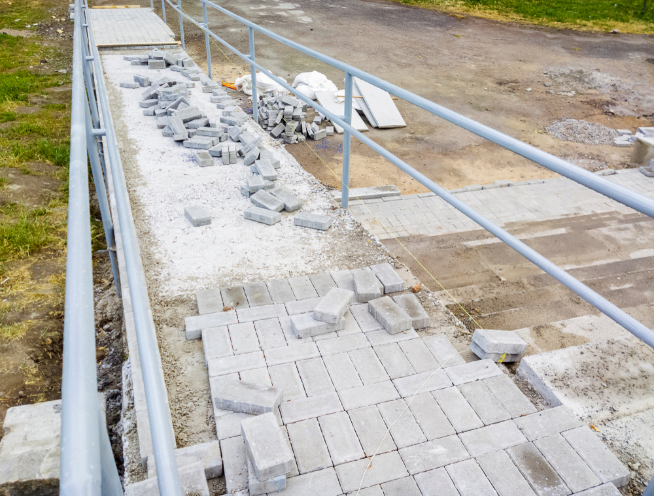
Capital Improvements – definition
2 CFR 200.439(a)(3)
Capital improvements are improvements that materially increase value or useful life to real property

Slide 12
Real Property – Prior Approval
Real property
Construction, major renovations, and acquisitions are not allowable costs to most ETA grants.
Exceptions
When explicitly authorized by program statutes and regulations such as
YouthBuild
Migrant Seasonal and Farmworkers Program
National Dislocated Worker Grants for disaster relief
Follow ETA’s prior approval process.

Slide 13
Types of Real Property
Describe allowable costs for non-Federal entity-owned properties
Discuss special conditions and provisions related to property with Federal or Reed Act equity
Discuss various lease types and allowable costs for rented properties

Slide 14
Types of Real Property – categories
Non-Federal entity-owned
State-owned with Federal equity
Reed Act properties
Leased properties

Slide 15
Non-Federal Entity Owned
Recovery of property costs is through depreciation
The amount of compensation for the use of the property is determined by computing depreciation for the accounting period based upon the pattern of use
Allocation for depreciation must be made in accordance with 2 CFR part 200 Appendices IV through VIII

Slide 16
Depreciation - Definition
2 CFR 200.436(a)
Depreciation is the method for allocating the cost of fixed assets to periods benefitting from asset use.
The non-Federal entity may be compensated for the use of its buildings and capital improvements provided that they are used and needed in the non-Federal entity's activities, and properly allocated to Federal awards.
Such compensation must be made by computing depreciation.

Slide 17
Depreciation – No Use Allowance
2 CFR 200.436(d)(4)
No depreciation may be allowed on any assets that have outlived their useful lives.
Use allowance is no longer allowed
May charge repair and maintenance cost
May charge depreciation on capital improvements if not fully depreciated

Slide 18
Depreciation Costs
Depreciation is computed based on acquisition costs and useful life of the property
Acquisition costs excludes:
Land cost
Useful life period must take into consideration
Type of construction
Historical data
Entities' property renewal and replacement policies

Slide 19
Depreciation – Calculation
Must use straight line depreciation
Absent clear evidence indicating property’s consumption is greater earlier than later in its useful life
Changes in depreciation methods requires prior approval

Slide 20
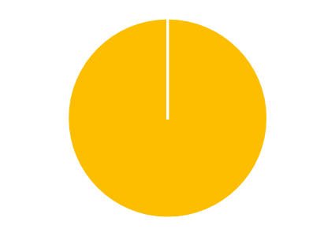
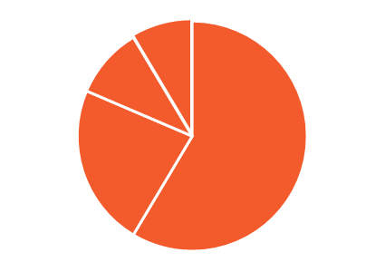
Depreciation – Two Methods
Two options for building depreciation described at 2 CFR 200.436(d)(3):
Treated as a single asset; depreciated over single useful life
Divided into multiple components; each component depreciated over its estimated useful life

Slide 21
Knowledge Check 1 – Questions
True or False?
After a building has been fully depreciated, a grantee may begin charging a 2% use allowance for the property.

Slide 22
Knowledge Check 1 – Answers
After a building has been fully depreciated, a grantee may begin charging a 2% use allowance for the property. False

Slide 23
Property With Federal/Reed Act Equity
20 CFR 683.240
Instructions for using real property with Federal/ Reed Act equity
Unemployment Insurance/Wagner-Peyser funded real property
Workforce Investment Act/Job Training Partnership Act property
State Reed Act property

Slide 24
Unemployment Insurance / Wagner-Peyser Equity
20 CFR 683.240(a)
Transfer of equity
Equity transferred to the States that used the grants to acquire the equity
Use
Carry out activities authorized under WIOA, title III of the Social Security Act (Unemployment Compensation program), or the Wagner-Peyser Act.
Disposition
Requires disposition instructions from the Grant Officer
Portion of proceeds attributable to transferred Federal equity must be used to carry out activities authorized under WIOA, title III of the Social Security Act, or Wagner-Peyser Act

Slide 25
WIOA / Job Training Partnership Act Equity
20 CFR 683.240(c)
Transfer of equity
Real property purchased with WIA funds or was transferred from JTPA to WIA is transferred to the WIOA title I programs.
Property must be used for WIOA purposes.
Disposition
Non-Federal entity must seek instructions from the Grant Officer or State (in the case of a subrecipient) prior to disposition or sale.

Slide 26
State Reed Act Property
20 CFR 683.240(b)
Use
May be used for the one-stop service delivery system to the extent that the proportionate share of Reed Act equity is less than or equal to the proportionate share of occupancy by the Unemployment Compensation and Wagner-Peyser Act programs in such properties
Disposition
State must request disposition instructions from the Grant Officer
The portion of the proceeds attributable to the Reed Act equity must be returned to the State’s account in the Unemployment Trust Fund and used in accordance with DOL-issued guidance

Slide 27
Leases
Describe difference between capital and operating leases
Describe limitations on “sale and lease back” and “less-than-arms-length” agreements
Discuss the unallowability of home offices

Slide 28
General Parameters for Leases
2 CFR 200.465
Rental costs under leases are allowable
To the extent reasonable
With certain limitations
Rental arrangements should be reviewed periodically

Slide 29
Reasonableness Factors
Rental costs of comparable property, if any
Market conditions in the area
Alternatives available
Type, life expectancy, condition, and value of the property leased

Slide 30
Limitations
Sale and lease-back
A non-Federal entity sells a property it owns and enters into a lease agreement to rent the property back from the new owner.
Less-than-arms-length
One party is able to control or substantially influence the actions of the other
Examples include:
Divisions of the non-Federal entity
The non-Federal entity under common control through common officers, directors, or members

Slide 31
Limitations on Allowable Costs
Under both “sale and lease back” arrangements and “less than arm’s length” leases allowable amount would not exceed the amount for
Depreciation
Maintenance
Taxes
Insurance

Slide 32
What is a Capital Lease?
Usually a non-cancellable lease for a fixed term with an option to buy
Lessors’ services are limited to financing the asset
Lessee pays all other costs—title remains with the lessor
Lessee
Cost to ETA programs is limited to depreciation and third- party financing costs or limit interest to least expensive alternative

Slide 33
What is an Operating Lease?
Lessor (or owner) transfers only the right to use the property to the lessee
Lessee returns the property to the lessor at the end of the lease period
Lease does not have ownership over the property
Lease generally provides for early termination fees
Lessee treats the lease expense as an expense to the grant

Slide 34
Termination Clauses
Leases should have termination clause
Unexpired lease costs are generally allowable where reasonably necessary for award performance, less residual value, if:
Amount claimed does not exceed reasonable use value for the award and further reasonable period
All efforts were made to terminate, assign, settle, or otherwise reduce the lease costs

Slide 35
Restriction on Home Office
2 CFR 200.465(c)(6)
Home office workspace
The rental of any property owned by any individuals or entities affiliated with the non-Federal entity for purposes such as home office workspace, is UNALLOWABLE.

Slide 36
Documentation
Lease or rental agreements for space used for Federal programs
Procurement process followed to ensure that rental or lease rates are fair and reasonable for the space
Floor plan or other allocation method used to determine amount of costs charged to Federal programs and the cost by program

Slide 37
Knowledge Check 2 – Questions
True or False?
A capital lease is the most common form of lease and is used by most organizations to rent space.

Slide 38
Knowledge Check 2 – Answers
A capital lease is the most common form of lease and is used by most organizations to rent space. False

Slide 39
Property Management
Maintenance or repair costs vs. capital improvements
Insurance coverage
Idle facilities/capacity costs
Interest costs
Donated property
Documentation issues
Common mistakes

Slide 40
Maintenance and Repair Costs – Definition
2 CFR 200.452
Costs incurred for,
Utilities
Insurance
Security
Necessary maintenance
Janitorial services
Repair, or
Upkeep of buildings
Neither add to the permanent value of the property nor appreciably prolong its intended life
No prior approval necessary

Slide 41
Maintenance and Repair Costs – Allowable
Allowable
Only allowable to the extent not paid through rental or other agreements
Allocate based on cost allocation plan

Slide 42
Insurance Coverage
2 CFR 200.310
Insurance coverage
The non-Federal entity must provide insurance for property acquired or improved with Federal funds equivalent to insurance coverage it provides for its own property.

Slide 43
Capital Improvements
Add to the permanent value of the buildings or appreciably prolong their intended life.
Must be treated as capital expenditures.
Costs are recovered
Through depreciation charges, or
As direct charge to period incurred where prior approved by DOL

Slide 44
Rearrangements/Reconversion Costs
2 CFR 200.462(a)
Ordinary and normal rearrangement and alteration costs are allowable as indirect costs.
Special arrangements/alterations incurred specifically for a Federal award are allowable as direct cost with PRIOR WRITTEN APPROVAL.
2 CFR 200.462(b)
Costs for restoration or rehabilitation of facilities after use by ETA programs, less normal wear and tear, are allowable

Slide 45
Idle Facilities and Idle Capacity
2 CFR 200.446 Idle Facilities and Idle Capacity
Idle Facilities – completely unused facilities
Excess to current needs
Unallowable with exceptions
Idle Capacity – unused capacity of partially used facilities
Difference between 100 percent usage and actual usage

Slide 46
Cost of Idle Facilities
Costs of idle facilities and idle capacity
Maintenance,
Repair,
Housing,
Rent, and
Other related costs, e.g.,
Insurance,
Interest, and
Depreciation

Slide 47
Cost of Idle Facilities (cont.)
2 CFR 200.446(b)
Costs are unallowable except when
They are necessary to meet fluctuations in workload
Although not necessary to meet fluctuations in workload, they were necessary when acquired
Idle because of changes in program requirements and other reasons
Under reasonable exceptions stated in this requirement, costs are allowable for a reasonable period
Up to one year depending on initiative to use, lease, or dispose of such facilities

Slide 48
Cost of Idle Capacity
2 CFR 200.446(c)
Normal cost of doing business
Allowable with provisions
Capacity is reasonably anticipated to be necessary to carry out the purpose of the Federal award or
Capacity was originally reasonable
Not subject to other reduction or elimination of other Federal awards, subletting, renting, or sale, in accordance with sound business, economic, or security practices
Widespread idle capacity (may be idle facility)

Slide 49
Interest Expense
2 CFR 200.449(a)
Costs incurred for interest on borrowed capital, temporary use of endowment funds, or the use of the non-Federal entity’s own funds, however represented, are UNALLOWABLE.
Financing costs (including interest) to acquire, construct, or replace assets are allowable, under very limited circumstances; except ETA does not allow acquisition or construction of buildings

Slide 50
Donated Real Property
Donated real property must be valued
Value
Determined by independent appraiser;
Certified by DOL official
Value established based on the fair market value at the time of the donation
Basis excludes land value
Value recovered through depreciation
May be charged as cost to Federal award, or
Claimed as matching,
But not both

Slide 51
Donated Space
Value must not exceed fair rental value of
Comparable space and facilities
In a privately-owned building
In the same locality
Value established by independent appraiser.
The valuation of the donated space must be assessed again each subsequent year.

Slide 52
Knowledge Check 3 – Questions
True or False?
The cost of idle facilities is an unallowable cost to Federal awards except under limited circumstances.

Slide 53
Knowledge Check 3 – Answers
The cost of idle facilities is an unallowable cost to Federal awards except under limited circumstances. True

Slide 54
Common Mistakes

Slide 55
Common Mistakes Related to Facilities
Missing or unreasonable termination clauses
Inadequate documentation to support ETA program’s fair share of facilities cost
Depreciation charged on fully depreciated building
Accelerated depreciation charged without justification
Mortgage payments charged to awards
Failure to obtain prior written approval for questionable capital improvement projects
Interagency transfers for capital projects reflected as expenditures in the books of account

Slide 56
Core Monitoring Guide – Objective 2.c: Property Management
Indicator 2.c.1: Insurance Coverage
Does the grant recipient have minimum insurance coverage for real property and equipment acquired with grant funds?
Indicator 2.c.2: Real Property
Does the grant recipient have policies and procedures in place when acquiring, managing, and disposing of real property purchased with grant funds?
Indicator 2.c.4: Rental or Leasing Costs for Property
Do the agreements have a schedule of payments and it is signed by a grant signatory that is authorized to sign on behalf of the organization?
Are rental agreements reviewed periodically to determine if circumstances have changed and other options are available?

Slide 57
SMART Checklist
Property Management (Facilities & Leases)
Develop or update policies to ensure that distinguish allowable costs of a operating and capital lease which may require prior approval.
Update policies to incorporate the new requirements for use of idle or vacant space.
Develop policies and procedures to determine whether or not rental costs for real property and equipment are reasonable.
Where applicable, develop or update procedures to incorporate the requirements for disposition of any facility or property containing Federal equity.
Communicate and train staff on all changes and new requirements governing property management found in the Uniform Guidance.

Slide 58
Module Review
Capital improvements, directly charged, require prior approvals.
Capital improvements may be depreciated
Unallowable costs include: land, amortizations, and construction of facilities.
Costs for non-Federal entity-owned facilities are based on depreciation.
Space costs are relative to occupancy.
Costs are charged in accordance with cost allocation plan.
ADA requirements must be followed.
Donated real property may be charged through depreciation as grant charges or match, but not both.

Slide 59
ETA and Uniform Guidance Resources
Core Monitoring Guide
Objective 2.c Property Management
Grant & Financial Management Technical Assistance Guide
Chapter 5: Property Management
WIOA Administrative Provisions
20 CFR 683.240
Uniform Administrative Requirements, Cost Principles, and Audit Requirements for Federal Awards 2 CFR Part 200
2 CFR 200.12
2 CFR 200.13
2 CFR 200.85
2 CFR 200.310
2 CFR 200.436
2 CFR 200.439
2 CFR 200.446
2 CFR 200.449
2 CFR 200.452
2 CFR 200.465
2 CFR 200.469

Slide 60
Web Resources
What is the best way to find your local American Job Center (AJC)?
See DOL’s Service Locator
Want More Information?
DOLETA.gov/Grants
Funding Opportunities
How to Apply
Manage Your Awarded Grant
Resources and Information
ETA Grantee Handbook
Annual Grant Terms Template
Core Monitoring Guide
Technical Assistance Guides
Uniform Guidance Quick Reference Sheet
Want More Training?
Workforce GPS’s Grants Application and Management Community of Practice
Financial Reporting
Subrecipient Management and Oversight
Indirect Cost Rates
Policies and Procedures
Procurement and Performance-Based Contracts
Capital Assets and More
WorkforceGPS

Slide 61
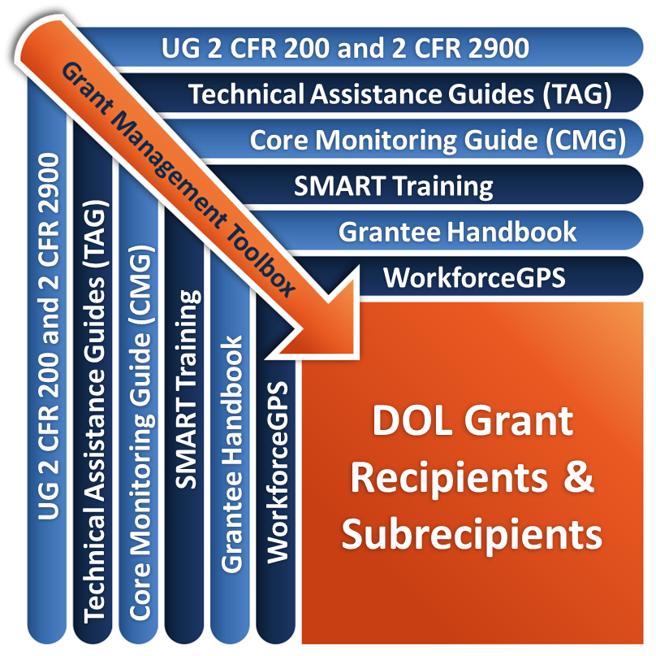
Remember the Grant Management Toolbox!

Slide 62
Questions?

Slide 63
Thank you.
This presentation was developed using Federal funds for training purposes and cannot be used by third parties to earn money or fees.

