Slide 1
Complaints, Grievances, and Incident Reports
SMART 3.0 Training
October 24, 2019

Slide 2
Today’s Speakers
Nancy Taylor
Senior Accountant, DFMAS
U.S. Department of Labor – Region 5
Chicago, IL
Taylor.Nancy@dol.gov

Slide 3
SMART 3.0 Training Strategies
S
SMART 3.0 Training Series:
The training modules are focused on: Strategies for sound grant management that includes: Monitoring, Accountability, Risk mitigation and Transparency
These four themes are weaved throughout the OMB Uniform Administrative Requirements, Cost Principles, and Audit Requirements for Federal Awards also known as the Uniform Guidance (2 CFR Part 200 and 2 CFR Part 2900).
Strategies
M
Monitoring
A
Accountability
R
Risk Mitigation
T
Transparency

Slide 4
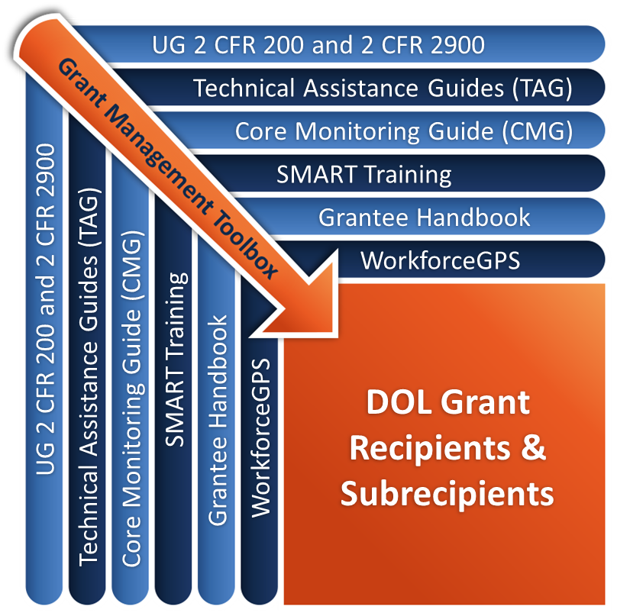
Grant Management Toolbox

Slide 5
Module Overview
Different types of allegations
WIOA complaints and grievances
Discrimination complaints
Allegations of Fraud, Misconduct and Abuse
Describe the processes that recipients must establish to handle and resolve all these issues

Slide 6
Three Types of Allegations
Program related Complaints and Grievances
Participants
Service providers
Procurement related parties – bidders or respondents
Employees
Other interested or affected parties
Discrimination
Allegations of fraud or other forms of misconduct

Slide 7
WIOA Complaints and Grievances
General Requirements
LWDA Procedures
State Procedures
Direct Recipient Procedures
Resolution System Components
DOL’s Role

Slide 8
WIOA Complaints and Grievance Procedures
20 CFR 683.600(a)&(b)
Each state, local area and direct grant recipient must:
Establish and maintain a procedure for grievances or complaints alleging violations of the Act.
Provide information on these procedures to participants and other interested or affected parties, including one-stop partners and service providers.
Require every entity receiving Title I funds to provide this information to their participants.
Assure that the information is understood by affected individuals, including youth and limited-English speaking individuals.

Slide 9
WIOA Complaints and Grievance Procedures: LWDA
20 CFR 683.600(c) Procedures must include:
Process for dealing with grievances and complaints from participants and other interested parties
Opportunity for informal resolution and hearing to be completed within 60 days from date of filing
Binding arbitration procedure, if required by collective bargaining agreement, for alleged labor standards violation
Opportunity for appeal to the state if:
No decision within 60 days
Either party is dissatisfied with the local hearing decision

Slide 10
WIOA Complaints and Grievance Procedures: State
20 CFR 683.600(d) Procedures must include:
Resolving grievances and complaints in 60 days
Hearing appeals from local areas in 60 days
Remanding local WIOA-related complaints
Opportunity for informal resolution and hearing
Additional state appeal procedures for:
Non-designation of local areas
Denial or termination of training providers, providers of OJT and customized training, one-stop operators
Testing and sanctioning for controlled substances

Slide 11
WIOA Complaints and Grievance Procedures: Direct Recipient
20 CFR 683.600(e) Procedures must include:
Process for dealing with grievances and complaints from participants and other interested parties, including complaints against subrecipients and other service providers
Opportunity for informal resolution and hearing to be completed within 60 days of date of filing

Slide 12
WIOA Resolution System Components
Notifications:
Inform participants and other interested parties of the process and their acknowledgement of receipt of procedures
Written notice of final resolution, including:
Statement of facts, decisions and rationale, and corrective actions or remedies, if any
Appeal rights and procedures
Policies and procedures for WIOA complaints

Slide 13
WIOA Resolution System Components (cont.)
Staff assigned to manage the process:
Equal Opportunity officer or
Complaints officer, or
Authorized decision maker
Timelines
Prescribed method of investigating the complaint
Final resolution and appeal rights

Slide 14
DOL’s Role
Appeals to Secretary of Labor limited to when:
State does not issue a decision within 60 days on an original complaint or on an appeal/hearing
Either party may file appeal to Secretary within 120 days of date of original complaint or appeal
Party to which state decision is adverse may appeal to Secretary within 60 days of decision
Appeal of non-designation of local areas if filed within 30 days of denial of designation
Appeal by local area within 30 days if state revokes local plan or imposes reorganization plan

Slide 15
DOL’s Role (2)
20 CFR 683.610
Scope of USDOL Review Limited to:
Investigations & impositions of remedies
Focused on determination
Violations of requirements
Were proper procedures followed?
Must follow the internal appeals process before appealing to the USDOL

Slide 16
Knowledge Check 1 – Questions
True or False?
Every WIOA-funded recipient must have a procedure for resolving complaints and grievances.
Subrecipients are not required to provide access to a process for hearing complaints and grievances.
Every WIOA-funded recipient must provide an opportunity for informal resolution and hearing to be completed within 60 days from date of filing.
All adverse decisions may be appealed to DOL.

Slide 17
Knowledge Check 1 – Answers
Every WIOA-funded recipient must have a procedure for resolving complaints and grievances. True
Subrecipients are not required to provide access to a process for hearing complaints and grievances. False
Every WIOA-funded recipient must provide an opportunity for informal resolution and hearing to be completed within 60 days from date of filing. True
All adverse decisions may be appealed to DOL. False

Slide 18
Discrimination Complaints
Describe the requirements for handling complaints of discrimination

Slide 19
Important Updates – WIOA Final Rule
29 CFR Part 37 to 29 CFR Part 38
The Final Rule provides important updates to the existing regulations, which have not been substantively updated since 1999.
The old rule did not reflect the many developments in civil rights law since that time, changes in the CRC’s enforcement procedures and processes, or new practices of recipients of WIOA Title I financial assistance and beneficiaries (for example, the routine use of computer and internet-based systems).

Slide 20
WIOA Final Rule …
Updates the nondiscrimination and equal opportunity provisions to align them with current law and legal principles.
The rule captures developments since 1999 under the following laws, reflected in case law and in regulations issued by other Federal agencies, including the Departments of Justice and Education and the Equal Employment Opportunity Commission:
Title VI and Title VII of the Civil Rights Act of 1964;
Title IX of the Education Amendments of 1972;
The Americans with Disabilities Act of 1990 and the ADA Amendments Act of 2008; and
Section 504 of the Rehabilitation Act of 1973.

Slide 21
Effective Date
The new WIOA Section 188 regulations were published in the Federal Register on December 2, 2016 and become effective on January 3, 2017.
They can be found through the links on our website: www.dol.gov/crc.

Slide 22
Statutes Prohibit Discrimination
Among the many relevant statutes are:
WIOA Section 188
Title VII Civil Rights Act of 1964 as amended
Civil Rights Act of 1991
Equal Pay Act 1963
Lilly Ledbetter Fair Pay Act 2009
Section 504, Rehabilitation Act of 1973
Americans With Disabilities Amendments Act 1990
Age Discrimination in Employment Act 1967
State statutes

Slide 23
Other Prohibitions on Discrimination
Executive Order 13160
Nondiscrimination on the Basis of Race, Sex, Color, National Origin, Disability, Religion, Age, Sexual Orientation, and Status as a Parent in Federally Conducted Education and Training Programs
Executive Order 13145
To Prohibit Discrimination in Federal Employment Based on Genetic Information
Executive Order 13166
Improving Access to Services for Persons With Limited English Proficiency.
Regulations and Policies:
EEOC’s Management Directive 110 Complaint Processing
EEOC’s Management Directive 715 Affirmative Action Programs
Harassing Conduct Policy Statement 2013
DOL’s Policy on EEO 2013

Slide 24
Types of Prohibited Discrimination
WIOA Sec. 188 (29 CFR Part 38)
It is unlawful to discriminate on the grounds of:
Race
Color
Religion
Sex
National Origin
Age (except when criterion for program eligibility)
Disability
Political Affiliation or Belief
Citizenship
Other bases (not an exhaustive list)

Slide 25
DOL Civil Rights Center
DOL Civil Rights Center (CRC)
Implements non-discrimination and equal opportunity provisions in WIOA
Regulation is in the process of being updated for WIOA and will be issued through the NPRM process
29 CFR Part 38 Provisions apply to:
Any recipient of WIOA financial assistance
Programs and activities that are part of the one-stop system and operated by one-stop partners
Employment practices of a recipient or one-stop partner

Slide 26
State Nondiscrimination Plans (NDP)
NDP (29 CFR Part 38)
NDP contains policies, procedures, and systems to provide reasonable guarantee of compliance with the nondiscrimination and equal opportunity requirements of WIOA and implementing regulations
Local workforce areas must adhere to state NDP
NDP includes procedures for obtaining prompt corrective action and imposing sanctions where necessary, including retroactive and prospective relief

Slide 27
Non-Federal Entity Responsibilities
Comply with:
WIOA Section 188
29 CFR 38
Section 504 of Rehabilitation Act of 1973
NDP
Establish procedure for processing complaints
Monitor subrecipient/ service provider compliance
Appoint Equal Opportunity Officer, except for:
Service providers
Compliance rests with state or LWDA
Small grant recipients
Fewer than 15 participants and 15 employees
But still must designate person to process complaints

Slide 28
Discrimination Complaint Procedures
29 CFR 38.54
Recipient Complaint Procedures
Written notice to complainant acknowledging receipt of complaint and right to representation
Written statement summarizing issues raised
Issue(s) accepted? If rejected, reasons for rejection:
Period for fact finding, investigation, resolution
Include offer of Alternative Dispute Resolution
Issue Notice of Final Action within 90 days from date of filing
If lacking jurisdiction, refer to appropriate agency

Slide 29
Complainant Responsibilities
Complainant responsibilities:
May file at state/local level or directly with CRC
File within 180 days of incident (only CRC may extend)
If no action within 90 days or if not satisfied with decision, may file a new complaint (not an appeal) with CRC within 30 days
Employment discrimination and civil rights cases are referred to EEOC
Age discrimination complaints are referred to Federal Mediation and Conciliation Service
If not mediated within 60 days, goes to CRC

Slide 30
Resolution of Complaint
If reasonable cause is determined by recipient
Issue Initial Determination of specific findings
List proposed remedial actions and timeline for completion
Specify if a written agreement is necessary
Provide the opportunity for negotiations
Notice of Final Action
Decision on the issue(s) and the reasons for decision
Description of the way the parties resolved the issue
Notice that the complainant may file with CRC if dissatisfied with the decision

Slide 31
Knowledge Check 2 – Questions
True or False?
A discrimination complaint may be filed at the state/local level or with the DOL Civil Rights Center.
The process and time frame for handling a discrimination complaint are the same as for non-discrimination complaints or grievances.
The DOL regulations governing discrimination complaints are found at 29 CFR Part 38.
Alternative dispute resolution must be offered as an option for resolving discrimination complaints.
Notice of Final Action on a complaint of discrimination must be issued within 90 days.

Slide 32
Knowledge Check 2 – Answers
A discrimination complaint may be filed at the state/local level or with the DOL Civil Rights Center. True
The process and time frame for handling a discrimination complaint are the same as for non-discrimination complaints or grievances. False
The DOL regulations governing discrimination complaints are found at 29 CFR Part 38. True
Alternative dispute resolution must be offered as an option for resolving discrimination complaints. True
Notice of Final Action on a complaint of discrimination must be issued within 90 days. True

Slide 33
Allegations of Fraud, Misconduct, and Abuse
Describe the requirements for identifying and reporting incidents of fraud, waste, and abuse
Describe the processes that recipients must establish to handle and resolve all these issues

Slide 34
Disclosure Requirement
Mandatory disclosures 2 CFR 200.113
The non-Federal entity or applicant for a Federal award must disclose, in a timely manner, in writing to the Federal awarding agency or pass-through entity all violations of Federal criminal law involving fraud, bribery, or gratuity violations potentially affecting the Federal award.
Failure to make required disclosures can result in any of the remedies described in 2 CFR 200.338 Remedies for noncompliance, including suspension or debarment. (See also 2 CFR Part 180 and 31 U.S.C. 3321).

Slide 35
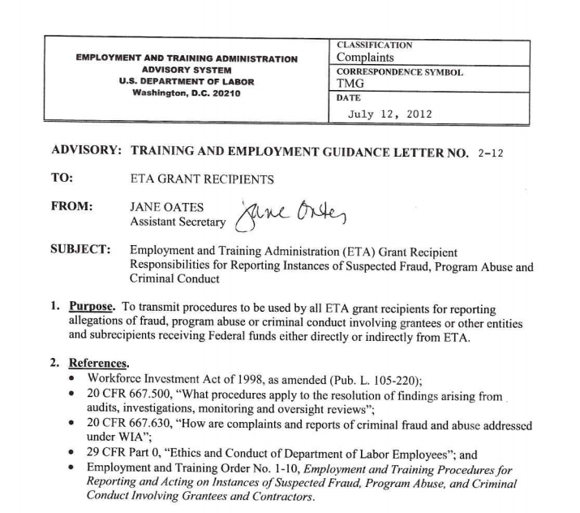
Incidents
Incidents are events involving:
Fraud, misfeasance, nonfeasance, or malfeasance
Misapplication of funds
Gross mismanagement
Employee or participant misconduct
Waste and program abuse
Training and Employment Guidance Letter (TEGL) 2-12

Slide 36
What Recipients Must Report
Recipients are required to immediately document and report allegations, suspicions, and complaints of:
Fraud, misfeasance, nonfeasance, or malfeasance
Misapplication of funds
Gross mismanagement and misconduct
Criminal activity
Waste and program abuse
If imminent health or safety concerns or imminent loss of funds exceeding $50,000:
Report to the OIG and ETA immediately by telephone followed by a written Incident Report (IR) no later than one working day
Mandatory reporting of fraud and other criminal acts 2 CFR 200.113

Slide 37
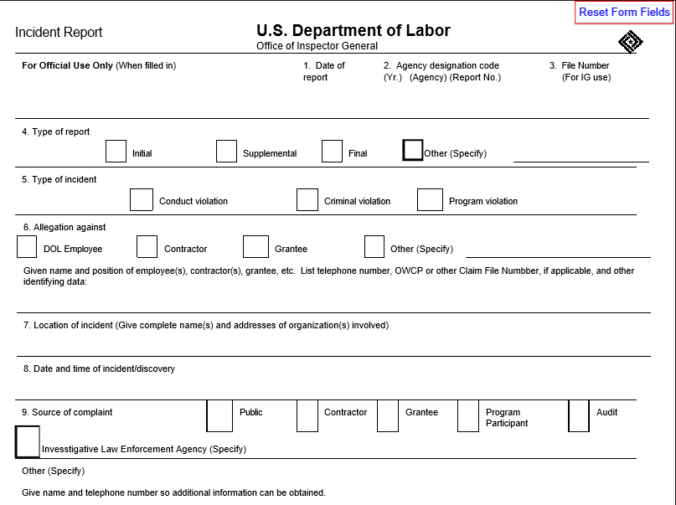
DL 1-156 Incident Reporting Form

Slide 38
Reporting Mechanisms
DOL Hotline - Office of Inspector General
1-800-347-3756 or (202) 693-6999
DOL's Incident Reporting System (TEGL 2-12)
Incident Report Form DL 1-156
File with DOL Office of Inspector General in D.C. or to Regional Inspector General for Investigations
Copy simultaneously provided to ETA
Incidents may be channeled through a state or local system
But in all cases DOL must be notified
Cannot prevent anyone from reporting incident directly to OIG
WHEN IN DOUBT, FILE A REPORT!

Slide 39
The Investigative Process
Submit Incident Report to OIG with copy to ETA
OIG assigns investigative responsibility
OIG determines whether the allegation has merit and may conduct or arrange for an investigation or audit
OIG may refer the case back to ETA for resolution
ETA may conduct its own review of the allegation
ETA may refer the case for state review
Reviewing agency prepares report on findings and conclusions
Report submitted to OIG with ETA recommendations
Follow-up or corrective actions completed
When OIG accepts final resolution, the incident is closed

Slide 40
Common Types of Incidents
False claims
Time & attendance
Improper travel payments
Procurement (including bid rigging, sole sourcing)
Contract compliance violations
Double billing
Duplicate charging
Simple theft
Waste
Abuse of program funds
Employee misconduct

Slide 41
Sources of Detection
Tips
Internal audit
By accident
Internal controls
External audit
Notified by police

Slide 42
Fraud Triangle
Some incidents can be prevented:
Robust system of internal controls
Trained and competent staff
Consistent application of policies
Fraud Triangle
Opportunity
Motivation
Rationalization

Slide 43
Actions to Avoid Fraud
Robust system of internal controls
Policies, procedures, administrative standards
Written standards required for procurement staff and activities
Financial standards and controls
Procurement policies and procedures
Ensure service providers do same
Monitor internal and external operations
Train staff on ethics, incident report policies and procedures
Report promptly any incidents or suspicions

Slide 44
Implement an Incident Reporting (IR) System
Follow TEGL 2-12 instructions
Establish procedures for incident reporting
Identify types of incidents to be reported
Train staff on TEGL and your procedures
Report even suspicions of misconduct
Gather information to report, do not “investigate”
Cases of imminent health or safety concerns and/or imminent loss >$50,000
Report to the OIG and ETA immediately by telephone and written IR within one working day
DOL Hotline—Office of Inspector General
1-800-347-3756 or (202) 693-6999
Contact ETA Regional Office for assistance

Slide 45
Knowledge Check 3 – Questions
True or False?
An Incident Report is filed for possible criminal activities while a complaint usually relates to a possible program violation.
The recipient must file an Incident Report only for known criminal activities.
Imminent loss of funds exceeding $50,000 must be reported immediately to OIG by phone followed by a written incident report within one working day.
Incidents can be reported and channeled through a state or local system if that process is able to resolve the matter.
A robust internal control system will help to prevent or detect potential criminal activity.

Slide 46
Knowledge Check 3 – Answers
An Incident Report is filed for possible criminal activities while a complaint usually relates to a possible program violation. True
The recipient must file an Incident Report only for known criminal activities. False
Imminent loss of funds exceeding $50,000 must be reported immediately to OIG by phone followed by a written incident report within one working day. True
Incidents can be reported and channeled through a state or local system if that process is able to resolve the matter. False
A robust internal control system will help to prevent or detect potential criminal activity. True

Slide 47
Core Monitoring Guide – Objective 2.i Civil Rights, Complaints, Grievances, & Incident Reporting
Indicator 2.i.4: Grievance and Complaint System
Does the grant recipient have a written procedure for grievances or complaints alleging violations of WIOA?
Does the grant recipient have a process to provide information on these procedures to participants and other interested or affected parties, including One-Stop partners and service providers?
Indicator 2.i.5: Incident Reporting
Is the grant recipient aware of any incident described above and were these allegations immediately reported through the DOL incident reporting system?

Slide 48
Module Review
Distinguish the different types of allegations
Establish systems and procedures to handle complaints and grievances for each type of allegation
Follow the additional requirements for handling complaints of discrimination
Identify and report incidents following guidelines in TEGL 2-12 and Uniform Guidance
Establish robust internal control system to prevent and detect fraud, waste, and abuse

Slide 49
ETA and Uniform Guidance Resources
Core Monitoring Guide
Objective 2.i Civil Rights, Complaints, Grievances, & Incident Reporting
WIOA Administrative Provisions 20 CFR 683 – Subpart F
TEGL 2-12: Employment and Training Administration (ETA) Grant Recipient Responsibilities for Reporting Instances of Suspected Fraud, Program Abuse and Criminal Conduct
Uniform Administrative Requirements, Cost Principles, and Audit Requirements for Federal Awards 2 CFR Part 200
2 CFR 200.113
2 CFR 200.338

Slide 50
Web Resources
What is the best way to find your local American Job Center (AJC)?
See DOL’s Service Locator
Want More Information?
DOLETA.gov/Grants
Funding Opportunities
How to Apply
Manage Your Awarded Grant
Resources and Information
ETA Grantee Handbook
Annual Grant Terms Template
Core Monitoring Guide
Technical Assistance Guides
Uniform Guidance Quick Reference Sheet
Want More Training?
Workforce GPS’s Grants Application and Management Community of Practice
Financial Reporting
Subrecipient Management and Oversight
Indirect Cost Rates
Policies and Procedures
Procurement and Performance-Based Contracts
Capital Assets and More
WorkforceGPS

Slide 51
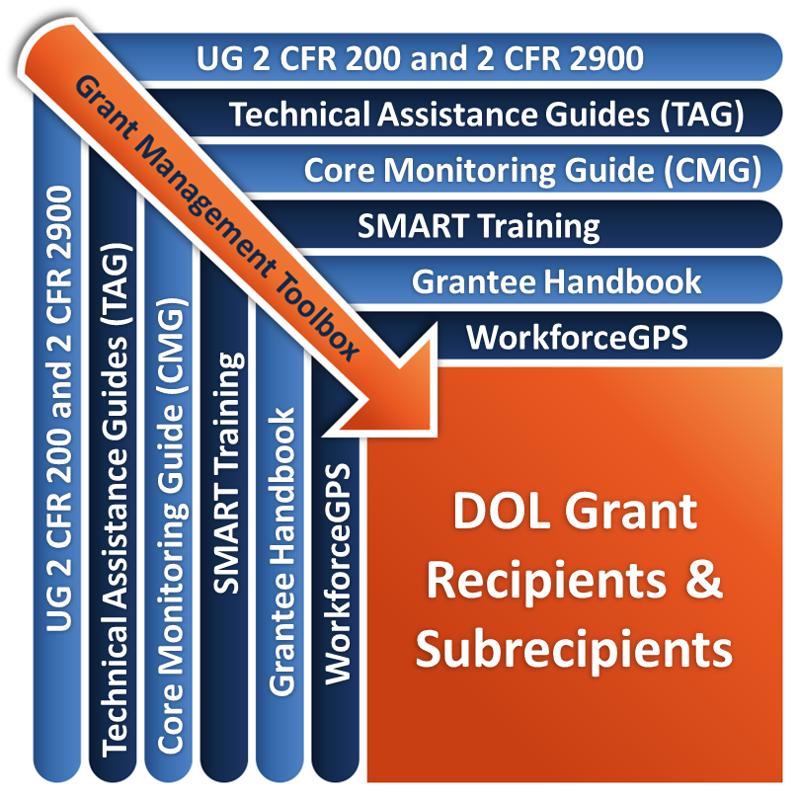
Remember the Grant Management Toolbox!

Slide 52
Questions?

Slide 53
Thank you.
This presentation was developed using Federal funds for training purposes and cannot be used by third parties to earn money or fees.

