Slide 1
Audits and Audit Resolution
SMART 3.0 Training
October 31, 2019

Slide 2
Today’s Speakers
Latonya Torrence
Division Chief, OGM DPRR
U.S. Department of Labor
Washington, DC
Torrence.Latonya@dol.gov
Nancy Taylor
Senior Accountant, DFMAS
U.S. Department of Labor – Region 5
Chicago, IL
Taylor.Nancy@dol.gov

Slide 3
SMART 3.0 Training Strategies
S
SMART 3.0 Training Series:
The training modules are focused on: Strategies for sound grant management that includes: Monitoring, Accountability, Risk mitigation and Transparency
These four themes are weaved throughout the OMB Uniform Administrative Requirements, Cost Principles, and Audit Requirements for Federal Awards also known as the Uniform Guidance (2 CFR Part 200 and 2 CFR Part 2900).
Strategies
M
Monitoring
A
Accountability
R
Risk Mitigation
T
Transparency

Slide 4
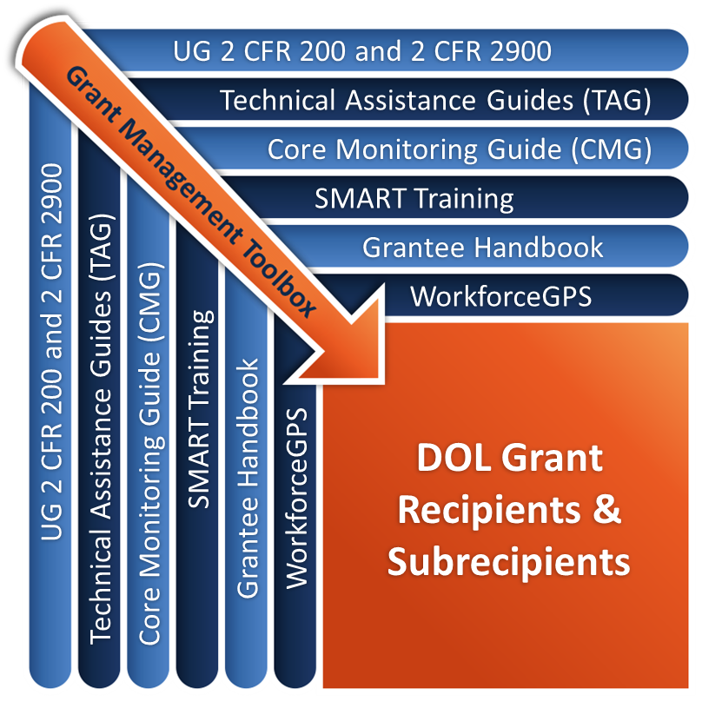
Grant Management Toolbox

Slide 5
Module Overview
Applicability
Types of audits
Auditee and PTE responsibilities
Report Framework
Resolution - UG and DOL processes
Debt Collection

Slide 6
Audit Requirements
Applicability of the Audit Requirements
Dollar Threshold
Types of Audits
Required Reports/Financial Schedules
Record Retention
Auditee and PTE Responsibilities

Slide 7
Applicability
All recipients and subrecipients of a Federal award:
States & local governments
Non-profit organizations
Indian tribes
Institutions of Higher Education (IHE)
For-profit or commercial entities*
Foreign organizations and foreign public entities* (For DOL grants only)
*Per 2 CFR 2900.2 Non-Federal entity

Slide 8
Dollar Threshold
A Single Audit or program-specific audit is required when a non-Federal entity expends $750,000 or more in Federal awards in a fiscal year [2 CFR 200.501(a)]
Must make all records available for audit or review by the Federal agency, its pass-through agency, and/or GAO
Basis for determining Federal awards includes accrued costs, disbursements to subrecipients [2 CFR 200.502]
Federal Agency or Inspectors General (OIG) may require audits to meet regulatory or statutory requirements

Slide 9
Determining Dollar Threshold
Expenditure/expense transactions associated with awards, including grants, cost-reimbursement contracts under the final audit report, compacts with Indian Tribes, cooperative agreements, and direct appropriations
Disbursement of funds to subrecipients
Use of loan proceeds under loan and loan guarantee programs
Receipt of property
Receipt of surplus property
Receipt or use of program income
Distribution or use of food commodities
Disbursement of amounts entitling the grant recipient to an interest subsidy
Period when insurance is in force

Slide 10
Purpose of Single Audit Act
Set standards for obtaining consistency and uniformity among Federal agencies:
Audit of non-Federal entities expending Federal awards
Provides an overview of an organization’s financial operations
It is NOT intended to provide detailed financial coverage or in-depth review of individual programs/awards

Slide 11
Types of Audits
Single Audit
Program-Specific Audit
Limited scope
Agreed-upon procedures

Slide 12
Single Audit
Federal awards from two or more Federal programs
Conducted in accordance with GAGAS and 2 CFR 200.514 Scope of Audit
Organizational-wide audit
Process of collecting and evaluating financial evidence to formulate an independent, professional opinion or other judgment about assertions made by management
(GAO) issues a compliance supplement for Federal awards updated on an annual basis

Slide 13
Program-Specific Audit
Federal awards came from only one Federal program
Federal program's statutes, regulations, or the terms and conditions of the Federal award do not require an organization-wide financial statement audit
Conducted in accordance with 2 CFR 200.507 Program-specific audits.
Program-specific audit guides may be available

Slide 14
Other Types of Audits
Types of alternative audits
Limited scope
Agreed-upon procedures
Costs
Federal agency may pay for additional audits
Additional audits - Unallowable cost
Pass-through entities pay for oversight audits

Slide 15
Frequency and Timing of Submission
2 CFR 200.504 and 2 CFR 200.512
Performed annually
Biennial audit exceptions continue for certain states
Submission of audit report/data collection form to Federal Audit Clearinghouse within the earlier of:
One month after receipt of audit report or
Nine months after the end of the audit period (fiscal year)

Slide 16
Reporting Package
Auditor’s report(s)
Financial statements
Schedule of Expenditures of Federal awards
Summary and status of prior year’s findings
Corrective action plan prepared by auditee
Auditor’s Data collection form (SF-SAC)
Signature attesting to compliance by senior official

Slide 17
Exception for Indian Tribes or Tribal Organizations
2 CFR 200.512(b)(2)
May opt to instruct the FAC: no public access to the reporting package
If a subrecipient, must pass-through entity providing funding

Slide 18
Federal Audit Clearinghouse
Submit data collection form and reporting package to FAC electronically.
Pass-through entity requests copies of each audit where there are findings
FAC’s website allows users to query its audit database https://harvester.census.gov/facweb/

Slide 19
Audit Record Retention Period
Auditee must retain a copy of the Data Collection form (SF-SAC) and Reporting Package:
Minimum 3 years from submission to the FAC
May be extended if issues remain open
Make available upon request

Slide 20
Auditee Responsibilities
Procure/arrange for audit in accordance with 2 CFR 200.509
Always purchase audit services through a competitive procurement process
Allow for peer review
Prepare appropriate financial statements
Provide access to auditor of needed information
Promptly follow up on corrective actions

Slide 21
Auditee Responsibilities (cont.)
Identify all Federal awards received and expended by program
Maintain internal control over Federal programs
Comply with laws, regulations, and provisions of contracts or grant agreements
Ensure audits are properly performed and submitted when due

Slide 22
Pass-Through Entity Responsibilities
2 CFR 200.331(c)
Verify subrecipients meet audit requirements
Prepare management decisions on subrecipient audit findings
Pursue debt collection

Slide 23
Knowledge Check – Questions
True or False?
Auditees do not have to be concerned with full and open competition when procuring audit services.

Slide 24
Knowledge Check – Answers
Auditees do not have to be concerned with full and open competition when procuring audit services. False

Slide 25
Report Framework
Framework
Type opinions

Slide 26
What is in an Audit Report?
2 CFR 200.515
An opinion (or disclaimer) on financial statements and schedule of expenditures of Federal awards
Report on internal controls over financial reporting and compliance
Report on compliance for each major program and internal control over compliance
Schedule of findings and questioned costs which must include:
Summary of auditors results
Findings related to the financial statements
Findings and questioned costs for Federal awards

Slide 27
Financial Statement Opinions
Adverse Opinion…
Disclaimer of Opinion…
the auditor concludes that the financial statements do not present the entity's financial position, results of operations, and cash flows in conformity with GAAP.
issued when the auditor is unable to form an opinion on an entity's financial statements.
Unmodified Opinion…
Qualified Opinion…
the financial statements are presented fairly in conformity with GAAP. (Auditor’s Clean Bill of Health)
the financial statements present the entity's financial position, results of operations, and cash flows in conformity with GAAP, except for the matter of the qualification.

Slide 28
Opinions on Internal Controls
A significant deficiency…
A material weakness…
is a control deficiency, or combination of control deficiencies, that adversely affects the entity's ability to administer a federal program such that there is more than a remote likelihood that noncompliance with a type of compliance requirement of a federal program that is more than inconsequential will not be prevented or detected.
is a significant deficiency, or combination of significant deficiencies, that results in more than a remote likelihood that material noncompliance with a type of compliance requirement of a federal program will not be prevented or detected.

Slide 29
Audit Resolution
Recipient/PTE resolution process
DOL’s cooperative resolution process

Slide 30
Recipient/PTE Audit Resolution Process
WIOA 20 CFR 683.420
State or direct grant recipient
Must utilize the written monitoring and audit resolution, debt collection and appeal procedures that it uses for other Federal grant programs.
If no such written procedures, must prescribe standards and procedures to be used for this grant program.
Other PTEs
Must prescribe standards and procedures to be used for resolving subrecipient audits.

Slide 31
Recipient/PTE Audit Resolution Process (cont.)
Issue management decision
Ensure corrective action
Allow or disallow costs
Determine applicability of “stand-in” costs
Establish debt
For its subrecipients, the pass-through entity must issue a management decision within 12 months of the audit acceptance by FAC [2 CFR 2900.21]
Provide appeal rights

Slide 32
Management Decisions
2 CFR 200.521
Pass-through entities must issue a management decision for audit findings related to Federal awards made to subrecipients detailing the corrective action necessary to resolve an audit or monitoring review finding. A management decision must:
Clearly state whether or not a finding is sustained
The reason for the decision
Expected auditee action to repay disallowed costs/make financial adjustments
Establish time requirements
Include reference numbers assigned by the auditor

Slide 33
Management Decisions – DOL Resolution Process
2 CFR 2900.21 – PTE is responsible for issuing a management decision within twelve months of acceptance of the audit report by the FAC. The auditee must initiate and proceed with corrective action as rapidly as possible and should begin corrective action no later than upon receipt of the audit report.

Slide 34
DOL Resolution Process
2 CFR 2900.20
Cooperative Audit Resolution Process
At a minimum, the process includes
An Initial Determination
An informal resolution process
A Final Determination
Time frames
Within 180 days of receipt from OIG
ETA recommends this process for PTEs

Slide 35
Non-Federal Appeal Process
Uniform Guidance:
No prescribed system
Must have process & procedures
WIOA 20 CFR 683.420
(i) A State or direct grant recipient must utilize the written monitoring and audit resolution, debt collection and appeal procedures that it uses for other Federal grant programs.
(ii) If a State or direct grant recipient does not have such written procedures, it must prescribe standards and procedures to be used for this grant program.

Slide 36
DOL Pre-Resolution Stage
Accept audit or return for additional work
Provide opportunity for additional documentation
Establish time frames
Provide contact information
Establish resolution tracking system

Slide 37
DOL Initial Determination
Review additional material
Permissibility of questioned costs/activities
Administrative or system findings
Sufficiency of corrective actions proposed by recipient
Determine use of “stand-in” costs
Followed by a period of informal resolution

Slide 38
DOL Final Determination
Results of informal resolution period
Matters where disagreement exists
Changes to facts stated in Initial Determination
Required corrective action
Sanctions
Appeal rights

Slide 39
Stand-In Costs
Comptroller General Decision B-208871.2
Allowable costs substituted for disallowed costs
Additional grant-activity costs not financed by grant
Included in audit scope
Not resulting in cost-limitation violation

Slide 40
Stand-In Costs (cont.)
Accounted for in recipient or subrecipient financial system
Documented in same manner as all grant costs
In-kind contributions not acceptable
Same time period
Costs of same organization

Slide 41
DOL Appeal Process
2 CFR 2900.22
Appeal to head of grantor agency
Within 21 days
Identify issues to be reviewed
Decision issued within 90 days
Appeal to Administrative Law Judge
Within 21 days
Identify issues to be reviewed
Decision issued within 90 days
Exception to the decision within 21 days
Identify procedure, and the finding of fact, law, or policy in dispute
Further limited appeal to Secretary of Labor

Slide 42
Knowledge Check 2 – Questions
True or False?
DOL uses a cooperative audit resolution process to resolve all audit findings.

Slide 43
Knowledge Check 2 – Answers
DOL uses a cooperative audit resolution process to resolve all audit findings. True

Slide 44
Debt Collection
UG requirements
WIOA special provisions

Slide 45
Federal Debt Collection
2 CFR 200.345
Federal debt collection provisions
Debt established in Management Decision (Final Determination) payable in 30 days
If not paid within 90 days Federal awarding agency may reduce the debt by:
Making an administrative offset
Withholding advance payments or
Taking other action permitted by Federal statute
Interest charged on overdue debt

Slide 46
Federal Debt Collection (cont.)
WIOA
Waiver of liability (Rare)
Prior approval of proposed corrective actions
Offset

Slide 47
Debt Collection – Subrecipients
No Prescribed System in Uniform Guidance
Must
Have process & procedures
Charge interest on overdue debts
May
Make an administrative offset
Withhold advance payments or
Take other actions
As permitted by Federal statute
If funding period has elapsed, return funds to ETA

Slide 48
WIOA Special Provisions
Direct recipient
Grant Officer waiver of imposition of sanctions
20 CFR 683.730
Subrecipient
Recipient’s request for advance approval of contemplated corrective actions
20 CFR 683.740
Offset
offset debt against future allotments
20 CFR 683.750
Grant and Financial Management TAG, sections 16.3 and 18.8, Special Considerations - WIOA

Slide 49
WIOA Waiver of Liability
20 CFR 683.730
Direct recipients may request Grant Officer waiver
Appeals process was exhausted
Further collection actions inappropriate or futile
Waiver request considered only if
Subrecipient level
Not gross negligence, willful disregard, or failure to follow standards
If fraud, aggressive action taken by recipient
Debt established and appeal process exhausted
Further debt collection futile
Formal request with supporting documents

Slide 50
WIOA Advance Approval of Contemplated Corrective Actions
20 CFR 683.740
Direct recipients may request prior approval for Grant Officer waiver for
Debt established against subrecipient
Waiver request considered only if
Misexpenditure was by a sub-subrecipient
Same provisions as required by the recipient “waiver” provisions were met

Slide 51
Collection of Amounts Due
2 CFR 200.345
Federal agencies may offset future payments if the debt is not paid within 90 days
Administrative offset against other requests
Withholding advance payments
Other action permitted by Federal statute
Interest on an overdue debt
Date interest begins not extended by litigation/appeal
U.S Treasury
Any source of funds

Slide 52
Pay.gov

Slide 53
Offset
20 CFR 683.750
Applicable to title I WIOA and Wagner-Peyser funds
State written request
Offset only if misexpenditures not due to:
willful disregard of the requirements of WIOA and regulations,
fraud,
gross negligence,
failure to observe accepted standards of administration, or
a pattern of misexpenditure

Slide 54
Offset (cont.)
20 CFR 683.750
Debt offset against amounts allotted to the recipient or subrecipient
Recipient-level disallowed expenditures offset against recipient administrative funds
Debt not fully satisfied until the GO reduces amounts allotted
For subrecipient expenditures disallowed against the state, state offsets against subrecipient administrative funds
State has taken appropriate corrective action to ensure local area full compliance.
Still must expend at level demanded by the allotment

Slide 55
Knowledge Check 3 – Questions
True or False?
Two conditions for waiver of debt are that the appeals process was exhausted and further collection actions are either inappropriate or futile.

Slide 56
Knowledge Check 3 – Answers
Two conditions for waiver of debt are that the appeals process was exhausted and further collection actions are either inappropriate or futile. True

Slide 57
Module Review
The threshold for UG required audit is $750,000 of Federal expenditures
Audits must be procured under the procurement standards at 2 CFR 200.317 – 200.326
ETA recommends PTEs use ETA cooperative resolution process if resolutions process is not already established.
The appeals process for DOL grantees is found in the DOL exceptions at 2 CFR 2900.22
Debts resolved through offset result in reduction of the recipient’s/subrecipient’s allotment available for administrative expenditures

Slide 58
Core Monitoring Guide – Objective 3.h Audits and Audit Resolution
Indicator 3.h.1: Audit Process
Did the grant recipient submit its latest single or program-specific audit to the FAC?
Indicator 3.h.2: Subrecipient’s Audit
Did the PTE have an audit report from its subrecipients?
Indicator 3.h.3: Report on Internal Controls
Does the grant recipient have any administrative findings, significant deficiencies, and/or material weaknesses surrounding its internal controls?

Slide 59
SMART Checklist
Audits and Audit Resolution
Determine whether the audit expenditure threshold of $750,000 is met.
Develop or update procedures to hire a qualified auditor procured as prescribed by the Procurement Standards at 2 CFR 200.317-326.
Establish adequate internal controls over financial management systems to comply with Federal regulations and prepare financial statements and a schedule of expenditures of Federal awards.
Develop or update procedures that ensure an audit is completed and submitted timely to the PTE or the FAC.
Develop or update procedures that ensure timely submission and collection of subrecipients audits.
Develop or update procedures to ensure timely resolution of audit findings.
Develop or update procedures that adhere to the timeframes for management decisions and requests for appeals or hearings.

Slide 60
ETA and Uniform Guidance Resources
Core Monitoring Guide
Objective 3.h Audits and Audit Resolution
Grant & Financial Management Technical Assistance Guide
Chapter 16: Audit and Audit Resolution
Department of Labor Exceptions 2 CFR Part 2900
2 CFR 2900.2
2 CFR 2900.20
2 CFR 2900.21
2 CFR 2900.22
WIOA Provisions 20 CFR Part 683
20 CFR 683.420
20 CFR 683.730-750
Uniform Administrative Requirements, Cost Principles, and Audit Requirements for Federal Awards 2 CFR Part 200
2 CFR 200.317-326
2 CFR 200.331
2 CFR 200.345
2 CFR 200.501
2 CFR 200.502
2 CFR 200.504
2 CFR 200.507
2 CFR 200.509
2 CFR 200.512
2 CFR 200.514
2 CFR 200.515
2 CFR 200.521

Slide 61
Web Resources
What is the best way to find your local American Job Center (AJC)?
See DOL’s Service Locator
Want More Information?
DOLETA.gov/Grants
Funding Opportunities
How to Apply
Manage Your Awarded Grant
Resources and Information
ETA Grantee Handbook
Annual Grant Terms Template
Core Monitoring Guide
Technical Assistance Guides
Uniform Guidance Quick Reference Sheet
Want More Training?
Workforce GPS’s Grants Application and Management Community of Practice
Financial Reporting
Subrecipient Management and Oversight
Indirect Cost Rates
Policies and Procedures
Procurement and Performance-Based Contracts
Capital Assets and More
WorkforceGPS

Slide 62
Remember the Grant Management Toolbox!

Slide 63
Questions?

Slide 64
Thank you.
This presentation was developed using Federal funds for training purposes and cannot be used by third parties to earn money or fees.

