Slide 1
Records Management and Closeout
SMART 3.0 Training
November 7, 2019
Notes:
The information in this session is crucial to your understanding of the Uniform Guidance requirements for closeout of grants and managing grant records.
All grants must be closed out at the end of the POP.
Timelines and process exist for closing grants.
Specific documents must be submitted to close a grant
Personally identifiable information (PII) must be protected.
Public access to records is required, with certain restrictions.
Policies and procedures reduce risk of non-compliance with closeout and record management requirements.

Slide 2


Today’s Speakers
Latonya Torrence
Division Chief, OGM DPRR
U.S. Department of Labor
Washington, DC
Torrence.Latonya@dol.gov
Nancy Taylor
Senior Accountant, DFMAS
U.S. Department of Labor – Region 5
Chicago, IL
Taylor.Nancy@dol.gov

Slide 3
SMART 3.0 Training Strategies
S
SMART 3.0 Training Series:
The training modules are focused on: Strategies for sound grant management that includes: Monitoring, Accountability, Risk mitigation and Transparency
These four themes are weaved throughout the OMB Uniform Administrative Requirements, Cost Principles, and Audit Requirements for Federal Awards also known as the Uniform Guidance (2 CFR Part 200 and 2 CFR Part 2900).
Strategies
M
Monitoring
A
Accountability
R
Risk Mitigation
T
Transparency
Notes:
So what do we mean by the term SMART. It stands for following Strategies of sound grant management that comprises:
Monitoring
Accountability
Risk Mitigation and
Transparency
These are based four themes that are weaved through out the Uniform Guidance.

Slide 4
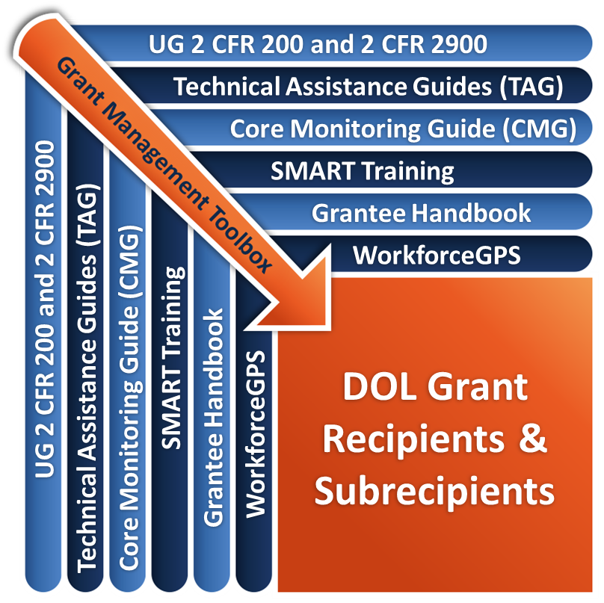
Grant Management Toolbox
Notes:
Throughout the SMART modules, you will see this icon, the Grant Management Toolbox with direct links to the tools being discussed.
SMART Training 3.0 is one of several tools of the grants management toolbox created to help FPOs and grantees manage grants. Also available are the 2018 Core Monitoring Guide, the ETA Grantee Handbook, the soon-to-be-published Grants Management and Funding Technical Assistance Guides, or TAGs, and WorkforceGPS resources such as the Sample MOU and Infrastructure Toolkit and other resources for your specific grants.
Today’s SMART Training and other additional trainings will be made available on the Grants Application and Management Community located in WorkforceGPS. Be sure to access all available tools when managing your grant.

Slide 5
Module Overview
Discuss the non-Federal entities' responsibilities for managing grant records including:
  Types and custody
  Retention period
  Access & PII
Discuss grant/subaward closeout process including
  Timelines
  Closeout package contents
  Federal and non-Federal entities’ responsibilities
Notes:
In this module, our goal is to increase your comfort level regarding grant closeout and records management for ETA grants.

Slide 6
Records Management
Types of records
Record retention requirements
Access to and custody of records
Collection, transmission & storage of records
Protecting PII
Protecting PII
Policies and procedures
Notes:
During this section of this module we will also
Discuss the types of records that non-Federal entities must retain, including records to determine whether the recipient has complied, or is complying, with the nondiscrimination and equal opportunity provisions of sec. 188 of WIOA, or 29 CFR 38.
Understand the records management requirements regarding record retention.
Understand the requirements regarding access and custody of records including the need for records in machine readable formats, and the need to recognize circumstances when PTEs should take custody of subrecipients’ records.
Identify personally identifiable information and the need to protect it.
Understand the effect of grant closeout and other exceptions to the record retention timeframe.
Discuss internal controls, also known as policies and procedures regarding records management.

Slide 7
Records Retention Requirements
2 CFR 200.333
With awards with specific period of performance, 3 years from the date the final expenditure report was submitted
For Federal awards that are renewed quarterly or annually, 3 years from the date the grant recipient submits the quarterly or annual financial report, respectively, as reported to the Federal awarding agency or PTE in the case of a subrecipient
ETA Core Monitoring Guide - Indicator 2.g.1: Records Retention and Resource L Retention of Records Table
Notes:
All grant recipient and subrecipient must have financial and programmatic records, supporting documents, or other records required by program regulations, grant agreement, or reasonably considered pertinent to program regulations or grant agreement.
For grantees with specific POP such as discretionary grantees, financial records, supporting documents, statistical records, and all other grant recipient records pertinent to a Federal award must be retained for a period of three years from the date the final expenditure report was submitted. Subrecipients must maintain their records until the PTE meets its 3-year retention requirement, unless the PTE takes custody of subrecipients records. Consequently, it is paramount that PTEs keep their subrecipients aware of the retention period.
For Federal awards that are renewed quarterly or annually, the 3-year retention requirement is from the date the grant recipient submits the quarterly or annual financial report, respectively, as reported to the Federal awarding agency or PTE in the case of a subrecipient. [2 CFR 200.333]
ETA’s Core Monitoring Guide Resource L Record Retention of Records table provides a detailed explanation of the requirement for Record retentions

Slide 8
Types of Records
2 CFR 200.302
Record in support of the expenditure of Federal funds
  Compliance with Federal statute and regulations
  Compliance with grant terms and conditions
Records that:
  Identify all Federal awards received and expended and the Federal programs under which they were received
  Provide accurate, current, and complete disclosure of the financial results of each Federal award or program
  Identify adequately the source and application of funds for Federally-funded activities
Notes:
The Uniform Guidance states that all financial records, supporting documents, statistical records, and all other non-Federal entity records pertinent to a Federal award must be retained. The Uniform Guidance at 2 CFR 200.302(a) provides that:
State's and the other grant recipient’s financial management systems, including records documenting compliance with Federal statutes, regulations, and the terms and conditions of the Federal award, must be sufficient to permit the preparation of reports required by general and program-specific terms and conditions and the tracing of funds to a level of expenditures adequate to establish that such funds have been used according to the Federal statutes, regulations, and terms and conditions of the Federal award.
Specifically, records must
identify all Federal awards received and expended and the Federal programs under which they were received
provide accurate, current, and complete disclosure of the financial results of each Federal award or program
Identify adequately the source and application of funds for federally-funded activities

Slide 9

Types of Records (2)
Financial (including but not limited to)
  General ledger and supporting documentation
  Statistical records
  Negotiated Indirect Cost Rate Agreement (NICRA)/ Cost Allocation Plan (CAP)
  Property records (including depreciation schedule)
Personnel
Program performance
Other type records
Notes:
Recipients must relate financial data to performance accomplishments of the Federal award; this includes, when applicable, providing cost information to demonstrate cost effective practices (e.g., through unit cost data). The recipient’s performance should be measured in a way that will help the Federal awarding agency and other grant recipients to improve program outcomes, share lessons learned, and spread the adoption of promising practices. Performance reporting not only allows the Federal awarding agency to understand the recipient’s progress but also to facilitate identification of promising practices among recipients and build the evidence upon which the Federal awarding agency’s program and performance decisions are made.
Consequently, recipients/subrecipients must maintain financial, personnel, program performance, and other type records in support of the expenditure of Federal funds.
Refer to ETA’s Grant and Financial Management TAG, Section 15.14, Attachment 15-2, Record Retention Schedule for Selected Records, to see a more complete list of the various types of financial, personnel, and performance records that must managed. We will display these specific type records when we soon discuss record retention requirements.

Slide 10
Types of Records (3)
WIOA sec. 185(a) and 2 CFR 200.302
Records sufficient to prepare title I WIOA required reports and to permit the tracing of funds to ensure funds have not been spent unlawfully
Records required to support title I WIOA programs’ performance and activities
Records to determine compliance with the nondisrimination and equal opportunity provisions of sec. 188 of WIOA, or 29 CFR Part 38.
Notes:
WIOA also provides guidance on required records that must be retained.
Recipients shall keep records that are sufficient to prepare reports required by this WIOA title I and to permit the tracing of funds to a level of expenditure adequate to ensure that the funds have not been spent unlawfully. [WIOA sec. 185(a)(1)]
Every recipient shall maintain records and submit reports required by the Secretary regarding the performance of programs and activities carried out under WIOA title I. In order to prepare the required performance reports recipients must maintain standardized records for all individual participants. [WIOA sec. 185(a)(2)-(3)]
WIOA also records to determine compliance with the nondiscrimination and equal opportunity provisions of sec. 188 of WIOA, or 29 CFR 38.

Slide 11

Uniform Guidance Exceptions
2 CFR 200.333
Written notification to extend retention period
Litigation, claim or audit
Records for real property and equipment
Records transferred or maintained by the Federal awarding agency
Indirect cost rate proposals and cost allocation plans
Program income
Notes:
There are situations that may extend the standard three-year record retention period and some specific types of records have their own record retention period-triggering activities. Some exceptions to the regular retention period includes:
Written notification to extend: If the DOL, cognizant agency for audit, oversight agency for audit, cognizant agency for indirect costs, or PTE notifies the non-Federal entity in writing to extend the retention period, the records must be retained for as long as directed. [2 CFR 200.333(b)]
Litigation/audit records: If any litigation, claim, audit, or monitoring by a Federal Project Officer, Grant Officer, PTE monitor, or other authorized DOLETA representative is started before the expiration of the three-year period, the records must be retained until all litigation, claims, audit findings, or monitoring findings involving the records have been resolved and final action taken, or until the end of the regular three-year record retention period, whichever is later. Failure to obtain an audit extends the record retention requirement indefinitely. A delay in obtaining an audit or in resolving audit findings extends the record retention period until all audit requirements have been satisfied and all findings have been resolved to the awarding agency’s satisfaction. [2 CFR 200.333(a) and 2 CFR 2900.3]
Real property and equipment: Records for real property and equipment acquired with Federal funds must be retained for three years after final disposition, pursuant to 2 CFR 200.333(c).
Records transfer: If records are transferred to or maintained by the DOL or PTE, the three-year retention requirement is not applicable to the transferring non-Federal entity, pursuant to 2 CFR 200.333(d).
Indirect cost records: Indirect cost records include items, such as actual computations, indirect cost proposals, cost allocation plans, and supporting documentation and records. Indirect costs-related documents have different retention depending on whether or not the proposal was required to be submitted for negotiation. If required to be submitted for negotiation with the Federal government (or to the PTE), the 3-year retention period for its supporting records starts from the date of such submission. If not required to be submitted for negotiation, the 3-year retention period starts from the end of the fiscal year (or other accounting period) covered by the proposal, plan, or other computation. [2 CFR 200.333(f)(1)&(2)]
Program income. DOL expects grantees to return or refund for program income generated during the life of the grant. Earning after the grant closing is irrelevant since not federal funds were used to generate the program income.

Slide 12
Access to Records
2 CFR 200.336
Awarding agency, Inspectors General, U.S. Comptroller General, pass-through entity, or any of their authorized representatives have right of access to any records pertinent to a grant to make audits, examination, excerpts and transcripts
For WIOA title I grant recipients, the Director at the Office of Civil Rights has the same rights of access
Restriction applies to access to name of victim of a crime
Right of access not limited to period of retention, but lasts as long as the records are retained
Notes:
The DOL, including its Inspector General, the Comptroller General of the United States, the PTE, and/or any of their authorized representatives have the right of access to any documents, papers, or other records (including electronic writings and records) of the grant recipient that are pertinent to the Federal award in order to make audits, monitoring reviews, examinations, excerpts, and transcripts. The right also includes timely and reasonable access to the grant recipient’s personnel for the purpose of interview and discussion related to such documents. [2 CFR 200.336]
For WIOA title I grant recipients, the Director at the Office of Civil Rights has the same rights of access described above per the requirements of 29 CFR Part 38.
Only under extraordinary and rare circumstances would such access include reviewing of the true name of victims of a crime. Routine monitoring cannot be considered extraordinary and rare circumstances that would necessitate access to this information. When access to the true name of victims of a crime is necessary, appropriate steps to protect this sensitive information must be taken by both the grant recipient and the DOL. Any such access, other than under a court order or subpoena pursuant to a bona fide confidential investigation, must be approved by the head of the DOL or delegate. [2 CFR 200.336(b)]
This right of access is not limited to the period of retention, but lasts as long as the records are retained

Slide 13
Access to Records (cont.)
2 CFR 200.337
DOL will not limit public access to its records pertinent to a Federal award, except
  For protected personally identifiable information (PII)
  When DOL can demonstrate such records will be kept confidential and
    Would have been exempted from disclosure pursuant to the Freedom of Information Act (FOIA), or
    Controlled unclassified information pursuant to Executive Order 13556 if the records had belonged to the DOL
Notes:
Restrictions on public access to records: The DOL will not place restrictions on the grant recipient that limit public access to its records pertinent to a Federal award, except for protected personally identifiable information (PII), as defined at 2 CFR 200.82, or when the DOL can demonstrate that such records will be kept confidential and would have been exempted from disclosure pursuant to the Freedom of Information Act (5 U.S.C. 552) or controlled unclassified information pursuant to Executive Order 13556 if the records had belonged to the DOL. [2 CFR 200.337]
The Freedom of Information Act and Privacy Act (5 U.S.C. 552 and 552a) generally do not apply to ETA-funded records in the possession of recipients and subrecipients. The provisions of these Acts apply to recipients’/subrecipients’ records only if they have been transferred to the Secretary of Labor. There may be limited occasions in which the Privacy Act could apply to records under the provisions of 5 U.S.C. 552a(m)(1). [2 CFR 200.337]
Processing fees.
Grant recipients may charge fees sufficient to recover the costs of processing requests for records, such as copying costs. [WIOA sec. 185(a)(4)(C)]
Now let’s talk more about the need to protect PII

Slide 14
Collection, Transmission, and Storage
2 CFR 200.335
Must retain and store records in a manner that will preserve their integrity and admissibility as evidence in any audit/litigation or other proceeding.
Burden of producing and authenticating records on custodian
  Failure to authenticate; not for evidentiary purpose
Microfilmed or photocopied records can be substituted for original records as admissible for evidentiary purposes.
If data are stored in a computer or similar device, any printout or other output readable by sight, shown to reflect the data accurately, is an original.
To prove the content of a writing or recording, the original writing or recording is required.
Notes:
Non-Federal entities must retain and store records in a manner that will preserve their integrity and admissibility as evidence in any audit/litigation or other proceeding.
The custodian of the records has the burden of producing and authenticating the records. Failure to authenticate the record will deny the right to use it for any evidentiary purpose. Thus, if a grant recipient maintains its participant eligibility records on computer files and is unable to show that the records were secure or were tamper-proof, the records cannot be used to prove that participants were eligible for services they receive. Additional requirements related to the admissibility of records in evidence can be found at 29 CFR 18.902.
Microfilmed or photocopied records can be substituted for original records because they are generally accepted (unless questions as to authenticity are raised) as admissible for evidentiary purposes. [29 CFR 18.1002-1003]
If data are stored in a computer or similar device, any printout or other output readable by sight, shown to reflect the data accurately, is an original. [29 CFR 18.1001(a)(3)]
To prove the content of a writing or recording, the original writing or recording is required. [29 CFR 18.1002]

Slide 15

Protected Personally Identifiable Information
2 CFR 200. 82
Protected PII means an individual's first name or first initial and last name in combination with any one or more of types of information, including, but not limited to:
  social security number,
  passport number,
  credit card numbers,
  clearances,
  bank numbers,
  biometrics,
  date and place of birth,
  mother's maiden name,
  criminal, medical and financial records,
  educational transcripts.
This does not include PII that is required by law to be disclosed.
Notes:
Protected PII means an individual's first name or first initial and last name in combination with any one or more of types of information, including, but not limited to, social security number, passport number, credit card numbers, clearances, bank numbers, biometrics, date and place of birth, mother's maiden name, criminal, medical and financial records, educational transcripts. This does not include PII that is required by law to be disclosed.

Slide 16
Collection, Transmission, and Storage
May 2013 Executive Order on Making Open and Machine Readable the New Default for Government Information:
  Responsibilities of Federal awarding agency and Pass-through entity
  Requirements for digital and paper records
    Digital records must be housed in a system that limits alterations or changes
    2 cfr 200.335
Notes:
E.O. 13642 issued May 9, 2013 requires that Government information shall be open and machine readable to ensure that data is released to the public in what that make the data easy to find, accessible, and usable. The specific requirements for collection, transmission and storage of information can be found at 2 CFR 200.335.
Can the records be retained in electronic format, or do you require everything to be on paper?
ANSWER: Refer to 2 cfr 200.335
When original records are electronic and cannot be altered, there is no need to create and retain paper copies.

Slide 17

Personally Identifiable Information (PII)
2 CFR 200.79
PII means information that can be used to distinguish or trace an individual’s identity, either alone or when with other personal or identifying information that is linked or linkable to a specific individual.
Notes:
What is Personally identifiable information or PII?
PII means information that can be used to distinguish or trace an individual's identity, either alone or when combined with other personal or identifying information that is linked or linkable to a specific individual. Some information that is considered to be PII is available in public sources such as telephone books, public Web sites, and university listings. This type of information is considered to be Public PII and includes, for example, first and last name, address, work telephone number, email address, home telephone number, and general educational credentials. The definition of PII is not anchored to any single category of information or technology. Rather, it requires a case-by-case assessment of the specific risk that an individual can be identified. Non-PII can become PII whenever additional information is made publicly available, in any medium and from any source, that, when combined with other available information, could be used to identify an individual.
Now lets discuss protected PII.

Slide 18

Protection of Personally Identifiable Information
2 CFR 200.303, 2 CFR 200.337, TEGL 39-11
Internal controls to safeguard
  Protected PII and
  Other information designated as sensitive or considered sensitive
PII may be
  Paper
  Electronic
Public has no access to PII
Notes:
The Uniform Guidance at 2 CFR 200.303(e) requires that certain personally identifiable information must be protected against release to protect individuals’ privacy. While some personal information in award-related record is available from other public sources, other information that can be used to invade an individual’s privacy is also included in award-related records and must, therefore, be protected from being disclosed to the public.
The non-Federal entity must also take reasonable measures to safeguard protected personally identifiable information or other information the Federal awarding agency or pass-through entity designates as sensitive or the non-Federal entity considers sensitive consistent with applicable Federal, state, local and tribal laws regarding privacy and obligations of confidentiality.
Record retention and access policy and procedures must contain internal controls to mitigate the possibility of unauthorized access to PII, whether such records are paper or electronic.
A grant recipient may not limit public access to records that are pertinent to a Federal award (e.g., financial, performance, etc.) however, the public does not have access to protected PII. This means the public is entitled to know how much money was expended on training, how many individuals received training, how many of those receiving training entered unsubsidized training, etc., but is not entitled to know the social security numbers of those who attended training or entered unsubsidized employment.

Slide 19
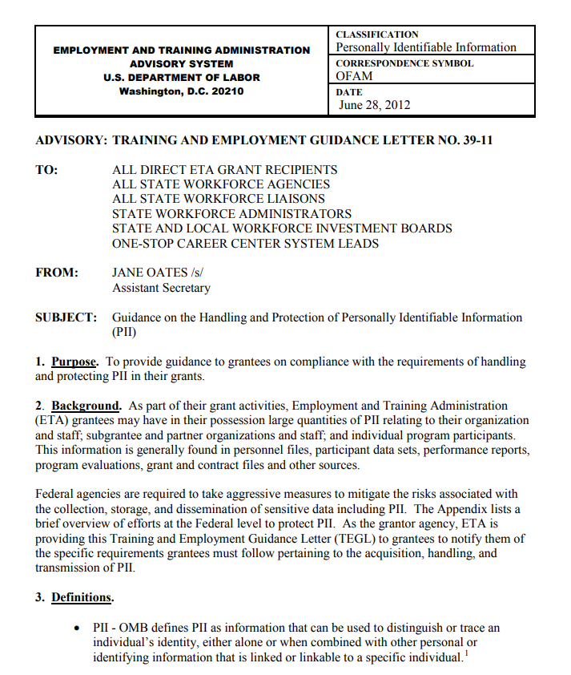
PII Collection, Transmission, and Storage
PII and Sensitive Data transmission and storage requirements TEGL 39-11
Notes:
Protected PII is the most sensitive information that you may encounter in the course of your grant work, and it is important that it stays protected. Grantees are required to protect PII when transmitting information, but are also required to protect PII and sensitive information when collecting, storing and/or disposing of information as well. TEGL 39-11 provides guidance on protecting PII. We will discuss TEGL 39-11 on the next slide.

Slide 20
Methods to Protect PII
TEGL 39-11
Have participants sign releases acknowledging the use of PII for grant purposes
Use unique identifiers for participant tracking
Use appropriate methods for destroying sensitive PII in paper files and securely deleting sensitive electronic PII.
Do not leave records containing PII open and unattended
Store documents containing PII in locked cabinets when not in use
Notes:
Some recommendations for protecting PII include:
• Before collecting participants’ PII or sensitive information, have participants sign releases acknowledging the use of PII for grant purposes only.
• Whenever possible, ETA recommends the use of unique identifiers for participant tracking instead of SSNs. While SSNs may initially be required for performance tracking purposes, a unique identifier could be linked to the each individual record. Once the SSN is entered for performance tracking, the unique identifier would be used in place of the SSN for tracking purposes. If SSNs are to be used for tracking purposes, they must be stored or displayed in a way that is not attributable to a particular individual, such as using a truncated SSN.
Use appropriate methods for destroying sensitive PII in paper files (i.e., shredding/using a burn bag) and securely deleting sensitive electronic PII.
• Do not leave records containing PII open and unattended.
• Store documents containing PII in locked cabinets when not in use.

Slide 21
Transfer and Custody of Records
Pass-through entity’s custody of subrecipient records
  Prevents duplication
  Ensure access to subrecipient records – retention policy may vary
  Take custody of subrecipient records when relationship ends
  Protect PII and other sensitive records; encryption techniques should be employed
DOL custody of records
  When determined that records possess long-term retention value
Transfer or storage Costs
  2 CFR 200.334 - Requests for transfer of records
  DOL exception at 2 CFR 2900.18 provides that the cost of storing and transferring records to DOL is an allowable cost.
Notes:
A PTE may request a subrecipient to transfer grants records to the PTE for multiple reasons.
Prevents duplication. To avoid duplicate record keeping, grant recipients may make special arrangements with subrecipients, contractors, and others to retain records that are continuously needed for joint use. The grant recipient will request transfer of records to its custody when it determines that the records possess long-term value. When the records are transferred to or maintained by the grant recipient, the retention requirement does not apply to the entity that relinquished the records
Ensure access to subrecipient records – retention policy may vary because PTE’s retention needs will be beyond subrecipients.
Take custody of subrecipient records when relationship ends. When a PTE’s relationship with a subrecipient is terminated, the subrecipient’s responsibility to maintain and retain records does not end. However, the PTE may want to take custody of the original records to assure that they are available if needed in instances where the subrecipient is unable (e.g., going out of business) to physically retain them.
When a transfer of records is requested, the transferring entity must take reasonable measures to safeguard from unauthorized access protected PII and other information the Federal awarding agency or PTE designates as sensitive or the grant recipient considers sensitive consistent with applicable Federal, State, and local laws regarding privacy and obligations of confidentiality in accordance with 2 CFR 200.303(e) Encryption techniques should be employed to prevent the identification of an individual, e.g., an individual social security number or other information that might be traced back to an individual participant.
UG requires the Federal awarding agency to request transfer of certain records to its custody from the non-Federal entity when it determines that the records possess long-term retention value or may make arrangements with the recipient to maintain the records if they have a joint-use purpose.
In terms of the cost associated with transferring records, DOL has an exception at 2 CFR 2900.18 that allows the costs of transferring records to us. See ETA’s Grant and Financial Management TAG, section 15.8 for information on allowable costs for storage of records.

Slide 22
Policies and Procedures
Must meet requirements of applicable Federal laws and regulations.
When implementing record retention policies, recipients and subrecipients must consider State and local policies and requirements.
Identifies financial records, supporting documents, statistical records and all other records pertinent to the Federal award that must be retained.
Includes a retention schedule, disaster plan and file back-up.
Designates staff person with custodian of record duties.
Addresses PII safeguards, staff access and handling of such data.
Encryption techniques to protect individuals identification.
Notes:
An appropriate policy and procedure should be maintained for the retention of records pertinent to the Federal award that meets the requirements of applicable Federal laws, regulations, or grant agreement purposes and must consider State and local policies and requirements
.
Implementing record retention policies, recipients and subrecipients must consider State and local policies and requirements. When records are transferred, the transferring entity must take reasonable measures to safeguard from unauthorized access protected PII and other information the Federal awarding agency or PTE designates as sensitive or the grant recipient considers sensitive consistent with applicable Federal, State, and local laws regarding privacy and obligations of confidentiality in accordance with 2 CFR 200.303(e).
The elements of an effective records management policy and procedures identifies financial records, supporting documents, statistical records that must be retained; includes a retention schedule, disaster plan and file back-up; designates a custodian of record duties; and addresses PII safeguards, staff access and handling of such data.
Encryption techniques should be employed to prevent the identification of an individual, e.g., an individual social security number or other information that might be traced back to an individual participant.

Slide 23
Common Mistakes
Lack of written records management policy and procedures.
PII restricted access not limited to necessary personnel.
Destruction of records before the required retention period ends.
Subrecipient records with retention periods ending earlier than the PTE’s not available for the PTE’s required retention period.
Subrecipients records not kept for the required period for subawards that are terminated prematurely or for subrecipients who go out of business.
Release of protected personally identifiable information (PII) or other sensitive or confidential information.
Records improperly stored.
Notes:
Here a few common mistakes identified during monitoring reviews. Ask participants: Are there others that you can think of?

Slide 24
Knowledge Check 1 – Questions
True or False?
Non-Federal entities must establish internal controls to ensure the protection of PII.
Notes:
False. Records for real property and equipment acquired with Federal funds must be retained for three years from the date of final disposition.
True. Right of access is not limited to period of retention, but as long as the records are retained
False. Microfilmed or photocopied records can be substituted for original records because they are generally accepted (unless questions as to authenticity are raised) as admissible for evidentiary purposes
4. True. Non-Federal entities must establish internal controls to ensure the protection of PII or other information the Federal awarding agency or pass-through entity designates as sensitive or the non-Federal entity considers sensitive consistent with applicable Federal, state, local and tribal laws regarding privacy and obligations of confidentiality.

Slide 25
Knowledge Check 1 – Answers
Non-Federal entities must establish internal controls to ensure the protection of PII. True
Notes:
1. True. Non-Federal entities must establish internal controls to ensure the protection of PII or other information the Federal awarding agency or pass-through entity designates as sensitive or the non-Federal entity considers sensitive consistent with applicable Federal, state, local and tribal laws regarding privacy and obligations of confidentiality.

Slide 26
Core Monitoring Guide – Objective 2.g Records Management
Indicator 2.g.1: Record Retention
  Has the grant recipient properly identified all financial records, supporting documents, statistical records, and all other records pertinent to the Federal award that must be retained?
Indicator 2.g.2: Accessibility
  Are grant records accessible and available for timely review by authorized officials and representatives?
Indicator 2.g.3: Protected PII
  Does the grant recipient have reasonable internal controls in place to safeguard protected PII, consistent with the requirements of the grant award?
Indicator 2.g.4: Custody and Transfer
  Does the record retention requirement address circumstances under which custody of the records should be transferred to the grant recipient?
Notes:
The Core Monitoring Guide provides questions related to Records Management that may be reviewed as part of monitoring and oversight of your grants.
Each Indicator provides questions.
Examples are listed on this slide from each Objective.
Note that there are multiple questions for consideration per indicator.
Please see the Core Monitoring Guide for more information on Records Management.
26

Slide 27
Closeout
Closeout process and timelines
Responsibilities of DOL, grant recipient, subrecipient, and pass-through entity (PTE)
Contents of the closeout package
Common issues for delay in closeout process
Grant recipient’s post-closeout responsibilities
Notes:
The objectives of the section on Closeout is to provide you an overview of the closeout process including timelines. We will further describe DOL’s, the grant recipients’, subrecipients’, and PTEs’ responsibilities during the closeout process. We will also discuss what makes up a complete closeout package, including discussing many items that must be accounted for at closeout. We will also address some of the common issues discovered during closeout. Lastly, it is important that you understand all of your post-closeout responsibilities.

Slide 28
What is Grant Closeout?
2 CFR 200.16
Closeout means the process by which the Federal awarding agency or PTE determines that all applicable administrative actions and all required work of the Federal award have been completed and takes required actions described in 2 CFR 200.343 Closeout.
Completion of the grant life cycle
Official end of the grantor/grantee relationship
Closeout period – 90 day period following end of the grant’s period of performance
Notes:
What is grant closeout. Closeout means the process by which the Federal awarding agency or pass-through entity determines that all applicable administrative actions and all required work of the Federal award have been completed and takes required actions described in §200.343 Closeout.
Closeout represents the end of the grant life cycle and the official end of the grantee’s relationship with the Federal agency for this grant award.
Closeout period is the 90 day period following end of PoP

Slide 29
What are Closeout Required Actions?
2 CFR 200.343
Grant Recipient
  Submits all final required reports
  Liquidates all accrued expenditures (2 CFR 2900.15)
  Refunds any balances of unobligated funds
  Accounts for real and personal property
Federal agency/PTE
  Makes prompt payments to the non-Federal entity for allowable reimbursable costs
  Makes settlement for any upward or downward adjustments to the Federal share of costs
  Completes all closeout actions for Federal awards no later than one year after receipt and acceptance of all required final reports
Notes:
What are the required closeout actions, They are found at 2 CFR 200.343.
Grantee required actions
The non-Federal entity must submit, no later than 90 calendar days after the end date of the period of performance, all financial, performance, and other reports as required by the terms and conditions of the Federal award. The Federal awarding agency or pass-through entity may approve extensions when requested by the non-Federal entity.
Unless the Federal awarding agency or pass-through entity authorizes an extension, a non-Federal entity must liquidate all ACCRUED expenditures. Please note this change because of 2 CFR 2900.15 which does NOT allow the liquidation of obligations.
The non-Federal entity must account for any real and personal property acquired with Federal funds or received from the Federal Government in accordance with §§200.310 Insurance coverage through 200.316 Property trust relationship and 200.329 Reporting on real property
Federal agency and PTE required actions
The Federal awarding agency or pass-through entity must make prompt payments to the non-Federal entity for allowable reimbursable costs under the Federal award being closed out.
The non-Federal entity must promptly refund any balances of unobligated cash that the Federal awarding agency or pass-through entity paid in advance or paid and that are not authorized to be retained by the non-Federal entity for use in other projects. See OMB Circular A-129 and see §200.345 Collection of amounts due, for requirements regarding unreturned amounts that become delinquent debts.
Consistent with the terms and conditions of the Federal award, the Federal awarding agency or pass-through entity must make a settlement for any upward or downward adjustments to the Federal share of costs after closeout reports are received.
.
(g) The Federal awarding agency or pass-through entity should complete all closeout actions for Federal awards no later than one year after receipt and acceptance of all required final reports.

Slide 30
Closeout Regulations
20 CFR 683.150 WIOA closeout
2 CFR 200.16 Closeout defined
2 CFR 200.343 Closeout requirements
2 CFR 200.344 Post-closeout adjustment
2 CFR 200.345 Collection of amounts due
2 CFR 2900.15 and 2 CFR 2900.17 Post Federal award requirements
Notes:
The following federal regulations outline the various requirements for closeout.
20 CFR 683.150 – provides WIOA Closeout requirements
As we just previously discussed 2 CFR 200.16 defines what closeout is and 2 CFR 200.343 describes the actions that the non-Federal entity and the Federal awarding agency or pass-through entity must take in order to complete the closeout process at the end of the period of performance.
2 CFR 200.344 details what may be necessary as a result of an audit or a monitoring review
2 CFR 200.345defines monies due to the Federal awarding agency, and the steps that may be taken to assure any amounts due are repaid to the Federal government.
The DOL exceptions at 2 CFR 2900.15 and 2900.17, respectively, requires that the only expenditures that can occur during closeout is the liquidation of accrued expenditures that occurred prior to the end of the POP, and adjustments to indirect cost rates resulting from a determination of unallowable costs being included in the rate proposal may result in the reissuance of negotiated rate agreement.

Slide 31
Closeout Process
Direct Grant Recipients
DOL email notification to grant recipient, typically 30 days before a grant expires
Closeout package electronically transmitted
Documentation within 90 days of end of the grant’s period of performance
Subrecipients
Pass-through entities must establish appropriate close out procedures
Notes:
How does the ETA closeout process work for direct grant recipients?
Prior to expiration of a grant, an electronic notification is transmitted to a recipient, typically 30 days before a grant expires. This alert allows the recipient sufficient time to begin the collection of all costs and other information that must be reported on the various report forms. It may also serve as a trigger for you to begin the closeout process with your subrecipients if you have not already done so.
The closeout package is then transmitted electronically to you. All the required forms are either included or identified and, again, this will enable you to transmit such forms as needed to your subrecipients.
The grantee must submit closeout documentation 90 days from the expiration of the grant unless an extension has been requested and approved by the grant officer. This means that you must have closed all subawards prior to that date to ensure an accurate accounting of grant activity.
For subrecipients
Pass-through entities must establish appropriate procedures for closing out subawards. As with reporting, the ETA schedule and deadlines are important factors in determining closeout procedures between pass-through entities and their subrecipients.

Slide 32
Closeout Timeline
Final quarterly ETA 9130 financial report due within 45 days after grant’s period of performance (POP) ends
Closeout specialist follow-up reminder 70 -75 days after grant’s period of performance’s end date
All closeout documents due no later than 90 days after the grant’s period of performance’s end date (2 CFR 200.343(a))
91+ days after grant’s period of performance’s end date, ETA’s closeout specialist review documents for compliance
Notes:
Within 45 days after the POP, the grantee will check “Final” in box 6a on the final quarterly ETA 9130 report indicating end of the performance period and submit final quarterly ETA 9130 report.
Approx. 70 -75 days after POP end date, closeout specialist will send follow up reminder to grantee to submit all documents.
All documents must be submitted no later than 90 calendar days after POP end date.
91+ days after POP end date the closeout specialist will review documents for compliance and communicate with grantee for any explanations or requests for changes to closeout documents.
The requirements for closeout flow down from the recipient to the sub recipient. It is critical that appropriate policies and procedures are in place to ensure timely completion of all closeout documents within GC

Slide 33
Closeout Timeline Example
September 30, 2019
November 14, 2019
December 30, 2019
Grant expires, closeout begins.
Final quarterly ETA 9130 due.
Closeout ETA 9130 and remaining closeout documents due.
Last day to draw down funds without permission from closeout unit.
Notes:
Here on the screen is a timeline example we can walk through.

Slide 34
DOL - Federal Awarding Agency Responsibilities
Track workload one year out to ensure timeliness of closeout
For DOL grants, notify grant recipient not less than 7 days prior to the grant’s period of performance’s end date.
Follow up with grant recipient when delays are encountered
Grants Oversight and New Efficiency Act (GONE Act – Public Law 114-117) requires agencies to report Federal grant awards which have not yet been closed out more than two years after the grant’s period of performance ends.
Issue initial and final determinations when disallowed costs are identified.
Notes:
Using our E-grants system, the closeout units tracks workload one year out.
When grants reach their period of performance end date, the closeout until will confirm whether any extensions have been granted before moving forward.
Federal requirements dictate that all grants need to be closed with 12 months after the period of performance end date. Additionally, we have to report the names of all grant recipients where the award remains open 2 years after the period of performance end date.
During the compliance review of the closeout documents, If noncompliance exists resulting in question costs, an initial and final determination will be issued. Funds should be sent electronically through Pay.gov.

Slide 35
Grant Closeout System
Notification Letter Sample
Notes:
On the screen is a sample grant closeout notification letter.

Slide 36
Grant Closeout System (cont.)
Dear Grantee,
This email is to notify you that your grant number AB222441460A0 with the Employment and Training Administration (ETA) will expire/expired on 06/30/17.
If you agreed with the expiration, as specified at 2 CFR 200.343, 2 CFR 2900.15, 29 CFR 97.40(b)(1), 97.41(b)(1), 97.50(b), you are required to submit electronically all the closeout forms in your specified closeout package
in the Grant Closeout System (GCS) no later than 90 days from the expiration date.
NOTE: After you have completed the final expenditure report(s) Form 9130, you must certify the
closeout financial report(s) as well. The Grant Closeout System (GCS) is accessed via the following URL:
http://www.etareports.doleta.gov/grant_closeout.cfm
Please enter the password assigned to you for your financial reporting to log into your Financial Reporting System home page, and then click on the Grant Closeout System menu on this page to
go to the GCS system.
You will receive the Grant Closeout System End User's manual in another email shortly. Please use
the End User's Manual and the Closeout Instructions posted in the Grant Closeout System to assist you in doing your closeout reporting.
Inquiries should be directed to the Resolution Specialist.
Allows for electronic posting of closeout required documents
Notes:
The Grant Closeout system allows recipients to download all necessary closeout forms. It provides two separate packages, one for governmental and one for non-governmental.
The grantee will complete the closeout forms online. Once they click the link in the email, they log into the “Grantee Reporting System” – this is the same way that they login to complete the quarterly financial reports. Once they login, on the top right side corner, there is a link that says “Go to Close out Grant”. The grantee clicks on this link and it takes them to the closeout package.

Slide 37
Grant Recipient Responsibilities
Monitor and track ALL grant-related expenditures
Timely program and financial reports
Maintain source documentation
Submit all appropriate documents to grant closeout specialist
Closeout subawards
  Establish closeout procedures for use at both levels.
Grant staff should be familiar with the terms and conditions and financial reporting requirements of the grant
Unless specifically allowed for in guidance by ETA, do not charge staff time incurred during closeout can not be charged to the grant
Notes:
Next, it is important to discuss your responsibility as the grant recipient and/or pass through entity in the closeout process. The closeout requirements are no different than the normal financial management responsibilities carried out throughout the life of the grant. It is important that grant recipients establish effective systems in place to ensure they meet all requirements of the grant. If you do that work upfront, closeout issues can be avoided. You responsibilities include:
Monitor and track ALL grant-related expenditures
Timely program and financial reports
Maintain source documentation
Submit all appropriate documents to grant closeout specialist
Closeout sub-awards. Which means you must establish closeout procedures for use at both levels.
It is important to note that if the grantee is a pass through entity, the grantee must close out all sub awards as part of the overall closeout process.
Grant recipient should be familiar with the all terms and conditions and reporting requirements of their grant award and when updates to the grant agreement are needed a modification should be submitted.
Updates would include changes in address, telephone numbers, signatory offices etc. necessary should submit a modification for update.
Grant recipient may not direct charge staff time to work on closeout of grant after POP end date.

Slide 38
Grant Recipient Responsibilities (cont.)
All accrued expenditures must be liquidated prior to submission of the closeout documents (2 CFR 2900.15).
Negotiated Indirect Cost Rate Agreements (NICRAs) or Cost Allocation Plans (CAPs) must be provided at closeout if indirect costs claimed.
Refund any obligated funds/cash.
Leveraged resources must be reported throughout the performance of the grant and during closeout.
Review of match requirements 2 CFR 200.29, 2 CFR 200.306, and 2 CFR 2900.8
  2 CFR 200.306(b) – the non-Federal entity accounts for funds used for cost sharing or match must have been reported and expended to further the grant objectives, if required either by statute or within the grant agreement as a condition of funding
Notes:
All accrued expenditures must be liquidate prior to submission of the closeout documents
Pursuant to 2 CFR 2900.15, for non-Federal entities reporting on an accrual basis and operating on an expenditure period, unless otherwise noted in the grant agreement, the only liquidation that can occur during closeout is the liquidation of accrued expenditures (NOT obligations) for goods and/or services received during the grant period.
If indirect costs have been claimed, remember to provide a copy of the NICRA or CAP at closeout
Grant recipients are required to refund any balances of unobligated cash. DOL/ETA no longer accepts paper checks. The US Department of Treasury provides a avenue for grant recipients to electronically return fund via Pay.gov (do we need a link?). Grant recipients returning funds to their perspective grants would use PMS.
Leverage resources
All match requirements agreed upon in the grant award document should be reported on the financial report. Match is defined as the portion of project costs not paid by Federal funds (unless otherwise authorized by Federal statue). DOL requires that you expended match dollars before being recognized as part of the grant requirements.

Slide 39

Subrecipient Procedures
PTE-established to ensure successful closeout process.
Ensures both entities can meet the closeout requirements timely.
  May need to shorten timeframes to accommodate subrecipients
Ensures certain rights of awarding agencies continue beyond closeout.
Notes:
To ensure a successful closeout, the Grant recipient should establish procedures for both itself and it’s subrecipients.
Pass-Through Entities will need to establish shorter timeframes for the closeout of the subrecipient. Timely closeout of the award depends on receiving accurate and timely information from subs. If subrecipients have subrecipients, that timeframe becomes even shorter. Preparation and procedures are key.

Slide 40
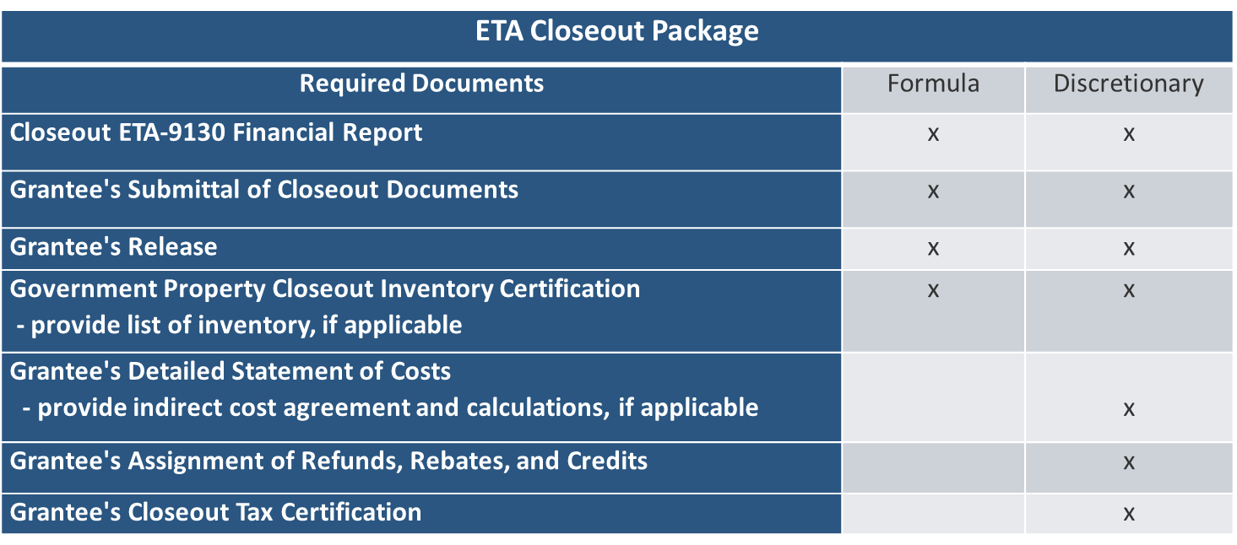
ETA Closeout Package
Notes:
Elements of a complete closeout package contain the following documents.
The closeout package will be sent via email to your grant’s signatory official. The signatory official is the authorized representative identified on application of federal award. If you have not received your package by the time the grant has expired, please contract your FP to ensure that the authorized representative's email address is correct.
Final Qtr 9130 (maked final in box 6) and the Closeout 9130
Grantee’s release – The recipient certifies the release of the grant agency for further monetary obligations under the grant
Recipient’s assignment of refunds, rebates, and credits. The recipient waives claim to any refunds, rebates, or credits received after the grant has terminated and assures prompt remittance to the grantor agency.
Property Inventory Certificate – provides for an inventory of all real or personal property purchases acquired with grant funds or received from the federal government where DOL reserves the right to take title or a certificate that not such property was acquired with grant funds.
Recipient’s closeout tax certification. This document provides assurances that the recipient/subrecipient has complied with all applicable tax requirements
The entire closeout package can be returned electronically with 2 exceptions, that need to be emailed – this is the copy of the NICRA and the list of equipment (if applicable).

Slide 41
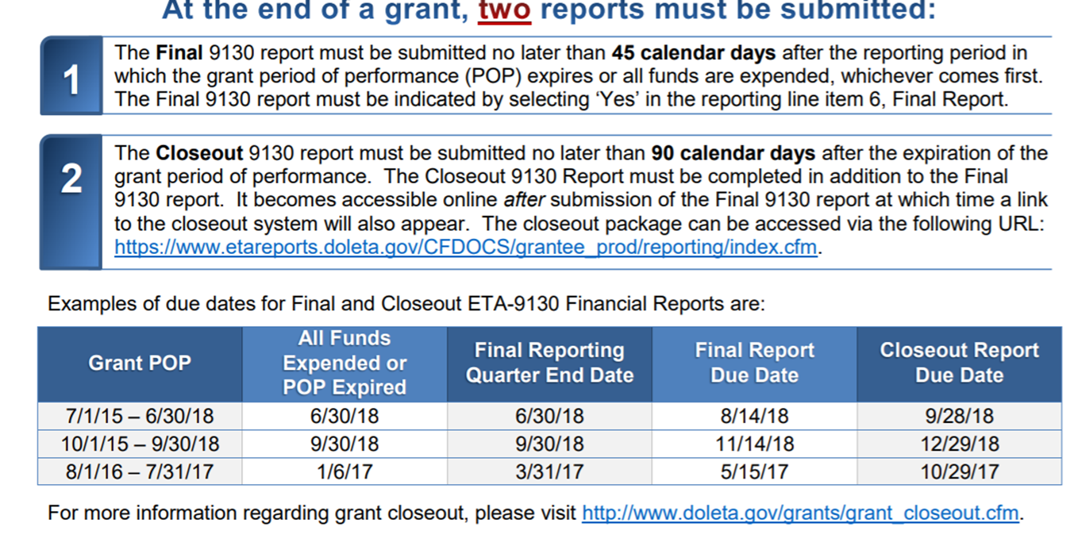
9130 Reports
Notes:
The first item on the list of deliverables for closeout are ETA 9130 reports
it is important to note that there are separate reports. We discussed previously the timeline for submission of both reports. We also discussed the need to shorten that timeline to receive information from your subrecipients.
Again, PTE and subrecipient must liquidate all unpaid accrued expenditures that were incurred prior to the POP end date. The subrecipient must also liquidate all allowable accrued expenditures prior to submission to the PTE.

Slide 42
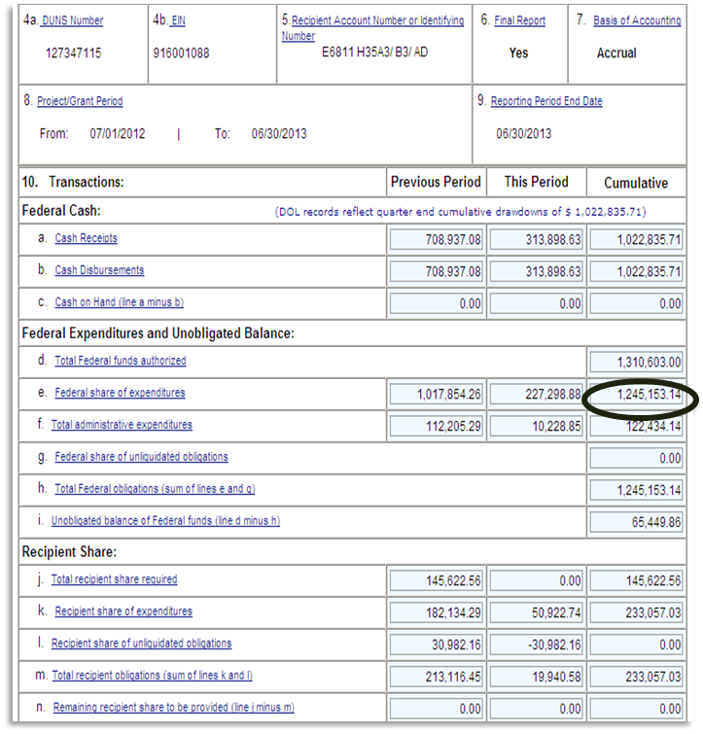
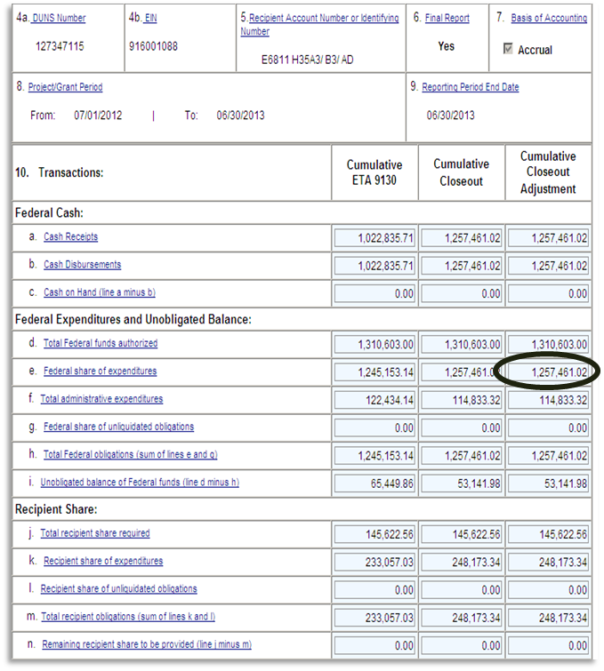
9130 Reports – Examples
Final Quarterly 9130
Closeout 9130
Notes:
This slide shows an example of the Final and Closeout 9130 Reports
Cash Reconciliation and adjustment –
For the amount of cash including cash advances there were issued to subrecipients and contractors should be equal to final expenditures report to the awarding agency at closeout.
Prior to submission of closeout documents, the PTE must adjust the total amount of cash advances received by drawing down additional cash or returning excess cash to awarding agency.
Pending invoices and claims – Procedures should establish firm deadlines for the submission of outstanding invoices and claims in order to avoid any late charges since any costs incurred after the expiration of the grant are not allowable an may not be paid.

Slide 43

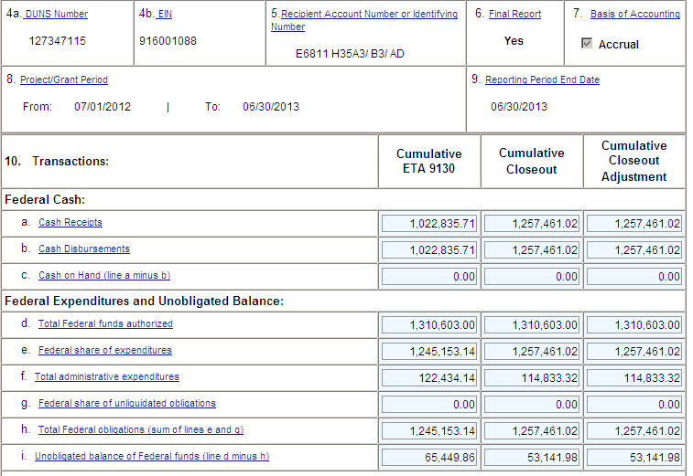
Administrative Costs
Program Specific
  Be mindful of the specified limitation for administrative costs.
Notes:
An entry on the ETA 9130 financial report is required for programs that are subject to administrative cost limitations. Be sure to review the requirements for each of your programs.
The amount reported for administrative costs is a portion of the total federal funds authorized. Administrative costs in excess of the grant limits are subject to be determined unallowable and repayable to the grant.

Slide 44
Liquidation of Accrued Expenditures
2 CFR 2900.15
No new obligations may be incurred.
The only liquidation that can occur during closeout is the liquidation of accrued expenditures (NOT obligations) for goods and/or services received during the grant period.
Grant recipient may not direct charge staff time to work on closeout of grant after period of performance end date.
Notes:
Grantees are not permitted to incur any new obligations after the end of the performance period. If goods or services have not been received or rendered PRIOR to the expiration of the grant, then any liquidation of the existing obligation can NOT occur. Grantees are allowed to charge the grant allowable accrued expenditures incurred during the funding period; for example, paying an invoice for service rendered during the POP. No new expenditures may be incurred after the POP. In summary, you may pay your existing bills at the end of the POP and you have that 90 period to liquidate those expenditures.
This last bullet is very important because it might be a natural assumption to think you can charge your staff closeout activity to the grant after the POP. Unfortunately, you can not. How can you charge that time? Well let’s think back to the discussion on indirect costs. Under the OMB cost principles (2 CFR 220, 225, 230), indirect costs are those that have been incurred for common or joint objectives and cannot be readily identified with a particular final cost objective. Top management personnel, fiscal operations, HR, payroll, and general administration and general expenses are examples of indirect costs. Closeout activities may be performed by individuals included in your indirect cost pool and their costs are thus recouped through the indirect charges under your rate made across all your federal grants. Therefore, if the closeout activities under your grant are part of your indirect cost pool, those costs are not direct chargeable to the grant and would be part of the indirect costs recovered for your grants. However, after the end date of your grant, you would NOT be able to charge indirect costs, as there are no direct costs to apply your rate to.
If your organization does not have an indirect cost rate, but rather an approved cost allocation plan, or closeout activities have been assigned to an individual that has direct charged the grant, then they may not be reimbursed by ETA or any other grant award as they are directly associated with your ETA grant award.

Slide 45
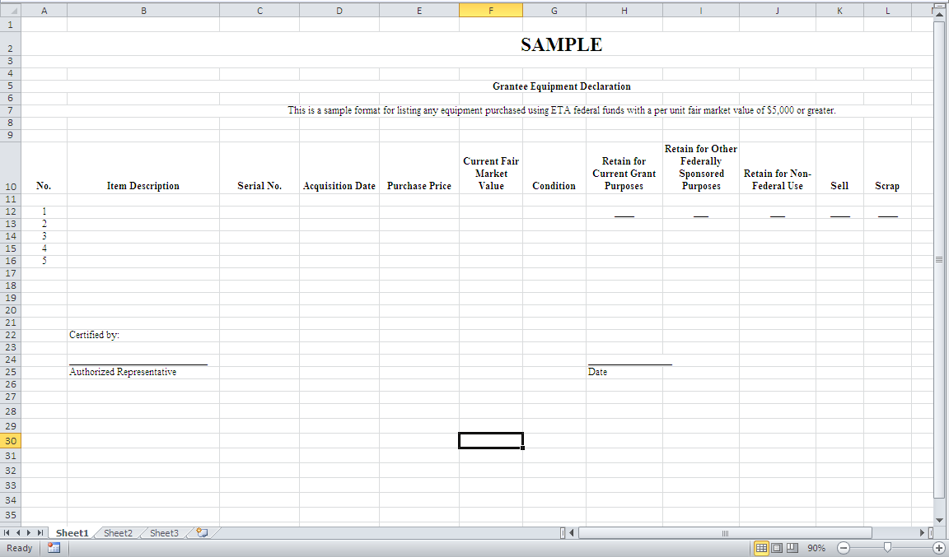
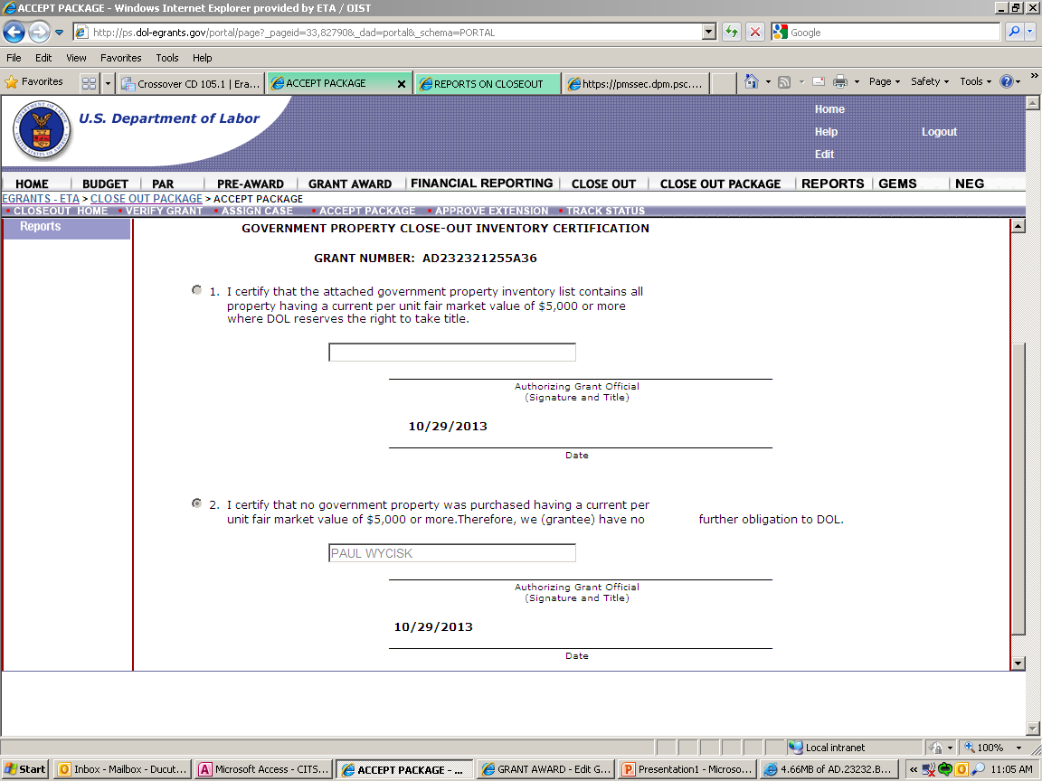
Property Certification Form
Notes:
This form is used to determine if a recipient has equipment purchased with grant funds have a fair market value of $5,000 or greater at closeout. If a recipient elects yes, an inventory listing will be required. Please note that this form is cross-referenced in our EGrants system to ensure that the appropriate approvals were received prior to equipment purchase. More information is provided regarding accounting for property in the modules on Real Property and Leases and Property Management: Equipment, Supplies, and Intangible Property and Chapter 5 of ETA’s Grant and Financial Management TAG.

Slide 46
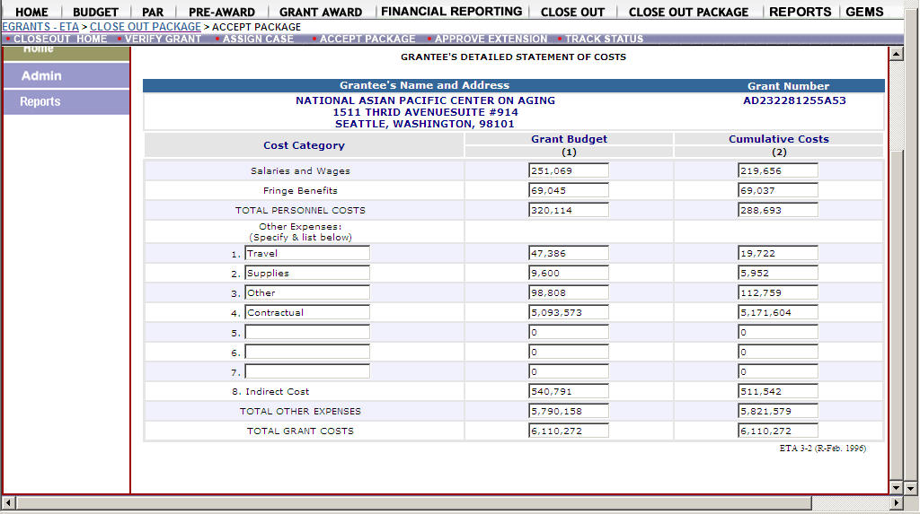
Detailed Statement of Costs
Notes:
The closeout specialist will review the Grantee’s Detailed Statement of Costs which shows how funds were spent in accordance with the budget categories. The review will be based on the SF-424 and 424A approved in the initial grant award, or the most recently-approved budget realignment. Note that at closeout, all “Grant Budget” line items must be consistent with those on the last approved budget.
For any change that exceeds the Simplified Acquisition Threshold, ETA requires prior approval if budget changes exceed 10% of the total grant award. The Simplified Acquisition threshold is currently at $250,000. (See 2 CFR 200.308(e), 2 CFR 2900.9, and 2900.10).

Slide 47
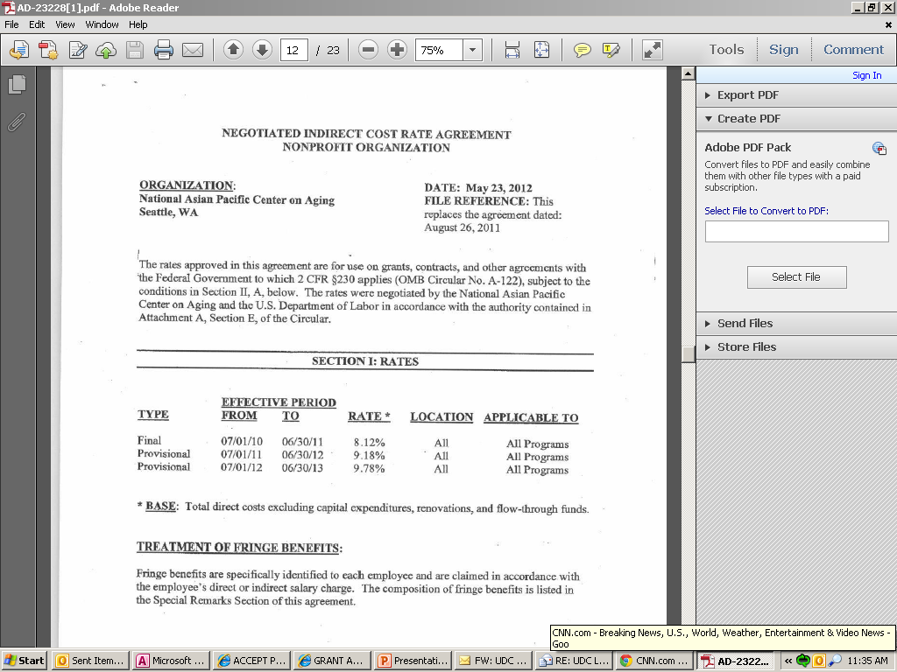
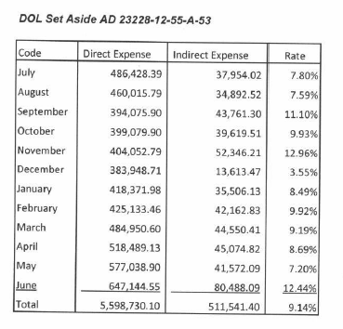
Indirect Costs – NICRA or CAP
A negotiated indirect cost rate or CAP from the Federal cognizant agency
Copy of the NICRA/ CAP must be submitted with the closeout package.
Have indirect costs been reported on both the FINAL & CLOSEOUT 9130?
Notes:
When do you report indirect costs on a 9130 Form? As you know the new report contains a new section to report indirect costs. As a grantee you are responsible for completing that section when submitting a FINAL report and during closeout.
If the grantee charged indirect costs to the award using an a negotiated IDC rate agreement or CAP, a copy of the IDC agreement/CAP must be submitted with the closeout package. The CAP referred to here is a CAP approved by the cognizant agency indirect cost specialist. CAPs only apply to State and Local governments (See 2 CFR Part 200 Appendix V State/Local Governmentwide Central Service Cost Allocation Plans). Grantee will be required to show the calculation of indirect costs charged.

Slide 48
Match Resources
Match - Portion of project costs not covered by Federal funds
  2 CFR 200.29, 2 CFR 200.306,
  2 CFR 2900.8 - match must be expended before it is recognized as fulfilling a requirement of the grant
Must be spent on fulfilling the objective or goal of the program or project.
If required match is not met:
  Federal share is proportionally reduced
  Shortfall maybe subject to debt collection and affect future award potential
Notes:
Match is not covered by Federal Funds unless otherwise authorized by Statue
2 CFR 2900.8 specifies the following: ‘In addition to the guidance set forth in 2 CFR 200.306(b), for Federal awards from the Department of Labor, the non-Federal entity accounts for funds used for cost sharing or match within their accounting systems as the funds are expended.
If match requirements are not met, the Closeout Specialist will determine whether or not the match required was required under statute or regulation. If required under statute or regulation, and the match requirement is not met, the Federal share will be reduced in proportion to the match shortfall. This reduction will maintain the required share of match to funds expended.

Slide 49
Program Income
WIOA Sec. 194(7)(B), WIOA 20 CFR 683.200(e)(8), and 2 CFR 200.307
ALWAYS SPEND before requesting more Federal funds
Income generated from allowable grant activity must be reported
Interest income earned on title I of WIOA and the Wagner-Peyser Act Program income must be expended first before drawing additional grant funds
If unused, must be returned/refunded to the DOL at closeout
Notes:
Grant recipient and subrecipients should have written policies and procedures in place to accurately record and expend the program in compliance with the identified regulations listed. Under WIOA grant recipients/subrecipients are required to expend on the allowable grant activities prior to drawing grant funds, program income, including interest income earned on title I of WIOA and the Wagner-Peyser Act. You have to earn and expend before reporting and before using grant funds.
Please remember that these requirements extend down to the subrecipient. So, any unused funds must be reported to the PTE as part of the closeout process.
Upon reviewing the closeout documents, if the grantees did not use the program income, we make sure they refund before finalizing the closeout process. The good thing is that the grantees have been cooperating with us.

Slide 50

Budget Realignments in Closeout
Grant recipient provides written justification to Federal Project Officer (FPO)
FPO determines if appropriate
FPO sends justification to ETA Closeout specialist and documented in file
Notes:
Budget Realignment – a bi-lateral modification action, which is agreed upon and signed by both the Grant Officer and the grant recipient, and adjusts amounts among the line items of the SF- 424a budget document in accordance with actual expenditures. The total amount of the grant budget remains the same.
And in some instances a budget realignment is required at closeout. The closeout specialist will notify the recipient whose responsibility it is to prepare a formal letter, justification and revised SF-424A for review by the appropriate federal project officer (FPO). The FPO must review and provide a recommendation based on the merits of the request to the recipient and closeout specialist. In this case, the closeout unit is seeking a recommendation from the FPO on whether or not the budget realignment is reasonable and should be approved based on the FPO’s knowledge of the grant. The FPO’s recommendation will determine closeout next steps.

Slide 51
Refunds
2 CFR 200.343(d)
Grant closeout does not affect grant recipients obligation to return funds due to DOL as a result of refunds.
Prompt refund of any balances of unobligated funds.
Refunds may require revising final expenditure report.
Refunds can be electronically through Payment Management System (PMS) or Pay.Gov
Notes:
2 CFR §200.343 (d) require the recipients to promptly refund any balances of unobligated cash that the Federal awarding agency or pass-through entity paid in advance or paid and that are not authorized to be retained by the non-Federal entity for use in other projects.
Any recipient in receipt of excess funds or unobligated cash should return such funds as soon as possible. During the grant period of performance, recipients should only have cash on hand for immediate needs and not excess cash. As such, at closeout any unobligated funds should be returned to the grant.
Again, the closeout of a grant does not affect the recipients obligation to return funds due to refund corrections such as indirect cost adjustments based on a final rate, disallowed costs based on a later audit, the requirement for records retention and access requirements, real property or equipment management.
Records for a federal grant must be maintained for at least three years from the close-out date. This means that a multi-year grant of four years requires that documentation be maintained for at least seven years.

Slide 52

Closeout Does Not Affect DOL Authority
Disallowances
Debts
Access to Records
Property Management
Audit
Notes:
Closeout does not affect other subsequent actions that DOL may take with the recipient. This applies equally to the pass-through entity authority with its subrecipients. Consequently, closeout does not affect the following actions:
Disallowances that are discovered as a result of disallowed costs identified during a later audit or other review.
Debts owed to the Federal Government as a result of later refunds, corrections, or other transactions that have not been returned, constitute a debt to the Federal Government. For subrecipients, the debt would be established against the pass-through entity, as DOL has no relationship with the subrecipient.
Access to records. Recipients are required to follow record retention requirements as outlined in the Uniform Guidance, and have the records available for review on request by ETA. Similarly, subrecipient records must remain available to the pass-through entity.
Property management. Recipients must follow the applicable regulations for the proper handling and disposition of property, equipment, and supplies, including the procedures for making the request to the Federal awarding agency. This is something recipients likewise do on behalf of their subrecipients. Instructions for the disposition of the items will be provided by the awarding agency
And finally, audits, which are required in accordance with the Uniform Guidance, Subpart F. Such audits are required for recipients or subrecipients that expend more than $750,000 million in an organizational fiscal year.
Again, PTEs must pass these requirements on to your subrecipients, and this should be part of the final acceptance of a closeout package by the subrecipient.

Slide 53
Common Issues Which May Delay Closeout
Non-responsive grant recipients
Refunds
Equipment disposition
ETA 9130 issues
Administrative cost issues
Indirect cost issues
Question and disallowed costs/ IDs and FDs
Match
Budget Realignments
Notes:
Please remember that DOL is required to close out all grants within one year of their period of performance. Each year we close between 800 -1000s grants. Here are some of the common issues we encounter that delay the closeout process.
Non responsive grantees. In some cases, the contact information has not been updated in E-grants and so it is not going to the correct person. Or we need additional information, reached out to the correct person with not response.
Refunds: In some instances, a refund to a grant may be required as a result of an excess drawdown(s), refunds and rebates, questioned costs, or other matters.
9130 Issues: Again, Cash Receipts, Cash Disbursements and Federal share of expenditures must be the same and all administrative requirements must be satisfied for administrative cost limitations, match, program income, and any program specific requirements.
Indirect Costs: All indirect charges must be in accordance with the approved Negotiated Indirect Cost Rate Agreement (NICRA) or Cost Allocation Plan
Questioned and Disallowed Costs: Closeout is suspended as a result of questioned or disallowed costs
Match: All match requirements must be satisfied before a grant can be closed. In some cases, a recipient is unable to meet the match requirement for a various reasons. Should this be the case, consultation will be required between the recipient, the Closeout Grant Officer and possibly the program office.
Budget realignments: Realignments are often required at closeout for several reasons. A good practice for recipients is to conduct a quarterly assessment of your program needs against your approved budget and closely monitoring accrued expenditures and any deviations to eliminate delays at closeout.

Slide 54
Sustainability After Closeout
ETA Grant and Financial Management TAG, Section 17.7 Sustainability After Closeout
Using non-federal funds to continue to stimulate the development of creative solutions to specific workforce solutions.
  Evaluate past results
  Incorporate lessons learned into ongoing service delivery
  Identify funding source
  Build stronger relationships with established partners
  Continue employer support
  Sustainability plans
Notes:
As they wrap up their grants, competitively award recipients should consider how to make their programs sustainable using non-federal funds after the grant closeout.
Grant recipient should evaluate what worked and what did not. Based on those results, the grant recipient can determine which programs, approaches to service delivery, type of supportive services, training options, etc. contributed to the success of the program.
Lessons learned – either in it’s entirety or selected parts of the program that were successful can be carried forward into ongoing service delivery.
Pursue all possible sources including funding by local or state governments, matching funds, leverage resources, existing non-restricted funds,
Strengthening relationships with established partners allows for sharing of responsibilities, resources, and competencies

Slide 55
Knowledge Check 2 – Questions
True or False?
The recipient has 90 days from the end of the POP to submit the final ETA 9130 report.
Notes:
False. The FINAL quarterly reports are due 45 days after the end of the POP. The closeout 9130 is due no later than 90 days prior to end of POP.
True. Any unspent program income, including interest earned income on title I WIOA and Wagner-Peyser funds, must be returned.
False. DOL retains its right after closeout to recover disallowed costs identified during a later audit or other review.
4. False. If statutory/regulatory required match is not 100% met by the end of the POP, the allowable Federal share of the grant is proportionally reduced.

Slide 56
Knowledge Check 2 – Answers
The recipient has 90 days from the end of the POP to submit the final ETA 9130 report. False
Notes:
False. Final quarterly reports are due 45 days after the end of the POP. Final closeout 9130 is due no later than 90 days prior to end of POP.

Slide 57
SMART Checklist
Records Management
  Make sure policies and procedures including record retention schedules are updated to comply with applicable Federal laws and regulations.
  Identify all financial records, supporting documents, statistical records, and all other records pertinent to the Federal award that must be retained.
  Determine if the physical location of the space used for record retention is safe, adequate, and accessible.
  Install processes and update procedures that safeguard personally identifiable information (PII).
Notes:
This is the Records Management checklist from the Grant Management TAG (Chapter 15).
57

Slide 58
SMART Checklist (cont.)
  Determine, if records are in an electronic/digital system that it is secure and accessible during the record retention period. Ensure that access to electronic or digital records are safeguarded from intentional alterations.
  Ensure that the pass-through entities’ policies and procedures address circumstances under which the pass-through entity will take custody of the subrecipient’s records when necessary to ensure that records are available for the pass-through entity’s entire record retention period.
Notes:
This is a continuation of the SMART Checklist from Chapter 2 of the Grant Management TAG. See the Grant Management TAG for more information on Records Management.
58

Slide 59
ETA and Uniform Guidance Resources
Core Monitoring Guide
  Objective 2.g Records Management
Grant & Financial Management Technical Assistance Guide
  Chapter 15: Records Management
Department of Labor Exceptions 2 CFR Part 2900
  2 CFR 2900.8
  2 CFR 2900.15
  2 CFR 2900.17
  2 CFR 2900.18
TEGL 39-11
Uniform Administrative Requirements, Cost Principles, and Audit Requirements for Federal Awards 2 CFR Part 200
  2 CFR 200.16
  2 CFR 200.29
  2 CFR 200.79
  2 CFR 200.82
  2 CFR 200.302-307
  2 CFR 200.333-337
  2 C
WIOA Administrative Provisions 20 CFR Part 683
  20 CFR 683.150
  20 CFR 683.200
  FR 200.343-345
Notes:
59

Slide 60
Web Resources
What is the best way to find your local American Job Center (AJC)?
  See DOL’s Service Locator
Want More Information?
  DOLETA.gov/Grants
    Funding Opportunities
    How to Apply
    Manage Your Awarded Grant
    Resources and Information
      ETA Grantee Handbook
      Annual Grant Terms Template
      Core Monitoring Guide
      Technical Assistance Guides
      Uniform Guidance Quick Reference Sheet
Want More Training?
  Workforce GPS’s Grants Application and Management Community of Practice
    Financial Reporting
    Subrecipient Management and Oversight
    Indirect Cost Rates
    Policies and Procedures
    Procurement and Performance-Based Contracts
    Capital Assets and More
  WorkforceGPS
Notes:
60

Slide 61
Remember the Grant Management Toolbox!
Notes:
Remember the Grants Management Toolbox as you go back to your work. These tools are available to help you in the management of your grants!

Slide 62
Questions

Slide 63
Thank you.
This presentation was developed using Federal funds for training purposes and cannot be used by third parties to earn money or fees.

