Slide 1
Personnel Compensation, Systems, and Policies
SMART 3.0 Training
November 12, 2019

Slide 2
Today’s Speakers
Tom DiLisio
Senior Accountant, DFMAS
U.S. Department of Labor – Region 6
San Francisco, CA
Dilisio.Thomas@dol.gov
Debbie Strama
Fiscal Policy Unit Supervisor
U.S. Department of Labor – OGM DPRR
Chicago, IL
Strama.Deborah@dol.gov

Slide 3
SMART 3.0 Training Strategies
S
SMART 3.0 Training Series:
The training modules are focused on: Strategies for sound grant management that includes: Monitoring, Accountability, Risk mitigation and Transparency
These four themes are weaved throughout the OMB Uniform Administrative Requirements, Cost Principles, and Audit Requirements for Federal Awards also known as the Uniform Guidance (2 CFR Part 200 and 2 CFR Part 2900).
Strategies
M
Monitoring
A
Accountability
R
Risk Mitigation
T
Transparency

Slide 4
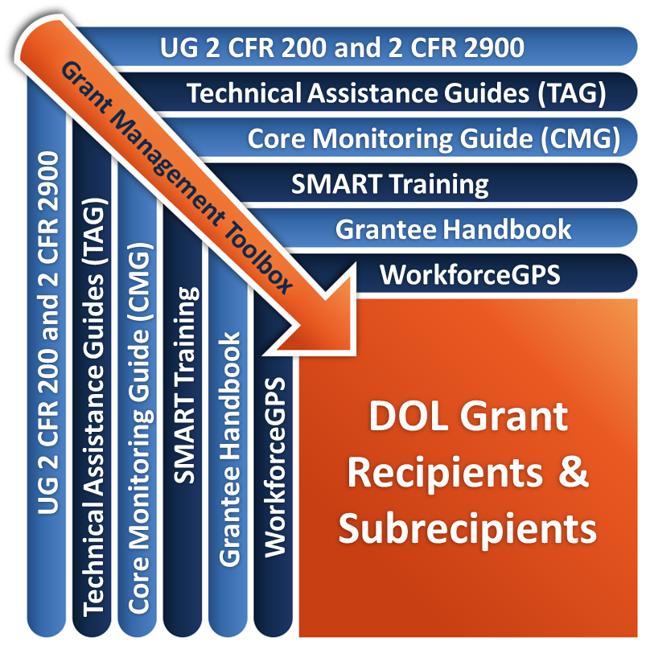
Grant Management Toolbox

Slide 5
Module Overview
Documenting Payroll Distribution
Identify the standards for documenting personnel services
Compensation: Personal Services
Identify the standards for allowable personal services
Compensation: Fringe Benefits
Identify the standards for fringe benefit costs
ETA Salary Cap
Define and apply the salary cap limitations associated with ETA grants

Slide 6
Documenting Payroll Distribution
Identify the standards for documentation of personal services

Slide 7
Basic Standards for Documentation – Definition
2 CFR 200.430(i)
Compensation – Personal Services
Supported by a system of internal controls
Provides reasonable assurances that charges are:
Accurate
Allowable and reasonable
Properly allocated

Slide 8
Basic Standards for Documentation – Payroll Distribution Records
Incorporated into the official records
Supported by a system of internal controls
Reasonably reflect the employee’s total activity
Encompass Federally assisted and all other activities compensated on an integrated basis (method of documentation is used consistently across all programs and encompasses all Federal and non-Federal activities)
Comply with accounting policies and practices
Support the distribution of salary or wages among specific activities or cost objectives

Slide 9
Basic Standards for Documentation – Standards
Meets Standards
Does Not Meet Standards
Payroll records meeting these standards do not need to further document work performed
Same standards apply to documenting salaries and wages for cost sharing and match requirements
Federal government may require personnel activity reports or equivalent if records do not meet these standards
Non-exempt employees must record total number of hours worked each day to comply with FLSA
Institutions of Higher Education may express categories of activities as a %
Intermingled Duties: precision not always feasible

Slide 10
Use of Budget Estimates
Alone does not qualify as support
May be used for interim accounting purposes provided:
They reasonably approximate actual activity performed
Entity identifies and records significant changes in activity
Entity has an internal control system to review after-the-fact actual charges and make needed adjustments
Payroll distribution is reasonable over the long term

Slide 11
Substitute Systems
2 CFR 200.430(i)(5)
Limited applicability
Only states, local governments, Indian tribes
Requires approval of cognizant agency for indirect costs
Random moment sampling
“Rolling” time studies
Case counts
Other quantifiable measures of work performed
Sampling must meet statistical sampling standards
Cognizant agencies encouraged to approve proposals based on outcomes and performance milestones

Slide 12
Substitute Systems?
Establish controls for efficiency and payroll disbursements
Audit testing of payroll distribution method as part of internal control system review
Allow non-Federal entities the flexibility to design and implement an internal control system that best fits its needs
Overall emphasis on a strong internal control system

Slide 13
Knowledge Check 1 - Questions
True or False?
Budget estimates alone provide sufficient documentation of payroll distribution as long as they are approved by the CFO.
Substitute systems may be used to document the distribution of payroll costs whenever they are consistent with the entity’s system of internal controls.
A Federal agency may require the use of personnel activity reports if the recipient fails to meet the payroll distribution standards in the Uniform Guidance.

Slide 14
Knowledge Check 1 - Answers
True or False?
Budget estimates alone provide sufficient documentation of payroll distribution as long as they are approved by the CFO. False
Substitute systems may be used to document the distribution of payroll costs whenever they are consistent with the entity’s system of internal controls. False
A Federal agency may require the use of personnel activity reports if the recipient fails to meet the payroll distribution standards in the Uniform Guidance. True

Slide 15
Compensation: Personal Services
Identify the standards for allowable personal services expenses

Slide 16
Basic Criteria for Compensation – Personal Services
2 CFR 200.430
Reasonable level of compensation
Conforms to established written policy
Follows an allowable appointment
Meets documentation requirements (needs to have written policies & procedures)
Same standards apply to salaries and wages used to meet cost sharing or match requirements

Slide 17
Reasonable Level of Compensation
If consistent with level of compensation paid to employees doing similar work in other activities
Or if no similar position, cost is comparable to that paid for similar work in the local labor market
Separate salary cap requirement applicable to ETA-funded grants (addressed later)

Slide 18
Reasonable Level of Compensation (cont.)
An employee’s time and effort may rely on time sheets or other reports, but the total activity must not exceed 100 percent
An employee only gets paid for actual work performed
Doing the job of two people is not justification to earning more $ - any additional responsibilities and/or compensation should be reflected in the job description and in approved written policies
Does your written compensation and fringe benefit policies or employee handbook address situations where employees have outside jobs that may conflict with the goals and missions of the agency?
See 2 CFR 200.430(h)(4) and 2 CFR 200.430(i)(1)(iii) for provisions regarding extra service pay.

Slide 19
Incentive Compensation
If based on cost reduction, efficient performance, suggestions/safety awards, etc.
Allowable to extent that overall compensation is determined to be reasonable
Pursuant to an agreement between recipient and employee before services were rendered or pursuant to established plan

Slide 20
Federal Funding Accountability and Transparency Act (FFATA)
Direct Grant Reciients - Prime recipients (receiving Federal funding through Federal awards) see 2 CFR Part 170
Awards over $25,000
Report subawards
Report five highest compensated individuals
Single, searchable website www.fsrs.gov
Data uploaded into USASpending.gov
Not an ETA reporting system
ETA pre-populates prime recipient award information
Details available online in ETA training library

Slide 21
Knowledge Check 2 - Questions
True or False?
Compensation for personal services is reasonable if it is comparable to an employee doing similar work in the organization or in the same labor market.
If there is no similar position in the organization, compensation may be established at any level needed to attract qualified candidates.

Slide 22
Knowledge Check 2 - Answers
True or False?
TRUE Compensation for personal services is reasonable if it is comparable to an employee doing similar work in the organization. True
FALSE If there is no similar position in the organization, compensation may be established at any level needed to attract qualified candidates. False

Slide 23
Definition for Compensation – Fringe Benefits
2 CFR 200.431
Fringe benefits are allowances and services provided by employers to their employees as compensation in addition to regular salaries and wages. Fringe benefits include, but are not limited to, the costs of leave (vacation, family-related, sick or military), employee insurance, pensions, and unemployment benefit plans. Except as provided elsewhere in these principles, the costs of fringe benefits are allowable provided that the benefits are reasonable and are required by law, non-Federal entity-employee agreement, or an established policy of the non-Federal entity.
There should be written policies and procedures related to Fringe Benefits.

Slide 24
Compensation: Fringe Benefits
Identify the standards for allowable fringe benefit costs

Slide 25
Fringe Benefit Standards
General Standard is Allowable if:
Reasonable and required by:
Law
Employer -employee agreement
Applies to:
Leave
Established written policy of entity
Life and Health Insurance
Incentive and/or severance pay
Workers Compensation
Pension Plans

Slide 26
Assigning Cost of Fringe Benefits to Cost Objectives
Identifying the cost of specific benefits for specific individual employees
or
Allocating costs on the basis of entity-wide salaries and wages
Separate allocations to selective groupings of employees unless costs in relationships to salaries and wages do not differ significantly for different groups of employees

Slide 27
Recognition of Leave Costs
Cash basis
Accrued as a liability at the time the leave is earned but not yet paid
Accrual basis
Cost recognized when taken and paid
Unused leave after retirement or termination allowable in year of payment as indirect cost
The amount of liability is valued at the lesser of the amount accrued or funded

Slide 28
Pension Costs
Allowable if:
Reasonable
In accordance with established policy
Method of allocation is not discriminatory
If accrual basis, assigned to each fiscal year in accordance with GAAP
Funded for all plan participants within six months after year-end

Slide 29
Severance
Allowable, if required by:
Law,
Employer-employee agreement,
Established policy that constitutes an implied agreement, or
Circumstances of the particular employment.

Slide 30
Severance Categories
Normal Turnover Severance
Allocated to all activities, or
Mass Abnormal Severance
Accruals generally not allowable; prior approval required
Reserve acceptable if charge to current operations is reasonable in light of past payments and if charged to all activities

Slide 31
Other Provisions (2)
Provision on employee morale replaced by allowing for the limited use of Employee Health and Welfare Costs that improve working conditions
Institutions of Higher Education only
Tuition for individual employees are allowable if granted per established policy and distributed to all activities on equitable basis
Not allowable for family members
Other detailed provisions in Uniform Guidance

Slide 32
Pay-As-You-Go Methods
Insurance premiums for Unemployment Insurance, Workers Compensation, health insurance, etc.
Pension plan termination insurance premiums under Employee Retirement Income Security Act (ERISA)
Leave when taken and paid for
Direct payments for workers compensation, unemployment compensation, severance pay, post-retirement health insurance, and similar benefits using a consistent costing policy

Slide 33
Funded Reserves
For Unemployment Compensation and Workers Compensation ONLY, reserves for self-insurance allowable if:
Based on reasonable estimates of the liabilities and the types and extent of coverage
Rates/premiums would have been allowable had insurance been purchased to cover the risks

Slide 34
Funded Reserves – Methods of Calculating
Pension plan costs, and post-retirement health plans not included in a pension plan, may be computed using two methods:
Pay-as-you-go method, or
Acceptable actuarial cost method (in accordance with established written policies)
See 2 CFR 200.431 for extended provisions on methods of calculation and timeframes for payments.

Slide 35
Conflict of Interest and Code of Conduct (Ethics)
Conflict of Interest
Must – 2 CFR Part 200 requires a Conflict of Interest (COI) policy in place for any employee participating in a procurement transaction
Should – Good business practice to apply COI policies to all employees
Code of Conduct (Ethics)
Should – Good business practice to have an agency- wide code of ethics policy for all employees, managers and board members
Policy should address situations where employees have outside or additional employment

Slide 36
Employee Handbook – Written Policies
Employee Handbook should identify the criteria for compensation and fringe benefits
Management compensation and fringe benefit packages should be consistent with industry standards
Handbook should outline salary and bonus limitations
Ensures submission and reporting to USASPENDING.GOV (www.fsrs.gov)
Specifies restrictions and unallowable compensation and fringe benefits

Slide 37
Unallowable Payments
Automobiles unallowable for personal use as fringe benefit or indirect F&A expense
Late charges, excise taxes, penalties under ERISA
Severance in excess of normal amounts or paid contingent on change in management control
Pension fund losses
Increased pension costs due to delay in funding the actuarial liability beyond 30 days after each quarter
Penalties, fines, interest expense

Slide 38
Knowledge Check 3 - Questions
True or False?
Unused leave after retirement or termination is allowable in the year of payment as an indirect cost.
An entity may establish a funded reserve account to cover selected fringe benefit costs instead of using a pay-as-you-go method of payment.

Slide 39
Knowledge Check 3 - Answers
True or False?
Unused leave after retirement or termination is allowable in the year of payment as an indirect cost. True
Under specific circumstances an entity may establish a funded reserve account to cover fringe benefit costs instead of using a pay-as-you-go method of payment. True

Slide 40
ETA Salary Cap
Define and apply the salary cap limitations associated with ETA grants
Current Pay limits on OPM.gov – Executive Schedule (EX) Level II

Slide 41
Personnel Compensation Caps – Implementing PL 109-234
PL 109-234, imposes a cap on compensation for many ETA grants
Applies to all ETA appropriate funds including: grants, contracts, and interagency agreements
Applies to funds available beginning June 15, 2006
Limits salary and bonus payments to individuals
Cap is included in WIOA Section 194(15)
ETA provided guidance in TEGL 5-06

Slide 42
Salary Cap
Cap applies to all WIOA funds and other ETA-funded programs, including:
Wagner-Peyser
UI Administration
Older Worker programs
Native American 166 programs
Veterans’ programs
The portion of other programs funded from ETA appropriations

Slide 43
Salary Cap Exclusions
The salary cap does not apply to the following programs:
H-1B grants – funded by revenues generated by employer fee payments
DUA benefits – funded from FEMA appropriated funds
Job Corps – there is a separate limitation that is applicable
WIOA Incentive grants – funded by Department of Education appropriation
UI Benefits – paid through each state’s UI Trust Fund

Slide 44
Who Is Covered?
Individuals paid by ETA appropriated funds and WIOA funds
Direct recipients and/or subrecipients
Anyone receiving wages or bonus payments from recipients or subrecipients whose grants are funded from ETA appropriations
Direct costs or through an indirect cost rate, including cost allocation plans
Contractors are not subject to limitation

Slide 45
What is Included?
Included
Compensation included on IRS form W-2
Excluded
Fringe benefits
Includes monetary awards, bonus payments, and monetary prizes
Profit sharing, when paid pursuant to established personnel policies as supplement to salary
Sole proprietor or partnership compensation for income realized on IRS Schedule C or E
Non-monetary compensation and corporate profit
Corporate profits paid on per share basis that have required investment

Slide 46
Measuring the Cap Limitation
Full Time RATE not to exceed Executive Level II
- 2019 maximum is $192,300
- Adjusted annually by OPM
Expressed as annual or hourly amount
Calendar year basis – IRS definition
OPM site: http://www.opm.gov/policy-data-oversight/pay-leave/salaries-wages/

Slide 47
Other Provisions
States may set lower limits for subrecipients
Salaries paid by multiple fund sources must be allocated and calculated accordingly
Salaries paid through indirect cost rates must be calculated accordingly
Does not impact consultant rate restrictions

Slide 48
Cap Example 1
Full Time Employees Charged to an ETA Funded Grant or WIOA Funds
Position | Annual Rate | Time spent on the Grant | Salary Cap Limit | Amount over Cap
Director | $200,000 | 100% | $192,300 | $ 7,700
Manager | $100,000 | 100% | $192,300 | 0
CFO | $180,000 | 100% | $192,300 | 0

Slide 49
Cap Example 2
Part-Time Employees Charged to an ETA Funded Grant
Position | A) Annual Rate | B) % of Time on ETA grant | C) ETA Grant Share (A * B) | (D) Salary Cap Limit (B * $192,300) | (E) Amount over Cap (C – D)
Director | $200,000 | 50% | $100,000 | $96,150 | $3,850
Manager | $100,000 | 25% | $25,000 | $48,075 | 0
CFO | $194,000 | 50% | $97,000 | $96,150 | $850
Special Assistant | $100,000 | 75% | $75,000 | $142,200 | 0

Slide 50
Cap Example 3
Indirect Costs Charged to an ETA Funded Grant
Position | % of Indirect Costs Allocable to ETA Grant | Actual Salary | 40.5% of Salary Allocable to ETA Grant | Salary Cap Limit 40.5% * $192,300 | Amount Over Cap Limit
HR Director | 40.5% | $180,000 | $72,900 | $77,881.50 | 0
CFO | 40.5% | $200,000 | $81,000 | $77,881.50 | $3,118.50

Slide 51
Knowledge Check 4 - Questions
True or False?
The salary cap limit applies to direct recipients but not to subrecipients.
Salaries of employees in an indirect cost pool or only working part-time on a DOL grant are excluded from the salary cap limitation.

Slide 52
Knowledge Check 4 - Answers
True or False?
The salary cap limit applies to direct recipients but not subrecipients. False
Employees who charge indirect costs to a WIOA award are excluded from the salary cap limitation. False

Slide 53
Module Summary
The Uniform Guidance relies on the entity’s internal control system as the basis for supporting and documenting payroll distribution.
Payroll and related costs must be allocated on the basis of actual work performed.
The amount of personnel compensation must be reasonable in amount and conform to established written policy.
To be allowable fringe benefits must be reasonable and required by law, employer-employee agreement, or established written policy.
The ETA salary cap limitation applies to all WIOA funded awards, other awards funded by ETA appropriations, and to direct recipients and subrecipients of those funds.

Slide 54
ETA and Uniform Guidance Resources
Core Monitoring Guide
Objective 2.d Procurement and Contract Administration
Grant & Financial Management Technical Assistance Guide
Chapter 6: Procurement, Contracts, and Leases
TEGL 5-06: Implementing the Salary and Bonus Limitations in Public Law 109-234
Uniform Administrative Requirements, Cost Principles, and Audit Requirements for Federal Awards 2 CFR Part 200
2 CFR 200.430
2 CFR 200.431
OPM Salary Website
Select year
Select Executive pay link
Find Executive Level II pay rate
Updated annually
Notes:
54

Slide 55
Web Resources
What is the best way to find your local American Job Center (AJC)?
See DOL’s Service Locator
Want More Information?
DOLETA.gov/Grants
Funding Opportunities
How to Apply
Manage Your Awarded Grant
Resources and Information
ETA Grantee Handbook
Annual Grant Terms Template
Core Monitoring Guide
Technical Assistance Guides
Uniform Guidance Quick Reference Sheet
Want More Training?
Workforce GPS’s Grants Application and Management Community of Practice
Financial Reporting
Subrecipient Management and Oversight
Indirect Cost Rates
Policies and Procedures
Procurement and Performance-Based Contracts
Capital Assets and More
WorkforceGPS
Notes:
55

Slide 56
Questions?

Slide 57
Thank you.
This presentation was developed using Federal funds for training purposes and cannot be used by third parties to earn money or fees.

