Slide 1
Who are you?
TAA Staff
TRA Staff
Both TAA and TRA Staff
Other (write in comments)

Slide 2
Guiding and Coaching Trade-Affected Workers

Slide 3
Susan Worden
Supervisory Program Analyst
USDOL/ETA/OTAA

Slide 4
ETA Introduction – demographic, 2 part navigator webinar, panel Q preview
Best Practice from Oregon
Best Practice from Montana
Panel
Questions
Related Resources and Save the Date

Slide 5
Characteristics of the TAA Participant

Slide 6
NAVIGATOR MODEL
Two Webinars
Guiding and Coaching Trade-Affected Workers
Business Engagement for Successful Outcomes

Slide 7
Panel Questions
Modifying Community College culture to tailor to adult learners
Working with participants in employee cohorts
Developmental Education/Remedial Learning/Work contextualized learning

Slide 8
Laura Lausmann
TAA Liaison
WorkSource Oregon/TAA
David White
Trade Act Navigator
WorkSource Oregon/TAA

Slide 9
Oregon TAA & Training Provider Partnerships
It’s not enough just to build the “bridge”, it must be maintained, so that when we need to cross it - we can.

Slide 10
We utilize Champions when we need to…
Individual
Worker Group
Systems
…think differently.

Slide 11
Individual Level
TAA Student goal: Mechanical Engineering Tech
AAS Industrial Engineering
Advisor error in degree audit review.
Student short 3 credit elective.
7 weeks of TRA completion benefits remaining.
Registration for FA 19 closed.
Contacted Dean of Program for assistance
*Student allowed to Register
Student will complete degree this term and concurrently work with our TAA Navigator for work search.

Slide 12
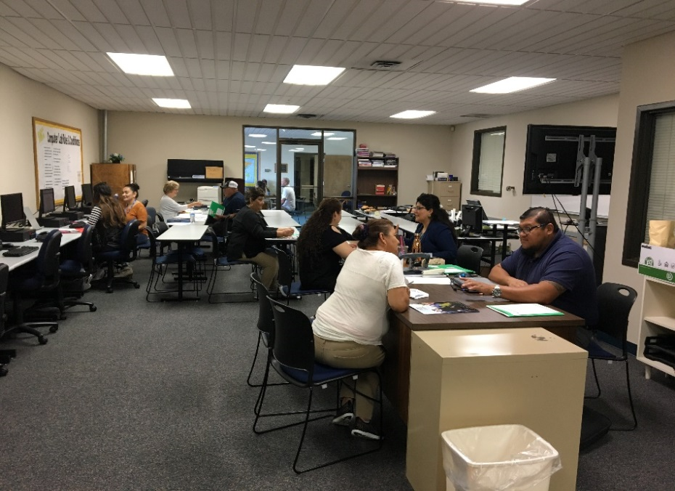
Worker Group Level
Facilitated meeting with ALL partners.
Developed plan to have workshops on campus.
Communication and service plan.
Small Community College – Capacity concerns
Additional Assistance Grant – Partners
50+ Workers – Limited English skills & average of 2nd-5th grade education levels.
TAA hearing workers unable to register
Partner desire to transition to TAA asap
Communication Breakdown
TAA led workshop on campus; TRA station, CC Advising/Enrollment station, TAA Training Proposal station.
*45 Workers registered, enrolled, and approved for needed training.

Slide 13
Systems…
Credential & Pell Grant Data Agreement
Higher Education Coordinating Commission
17 Memorandums of Understanding (partnering)
Community Colleges (CC)
Digital Outreach Screen
@ Community Colleges &
American Job Centers
Meeting with CC President led to invitation for a full page in the brochure they mail out to every household in their county.

Slide 14
Trade Act Navigator Local Point of Contact for Training Providers
Case Manager
Scheduled Campus Hours - available to both staff and students – assist with navigation of enrollment process.
Provides a high level overview of TAA Program and Process Flow.
Advisors, Instructors, & Career Coaches
Assists with College career fairs and invites TAA Completers to attend.
Participate in Career Fairs on campus.
Keeps College informed on Trade Activity in their area and potential increase of need of training.
TAA Navigator
Training
Providers
Participant

Slide 15
Trade Act Navigator Local Point of Contact for Training Participants
Provides guidance through career assessments and job market information and resources.
Assists students in finding Cooperative Work Experience site when college does not provide resources.
Follows up with college staff or student when information is needed by TAA case manager.
Conducts job development on behalf of TAA participant
Connects with local employers and Title 1B partners on OJT opportunities for participants.
Training
Providers
Career Exploration
Enrollment assistance
On campus support
Re-employment Assistance
Proposal Review
Training Approval
Progress Monitoring
Payment Processing
TAA Navigator
Case Manager
Participant

Slide 16
Katy Brooke
RevUp Project Coordinator
Montana University System

Slide 17
Barrier Breakers
Workforce Navigators in Education and the Workforce

Slide 18
Why Navigators?

Slide 19
RevUp Montana Navigator Pilot
Active Recruitment
Active Intervention
Reaching those not currently being targeted by education and training systems
Meeting participants where they are – physically and emotionally
Helping guide participants through difficult systems
Identifying and addressing barriers on an individual level
Following participants throughout their training to employment

Slide 20
Strengths-Based Assessment
Help participants identify feasible, specific and informed career goals
Help participants identify specific barriers to their goals
Connect participants to resources across agencies that can help them mitigate those barriers
The strength based approach often involves artfully asking questions to have participants articulate their own solutions
Reassure participants that have inherent skills, abilities and supports that can help vault them to success
Teach participants to begin establishing a long-term growth mindset and relying on their own strengths to reach their goals

Slide 21
Strengths-Based Assessment Tool

Slide 22
Targeted Training/Career Plan

Slide 23
Placement & Follow-Up
Establish relationships with local industry to have access to hiring avenues
Place participants in jobs that will align with their career goals and with the needs of employers
Follow-up with participants to ensure that the jobs remain a good fit for both them and for the employer
Report back to training providers with feedback from businesses on success/unsuccessful hiring based on training
Utilize industry partnerships to identify gaps in training that providers could address to make participants more desirable as employees

Slide 24
Workforce Navigator Training Modules
[Video]

Slide 25
Workforce Navigator Training Modules
Web-based Training
https://revupnavigator.wordpress.com/
Downloadable Modules (for desktop)
https://www.skillscommons.org/handle/taaccct/238
Field Guide of TAACCCT Innovations
http://support.skillscommons.org/showcases/field-guide/student-support/

Slide 26
Panel Questions
Modifying Community College culture to tailor to adult learners

Slide 27
Panel Questions
2. Working with participants in employee cohorts

Slide 28
Panel Questions
3. Developmental Education/Remedial Learning/Work contextualized learning

Slide 30
Business Engagement
November 19, 2019, 3-4:30PM Eastern
Seven Tips for Preparing Approvable TAA Program Reserve Funding Requests
December 11, 2019, 2:30-3:30PM Eastern

Slide 31
TAA Community on WorkforceGPS
Continue the Discussions!
https://taa.workforcegps.org/
OJT FAQ
On-The-Job Training (OJT) and the Trade Adjustment Assistance (TAA) Program: Frequently Asked Questions (FAQ) and Myths & Barriers/How to Overcome Them
https://www.doleta.gov/tradeact/benefits/docs/TAA_OJT_FAQ.pdf
Apprenticeship contacts
https://www.doleta.gov/oa/contactlist.cfm
Virginia Best Practice Model: Workforce & Adult Education Working Together
Webinar
https://www.workforcegps.org/events/2017/12/19/18/45/Virginia-Best-Practice-Model-Workforce-Adult-Education-Working-Together
On-The-Job Training (OJT) Best Practices and the Trade Adjustment Assistance (TAA) Program
Webinar
https://www.workforcegps.org/events/2019/02/20/15/45/On-The-Job-Training-OJT-Best-Practices-and-the-Trade-Adjustment-Assistance-TAA-Program

Slide 32
Susan Worden
Supervisory Program Analyst
USDOL/ETA/OTAA
Worden.susan@dol.gov
202.693.3517
Katy Brooke
Perkins Program Manager
Montana University System
kbrooke@montana.edu
406.407.2104
Laura Lausmann
TAA Liaison
WorkSource Oregon
Laura.E.Lausmann@oregon.gov
503.947.1236
David White
Portland Metro Trade Act Navigator
WorkSource Oregon
David.A.White@oregon.gov
503.341.5441

