Slide 1
What is your level of experience with Incumbent Worker Training?
High
Limited
Low
None

Slide 3
Business Engagement Series:
Incumbent Worker Training As A Business Service

Slide 4
Jeff Ryan
Business Solutions Specialist
US DOL/ETA

Slide 5
Marty Holliday
Executive Director
New River/Mount Rogers Workforce Development Board
Jenny Bolte
Deputy Director
New River/Mount Rogers Workforce Development Board

Slide 6
Kimber Simmons
Business Services Coordinator
New River/Mount Rogers Workforce Development Board
Lacy Hatcher
HR Director
ProChem, Inc
Adriana Kaplan
Workforce Analyst
Office of Workforce Investment, ETA

Slide 7
Introduction/Overview

Slide 8
Does your organization use resources for incumbent worker training?
Yes, we use WIOA funds
Yes, we use non-WIOA funds
Yes, we use both WIOA and non-WIOA funds
No
Not sure

Slide 9
Purpose of today’s webinar
We are kicking off our business engagement webinar series with a 3-pack of sessions focused on incumbent worker training as a business service
Today we are thrilled to be joined by folks from the New River/Mount Rogers Workforce Development Board to talk about how they utilize resources to provide incumbent worker training as a business service

Slide 10
What is business engagement?
A comprehensive, value-added set of strategies, activities, and partnerships designed to support and promote economic prosperity by providing valuable solutions to address the needs of businesses
The purpose of business engagement programs is to promote long-term economic stability, competitiveness, and growth
Business engagement is about more than just workforce services!

Slide 11
Value of Business Engagement
Successful, thriving businesses are a vital component of economic prosperity
Economic prosperity is of course an outcome that benefits workers and their communities as well as businesses
Whether we represent workforce development, economic development, education or any other government programs, ensuring business success through strong business engagement programs is critical

Slide 12
IWT as a Business Service
Business engagement is a big topic, so today we wanted to start with a discussion about a specific part
In future webinars we’ll broaden our focus, but today we are talking about using incumbent worker training as a business service

Slide 13
IWT Overview
Increases both participants’ and companies’ competitiveness so that businesses can prosper
Two primary reasons to use IWT:
It builds worker skills, so they can be promoted within the company and create backfill opportunities
Helps avert potential layoffs of employees
Many possible sources of funding for IWT, including WIOA
Adult & Dislocated Worker formula (limited to 20%)
Rapid Response funds (activities must be part of a layoff aversion strategy or activity)

Slide 15
New River/Mount Rogers Workforce Development Board
Mission
The New River/Mount Rogers Workforce Development Board supports the region’s economy through a collaborative approach to meeting needs of businesses and job seekers that is flexible and adaptable to the changing economic ecosystem. And we hold ourselves accountable to all our stakeholders in the region
Vision
The New River/Mount Rogers Workforce Development Board envisions a region where every business has access to a qualified, job-ready workforce and every citizen in the region has the skills needed to secure meaningful employment, competitive wages, and career advancement through an integrated workforce support infrastructure.

Slide 16
New River/Mount Rogers Workforce Development Board
Strategic Plan
Goal 1: Increase Business engagement and deliver value to the region’s business customers
Support the development of least one Sector Partnership in each of the four BSU areas (and/or connect with industry organizations already meeting) through sector partnerships.
Enhance collaboration among partners to provide at least one new training program/initiative each year.
Evaluate the effectiveness of the sector partnership and strategy through regular surveying of industry partners.

Slide 17
New River/Mount Rogers Workforce Development Board
America’s Promise Job Driven Grant Program
Building a pipeline of skilled workers to help businesses fill existing job openings and meet job needs for expansion.
$6,000,000 to serve 1,100 People in Manufacturing, Healthcare, and Information Technology Industries

Slide 18
New River/Mount Rogers Workforce Development Board
Includes Four Workforce Development Areas (34 Jurisdictions) in the Commonwealth of Virginia

Slide 19
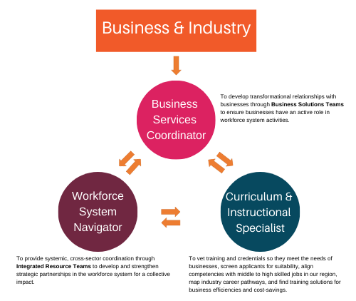
New River/Mount Rogers Workforce Development Board

Slide 20
New River/Mount Rogers Workforce Development Board
Customer Relationship Management System
to Evaluate, Report, Follow-up, Outreach, Monitor, and Manage
our Business and Participant Customers

Slide 21
New River/Mount Rogers Workforce Development Board
Our Philosophy of Business Engagement
Don’t go searching for a problem to fit your solution.
Don’t ask the company to mold their problems to fit your solution.

Slide 22
New River/Mount Rogers Workforce Development Board
Listen
Take information and work on some possibilities.
Programs and funding are tools in the toolbox.
All staff engaging businesses should have training in active listening.

Slide 23
New River/Mount Rogers Workforce Development Board
Pay Attention & Ask Questions
You’re not there to sell services, programs, or people.
Focus on Needs and Solutions.

Slide 24
New River/Mount Rogers Workforce Development Board
Business Services Team
Absolutely necessary in order to provide holistic services to businesses.

Slide 25
New River/Mount Rogers Workforce Development Board
Incumbent Worker Training
A win-win for the company and its employee.
A tool to open a business’s door.
A great way to forge a relationship with a company.
Easiest referral for our partners to make.

Slide 26
New River/Mount Rogers Workforce Development Board
From a Business’s Perspective

Slide 27
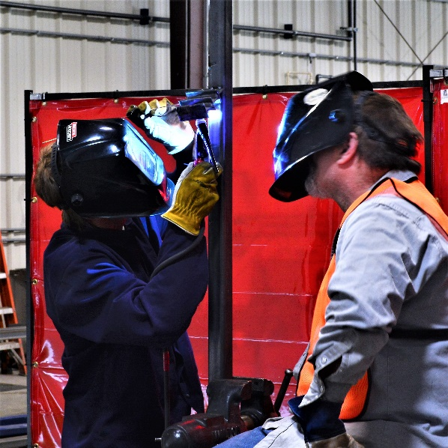
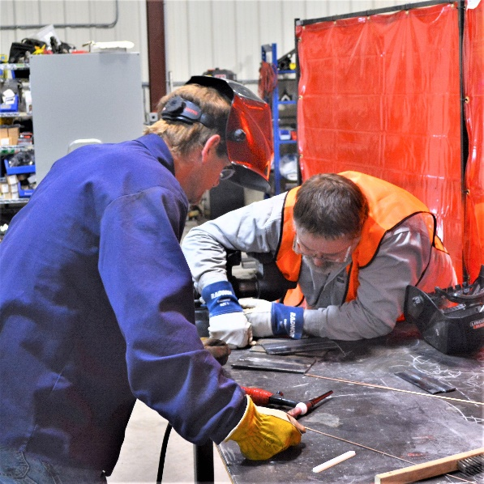
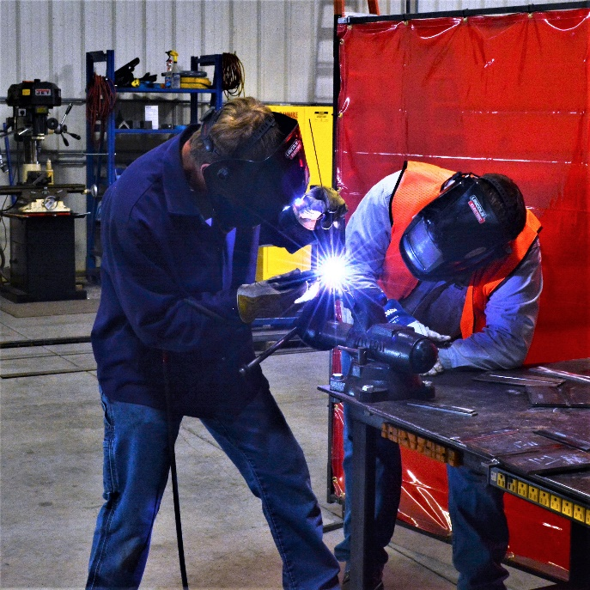
New River/Mount Rogers Workforce Development Board

Slide 28
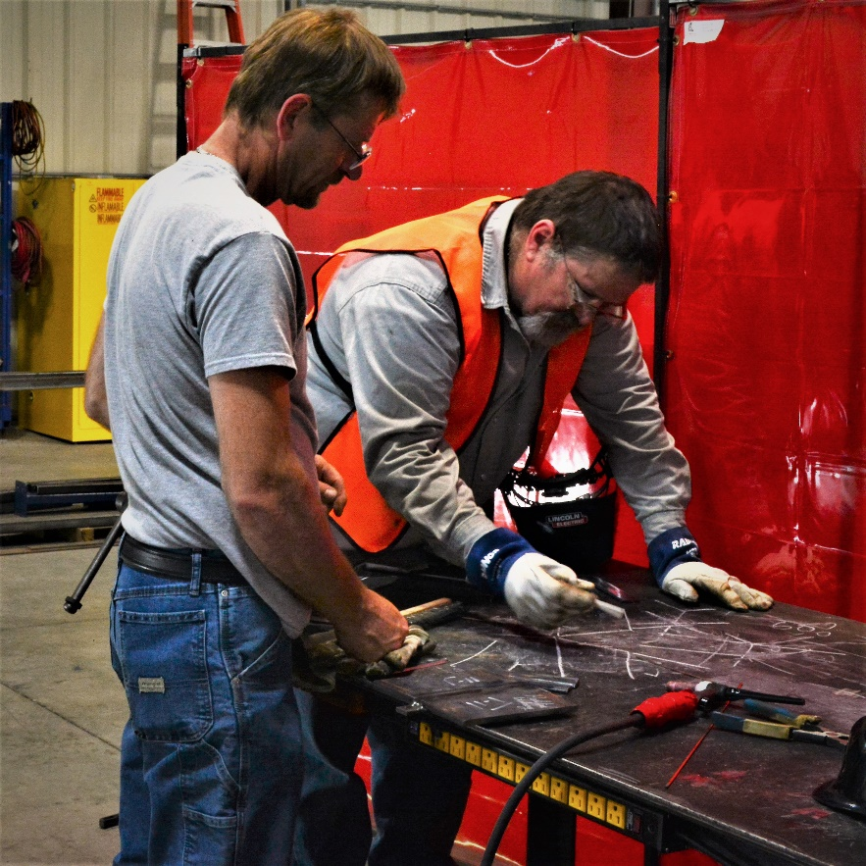
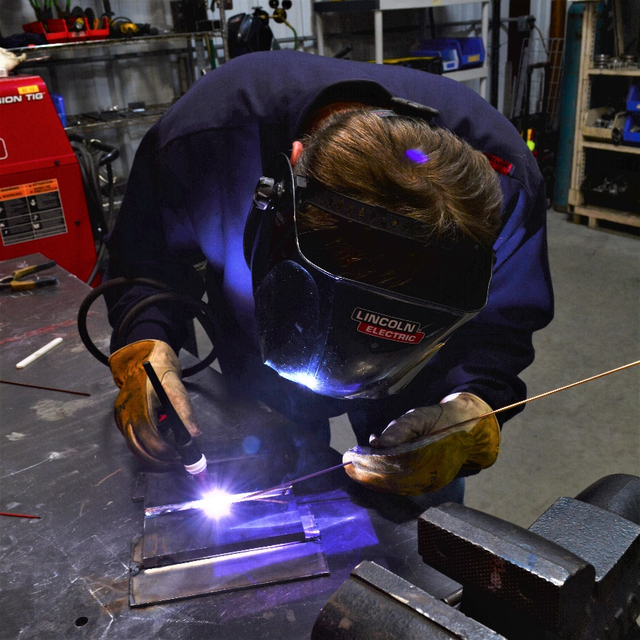
New River/Mount Rogers Workforce Development Board

Slide 29
Incumbent Worker Training Toolkit
Under construction, share comments

Slide 30
IWT Resources
ETA is currently developing a Tool Kit for incumbent worker training resources
The IWT Tool Kit will contain the following documents:
Policy and Procedures Manual
IWT Training Program
IWT Work Plan
IWT Registration Form
IWT Training Needs Assessment
IWT PowerPoint Deck
Please let us know in the comments if there are additional areas you’d like the Tool Kit to address

Slide 31
IWT Resources
The Tool Kit will live on the Incumbent Worker Training resource page on ION, which is part of Workforce GPS
Existing resources on this site include a desk aid and other materials on work-based-learning models.
https://ion.workforcegps.org/resources/2019/05/08/15/08/Incumbent-Worker-Training-IWT

Slide 32
Wrap Up
Thanks to today’s presenters!
Please reach out to them if you have any additional questions
Keep an eye out for additional webinars on various business engagement topics
Let us know in the comments if you have any particular topics that interest you!

Slide 34
Marty Holliday
Executive Director
New River/Mount Rogers Workforce Development Board
Marty.holliday@vcwnrmr.com
540-357-0651
Jenny Bolte
Deputy Director
New River/Mount Rogers Workforce Development Board
Jenny.bolte@vcwnrmr.com
540-838-9400
Kimber Simmons
Business Services Coordinator
New River/Mount Rogers Workforce Development Board
Kimber.simmons@vcwnrmr.com
540-357-1651

