Slide 1
Property Management: Supplies, Equipment, and Intangible Property
SMART 3.0 Training
November 19, 2019

Slide 2
Today’s Speakers
Chanel Castaneda
Grants Management Specialist
U.S. Department of Labor – OGM DPRR
Chicago, IL
Castaneda.Chanel@dol.gov
Trevor Capon
Federal Project Officer
U.S. Department of Labor – Region 1
Boston, MA
Capon.Trevor@dol.gov

Slide 3
SMART 3.0 Training Strategies
S
SMART 3.0 Training Series:
The training modules are focused on: Strategies for sound grant management that includes: Monitoring, Accountability, Risk mitigation and Transparency
These four themes are weaved throughout the OMB Uniform Administrative Requirements, Cost Principles, and Audit Requirements for Federal Awards also known as the Uniform Guidance (2 CFR Part 200 and 2 CFR Part 2900).
Strategies
M
Monitoring
A
Accountability
R
Risk Mitigation
T
Transparency

Slide 4
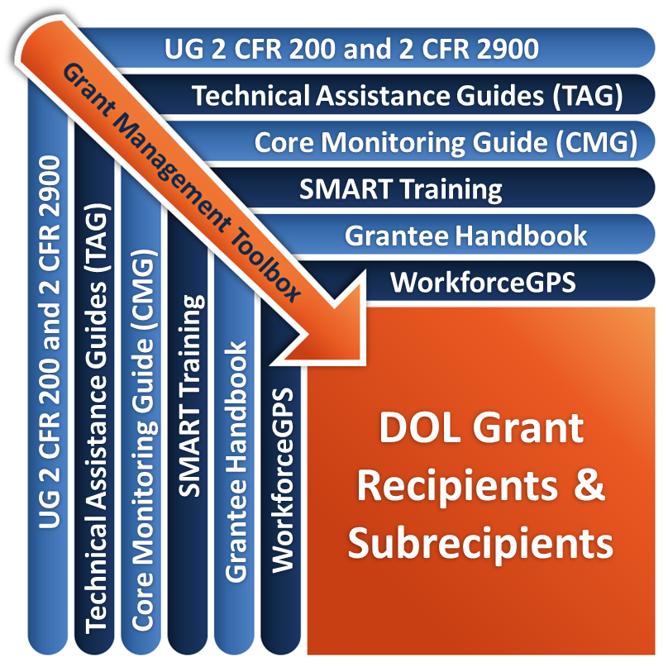
Grant Management Toolbox

Slide 5
Module Overview
Equipment
Intangible Property
Property Management Standards
Supplies
Prior Written Approval
Common Mistakes

Slide 6
Equipment
Define equipment
Discuss allowable costs and costs tracking
Explain change in Uniform Guidance related to fully depreciated assets

Slide 7
Equipment – Definition
2 CFR 200.33
Tangible personal property (including information technology systems) having a useful life of more than one year and a per-unit acquisition cost which equals or exceeds the lesser of the capitalization level established by the non-Federal entity for financial statement purposes, or $5,000.

Slide 8
Capital Assets
2 CFR 200.12
Tangible or intangible
Useful life of more than one year
Includes equipment and intellectual property
Capital asset levels
$5,000
Non-federal entities may have lower capital thresholds but not higher thresholds

Slide 9
Equipment Types
General Purpose (2 CFR 200.48)
Special Purpose (2 CFR 200.89)
Information Technology Systems (2 CFR 200.58)
Equipment not limited to technical activities
Used for research, medical, scientific, or other technical activities
Included in the definition of general purpose equipment

Slide 10
Buy American Act (BAA)
41 U.S.C. 8301-8303
The Buy American Act requires the grant recipient to use, with limited exceptions, only
Unmanufactured articles, materials, and supplies that have been mined or produced in the United States, and
Manufactures articles, materials, and supplies that have been manufactured in the United States substantially all from articles, materials or supplies that were mined, produced, or manufactured in the United States.

Slide 11
Allowable Cost for Equipment
Use by one program
If specifically authorized under a federal award, costs are assignable to the federal award regardless of later use when no longer needed for original purpose
Costs are directly charged to the authorized program at the time expended
Use by multiple programs
Allocate costs based on relative benefit and proportional use
Insurance and maintenance costs are allowable
Depreciation costs are allowable for non-Federal entity-owned equipment for remaining useful life

Slide 12
Depreciation – Definition
Depreciation is not allowed on equipment purchased with grant funds as the costs are directly charged to the Federal award at the time of acquisition.
Non-Federal entities may be compensated for the use of their equipment, donated equipment, and software projects capitalized in accordance with Generally Accepted Accounting Principles (GAAP)
Compensation must be made by computing depreciation for the accounting period based upon the pattern of use
Can not charge if fully depreciated (including a use allowance)

Slide 13
Depreciation – Rules
Allocation for depreciation must be made in accordance with 2 CFR part 200 Appendices IV through VIII.
Depreciation is computed based on acquisition costs and useful life of equipment.
Acquisition costs excludes:
Any portion of the costs borne by or donated by the Federal agency
Any portion of the costs contributed by or for the non-Federal entity where law or agreement prohibits recovery
Any asset acquired solely for the performance of a Federal award

Slide 14
Depreciation – Considerations
Useful life period must take into consideration
Nature of the equipment
Technological developments in the particular area
Historical data
Renewal and replacement policies followed for the individual items or classes of assets involved
Must use straight line depreciation
Absent clear evidence indicating equipment consumption is greater earlier than later in its useful life
Changes in depreciation methods requires prior approval

Slide 15
Depreciation – Requirements
May not depreciate equipment directly expensed, fully depreciated, or outlived useful life: use allowance not allowed
Donated equipment:
May be depreciated against grant; or claimed as match; but not both
Must be valuated at fair market value of equipment of same age and condition at time donated
Charges for depreciation must be supported by adequate property records
Physical inventories must be taken at least once every two years to ensure that the equipment exists and is usable, used, and needed

Slide 16
Knowledge Check 1 – Questions
True or False?
A non-Federal entity may directly charge to the Federal award the cost of equipment it purchased with non-Federal funds.

Slide 17
Knowledge Check 1 – Answers
A non-Federal entity may directly charge to the Federal award the cost of equipment it purchased with non-Federal funds. False

Slide 18
Intangible Property
Definition
Examples
Grant Provisions
Intellectual Property

Slide 19
Intangible Property – Definition
2 CFR 200.59
Intangible property means property having no physical existence, such as trademarks, copyrights, patents and patent applications, and property, such as loans, notes and other debt instruments, lease agreements, stock and other instruments of property ownership (whether the property is tangible or intangible).

Slide 20
Examples of Intangible Property
Copyrights
Registered by the Library of Congress.
Grants the right to exclusive publication, production, sale, or distribution of the work.
Trademarks
Word, name, symbol, device or combination.
Products or goods that are sold.
Patents
Inventors have exclusive rights to the benefits of inventions or improvements for a specified time period.
Service Marks
Loans, Notes, or Other Debt
Distinguishes your services from the competition.
May not apply to ETA grants.

Slide 21
Intangible Property – Usage
2 CFR 200.315
The Federal government reserves the rights to:
Obtain, reproduce, publish
Authorize others to receive, reproduce, publish
Title to intangible property (see 2 CFR 200.59 Intangible property) acquired under a Federal award vests upon acquisition in the non-Federal entity

Slide 22
Intellectual Property – Grant Provision
Government has a paid-up, nonexclusive and irrevocable license to use or authorize others to use intellectual property developed with grant funds
2 CFR 200.315(b)
The non-Federal entity may copyright any work that is subject to copyright and was developed, or for which ownership was acquired, under a Federal award. The Federal awarding agency reserves a royalty-free, nonexclusive and irrevocable right to reproduce, publish, or otherwise use the work for Federal purposes, and to authorize others to do so.

Slide 23
Quote
This workforce product was funded by a grant awarded by the U.S. Department of Labor’s Employment and Training Administration. The product was created by the grantee and does not necessarily reflect the official position of the U.S. Department of Labor. The Department of Labor makes no guarantees, warranties, or assurance of any kind, express or implied, with respect to such information, including, but not limited to, accuracy of the information or its completeness, timeliness, usefulness, adequacy, continued availability, or ownership. This solution is copyrighted by the Institution that created it. Internal use by an organization, and/or personal use by an individual or for non-commercial purposes, is permissible. All other uses require the prior authorization of the copyright owner.
DOL Grant Provision for Intellectual Property

Slide 24
Intellectual Property – Open Licensing
The Department of Labor’s competitive grant awards represent investments in the next generation of open educational resources (OER) by requiring that DOL-funded intellectual property developed under competitively-awarded grant programs, including digital content, be openly licensed for free use, adaptation, and improvement by others.
https://grantsapplicationandmanagement.workforcegps.org/resources/2018/08/01/13/55/Other-Resources

Slide 25
Equipment Use, Management, and Disposition Standards
Discuss equipment use, management and disposition standards, including user fees
Discuss types of internal controls

Slide 26
Equipment Use, Management, and Disposition Standards – Definition
States – follow their own policies and procedures
Other non-federal entities – must follow specific requirements of 2 CFR 200.313(c)-(e)
Same for all types of equipment

Slide 27
Equipment Use Standards
Priority order of use of equipment on projects or programs
Must be used for the originally-authorized purpose until funding ceases or no longer needed for the purposes of the project.
The equipment may be retained as long as needed for the project/program, whether or not the project/program continues to be supported by the Federal award.
When not needed for the original program or project may be used in following order of priority
Other DOL-funded activities
Activities under Federal awards for other than DOL, including consolidating equipment for information technology systems

Slide 28
Equipment Use Standards (cont.)
Availability of the use of equipment during grant period of performance
Non-Federal entity must make equipment available for use on other current or previous federally-funded projects if such use does not interfere with project for which originally acquired
Order of preference for use on other programs
Other DOL-funded activities
Other non-DOL federally-funded awards
Non-federally-funded programs or projects is also permissible
User fees should be considered if appropriate at a fee not be less than private entities charge for equivalent service

Slide 29
Equipment Management Standards
Property records inventory system
Property description
Serial number or other identification number
Funding source, including Federal Award Identification Number
Title holder
Date acquired
Cost
Federal percentage of participation
Location, use and condition
Ultimate disposition data
Physical inventory and reconciliation at least every two years

Slide 30
Equipment Management Standards (cont.)
Maintenance
Property should be maintained in good, working order
Insurance
Required for equipment purchased/improved with Federal funds
Insurance costs are allowable
Federal government not liable for insurance cost
Disposition policy/procedures
Procedures for requesting disposition instructions from ETA
Proper sales procedures, when authorized, to sell
Charges for depreciation must be supported by adequate property records
Physical inventories must be taken at least once every two years to ensure that the equipment exists and is usable, used, and needed

Slide 31
Equipment Disposition Standards
2 CFR 200.311(e)
Same for all types of equipment with a fair market value of $5,000 at the time of disposition
Non-federal entities must request disposition instructions from the federal awarding agency if required by the terms and conditions of the Federal award
Options for disposition include:
Keeping the property
Selling the property
Transferring the title to a third-party
Failure to take disposition actions may result in ETA directing the entity to take disposition actions

Slide 32
Equipment Disposition Process
ETA retains authority over disposition of property
End of direct grant’s period of performance
Subrecipients
Formula grants to State – end of period of performance:
States follow own procedures
States establish process for:
State subrecipients
Local areas
Local subrecipients

Slide 33
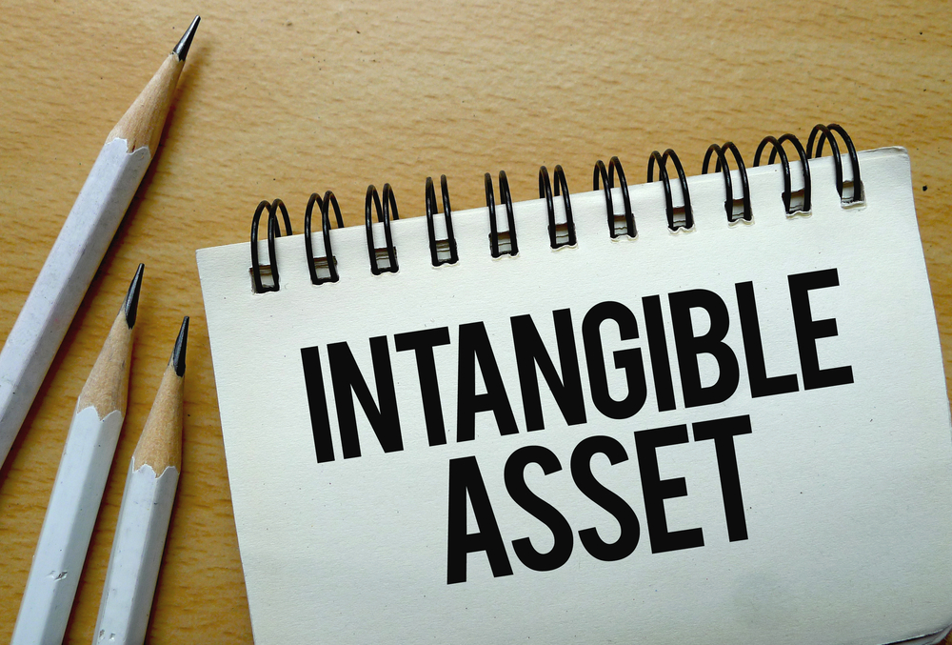
Intangible Property Disposition Standards
2 CFR 200.315(a)
Follows the disposition requirements related to equipment at 2 CFR 200.313(e)

Slide 34
Knowledge Check 2 – Questions
True or False?
A physical inventory of equipment is not necessary in years when no additional equipment has been purchased.

Slide 35
Knowledge Check 2 – Answers
A physical inventory of equipment is not necessary in years when no additional equipment has been purchased. False

Slide 36
Internal Controls
Purpose
Requirements
Policies and Procedures
Personally Identifiable Information (PII)

Slide 37
Internal Controls – Requirements
Equipment inventory – physical inventory; 2 years
Procedures to maintain equipment in good working order
Segregation of duties
Risk assessment to minimize loss of equipment
Activities to safeguard assets
Custody controls
Record retention

Slide 38
Internal Controls – Policies & Procedures
Policies and procedures
Manage donated property
Prevent unnecessary purchases
Maintain property records
Take custody of equipment from subrecipients
Requests for transfer of records
Methods for collection, transmission and storage of information
Access to records

Slide 39
Internal Controls – Transfer of Custody
To take custody of subrecipient equipment, supplies, intangible property when
Subawardee goes out of business
Subaward is terminated early for cause
Pass-through entity should
Update subaward boilerplate language/policies and procedures that outline ownership, title, and transfer process

Slide 40
Internal Controls -PII
Personally Identifiable Information (PII)
Must have system tracking, securing and accounting for equipment including securing the employee and participant PII housed in the equipment or computers/laptops/servers

Slide 41
Documentation
Estimates of costs and related documentation
Prior approvals
Maintain inventory and conduct physical inventory (detailed information)
Percentage of participation by Federal programs in cost
Supporting documentation for property charges
Record retention – three years after disposition or submission of final expenditure report, whichever is later (2 CFR 200.333 Retention requirements for records)

Slide 42
Supplies
Define and discuss supplies
Discuss disposition standards

Slide 43
Supplies – Definition
2 CFR 200.94
In contrast to Equipment…Supplies are all tangible personal property other than that described in 2 CFR 200.33 Equipment.
A computing device is a supply if the acquisition cost is below the lesser of the capitalization levels established by the non-Federal entity for financial statement purposes or $5,000, regardless of the length of its useful life.

Slide 44
Use and Disposition of Supplies
2 CFR 200.314
Must be used to support the Federal program for which they were purchased
May be used for non-Federally funded programs
User fees should be considered, if appropriate
Program income
If aggregate value of residual unused inventory exceeds $5,000 at end of grant
May use on other Federal programs
Must use on other non-Federal programs, or sell, but must compensate Federal agency for its share

Slide 45
Prior Written Approval
Explain the Uniform Guidance requirements relative to property prior approvals
Discuss review and approval process

Slide 46
Prior Written Approval
The Uniform Guidance requires prior approval for purchase of equipment
Requests for prior approval must be submitted in writing to the Grant Officer at least 30 days prior to the effective date of the requested action (DOL’s exception 2 CFR 2900.10)
The Grant Officer’s approval must be in writing

Slide 47
Prior Approval Process
State Formula Grants – Governor
Prior approval has been delegated to the governor unless noted in the grant award.
Subrecipients obtain prior approval from the governor.
State Other Direct Grants – Grant Officer
Prior approval requirements are not delegated. Must be given by Grant Officer.
Subrecipients must go through State for prior approval.
States request prior approval for the subrecipients from the Grant Officer.
Direct Grants (Non-State) – Grant Officer
Prior approval requirements are not delegated. Must be given by Grant Officer.
Subrecipients must go through direct grant recipient for prior approval.
Direct grant recipient requests prior approval for the subrecipients from the Grant Officer.

Slide 48
Review and Approval Process
Pass-Through Entities assign responsibility for managing prior approval requests at all levels, as appropriate, following proper protocol
Develop a process
Receipt
Review
Approval/disapproval
Criteria
Documentation
Justification
Reasonableness of cost
Need

Slide 49
Knowledge Check 3 – Questions
True or False?
A grant recipient purchased a computer costing $4,000 but failed to obtain prior approval. The grant recipient may incur questioned costs for this purchase.

Slide 50
Knowledge Check 3 – Answers
A grant recipient purchased a computer costing $4,000 but failed to obtain prior approval. The grant recipient may incur questioned costs for this purchase. False

Slide 51
Common Mistakes
Describe common mistakes related to equipment

Slide 52
Common Mistakes related to equipment
Expending grant funds on property without obtaining required prior approvals
Failing to receive disposition instructions before disposing of property
Loss/theft of property due to lack of oversight of subrecipients’ property management systems
Lack of internal and accountability controls over electronic information systems and PII of employees and customers

Slide 53
Core Monitoring Guide – Objective 2.c: Property Management
Indicator 2.c.3: Equipment
For equipment that was purchased with grant funds, was prior approval received prior to the acquisition or disposition of that equipment?
Indicator 2.c.5: Supplies
Does the grant recipient have policies and procedures covering supplies?
What procedure toes the grant recipient have in place to recognize and differentiate when supplies and equipment are purchased with grant funds?
Indicator 2.c.6: Intangible Property
Has the grant recipient acquired or developed any intangible property with grant funds?
Notes:
53

Slide 54
SMART Checklist
Property Management
Incorporate the following terms and definitions into written policies and procedures covering assets and inventory systems: computing devices, supplies, equipment, intellectual property, information technology systems, creative commons, specialized equipment, land, buildings, and idle facilities.
Develop or update procedures that outline the responsibilities of the submission, review, and authorization of prior approval requests for equipment purchases by organization and subrecipients.
Notes:
54

Slide 55
SMART Checklist (cont.)
Update contract boilerplate language and develop or update procedures that outline ownership, title, and transfer of equipment, property, intangible property, or other assets (such as supplies) purchased by contractor and subrecipients using grant funds.
Outline instructions and timelines for disposition and/or grant closeout of property, equipment, intangible property, or other assets (such as supplies) purchased directly with DOL grant funds or by a subrecipient.
Ensure periodic inventory checks are performed of grant purchased property and inventory or property records contains the required information outlined in the Uniform Guidance.
Notes:
55

Slide 56
Module Review
Prior written approval is required for equipment purchases in excess of $5,000 for discretionary grants
The Federal government retains an interest in intangible property
ETA recipients must provide a Creative Commons attribution license to intellectual property produced with assistance from grant funds
Internal control systems are required to protect property and PII housed in equipment/computers/laptops/servers
Disposition instructions must be requested from ETA for most types of capital assets

Slide 57
ETA and Uniform Guidance Resources
Core Monitoring Guide
Objective 2.c Property Management
Grant Management TAG
Chapter 5: Property Management
Buy American Act
Uniform Administrative Requirements, Cost Principles, and Audit Requirements for Federal Awards 2 CFR Part 200
2 CFR 200.33
2 CFR 200.48
2 CFR 200.58
2 CFR 200.59
2 CFR 200.89
2 CFR 200.94
2 CFR 200.246
2 CFR 200.306
2 CFR 200.311
2 CFR 200.313
2 CFR 200.315
2 CFR 200.333
2 CFR 200.436

Slide 58
Web Resources
What is the best way to find your local American Job Center (AJC)?
See DOL’s Service Locator
Want More Information?
DOLETA.gov/Grants
Funding Opportunities
How to Apply
Manage Your Awarded Grant
Resources and Information
ETA Grantee Handbook
Annual Grant Terms Template
Core Monitoring Guide
Technical Assistance Guides
Uniform Guidance Quick Reference Sheet
Want More Training?
Workforce GPS’s Grants Application and Management Community of Practice
Financial Reporting
Subrecipient Management and Oversight
Indirect Cost Rates
Policies and Procedures
Procurement and Performance-Based Contracts
Capital Assets and More
WorkforceGPS

Slide 59
Remember the Grant Management Toolbox!

Slide 60
Questions?

Slide 61
Putting it all Together
What’s next?

Slide 62
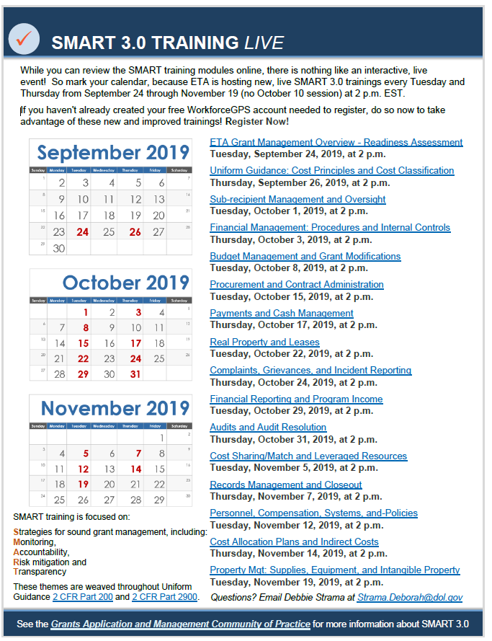
9 Weeks of e-SMART Training
We have trained over 5,000 people throughout this series
Nationwide launch
16 modules on grants administration and fiscal operations
Heard from 10 different experts from the National and Regional Offices

Slide 63
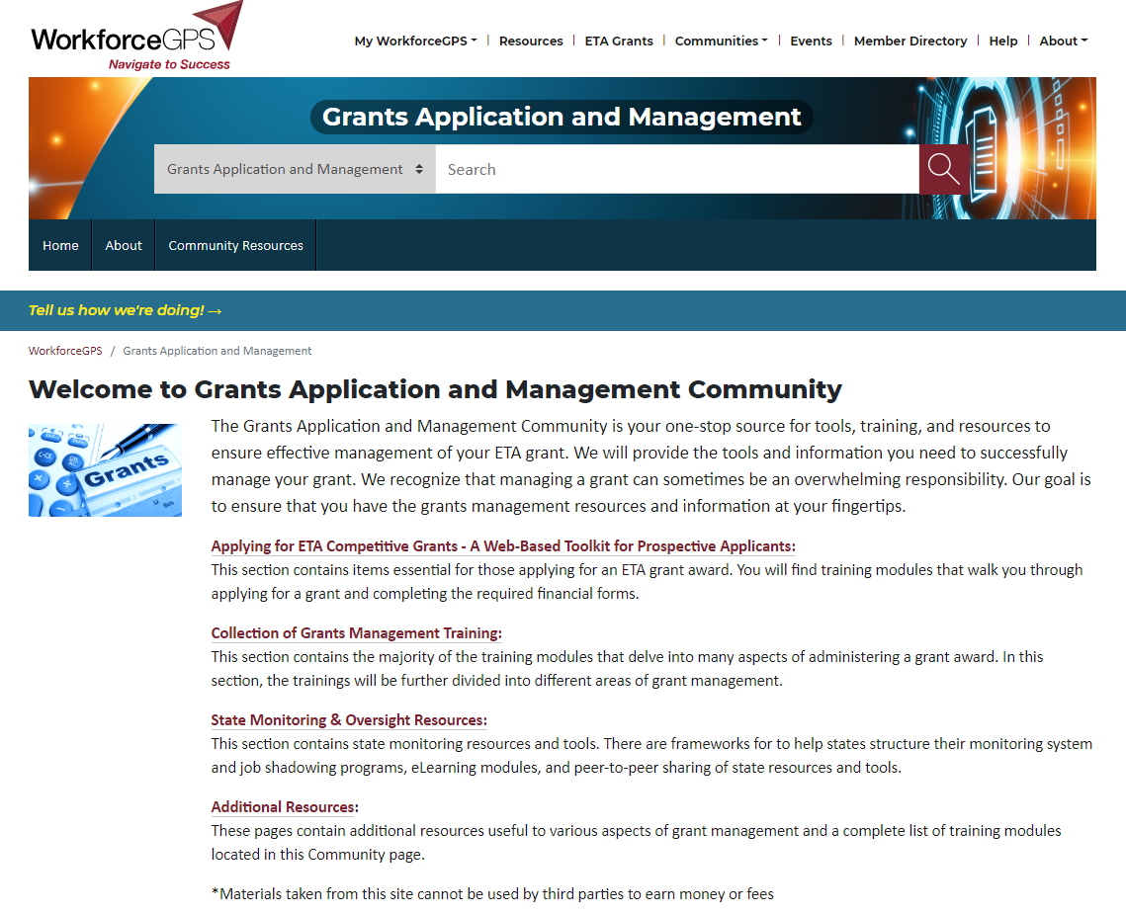
Where can you find past e-SMART sessions?
All 16 sessions have been recorded
Each have an accompanying transcript
You can find all the PPTs and other resources on the Grants Application and Management Community of Practice on WorkforceGPS
https://grantsapplicationandmanagement.workforcegps.org/

Slide 64
Spread the Word and Share the Knowledge
Let your colleagues know about e-SMART
Have new hires (on the program and fiscal side) listen to the recorded audios
Experienced grant staff can use a refresher
Remember our SMART Training Strategies
SMART is Uniform Guidance training that is focused on: Strategies for sound grant management that includes: Monitoring, Accountability, Risk mitigation and Transparency
Use our e-SMART PPTs (located on Grants Application and Management CoP)
Free to use (created using Federal funds) but cannot distribute or sell for a fee/profit
Sign up to WorkforceGPS
Receive emails when ETA puts up new resources

Slide 65
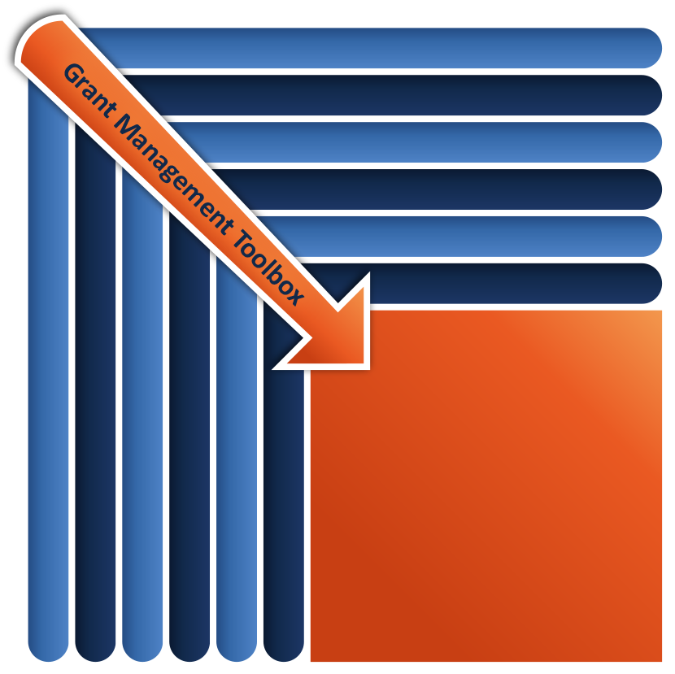
Familiarize yourself with the Grants Management Toolbox
UG 2 CFR 200 and 2 CFR 2900
Know how to access these resources
Remember our web resources
Use your FPO as a resource
Technical Assistance Guide (TAG)
Core Monitoring Guide (CMG)
SMART Training
Grantee Handbook
WorkforceGPS
UG 2 CFR 2 CFR 200 and 2 CFR 2900
DOL Grant Recipients & Subrecipients
Technical Assistance Guide (TAG)
SMART Training
Core Monitoring Guide (CMG)
Grantee Handbook
WorkforceGPS

Slide 66
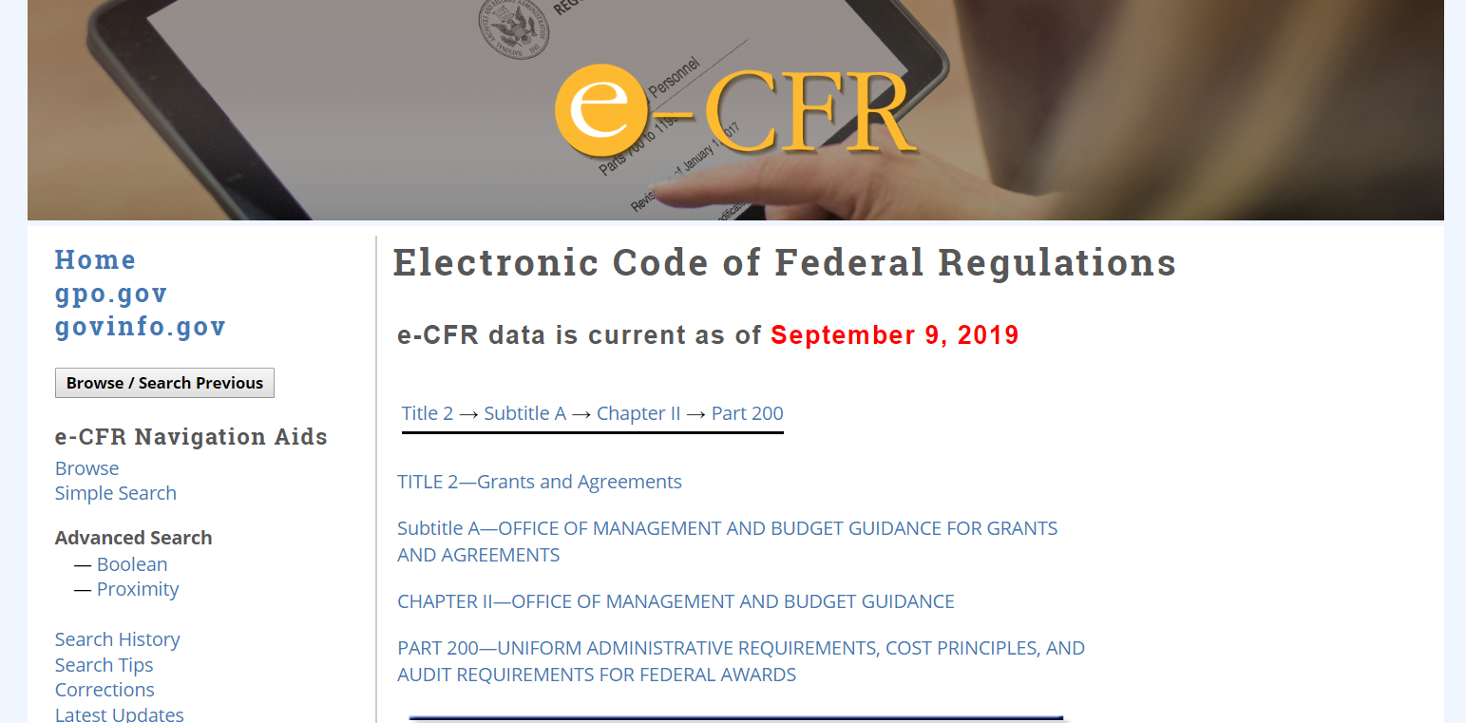
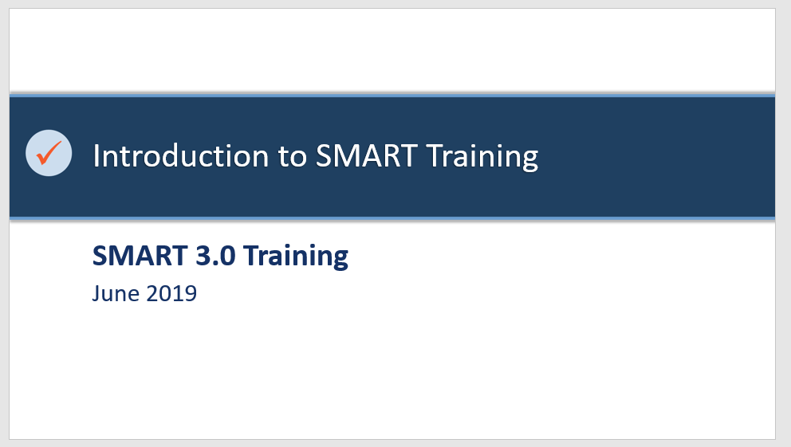
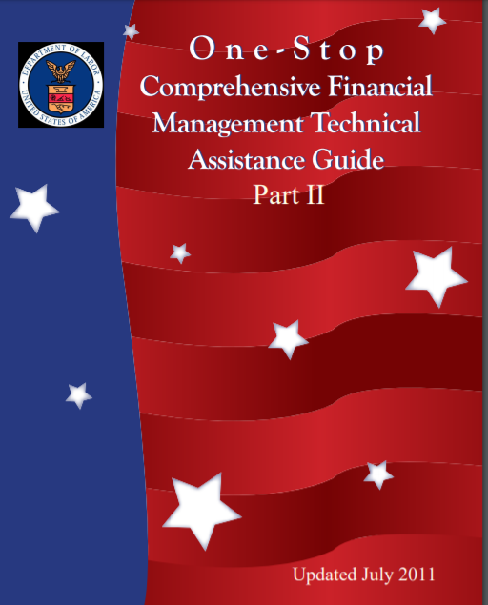
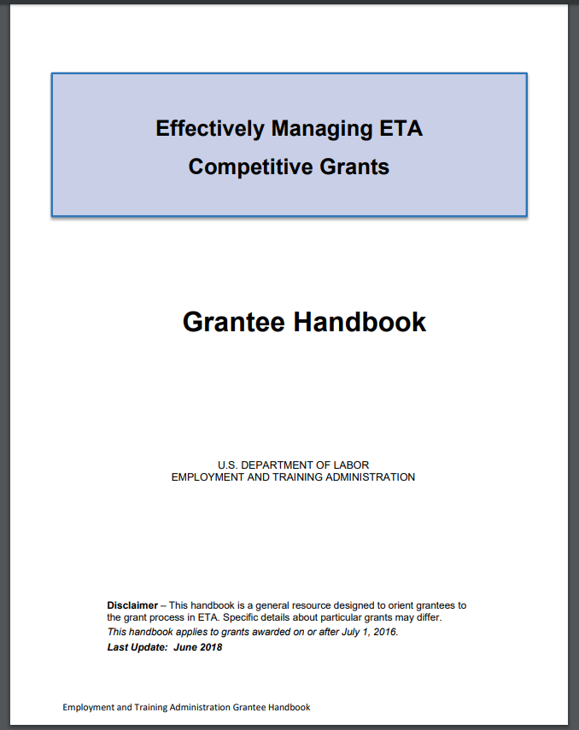
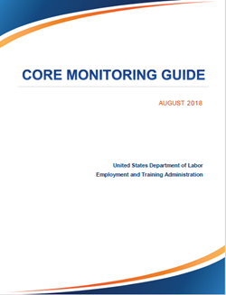
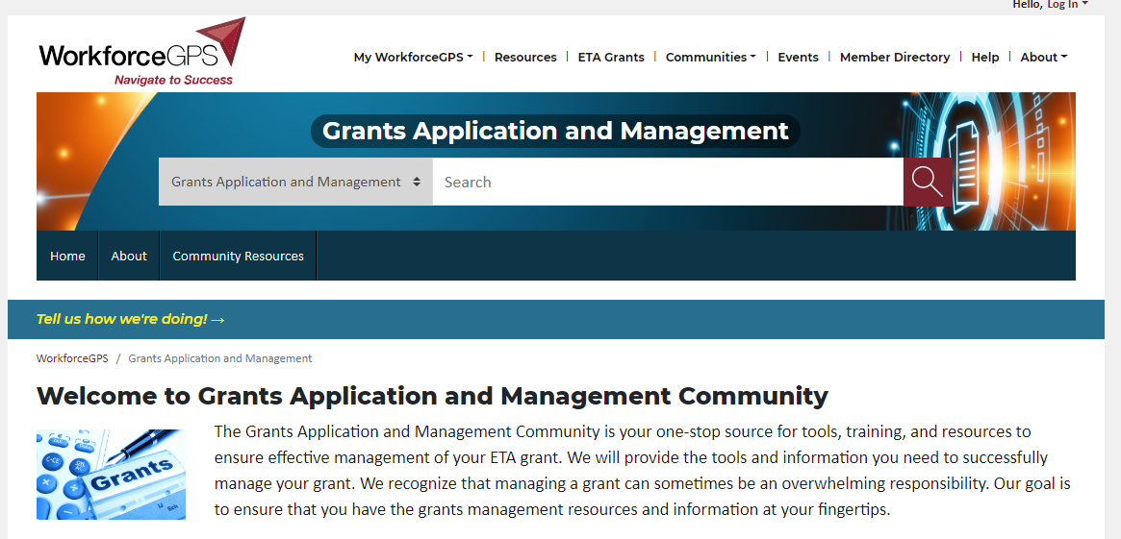
UG 2 CFR 200 and 2 CFR 2900
Technical Assistance Guide (TAG)
Core Monitoring Guide (CMG)
SMART Training
Grantee Handbook
WorkforceGPS
UG 2 CFR 2 CFR 200 and 2 CFR 2900
DOL Grant Recipients & Subrecipients
Technical Assistance Guide (TAG)
SMART Training
Core Monitoring Guide (CMG)
Grantee Handbook
WorkforceGPS

Slide 67
If you LOVED E-SMART, let us Know!
Please let us know what you think about the e-SMART webinar series!
What would you like to see with future SMART training?
Annual webinar?
Updated content?
New speakers?
Other?
Email SMART suggestions: Strama.Deborah@dol.gov

Slide 68
Thank you.
This presentation was developed using Federal funds for training purposes and cannot be used by third parties to earn money or fees.

