Slide 2
What is your level of experience with Incumbent Worker Training?
High
Some
Low
None

Slide 4
Business Engagement Series:
Incumbent Worker Training As A Business Service

Slide 5

Jeff Ryan
  Business Solutions Specialist
    US DOL/ETA

Slide 6

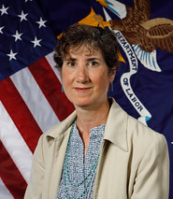
Darcy Hoffman
  Director of Business Services
    Workforce Southwest Washington
Adriana Kaplan
  Workforce Analyst
    Office of Workforce Investment/ ETA

Slide 7
Introduction/Overview

Slide 8
Does your organization use resources for incumbent worker training?
Yes, we use WIOA funds
Yes, we use non-WIOA funds
Yes, we use both WIOA and non-WIOA funds
No
Not sure

Slide 9
Purpose of today’s webinar
We are kicking off our business engagement webinar series with a 3-pack of sessions focused on incumbent worker training as a business service
Today we are thrilled to be joined by Workforce Southwest Washington to talk about their experience utilizing resources to provide incumbent worker training as a business service

Slide 10
What is business engagement?
A comprehensive, value-added set of strategies, activities, and partnerships designed to support and promote economic prosperity by providing valuable solutions to address the needs of businesses
The purpose of business engagement programs is to promote long-term economic stability, competitiveness, and growth
Business engagement is about more than just workforce services!

Slide 11
Value of Business Engagement
Successful, thriving businesses are a vital component of economic prosperity
Economic prosperity is of course an outcome that benefits workers and their communities as well as businesses
Whether we represent workforce development, economic development, education or any other government programs, ensuring business success through strong business engagement programs is critical

Slide 12
IWT as a Business Service
Business engagement is a big topic, so today we wanted to start with a discussion about a specific part
In future webinars we’ll broaden our focus, but today we are talking about using incumbent worker training as a business service

Slide 13
IWT Overview
Increases both participants’ and companies’ competitiveness so that businesses can prosper
Two primary reasons to use IWT:
  It builds worker skills, so they can be promoted within the company and create backfill opportunities
  Helps avert potential layoffs of employees
Many possible sources of funding for IWT, including WIOA
  Adult & Dislocated Worker formula (limited to 20%)
  Rapid Response funds (activities must be part of a layoff aversion strategy or activity)

Slide 14
Incumbent Worker Funds:
Create Clear Career Pathways
A strategy to support recruitment and increase retention of new and incumbent workers by demonstrating the career pathway.

Slide 15
History of Incumbent Worker Training in Southwest Washington
Began using formula funds for IWT in PY16
Awarded competitive funding (America’s Promise) in PY17
To date WSW has invested $480,367; private sector employer partners have invested $619,684 (co-investment model)
734 trained (promotions, pay increases, opportunity for future advancement)
$655 average cost per for WSW investment

Slide 16
WSW’s Incumbent Worker Program Journey

Slide 17
Takeaways
As WSW’s investment increases, so do positive outcomes for employees and employers (IE – promotions, industry recognized credentials, wage increases)
Employer investment is critical to long term success and sustainability
Today’s program assists companies in creating clear career pathways for new and incumbent workers to aid in recruitment and retention by clearly demonstrating a pathway to higher wages and more job responsibility

Slide 18
The Stories Behind the Numbers
Warehouse to CDL driver career pathways
Healthcare recruiter career pathway
Train the trainer pathways (cuts costs for employer and creates promotional opportunity for employees)
Lean manufacturing training
Humanitude Caregiver for employee retention and quality patient outcomes
OEM automated equipment training as layoff aversion service
Industry specific training for small groups – big impact!

Slide 19
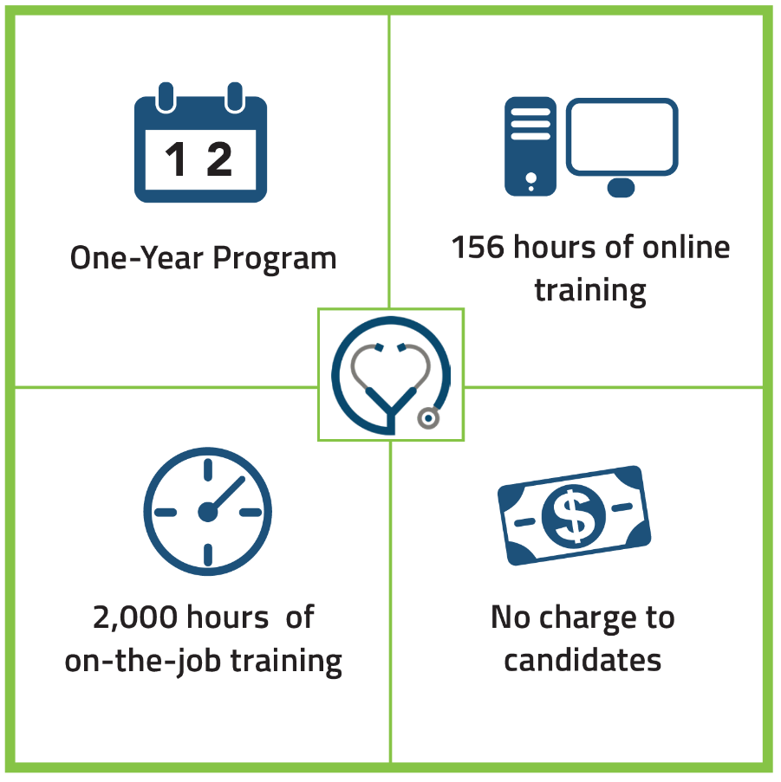
What’s Next?
Medical Assistant Apprenticeship
Successful bi-state workforce board partnership
All major healthcare organizations in the region (hospitals and clinics)
Using incumbent worker funds to infuse diverse candidates into the workforce with a clear career pathway (upskill / backfill)

Slide 20
Incumbent Worker Training Toolkit
Under construction, share comments

Slide 21
IWT Resources
ETA is currently developing a Tool Kit for incumbent worker training resources
The IWT Tool Kit will contain the following documents:
    Policy and Procedures Manual
    IWT Training Program
    IWT Work Plan
    IWT Registration Form
    IWT Training Needs Assessment
    IWT PowerPoint Deck
Please let us know in the comments if there are additional areas you’d like the Tool Kit to address

Slide 22
IWT Resources
The Tool Kit will live on the Incumbent Worker Training resource page on ION, which is part of Workforce GPS
Existing resources on this site include a desk aid and other materials on work-based-learning models.
  https://ion.workforcegps.org/resources/2019/05/08/15/08/Incumbent-Worker-Training-IWT

Slide 23
Wrap Up
Thanks to today’s presenters!
Please reach out to them if you have any additional questions
Keep an eye out for additional webinars on various business engagement topics
Let us know in the comments if you have any particular topics that interest you!

Slide 25
Darcy Hoffman
  Director of Business Services
    Workforce Southwest Washington
      Dhoffman@workforcesw.org
        360.608.4949

